Slide 1
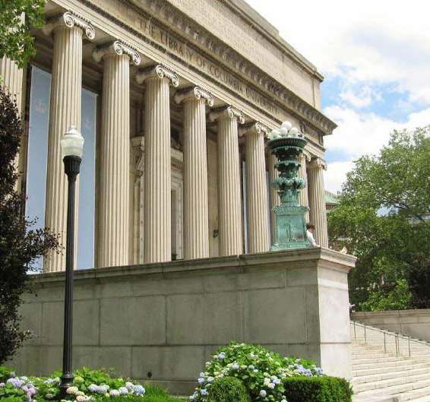
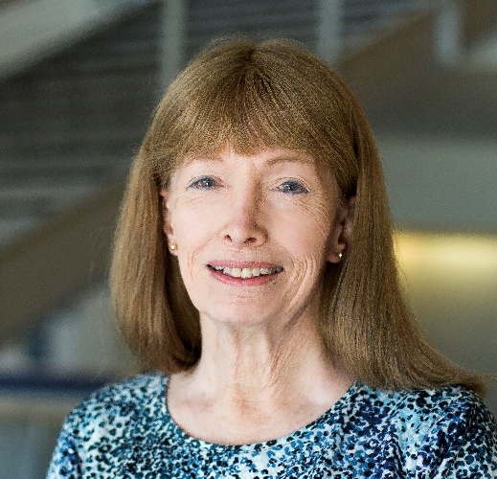
Our Travels Through Techno-Social Space-Time:
Envisioning Incoming Waves of Technological Innovation
Lynn Conway
Professor of EECS, Emerita
University of Michigan, Ann Arbor
2016 Magill Lecture
Fu Foundation School of
Engineering and Applied Science,
Columbia University
March 23, 2016
Note: This slideshow is posted online for later reference:
http://ai.eecs.umich.edu/people/conway/Memoirs/
Talks/Columbia/2016_Magill_Lecture.pptx
[ V 3-21-2016 ]

Slide 2
Notes re my student and early career years, 1955-68:
Studied Physics at MIT . . . EE, CS, Anthropology here at Columbia . . . did CS, EE at IBM Research.
My thought-influencers and heroes back then:
Galileo, Kepler, Newton, Maxwell, Einstein, Heaviside (math, electrical engineering), Steinmetz (AC revolution), Armstrong (radio revolution), Turing (math, computer science), Von Neuman (math, computer science), Weiner (cybernetics), Wilkes (computer science), Shannon (logic, Information theory), Van Quine (logic, quantitative philosophy), Hoffer (social philosophy), Malinowski (anthropology), Benedict (anthropology), Mead (anthropology), Merton (sociology), Rogers (diffusion of innovations), McCluhan (media theory), Kuhn (structure of scientific revolutions), Garfinkel (ethnomethodology).
My intellectual-passion during the 5⁺ decades since then (re-encoded into current-day phrasing):
“Meta-ethnomethodology”: Noticing, observing, decoding, abstracting, restructuring, re-encoding and exploratorily-diffusing “techno-social memetic-scripts”, partly out of curiosity and partly to better navigate my own journeys (forwards, sideways and backwards) through techno-social space-time (i.e., avant-garde artistry in generating “techno-social paradigm-shifts”).
By exploiting insights gained along the way and by playfully using our imaginations,
Let’s now do some visualizing about where we’ve been, where we are, and where we’re headed!

Slide 3
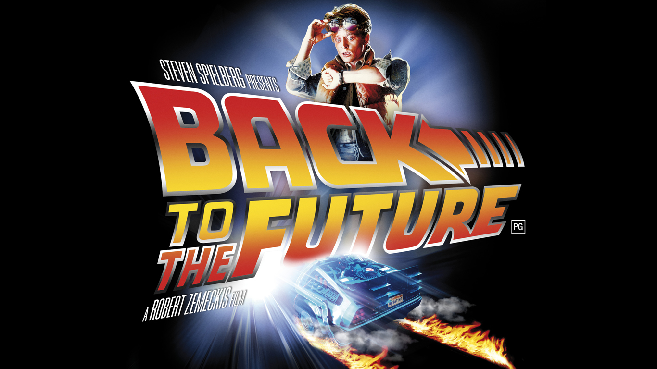
We’ll begin by visualizing some past waves of techno-social change . . .
Link
Dropping-back-in just before them, then coming forward through time . . .

Slide 4
But as we travel through space-time . . .
be sure to keep these words in mind:
Link
“The farther backward you can look, the farther forward you can see.” – Winston Churchill

Slide 5
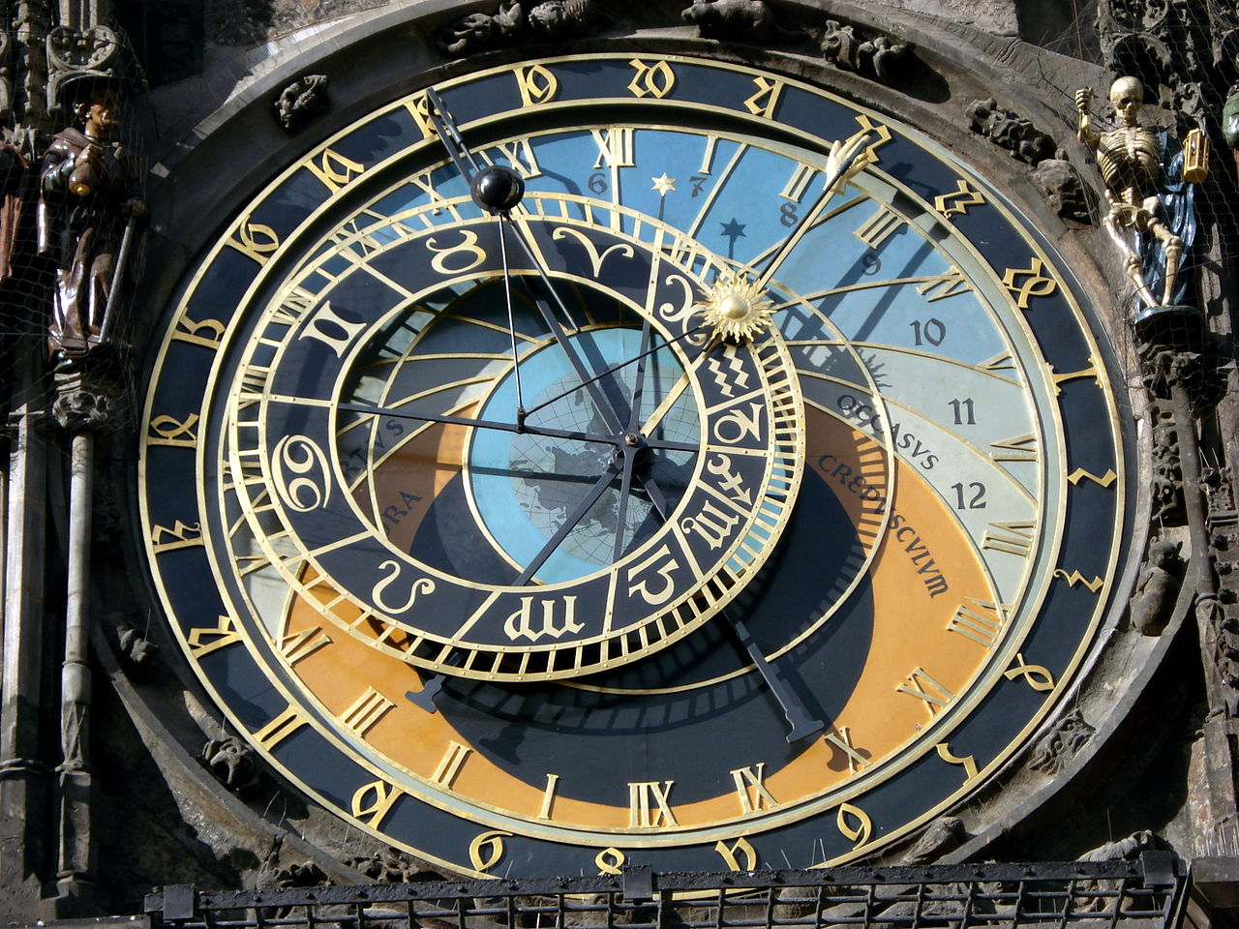
We begin in the 1400s, during the Renaissance, a time of transformational cultural advances . . .
When looking at the mechanization
of astronomical calculations by the
Prague Astronomical Clock, c. 1410:
We see a stunning confluence of the highly advanced Mathematics, Science, Engineering Architecture and Art at that time . . .
Photo by Hector Zenil (www.hectorzenil.net)

Slide 6
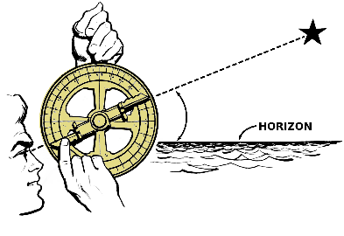
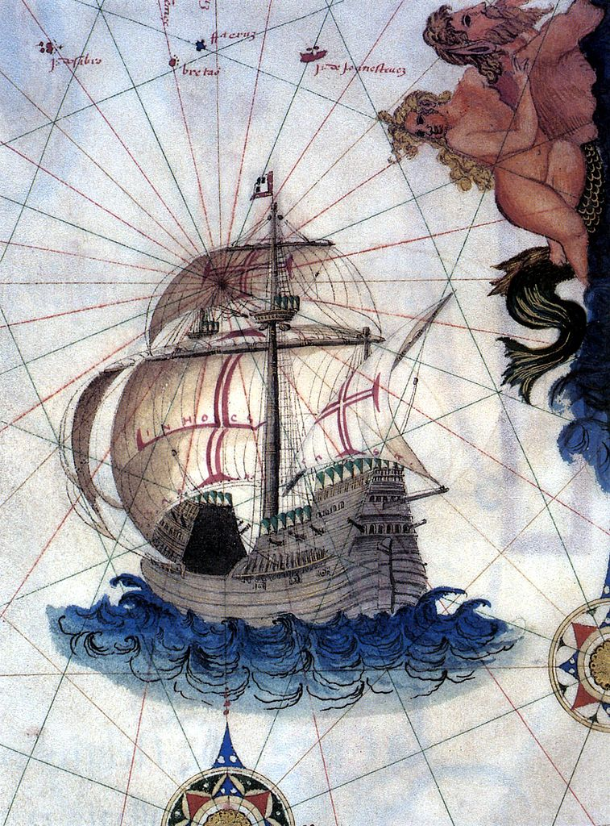
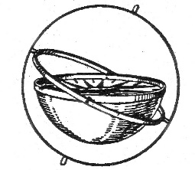
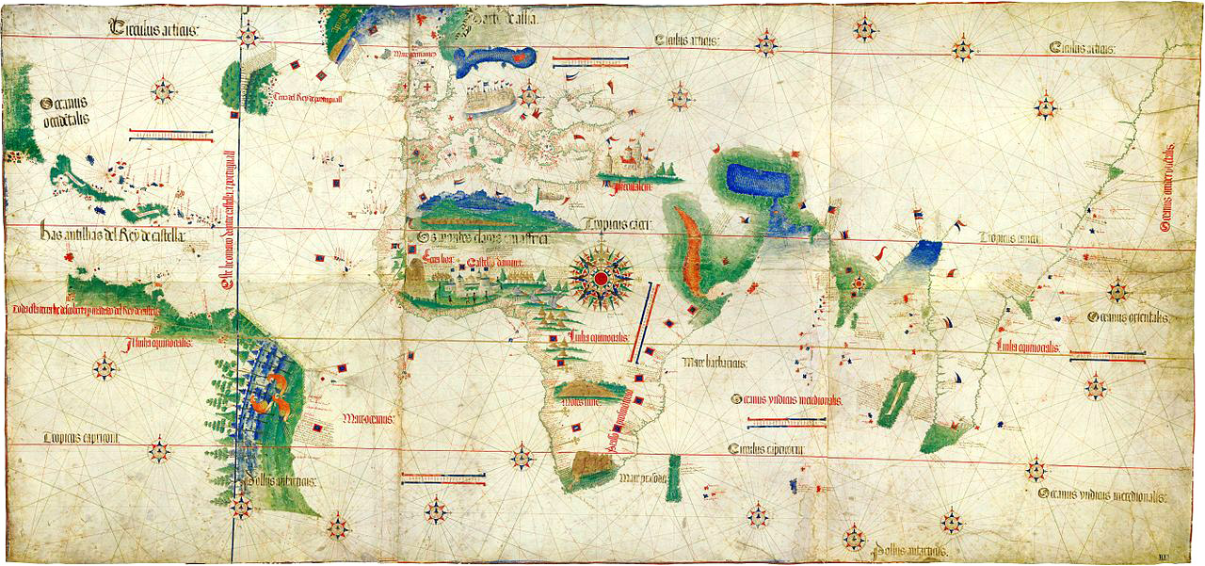
By the late 1400’s advances in shipbuilding, navigation & mapping reached a ‘tipping point’ . . .
Mariner’s Astrolabe
Portuguese Carrack
Triggering the Age of Discovery
by enabling explorations across
the open seas . . .
Gimbal Compass
Cantino planisphere (1502)

Slide 7
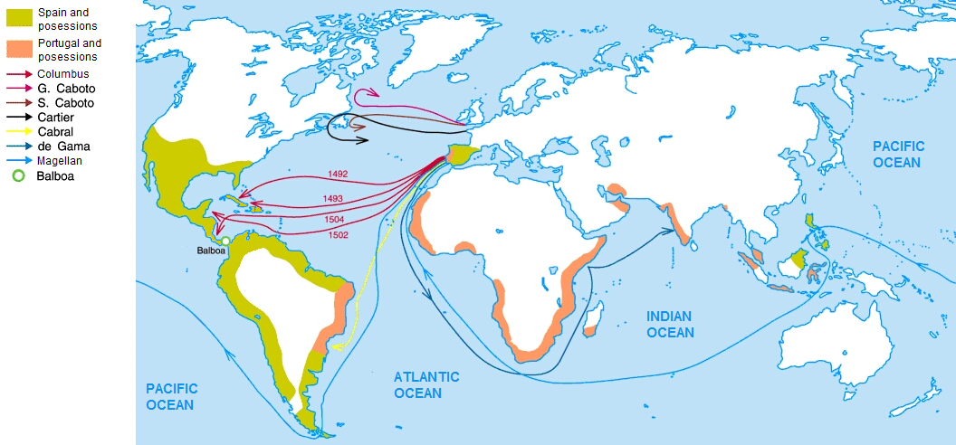
Thus it begins:
Charting the Early Voyages during the Age of Discovery, c.1492-1522 . . .
Wiki Commons

Slide 8
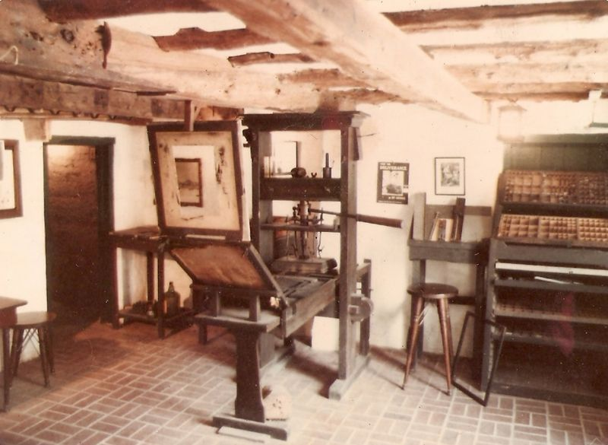
As mass-communication by printing spread in the late 1400s,
it enabled adventurers to ever-more quickly propagate news of what they’d found and where they’d found it . . . dramatically escalating the exploration rate . . .
Replica Gutenberg Press at the Featherbed Alley Printshop Museum:
Link; Attribution: Aodhdubh at English Wikipedia

Slide 9
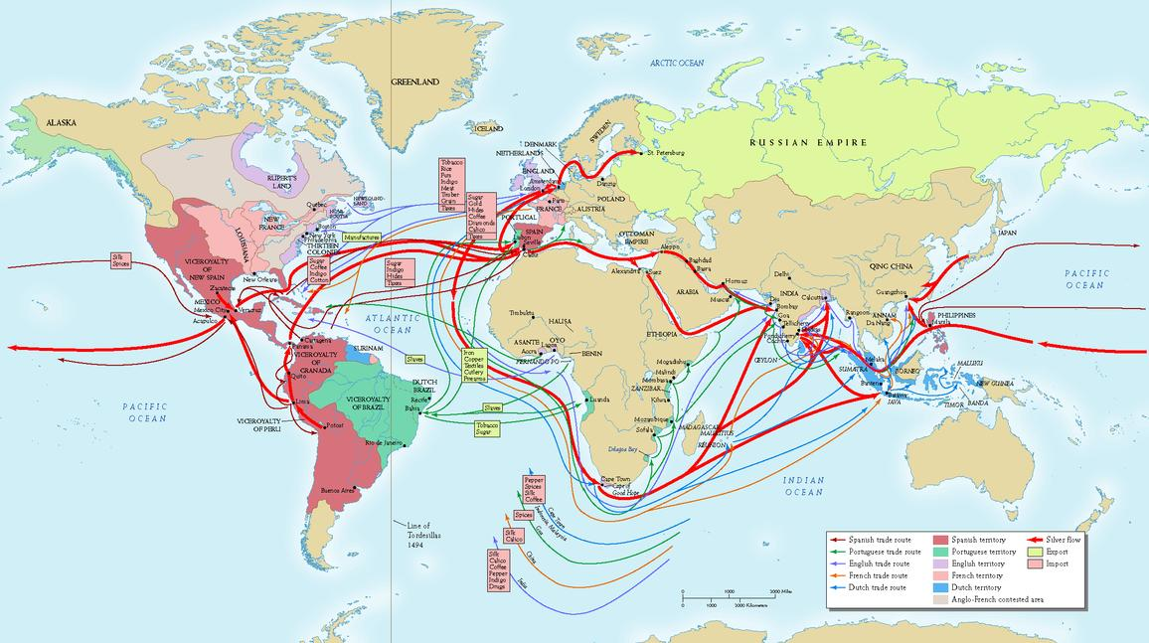
By the early 1700’s, exponentiation had generated a massive global trading system . . .
Source

Slide 10
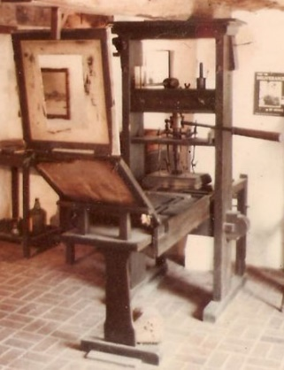
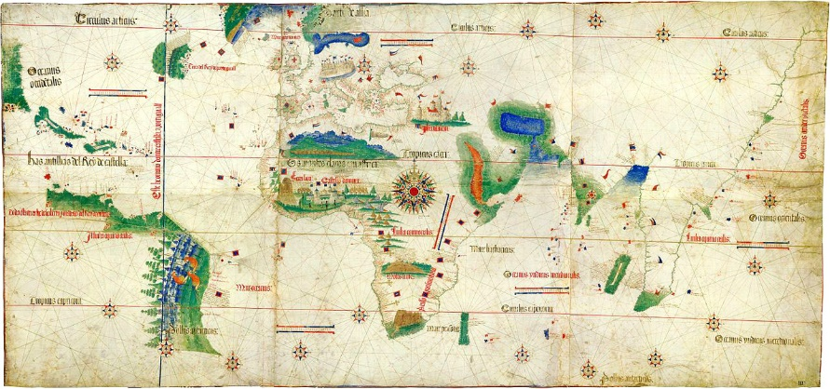
Now, what’ happening here?
Just exponentiation of THINGS?
Is that all this is?
Or also exponentiation and diffusion of key clusters of
innovative IDEAS thru the minds of ever more people?
IDEAS on how to MAKE and USE things . . .

Slide 11
By the mid-1700’s, the stage was set for yet another
tremendous disruptive wave of innovation . . .
and so began the industrial revolution (~1760) . . .
Link

Slide 12
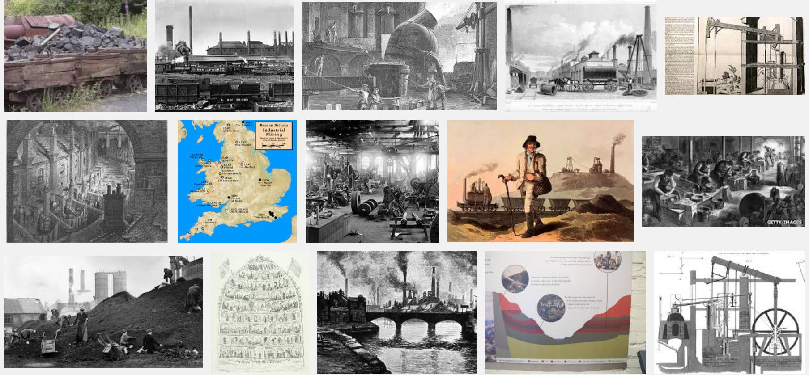
During the Industrial Revolution the mining/processing of
coal and iron-ore was greatly amplified by steam-power . . .
Snip from Google Images
Some of the resulting iron was used to make more steam engines,
and this positive feedback fueled an iterative expansion-process . . .

Slide 13
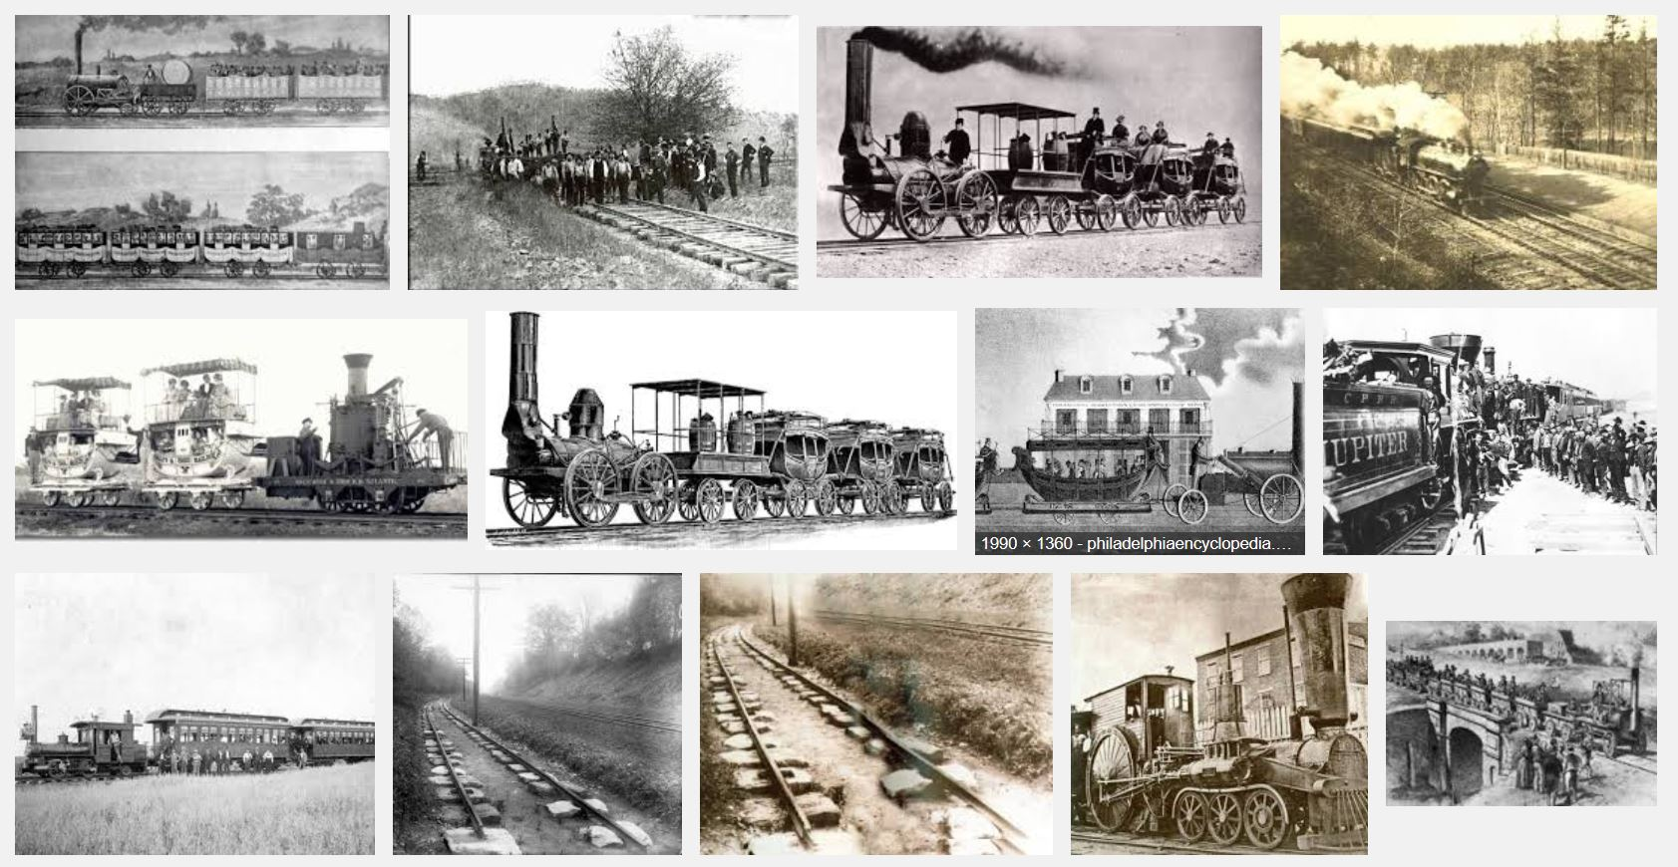
By the 1830’s, steam-powered railroads began interconnecting mines to
iron-works and rail-makers, enabling ever more rapid expansion of the railroads . . .
Snip from Google Images

Slide 14
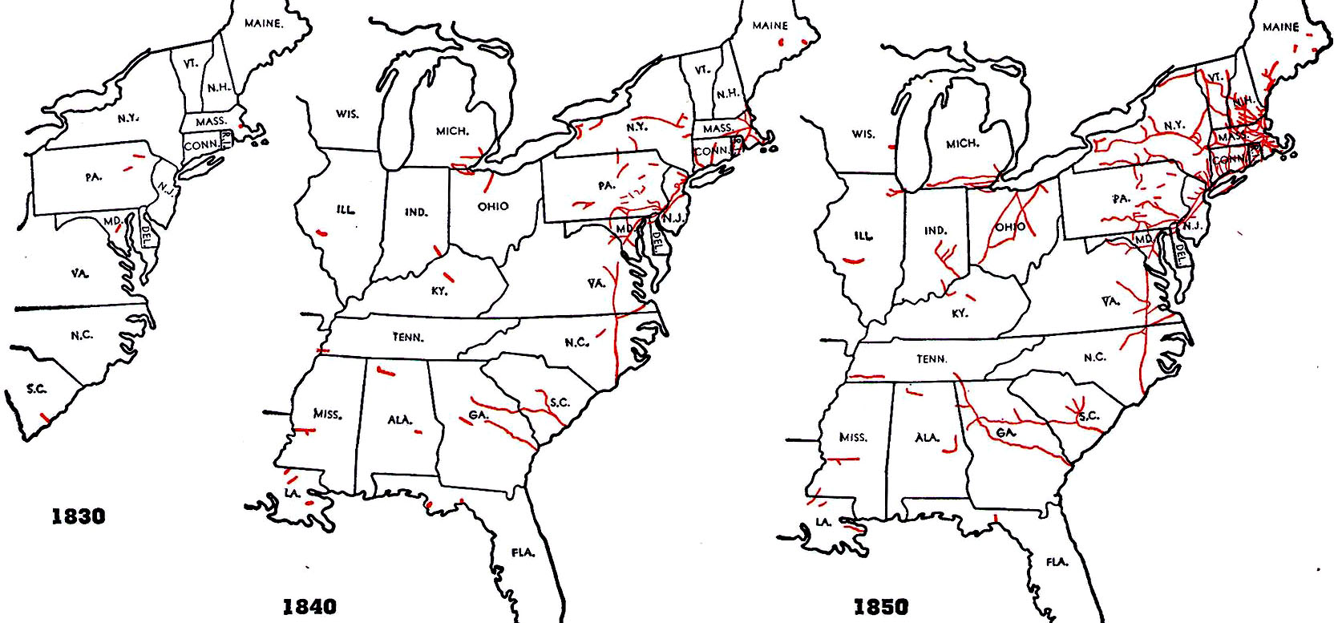
These maps show the rapid early-spread of railroading in the United States. . .
http://www.cprr.org/Museum/RR_Development.html#2

Slide 15
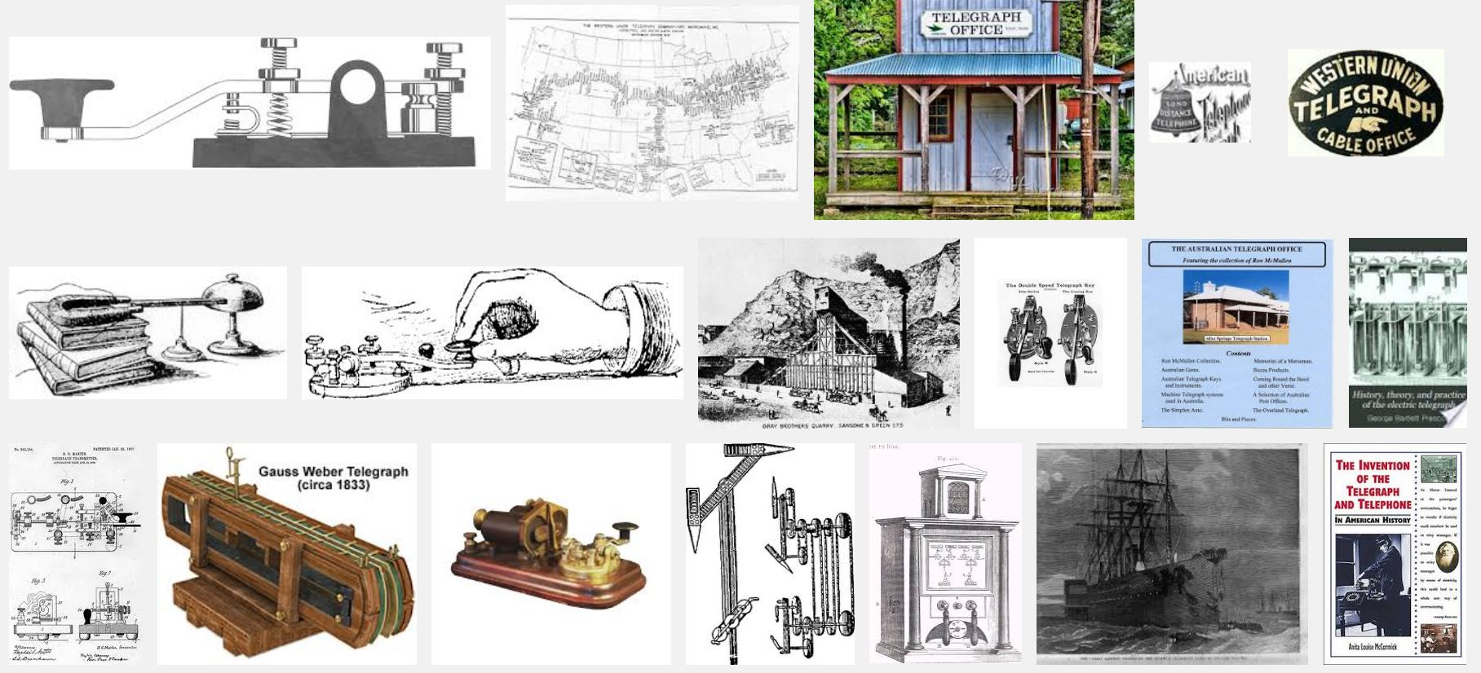
The expansion was accelerated by the rapid-spread of telegraphy in the 1850s,
an effect analogous to that of printing during the age of discovery . . .
(Snip from Google Images)

Slide 16
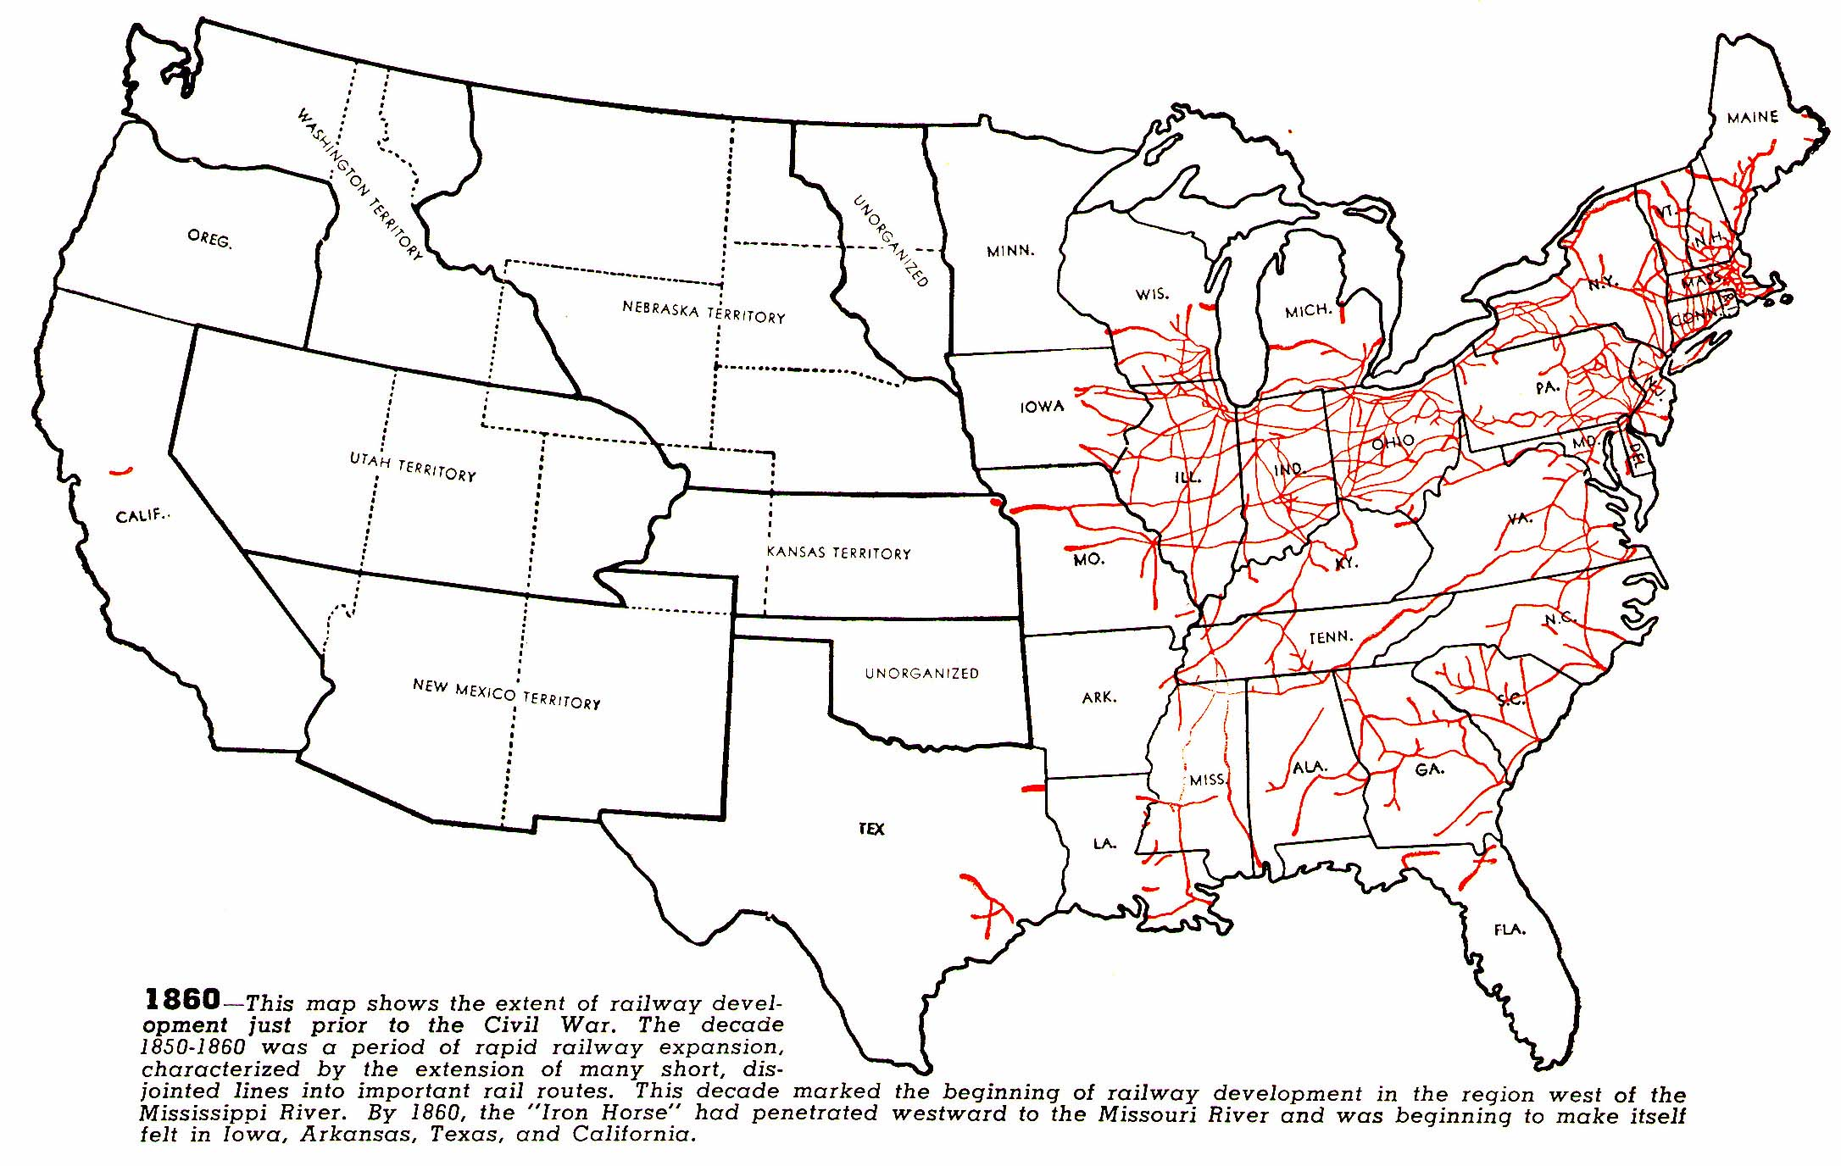
As seen in railroad maps from the following decades . . .
1860
source

Slide 17
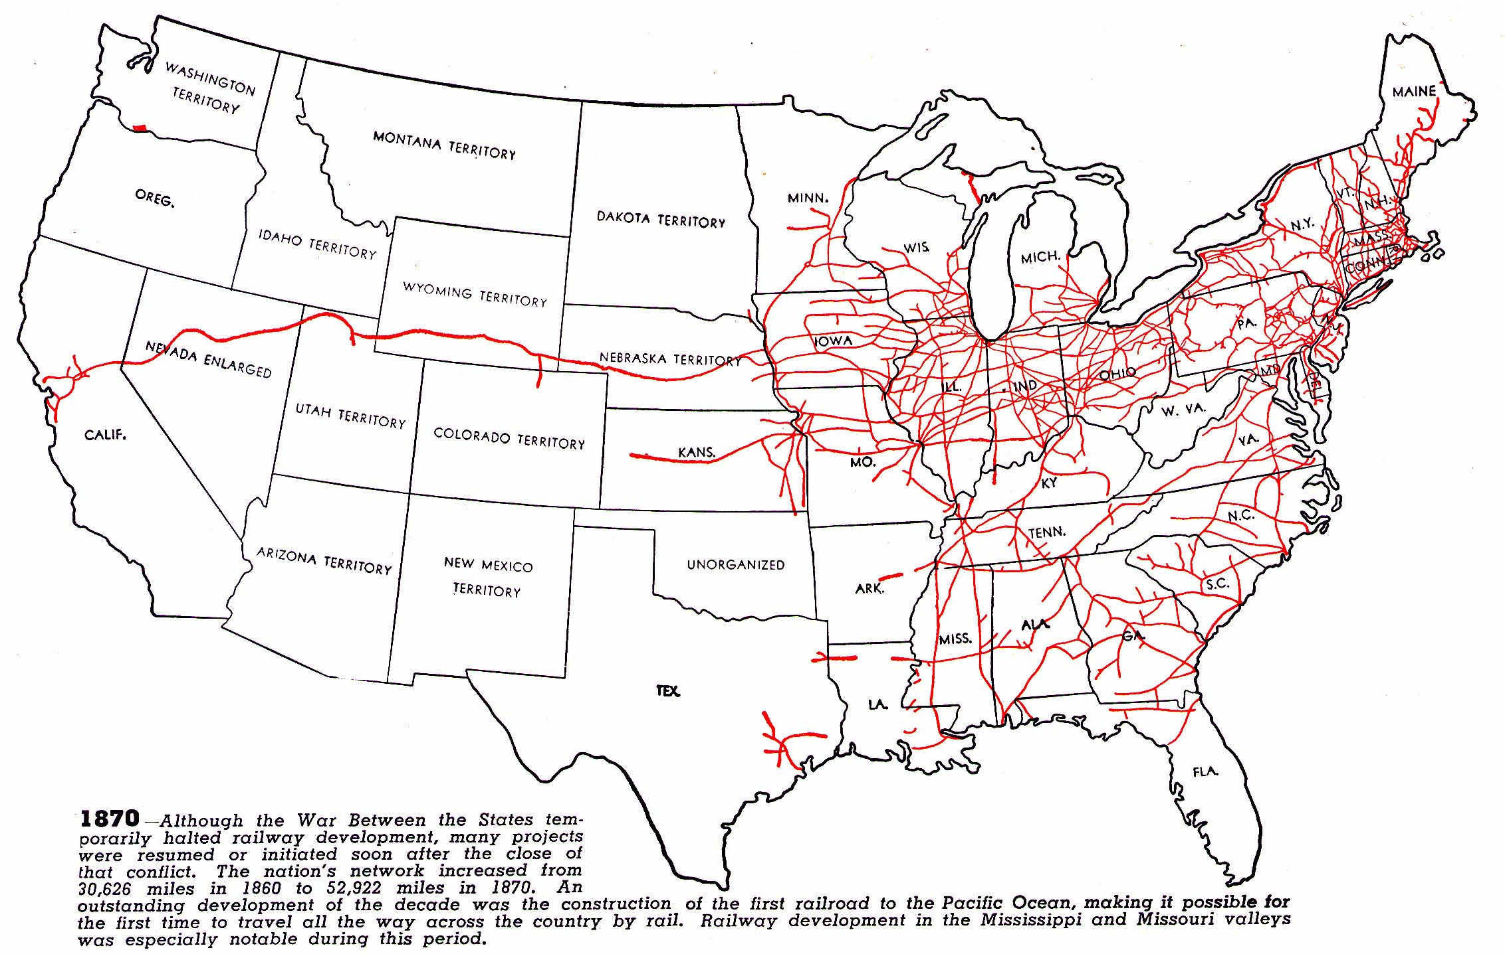
1870
source

Slide 18
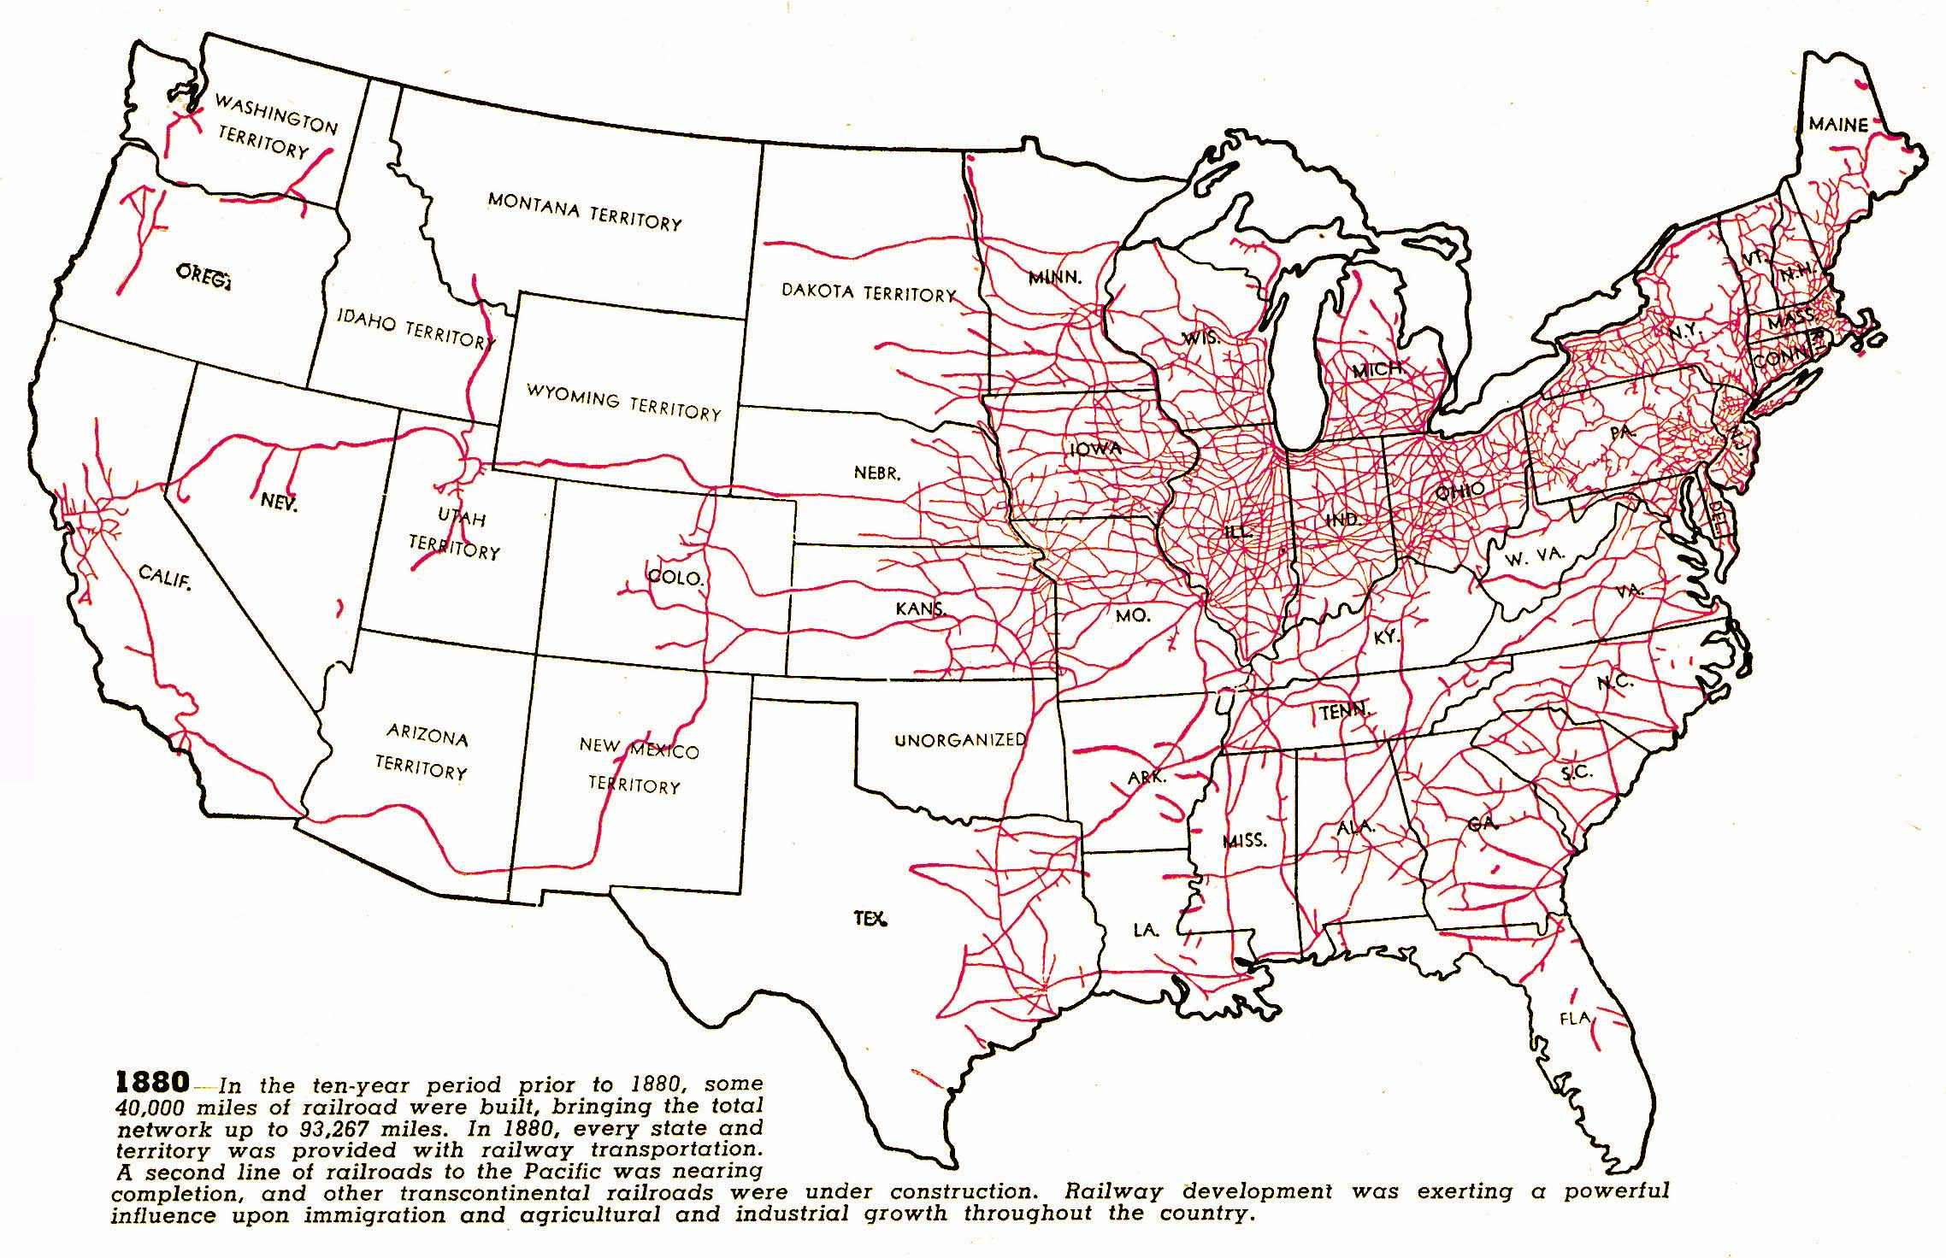
1880
source

Slide 19
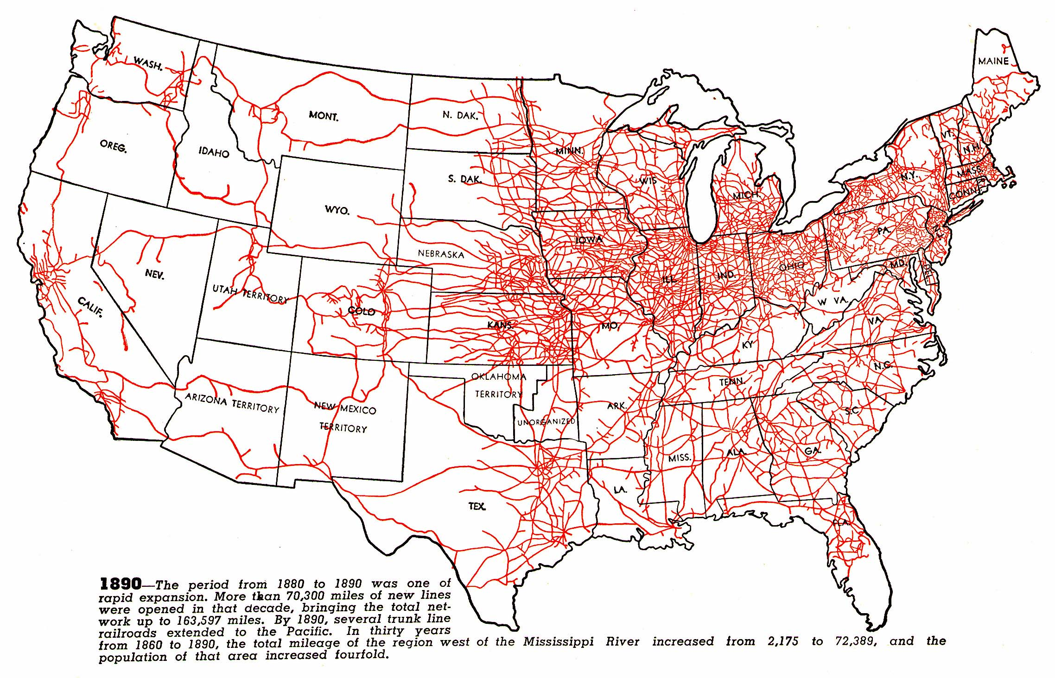
1890
source

Slide 20
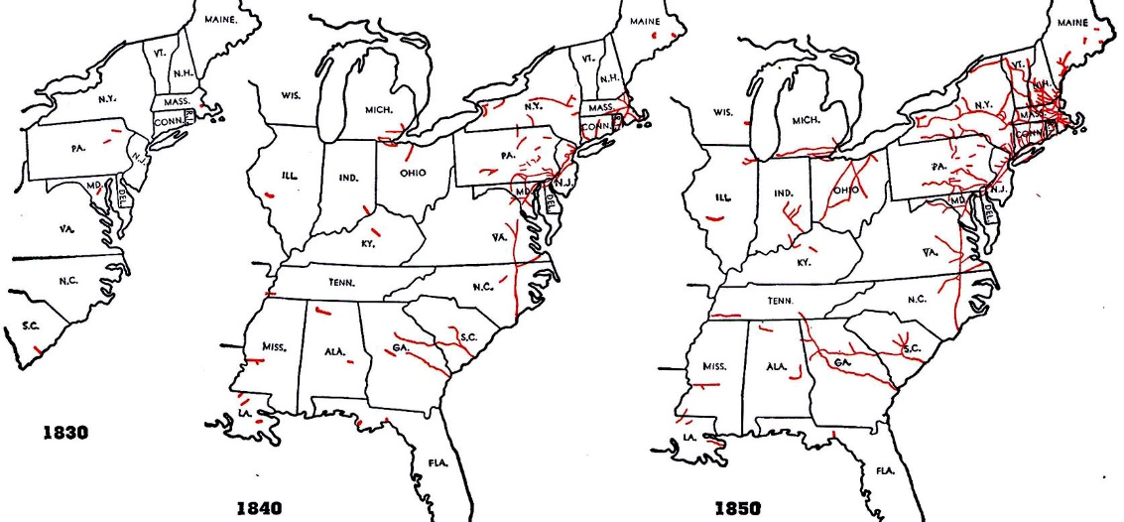
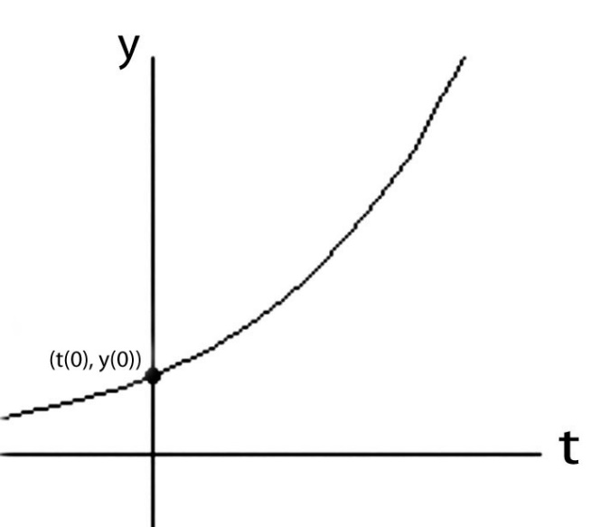
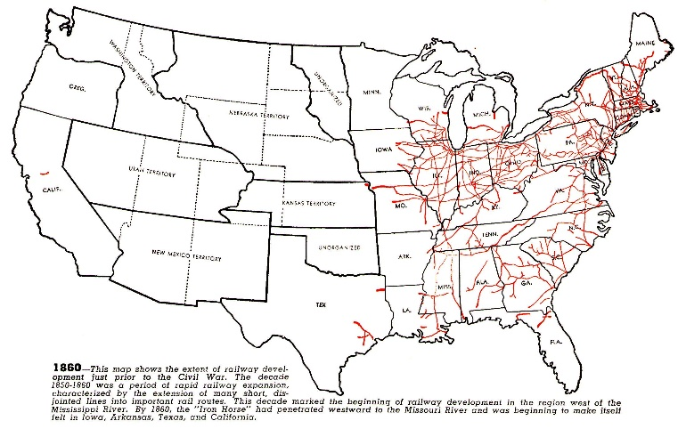
Like compound interest, the early social-diffusion rate of such clusters of technological ideas is proportional to what has materially accumulated at any given point in time . . .
(I.e., it’s an exponential function):
y(t) = y(0)e^rt
source

Slide 21
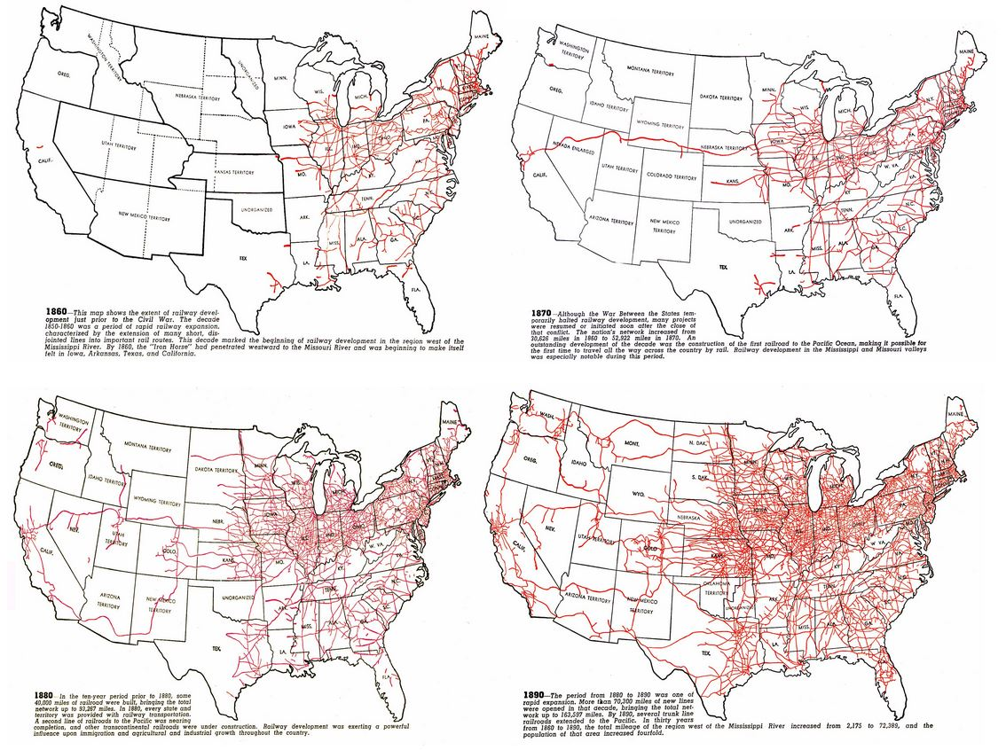
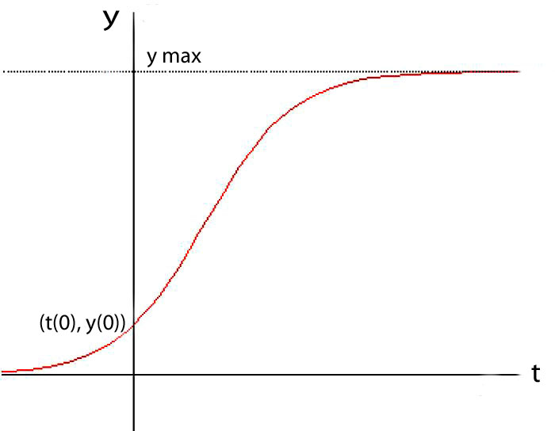
But as the opportunity-space fills,
diffusion of those technological ideas slows as that cluster nears its materially-expressed expansion limits . . .
(I.e., it becomes a logistic function):
later saturation
y(t) = ymax/(1+((ymax/y(0))–1))e^-rt)
early exponentiation
source

Slide 22
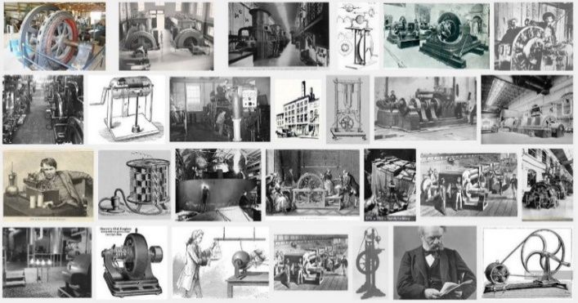
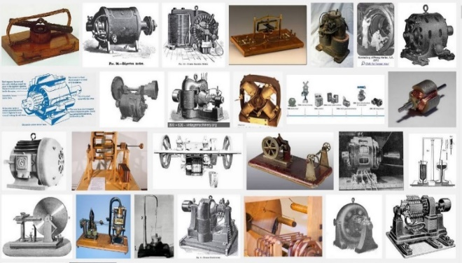
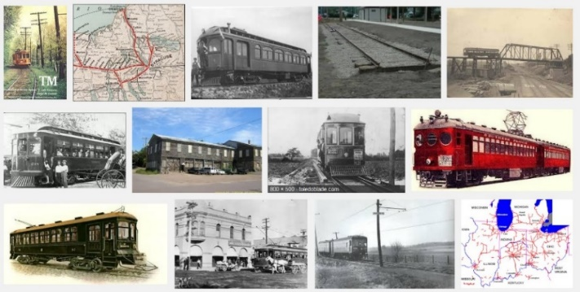
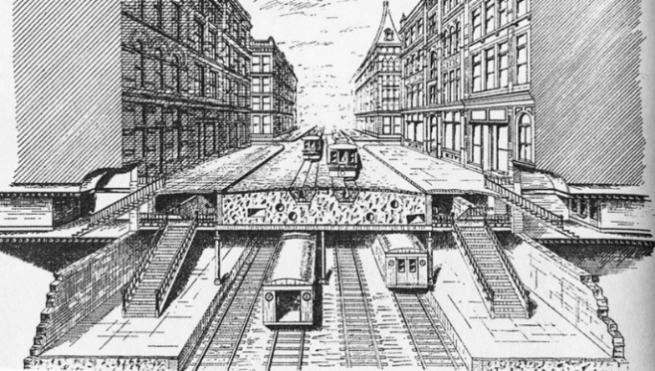
As a result of a widespread harnessing of electricity in the 1890’s, innovative technology clusters lurched out into wild dimensions . . . as electric generators and motors were embedded into new industrial and transportation systems:
Electrical Generators
Electrical Motors
Subways
Planning the IRT, 1891

Slide 23
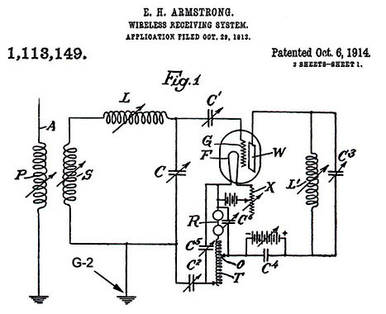
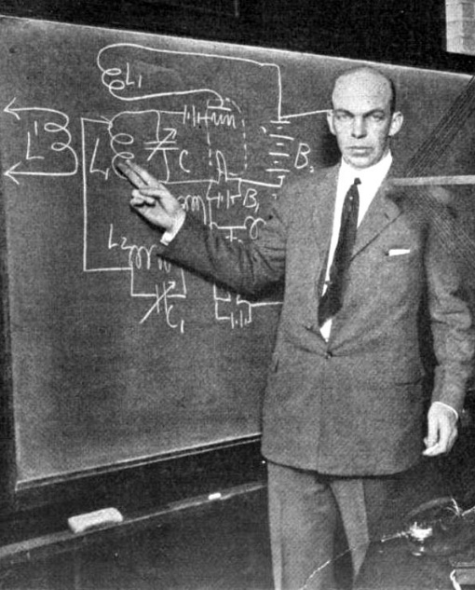
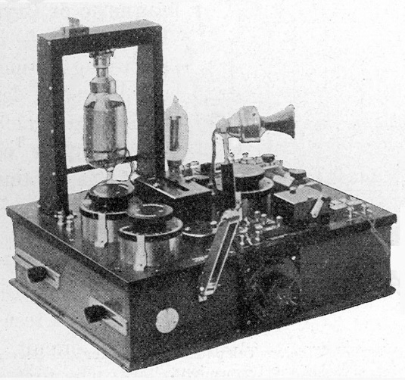
The rapidly diffusing electrification then co-evolved with rapidly-diffusing electric rail, subway, telephone and lighting systems, and with the new ‘wireless’ radio communication systems . . .
Armstrong at Columbia 1922
WWI military radio receiver
link
Back then, Edison, Westinghouse, Tesla, Steinmetz, Bell, Marconi and Armstrong
became household names for their seminal ideas behind these wild technologies.

Slide 24
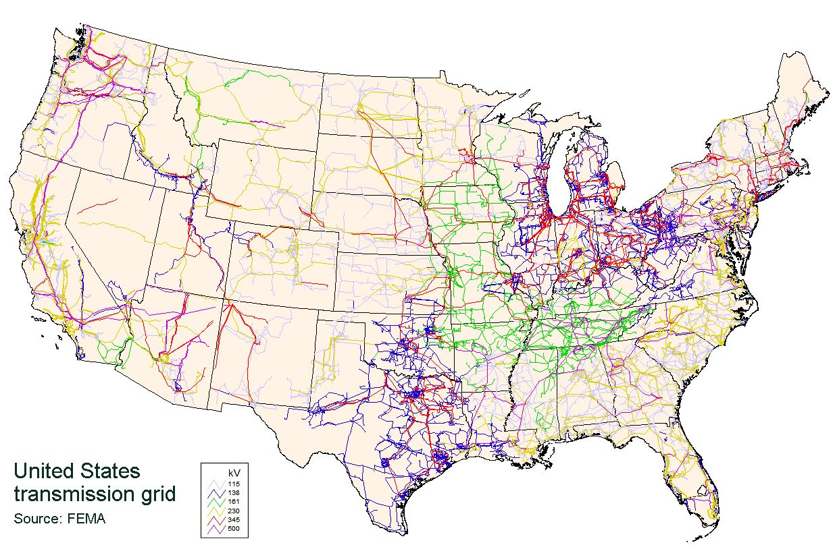
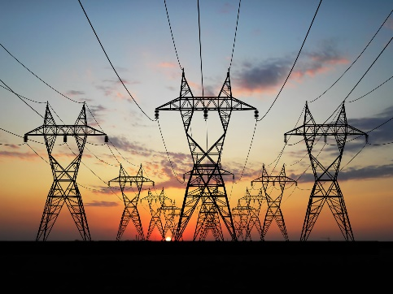
Leading to this high-voltage power grid by 2008!
Wiki

Slide 25
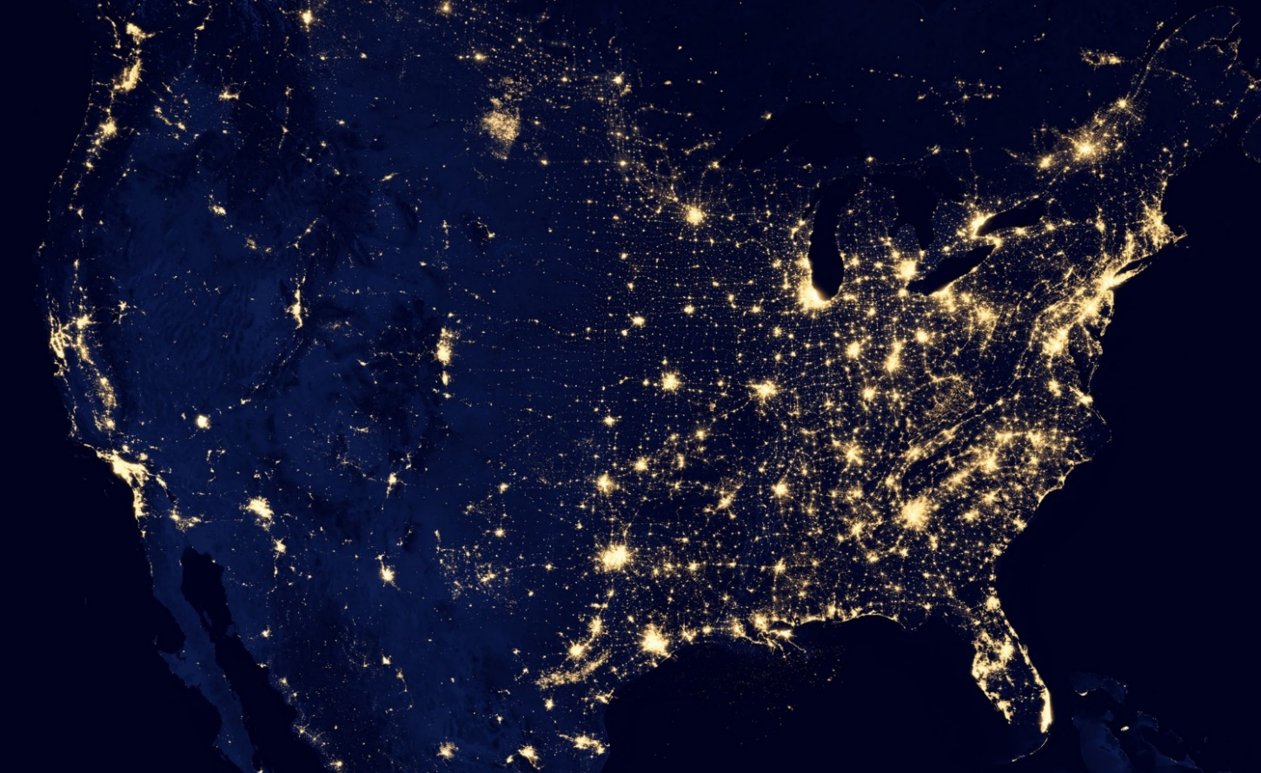
The dramatic results of the exponentiation
of electrification are easily seen from space today . . .
NASA
Think how many minds by now the foundational ideas of Faraday, Maxwell, Hertz,
Steinmetz, Marconi, Armstrong, etc., have cycled through to make this happen!

Slide 26
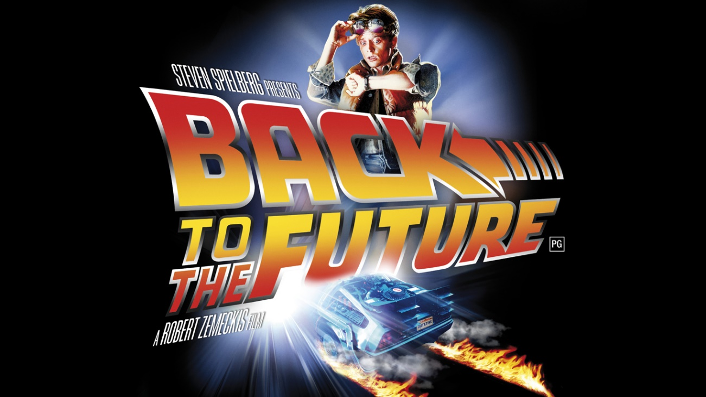
Let’s now look at a wave of innovation that I surfed back in the 1970’s:
The revolution in VLSI (Very Large Scale Integrated) microchip design . . .

Slide 27
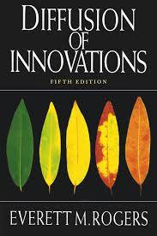
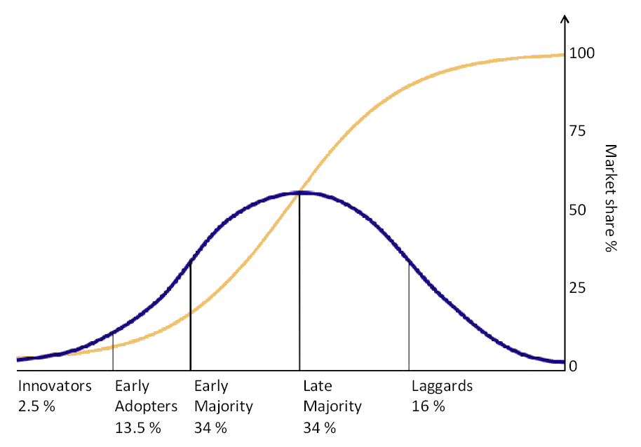
While doing so, let’s more-consciously
note how “the flow of ideas” expands . . .
as a function of the increasing connectivity and bandwidth . . . and the decreasing time-delays, in techno-social communication . . .
While also thinking along lines explored by Everett Rogers in his seminal 1962 text
Diffusion of Innovations:
URL

Slide 28
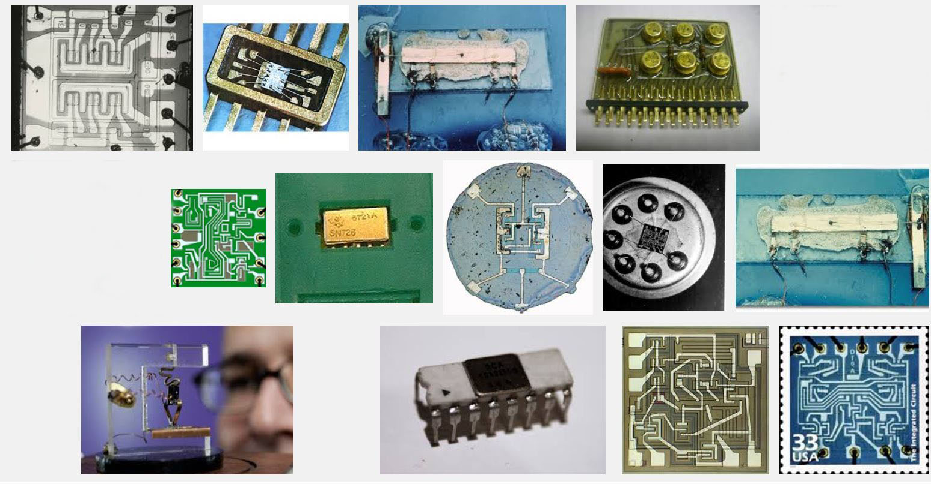
The stage was set by innovations in integrated circuitry in the 1960’s,
enabling transistors and wiring to be lithographically ‘printed’ onto chips of silicon . . .
Snip from Goggle images
Some early integrated circuits:

Slide 29
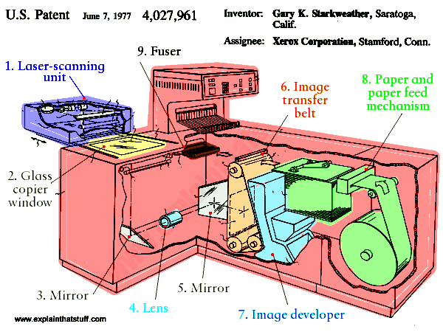
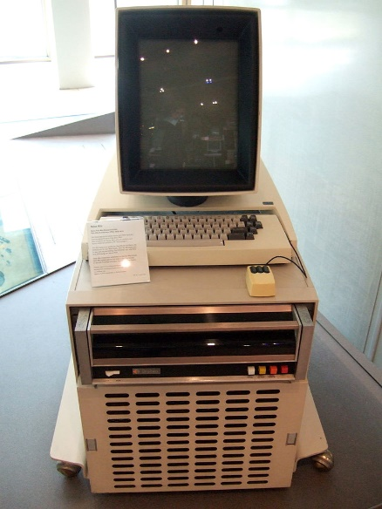
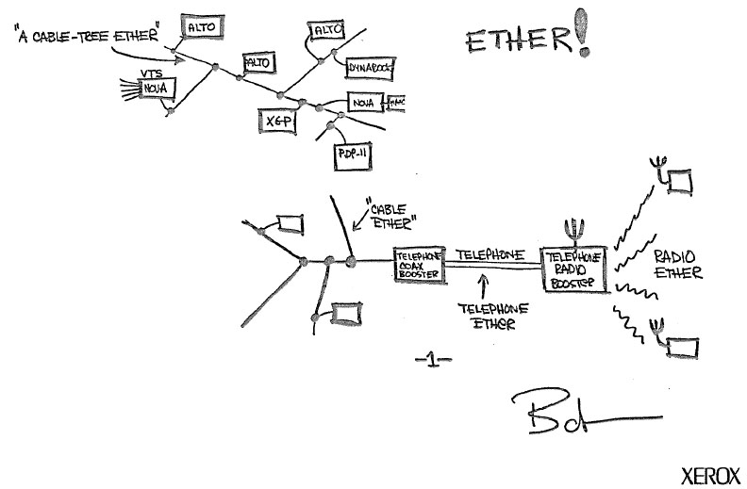
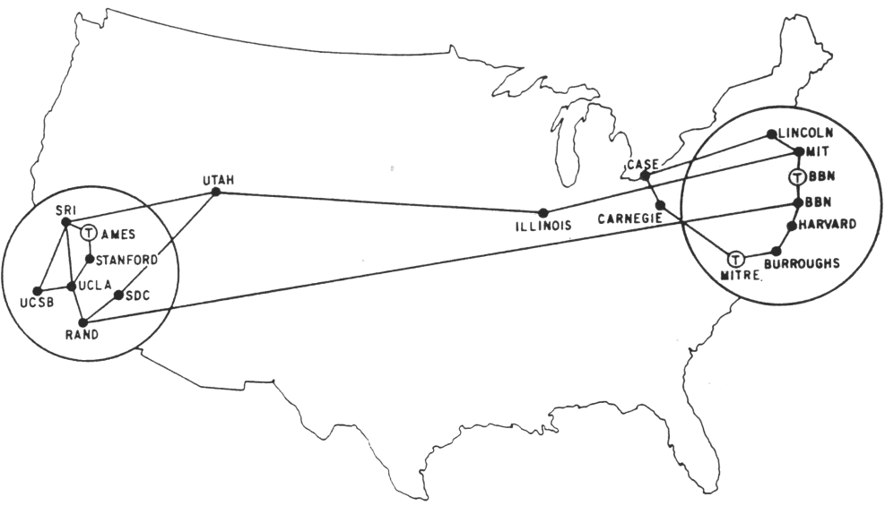
It was further set by innovations in computing at Xerox PARC in the early 70’s,
including the “Alto personal computer”, the “Ethernet” and the “laser printer”. . .
and by the rapid evolution of the “Arpanet” (the early internet) at DARPA . . .
Xerox Alto, 1973
Metcalfe’s original
Ethernet sketch, 1973
Laser printer, 1971
Source
Source
Wiki commons
Arpanet map, 1971

Slide 30
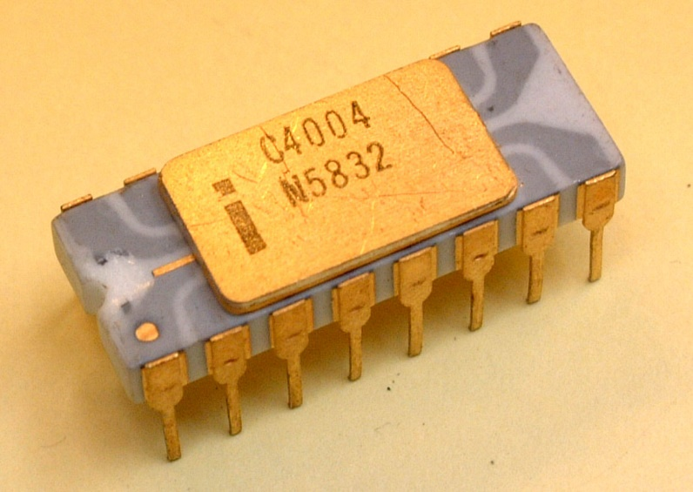
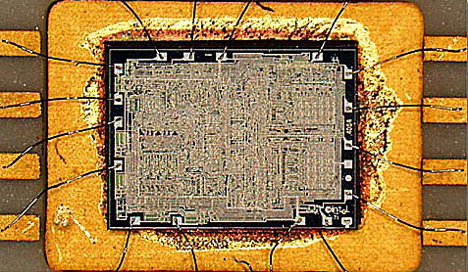
Advancing lithography enabled the ‘printing’ of ever-increasing numbers
of transistors on single chips.
A watershed was crossed in 1971
with the introduction of Intel’s 4004, the first single-chip “microprocessor”
Source
It contained 2300 transistors . . .
Source

Slide 31
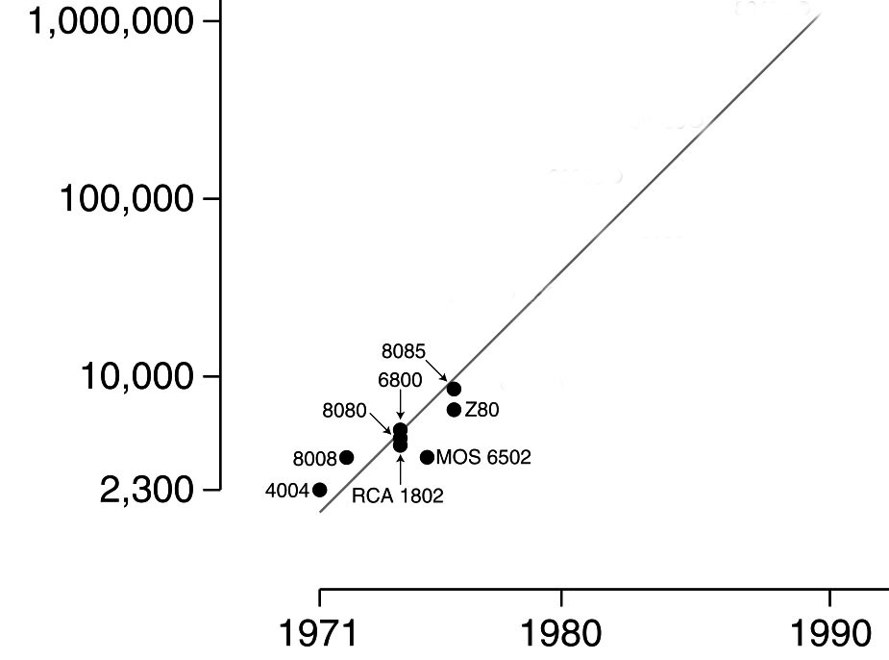
Gordon Moore at Intel noted that the number of transistors reliably printable on a chip was approximately doubling every two years . . .
Moore’s Law (as of 1976)
.
Caltech’s Carver Mead named this “Moore’s Law” and his grad student Bruce Hoeneisen proved there were no physical limits to increasing the
number up to at least 1 million transistors.
An exponential function,
graphed on a vertical log scale
N(t)/N(0) = 2^(t/2)
It appeared possible, even likely, that by ~1990
an entire “supercomputer” could be printed
on a single chip . . .
In 1976 this set-off a huge push by collaborating research teams at Xerox PARC and Caltech to figure out how to enable such complex chips to be designed.

Slide 32
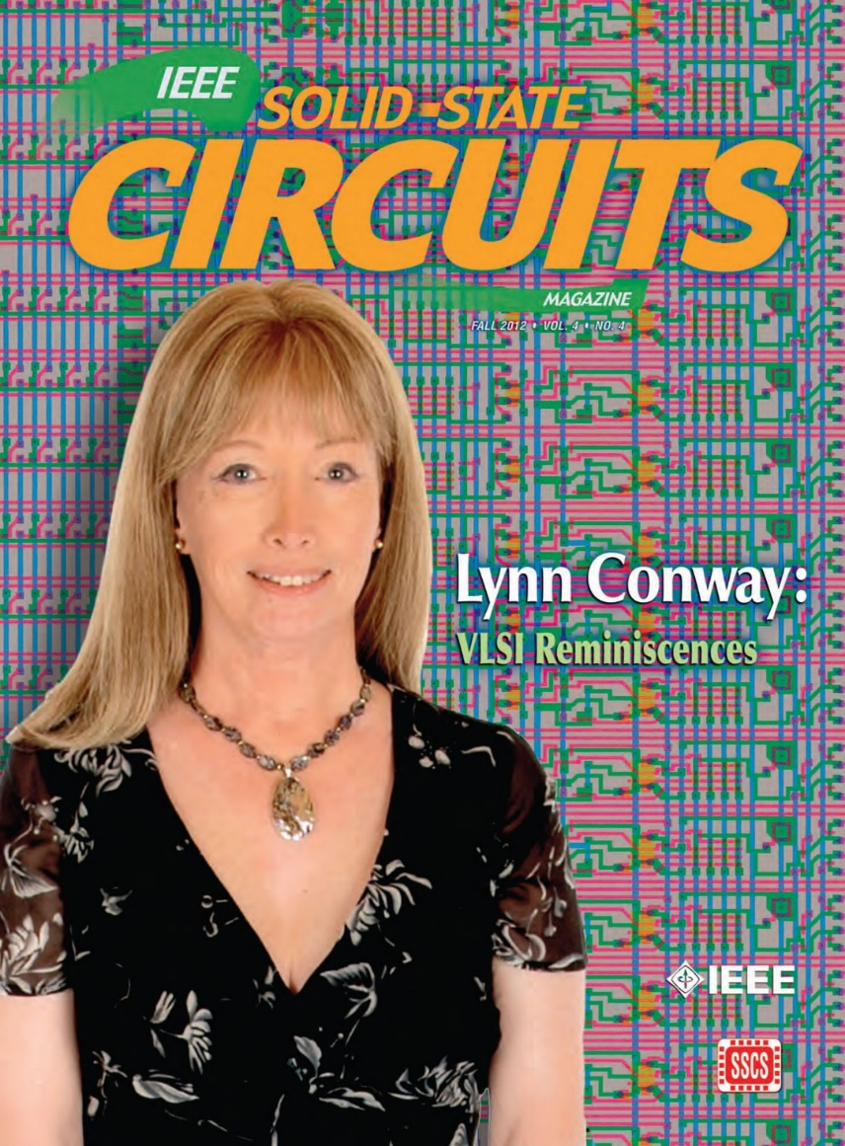
The story of what happened over
the next four years is quite a saga . . .
You’ll find insights into that saga in my
“Reminiscences of the VLSI Revolution” in
Fall 2012 IEEE Solid State Circuits Magazine
That was the very first time I’d stepped forward to tell the story . . .
Till then, since I didn’t look like an engineer,
Silicon Valley had no clue what I’d done
back during the 1970’s! (and still doesn’t!)
For now we’ll just hit some highlights . . .

Slide 33
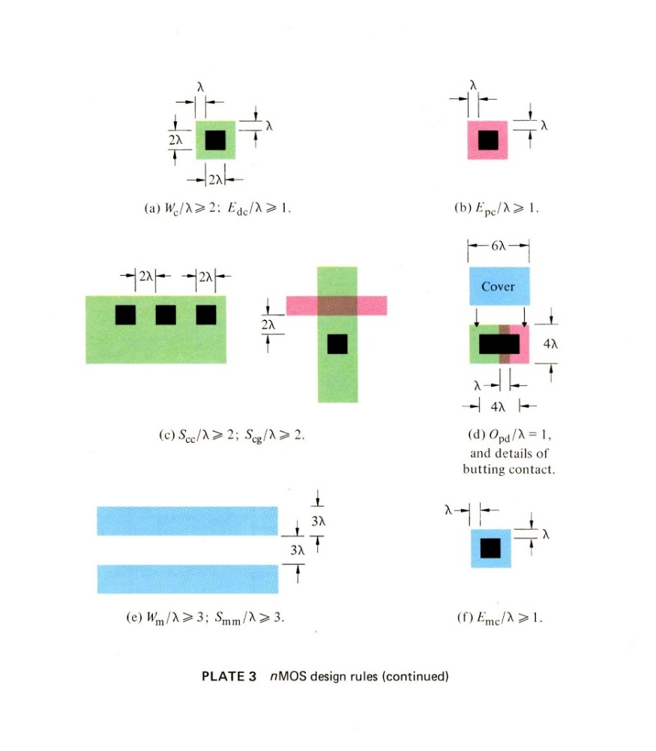
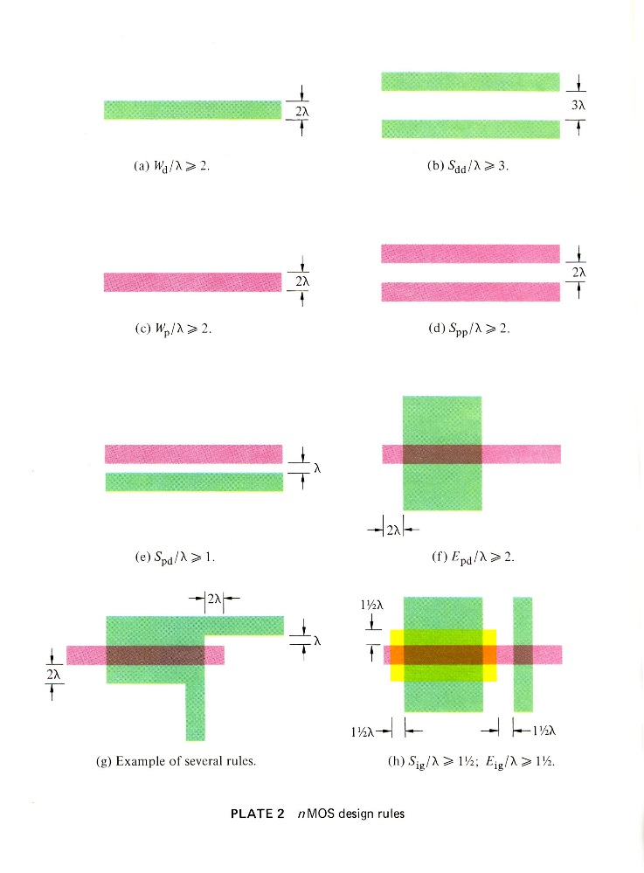
The breakout was triggered by a cluster of abstract innovations at Xerox PARC and Caltech . . .
Included were a set of digital scalable VLSI chip-layout design rules, framed as dimensionless inequality equations (Conway, PARC).
These enabled abstract chip designs to easily be digitally created, shrunk down and reused as Moore’s law rapidly advanced . . .
They also enabled accruing digital designs to be widely open-source-shared . . .
Link

Slide 34
The driving meta-architectural idea:
Given: As chip lithography scales-down according to Moore’s Law, ever-more
ever-faster transistors can be printed on individual chips as time passes.
STEP (i): Use a computer to design the chip-set for a more powerful computer . . .
then “print” that chip-set using the next-denser fabrication process.
STEP ( i+1): Use that more powerful chip-set to update your “computer-design computer” and its design tools, then repeat step (i).
If ever-more engineers and design-tool builders began doing this (on an expanding number of increasingly powerful computers), the iterative techno-social expansion-process could explosively generate ever-more, ever-more-powerful, digital systems . . .
I.e., that techno-social process could Exponentiate!

Slide 35
But there’s a big problem: Where will all these engineers/programmers
come from, and how will they learn to do all this?
To cope with this, I began documenting the new system of simplified, restructured
chip design methods in an evolving computer-edited book . . .
Link

Slide 36
Thus using Alto computers not only
to mechanize the generation of chip-designs, but also to mechanize the evolution of the design-knowledge-book itself . . .
That computer-edited, rapidly evolving book, printed using the laser printers at PARC, became the draft of the
later-iconic textbook . . .
Introduction to VLSI Systems
by Mead and Conway,
published in 1980 . . .

Slide 37
Then, following the techno-social-script used by Charles Steinmetz to propagate
his revolutionary AC electrification methods at Union College in 1910+,
I introduced the new design methods in a
special VLSI design course at MIT in 1978.
Link
Link
Link

Slide 38
Students learned the design methods
in the 1st half-course & designed project-chips in the 2nd half, which
were then “printed” at my colleague
Patricia Castro’s laboratory at HP . . .
The many amazing results included
a complete Lisp microprocessor chip
by MIT grad student Guy Steele . . .

Slide 39
Map and photomicrograph
of the 19 student projects on
the MIT’78 ‘MultiProject’ Chip
For more about the MIT’78 course, see Lynn’s “MIT Reminiscences”

Slide 40
The MIT’78 course stunned various top folks across Silicon Valley . . .
Chip design till then had been a mystery, only grasped by a few computer engineers working for chip manufacturers . . who thus had access to the “printing plants” . . .
Many other top research universities wanted to offer an “MIT-like” course. But how?
After intensive pondering, I grasped the answer: Rerun the MIT’78 course at a dozen research universities . . . using my MIT lecture notes to keep everything in sync.
But how to “print” all the student project chips?
I suddenly envisioned the conception of an “E-commerce” system, enabling student design files to be remotely submitted over the Arpanet to a “server” at PARC . . .
It would run software to pack designs into multi-project chips (like composing the
print-files for a magazine, using remotely-submitted articles) . . .
We’d then “print” the MPC’s again at HP (where Pat Castro had prototyped
the first “silicon foundry”), and quickly return the chips to students.

Slide 41
From PARC, I announced*, and then orchestrated, a huge “internet-happening” (MPC79) in the fall of ‘79 . . .
recruiting 129 budding student designers to take new Mead-Conway VLSI courses at 12 research universities . . .
MPC79 Arpanet E-commerce system:
*On my own initiative, without explaining to anyone what I was actually attempting . . .

Slide 42
1976
1977
1978
1979
Envisioning the exponentiating
wave of VLSI innovation . . .
’76: How to cope with VLSI complexity?
’77: Inventing scalable VLSI design rules.
’78: Launching the VLSI methods at MIT!
’79: Launching the VLSI courses via MPC79!!

Slide 43
Visualizing how techno-social system dynamics triggered exponentiation in the evolution and diffusion of the new VLSI design ideas . . .
in the emerging ARPAnet computer research community:
By 82/83, Mead-Conway VLSI courses were being offered at 113 universities around the world . . .
Thereby bootstrapping the modern “fabless-design”
+ “silicon-foundry” paradigm of chip-making . . . and establishing the “Freedom of the Silicon Press”!
From The MPC Adventures (p. 16)

Slide 44
And over the past 40+ years
Moore’s Law has stayed on-track all the way . . . as a “techno-social
synchronization function”
(exponential function
graphed on log scale)
N
(exponential function
with t in years)
N(t)/N(0) = 2^(t/2)
N(0), t(0)
Starting with several thousand
in 1971, the number of transistors on single chips had passed several billion by 2011!
(though there are signs that
it’s now nearing saturation)

Slide 45
For example, this iPhone 5 ‘A6’ chip
contains several
billion transistors!
<------
----->
Source
Source

Slide 46
Such chips are now used by engineers/programmers/makers to mechanize mathematical-logic
and thus functionally empower . . . all sorts of things they’re embedded inside of . . .
Smartphones
Wearables
Autos
Drones
Snips from Google Images

Slide 47
Including the chips that empower the vast internet infrastructure,
which also continues to expand exponentially . . .
Interactive Zoom-in
Internet Map, 2015
exponential function
Link

Slide 48
And with the internet connecting ever-more people and chip-empowered
things, just imagine what’s going on out there now . . .
all around the world!
NASA: Earth from space at night
Setting the stage for what’s coming next . . . !

Slide 49
For more about PARC and the
amazing things done there, see
Michael Hiltzik’s Dealers of Lightning:
For insights into the role of
gov’t in VLSI’s emergence,
see this book from the NRC:
For a wider sociological perspective on the internet’s emergence, see Thomas Streeter’s The Net Effect

Slide 50
"What's past is prologue" – William Shakespeare
Link
It’s now time to look forward, into the future . . . !

Slide 51
As we turn 180⁰ and look ahead . . .
we can glimpse another huge incoming
wave of innovation . . .
It’s out there now, just beyond the social-time-horizon . . .

Slide 52
One thing for sure:
This is the “Big One”! . . .
URL

Slide 53
But why is it starting now?
Until now microsystems have been deeply embedded,
out-of-sight and out-of-mind inside “things” like . . .
Smartphones
Wearables
Autos
Drones

Slide 54
Thus few folks can visualize the “ideas in motion” behind effects like the astonishing
‘out-of-body’ experiences while flying a Parrot Bebop using an Oculus Rift . . .
[Teardown Info]
www.youtube.com/watch?v=6ZdSMAG90Rs
www.youtube.com/watch?v=Io6V0NR7DN0

Slide 55
But that’s all about to change, as things like modular smartphones and modular wearables begin to popularize micro ‘Hardware Apps’ . . .
Namely, tiny modular micro-hardware versions
of up-till-now ‘big things” like cameras, GPS
units and inertial measurement systems.
The many microsystems in smartphones and
wearables will suddenly become socially-visible . . .
Especially the tiny micro-mechanisms (MEMS chips)
designed on computers and “printed” in “foundries”. . .

Slide 56
To sense where this is headed, check out the ONAGOfly smart nano drone:
a soon to be available $300 “micro-animated system” . . .
Indiegogo www.onagofly.com
Extremely tiny, it includes an HD videocam, IMU, GPS, MCU, IR obstacle avoidance, auto following, livestreaming and more…
It’s evolvable functionality has so many dimensions, it’s hard to say where the “system” begins and where it ends . . . as seen in this VIDEO!

Slide 57
These aren’t frivolous play-things . . . they instead illuminate a vast frontier for human empowerment and amplification . . .
Consider a patient confined to a hospital:
She can now explore the world beyond her window, using her smartphone to control her drone and see what’s out there . . .
Now imagine joining a group “drone-tour” of some remote exotic place, right from your own individual homes . . .
With each your drones remotely “carrying your eyes”, in the form of fisheye lens microcams (as in the Parrot Bebop) . . .
Which you look through using your Oculus Rift over the internet!

Slide 58
Then too, imagine the impact on tomorrow’s children when
they start taking apart old nanodrones!
Imagine the wild things they might figure out how to do in time!
URL

Slide 59
Some further “ideas-in-things” in the coming wave of innovation are hinted-at by
the Myo gesture control armbands from the mechatronics engineers at Thalmic Labs:
https://www.thalmic.com/en/myo/
VIDEO VIDEO VIDEO VIDEO!

Slide 60
So, what’s happening here?
Instead of printing a billion transistors onto single “large” smartphone chips.
We could also millions of transistors onto thousands of tiny but powerful chips.
[And you can do a LOT with a million transistors!]
Thus we could embed lots of tiny micro-control-processors . . . and MEMS micro-mechanisms . . . into almost everything.
Putting them where they measure and process local physical-data such as position, acceleration, temperature, pressure, etc.
Enabling embedded-clusters of tiny-chips to animate and interactively-control lots of macro-things . . . In robots, drones, mobility and health systems.

Slide 61
The embedded-microsystems revolution is getting up a big head of steam
in emerging techno-social innovation centers all around the world …
But how on earth can we visualize and follow what’s going on?

Slide 62
We can zoom-in on evolving fine-details in specific micro-technology areas
by using tech-mappings like this for microcamera image sensors . . .
Source

Slide 63
For the bigger picture we can zoom-out and follow paths of emerging application-clusters
along Gartner “Hype Cycle” infographs that frame the overall technology-wave . . .
2014
URL
Thereby gaining the venture capital community’s perspective on it all . . .

Slide 64
Look at just one cluster on that incoming wave: “consumer 3D Printing”. . .
Enabling all kinds of “things” to be rapidly “printed” from digital design specifications created on personal computers . . .
3D printed
prosthetic
<------------------ hand
URL
URL
Once perfected, such digital design files can be shared electronically
with and/or marketed to users of 3D printers anywhere . . .

Slide 65
Even better, think about making 3D printers that print 3D printers!
That’s Adrian Bowyer’s vision for the global RepRap Project:
For more about RepRap
and the philosophy behind it,
watch this remarkable video:
“A machine that builds itself?”
Just as some iron was fed-back to make more steam engines to help make more iron to further empower the industrial revolution . . .
Providing such systemic positive feedback can provide large “gain”
in the emergent 3D-printing technology-generation ecosystem.

Slide 66
But where will all the young innovators come from?
And how can they learn to surf on this vast incoming wave?
Fortunately, a wave of change is also sweeping through STEM education, just in time!

Slide 67
Many incoming students also have gained hands-on team-experiences at . . .
LEGO Camps
Maker Faires
FAB Labs
Robot Competitions

Slide 68
They’ll also gain emerging knowledge, just-in-time as needed,
using rapidly evolving internet-based learning-resources . . .
udemy
Coursera
Khan Academy
UDACITY
edX
NPTEL
MIT EdX
myopencourses
Image source

Slide 69
Some engineers will exploit new “multi-physics” design tools and
electronic design automation (EDA) to innovate new micro-systems:
Gyro Chip
Close-up of the MEMS
Gyro chip tuning-forks
Example:
A MEMS 3-axis gyroscope for
motion-sensing in an iPhone 4
Combined with a micro electronic
compass and a micro 3-axis
accelerometer, this provides full
9-degree-of-freedom motion sensing.
URL

Slide 70
While mechatronics designers will use team-based augmented reality systems, such as
Dassault’s 3D Experience Platform
and Canon’s MREAL System . . .
https://www.youtube.com/watch?v=hJ6vMfzMz5k
To imaginatively embed smart modular micro-hardware into, and thus animate, a new wave of human-scale systems . . .
https://www.youtube.com/watch?v=Ymsea8aEImE

Slide 71
World-wide, automotive technology will be a huge driver of rapid embeddings
of micro-hardware Apps into human-scale systems:
Starting in cars, then in Self-Driving cars
On into Mobility Technology
On into Smart Travelways

Slide 72
The innovative embedding
of ever-tiner micro-hardware
apps will quickly spread . . .
And begin
enhancing the functionality of just about everything:
http://blogs.jabil.com/2014/08/13/internet-of-things-infographic/

Slide 73
But how will we cope with the ‘complexity’ of
the emerging techno-social ecosystem?
From: The Age of Opportunity: Harnessing Complexity To Solve Big World Problems
by Frank Spencer, kedgefutures.com

Slide 74
We’ll exploit rapidly-evolving new techno-social-coordination methods, such as collaborative learning, crowdsourcing, crowdfunding, IP brokering, agile design rapid-digital-prototyping and more . . .
Link
Enabling everyone from engaged-users to innovators to makers to scale up their levels of participation and impact.

Slide 75
Only now, instead of just exploring how to make ever-bigger things that go ever-further, ever-faster . . . such as erecting skyscrapers that poke
into the clouds, and shooting ever bigger stuff out into “outer space”. . .
NASA

Slide 76
and peer
down into the “inner spaces” of the micro/bio/nano/pico worlds . . .
We’ll increasingly invert our spherical-perspective by 180⁰
Randy Scott Slavin
nupex.eu
As we explore how to make, share and exploit vast-exponentiations of ever-tinier, ever-more humanly-empowering “micro/bio/nano things” . . .

Slide 77
For example, as researchers zoom ever-further into the
micro-biological, molecular and atomic levels . . .
Scanning Tunneling Microscopy (STM)
Multiplexed Centrifuge Force Microscopy (CFM)
Atomic Force Microscopy (AFM)
Democratizing high-throughput single molecular-pairs’ force analyses
using integrated DNA nanoswitches multiplexed into miniature
benchtop CFMs. Just announced on 3/17/16 by Harvard Wyss Institute.
Their findings will help other adventurers better gear-up for explorations in places & frontier-fields such as . . .

Slide 78
Multi-physics EDA
Augmented Reality
Teleautonomous Systems
Photonics
Wyss Institute
Bio-Electronics Exploratory robotics
Hyperscaling
Model-Based Design
Biologically Inspired Engineering
Draper Lab
MIT Nano
Brain Science Nano Technology
Multiengineering
Meta^2Mathematics
Meta Architecture
Machine Vision
Machine Hearing
Augmented Kinesthetics
Social Physics
Techno-Social Dynamics
Social Machines
Biosocial Learning
DARPA Microsystems
Research Universities
Google ATAP
Microsoft Research
Facebook
Ecological Algorithms
Synthetic Biology
RI School of Design
UPS
Amazon
Data Science
Genetic Algorithms
Metamaterials
Self Assembling Systems
Techno-Social Exploration-Infrastructure
AI & Machine Learning
STEM + ARTS = STEAM

Slide 79
Study, for example, the first fully-hybrid biological-solid-state system just created in Ken Shepard’s Bioelectronics Systems Lab here at Columbia’s SEAS (video):
By powering CMOS microcircuitry using
ATP in an in-vitro electrogenic ion pump,
this work opens a path to powering tiny
nano-chips embedded inside living cells!

Slide 80
Thus it begins, as such knowledge rapidly spreads, all around the world . . .

Slide 81
Before long, adventurers everywhere will be “surfing” somewhere on these waves . . .!

Slide 82
But how on earth will humanity ever grasp and knowingly guide
what’s happening in such massive techno-social waves?
We’ll evolve techno-social methods that help us meaningfully
reflect-back-on and knowingly peer-ahead-into such evolving labyrinths,
methods and projections akin to today’s weather models . . .

Slide 83
Ex: To envision the masses of ideas now cycling in techno-social motion, recall how we
diagrammed the nested-social-evolutionary-processes of the VLSI revolution.
Only now, vastly more such processes are running in parallel and cross-fertilizing.
And a new science is beginning to explore and map-out what’s happening . . .
The MPC Adventures (p. 16) Xerox PARC 1981.
URL

Slide 84
Epidemic Processes are already providing
mathematical frameworks for partly-modeling
techno-social dynamical-systems:
From: “Epidemic processes in complex networks” by
Pastor-Satorras, et al, Rev. Mod. Phys. 87, 925 – 8/31/15
See also recent work in CNNs, LVars, etc.

Slide 85
Now note that the big incoming wave is way more than a few nested
logistic ‘epidemic’ processes where each looks something like this:
nearing
Saturation
y(t) = ymax/(1+((ymax/y(0))–1))e^-rt)
unfolding
exponentiation
And even in this simple case, each 2D slice hides tons of what “composes the wave”*
*For more insight into this all this, see Van Quine’s discussion of “the river” in From A Logical Point of View, Ch.IV.
Let’s re-slice and zoom into our incoming wave in 4D⁺ to gain a better perspective

Slide 86
Meta-ethnomethodology:
Envisioning the incoming wave of innovation as
a time-series of “GHC profiles”(i.e., 2D⁺ slices
thru the 3D⁺ wave at increments in time) . . .
Gartner Hype Cycle 2014
http://www.gartner.com/newsroom/id/2819918
Is this a Traveling Wave?
A Standing Wave? Or What?
This stunning video*
hints at ways to
think about what
it all means . . .
*"Water," by Morgan Maasen http://vimeo.com/90429499

Slide 87
Zooming-in, these processes seem remarkably
similar to the workings of the alchemists,
i.e., the labyrinths of techno-social processes
that evolved and eventually “self-abstracted”
into the sciences of chemistry and materials.
Zooming out, such processes can be visualized as actions partially-bounded within regions of enhanced Minkowski-like 4D⁺ techno-social space-time diagrams:
Especially see work at Columbia and Princeton on reenacting the unfolding of medieval European
alchemy, in a deep form of hands-on, techno-social reverse-engineering of what happened back then:
The Making and Knowing Project
by Pamela Smith, Columbia (video).
Decoding Alchemy freshman seminar
by Jennifer Rampling, Princeton.
See also Scientiae and the Society for the History of Alchemy and Chemistry (SHAC)
To practice visualizing 4D space-time see Online
Resources on 4D like Curved Spaces and 4D Draw

Slide 88
As bandwidths, connectivity & latencies improve, escalating rates of techno-social change will challenge existing cultural patterns, because of the massive accumulation of social habits:
What’s the new game?
Who gets to play?
What rules do we play by?
Where can we turn for guidance?
Especially, how do we drop old habits?
URL

Slide 89
Then too, “How can we ever adjust and keep up?”
Hasn’t the train already left the station for many folks?
Words to ponder:
"In a world of change, the learners shall inherit the earth,
while the learned shall find themselves perfectly suited for
a world that no longer exists" – Eric Hoffer
Meantime, something awesome has begun:
“As the rate of techno-social change increases,
we’ll all live far further into the unfolding techno-social future
than we ever dared dream“ – Lynn Conway

Slide 90
And, a word of caution!
Do avoid becoming distracted by all the rapidly-emerging “things.”
As Kentaro Toyama says in Geek Heresy, “technology alone won’t change the world”. . . We must instead rescue “Social Change from the Cult of Technology”!
URL
URL
One key will be the evolution
of empowering “social-teaming”
and “social leadership” for
the incoming “Social Age”, as discussed by Julian Stodd . . .
Kentaro Toyama, 2015
Julian Stodd, 2014

Slide 91
There are also extremely deep concerns about Data and Memory,
as in Juan Benet’s discussion of IPFS and the Permanent Web as a means to ensure the Web’s survival.
But then see “DNA Data Storage
Safe for Centuries”, NYT 12-3-15
And then explore historian Abby Rumsey’s breathtaking new book:
“A call to consciousness, When We Are No More explains why data storage is not memory; why forgetting is the first step towards remembering; and above all, why memory is about the future, not the past. “
Juan Benet, 2015
Abby Smith Rumsey, 2016

Slide 92
URL
Again, this isn’t about things.
It’s about the escalating rate
of generation + diffusion of
ever-better ideas on how
to make and use things!
This is triggering huge
re-alignments in political economy, including the role of The City in History.
URL
And to the emergence of the new “cooperative capitalism”, as discussed by Robin Chase of ZipCar fame in Peers Inc
Lewis Mumford, 1961
Robin Chase, 2015

Slide 93
In Conclusion, a Conjecture about possible futures:
By cooperatively generating and sharing ideas for doing ever-more with ever-less, the incoming wave of techno-social innovation has the stunning potential of:
Sustainably providing ever-increasing infrastructural functionality and life experiential-amplification per person,
While consuming ever-decreasing energy and material resources per person
Thus beginning the reigning-in of our unsustainable over-use of planet earth
While simultaneously opening-up unprecedented explorations of the greatest frontier . . . the frontier of what it’s possible to do!
Thus we Begin another Renaissance, as we Enter the Techno-Social Age.

Slide 94
Finally, a personal perspective on “Our Travels Through Time”. . .
Source
“If you want to change the future, start living as if you’re already there!”
– Lynn Conway

Slide 95
END
Links to Powerpoint Slides, Notes & References
http://ai.eecs.umich.edu/people/conway/Memoirs/Talks/Columbia/2016_Magill_Lecture.pptx
http://ai.eecs.umich.edu/people/conway/Memoirs/Talks/Columbia/2016_Magill_Lecture_SlidesNotesRefs.html

