Slide 1
Pix from HP Deer Creek IC Fab
From Pat Castro’s Scrapbook
April 14, 2012
These are ‘snapshots’ from Pat’s Album taken on my handheld Canon camera.
The quality looks pretty poor, partly due to reflected light in my kitchen, so that can clean up pretty good. All of them are in “yellow light” though, since that was the required Fab Lighting.
Pat can identify most of the equipment, and for any specific picture, she’ll be happy to talk. Her phone is 650-941-9846. email is pcastro35@gmail.com
Your job, Lynn, is to decide if any of these make sense, and if so, I can send you the photograph(s) and you can play with how to best capture the image, or alternatively, I can take the album to a photographer locally and see what we can get done
Pat doesn’t want to send the album around (understandable), and the pix are hard-mounted to it, so I don’t want to tax this system too heavily.
Let me know, and all the best
Chuck

Slide 2
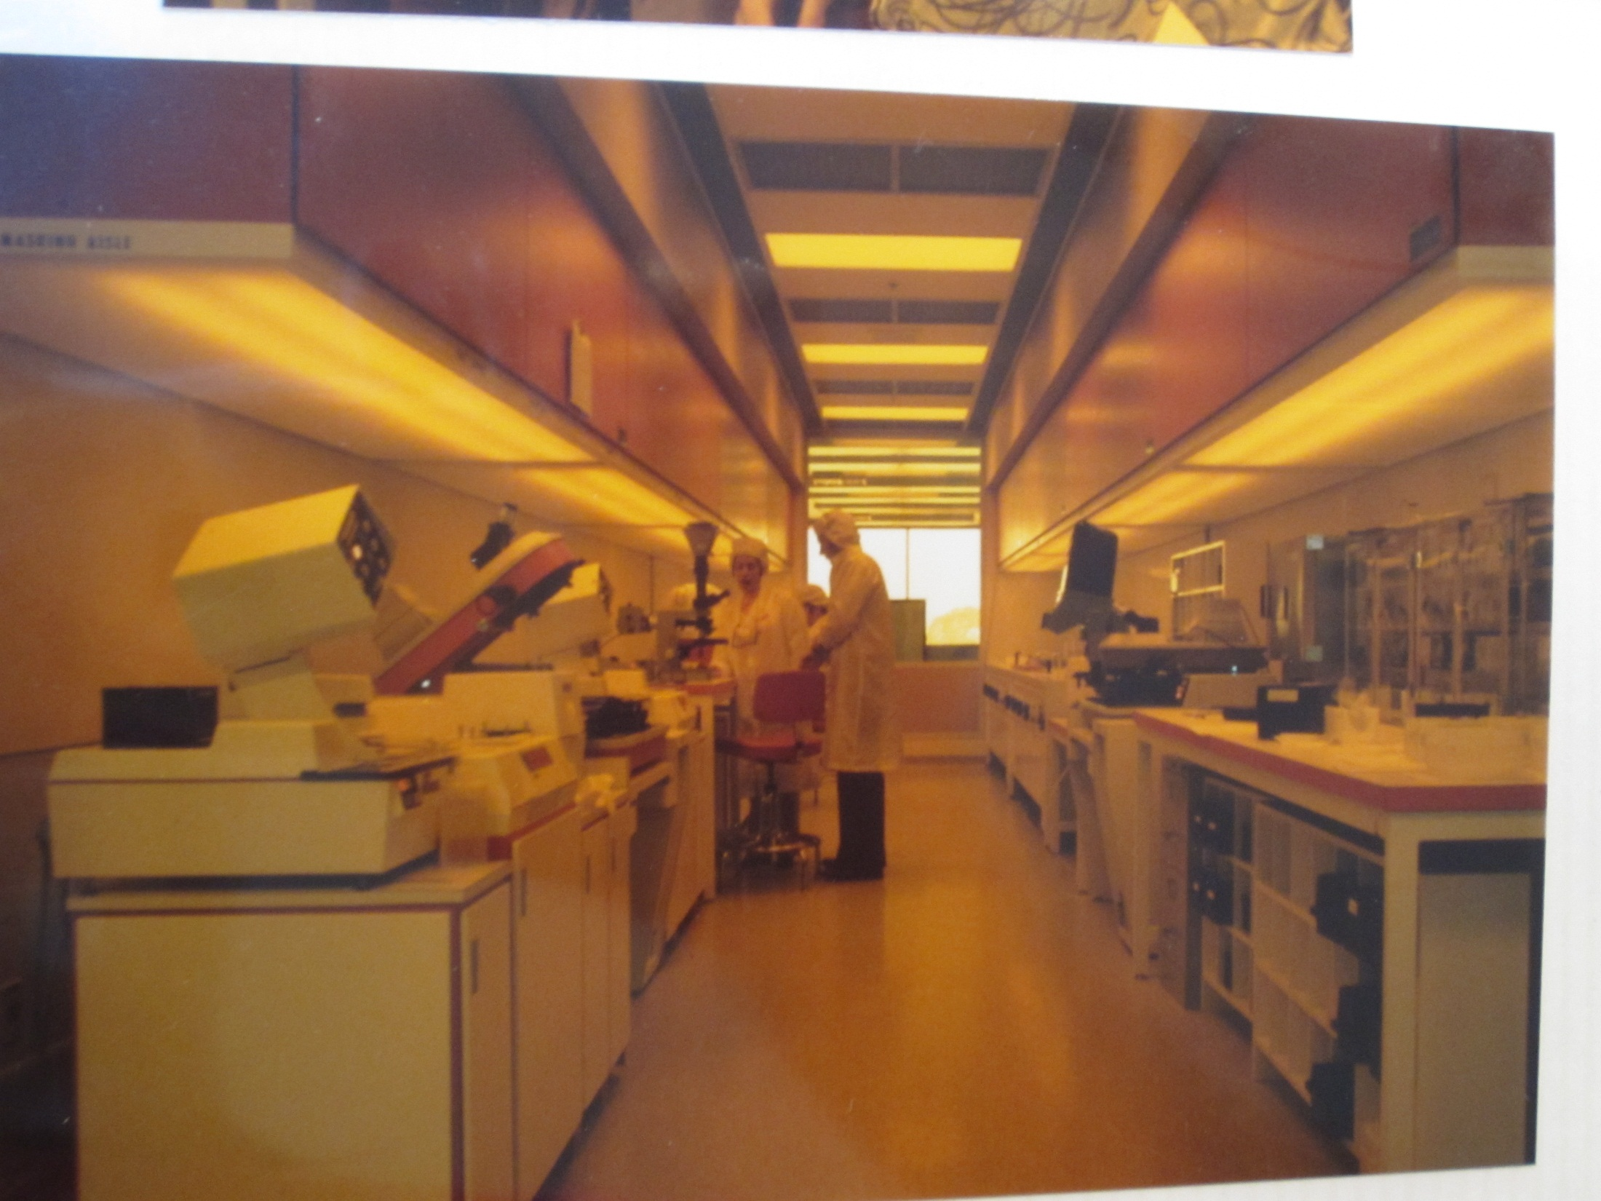

Slide 3
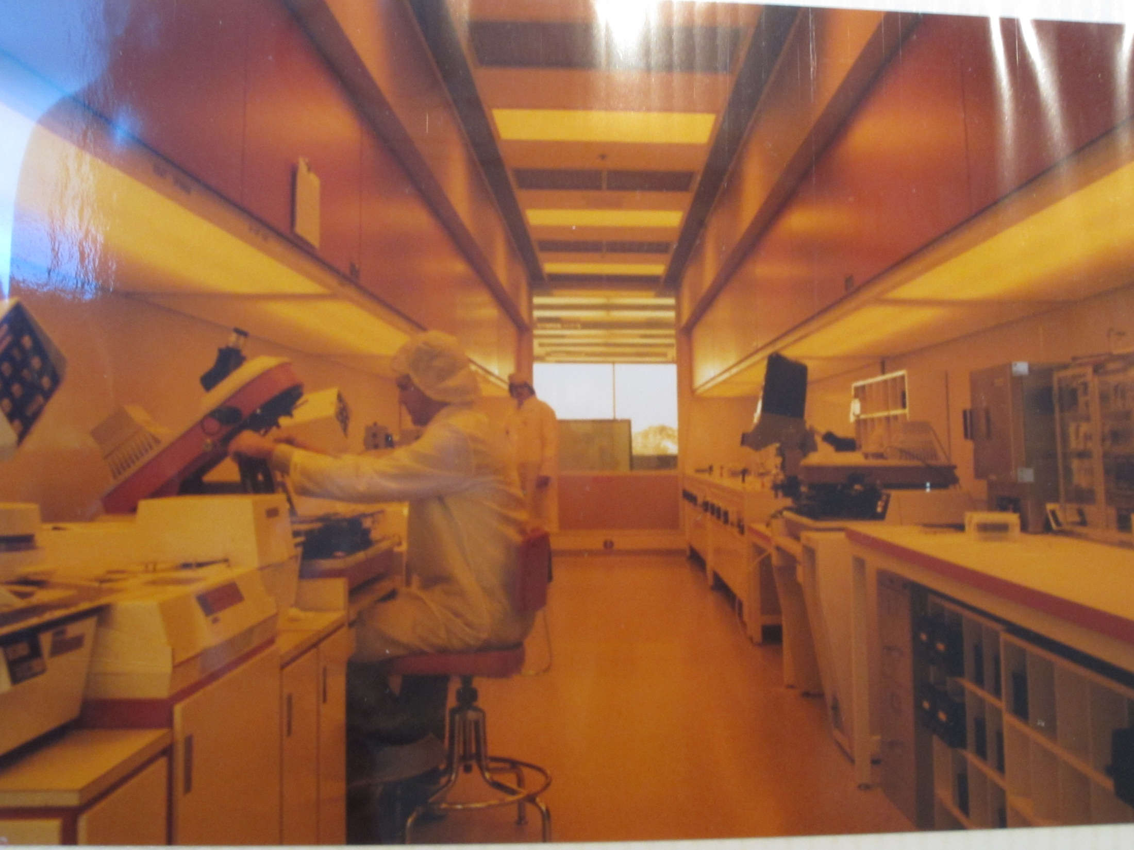

Slide 4
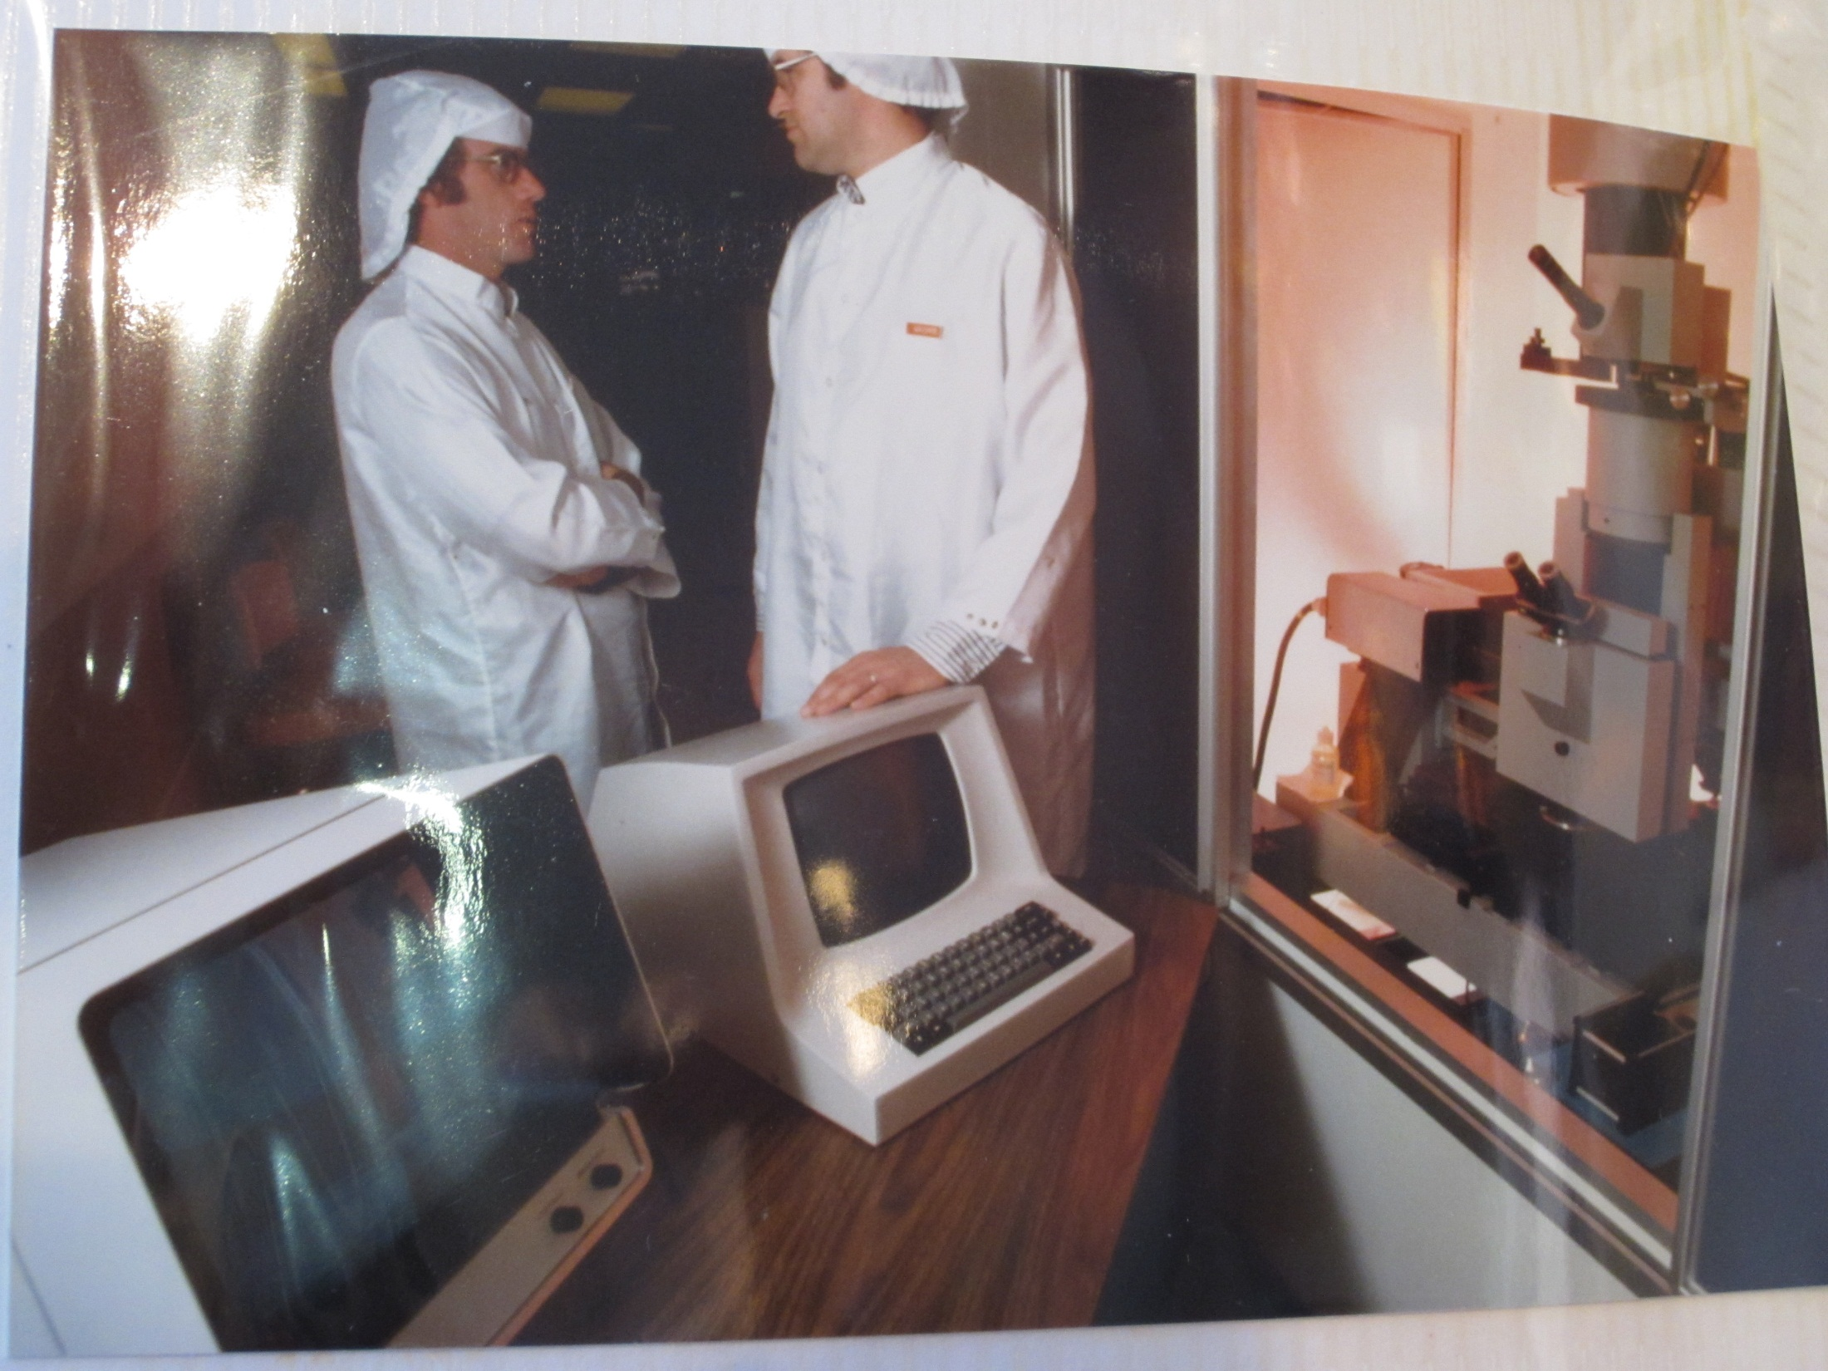

Slide 5
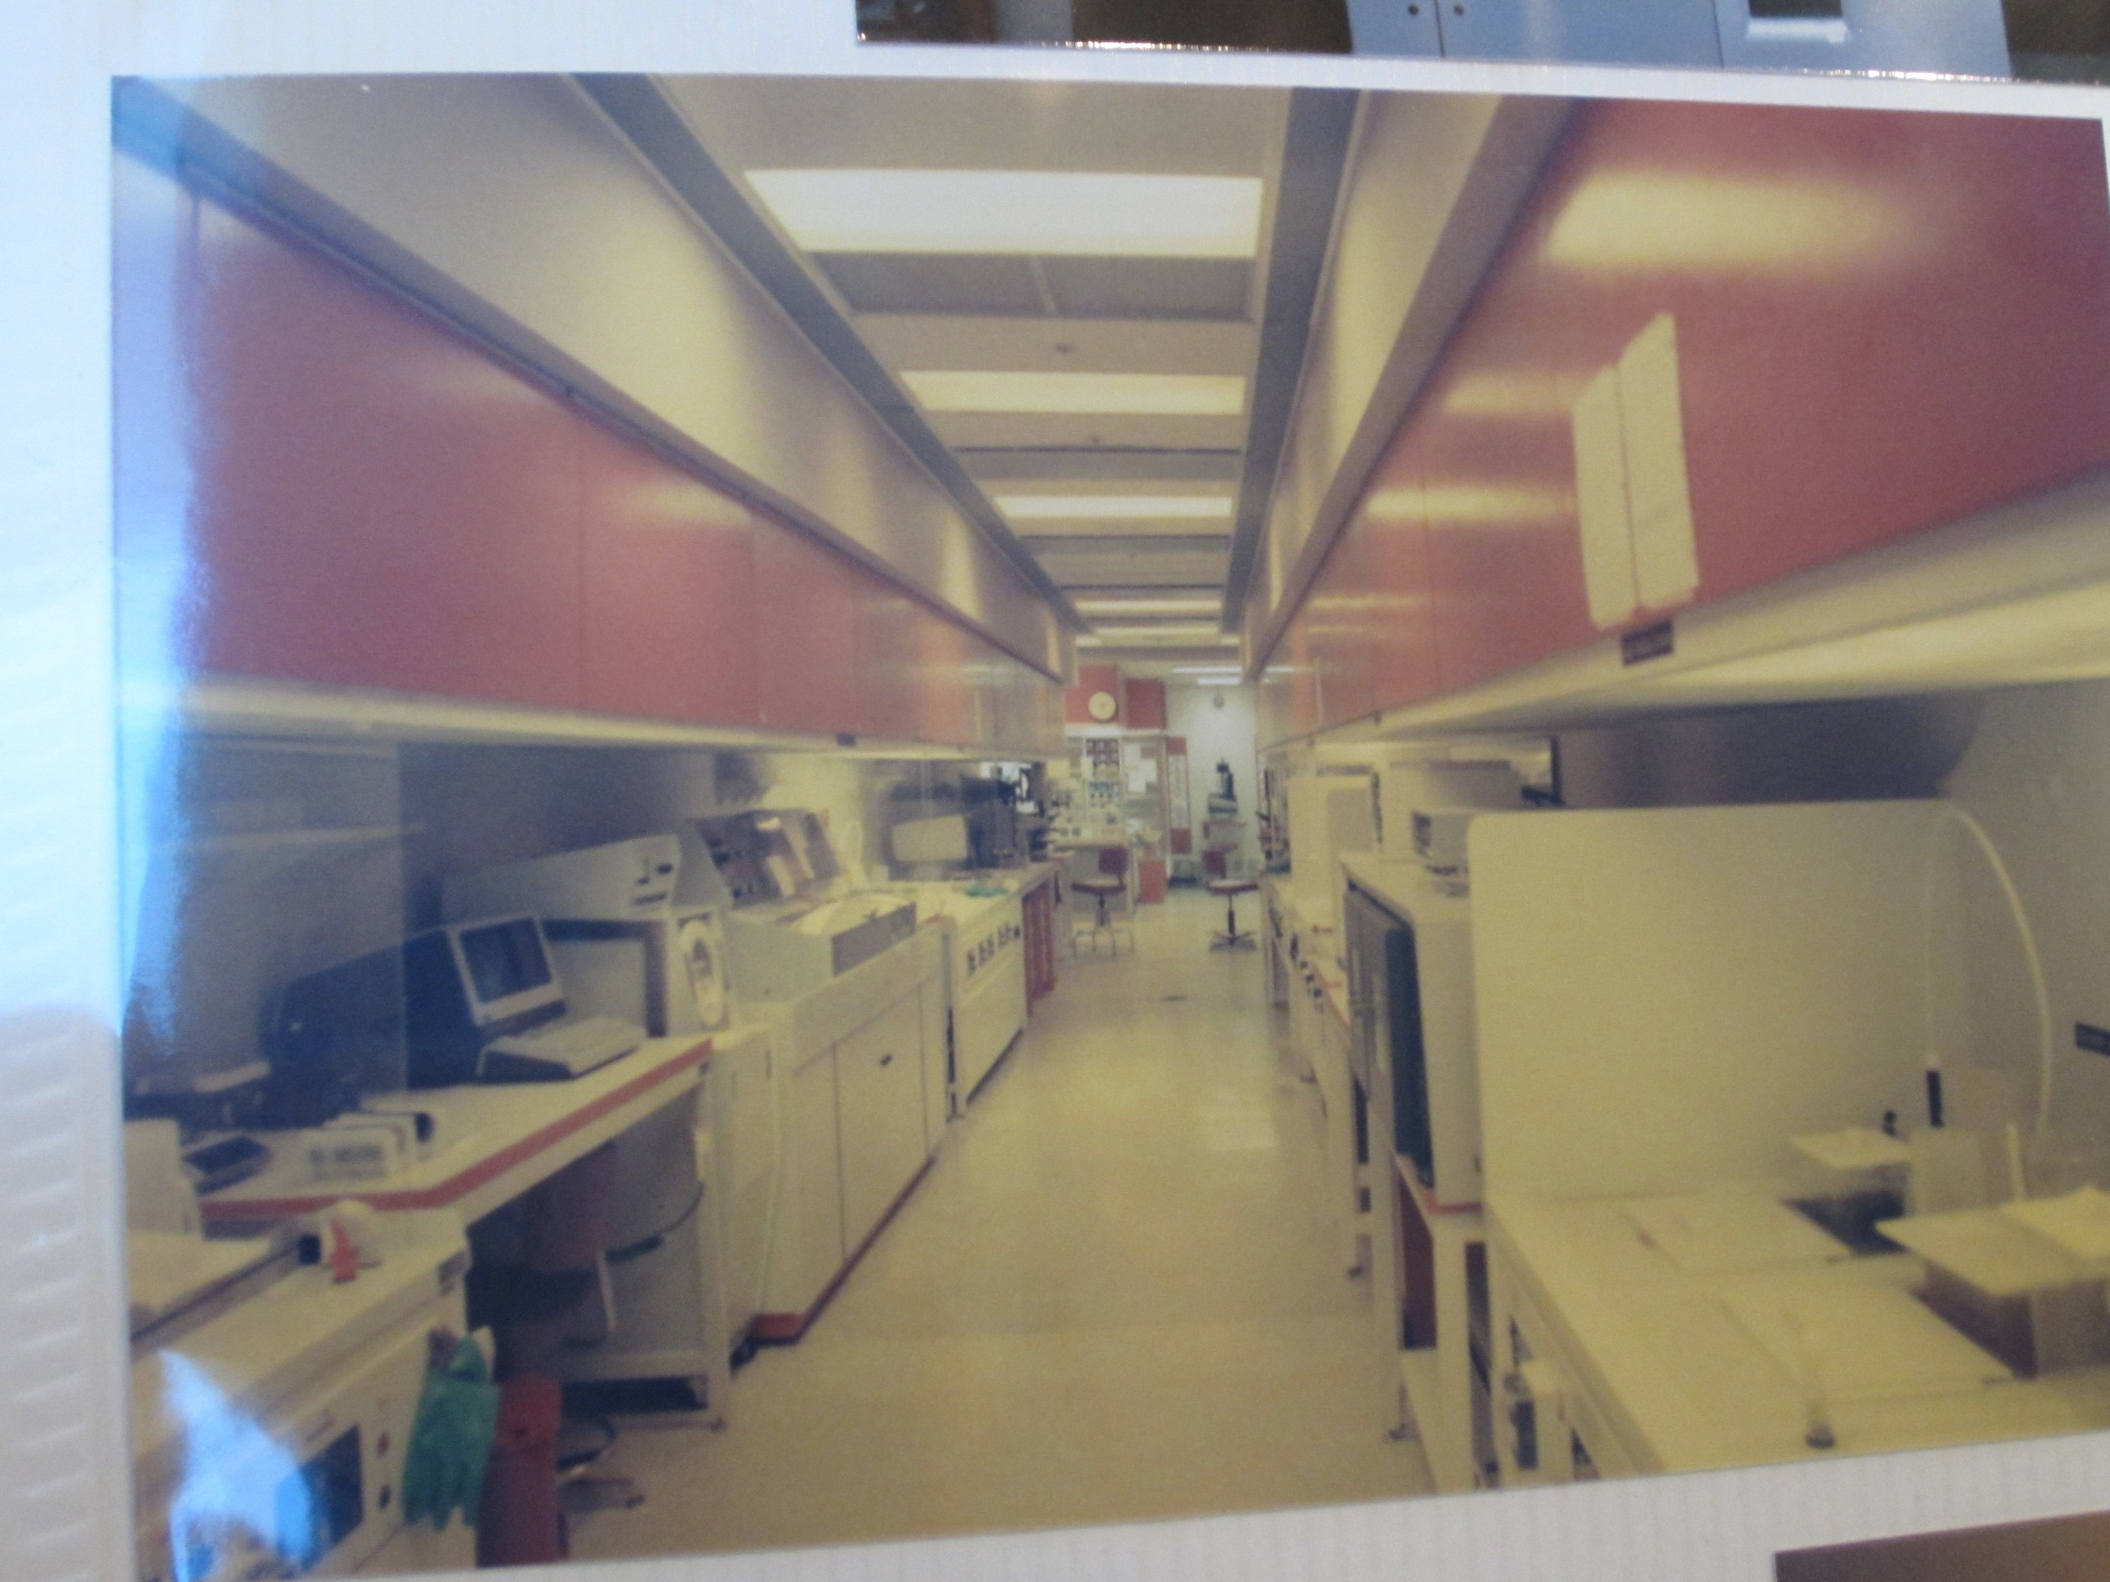

Slide 6
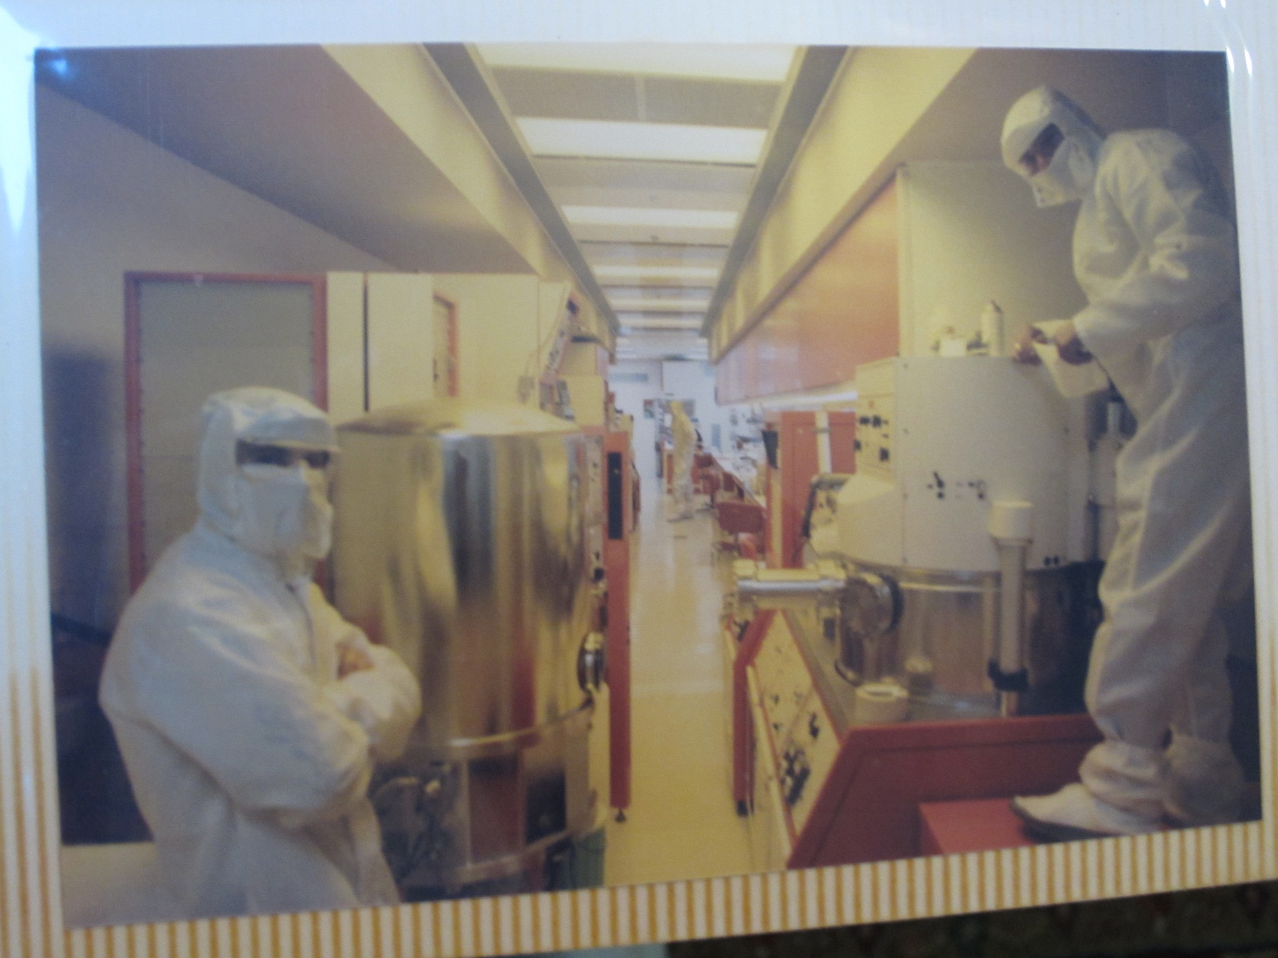

Slide 7
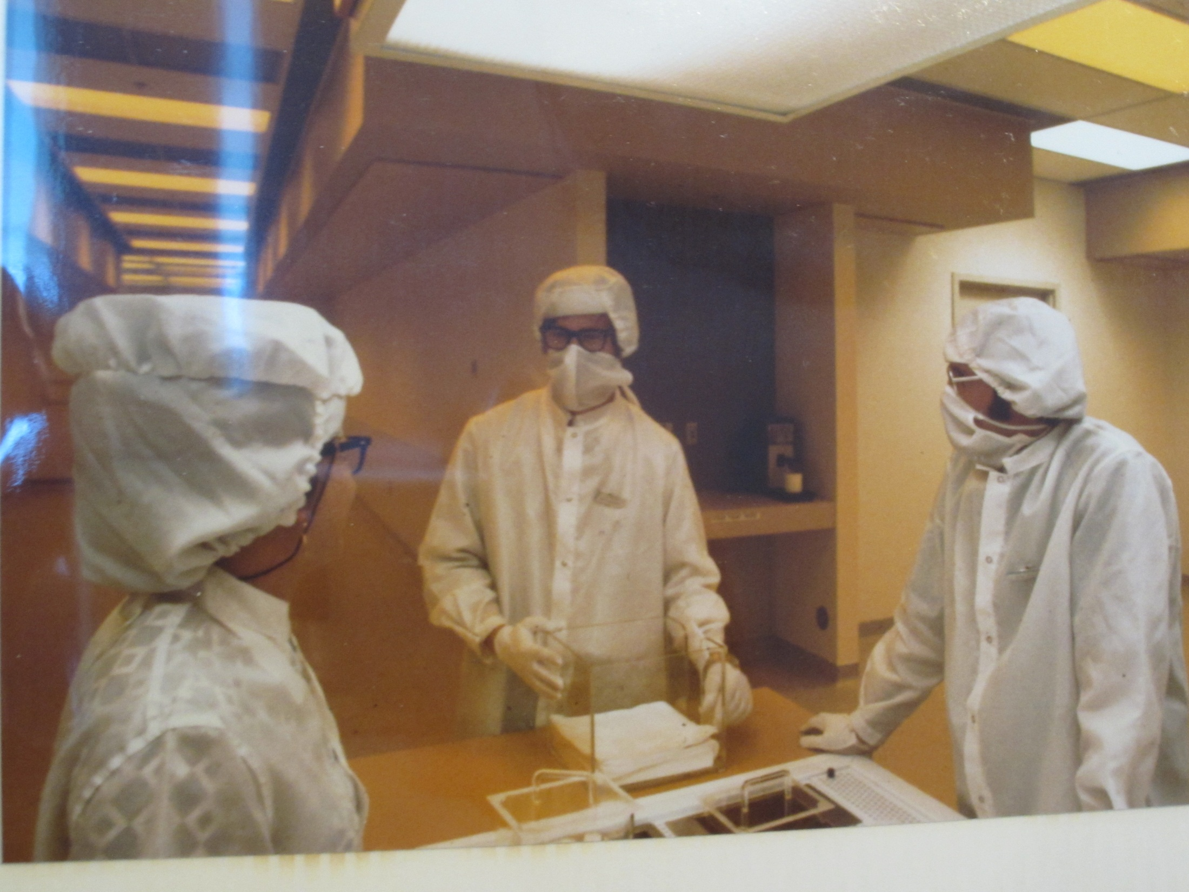

Slide 8
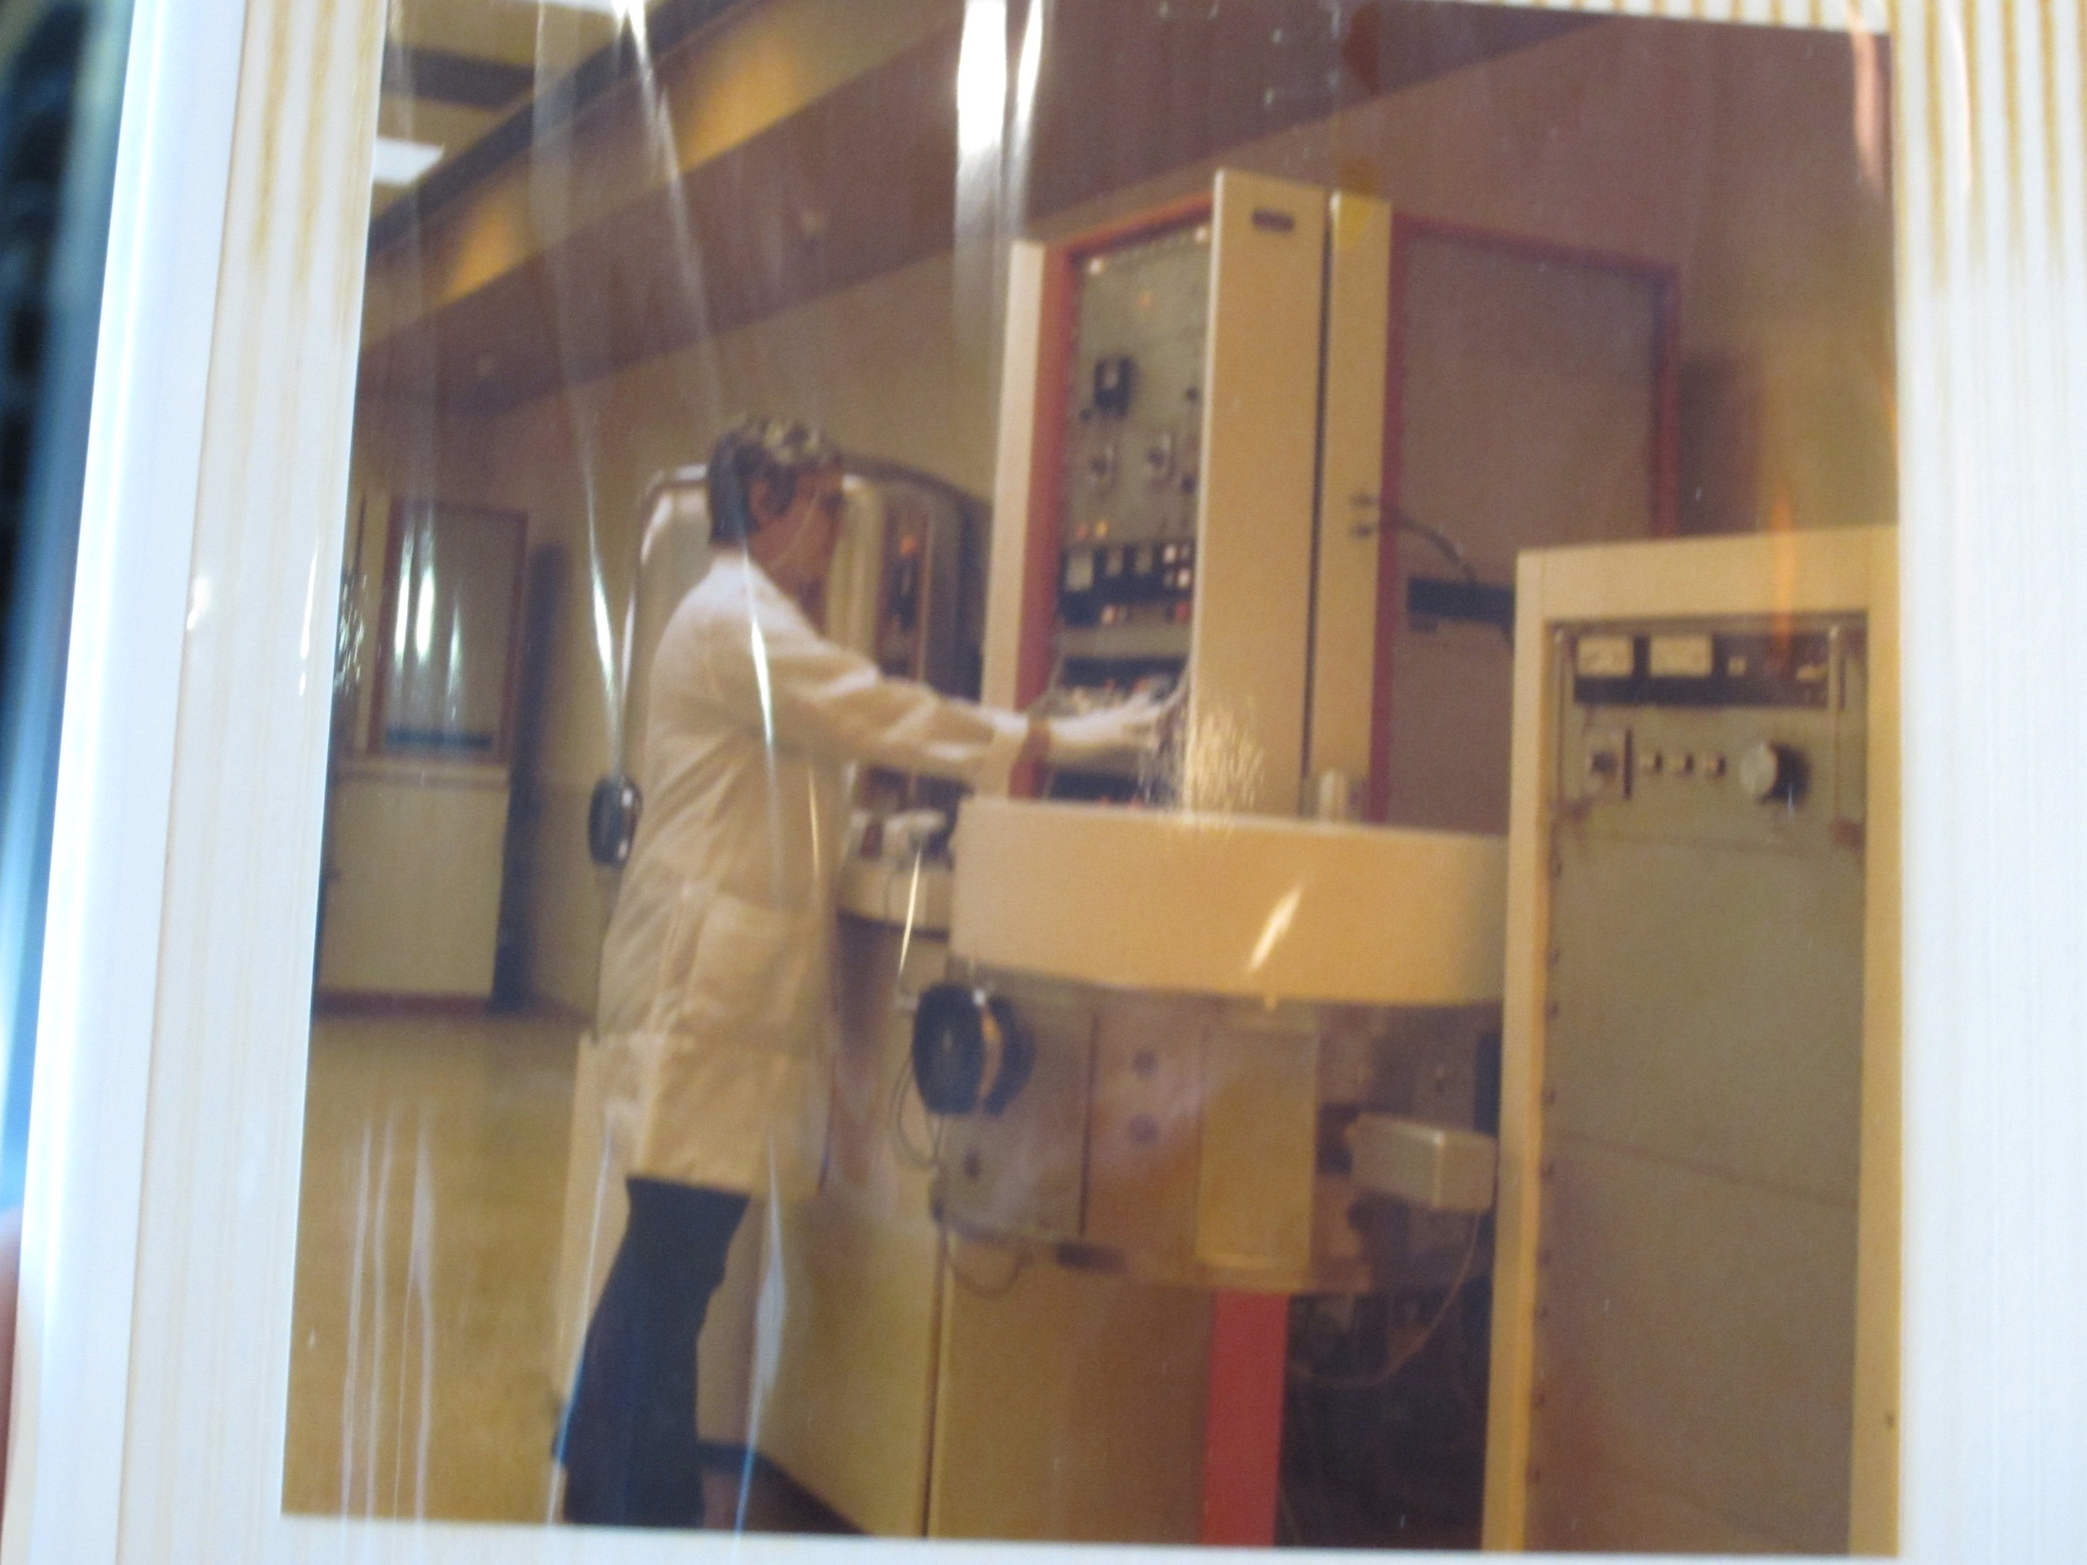

Slide 9
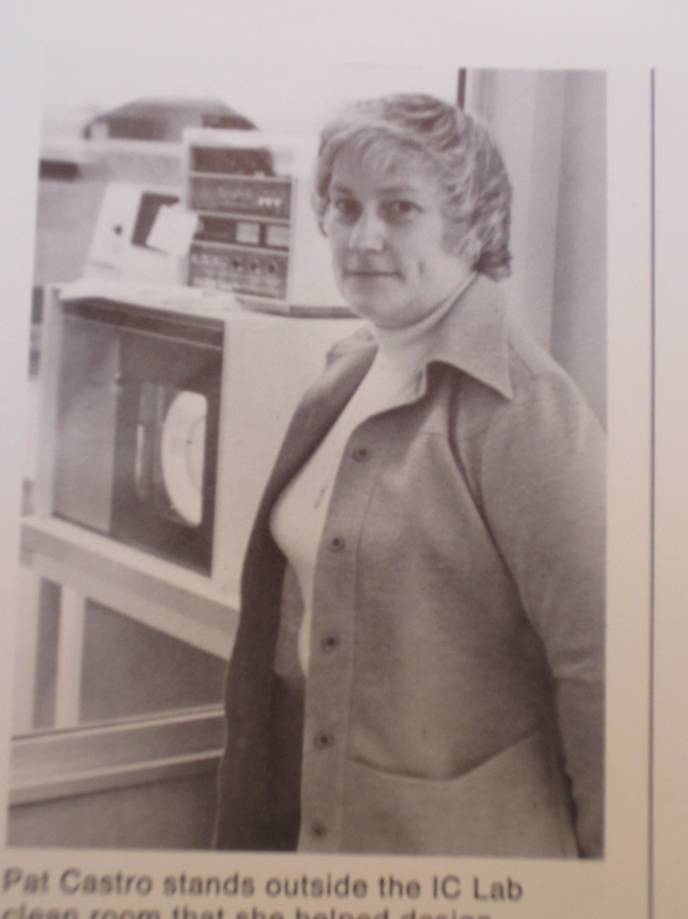

Slide 10
