Slide 1
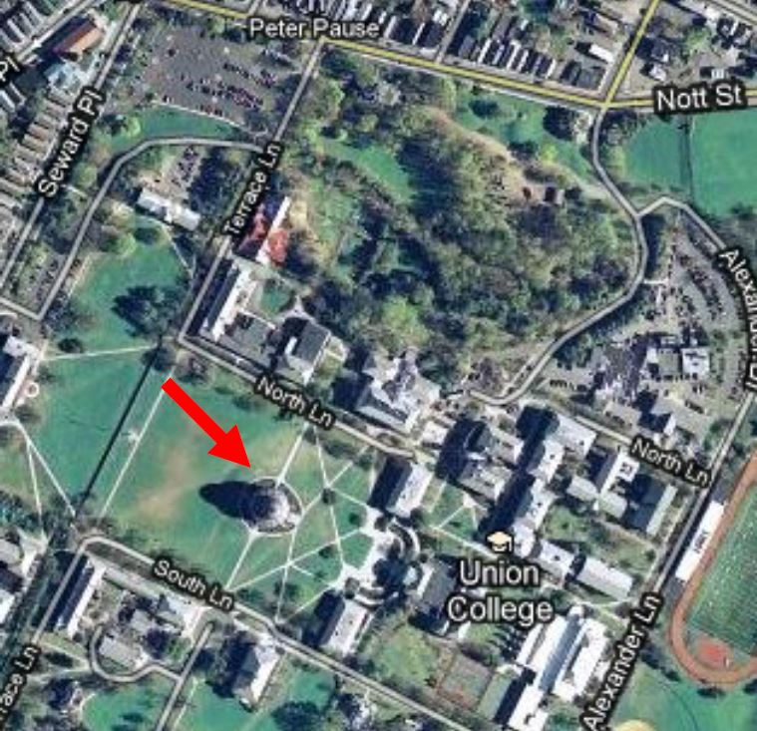
Union College and
IEEE Schenectady Section present
The Steinmetz Memorial Lecture for 2015
Our Travels Through Time:
Envisioning Historical Waves of Technological Innovation
Lynn Conway
Professor of EECS, Emerita
University of Michigan, Ann Arbor

Slide 2
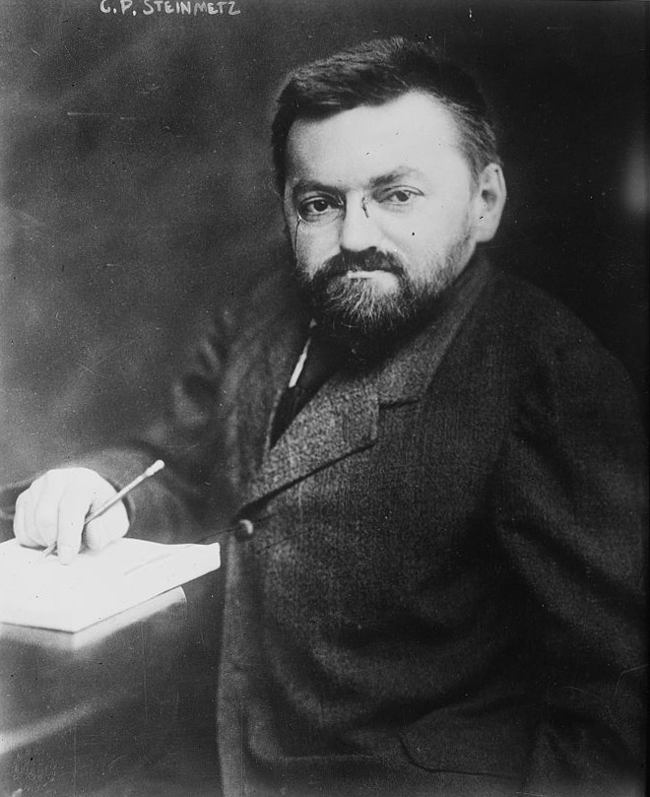
A lecture in memory of
Charles Proteus Steinmetz
Apr 9, 1865 – Oct 26, 1923
Legendary pioneer of electrical engineering,
On the 150th anniversary
of his birth
Wiki Commons

Slide 3
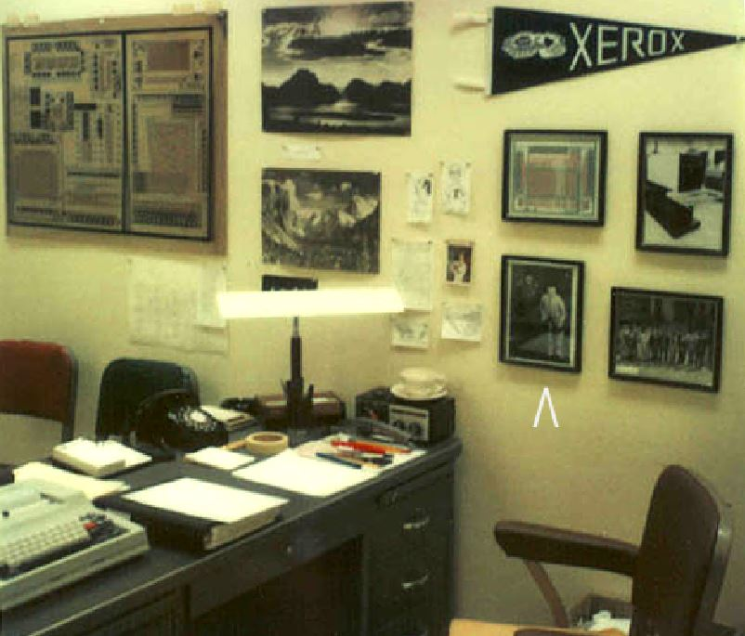
I’m especially honored to have been invited
to give this lecture for Steinmetz has been a powerful role model for me, because of his:
Pivotal role in the “AC revolution”,
Creatively living a wonderfully full life
And doing all this in the face of hardships that could have crushed a lesser soul.
Back in 1978 at MIT, as I struggled to launch a later revolution, I kept a his photo on my office wall (see at right, just above the chair) . . .
Lynn’s office at MIT, 1978

Slide 4
As we travel through time . . .
Link
Keep these words in mind . . . “The farther backward you can look, the farther forward you can see.” – Winston Churchill

Slide 5
We’ll first step back and reflect on some early waves of innovation
Then we’ll zoom-in on the AC electricity revolution
involving Steinmetz
And on the later VLSI microchip design revolution
that I participated in
We’ll then envisioning the huge incoming wave of innovation
as ever-smaller, ever-more-empowering microsystems
become embedded into almost everything.
Note: This slide-show (with links) will be posted online soon, for later reference.

Slide 6
To set the stage, let’s visualize some past waves of disruptive innovation . . .
Link

Slide 7
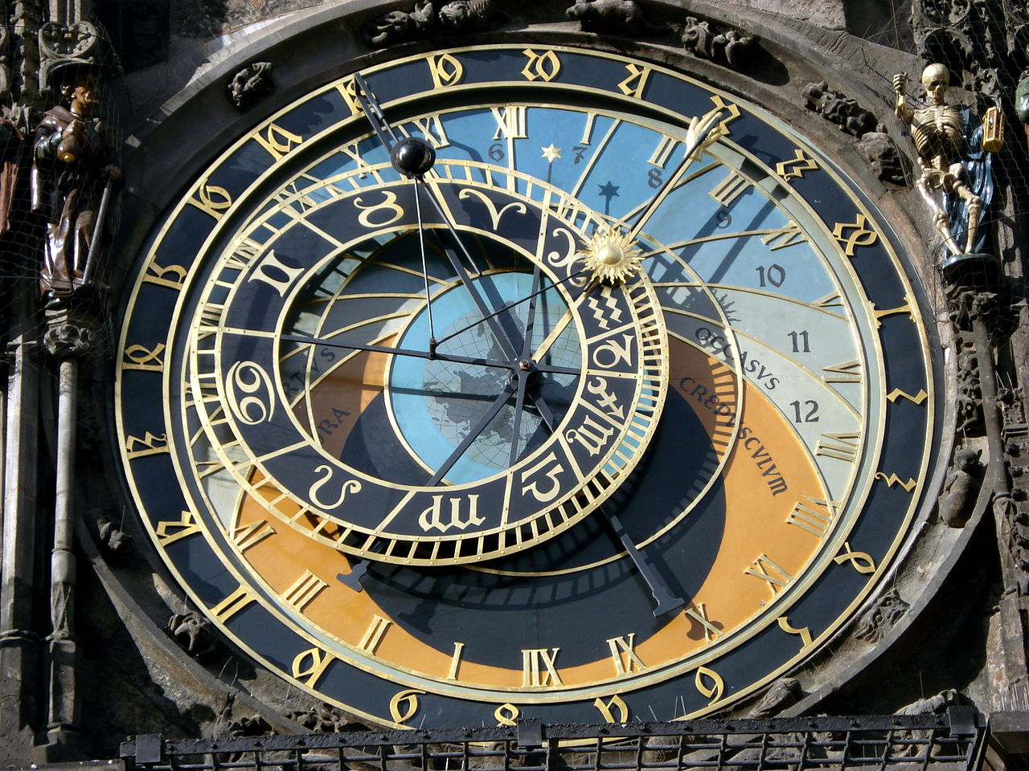
We’ll begin in the 1400s
during the renaissance,
a time of transformational
cultural advances . . .
Prague Astronomical Clock, c. 1410:
The mechanization of astronomical calculations during the renaissance:
A stunning confluence of the Mathematics, Science, Engineering
Architecture and Art of the time . . .
Photo by Hector Zenil (www.hectorzenil.net)

Slide 8
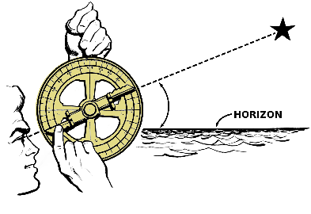
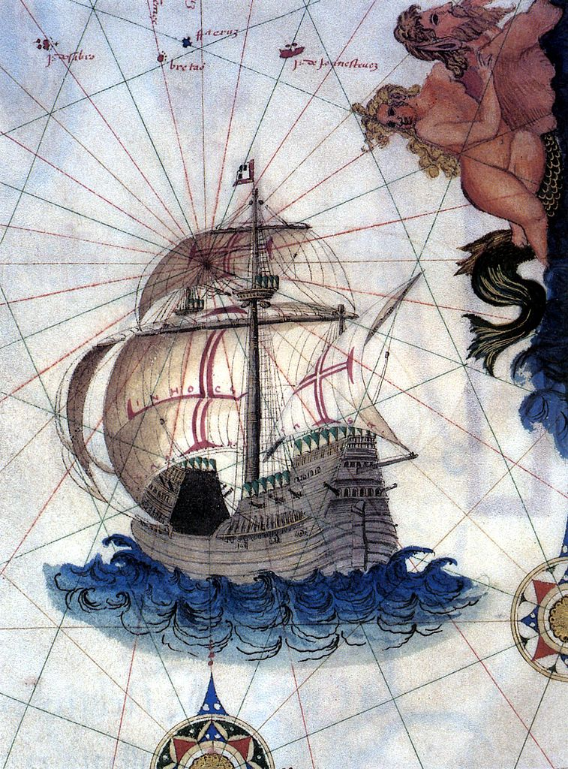
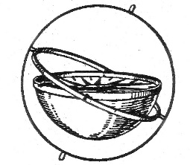
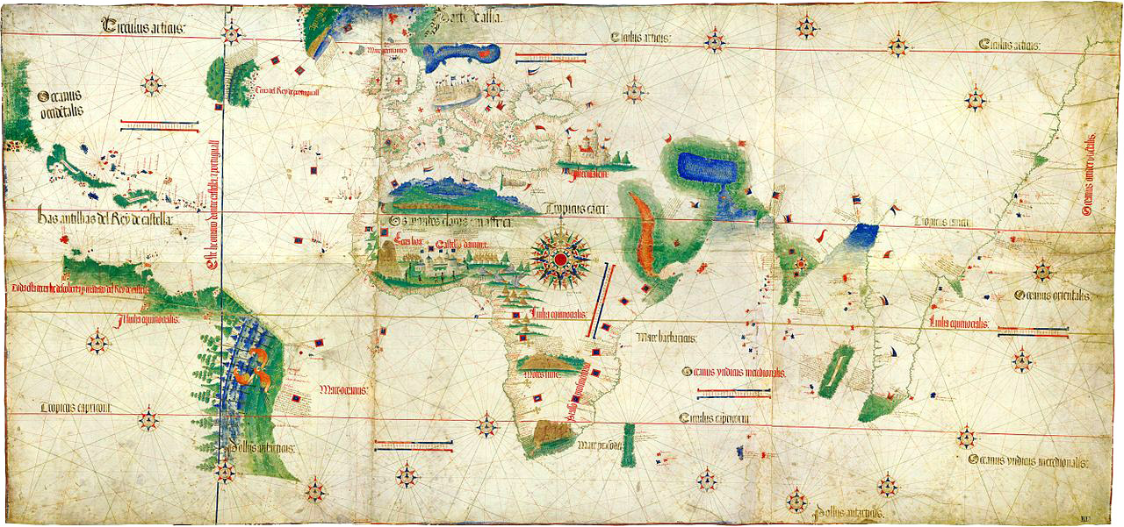
Towards the end of the 1400’s a commingling cluster of advances in shipbuilding, navigation and map-making reached a ‘tipping point’, triggering the onset of the Age of Discovery . . .
Mariner’s Astrolabe
Portuguese Carrack
Gimbal Compass
Cantino planisphere (1502)

Slide 9
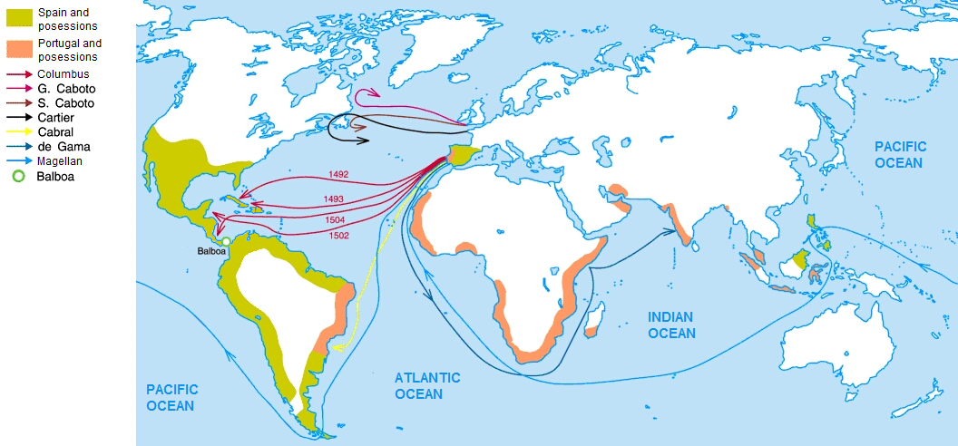
Thus it begins:
Charting the Early Voyages during the Age of Discovery, c.1492-1522 . . .
Wiki Commons

Slide 10
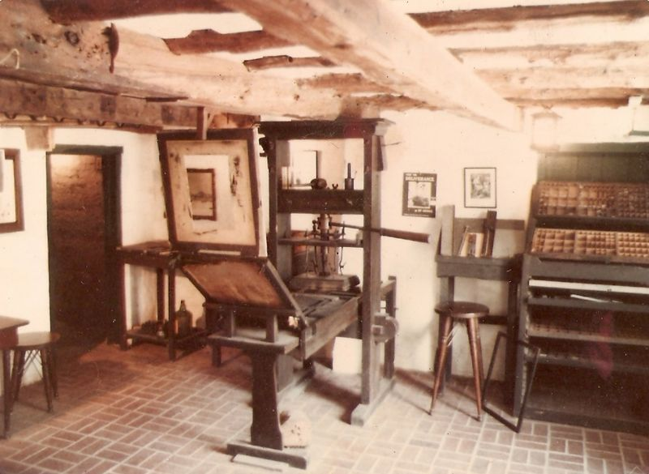
Exploration rates escalated as mass-communication by printing also spread in the late-1400s, enabling adventurers to ever more quickly propagate news of what they’d found
and how they’d found it . . .
Replica Gutenberg Press at the Featherbed Alley Printshop Museum:
Link; Attribution: Aodhdubh at English Wikipedia

Slide 11
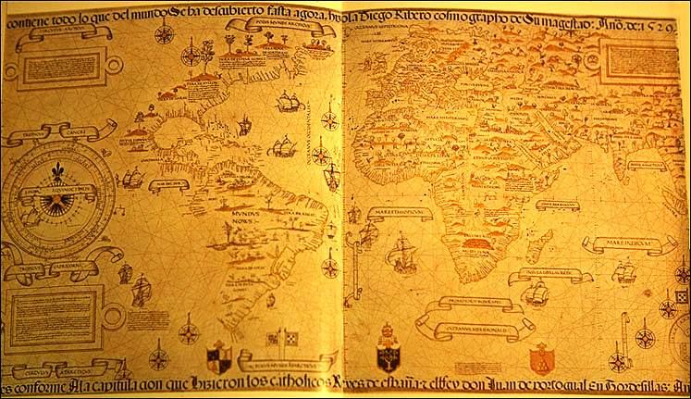
The escalation is evidenced, a generation later,
in Diogo Ribeiro’s much-more-detailed World Map as of 1527 . . .
Wiki Commons

Slide 12
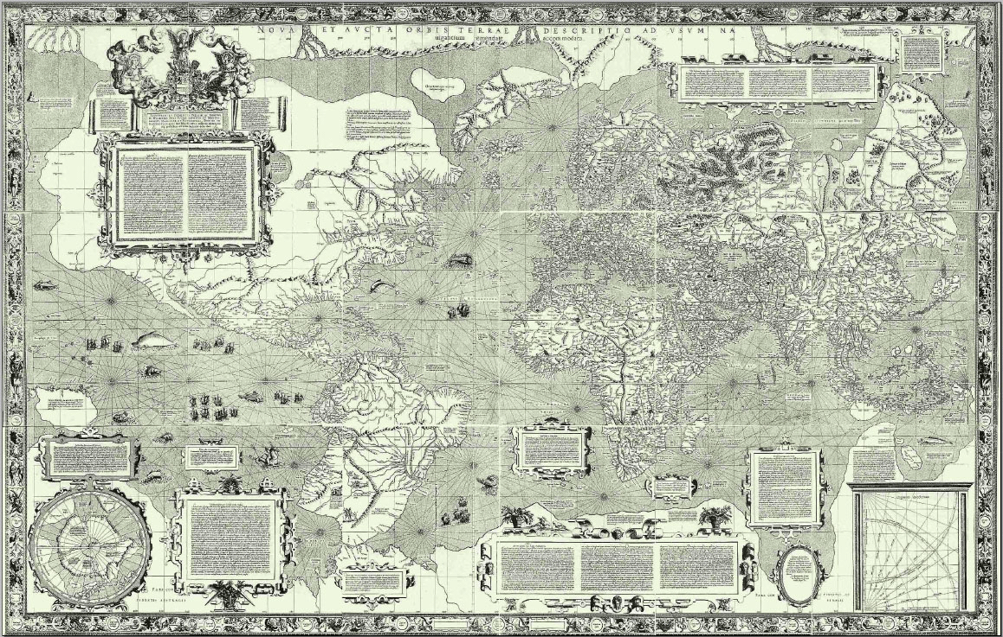
And two generations later, in Mercator’s projection-map of 1569 . . .
Wiki Commons

Slide 13
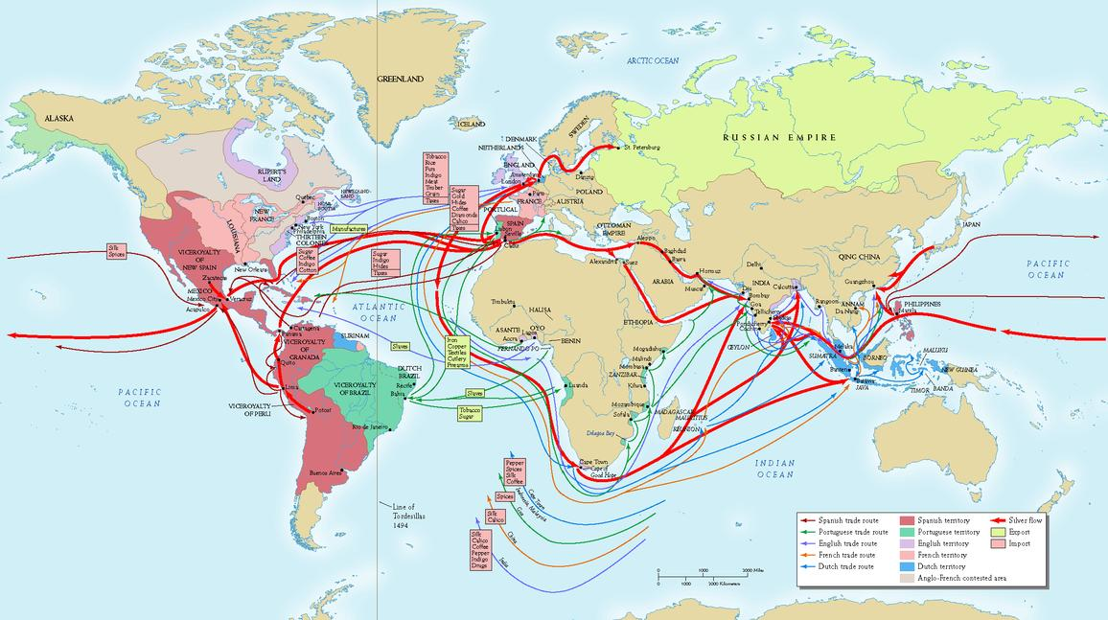
By the early 1700’s, exponentiation had generated a massive global trading system . . .
Source

Slide 14
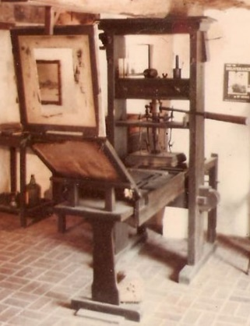
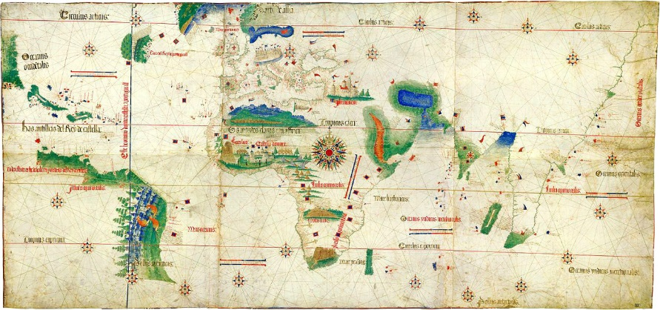
Now, what’ happening here?
Just exponentiation of THINGS?
Is that all it is?
Or exponentiation of key clusters of innovative
IDEAS in the minds of ever more people?
IDEAS on how to MAKE and USE things . . .

Slide 15
By the mid-1700’s, the stage was set for a tremendous disruptive wave of technological innovation
and so began the industrial revolution (~1760-1850) . . .
Link

Slide 16
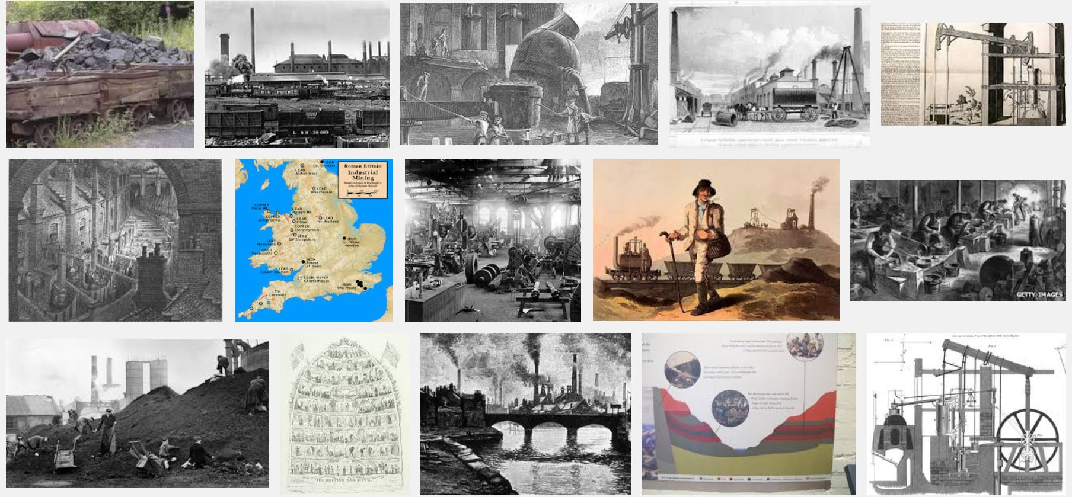
During the Industrial Revolution the mining of
coal and iron-ore was greatly amplified by steam-power . . .
Snip from Google Images
Some of the resulting iron was used to make more steam engines,
the positive feedback generating an iterative expansion-process . . .

Slide 17
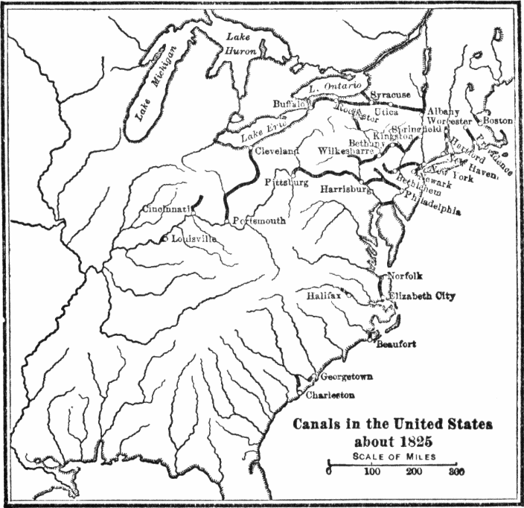
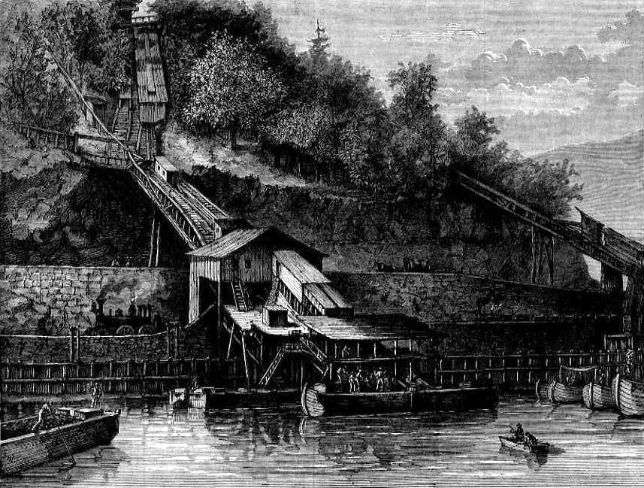
Initially, heavy industrial raw materials
and products were transported using
the expanding canal system:
Loading coal on the Lehigh Canal Wiki Commons
Wiki Commons

Slide 18
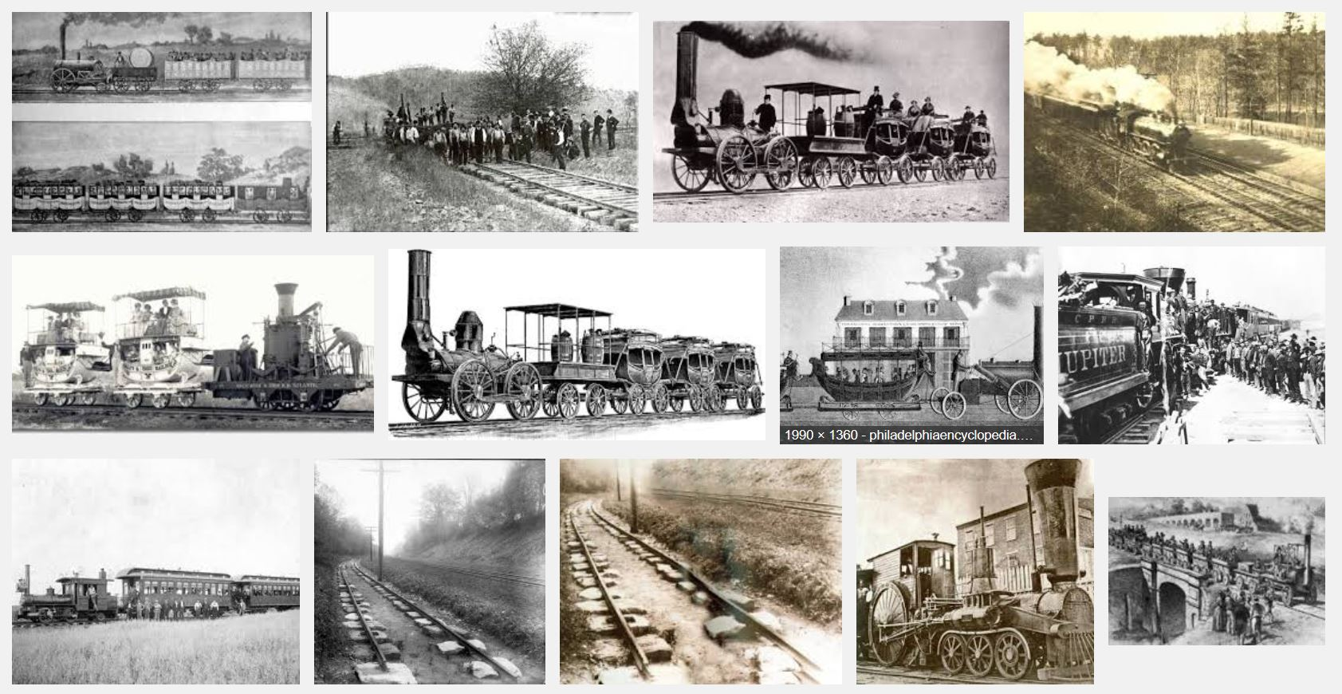
By the 1830’s, steam-powered railroads began interconnecting mines to
iron-works and rail-makers, enabling more-rapid expansion of railroads . . .
Snip from Google Images

Slide 19
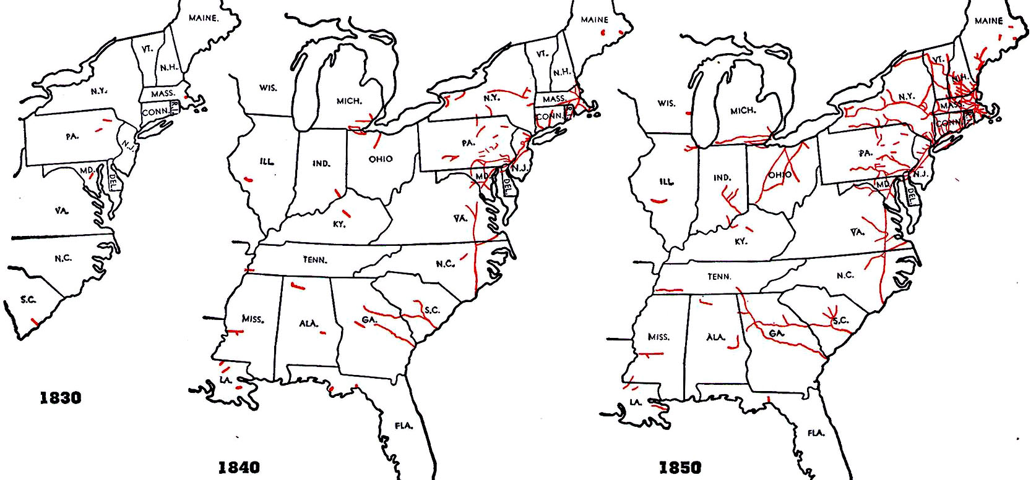
These charts reveal the rapid early spread of railroading in the US . . .
Source

Slide 20
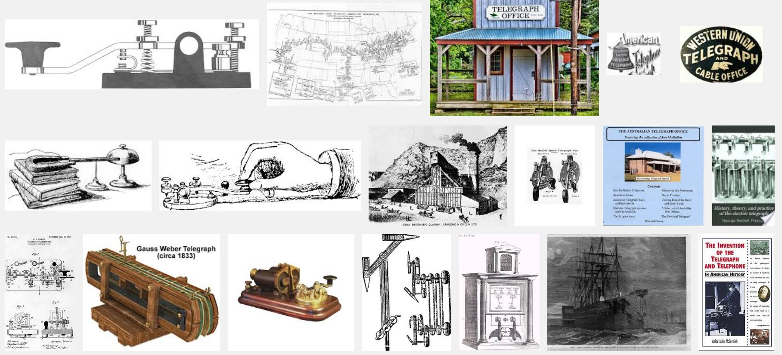
The expansion was accelerated by rapid spread of telegraphy in the 1850s,
the effect analogous to that of printing in the age of discovery . . .
(Snip from Google Images)

Slide 21
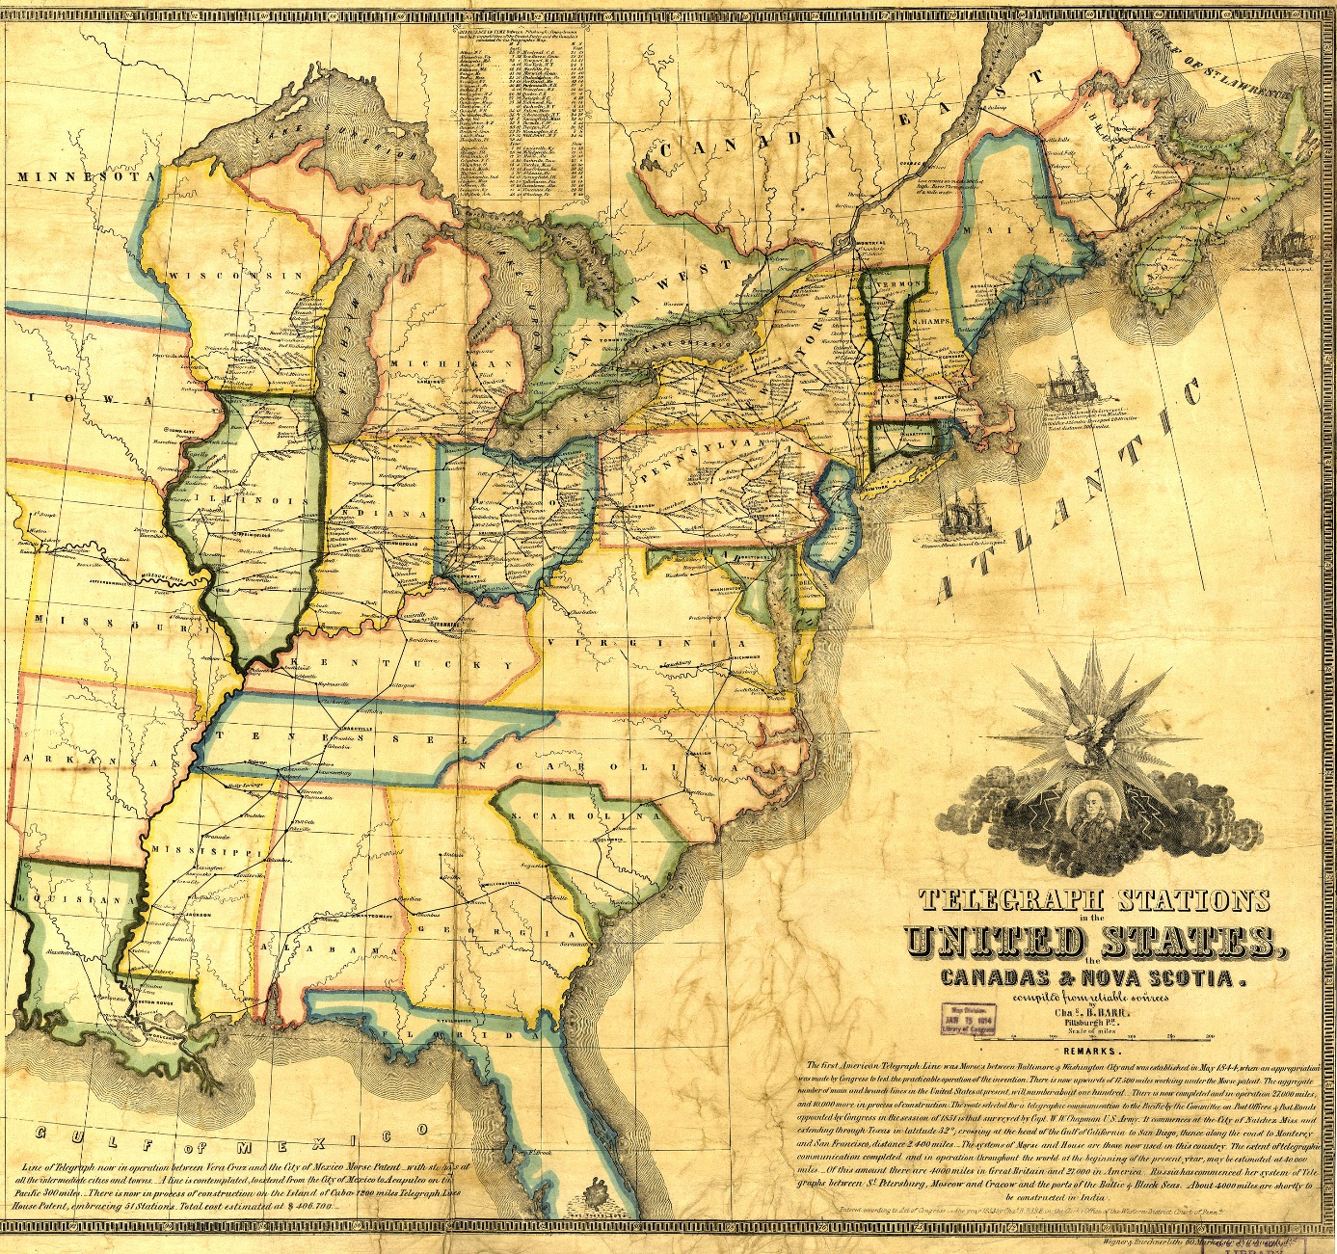
Map of telegraph stations in the United States, Canada and Nova Scotia, 1853
http://www.telegraph-history.org/
http://www.telegraph-history.org/map2.htm

Slide 22
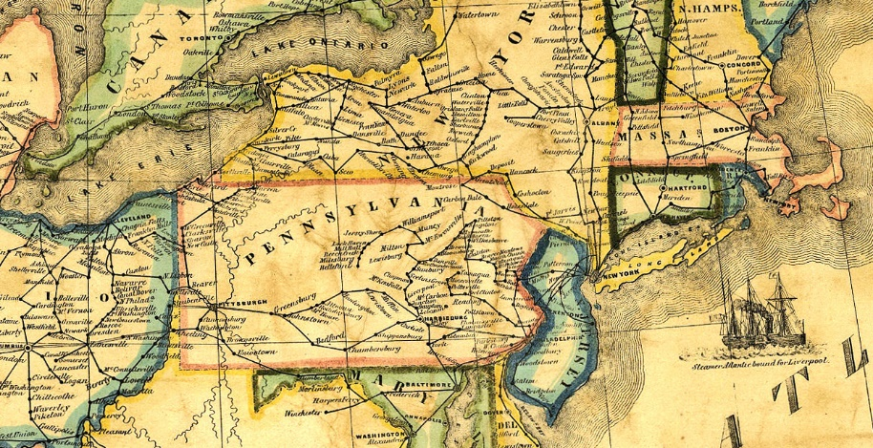
Zooming into the map of telegraph stations in 1853 . . .
http://www.telegraph-history.org/map2.htm

Slide 23
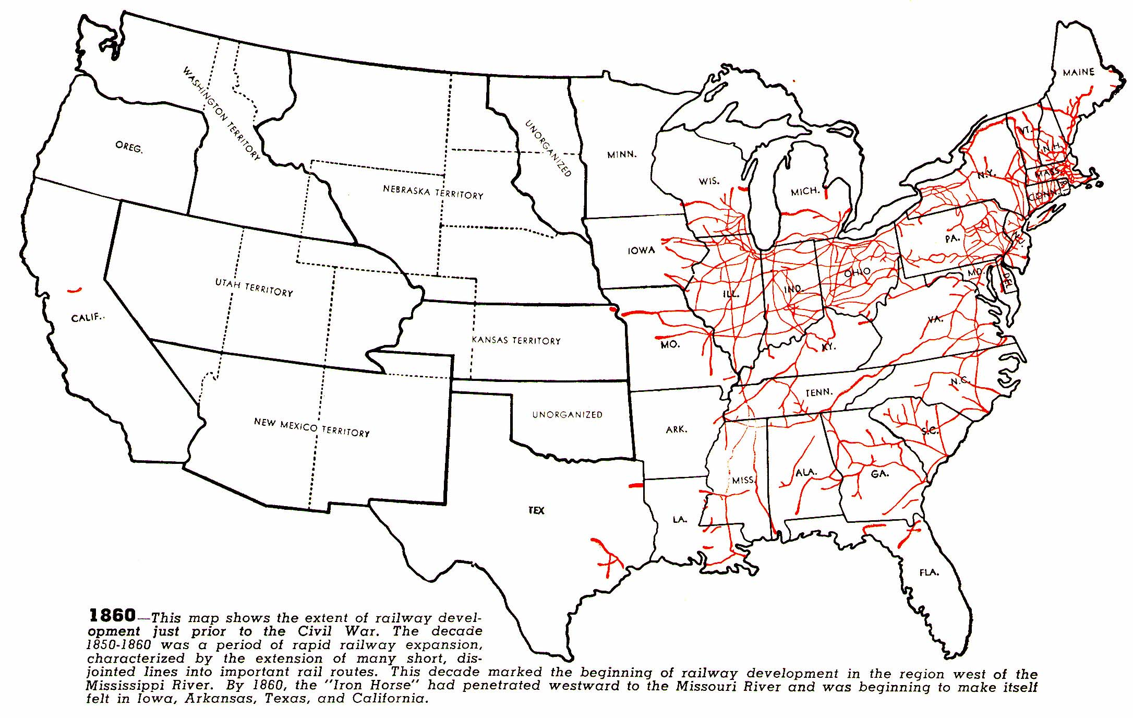
The much expanded railroad system, as of 1860 . . .
source

Slide 24
All that set the stage for another disruptive wave of innovation,
and the Second Industrial Revolution began in the 1860s/70s . . .

Slide 25
The Second Industrial Revolution was characterized by
(1) the build out of railroads
(2) large scale iron and steel production
(3) widespread use of machinery in manufacturing
(4) greatly increased use of steam power
(5) use of oil
(6) beginning of electricity
(7) electrical communications – Wikipedia
Let’s first zoom-in and follow the progress of the
“build out of the railroads” from 1860 – 1890 . . .

Slide 26
1860
source

Slide 27
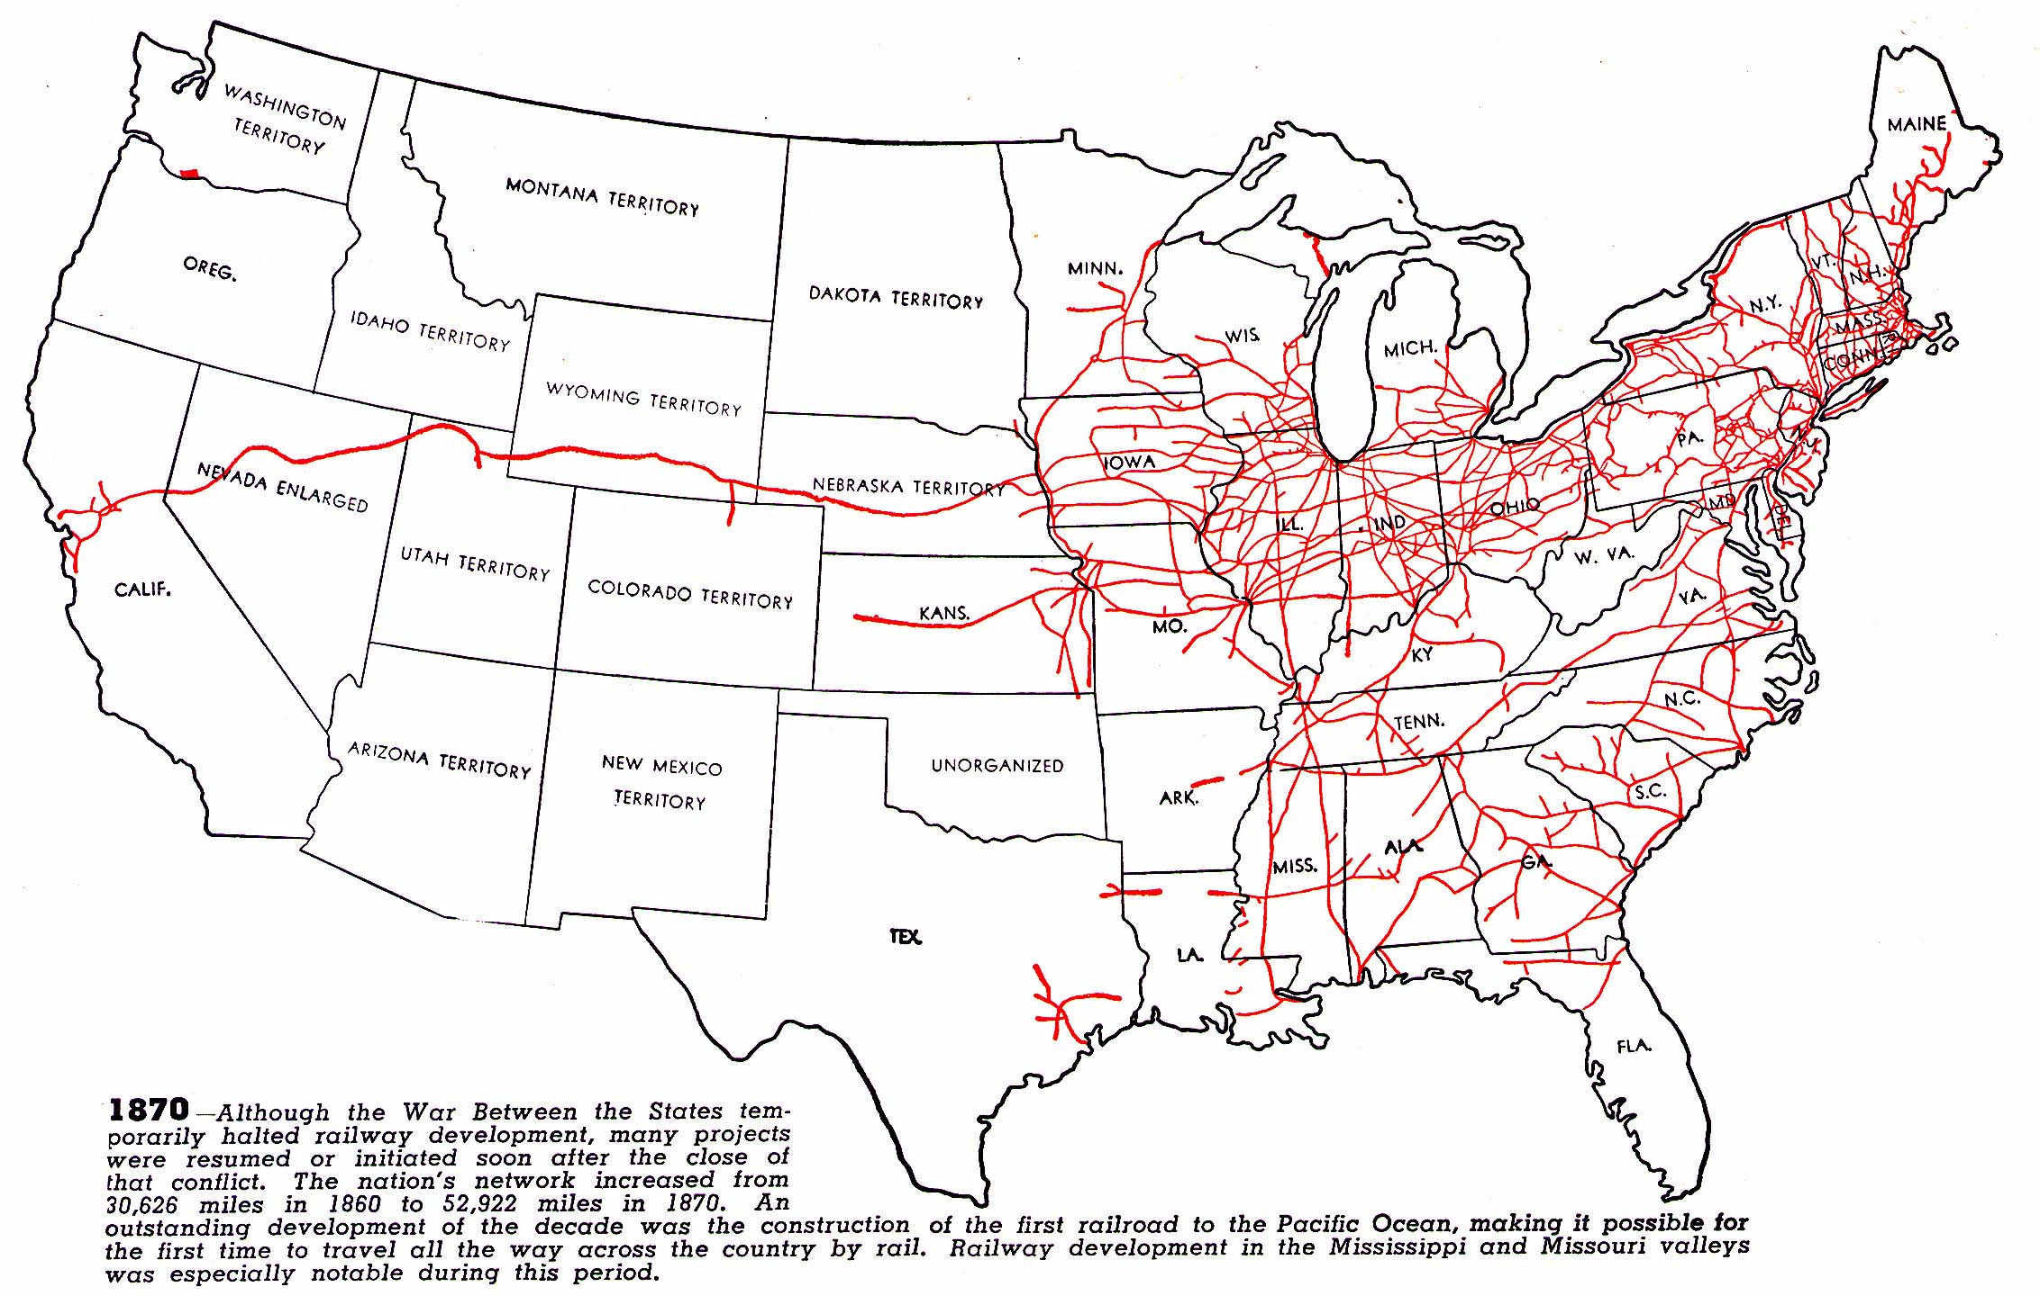
1870
source

Slide 28
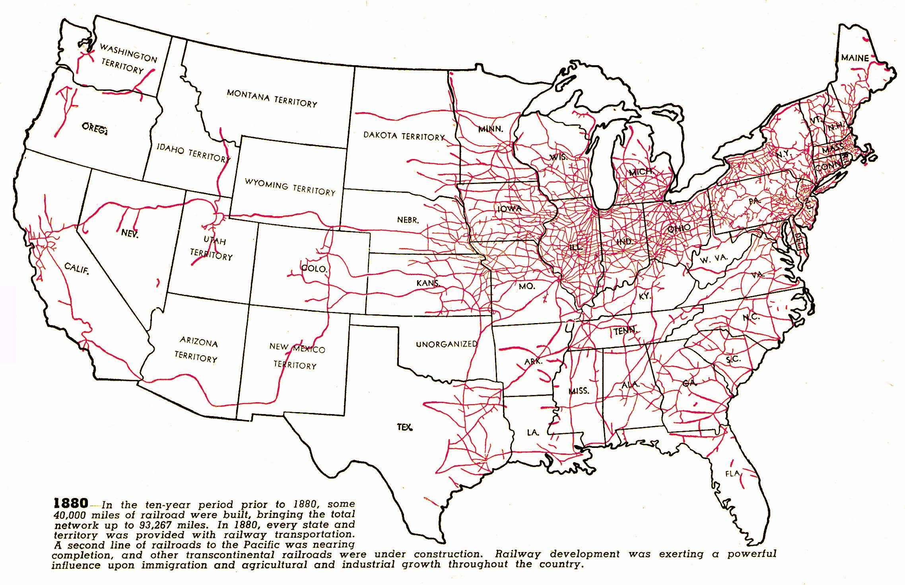
1880
source

Slide 29
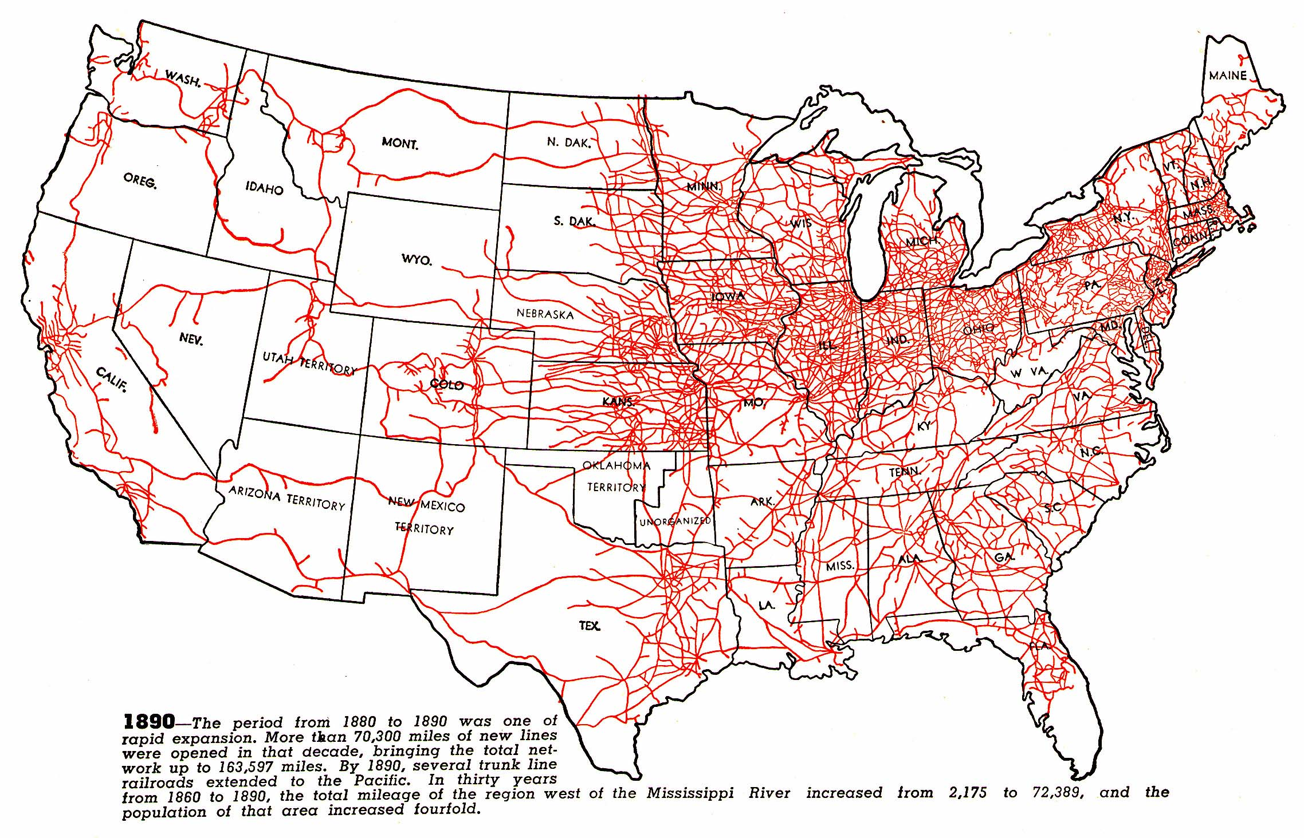
1890
source

Slide 30
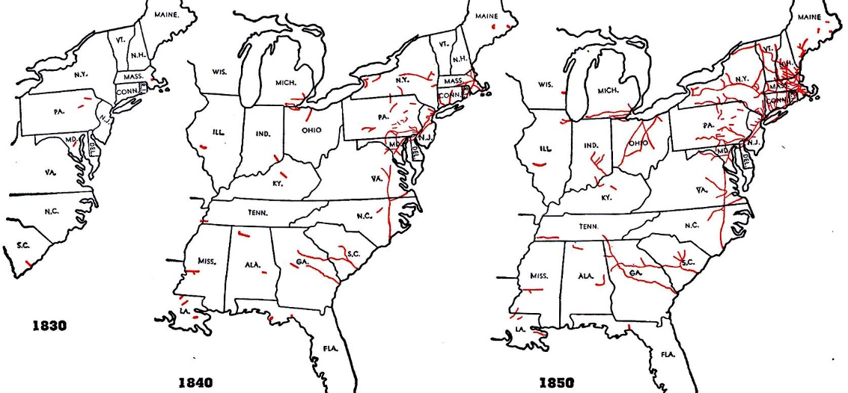
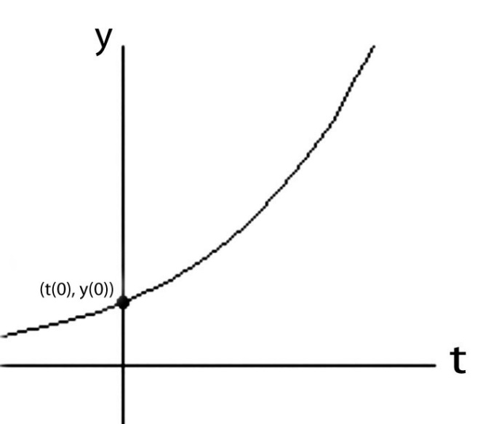
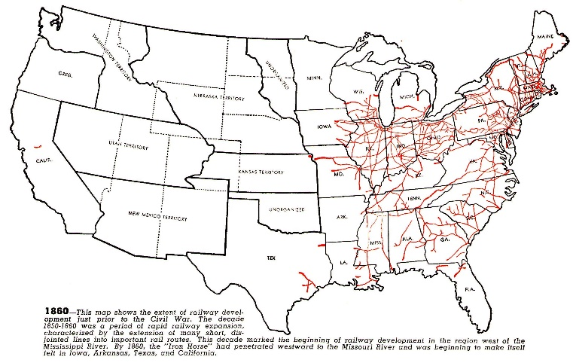
Like compound interest, the early social-diffusion rate of such clusters of technological ideas is approximately proportional to what’s already there
at any given point in time . . .
(i.e., exponential function):
y(t) = y(0)e^rt
source

Slide 31
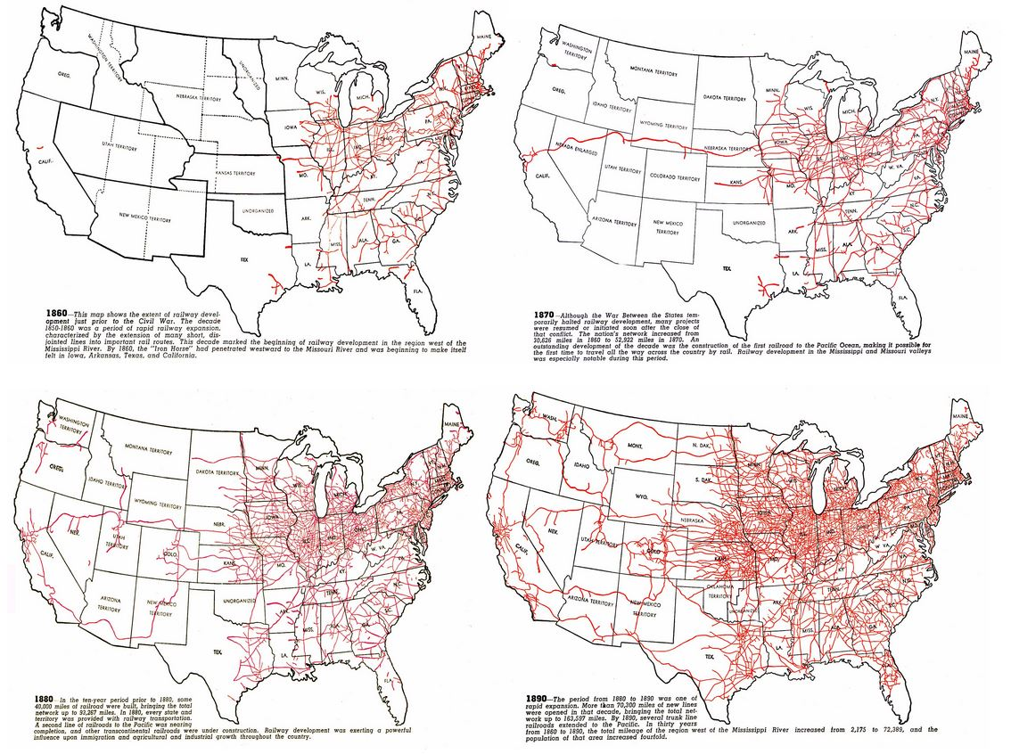
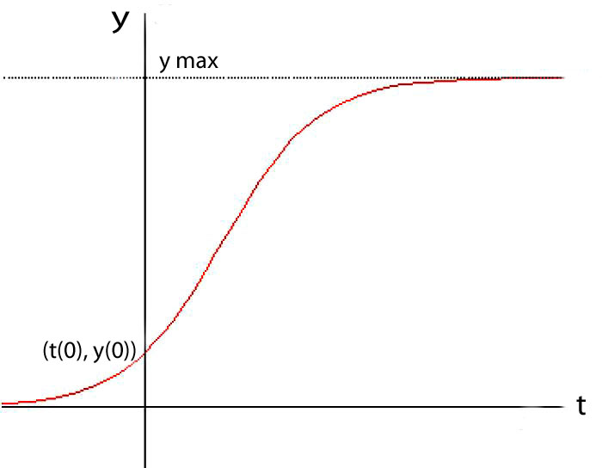
But as the opportunity-space fills,
the diffusion rate of technological ideas slows as the cluster nears its expansion limits . . .
(i.e., logistic function):
later saturation
y(t) = ymax/(1+((ymax/y(0))–1))e^-rt)
early exponentiation
source

Slide 32
Let’s visualize the harnessing “electricity” by the 1890’s:
Electric generators, motors and lights were being embedded in a rapidly-expanding electrically-empowered industrial, commercial and transportation infrastructure.
Names such as Edison, Westinghouse, Tesla, Steinmetz and Sprague were becoming famous for roles in creating the newly-spreading technologies.
And the alternating vs direct (AC vs DC) “war of the currents” was on . . .
The dramatic story of that era is revealed in detail in the website, displays and resources of the Edison Tech Center here in Schenectady.

Slide 33
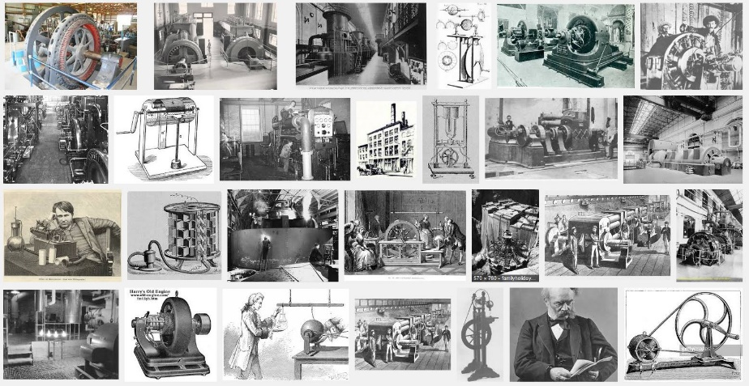
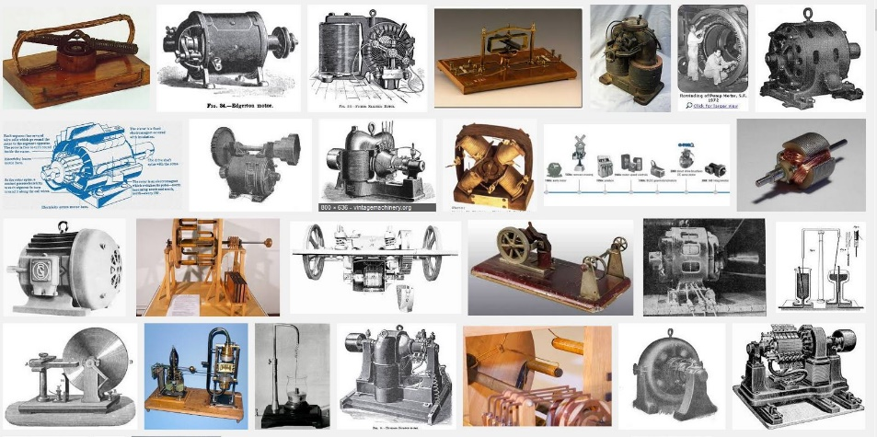
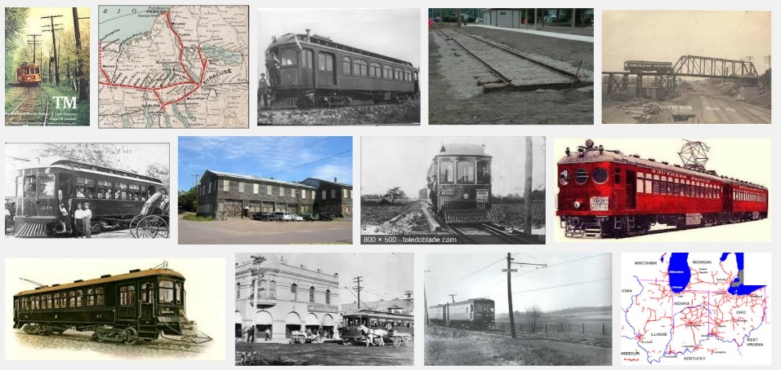
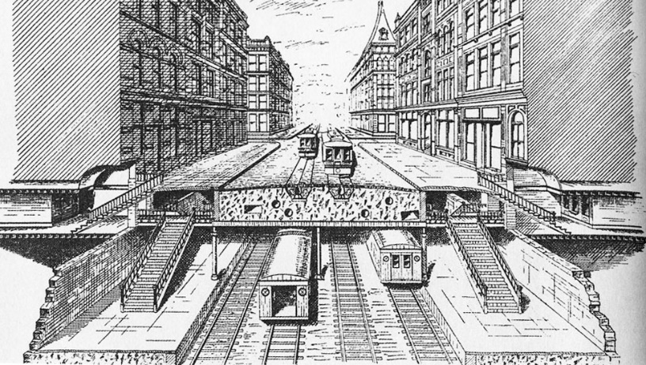
Visualizing the spread of electrification, and it’s co-evolution with the
spread of electric traction subways and interurban light-rail systems . . .
Generators
Motors
Interurban rail
Subways
Planning the IRT, 1891

Slide 34
Now let’s zoom-in and look at the special role of Steinmetz in the AC revolution . . .

Slide 35
Encyclopedia Brittanica:
1892:
“Steinmetz’ experiments . . . led to his first important work, the law of hysteresis.
. . . Until that time the power losses in motors, generators, transformers, and other electrically powered machines could be known only after they were built.
Once Steinmetz had found the law . . . engineers could calculate and minimize losses of electric power . . . before starting the construction of such machines . . .
His work was immediately recognized as a classic . . . Steinmetz’ reputation was assured at the age of 27.”

Slide 36
1893:
“His second contribution was . . . a symbolic method of calculating alternating-current phenomena and in so doing simplified an extremely complicated and barely understood field so that the average engineer could work with alternating current.
This accomplishment was largely responsible for the rapid progress made in the commercial introduction of alternating-current apparatus . . .
The problem that Steinmetz faced was that electrical engineers were not taught enough mathematics to understand his new mathematical treatment of problems using complex numbers.
1897-1911:
To educate the electrical engineering profession, he published several textbooks . . . through his writing, lecturing, and teaching*, his method of calculation with complex numbers was universally adopted in work with alternating currents.”
*at Union College
Encyclopedia Brittanica

Slide 37
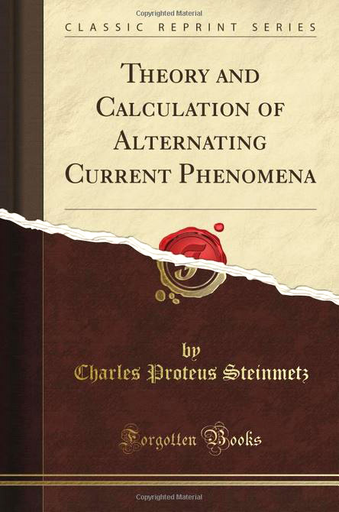
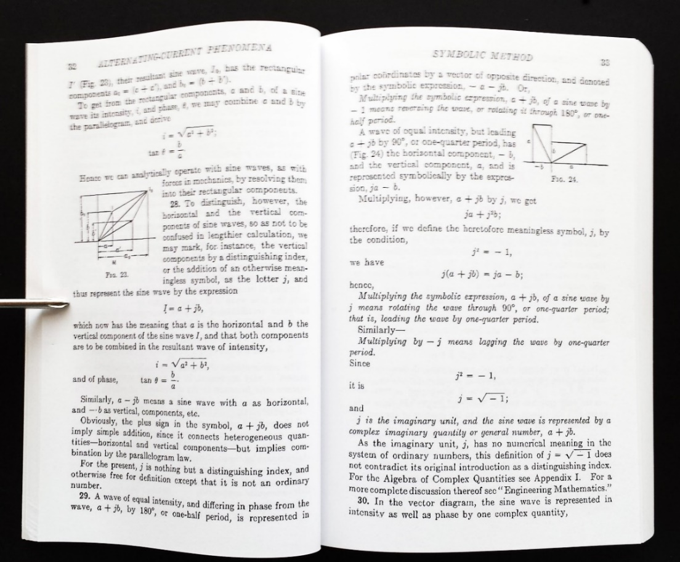
Steinmetz’s symbolic mathematical methods that enabled large numbers
of engineers to easily “navigate” the world of AC electricity:
In doing this work, Steinmetz also pioneered in the emergence of
20th century methods in engineering science and engineering education . . .

Slide 38
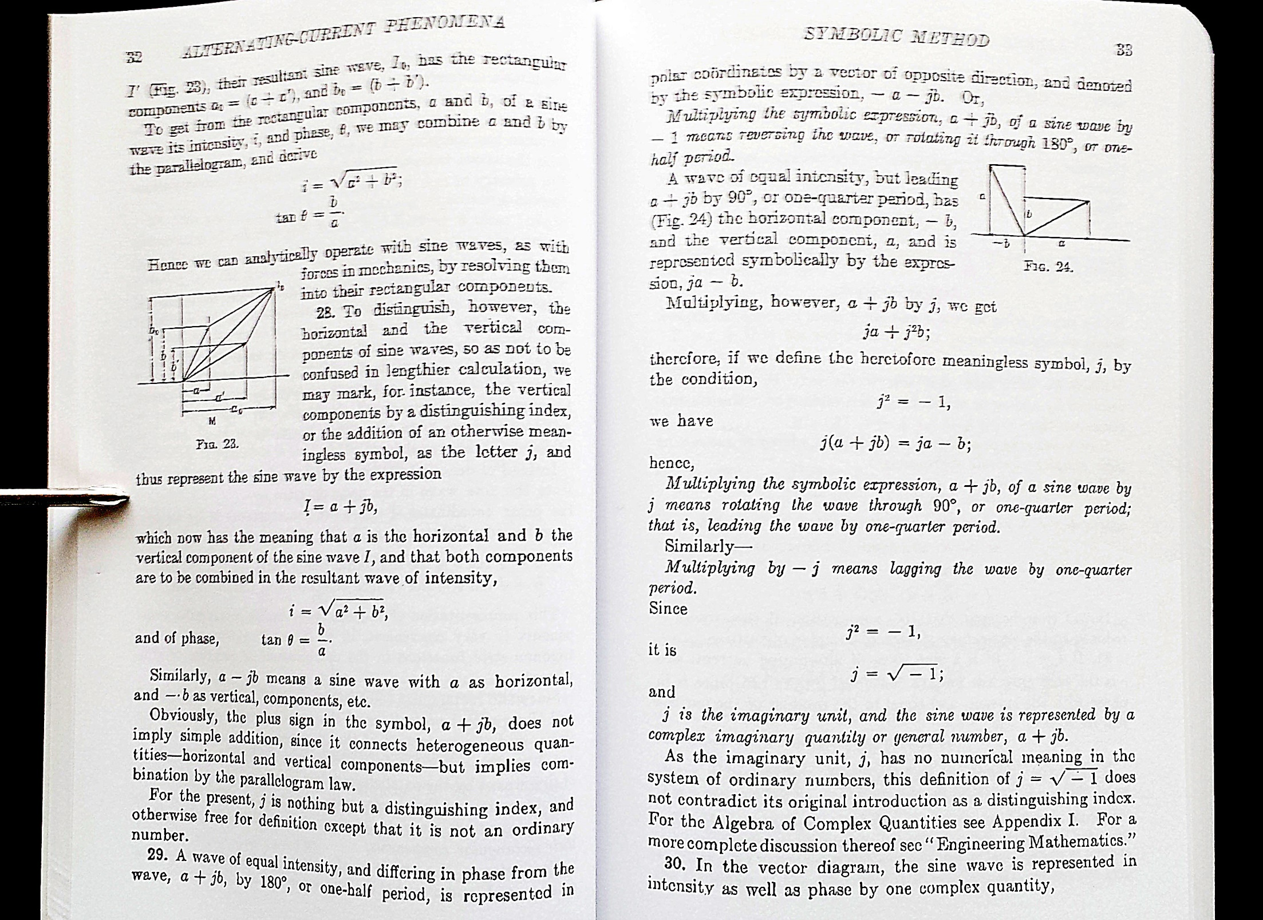

Slide 39
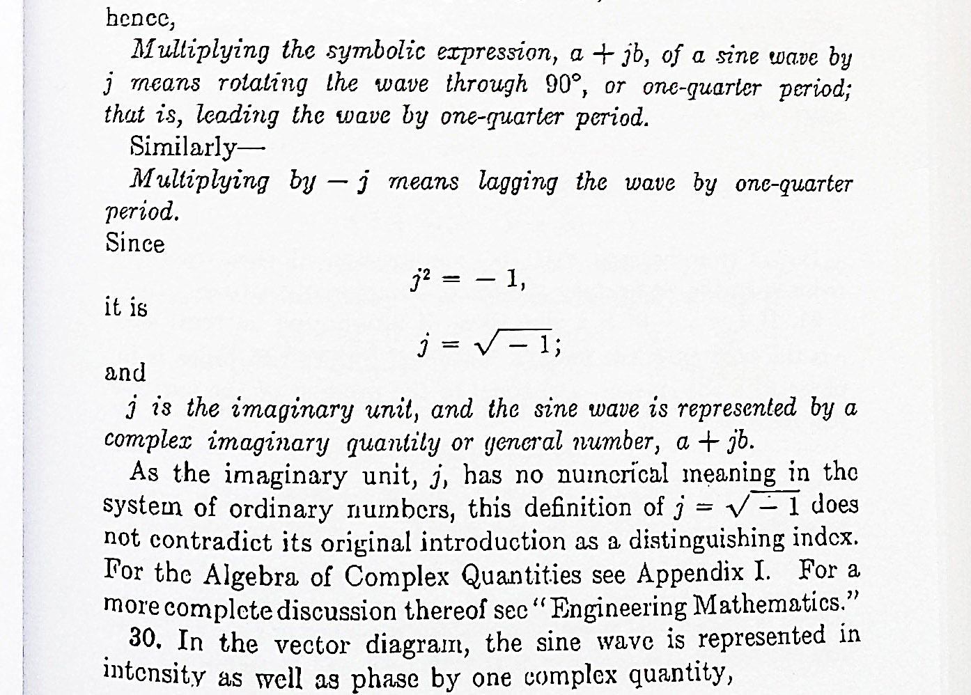

Slide 40
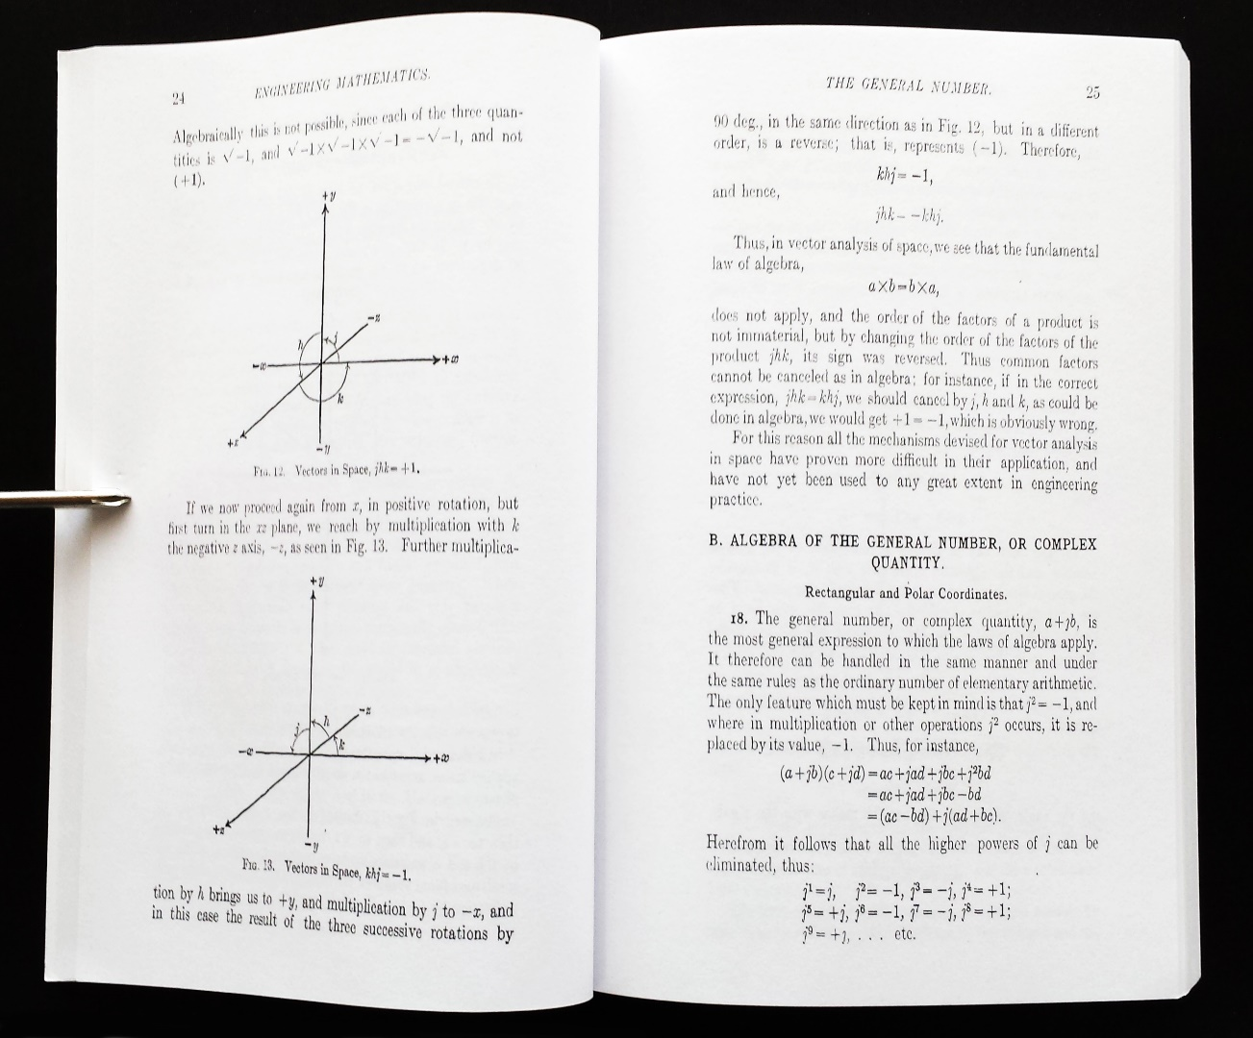
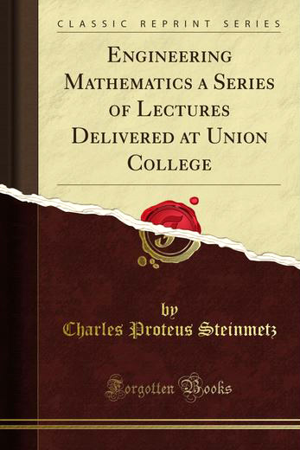
He also masterfully unfolded the abstract mathematics behind his symbolic methods . . .
Link

Slide 41
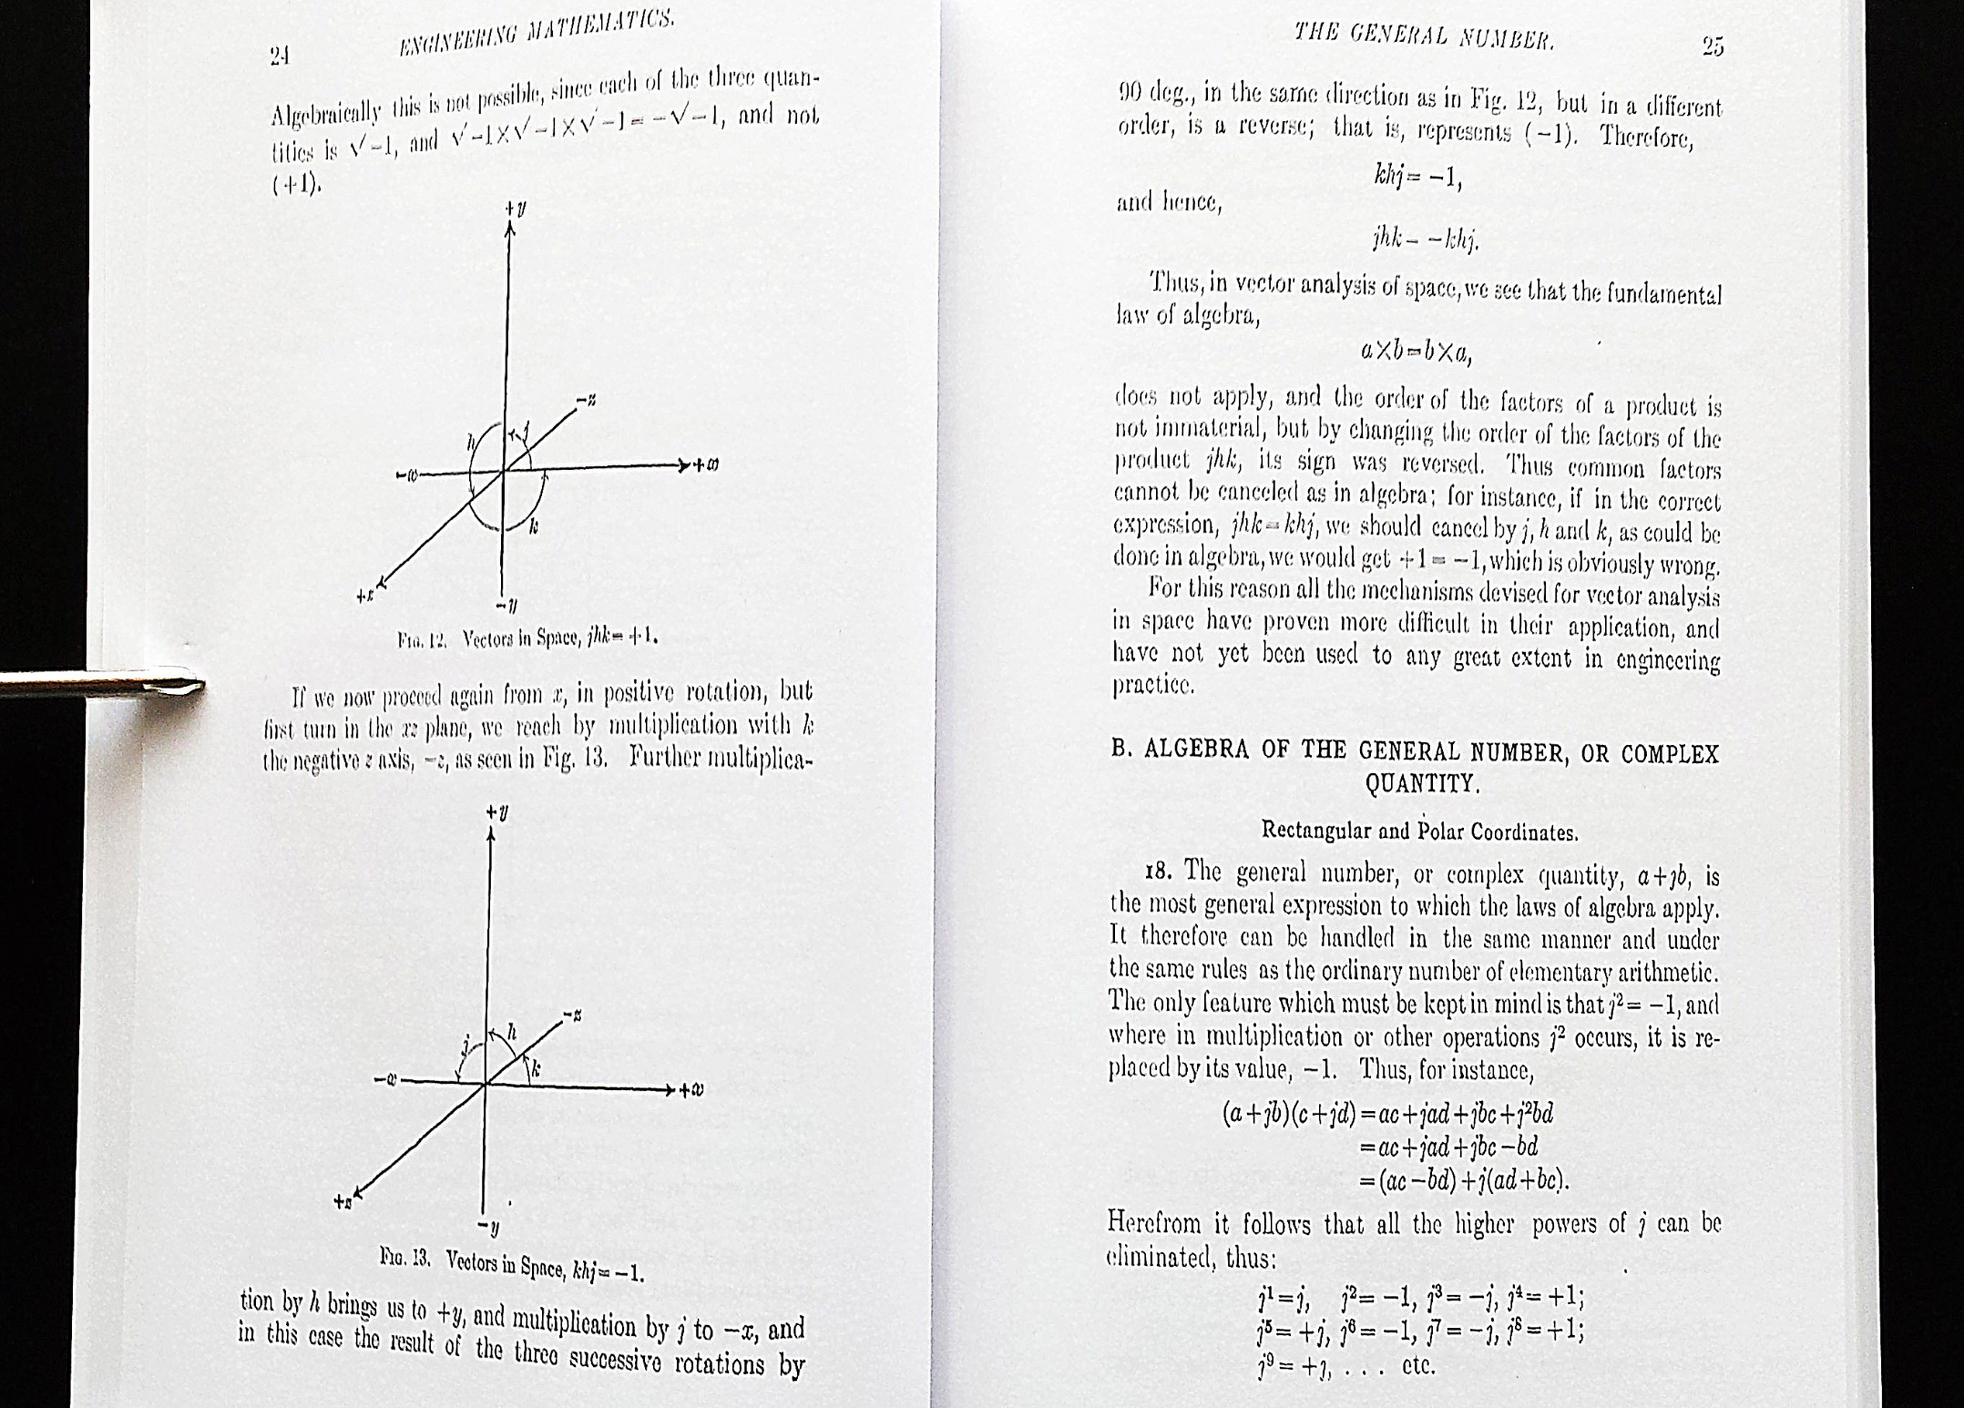

Slide 42
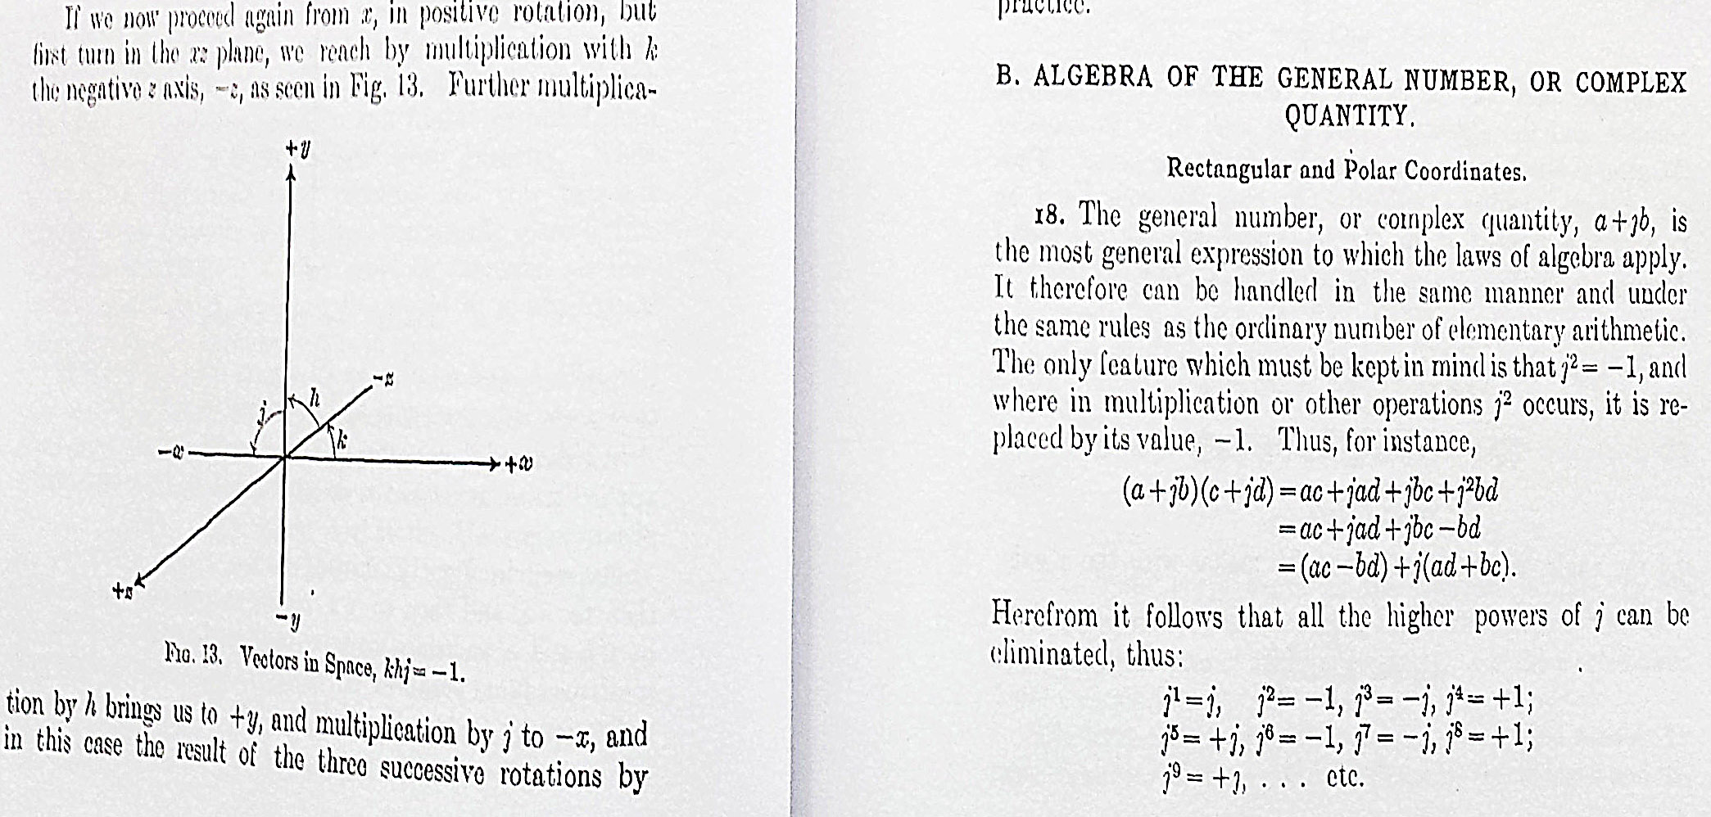

Slide 43
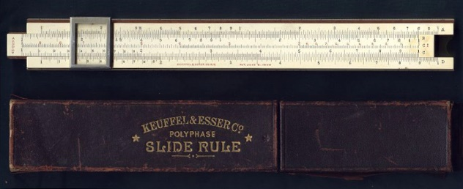
With the result that newly-educated electrical engineers could mechanize
the resulting mathematical calculations using instruments such as this
K&E 4053-3 Slide Rule, c.1910 . . .
Source

Slide 44
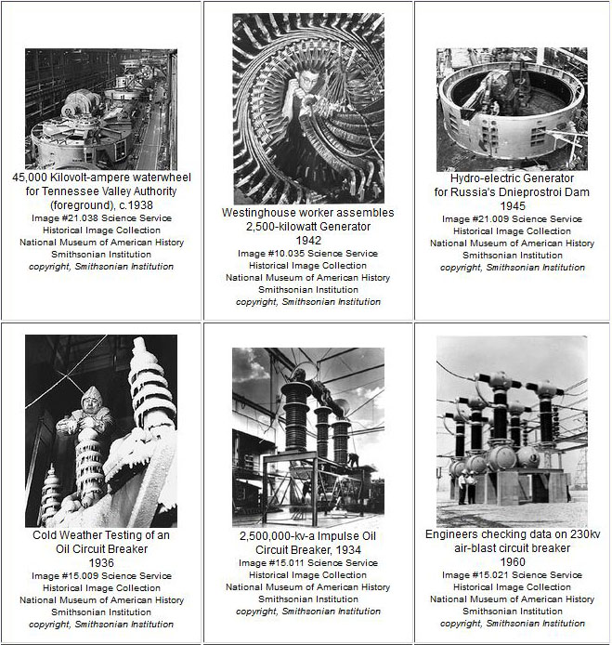
Leading to a rapid build-out of AC generation and transmission infrastructure from 1900’s onwards . . .
Smithsonian
Smithsonian

Slide 45
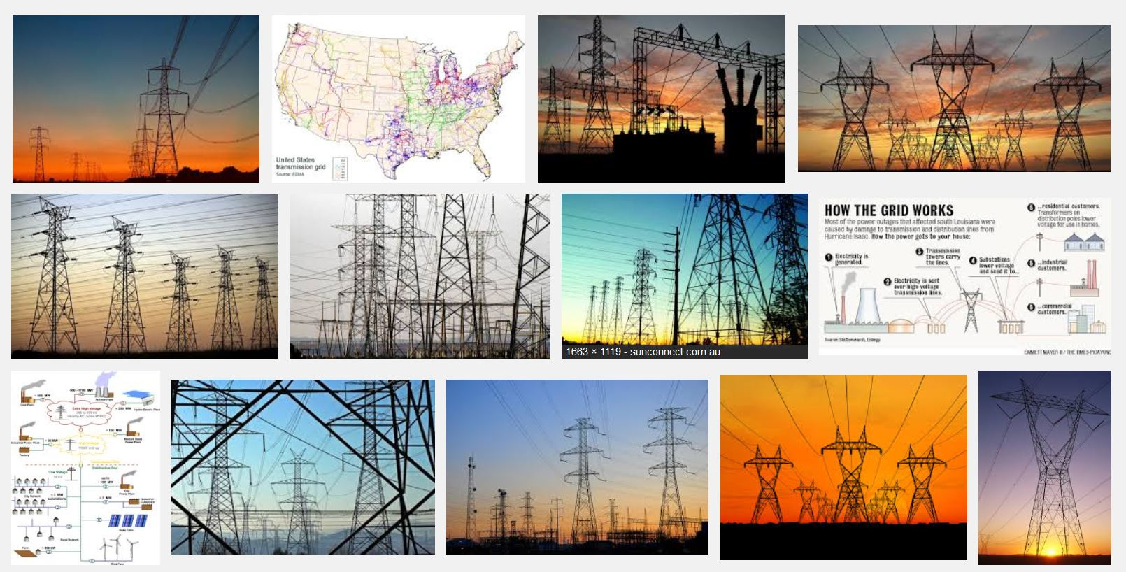
Expanding into the vast infrastructure now used for efficiently generating
and transmitting AC electric power from energy-sources to end-users . . .
Snip from Goggle images

Slide 46
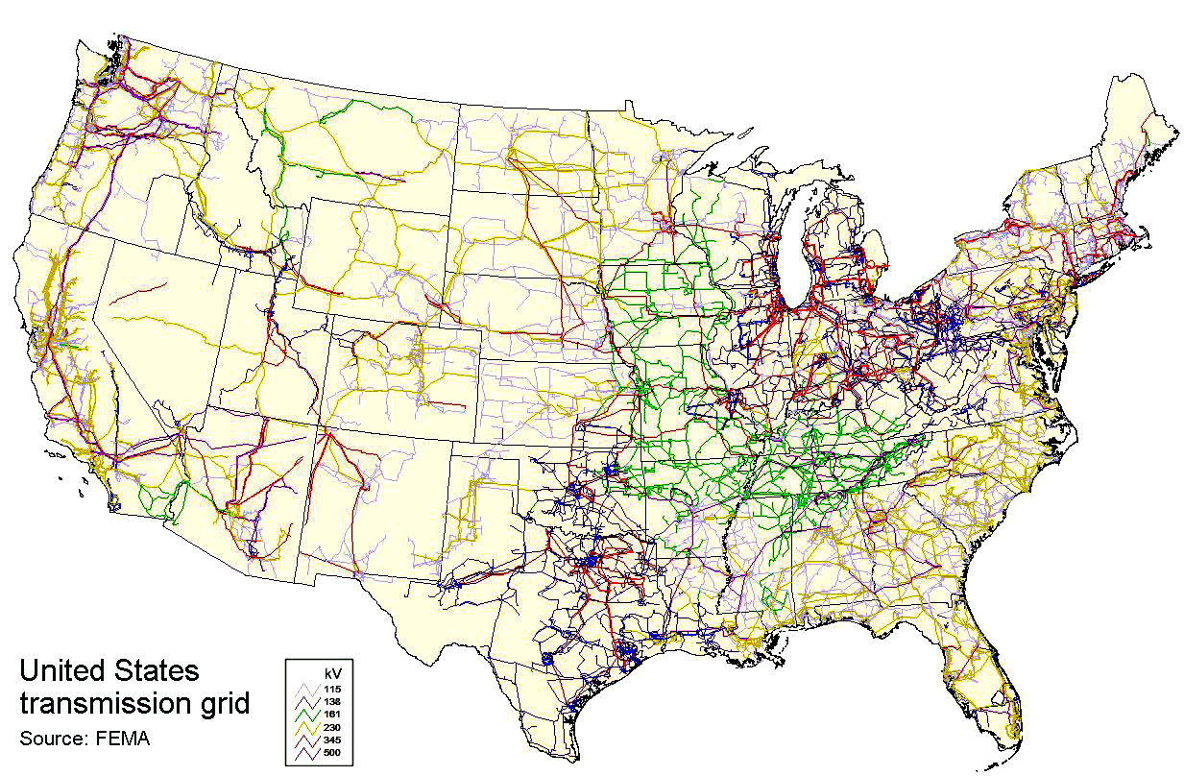
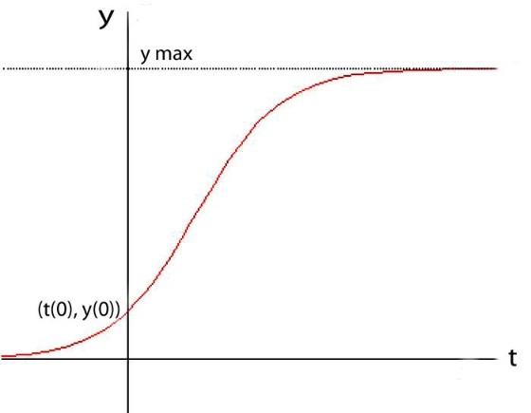
Visualizing the U.S. high-voltage AC transmission grid
(as of 2008)
Logistic function
Wiki Commons

Slide 47
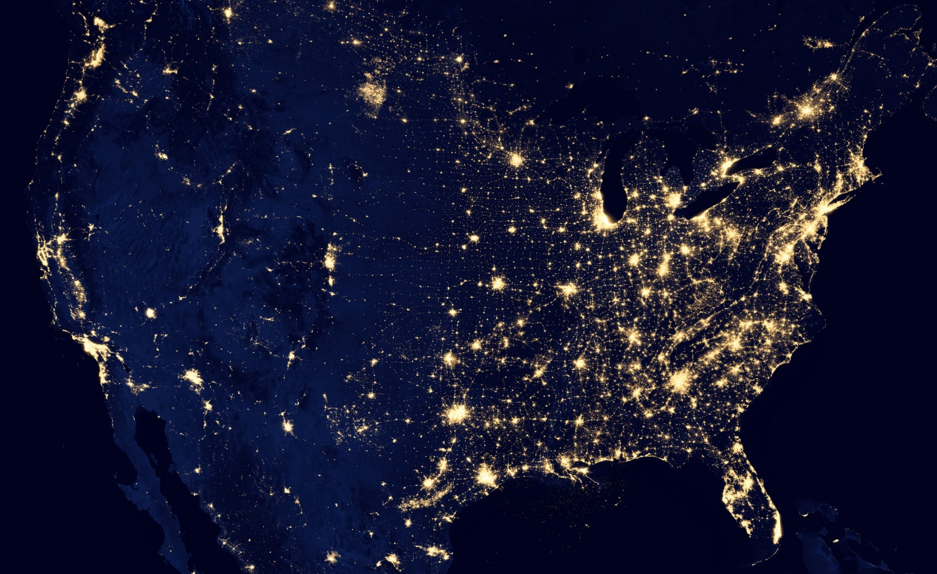
To envision its dramatic scale, look at the US at night, as seen from space . . .
NASA
Think how many minds Steinmetz’s ideas passed thru to make this happen . . .

Slide 48
Readings where you can learn more about Steinmetz’s amazing life . . .
1992
1924
1929
Link
Link
Link

Slide 49
Working in his home laboratories . .
and at Camp Mohawk . .
enjoying life with his adopted family
Steinmetz Digital Collection of Schenectady

Slide 50
Let’s go ‘Back to the Future’ again, and zoom-in on a later
disruptive wave of innovation in electronics and computing . . .
One I participated in: the revolution in Very Large Scale Integrated (VLSI) microchip design, beginning in 1976 . . .

Slide 51
The stage was set by emergence of integrated circuit technology in the 1960’s, enabling numbers of transistors and their wiring to be ‘printed’ onto chips of silicon . . .
Some early integrated circuits:
Snip from Goggle images

Slide 52
And by the early 70s revolution in computer design (using MSI integrated circuits):
Innovation of the interactive-display, mouse-controlled “personal computer”,
the “Ethernet” local-area network, and the “laser printer” (at Xerox PARC) . . .
And the Dept. of Defense’s “Arpanet” (the early internet, at DARPA) . . .
Xerox Alto, 1973
Metcalfe’s original
Ethernet sketch, 1973
Laser printer, 1971
Source
Source
Arpanet map, 1971
Wiki commons

Slide 53
Ongoing advances in lithography enabled ever-finer features to be printed, rapidly increasing the number of transistors printable on single chips.
And by 1971, a watershed was crossed
with the introduction of the Intel 4004, the first single-chip “microprocessor”:
a “computer processor on a chip” . . .
Source
It contained 2300 transistors . . .

Slide 54
Here’s a 4004’s mask set (overlain like a stack of photo negatives), showing patterns “printed”
in each layer of the chip that together will create the 2300 transistors and their interconnections.
This “at-the-time” complex design had to be manually drafted, without aid of computers.
Each mask layer was crafted
by hand-cutting its drafted pattern into a large sheet of ‘rubylith’.
Sheets were then overlain to check for interlayer design-rule violations.
Then each photo-reduced to make the 4004’s mask set.

Slide 55
Gordon Moore at Intel observed
that the number of transistors reliably printed on chips was roughly doubling every two years . . .
Carver Mead named this “Moore’s Law” and determined that there were no physical limits to increasing the density up to ~ 1 million transistors.
In 1976 this set-off a push at Xerox PARC and Caltech to figure out how to enable such complex things to be designed.
Moore’s Law (as of 1976)
.
An exponential function,
graphed on a vertical log scale
N(t)/N(0) = 2^(t/2)
After all, looking ahead it appeared conceivable that
by ~1990 an entire superscalar “supercomputer” could be printed on a single chip. . .

Slide 56
The story of what unfolded over the following three/four years is quite a saga . . .
For more insight into that, you can browse my “Reminiscences of the VLSI Revolution” in the
Fall 2012 IEEE Solid State Circuits Magazine.
That was the first time I’d come forward to tell the whole story . . .
Tonight we’ll just hit the highlights, including how Steinmetz’s story influenced the outcome ...

Slide 57
The breakout was triggered by a cluster of abstract innovations at Xerox PARC and Caltech . . .
Included were a set of scalable VLSI chip-layout design rules, in the form of ratioed (dimensionless) inequality equations (Conway, Xerox PARC) . . .
These enabled abstract chip designs to be digitally shrunk down (and reused) as Moore’s law rapidly advanced . . .
They also enabled accruing chip subsystem designs to be widely shared . . .
Link

Slide 58
The driving idea:
Assuming that chip lithography scales-down year by year according to Moore’s Law,
And ever-more ever-faster transistors can be printed on single chips as time goes by, do:
Step (i): Use a computer and the new methods to design the layout patterns for a processor of more a powerful computer, to be “printed” in the next denser process.
Step( i+1): Use the new chips and new software chip-design tools to create more powerful “computer-design” computers, then repeat step (i).
If ever more engineers and programmers could do this, and on an expanding number of increasingly powerful computers, then the iterative expanding-process could explosively generate ever-more and ever-more-powerful digital systems . . . (i.e., exponentiate!).
The big problem:
Where are all the engineers and programmers going to come from, and how are they going to learn how to do this? Aha! Recall how Steinmetz coped with this problem . . .

Slide 59
So, we first documented the ‘Mead-Conway’ system of simplified, restructured,
design-level abstractions and chip design methods in an evolving computer-edited book . . .
Thus we used our Alto computers to mechanize not only our computations,
and our generation of chip-design layouts, but also the evolution of the book itself . . .
Link

Slide 60
That computer-edited evolving book, printed using the laser printers at PARC, became the draft of the famous textbook:
Introduction to VLSI Systems
by Mead and Conway,
published in 1980 . . .

Slide 61
We also used our Altos to generate (at Xerox PARC) many open-source cell-layout-designs
for key digital-subsystems, easily disseminated to students and colleagues via the Arpanet …
URL
PLA cells
Clock drivers
I/O Pads
Cell locations
CIF 2.0 Cell-Library code

Slide 62
And, following the “script” Steinmetz used to propagate his revolutionary AC methods at Union College, I introduced the new methods in a special VLSI design course at MIT in 1978.
Link
Link
Link

Slide 63
The students learned to design chips in the 1st half of the course, then did project-chip designs in the 2nd half. They were fabricated in Pat Castro’s lab at HP shortly after the course.
There were many amazing results including a complete Lisp microprocessor design
by Guy Steele . . .

Slide 64
Map and photomicrograph
of the 19 student projects on
the MIT’78 ‘MultiProject’ Chip
For more about the MIT’78 course, see Lynn’s “MIT Reminiscences”

Slide 65
The MIT’78 course stunned top folks in Silicon Valley . . . Chip design till then had been a mystery, only grasped by a few computer architects working for chip manufacturers . . who thus had access to the “printing plants” . . .
Many other top research universities wanted to offer such a course. But how?
After intensive pondering, I came up with the answer: Rerun the MIT’78 course at a dozen research universities, using my MIT lecture notes to keep everything in sync.
But how to “print” the student project chips?
I suddenly envisioned a new form of “E-commerce” system, enabling student design files to be remotely submitted via the Arpanet to a “server” at PARC . . .
The server would run logistics-software to pack the designs into multi-project chip files (like composing the print-files for a magazine, using remotely-submitted articles) . . .
We’d then make masks, “print” MPC’s at HP Labs (where my collaborator Pat Castro had prototyped the first “silicon foundry”), and quickly return the chips to students.

Slide 66
In the fall of 1979, we orchestrated a huge “happening” (MPC79*) . . . It involved 129 budding VLSI designers taking Mead-Conway courses at 12 research universities…
MPC79 Arpanet E-commerce system:
*The MPC Adventures, L. Conway, Xerox PARC, 1981

Slide 67
MPC79 not only provided a large-scale “demonstration-operation-validation” of the design methods, design courses, design tools and e-commerce digital-prototyping technology …
it also triggered ‘cyclic gain’ in, and exponentiation of, the budding VLSI-design-ecosystem…
The MPC Adventures, L.ynn Conway, Xerox PARC 1981.

Slide 68
Thus breaking the “VLSI complexity barrier”, spawning the MOSIS* national chip-prototyping
service, and bootstrapping the “fabless-design + silicon foundry” paradigm of chip-making …
MPC79:
Wafer . . . . .
Chip . . . . . . .
Packaged Chip . .
Lynn and her team prepare packaged
chips to send to designers,
Jan 4, 1980
Example:
Jim Clark’s “Geometry
Engine”
*By transfer of MPC79 technology from Xerox
PARC to USC-ISI

Slide 69
Visualizing how techno-social dynamics triggered an exponentiation in the spread of the innovative VLSI design ideas via the emerging internet communication technology . . .
By 1982-83, Mead-Conway VLSI design courses were
being offered at 113 universities all around the world
The MPC Adventures (p. 16)

Slide 70
In parallel with all that, over the past 40 years or so, we’ve see Moore’s Law stay on track all the way!
(exponential function
graphed on log scale)
N
(exponential function
with t in years)
N(t)/N(0) = 2^(t/2)
N(0), t(0)
Starting with several thousand
in 1971, by 2011 the number of transistors on a chip had passed several billion!

Slide 71
Visualizing the Internet’s expansion by 2010 . . .
Here’s a partial map of the Internet . . .
Zooming in to see IP Addresses . . .
Wiki Commons

Slide 72
And Under Construction, June 26, 2014!
Global Foundries VLSI silicon-chip fabrication plant, Malta, NY . . .
A giant “printing plant” for patterning complex microsystems
onto vast numbers of silicon chips . . .
Panoramio, Google Maps

Slide 73
And here are the top “Silicon Foundries,” as of 2013:
These are where many of the world’s VLSI silicon microchips are “printed” . . .
Wikipedia

Slide 74
Taking a glimpse inside the huge TSMC foundry in Taiwan . . .
Google Images

Slide 75
The microchip designs are being created by engineers in companies all
around the world, then sent via the internet to such “foundries” for “printing” . . .
In effect, turning “Sand” (which is mostly SiO2) into “Gold”. . . !

Slide 76
The resulting VLSI chips are then used by design engineers to functionally empower and control all sorts of things . . . things that they’re deeply embedded into . . .
Smartphones
Wearables
Autos
Drones
Snips from Google Images

Slide 77
Zooming in on
one example,
here we see an
iPhone 5 chip with Dual ARM Cores and multiple GPUs

Slide 78
This also includes chips that empower the internet . . .
which continues to expand exponentially . . .
Interactive Zoom-in
Internet Map, 2015
exponential function
Link

Slide 79
With the internet connecting ever-more-people and chip-empowered-things,
just imagine what’s going on out there, right now, all around the world!
NASA: Earth from space at night
Thus setting the stage for what’s coming next . . . !

Slide 80
To learn more about the social, technological and human drama surrounding
the remarkable birth of personal computing and the internet, see these books:
1999
1999
2010
Link
Link
Link

Slide 81
"What's past is prologue" – William Shakespeare
Link
It’s now time to look forward, into the future . . . !

Slide 82
As we turn 180⁰ and look ahead . . .
we can visualize a huge incoming
wave of innovation out there, now just beyond the social-time-horizon . . .

Slide 83
One thing for sure:
This one is the “Big One”! . . .
Link

Slide 84
But why is it starting now? . . . Let’s set the stage:
Up until now microsystems have been deeply embedded
out-of-sight and out-of-mind inside of “things” like . . .
Smartphones
Wearables
Autos
Drones

Slide 85
Thus few folks visualize the “many ideas in motion” that generate the astonishing
‘out-of-body’ experiences when flying a Parrot Bebop with an Oculus Rift. . .
www.youtube.com/watch?v=6ZdSMAG90Rs
www.youtube.com/watch?v=Io6V0NR7DN0

Slide 86
That’s all about to change due to technological milestones such as
Motorola's "Project Ara" to create modular smartphones . . .

Slide 87
Ara’s ‘Phonebloks’ will popularize the
concept of micro ‘Hardware Apps’
Many far-tinier than current-day
‘big things” like cameras, GPS units, servos, bluetooth links, microphones . . .
Such microsystems now in our smartphones (but out of sight and out of mind) will suddenly become more visible.
And they’re not just processor chips, they’re
also Micro Electro Mechanical (MEMS) Chips,
tiny micro-mechanisms also printed lithographically in “foundries”. . .

Slide 88
MEMS, such as inertial measurement units (IMUs), microsensors, microcams
and microtransducers . . . and their microcontrollers and micro-interconnects . . .
IMUs
Microcameras
Sensors
Interconnects

Slide 89
And they’re all getting a LOT tinier!
See for example: The Michigan Micro Mote:
“ . . . researchers at the University of Michigan under the direction of Professors David Blaauw, Dennis Sylvester, David Wentzlof and Prabal Dutta have recently announced the . . . “Michigan Micro Mote.”
. . . a multi-layered integrated circuit with built-in solar cells, battery, microprocessor, sensors, radio and memory . . . come(s) in three types, measuring temperature, pressure or images“
Computer History Museum

Slide 90
To glimpse where this is heading, check out the Zano drone,
a recently launched “animated system” …
Source
Extremely tiny, it includes an HD cam, IMU, GPS, MCU, IR obstacle avoidance, gesture control, auto following, swarming and more…
There are so many dimensions to its capabilities, it’s hard to even say where the “system” begins and where it ends . . . check out this amazing VIDEO!
https://www.youtube.com/watch?v=hgkbhjXTbOE

Slide 91
These aren’t just frivolous recreational play-things, but instead have vast potential for human empowerment . . .
Consider the story of a heart-patient confined by an lengthy hospital stay
He can now enjoy exploring the beautiful world outside his window, a laptop controlling his drone, providing stunning views of what’s out there
It won’t be long before we can join friends on group “drone-tours” of remote places around the world, right from own individual homes . . .
With each our drones “carrying our eyes” remotely in the form of fisheye lenses and microcams (as in the Bebop)
Which we see through by using our Oculus Rifts over the internet!

Slide 92
Imagine the impact as today’s kids start peeking at the insides of Zano nanodrones!
Think of the possibilities of what they might do next!
URL

Slide 93
Some ideas/things in the coming wave of innovations are hinted-at by the new
Myo gesture control armbands from the mechatronics engineers at Thalmic Labs:
https://www.thalmic.com/en/myo/

Slide 94
So, what’s happening here?
Instead of just printing a billion transistors onto single “large” smartphone chips.
We can also print a million transistors onto 1000 very tiny but very powerful chips.
I.e., you can actually do a lot with a million transistors!
So we can now embed lots and lots of tiny micro-processors and MEMS micro-mechanisms into almost everything.
Placing them were they can get local physical data such as position, acceleration, temperature, pressure, etc.
Thus enabling smart-distributed-clusters of tiny chips to animate and interactively control many macro-scale systems such as robots, drones, autos . . .

Slide 95
Such chips can be selected and embedded in macro-scale systems
By exploiting innovations in selection methods, and innovations
in woven, printed, near-field and wireless interconnections . . .
Micro Chiplets (XeroxPARC)
Low-energy Bluetooth beacons
Smart textiles (PASTA
Near-field communications

Slide 96
This embedded-microsystems revolution is getting up a big head of steam in
emerging “Silicon Valleys”, “Cambridges” and “Maker Valley’s” all around the world …

Slide 97
We can zoom-in and watch it unfold in mappings of many specific areas of
micro-system technology, such as the image sensors for “microcameras” . . .
Source

Slide 98
And in the movement of “application-idea-clusters” along Gartner’s “Hype Cycle”
2014
URL

Slide 99
One key cluster of innovations on that wave is “3D Printing”. . .
Enabling macro-scale 3D “things” to be quickly made from
digital-specs created by designers using personal computers . . .

Slide 100
3D printers enable making prototype macrostructures such as robots, drones, medical devices, and more . . . into which microsystems can be embedded . . .
Once prototypes are perfected, design-files can be shared or marketed to other 3D printer users anywhere . . .
When those “things” become obsolete, their polymer macro-structures can be ‘melted-down’ and reused to make new “things” . . .

Slide 101
Innovative new micro-hardware apps can also be inserted into such additive manufacturing systems . . . enabling a 3D printer that print 3D printers* to prototype a yet more powerful 3-D printer!
*“Printers for Pearce: An Interview with 3D Printers for Peace’s Dr. Joshua Pearce”, Michael Molitch-Hou, 3D Printing Industry, 10/18/13 See also: http://www.youtube.com/watch?v=C8Wv3LCJcUE and http://www.youtube.com/watch?v=yiJDx9dCfEQ
Just as when some of the iron was fed-back to make more steam engines to further empower the industrial revolution . . .
Innovating such iterative feedback loops yields “gain” in the technological exploration system . . .

Slide 102
But (recalling Steinmetz’s dilemma) how will all the young
innovators learn to grasp the new wave of concepts propelling this revolution?
Fortunately, a wave of exploratory change is sweeping engineering education, just in time . . .
‘What is a MOOC?’ by giulia.forsythe, Flickr
‘Blended Learning’ by giulia.forsythe, Flickr

Slide 103
And more . . .
Source

Slide 104
Many young incoming engineering students have also gained deep-experiences at. . .
LEGO Camps
Maker Faires
FAB Labs
Robot Competitions

Slide 105
Plus, they can now gain ongoing knowledge as needed, using internet-based
lifelong-learning resources . . .

Slide 106
Some (the “microsystems designers”) will go on to exploit rapidly-evolving electronic design automation (EDA) and “multi-physics” design tools to create new micro-hardware apps . . .
Snip from Google Images

Slide 107
Exploiting innovations such as 3D chip-stacking and through-silicon vias (TSVs)
to compose ever-tiner chip-modules and “hardware Apps” (like the ‘Micro Mote’) . . .

Slide 108
Many others (the “mechatronics designers”) will use collaborative macro-scale design tools such as Dessault Systems’
‘3D Experience Platform’
To innovatively embed smart modular hardware-apps to dramatically animate
a new wave of human-scale systems . . .
https://www.youtube.com/watch?v=IPu28vUcZzI

Slide 109
World-wide automotive technology will be a huge driver of the rapid embedding
of micro-hardware Apps into human-scale systems. . .
Starting within cars
and on into Mobility technology
and into Smart Roadways

Slide 110
LA Times Infographic:
Now we’ve all heard about Self-driving cars . . .

Slide 111
But what about exploiting “Augmented Reality” (as in “Parrot Bebop + Oculus Rift”)
in conjunction with mobility technology . . .
For example, just this week at the Shanghai Motor Show (April 20-29, 2015) Mini is showcasing their new augmented-reality glasses concept . . .
To visualize the
many possibilities of this concept, watch this remarkable VIDEO
http://traffictechnologytoday.com/news.php?NewsID=68125

Slide 112
VIDEO: Approaching the Mini . . .
Seeing through the side-doors . . .
Seeing real wheel when parking . . .
Deciding where to go next . . .
https://www.youtube.com/watch?v=QARt89_6Jrs#t=19

Slide 113
The innovative embedding of ever-tiner micro-hardware apps will quickly spread . . .
http://blogs.jabil.com/2014/08/13/internet-of-things-infographic/

Slide 114
And begin to functionally enhance just about everything . . .
http://blogs.jabil.com/2014/08/13/internet-of-things-infographic/

Slide 115
Along the way, the microsystem supply-chains into the electronics, automotive, medical,
clothing, home-appliance and building industries will cross-couple and commingle
and enhancements gained in each will quickly cross-fertilize others . . .
Source

Slide 116
There will be many disruptive changes
in current business models such as . . .
Logistics systems will take center stage . . .
Reshorings will reduce clustered turnaround times . . .
Order-to-Delivery times pace rates of exploration . . .
Source
Source

Slide 117
But how will we cope with the ‘complexity’ of
the emerging techno-social ecosystem?
From: The Age of Opportunity: Harnessing Complexity To Solve Big World Problems
by Frank Spencer, kedgefutures.com

Slide 118
By exploiting things like
collaborative learning, crowdsourcing, crowdfunding, IP brokering, agile methods, rapid-digital-prototyping,
and more . . .
Everyone, from
engaged-users to makers,
will be able to scale up their participation and impact.

Slide 119
Only now, instead of just exploring how to make ever bigger things that
go ever further and ever faster, such as when reaching for “outer space”. . .
NASA

Slide 120
We’ve inverted our perspective 180⁰, reaching down into the
“deep inner spaces” of the micro/nano/pico world . . .
And are exploring how to make and exploit vast-quantities of
ever-tinier, ever-more-empowering “micro/nano things” . . .
Google Images

Slide 121
For example, using Scanning Electron Microscopy (SEM) to study
the details of the tiny micro-machinery printed on MEMS chips . . .

Slide 122
And zooming-in even further to measure and maps things down at the molecular and atomic levels . . .
Scanning Tunneling Microscopy (STM)
Atomic Force Microscopy (AFM)
So as to guide adventurers
on explorations at places
and in fields such as . . .

Slide 123
Augmented Reality
Social Media
Harvard Wyss Institute
Model-Based Design
Biologically Inspired Engineering
Draper Lab
MIT Nano
Collaboration Technology
Multiengineering
Meta^2Mathematics
MetaArchitecture
Machine Vision
Machine Hearing
Augmented Kinesthetics
Social Physics
Social Dynamics
Social Machines
Social Learning
DARPA Microsystems
Research Universities
Google ATAP
Microsoft Research
Facebook
Synthetic Biology
UPS
Amazon
Genetic Algorithms
Self Assembling Systems
Exploration Infrastructure
STEM + ARTS = STEAM

Slide 124
Thus it begins, all around the world . . .

Slide 125
And is on its way . . . !
Link

Slide 126
Before long, adventurers around the world will be “surfing” somewhere on this wave . . .!

Slide 127
Ah, but the escalating rates of techno-social-change will challenge existing cultural patterns, because of massive social accumulations of past habits:
What’s the new game this time?
Who gets to play?
What rules do we play by?
Where can we turn for guidance?
And how do we drop old habits? . . .
URL

Slide 128
For insight into what's about to happen, reflect on this news:
'Apple Watch designers on easing the smartphone tyranny they created'
http://www.wired.com/2015/04/the-apple-watch/
It will help you "Remember, this bold step into the future is NOT about "the things", it's about the creative "IDEAS and VISION embodied in the things“. – Lynn Conway

Slide 129
But you say, “how can we ever keep up?”
Hasn’t the train already left the station, for many of us?
Some words to remember: "In a world of change, the learners shall inherit the earth, while the learned shall find themselves perfectly suited for a world that no longer exists" – Eric Hoffer
And it’s ever-easier to engage in fun-filled, lifelong learning . . .
Besides,
“As the rate of techno-social change increases, we’ll all live far further into the unfolding future than we ever dared dream“ – Lynn Conway

Slide 130
When visualizing these swirling masses of ideas in motion reflect back
on the rapid-evolutionary-process-diagram from the VLSI revolution . . .
Only now, vastly more such processes run in parallel and cross-fertilize . . .
While a new science explores, maps and describes what’s happening . . .
The MPC Adventures (p. 16) Xerox PARC 1981.
URL

Slide 131
1976
1977
1978
1979
Visualizing the exponentiating
wave of VLSI innovation . . .
’76: How to cope with VLSI complexity?
’77: Inventing scalable VLSI design rules.
’78: Launching the VLSI methods at MIT!
’79: Launching the VLSI courses via MPC79!!

Slide 132
Some questions to ponder as we begin surfing such wave:
How do we gear-up and learn the basic moves?
Who do we team-up with and where do we go exploring?
Where is this thing headed and what’s our mission?
nearing saturation
unfolding exponentiation
Of course such 2D views miss lots of what’s happening . . .
Let’s play with visualizing waves in 4D to gain a better perspective . . .

Slide 133
Lets playfully visualize the incoming wave of
innovation as a time series of “GHC profiles”
(2D slices thru the 3D wave at increments in time) . . .
Gartner Hype Cycle 2014
http://www.gartner.com/newsroom/id/2819918
Is this a Traveling Wave?
A Standing Wave?
Or What?
This stunning video*
hints at ways
to think about it . . .
*"Water," by Morgan Maasen http://vimeo.com/90429499

Slide 134
Finally, some conjectures about possible futures:
By cooperatively learning and sharing ideas on how to do more-and-more with less- and-less, the incoming wave of innovations has the stunning potential of:
Sustainably providing ever-increasing infrastructural functionality and life empowerment per person,
While consuming ever-decreasing energy and material resources per person
Thus beginning the reigning-in of our unsustainable over-use of planet earth
While simultaneously opening an unprecedented collaborative/competitive exploration of the greatest of frontiers, the frontier of “What it’s possible to do”!

Slide 135
And a personal perspective on “Our Travels Through Time”. . .
Source
“If you want to change the future, start living as if you’re already there!”
– Lynn Conway

Slide 136
END

