Slide 1
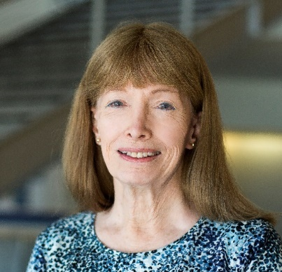
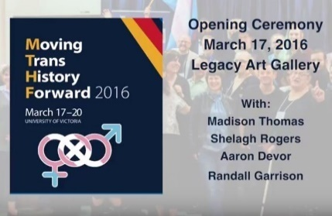
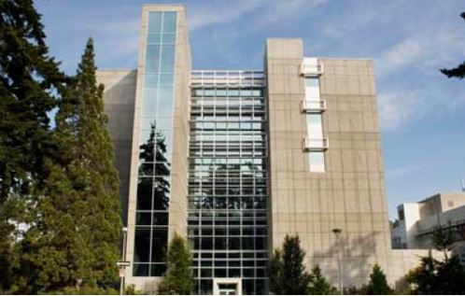
Our Travels Through Techno-Social Space-Time:
Envisioning Incoming Waves of Technological Innovation
November 9, 2016
Lynn Conway, Professor of EECS Emerita
University of Michigan, Ann Arbor
How can we visualize our life-journeys through an ever-more rapidly-changing techno-social landscape? How did the processes of social-change begin speeding-up in the first place? Where are we headed as we enter the looming techno-social age? These questions are on ever-more minds all around the world. For insights we reflect on, then follow, evidence and words of wisdom from the past.
UVIC Transgender Archives
UVIC Engineering & Computer Science
This slideshow with embedded links is posted online for later study & reference:
http://ai.eecs.umich.edu/people/conway/Memoirs/Talks/UVIC/Techno_Social_Talk.pptx
http://ai.eecs.umich.edu/people/conway/Memoirs/Talks/UVIC/Techno_Social_Talk.pdf

Slide 2
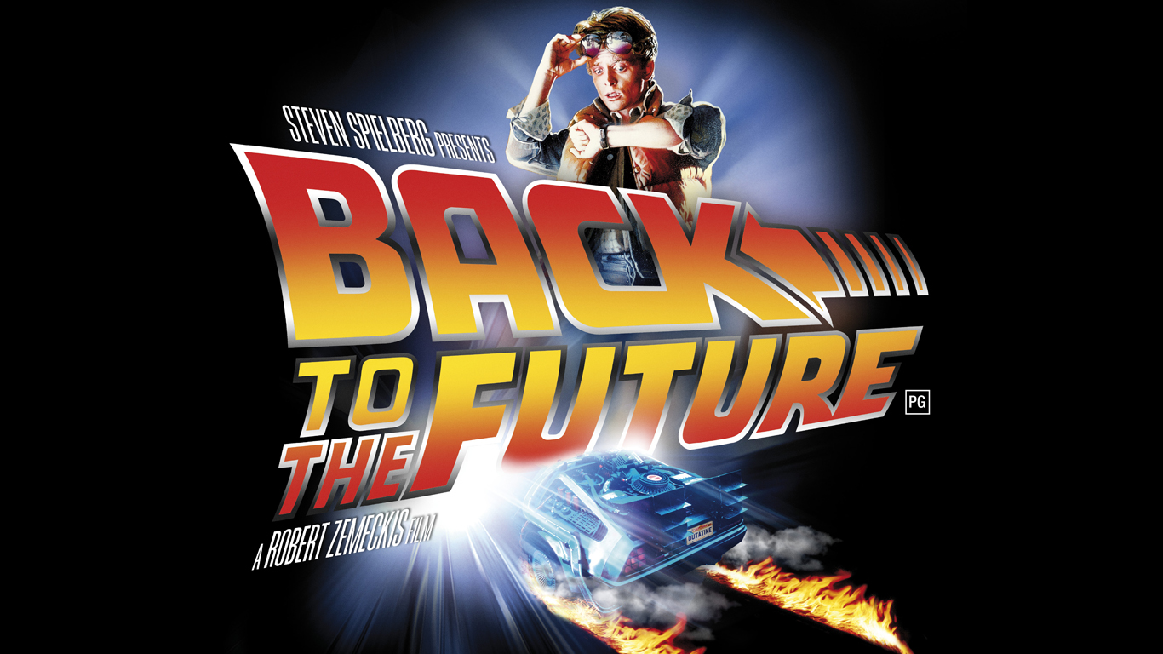
Let’s begin by visualizing some past waves of techno-social change . . .
Link
Dropping-back-in just before them, then coming forward through time . . .

Slide 3
And as we travel through space-time . . .
be sure to keep these words in mind:
Link
“The farther backward you can look, the farther forward you can see.”
– Winston Churchill

Slide 4
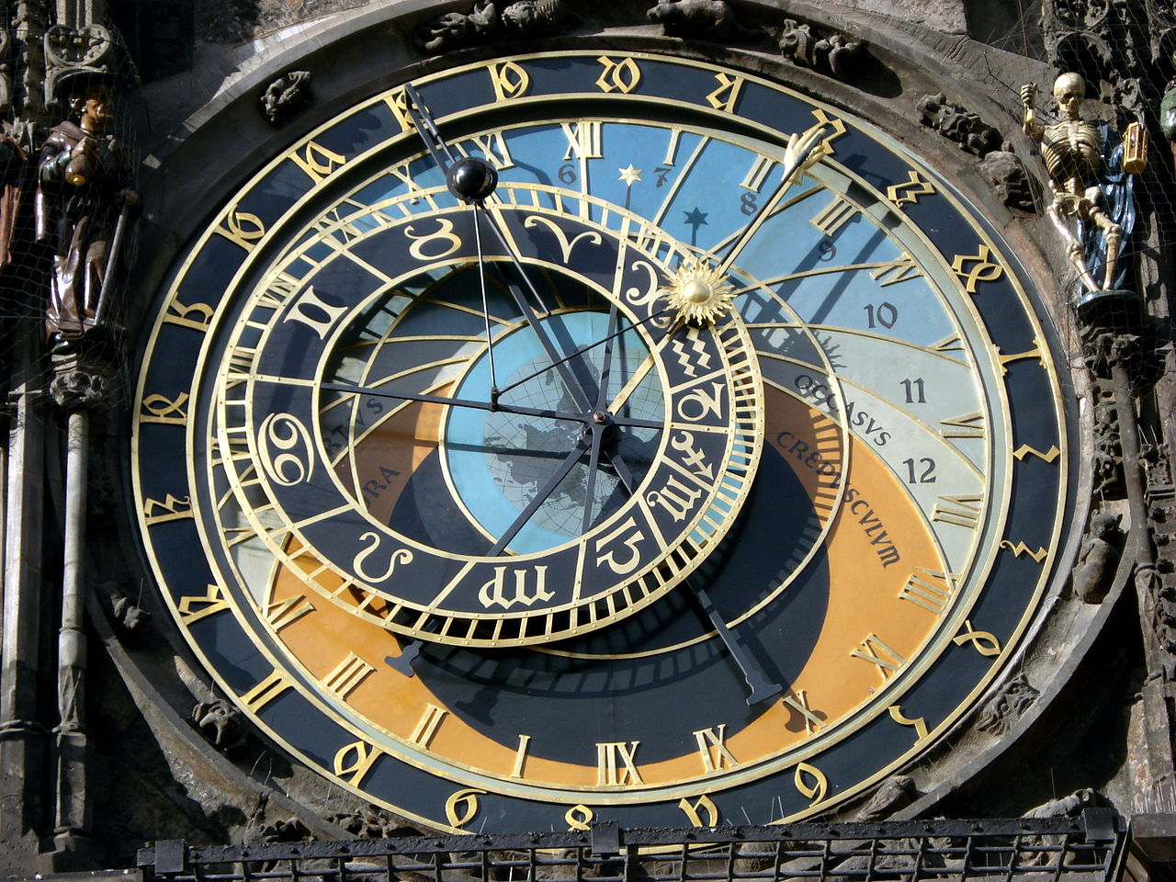
We begin during the Renaissance in the 1400s,
a time of transformational cultural advances . . .
Just look at the mechanization of astronomical calculations by the
Prague Astronomical Clock, c. 1410
It’s a stunning confluence of the highly advanced Mathematics, Science, Engineering, Architecture and Art at That Time . . .
Photo by Hector Zenil (www.hectorzenil.net)

Slide 5
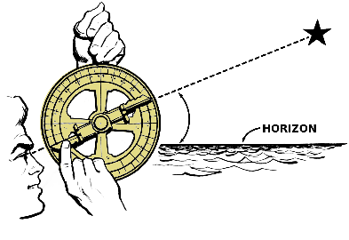
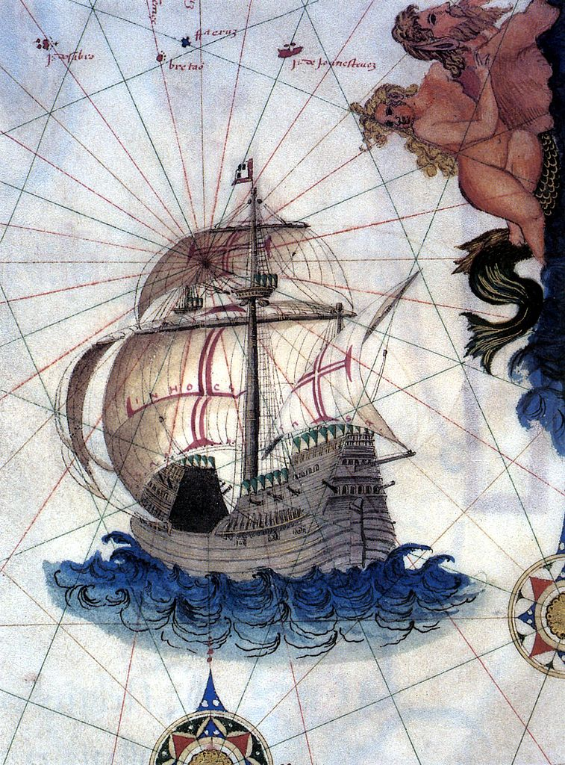
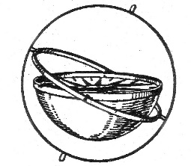
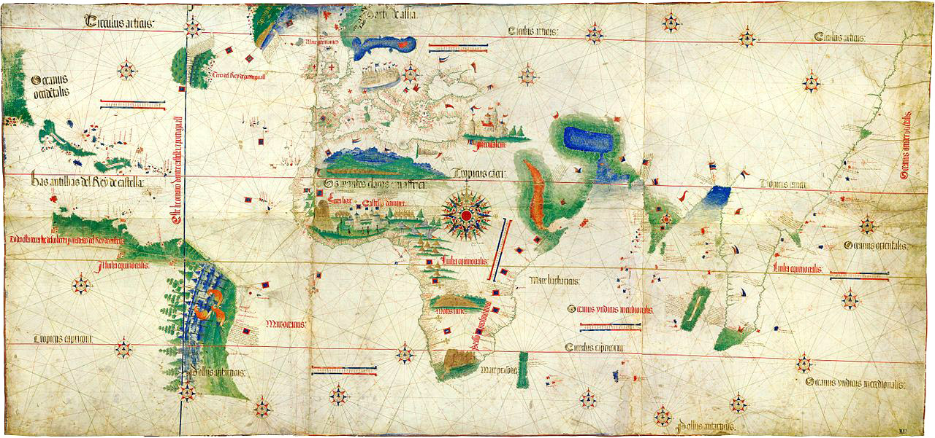
By the late 1400’s advances in shipbuilding, navigation & mapping reached a ‘tipping point’ . . .
Mariner’s Astrolabe
Portuguese Carrack
Triggering the Age of Discovery
by enabling explorations across
the open seas . . .
Gimbal Compass
Cantino planisphere (1502)

Slide 6
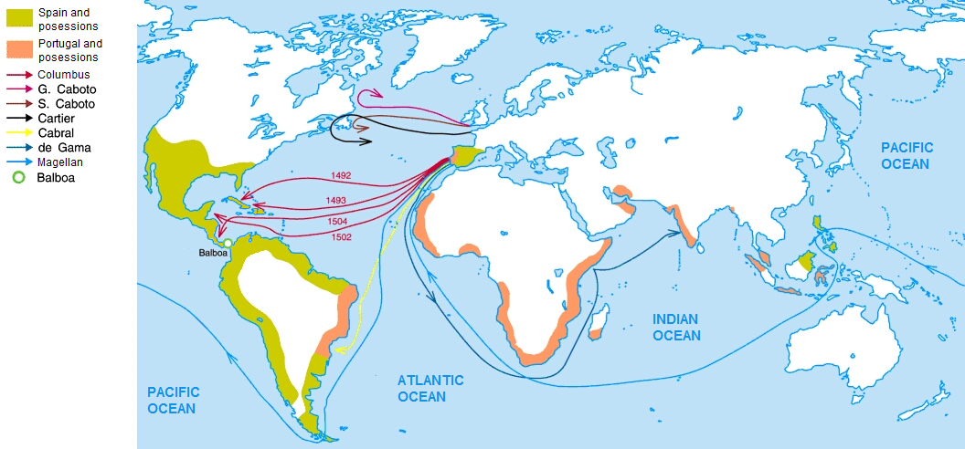
Thus it begins:
Charting the Early Voyages during the Age of Discovery, c.1492-1522 . . .
Wiki Commons

Slide 7
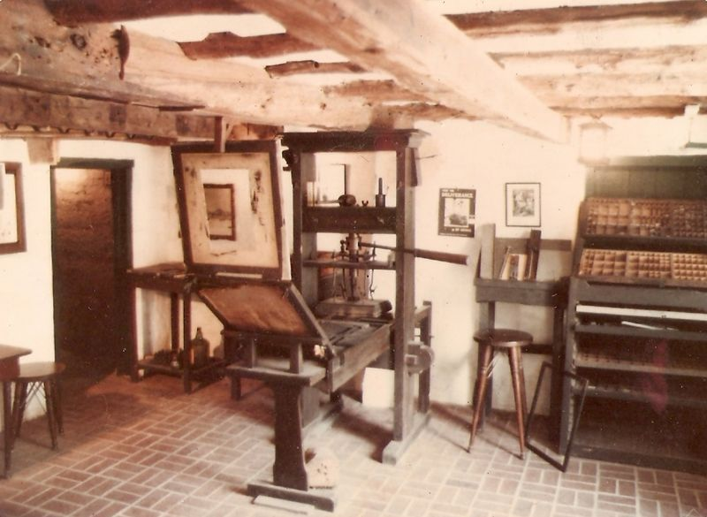
As mass-communication by printing spread in the late 1400s,
it enabled adventurers to ever-more quickly propagate news of what they’d found and where they’d found it . . . dramatically escalating the exploration rate . . .
Replica Gutenberg Press at the Featherbed Alley Printshop Museum:
Link; Attribution: Aodhdubh at English Wikipedia

Slide 8
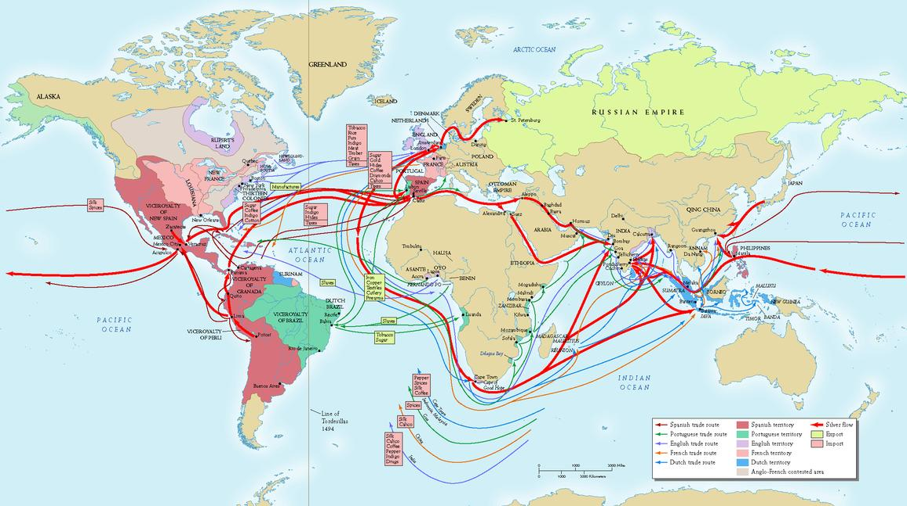
By the early 1700’s, exponentiation had generated a massive global trading system . . .
Source

Slide 9
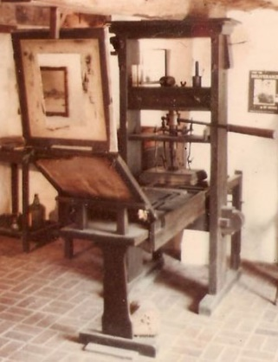
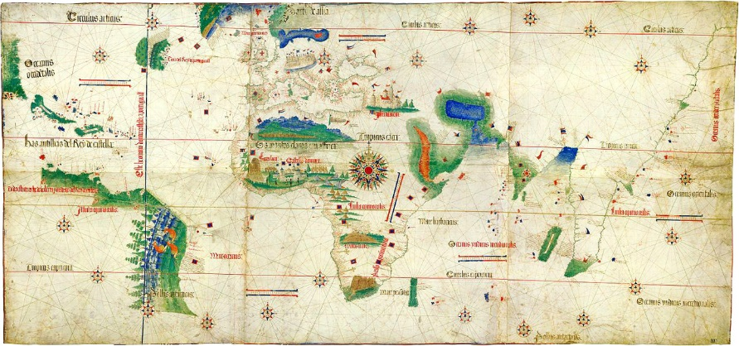
Now, what’ happening here?
Just exponentiation of THINGS?
Is that all this is?
Or also exponentiation and diffusion of key clusters of
innovative IDEAS thru the minds of ever more people?
IDEAS on how to MAKE and USE things . . .

Slide 10
By the mid-1700’s, the stage was set for yet another
tremendous disruptive wave of innovation . . .
and so began the industrial revolution (~1760) . . .
Link

Slide 11
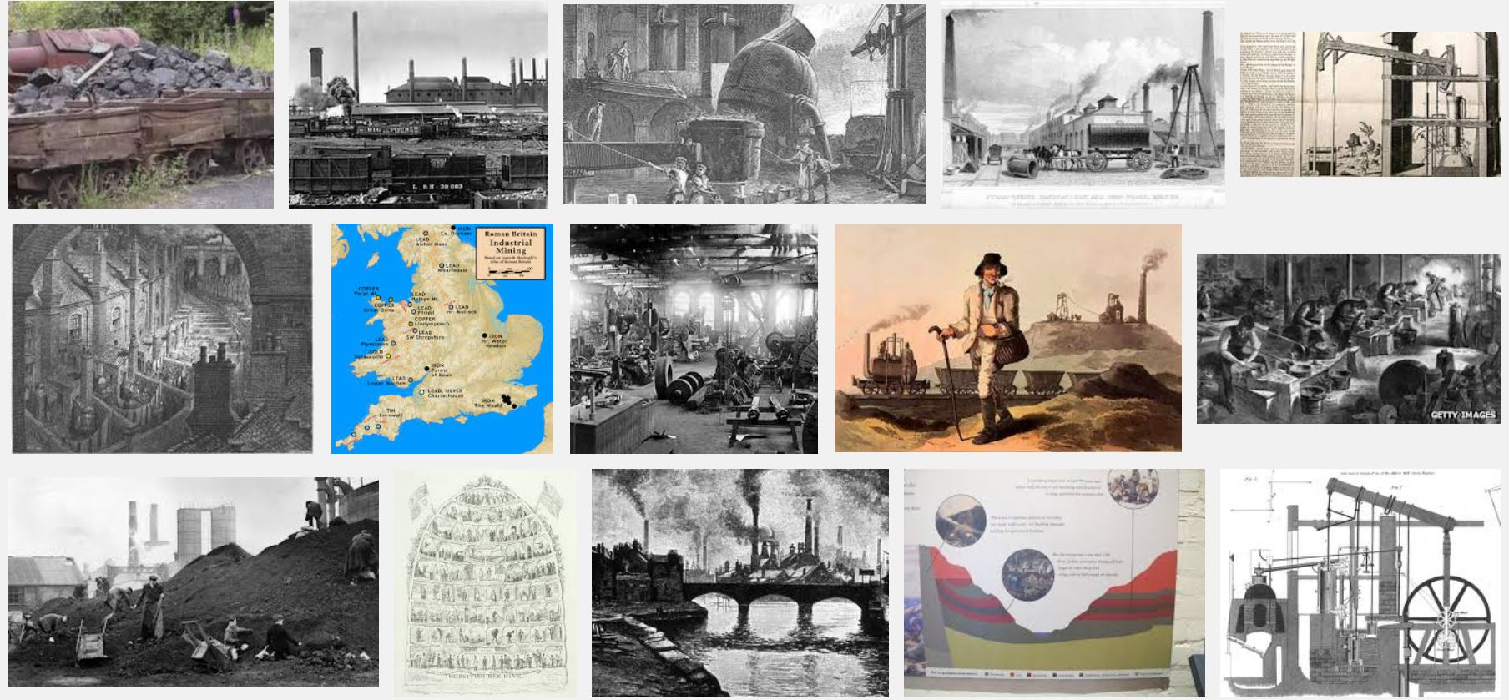
During the Industrial Revolution the mining/processing of
coal and iron-ore was greatly amplified by steam-power . . .
Snip from Google Images
Some of the resulting iron was used to make more steam engines,
and this positive feedback fueled an iterative expansion-process . . .

Slide 12
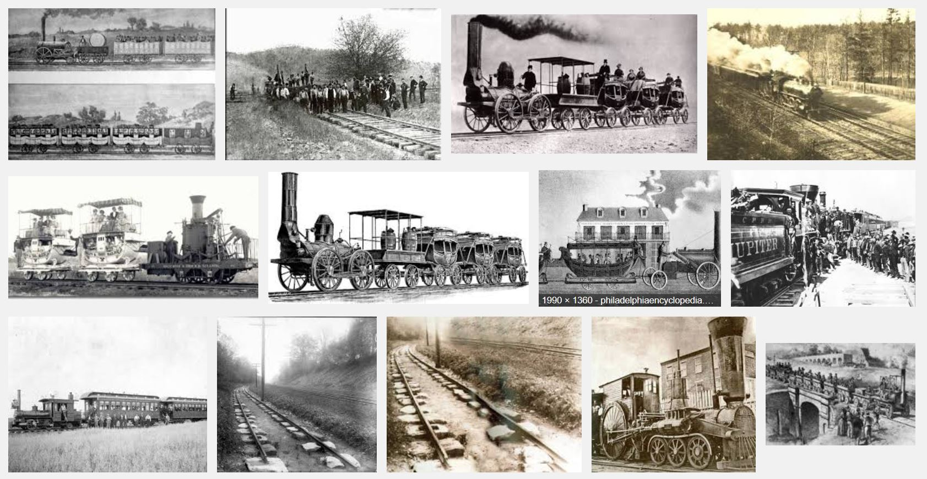
By the 1830’s, steam-powered railroads began interconnecting mines to
iron-works and rail-makers, enabling ever more rapid expansion of the railroads . . .
Snip from Google Images

Slide 13
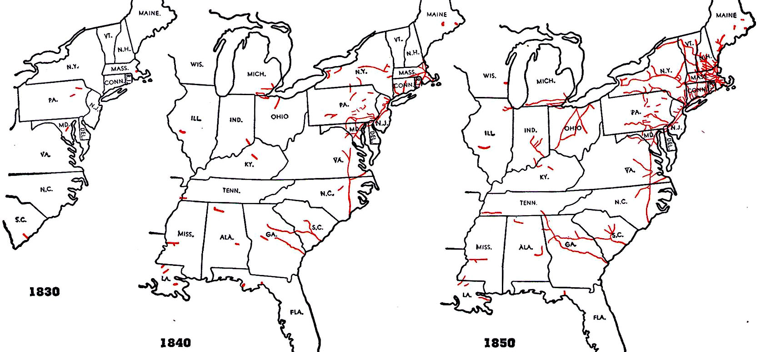
These maps show the rapid early-spread of railroading in the United States. . .
http://www.cprr.org/Museum/RR_Development.html#2

Slide 14
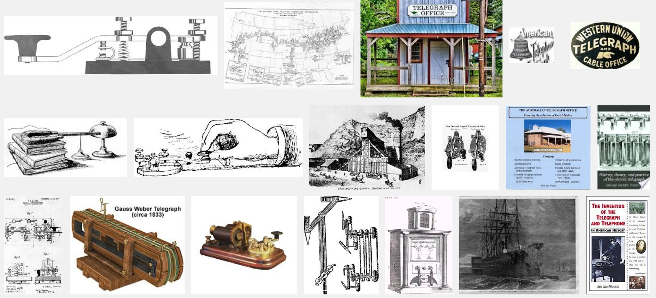
The expansion was accelerated by the rapid-spread of telegraphy in the 1850s,
an effect analogous to that of printing during the age of discovery . . .
(Snip from Google Images)

Slide 15
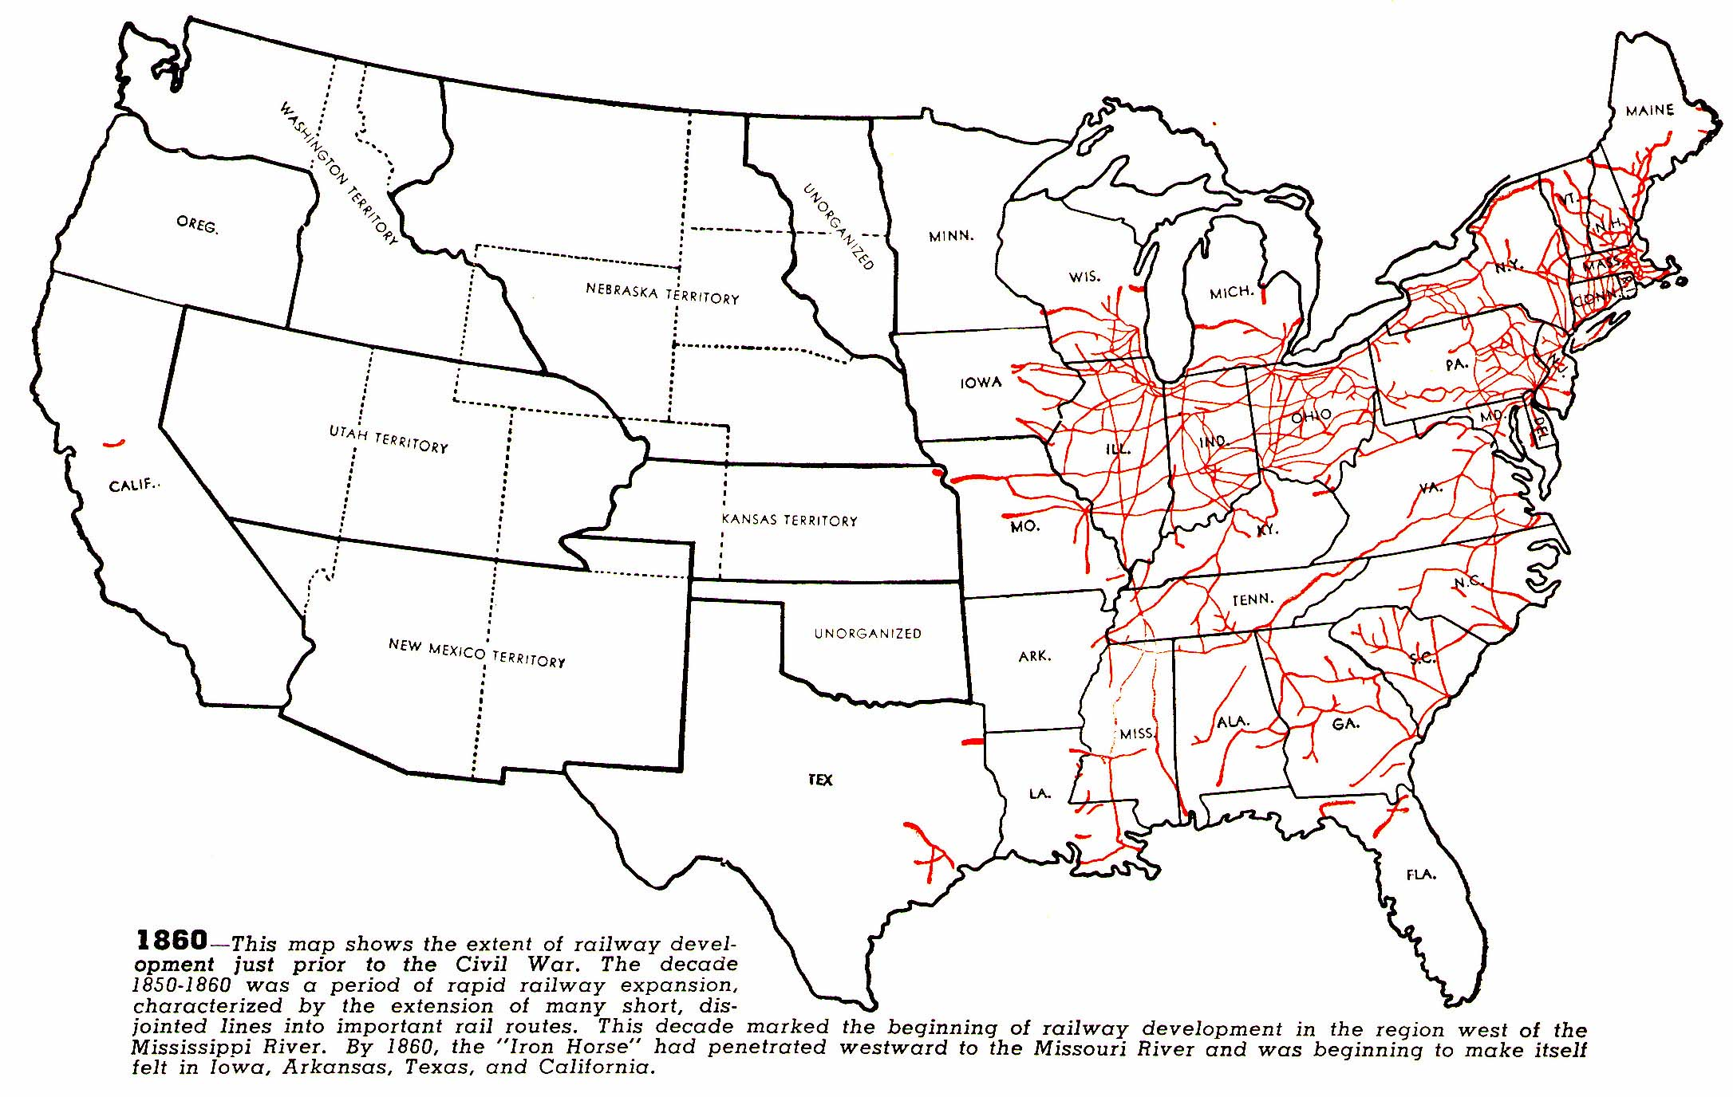
As seen in railroad maps from the following decades . . .
1860
source

Slide 16
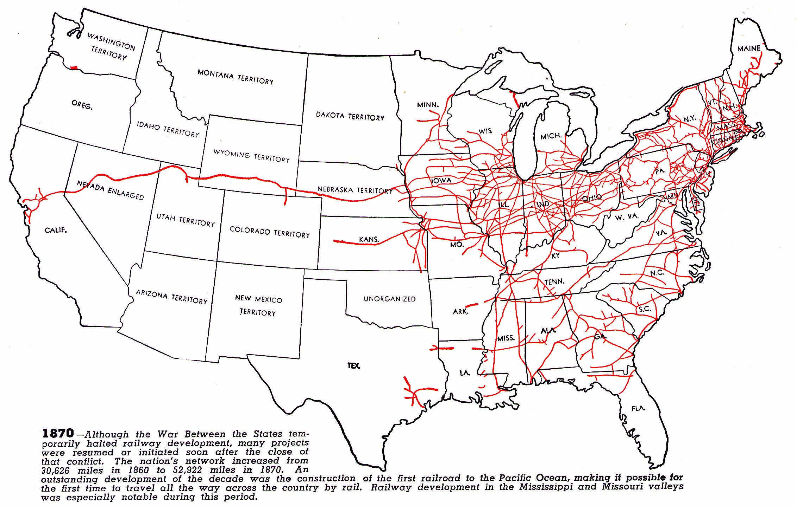
1870
source

Slide 17
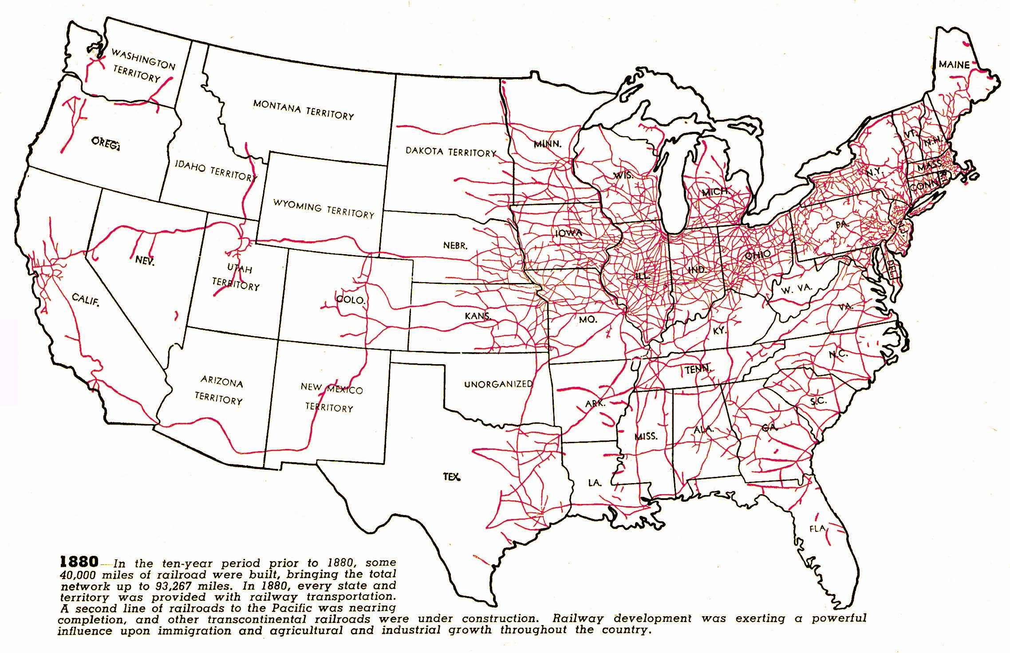
1880
source

Slide 18
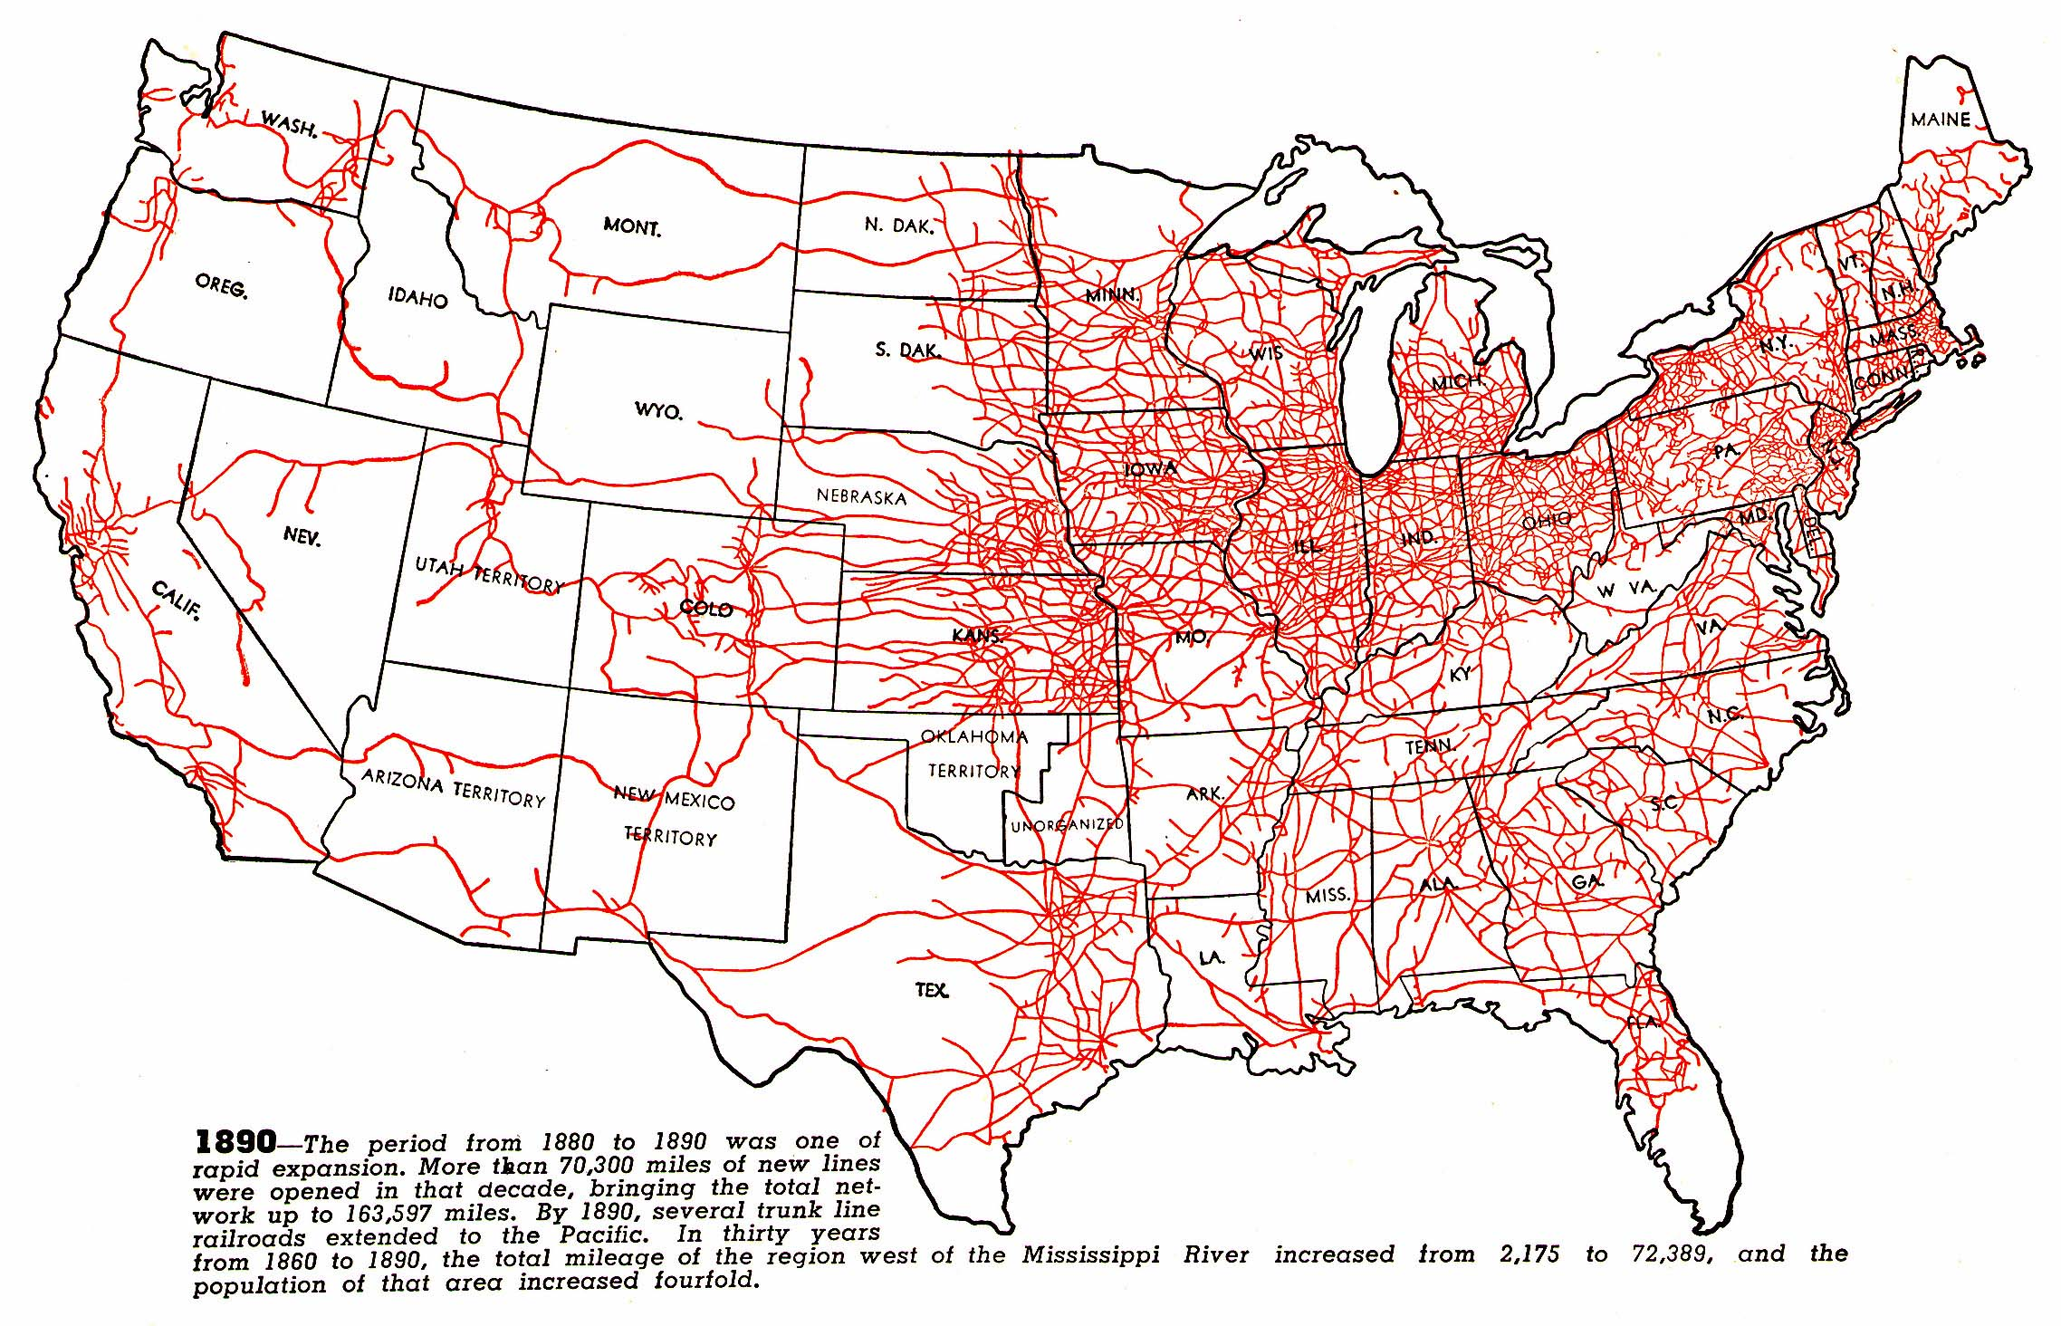
1890
source

Slide 19
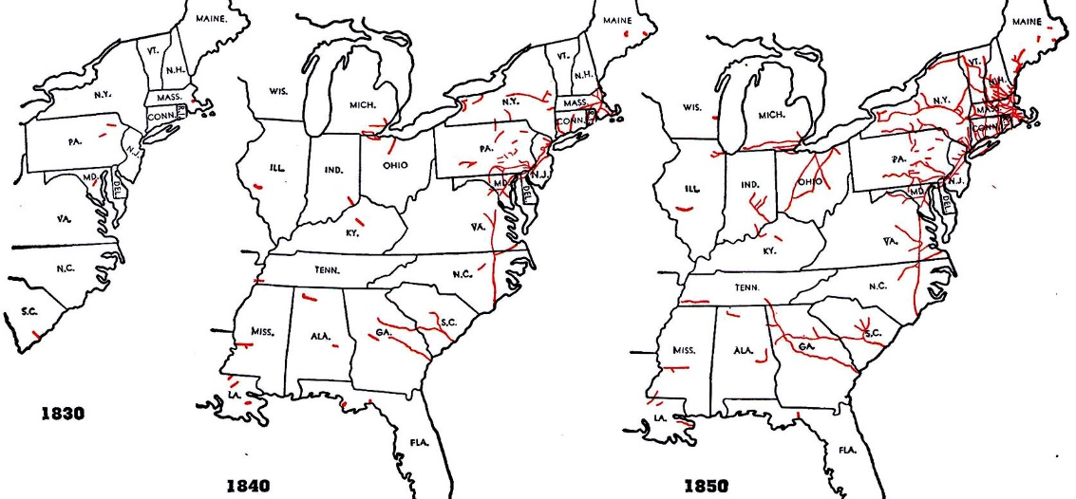
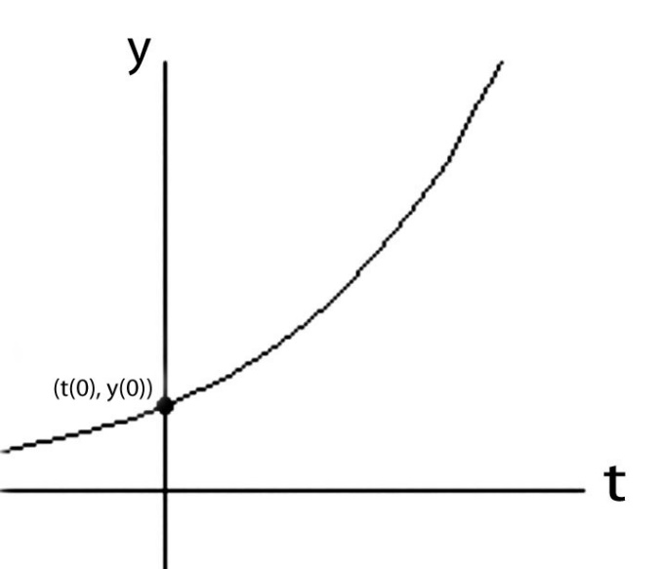
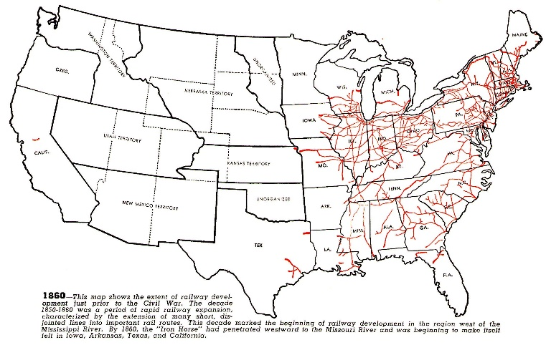
Like compound interest, the early social-diffusion rate of such clusters of technological ideas is proportional to what has materially accumulated at any given point in time . . .
(I.e., it’s an exponential function):
y(t) = y(0)e^rt
source

Slide 20
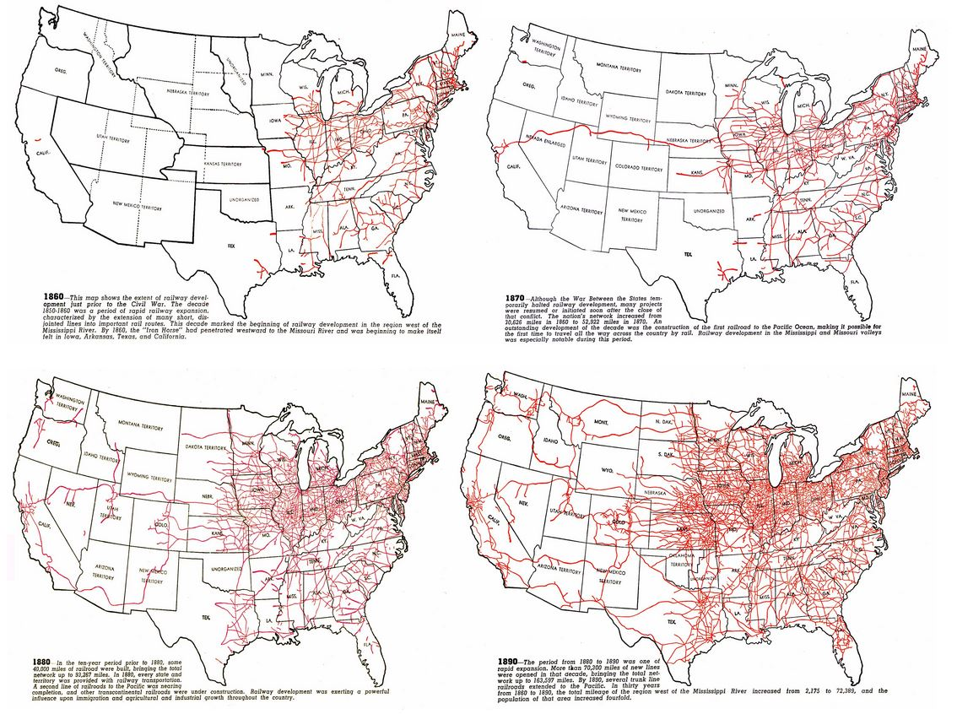
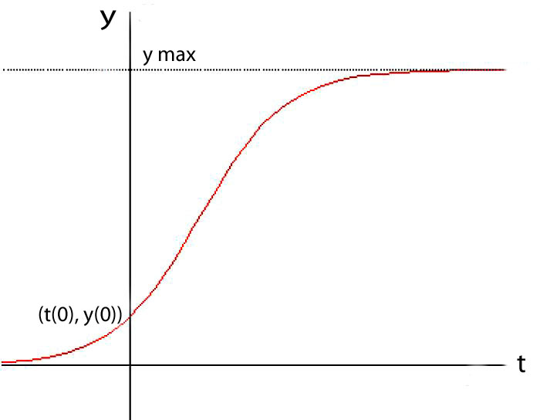
But as the opportunity-space fills,
diffusion of those technological ideas slows as that cluster nears its materially-expressed expansion limits . . .
(I.e., it becomes a logistic function):
later saturation
y(t) = ymax/(1+((ymax/y(0))–1))e^-rt)
early exponentiation
source

Slide 21
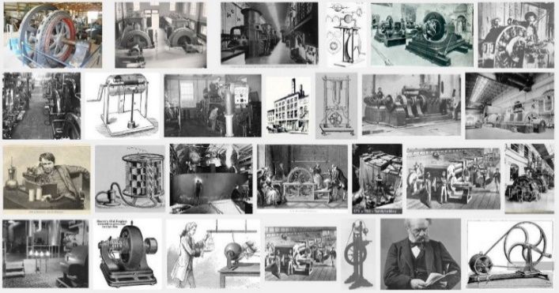
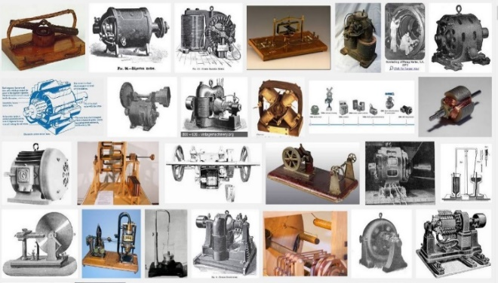
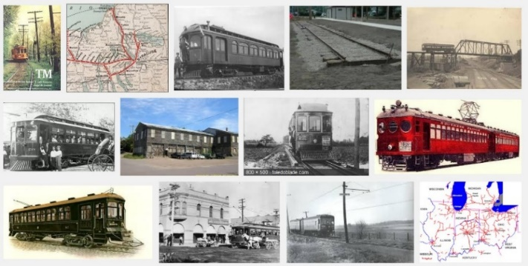
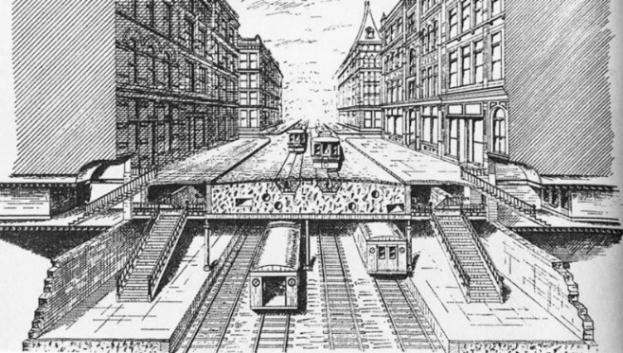
As a result of a widespread harnessing of electricity in the 1890’s, innovative technology clusters lurched out into wild dimensions . . . as electric generators and motors were embedded into new industrial and transportation systems:
Electrical Generators
Electrical Motors
Subways
Planning the IRT, 1891

Slide 22
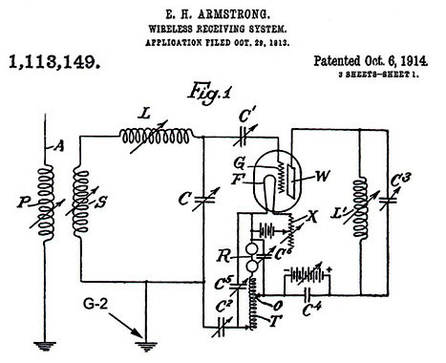
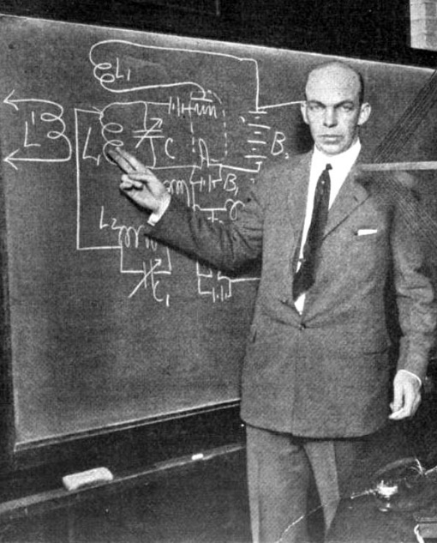
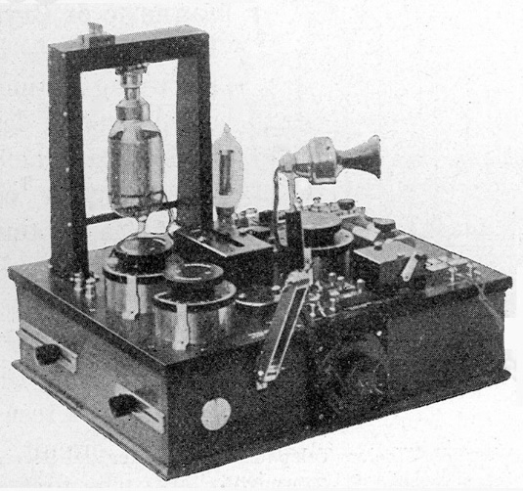
The rapidly diffusing electrification then co-evolved with rapidly-diffusing electric rail, subway, telephone and lighting systems, then with the new ‘wireless’ radio communication systems . . .
Armstrong at Columbia 1922
WWI military radio receiver
link
Back then, Edison, Westinghouse, Tesla, Steinmetz, Bell, Marconi and Armstrong became household names for their seminal ideas behind these wild technologies.

Slide 23
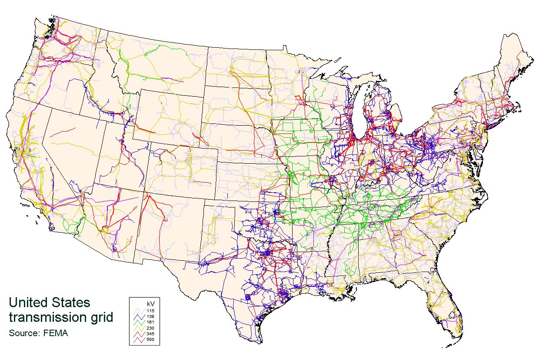
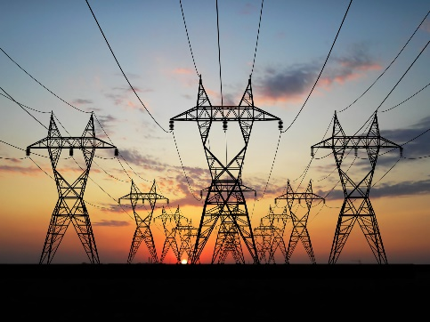
Leading, for example, to this high-voltage power grid by 2008!
Wiki

Slide 24
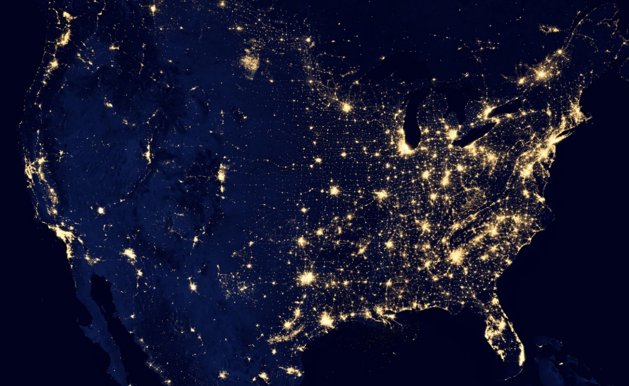
The dramatic results of the exponentiation
of electrification are easily seen from space today . . .
NASA
Think how many minds the foundational ideas of Faraday, Maxwell, Hertz,
Steinmetz, Marconi, Armstrong, . . . have cycled through to make this happen!

Slide 25
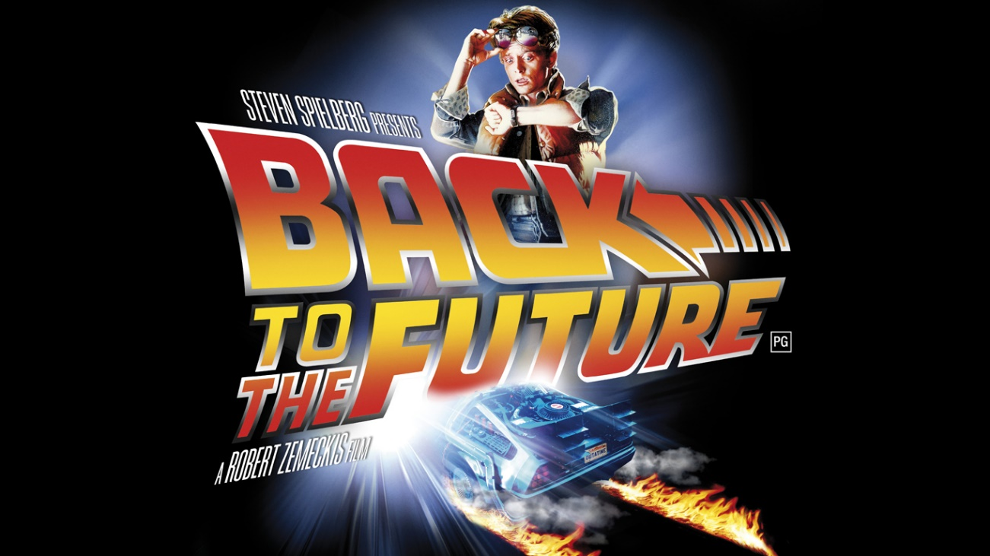
Let’s now look at a wave of innovation that I surfed back in the 1970’s:
The revolution in VLSI (Very Large Scale Integrated) microchip design . . .

Slide 26
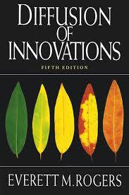
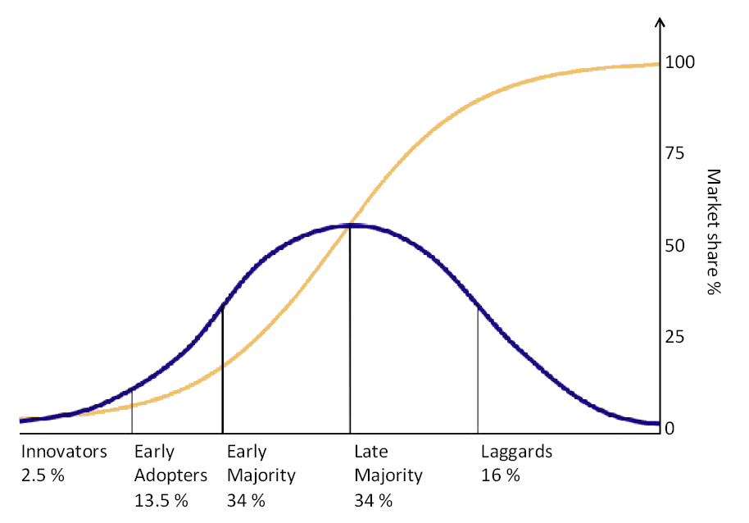
While doing this let’s consciously notice how “the flow of ideas” expands as a function of
the increasing connectivity and bandwidth . . .
and the decreasing time-delays . . .
in techno-social communication.
We’ll also think along lines explored by
Everett Rogers in his seminal 1962 text
Diffusion of Innovations:
URL

Slide 27
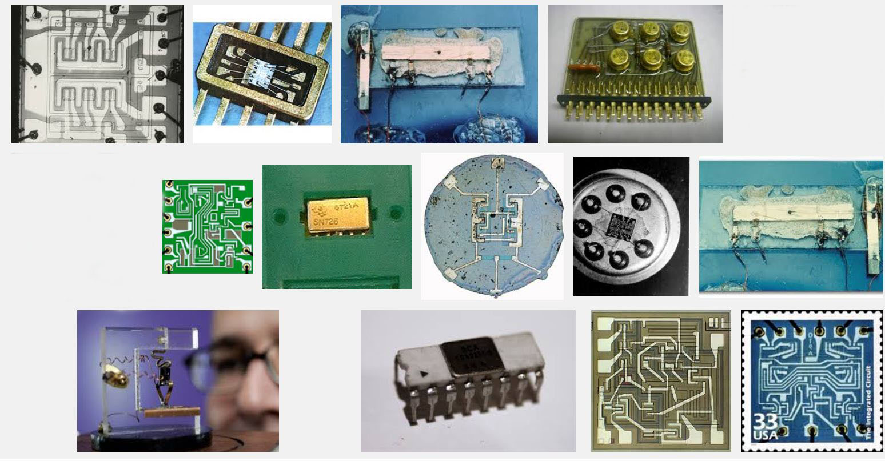
The stage was set by the emergence of integrated circuit technology in the 1960’s, enabling modest numbers of transistors and wiring to be ‘printed’ onto chips of silicon . . .
Some early integrated circuits:
Snip from Goggle images

Slide 28
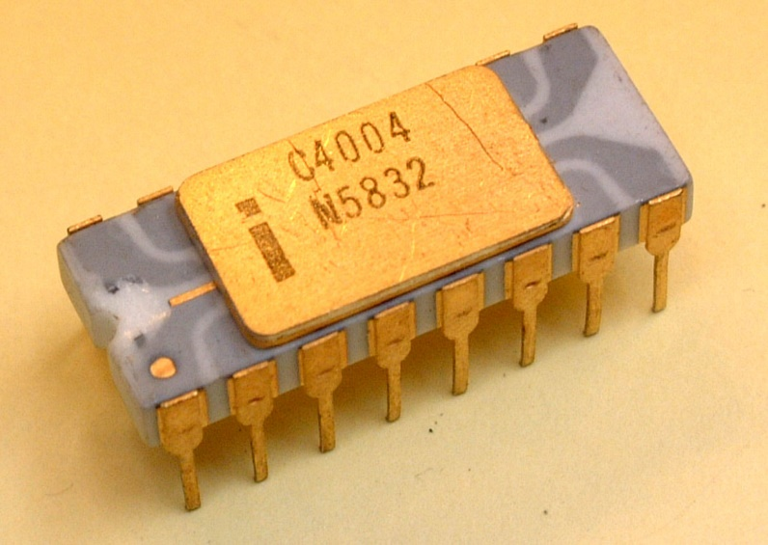
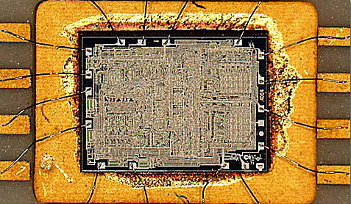
Rapid advances in lithography enabled ever-finer features to be printed, ever-increasing the numbers of transistors printable on single chips.
By 1971, a watershed was crossed
with the introduction of the Intel 4004, the first single-chip “microprocessor”:
a “computer processor on a chip” . . .
Source
It contained 2300 transistors . . .
Source

Slide 29
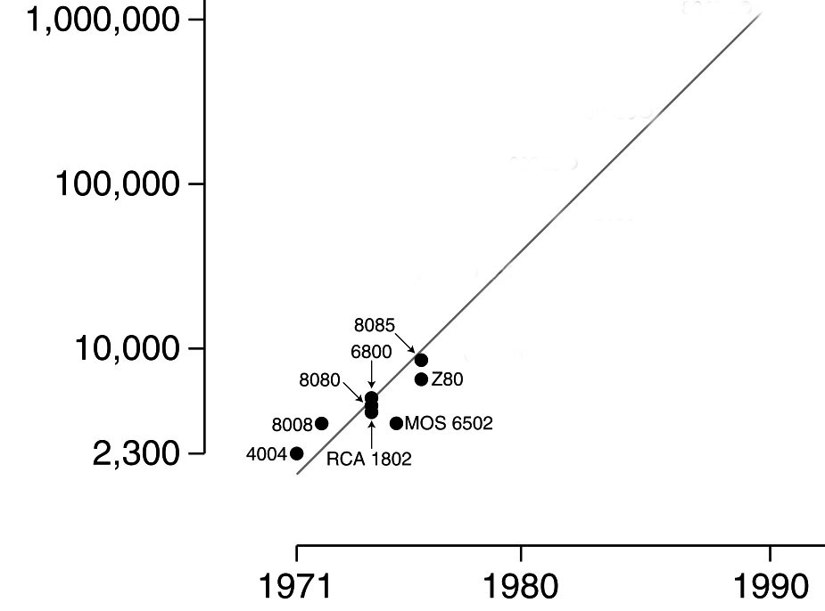
Gordon Moore at Intel observed
that the number of transistors reliably printable on commercial chips was roughly doubling every two years . . .
Moore’s Law (as of 1976)
.
An exponential function,
graphed on a vertical log scale
Carver Mead named this “Moore’s Law”
(clever career move, eh?) and his student Bruce Hoeneisen showed there were no physical limits to densities up to several million transistors/cm².
N(t)/N(0) = 2^(t/2)
Looking ahead it was conceivable that
by ~1990 an entire “supercomputer” could
be printed on a single chip . . .
In 1976 this set-off a push at Xerox PARC and Caltech to explore how to enable such complex chips to be designed.

Slide 30
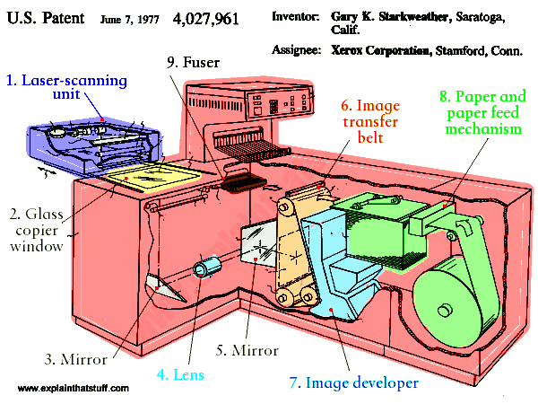
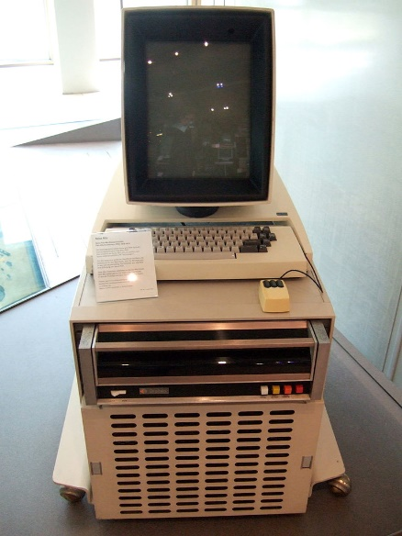
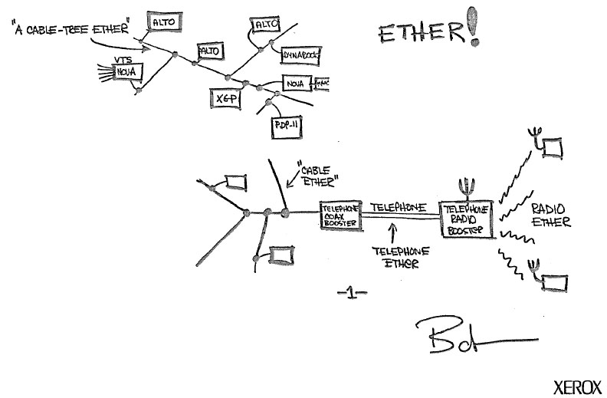
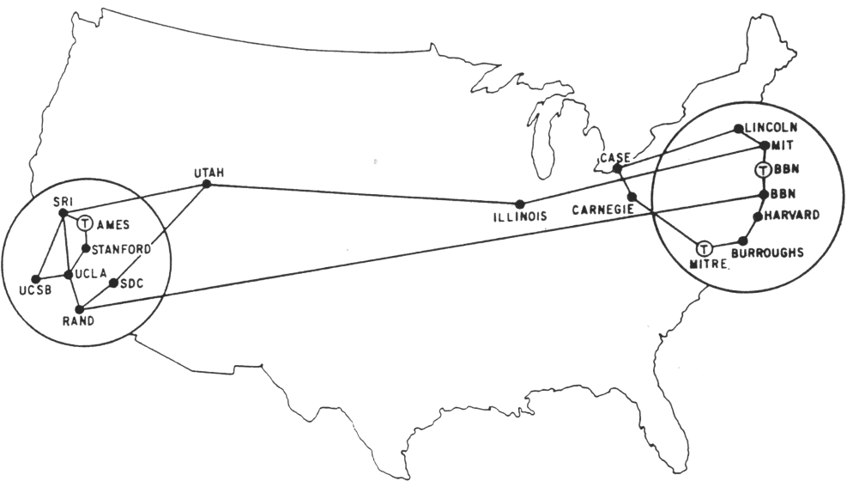
The stage was further set by seminal innovations in personal computing & networking:
Innovation of the interactive-display, mouse-controlled “personal computer”,
the “Ethernet” local-area network, and the “laser printer” (at Xerox PARC) . . .
And the Dept. of Defense’s “Arpanet” (the early internet, at DARPA) . . .
Xerox Alto, 1973
Metcalfe’s original
Ethernet sketch, 1973
Laser printer, 1971
Source
Source
Arpanet map, 1971
Wiki commons

Slide 31
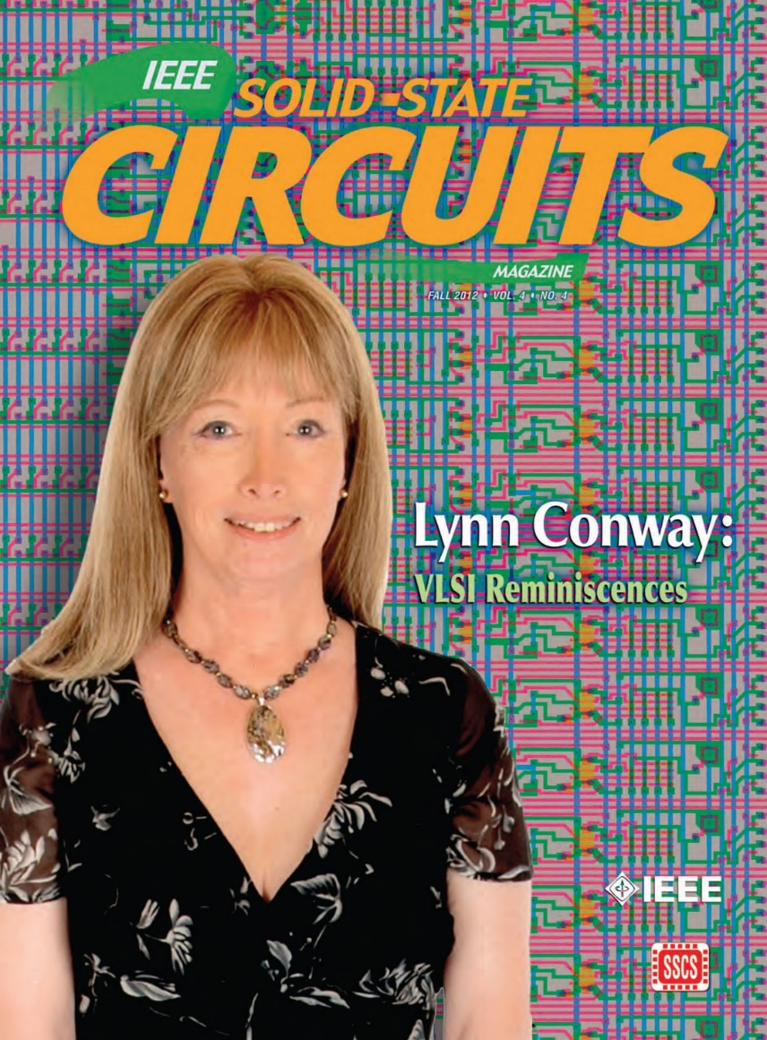
The story of what happened over
the next four years is quite a saga . . .
You’ll find insights into that saga in my
“Reminiscences of the VLSI Revolution” in
Fall 2012 IEEE Solid State Circuits Magazine
That was the very first time I’d stepped forward to tell the story . . .
Till then, since I didn’t look like an engineer,
Silicon Valley had no clue what I’d done
back during the 1970’s! (and still doesn’t!)
For now we’ll just hit some highlights . . .

Slide 32
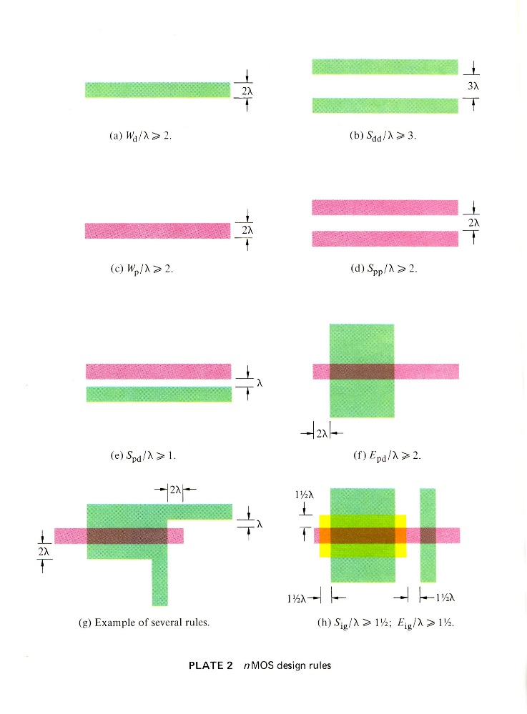
A sudden disruptive breakout was triggered
by a cluster of abstract innovations, primarily at PARC . . .
Included was a set of scalable VLSI chip-layout digital design rules, as ratioed (dimensionless) inequality equations (Conway, Xerox PARC) . . .
These enabled digital chip designs to be numerically encoded, scaled, and reused as Moore’s law rapidly advanced . . .
They also enabled subsystem designs to be scaled and open-source shared . . .
Link

Slide 33
The driving meta-architectural idea:
As chip lithography scales-down according to Moore’s Law, and ever-more ever-faster transistors can be printed on individual chips as time passes, we can imagine launching the following “techno-social scripted-process”:
STEP (i):
Use design tools on current computers to Design chip-sets for more powerful computers.
Print the more powerful chip-sets using foundries’ next-denser fabrication processes.
Use some of those chip-sets to Update current computer-design computers & design tools.
REPEAT (as STEP (i+1))
If ever-more engineers and design-tool builders did this (on an expanding number of increasingly powerful computers), the iterating techno-social expansion-process could exploratorily and innovatively-generate ever-more, ever-more-powerful, digital systems . . .
I.e., that techno-social process could exponentiate! (until Moore’s Law saturates . . . )

Slide 34
But there’s a big problem: Where will all these engineers/programmers
come from, and how will they learn to do all this?
To cope with this, I began documenting the new system of simplified, restructured
chip design methods in an evolving computer-edited book . . .
Link

Slide 35
Thus using our Alto computers not only to mechanize the generation of chip-designs, but also to mechanize the evolution of the design-knowledge-book itself . . .
That computer-edited evolving book, printed on laser printers at PARC, became the draft of the seminal textbook . . .
Introduction to VLSI Systems
by Mead and Conway, 1980.
(later called “the book that
changed everything” . . . )

Slide 36
Following the “script” Charles Steinmetz used to propagate his revolutionary AC electricity methods at Union College in 1912, I introduced the new methods in a special VLSI design course at MIT in 1978.
Link
Link
Link

Slide 37
The students learned to design chips
in the 1st half of the course, then did project-chip designs in the 2nd half. These were fabricated in Pat Castro’s lab at HP shortly after the course.
There were many amazing results including a complete Lisp microprocessor design
by Guy Steele . . .

Slide 38
Map and photomicrograph
of the 19 student projects on
the MIT’78 ‘MultiProject’ Chip
For more about the MIT’78 course, see Lynn’s “MIT Reminiscences”

Slide 39
The MIT’78 course stunned various top folks across Silicon Valley . . .
Chip design till then had been a mystery, only grasped by a few computer engineers working for chip manufacturers . . and who thus had access to the “printing plants” . . .
Many other top research universities wanted to offer an “MIT-like” course. But how?
After intensive pondering, I grasped the answer: Rerun the MIT’78 course at a dozen research universities . . . using my MIT lecture notes to keep everything in sync.
But how to “print” all the student project chips?
I suddenly envisioned the idea of (what’s now called) an “e-commerce” system enabling student design files to be remotely submitted via the Arpanet to a “server” at PARC .
That server would run software to pack designs into multi-project chips (like composing the print-files for a magazine, using remotely-submitted articles) . . .
We’d then “print” the MPC’s again at HP (where Pat Castro had prototyped
the first “silicon foundry”), and quickly return the chips to students.

Slide 40
In the fall of 1979, I orchestrated a huge “happening” (MPC79)* . . . It involved 129 budding VLSI designers taking Mead-Conway courses at 12 research universities…
MPC79 e-commerce-system ARPANET interface:
*The MPC Adventures: Experiences with the Generation of VLSI Design
and Implementation Methodologies, L. Conway, Xerox PARC, 1981 (PDF)

Slide 41
MPC79 not only provided a large-scale “demonstration-operation-validation” of the design methods, design courses, design tools and e-commerce digital-prototyping technology …
it also triggered ‘cyclic gain’ in, and exponentiation of, the budding VLSI-design-ecosystem…
The MPC Adventures, L.ynn Conway, Xerox PARC, 1981.

Slide 42
Visualizing how techno-social-system dynamics triggered an exponentiation of the new
VLSI chip design-and-making ecosystem via the emergent internet-communication technology . . .
By 1982-83, Mead-Conway VLSI design courses were
being offered at 113 universities all around the world
*An early exploration of emergent techno-social-system dynamics
by doing what decades later is becoming known as “social physics”
The MPC Adventures* (LC, 1981, p. 16)

Slide 43
1976
1977
1978
1979
Envisioning the exponentiating
wave of VLSI innovation . . .
’76: How to cope with VLSI complexity?
’77: Inventing scalable VLSI design rules.
’78: Launching the VLSI methods at MIT!
’79: Launching the VLSI courses via MPC79!!

Slide 44
Over the past 40 years or so, Moore’s Law stayed on track all the way:
N
(exponential function
graphed on log scale)
(exponential function
with t in years)
N(t)/N(0) = 2^(t/2)
N(0), t(0)
Starting with several thousand in 1971, the number of transistors on
a chip passed one million by 1991, and passed several billion by 2011!

Slide 45
For example, this iPhone 5 ‘A6’ chip
contains several
billion transistors!
<------
----->
Source
Source

Slide 46
For more about PARC and the
amazing things done there, see
Michael Hiltzik’s Dealers of Lightning:
For insights into the role of
gov’t in VLSI’s emergence,
see this book from the NRC:
For a wider sociological perspective on the internet’s emergence, see Thomas Streeter’s The Net Effect

Slide 47
VLSI chips also empower the vast internet infrastructure,
which also continues to expand exponentially . . .
Interactive Zoom-in
Internet Map, 2015
exponential function
Link

Slide 48
And with the internet connecting ever-more people and chip-empowered
things, just imagine what’s going on out there now . . .
all around the world!
NASA: Earth from space at night
Setting the stage for what’s coming next . . . !

Slide 49
"What's past is prologue" – William Shakespeare
Link
It’s now time to look forward, into the future . . . !

Slide 50
As we turn 180⁰ and look ahead . . .
we can glimpse another huge incoming
wave of innovation . . .
It’s out there now, just beyond the social-time-horizon . . .

Slide 51
One thing for sure:
This is the “Big One”! . . .
URL

Slide 52
But why is it starting now?
Until now microchip systems have been deeply embedded,
out-of-sight and out-of-mind inside “things” like . . .
Smartphones
Wearables
Autos
Drones

Slide 53
Thus few folks visualize the “ideas in motion” behind effects like the astonishing
‘out-of-body’ experiences while flying a Parrot Bebop using an Oculus Rift . . .
Unless They
Do Teardowns!
www.youtube.com/watch?v=Io6V0NR7DN0
www.youtube.com/watch?v=6ZdSMAG90Rs

Slide 54
Thus that “idea invisibility” is changing
as teardowns of drones, smartphones
and wearables make socially-visible the
microsystem “hardware apps” within . . .
Oculus Rift Teardown
- - - - - - - →
I
I
I
I
I
I
I
Headtracker Subsystem:
ARM MCU, 6-dof IMU
3-dof e-compass and more
Namely, tiny modular micro-hardware versions of up-till-now ‘big things”
like video-cameras, GPS units and inertial-measurement-units (IMU’s).
Including micro-electro-mechanical
systems designed on computers and “printed” on “MEMS chips“ in “foundries.”

Slide 55
Then too, imagine the impact on tomorrow’s children when
they start taking apart old nanodrones!
Imagine the wild things they might figure out how to do in time!
URL

Slide 56
Further “ideas-in-things” in the coming wave of innovation are hinted-at by the Myo gesture control armbands from mechatronics engineers at Thalmic Labs (Kitchener, Ont.)
https://www.thalmic.com/en/myo/
VIDEO VIDEO VIDEO VIDEO!

Slide 57
So, what’s happening here?
Instead of printing billions of transistors on single “large” smartphone chips.
We can print millions of transistors onto thousands of tiny but powerful chips.
[ you can do a lot with a million transistors! ]
And embed lots of tiny micro-control-processors . . . and MEMS micro-mechanisms . . . into almost everything.
Putting them where they measure, process and transmit local physical-data such as position, acceleration, temperature, pressure, etc.
Embedded-clusters of tiny-chips could animate and interactively-control lots of macro-things . . . such as robots, drones, mobility-aids and health-systems.

Slide 58
These aren’t frivolous play-things . . . they instead illuminate a vast frontier for human empowerment and amplification . . .
Consider a patient confined to a hospital even now:
She can now explore the world beyond her window, using her smartphone to control a basic drone and see what’s out there . . .
Now imagine joining a group “drone-tour” of some remote exotic place, right from your own individual homes . . .
With each your drones remotely “carrying your eyes”, in the form of fisheye lens microcams (as in the Parrot Bebop) . . .
Which you look through using your Oculus Rift over the internet!

Slide 59
This embedded-microsystems revolution is getting up a big head of steam
in emerging techno-social innovation centers all around the world …
But how on earth can we visualize and follow what’s going on?

Slide 60
We can zoom-in on evolving fine-details in specific micro-technology areas
by using tech-mappings like this for microcamera image sensors . . .
Source

Slide 61
We can also follow, even participate in tech such as “consumer 3D Printing,”
enabling us to rapidly “make” all kinds of “things” from digital design specs created on personal computers . . .
3D printed
prosthetic
<------------------ hand
URL
URL
Once perfected, such digital design files can be shared electronically
with and/or marketed to users of 3D printers anywhere . . .

Slide 62
Even better, what about making 3D printers that print 3D printers!
That’s the UK’s Adrian Bowyer’s vision for the global RepRap Project:
For more about RepRap
and the philosophy behind it,
watch this remarkable video:
“A machine that builds itself?”
Just as some iron was fed-back to make more steam engines to help make more iron to further empower the industrial revolution . . .
Such systemic positive feedback can provide large “gain” in the
emergent 3D-printing technology-generation ecosystem.

Slide 63
For the bigger picture we can zoom-out and follow paths of emerging application-clusters
along Gartner “Hype Cycle” infographs that frame the overall technology-wave . . .
2014
URL
Thereby gaining the venture capital community’s perspective on it all . . .

Slide 64
But where will all the young innovators come from?
And how can they learn to surf on this vast incoming wave?
Fortunately, a wave of change is also sweeping through STEM education, just in time!

Slide 65
Many incoming students also have gained hands-on team-experiences at . . .
LEGO Camps
Maker Faires
FAB Labs
Robot Competitions

Slide 66
They’ll also gain emerging knowledge, just-in-time as needed,
using rapidly evolving internet-based learning-resources . . .
udemy
Coursera
Khan Academy
UDACITY
edX
NPTEL
MIT EdX
myopencourses
Image source

Slide 67
The innovative embedding
of ever-tiner micro-hardware
apps will quickly spread . . .
And begin
enhancing the functionality of just about everything:
http://blogs.jabil.com/2014/08/13/internet-of-things-infographic/

Slide 68
But how will we cope with the ‘complexity’ of
the emerging techno-social ecosystem?
From: The Age of Opportunity: Harnessing Complexity To Solve Big World Problems
by Frank Spencer, kedgefutures.com

Slide 69
We’ll exploit rapidly-evolving new techno-social-coordination methods, such as collaborative learning, crowdsourcing, crowdfunding, IP brokering, agile design rapid-digital-prototyping and more . . .
Link
Enabling everyone from engaged-users to innovators to makers to scale up their levels of participation and impact.

Slide 70
Only now, instead of just exploring how to make ever-bigger things that go ever-further, ever-faster . . . such as erecting skyscrapers that poke
into the clouds, and shooting ever-bigger stuff out into “outer space”. . .
NASA

Slide 71
and peer
down into the “inner spaces” of the micro/bio/nano/pico worlds . . .
We’ll increasingly invert our spherical-perspective by 180⁰
Randy Scott Slavin
nupex.eu
As we explore how to make, share and exploit vast-exponentiations of ever-tinier, ever-more humanly-empowering “micro/bio/nano things” . . .

Slide 72
Study, for example, the first fully-hybrid biological solid-state system created by
Ken Shepard’s team at Columbia University’s
Bioelectronics Systems Lab (video):
By powering CMOS microcircuitry using
ATP in an in-vitro electrogenic ion pump,
this work opens a path to powering tiny
nano-chips embedded inside living cells!

Slide 73
And as researchers zoom ever-further into the
micro-biological, molecular and atomic levels . . .
Scanning Tunneling Microscopy (STM)
Multiplexed Centrifuge Force Microscopy (CFM)
Atomic Force Microscopy (AFM)
Democratizing high-throughput single molecular-pairs’ force analyses
using integrated DNA nanoswitches multiplexed into miniature
benchtop CFMs. Just announced on 3/17/16 by Harvard Wyss Institute.
Their findings will help other adventurers better gear-up for explorations in places & frontier-fields such as . . .

Slide 74
Multi-physics EDA
Augmented Reality
Teleautonomous Systems
Photonics
Wyss Institute
Bio-Electronics Exploratory robotics
Hyperscaling
Model-Based Design
Biologically Inspired Engineering
Draper Lab
MIT Nano
Brain Science Nano Technology
Multiengineering
Meta^2Mathematics
Meta Architecture
Machine Vision
Machine Hearing
Augmented Kinesthetics
Social Physics
Techno-Social Dynamics
Memetic Generators
Biosocial Learning
DARPA Microsystems
Research Universities
Google ATAP
Microsoft Research
Facebook
Ecological Algorithms
UPS
Amazon
Synthetic Biology
RI School of Design
Data Science
Genetic Algorithms
Metamaterials
Self Assembling Systems
Techno-Social Exploration-Infrastructure
AI & Machine Learning
STEM + ARTS = STEAM
Molecular Machines

Slide 75
Thus it begins, as such knowledge rapidly spreads, all around the world . . .

Slide 76
Before long, adventurers everywhere will be “surfing” somewhere on these waves . . .!

Slide 77
But how on earth will humanity ever grasp and knowingly guide
what’s happening in such massive techno-social waves?
We’ll evolve techno-social methods that help us meaningfully
reflect-back-on and knowingly peer-ahead-into such evolving labyrinths,
using methods and projections akin to today’s weather models . . .

Slide 78
To envision the masses of ideas now cycling in techno-social motion, recall how we
diagrammed the nested-social-evolutionary-processes of the VLSI revolution.
Only now, vastly more such processes are running in parallel and cross-fertilizing.
And new science is beginning to explore and map-out what’s happening . . .
The MPC Adventures (p. 16) Xerox PARC 1981.
URL

Slide 79
Epidemic Processes are already providing
mathematical frameworks for partly-modeling
techno-social dynamical-systems:
From: “Epidemic processes in complex networks” by
Pastor-Satorras, et al, Rev. Mod. Phys. 87, 925 – 8/31/15
See also recent work in CNNs, LVars (L. Kuper), etc.

Slide 80
Note that the big incoming wave is way more than a few nested
logistic ‘epidemic’ processes where each looks something like this:
nearing
Saturation
y(t) = ymax/(1+((ymax/y(0))–1))e^-rt)
unfolding
exponentiation
And even in this simple case, each 2D slice hides tons of what “composes the wave”*
*For more insight into this all this, see Van Quine’s discussion of “the river” in From A Logical Point of View, Ch.IV.
Let’s re-slice and zoom into our incoming wave in 4D⁺ to gain a better perspective

Slide 81
Meta-ethnomethodology:
Envisioning the incoming wave of innovation as
a time-series of “GHC profiles”(i.e., 2D⁺ slices
thru the 3D⁺ wave at increments in time) . . .
Gartner Hype Cycle 2014
http://www.gartner.com/newsroom/id/2819918
Is this a Traveling Wave?
A Standing Wave? Or What?
This stunning video*
hints at ways to
think about what
it all means . . .
*"Water," by Morgan Maasen http://vimeo.com/90429499

Slide 82
Looking back, these processes seem remarkably
similar to the explorations of the alchemists,
i.e., the labyrinths of emergent techno-social
processes that gradually “self-abstracted” into
the later sciences of chemistry and materials.
Looking forward, are there limits to what it’s possible to create? Doesn’t the 2nd Law of Thermodynamics say everything’s “running down” as entropy inexorably increases?
(as popularized by Arthur Eddington in 1927)
But that’s not so given emerging insights re the physics of time!
Ex: See the work at Columbia and Princeton on reenacting the unfolding of medieval European
alchemy via hands-on, techno-social reverse-engineering of what happened back then:
The Making and Knowing Project
by Pamela Smith, Columbia (video).
Decoding Alchemy freshman seminar
by Jennifer Rampling, Princeton.
Also see Scientiae and the Society for the History of Alchemy and Chemistry (SHAC)

Slide 83
Meanwhile, as bandwidths, connectivity & latencies improve, escalating rates of techno-social change will challenge existing cultural patterns, because of the
massive accumulation of social habits:
What’s the new game?
Who gets to play?
What rules do we play by?
Where can we turn for guidance?
Especially, how do we drop old habits?
URL

Slide 84
Then too, “How can we ever adjust and keep up?”
Hasn’t the train already left the station for many folks?
Words to ponder:
"In a world of change, the learners shall inherit the earth,
while the learned shall find themselves perfectly suited for
a world that no longer exists" – Eric Hoffer
Meantime, something awesome has begun:
“As the rate of techno-social change increases,
we’ll all live far further into the unfolding techno-social future
than we ever dared dream“ – Lynn Conway

Slide 85
And, a word of caution!
Do avoid becoming distracted by all the rapidly-emerging “things.”
As Kentaro Toyama says in Geek Heresy, “technology alone won’t change the world”. . . We must instead rescue “Social Change from the Cult of Technology”!
URL
URL
One key will be the evolution
of empowering “social-teaming”
and “social leadership” for
the incoming “Social Age”, as discussed by Julian Stodd . . .
Kentaro Toyama, 2015
Julian Stodd, 2014

Slide 86
There are also deep concerns about Data and Memory . . .
As in Juan Benet’s discussion of
IPFS and the Permanent Web as a way to ensure the Web’s survival.
But then see “DNA Data Storage
Safe for Centuries”, NYT 12-3-15
And then explore historian Abby Rumsey’s breathtaking book:
“A call to consciousness, When We Are No More explains why data storage is not memory; why forgetting is the first step towards remembering; and above all, why memory is about the future, not the past. “
Juan Benet, 2015
Abby Smith Rumsey, 2016

Slide 87
URL
Again, this isn’t about things.
It’s about the escalating rate
of generation + diffusion of
ever-better ideas on how
to make and use things!
This is triggering huge
re-alignments in political economy, including the role of The City in History.
URL
And to the emergence of “cooperative capitalism”,
as discussed by Robin Chase
of ZipCar fame in Peers Inc
Lewis Mumford, 1961
Robin Chase, 2015

Slide 88
Most of all, it’s about being human . . .
Where we came from . . .
What we’re doing . . .
Where we’re going . . .
https://www.evogeneao.com/learn/tree-of-life
https://en.wikipedia.org/wiki/The_Tree_of_Life_(film)
http://screenmusings.org/movie/hd/The-Tree-of-Life/

Slide 89
How Can We Best Enter, Explore and Unfold These Possible Futures?
By Building On and Sharing:
Models and Visualizations of Unfolding Techno-Social Dynamical Systems
Always Rethinking Foundations and Boundary-Conditions in:
Mathematics, Statistics, Space-Time, Entropy, Complexity, Evolution . . .
While “On-the-Move” Living, Training, Participating and Adventuring In:
Creative-Explorations and Mappings, Social-Learning, Political Economics . . .
N. Wiener ’61 R. B. Fuller ’68 W. B. Arthur, Ed ’97
S. H. Strogatz ‘14 S. M. Stigler ’16 R. A. Muller ‘16
Oliver Sachs ‘15

Slide 90
In Conclusion: A Conjecture about Possible Futures (& alt. measures to GDP):
By cooperatively creating and sharing of ideas for doing ever-more with ever-less,
the incoming wave of techno-social innovation now has the stunning potential of:
Sustainably providing ever-increasing infrastructural functionality and life experiential-amplification per person,
While consuming ever-decreasing energy and material resources per person
Thus beginning the reigning-in of our unsustainable over-use of planet earth
While simultaneously opening-up unprecedented explorations of the greatest evolutionary frontier . . . the frontier of what it’s possible to do!
Thus we begin another Renaissance, as we enter the Techno-Social Age.

Slide 91
Finally, a personal perspective on “Our Travels Through Time”. . .
Source
“If you want to change the future, start living as if you’re already there!”
– Lynn Conway

Slide 92
END
This slideshow with all embedded links is posted online for later study & reference:
http://ai.eecs.umich.edu/people/conway/Memoirs/Talks/UVIC/Techno_Social_Talk.pptx
http://ai.eecs.umich.edu/people/conway/Memoirs/Talks/UVIC/Techno_Social_Talk.pdf

