Slide 1
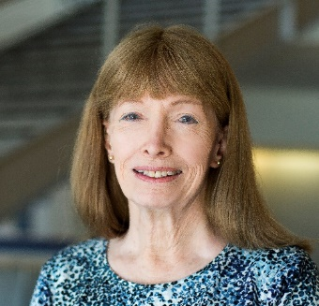
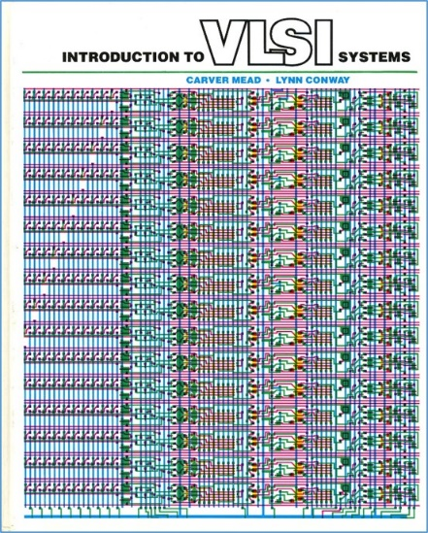
An Invisible Woman: The Inside Story Behind the Microelectronic Computing Revolution in Silicon Valley^{1,2,3}
Lynn Conway, Professor of EECS Emerita, University of Michigan, Ann Arbor
Opening Keynote: #UNIT 2017, Berlin, Germany, May 6, 2017
In 2015, US CTO Megan Smith raised profound questions about women’s contributions in science, engineering and math being erased from history.
In this talk we explore a case study of such erasure, and surface a very
counter-intuitive conjecture about the underlying causes and effects.
1. In remembrance of pioneering novelist Ralph Ellison, author of Invisible Man, 1952.
2. Based on a Pride Keynote at the National Science Foundation, Arlington, VA, June 10, 2015.
3. Posted online: http://ai.eecs.umich.edu/people/conway/Memoirs/Talks/UNIT_2017/Inside_Story_Talk.pptx and .pdf

Slide 2
Framing the Story:
Reflecting on the 2013 LGBT Pride Celebration at the White House
Visualizing Erasures of Women’s Contributions in STEM:
Past US-CTO Megan Smith Describes the Phenomenon (VIDEO)
Example Case Study: The Inside Story Behind the VLSI Revolution
An Explanatory Conjecture:
It’s because of “The Conway Effect”!
Q/A and Discussion:
Including Thought-Experiments re the ‘Propagation of Innovations’

Slide 3
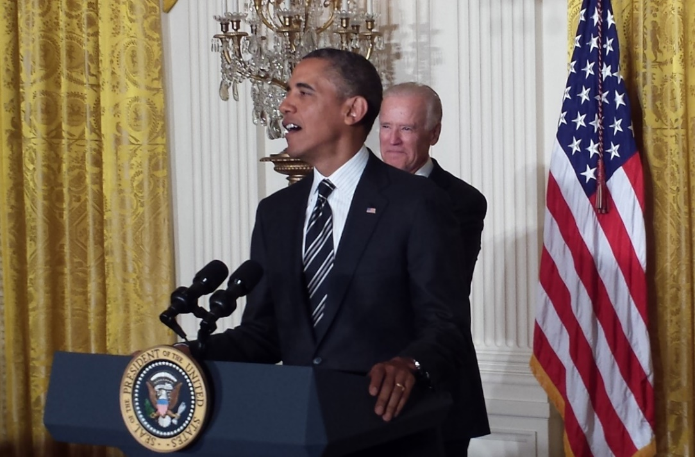
Reflections on the White House Reception
Celebrating of LGBT Pride Month, June 13, 2013:
The Many Shades of ‘Out’, by Lynn Conway
http://www.huffingtonpost.com/lynn-conway/the-many-shades-of-out_b_3591764.html

Slide 4
The Many Shades of ‘Out’, by Lynn Conway:
On a sultry June afternoon, as my husband and I walked towards the White House, I reflected back on my gender transition in 1968.
Shamed as a social outcast, I'd lost my family, friends and social support. Fired by IBM, I’d lost a promising research career. In many cities I could’ve been arrested, or worse yet, institutionalized.
Evading those fates, I completed my transition, took on a secret new identity, and started all over as a contract programmer. Any 'outing' and I'd have become unemployable . . . Fear channeled me into 'stealth-mode‘. For over 30 years I covered my past, living as if I was a spy in my own country.
But it was now June 13, 2013 . . . My husband Charlie and I were joining many other advocates at the President's White House Reception for LGBT Pride Month. The air was full of joy, and as we awaited the President I reflected further.
I’d been 'out' for 15 years . . . or so I'd thought: out on the Internet to reveal my past to colleagues, out as an trans advocate and an activist against psychiatry’s pathologization of gender variance.
When I was hidden in the back-rooms of Xerox Palo Alto Research Center decades before, launching innovations as the hidden-hand behind the VLSI microelectronics revolution, I didn't mind being invisible in my field back then or that no one had a clue what I was doing . . . I was thrilled to even have a job.
But 'out' has many shades of grey -- and even in recent years I kept on shyly holding back, covering in the darker shadows. Although times had changed, I'd clung to old habits.
Down through the decades no one could explain how the VLSI revolution actually happened. The results were simply taken for granted. Although I'd gained vital knowledge about generating such paradigm shifts, I feared my personal history would loom large in folk's minds and obscure any attempt at explanation. It wasn't till 2012 that I got up the nerve to publish a memoir to begin revealing how the VLSI revolution came about.
As the president entered the room, I glanced around and took in the joyful vibes. As he began to speak, I grasped how far we'd come. Times had more than changed: a fresh wind was sweeping through our society, especially amongst younger generations.
Then I thought of the millions of other LGBT people out there. I tried to envision their lifelong struggles against ostracism, their losses of families and employment, their oppression by having to 'cover', while not being known for who they were, what they'd done, who they loved or who loved them.
In a flash, I saw the vastness of the suffering . . . Then it hit me: we've come so far so fast that many others could now begin uncovering too! After all, freedom isn't just an external concept framed by our laws. It's a gift of the spirit that we must give ourselves, by going towards brighter shades of 'out'.
http://www.huffingtonpost.com/lynn-conway/the-many-shades-of-out_b_3591764.html

Slide 5
With that as a backdrop, let’s now examine
history’s treatment of women’s contributions in STEM
Link

Slide 6
First, listen to former U. S. Chief Technology Officer Megan Smith
revealing how women in STEM are erased from history . . .
http://www.youtube.com/watch?v=fHyRdAyqV5c&t=0m1s
http://boingboing.net/2015/05/08/cto-megan-smith-explains-how-w.html
http://www.charlierose.com/watch/60554078 (4-28-15)

Slide 7
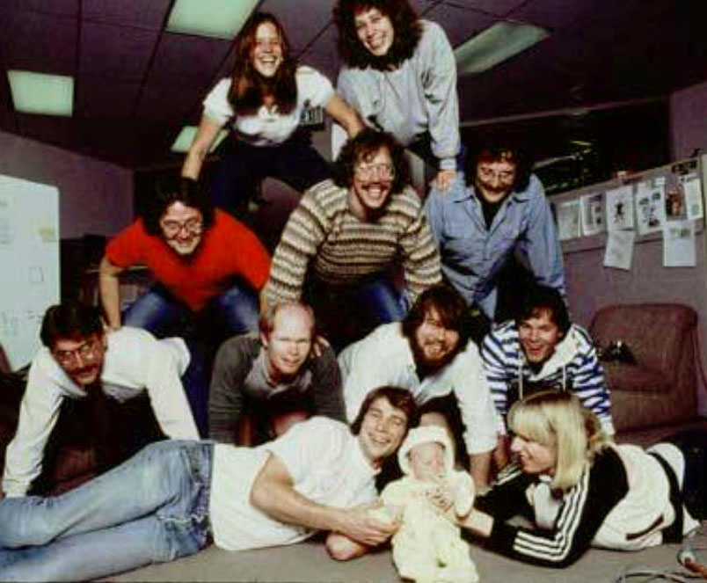
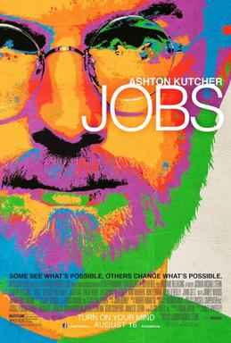
There were four women on the Macintosh team in the 1980s, but not a single one was cast in the 2013 biopic Jobs. Even worse, all seven men on the project had speaking roles in the film.
It’s not just harder for women to break into STEM fields, but the many contributions they do make aren’t celebrated. “It's debilitating to our young women to have their history almost erased,” Smith explains.

Slide 8
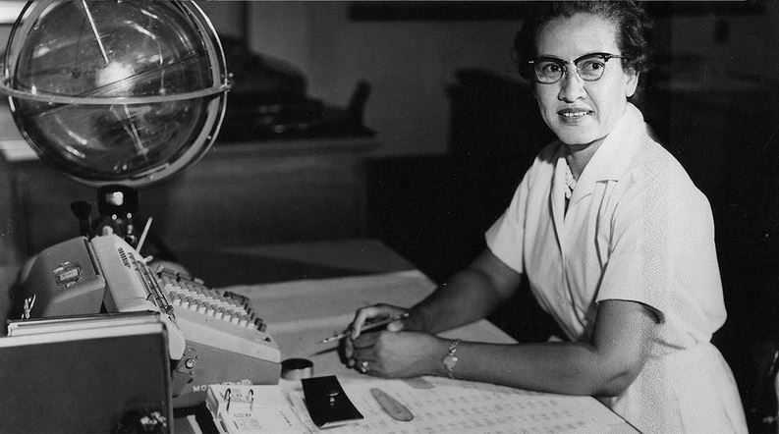
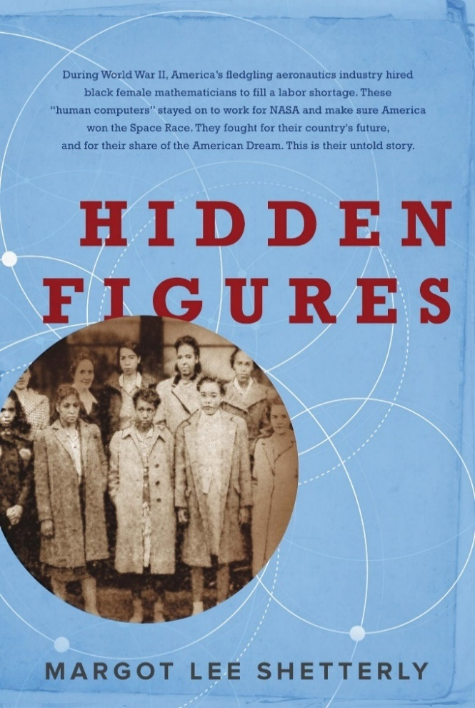
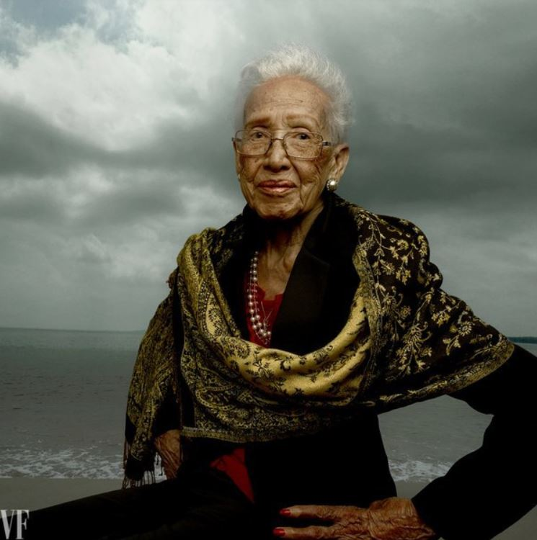
For more about Katherine Johnson, the NASA mathematician whose
story was discussed by Megan Smith, see the 2016 book and movie:
Hidden Figures: The Story of the African-American Women Who Helped Win the Space Race, Margot Lee Shetterly (2016)
Katherine Johnson at her NASA Langley desk, 1960
Katherine Johnson, age 98 Photo by Annie Leibovitz for Vanity Fair, 2016
Fortunately, she’s lived long-enough to see her story told!

Slide 9
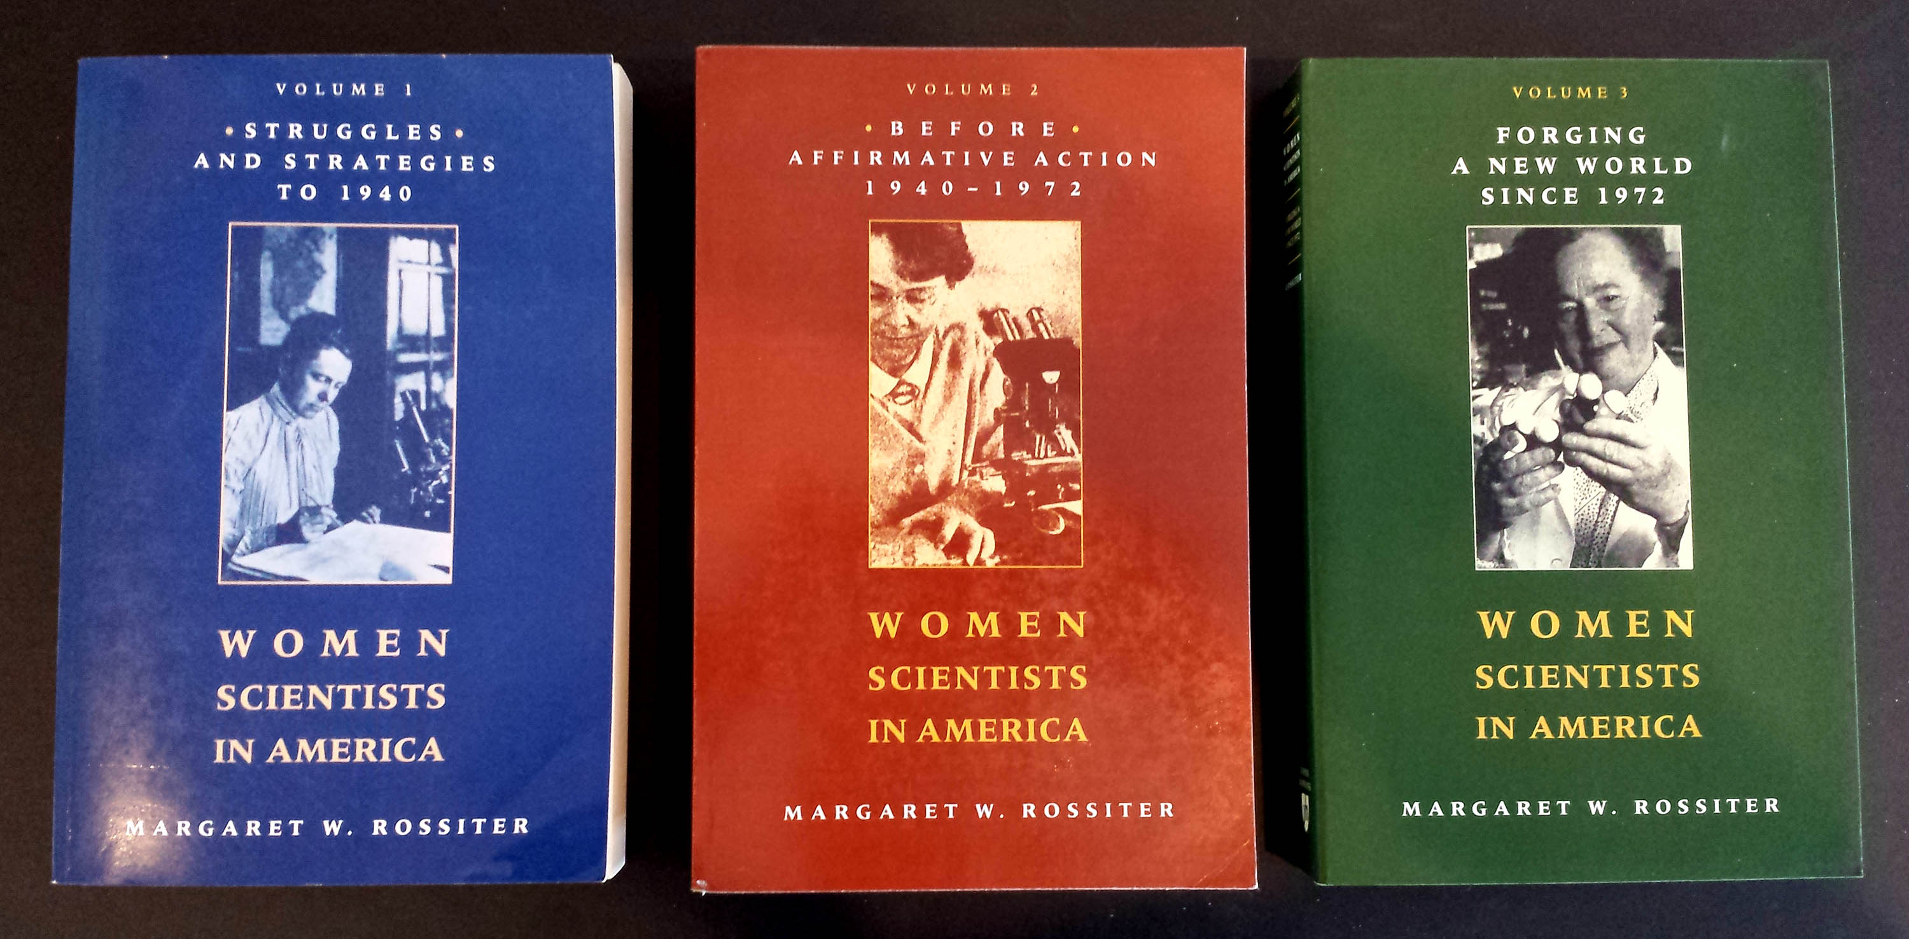
This effect is seen throughout the history of women in science, as reported by
science historian Margaret Rossiter in Women Scientists in America (V 1-3):

Slide 10
Margaret Rossiter coined the term “Matilda effect” in 1993 for the systemic repression and denial of contributions of women scientists, whose work is often attributed to male colleagues.
This is similar to the term "Matthew effect“ that sociologist Robert Merton coined in 1968, describing how eminent scientists get more credit than lesser-known researchers, even if their work is similar.
For example: a prize will usually awarded to the most senior researcher in a project, even if a grad student did all the work.

Slide 11
CASE STUDY:
The revolution in Very Large Scale Integrated (VLSI) silicon microchip design and manufacturing, beginning in 1976.
Link

Slide 12
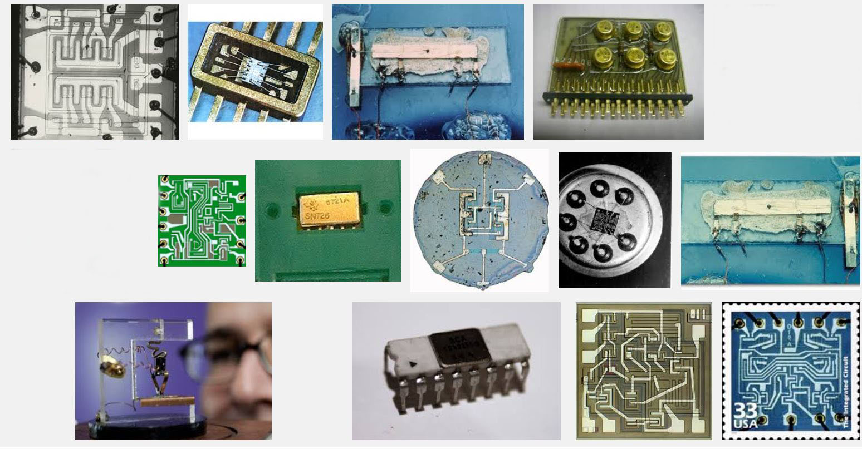
The stage was set by the emergence of integrated circuit technology in the 1960’s, enabling modest numbers of transistors and wiring to be ‘printed’ onto chips of silicon . . .
Some early integrated circuits:
Snip from Goggle images

Slide 13
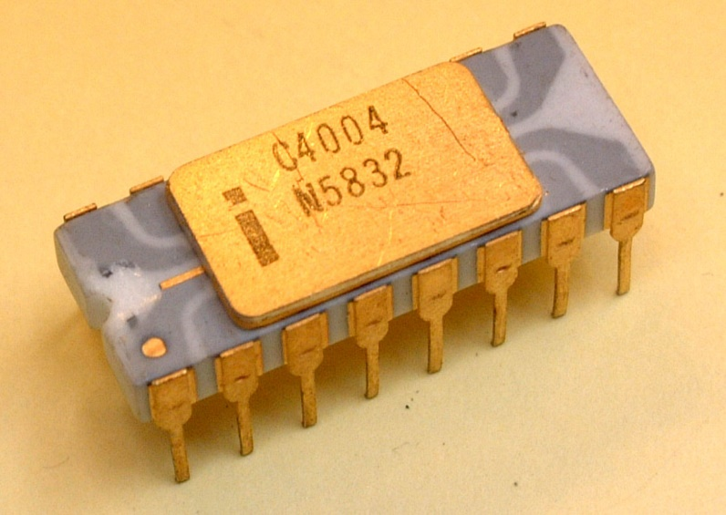
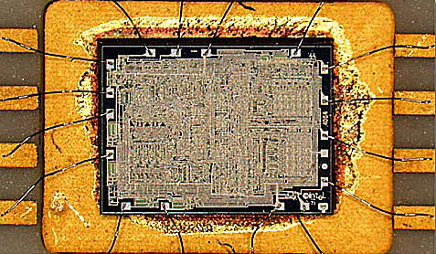
Rapid advances in lithography enabled the printing of ever-finer features, enabling ever-increasing the numbers of transistors to be printed on single chips.
A watershed was crossed in 1971
with the introduction of the Intel 4004, the first single-chip “microprocessor”:
a “computer processor on a chip” . . .
Source
It contained 2300 transistors . . .
Source

Slide 14
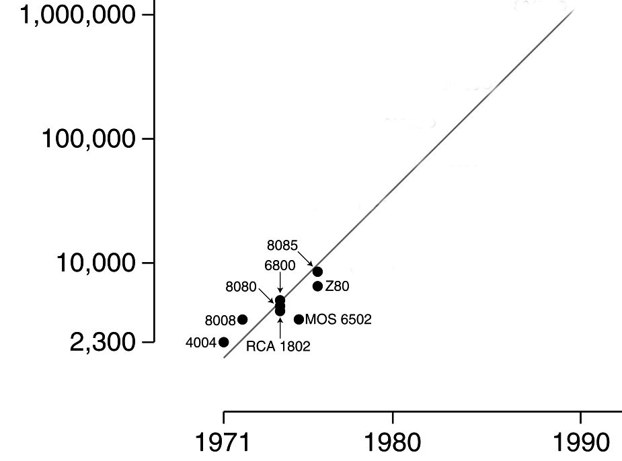
Intel’s Gordon Moore observed that the number of transistors reliably printable on chips was roughly doubling every two years . . .
Moore’s Law (as of 1976)
.
An exponential function,
graphed on a vertical log scale
Carver Mead named this “Moore’s Law”
(clever career move, eh?) and his student Bruce Hoeneisen showed there were no physical limits to densities up to several million transistors/cm².
N(t)/N(0) = 2^(t/2)
Looking ahead it was conceivable that
by ~1990 an entire “supercomputer” could
be printed on a single chip . . .
In 1976 this triggered a research effort at Xerox PARC and Caltech to explore how to enable such complex chips to be designed.

Slide 15
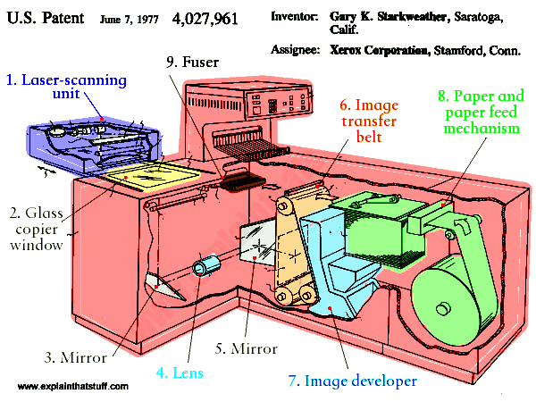
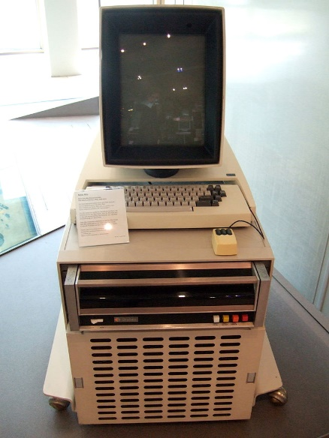
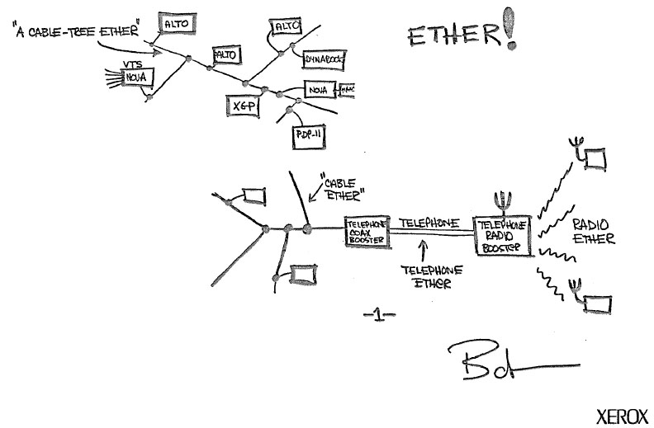
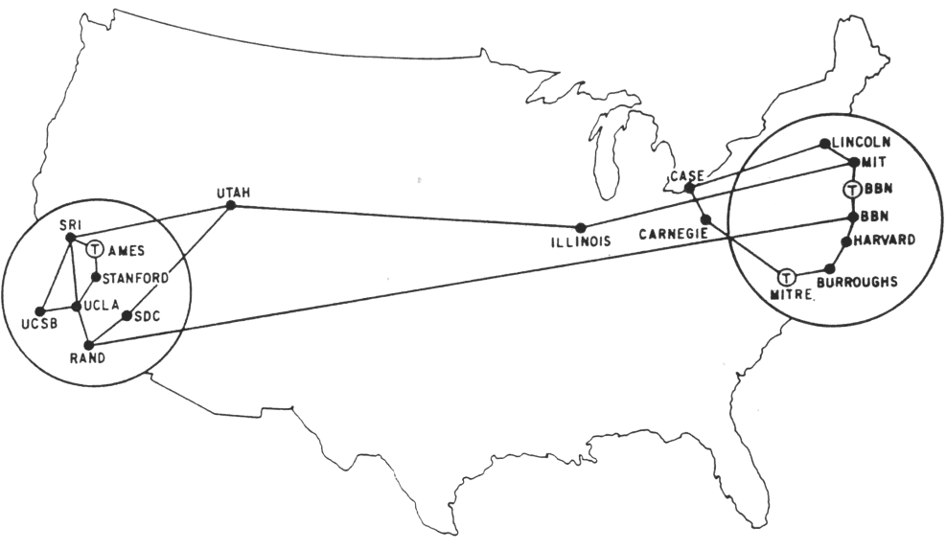
The stage was further set by seminal innovations in personal computing & networking:
The innovation of the interactive-display, mouse-controlled “personal computer”,
the “Ethernet” local-area network, and the “laser printer” at Xerox PARC) . . .
And by the Dept. of Defense’s “Arpanet” (the early internet), at DARPA . . .
Xerox Alto, 1973
Metcalfe’s original
Ethernet sketch, 1973
Laser printer, 1971
Source
Source
Arpanet map, 1971
Wiki commons

Slide 16
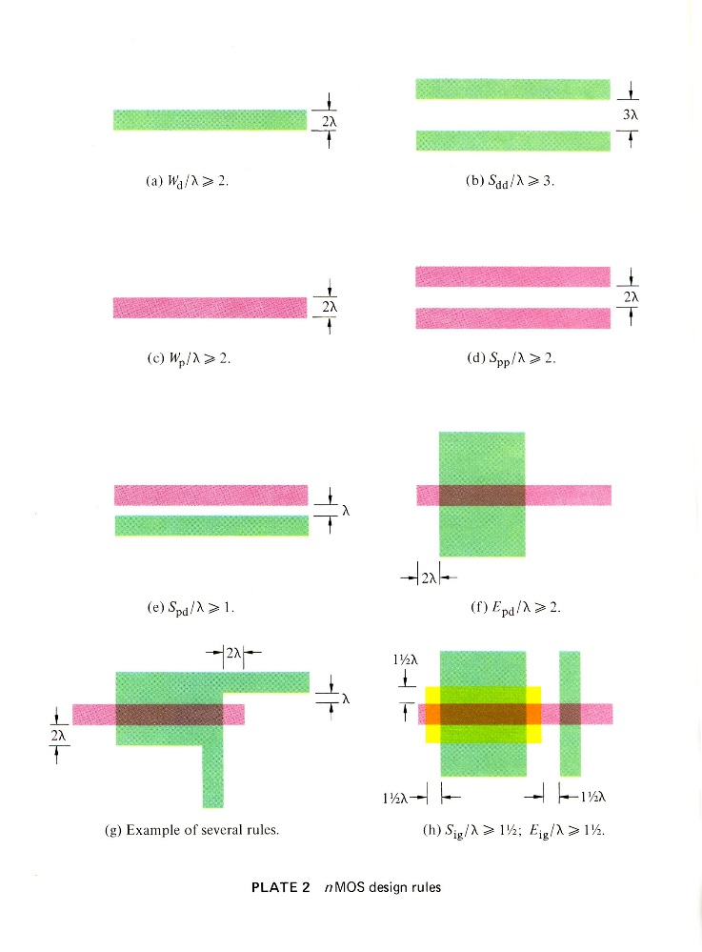
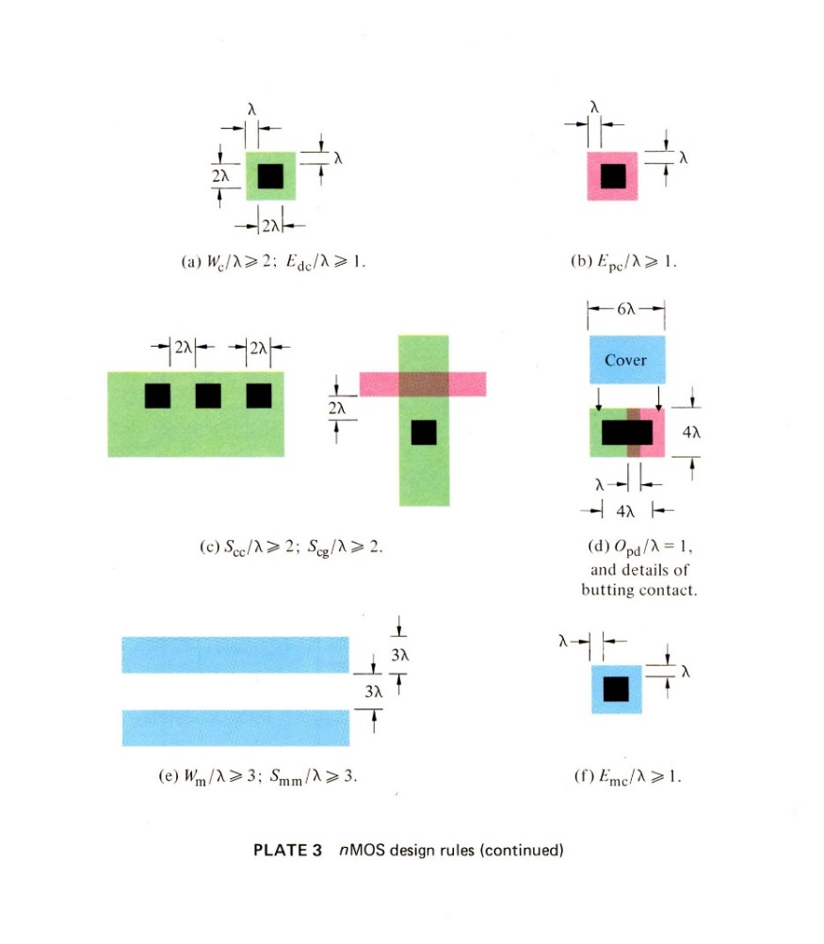
A sudden disruptive breakout was triggered by a cluster of abstract innovations by Lynn Conway at PARC . . .
Included in them was a set of scalable VLSI chip-layout digital design-rules, encoded as ratioed (i.e. dimensionless) inequality equations
These enabled digital chip designs to be numerically encoded, scaled, and reused as Moore’s law advanced . . .
They also enabled chip design modules to be scaled and open-source shared . . .
Link

Slide 17
The driving meta-architectural techno-social innovation:
As chip lithography scales-down according to Moore’s Law, and ever-more ever-faster transistors can be printed on individual chips as time passes, we visualize launching the following “techno-social scripted-process”:
STEP (i):
Use design tools on current computers to Design chip-sets for more powerful computers.
Print the more powerful chip-sets using foundries’ next-denser fabrication processes.
Use some of those chip-sets to Update current computer-design computers & design tools.
REPEAT (as STEP (i+1))
If ever-more engineers and design-tool builders did this (on an expanding number of increasingly powerful computers), the iterating techno-social expansion-process could exploratorily and innovatively-generate ever-more, ever-more-powerful, digital systems . . .
I.e., that techno-social process could exponentiate! (until Moore’s Law saturates . . . )

Slide 18
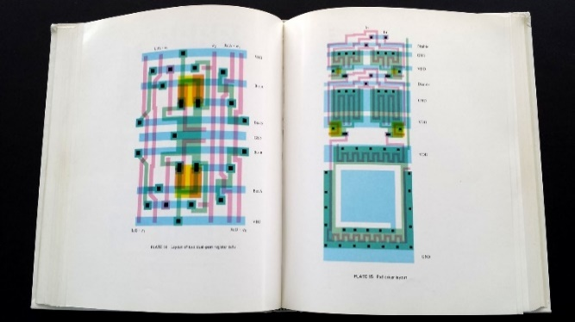
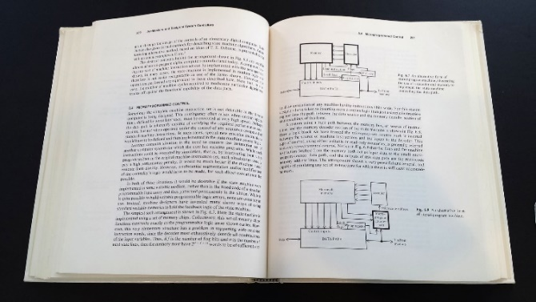
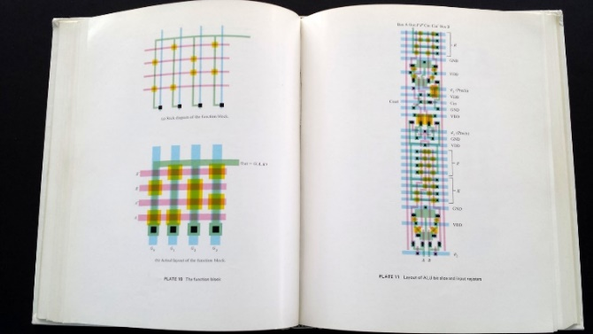
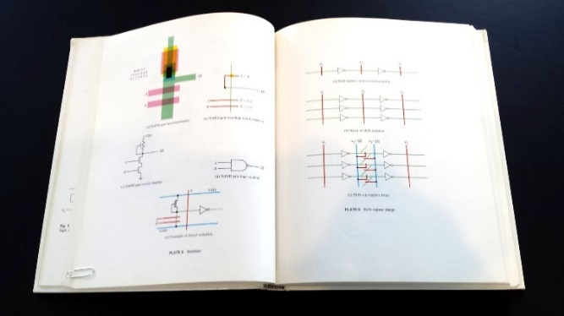
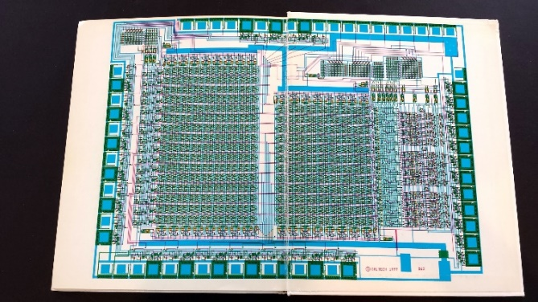
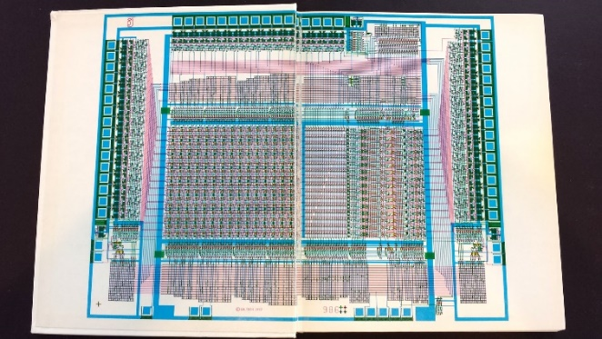
But there was a big problem: Where would all these engineers/programmers come from, and how would they learn to do all this?
In 1977, to help spread the ideas, I began documenting the innovative new
VLSI chip design methods in an evolving computer-edited textbook . . .
Link

Slide 19
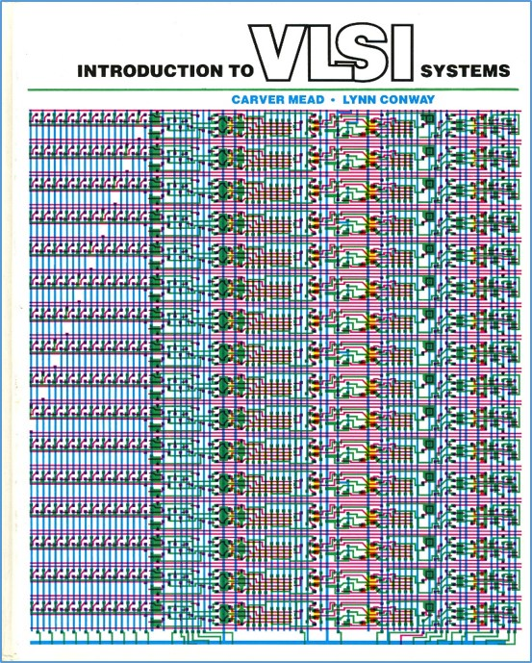
Using Alto computers not only to help mechanize the evolution of chip designs, but also to help mechanize the evolution of the design-knowledge itself . . .
The computer-edited evolving book, printed on PARC laser printers, became the draft of the seminal textbook . . .
Introduction to VLSI Systems
by Mead and Conway, 1980.
(later called “the book that
changed everything” . . . )

Slide 20
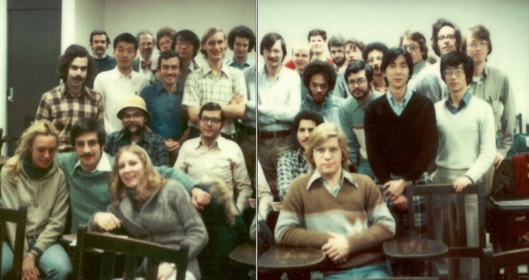
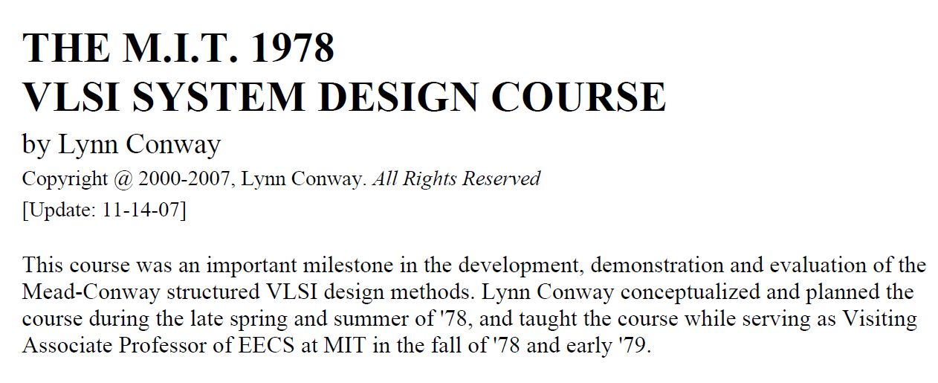
Following the ‘script’ Charles Steinmetz used to propagate his revolutionary AC electricity methods at Union College in 1912, I introduced the new chip design methods in a special VLSI design course at MIT in 1978.
Link
Link
Link

Slide 21
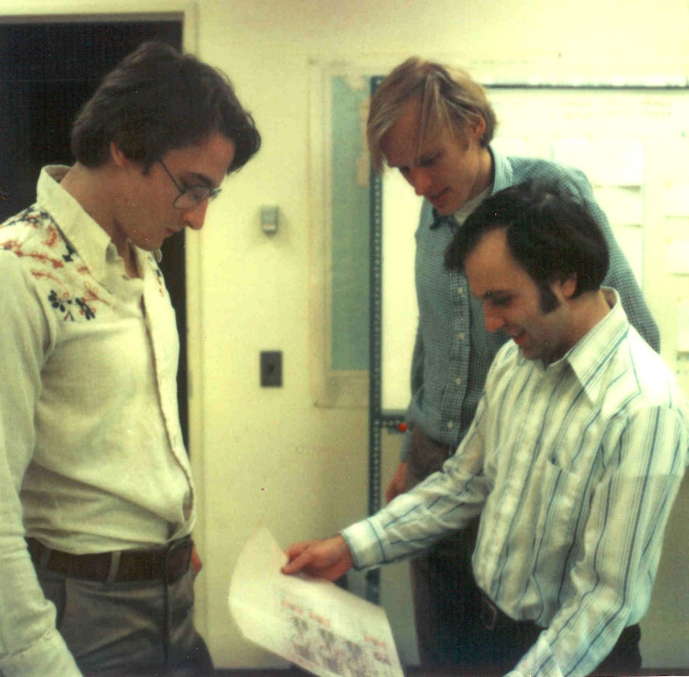
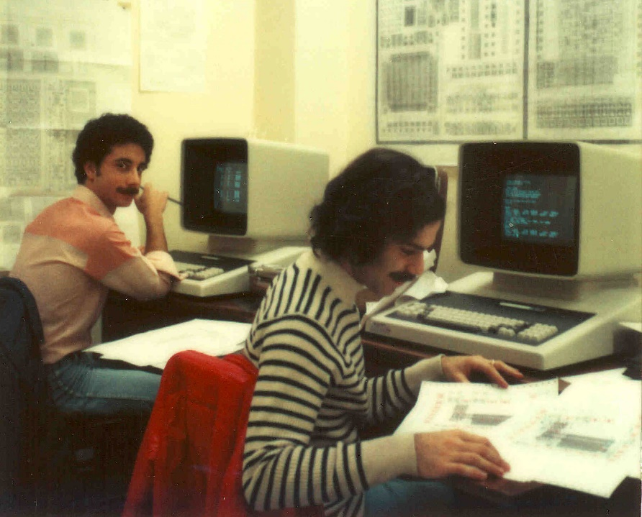
Students learned chip design in the
1st half course, and did project-chip designs in the 2nd half . . . which were fabricated at HP right after the course.
Among many amazing results was
a complete Lisp microprocessor designed by Guy Steele . . .

Slide 22
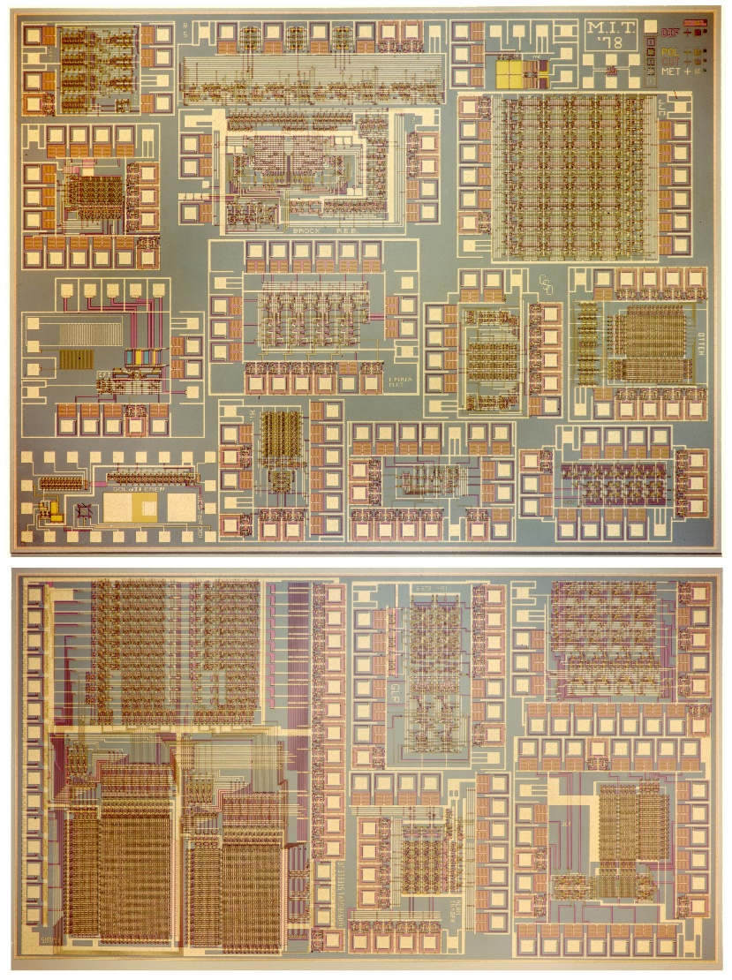
Map and photomicrograph
of the 19 student projects on
the MIT’78 ‘MultiProject’ Chip
For more about the MIT’78 course, see Lynn’s “MIT Reminiscences”

Slide 23
The MIT’78 course stunned various top folks across Silicon Valley . . .
Until then chip design had been mysterious, only grasped by a few computer engineers working for chip manufacturers . . thus having inside access to the “printing plants” . . .
Many other top research universities wanted to offer “MIT-like” courses. But how?
After intensive pondering, I grasped the answer: Rerun the MIT’78 course at a dozen research universities . . . using my MIT lecture notes to keep everything in sync.
But how to “print” all the student project chips?
I suddenly envisioned the idea of (what’s now called) an “e-commerce system” enabling student design files to be remotely submitted via the Arpanet to a “server” at PARC .
That server would run software to pack designs into multi-project chips (like composing the print-files for a magazine, using remotely-submitted articles) . . .
We’d then “print” the MPC’s again at HP Labs (where my colleague Pat Castro had prototyped the first “silicon foundry”), and quickly return the chips to students.

Slide 24
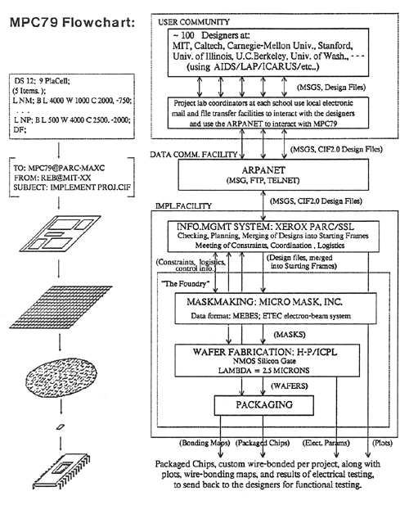
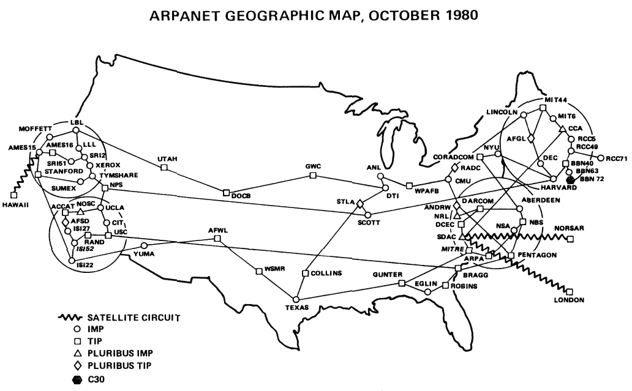
In the fall of 1979, I orchestrated a huge “happening” (MPC79)* . . . It involved 129 budding VLSI designers taking Mead-Conway courses at 12 research universities…
*The MPC Adventures: Experiences with the Generation of VLSI Design
and Implementation Methodologies, L. Conway, Xerox PARC, 1981 (PDF)

Slide 25
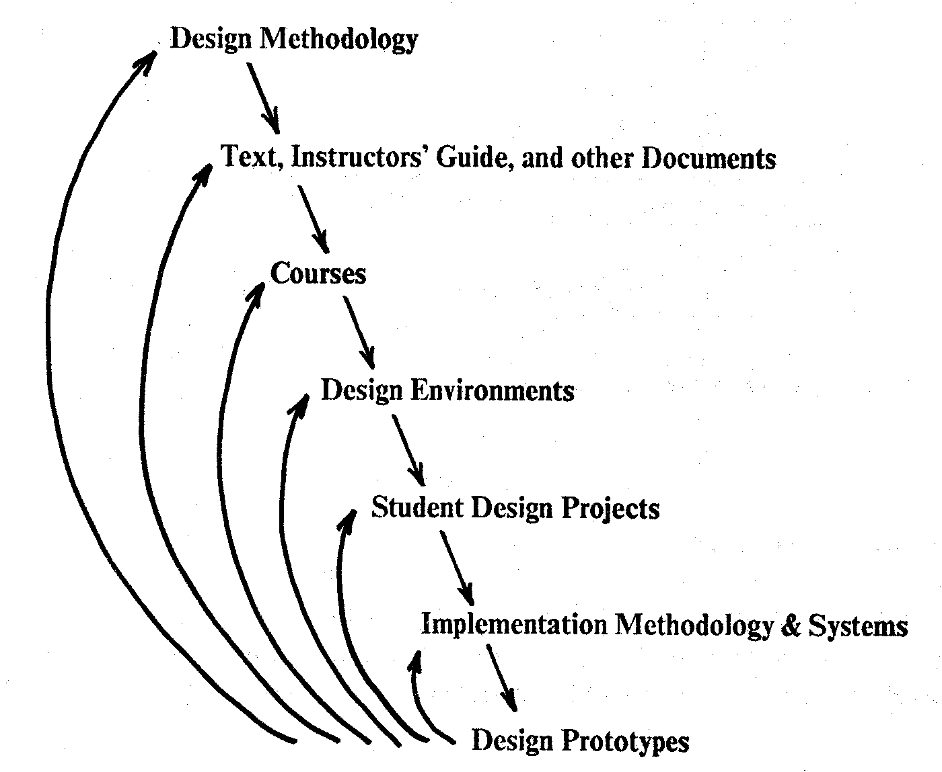
MPC79 provided a large-scale “demonstration-operation-validation” of the design methods, design courses, design tools and e-commerce digital-prototyping infrastructure . . .
It also triggered ‘cyclic gain’ in and exponentiation of the budding VLSI design techno-social ecosystem
By 1982-83, Mead-Conway VLSI design courses were
being offered at 113 universities all around the world
It was an early interactive experimental-exploration of emergent techno-social system-dynamics in an adventure in what’s now becoming known as “social physics”
Figure 8. The Joint Evolution of the Multi-Level Cluster
of (Techno-Social) Systems
From The MPC Adventures* (Lynn Conway, 1981, p. 16)

Slide 26
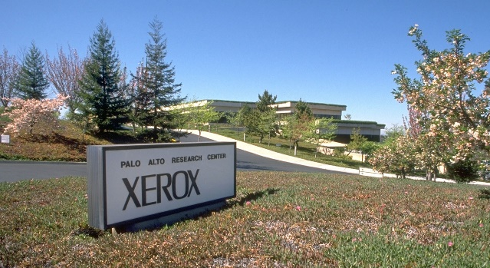
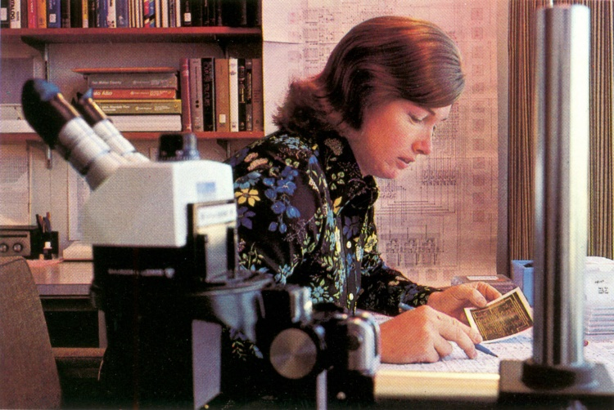
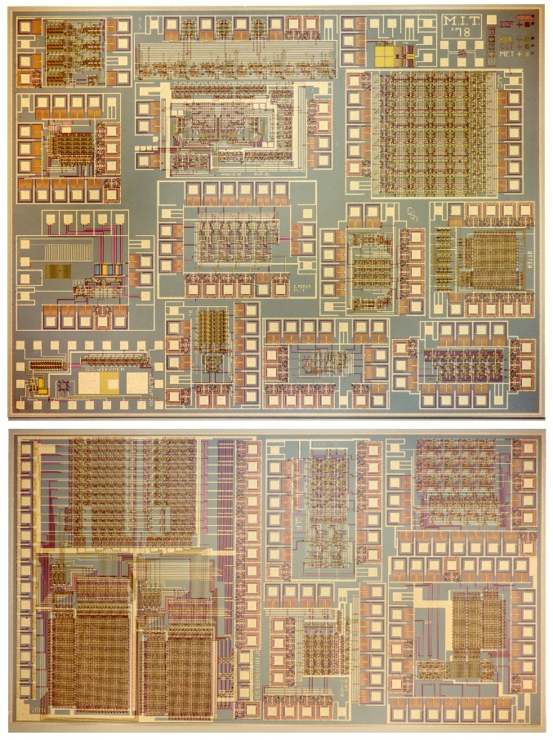
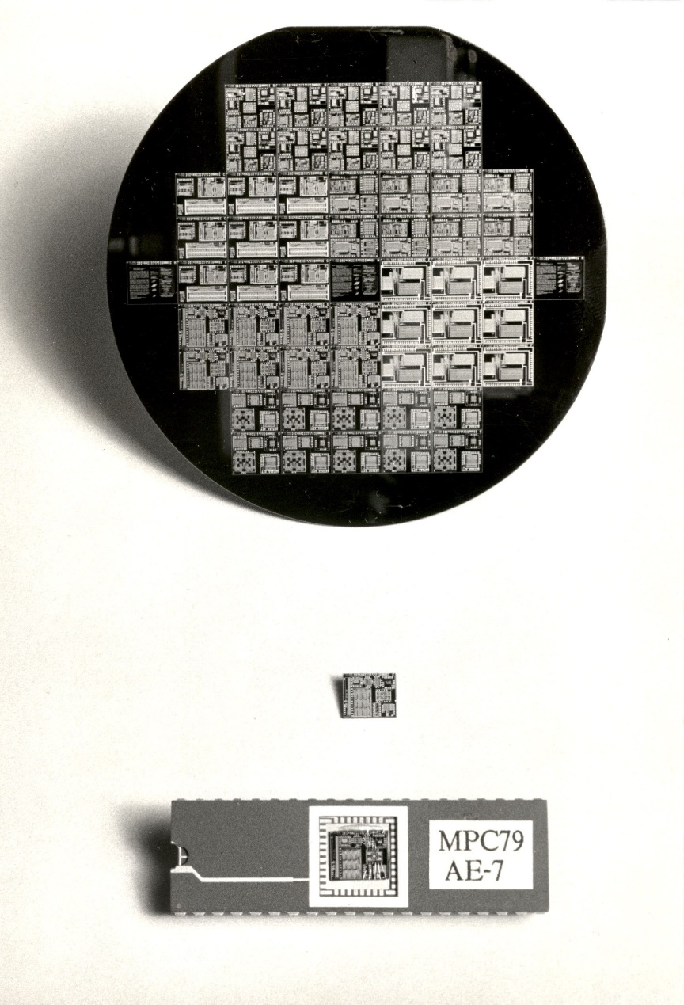
1976
1977
1978
1979
Visualizing the exponentiating
wave of VLSI innovation . . .
’76: How to cope with VLSI complexity?
’77: Inventing scalable VLSI design rules.
’78: Launching the VLSI methods at MIT!
’79: Launching the VLSI courses via MPC79!!

Slide 27
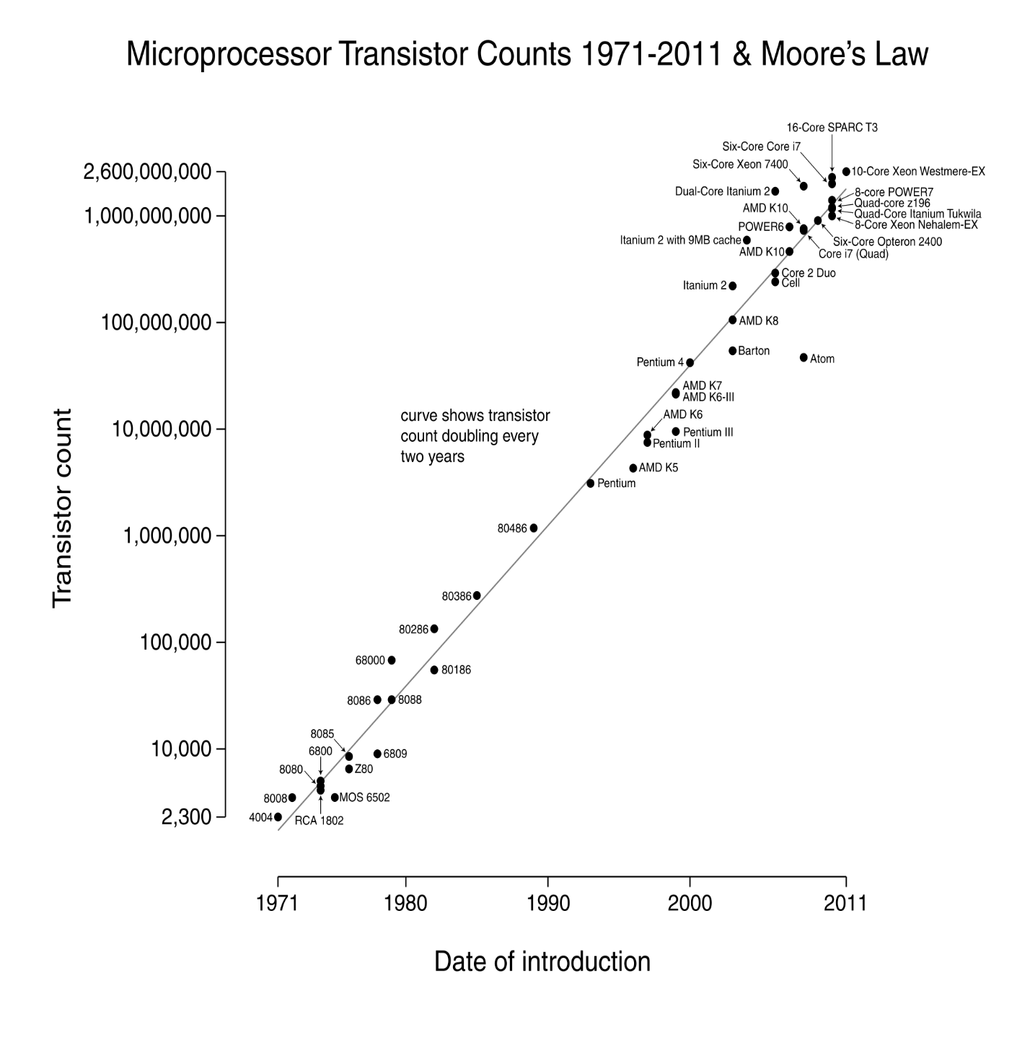
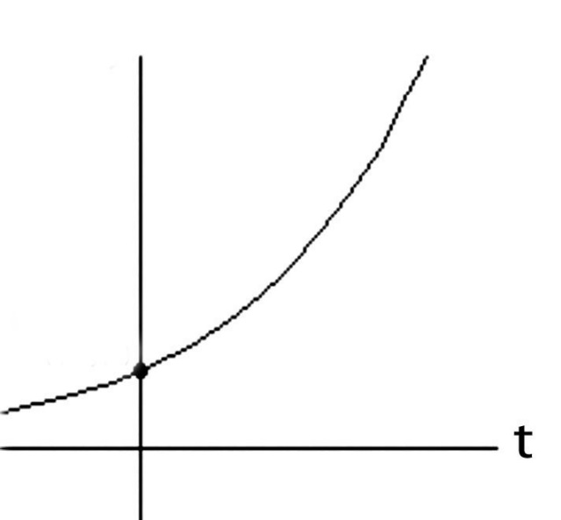
Over the past 40 years or so, Moore’s Law stayed on track all the way:
N
(exponential function
graphed on log scale)
(exponential function
with t in years)
N(t)/N(0) = 2^(t/2)
N(0), t(0)
Starting with several thousand in 1971, the number of transistors on
a chip passed one million by 1991, and passed several billion by 2011!

Slide 28
Exponentiation! Visualizing the compounding of techno-social-system “interest” . . .
Source

Slide 29
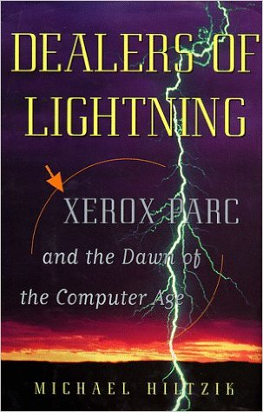
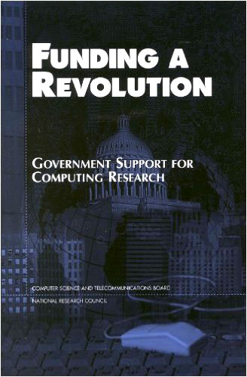
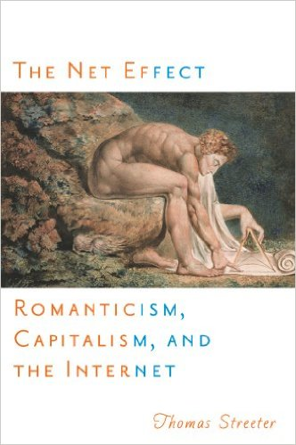
For more about PARC and the
amazing things done there, see
Michael Hiltzik’s Dealers of Lightning:
For insights into the role of
gov’t in VLSI’s emergence,
see this book from the NRC:
For a wider sociological perspective on the internet’s emergence, see Thomas Streeter’s The Net Effect

Slide 30
Let’s now go back and follow the high-tech community’s reactions
to the “Mead-Conway” innovations over the ensuing decades:
Link

Slide 31
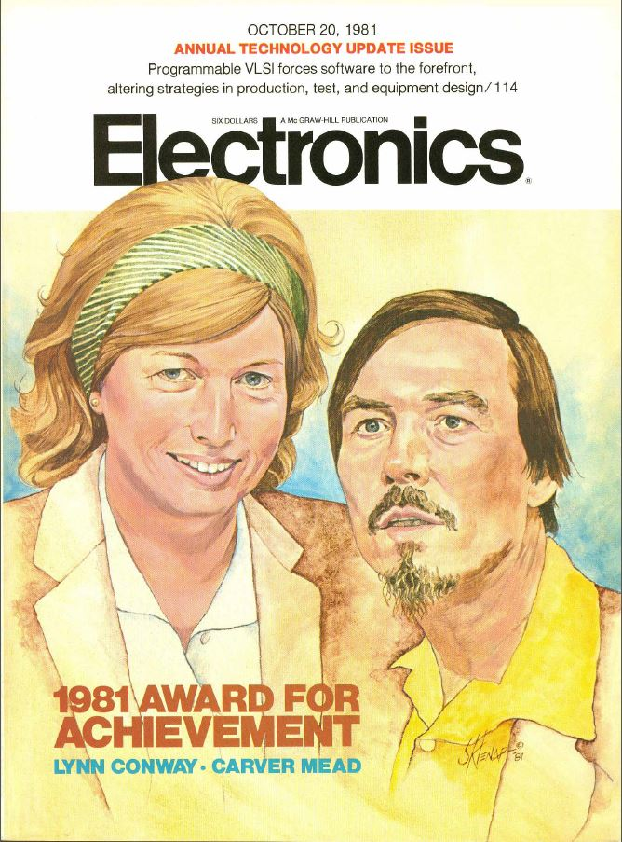
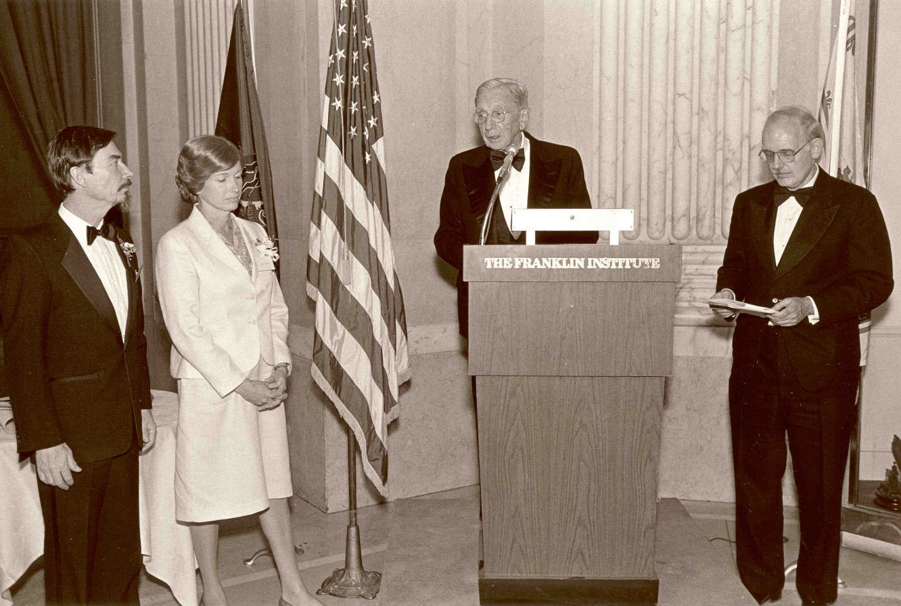
By ’81 key people sensed ‘something significant’
had happened, and Mead & Conway began
receiving major recognition during the 1980s:
Electronics Award for Achievement ‘81
Pender Award, Moore School ‘84
Wetherill Medal, Franklin Institute ’85
NAE, Mead ‘84
NAE, Conway ‘89. . .

Slide 32
However, from ‘89 on through the 00s, Mead received increasingly
major recognitions, while Conway’s role was erased*:
NAS ‘89
American Academy of Arts and Sciences ‘91
EDAC Phil Kaufman Award ‘96
IEEE John Von Neuman Medal ‘96
ACM Allen Newell Award ‘97
MIT Lemelson Award ‘99 ($500,000)
Fellow Award, Computer History Museum ‘02
National Medal of Technology ‘02
NAE Founders Award ‘03
Inventors Hall of Fame, at Computer History Museum Gala ‘09
*Most of these awards were for innovations that were solely Conway’s

Slide 33
As a result, by 2009 the erasure was complete:
Chip inventors getting their due at Hall of Fame induction
By Mike Cassidy, San Jose Mercury News
Apr. 30, 2009 --The 50th birthday celebration of the integrated circuit kicks off in Silicon Valley this weekend, and frankly, I'm a little overwhelmed . . .
On Saturday night, the National Inventors Hall of Fame is inducting this year's class. The sold-out ceremony (at the Computer History Museum) is in Silicon Valley for the first time, because the Ohio-based hall is honoring 15 who are responsible for breakthroughs in semiconductor technology -- the technology that put the "silicon" in Silicon Valley . . . In a way, it's as if the valley's founding fathers are coming together to be honored in person and posthumously. Inductees Gordon Moore, co-founder of Intel and namesake of Moore's Law, and Carver Mead, chip design pioneer and all-around brainiac, will be at the ceremony. So will lifetime achievement honoree Andy Grove, Intel's former CEO . . .

Slide 34
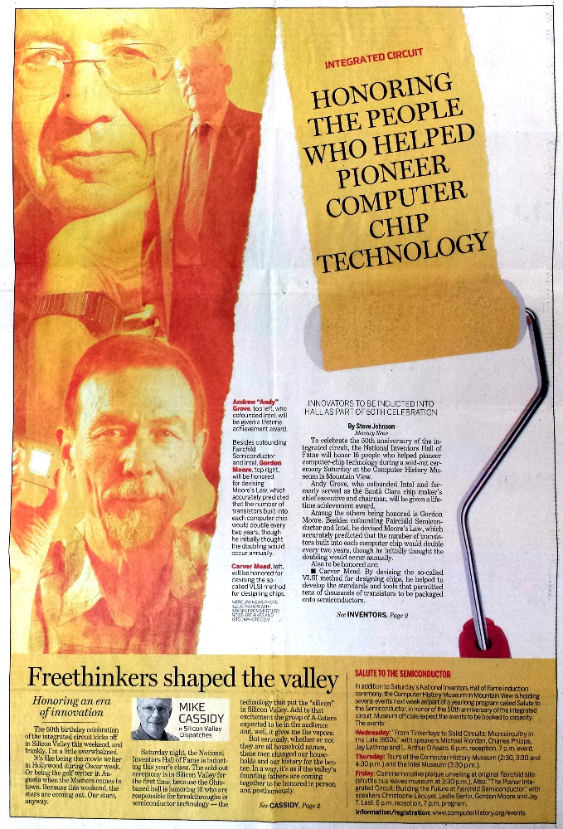
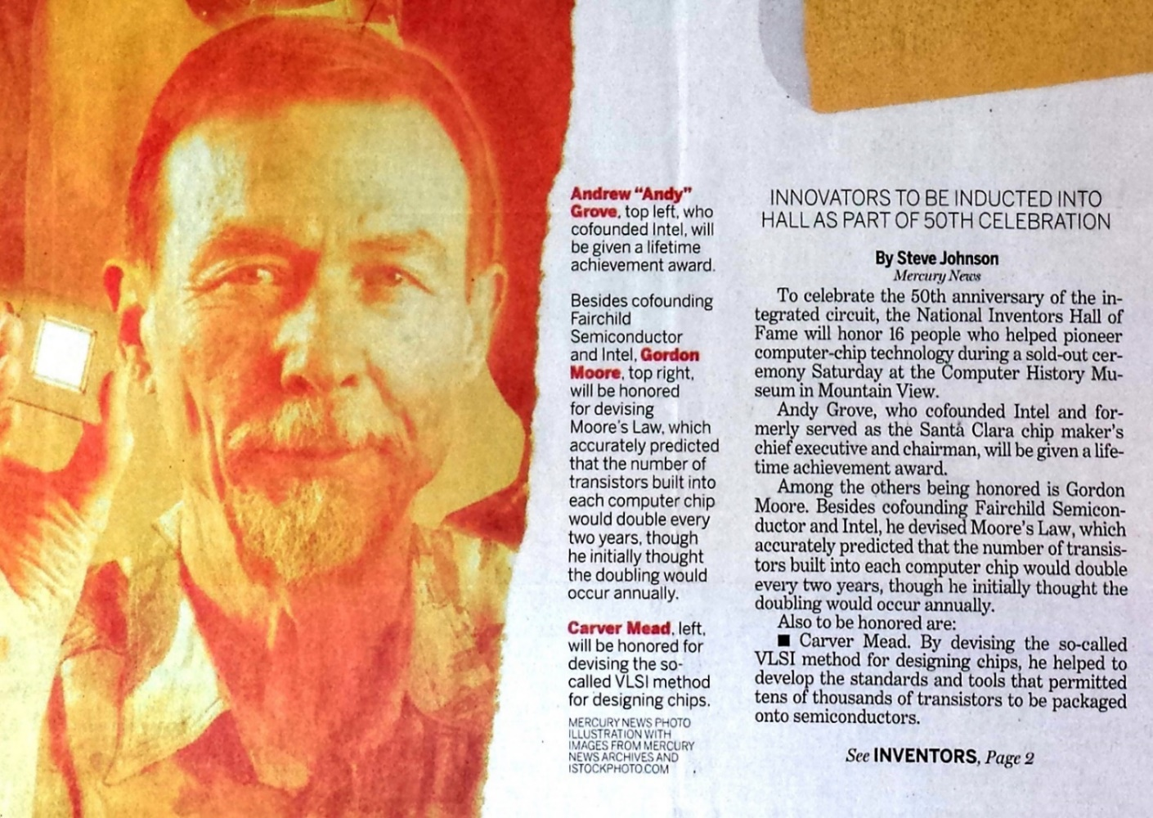
With Andy Grove, Gordon Moore and Carver Mead taking center stage:
San Jose Mercury News April 30, 2009
BTW, not only was Lynn Conway not invited, she didn’t even know it was happening!
Hmm. Reminds us of the Apple Macintosh story, eh?

Slide 35
My recent investigations into and reporting on what happened,
hoping to regain some of my legacy along the way . . .
Link

Slide 36
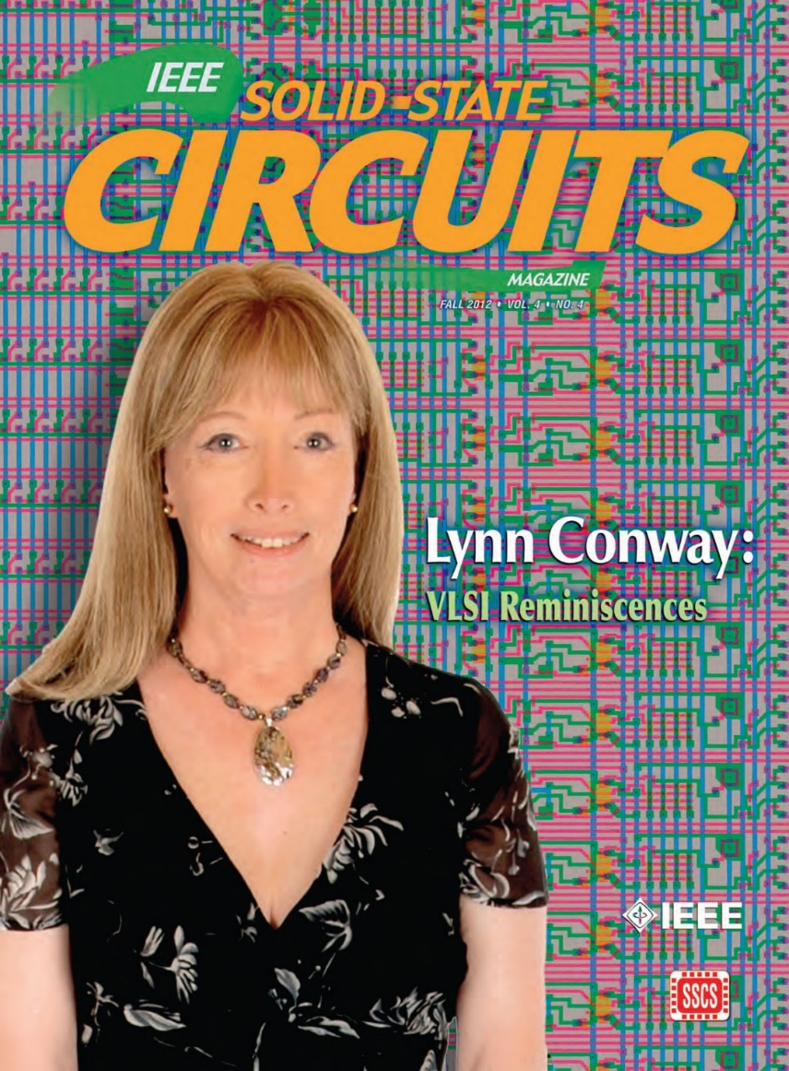
The story of my recent investigations is quite a saga, yet to be fully told . . .
But to make it short, along the way
I uncovered all sorts of fascinating
data and evidence.
And all that led me to write and publish my “Reminiscences of the VLSI Revolution” in the
Fall 2012 IEEE Solid State Circuits Magazine.
It was the first time in decades that
I’d stepped forward to tell the story . . .

Slide 37
Here are links regarding my investigation to understand
what happened and to reclaim my life-legacy:
Compilation of the VLSI Archive, 2009-2012
Publication of my IBM-ACS Reminiscences, 2011
Publication of my VLSI Reminiscences, 2012
Publication of The Many Shades of ‘Out’, 2013
Publication of my MIT Reminiscences, 2014
Here’s evidence that “the paradigm is shifting”:
Hall of Fellows, Computer History Museum, 2014
Honorary Doctorate, Illinois Institute of Technology, 2014
IEEE & Royal Society of Edinburgh, James Clerk Maxwell Medal, 2015
Honorary Doctorate, University of Victoria, Nov. 9, 2016

Slide 38
And now a Counter-Intuitive Explanatory-Conjecture for
the Mathew Effect, Matilda Effect and ‘Conway Effect’!
Link

Slide 39
Throughout this case-study we “appear to observe” the following effects:
(i) the “Matilda effect” (repression of women scientists’ contributions)
(ii) the "Matthew effect“ (eminent scientists get more credit)
These effects involve “self-fulfilling prophecies”, which Merton describes as:
“. . . a false definition of the situation evoking a new behavior which makes the original false conception come true. This specious validity of the self-fulfilling prophecy perpetuates a reign of error. For the prophet will cite the actual course of events as proof that he was right from the very beginning.”
But is that all that’s happening? Or are other, deeper forces in play?

Slide 40
On closer investigation, I realized that something far more subliminal and fundamental was happening at a social level . . . something that involves no errors, no conspiracies, no repressions and no ‘bad guys’:
CONJECTURE: Almost all people are blind to innovations, especially ones made by ‘others’ whom they do not expect to make innovations.
Since for most people, ‘others’ = ‘almost all people’, few people ever witness or visualize innovations, even ones made right in front of their eyes, even including some made by themselves!
Instead, when constructing internal-orientations towards ‘novelties’ they stumble upon, they look for cues by others . . . not just whether or not to accept or reject a novelty . . . but even whether to notice it in the first place!
From this perspective, the Mathew Effect and Matilda Effect are derivatives
of the conjectured “Conway Effect”, which covers ‘all outsiders’.
Link

Slide 41
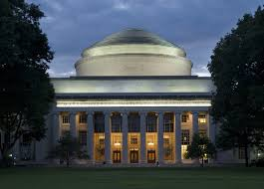
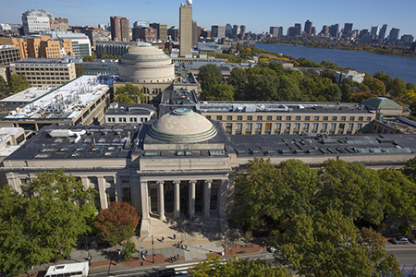
Visualizing the Conway Effect in action:
Most students in MIT’78 thought they were learning “how chips were designed in Silicon Valley” (the course was, in effect, a giant MIT hack!). They “did it” without realizing they were learning radical new methods.
The astonished reaction amongst Silicon Valley cognoscenti led to intense interest in reverse engineering “How MIT did this”, and many research universities immediately wanted to offer similar “MIT VLSI courses”.
The next year, the users of MPC79 took it for granted and just ‘used it’.
No one realized MPC79 was an even larger paradigm-shifting-hackathon
that launched the modern industrial system of “fabless design” + “silicon foundries” + “internet-based e-commerce infrastructure.”
By analogy with Doug Engelbart’s ‘68 “Mother of All Demos” that framed the emergence of PARC PC’s: MPC79 was “The Godmother of All Demos”

Slide 42
What might MPC79 participants been thinking?
Since MPC79 used the ARPANET, many thought DoD’s DARPA had “innovated it.”
When DARPA later funded the transfer of the MPC79 technology to USC’s Info. Sci. Inst.,
many high-tech’ers and future users thought “MOSIS” had been “innovated by DARPA”!
Government-sponsored MOSIS-like services even sprang up in other countries too!
Thus the VLSI revolution swept through the high-tech community without anyone realizing
it had been deliberately generated, much less how that was done, or who did it.
Although the VLSI Book by ‘Mead’ was iconically-connected with these large-scale
techno-social events, Mead himself was never able to explain what happened . . .
Meanwhile, Conway remained hidden in the shadows until 2012, when she finally
felt able to emerge and explain how it happened . . .

Slide 43
The Conway Effect: Almost all people are blind to innovations,
especially those made by folks they don’t expect to make innovations.
• Innovations diffuse via social-processes involving subliminal subgroup noticings,
mimickings, rejections, adoptions, adaptations, tradings and displacements
Meanwhile, credits for innovations as social tokens are separately
subliminally assigned, gained, granted, bartered, seized, etc . . .
• Crediting-processes are modulated by visibility, status, prestige, class, power,
location, credentials, prejudice, popularity, influence, money and accident . . .
The visibility of crediting (vs invisibility of innovations) thus sustains
the crediting-processes and the ongoing-blindness to innovations.
Corollary: It’s possible to trigger large paradigm-shifts right out in
the open, as long as people have no clue what you’re doing!
Distracted by Greed:
Link
Covert Visioneering!

Slide 44
Link
THE END
Moral Of The Story:
“When Weirdness breaks out, don’t get upset . . . Do Science On It!”
http://ai.eecs.umich.edu/people/conway/Memoirs/Talks/UNIT_2017/Inside_Story_Talk.pptx
http://ai.eecs.umich.edu/people/conway/Memoirs/Talks/UNIT_2017/Inside_Story_Talk.pdf
www.lynnconway.com ; conway@umich.edu

Slide 45
Q/A and Discussion:
Questions for you to ponder!
Have you noticed an innovation this week?
Have you made an innovation this week?
What is an innovation???
Meta: How to think abstractly about such things?
Gaining insights from the evolution of culture in animals . . .
Glimpses into Emerging Techno-Social Dynamical-Systems . . .

Slide 46
Thought Experiment!*
Visualizing the
diffusion of an ‘innovation’,
1921-1949
Mapping
an example
space-time diffusion process
t4
t3
t2
t1
John Tyler Bonner, The Evolution of Culture in Animals,
Princeton University Press, 1980, p.183-4.
*As unfolded by Lynn to mystified audiences decades ago
in her spirited keynotes at Spring Compcon ’83 and DAC ‘84.

Slide 47
Thought experiment!**
“The most remarkable of such examples comes from the work of the Japanese Monkey Center where macaques were isolated in groups on small islands, and differences in the behavior patterns of different island populations arose by cultural evolution . . .
The greatest achievement is that of Imo, the female genius among the macaques.
At the age of two she invented washing the sand off sweet potatoes before eating them, and at a later date she found a way of separating wheat from sand by throwing the mixture in the water and skimming off the wheat from the surface.
These discoveries spread slowly through the colony, although in general the older individuals were the last to acquire the new tricks.”***
***John Tyler Bonner, The Evolution of Culture in Animals,
Princeton University Press, 1980, p.184.
**As unfolded by Lynn to mystified audiences decades ago
in her spirited keynotes at Spring Compcon ’83 and DAC ‘84.
Source

Slide 48
Thought Experiment: Inside Rackspace's Headquarters (video of “The Castle”)
Just imagine what’s going on inside “1 Fanatical Place, Windcrest, TX”,
and similar high-technology exploration-grounds all around the world!

Slide 49
For glimpses into Techno-Social Systems in the emerging Social Age see:
http://ai.eecs.umich.edu/people/conway/Memoirs/Talks/UVIC/Techno_Social_Talk.pptx
http://ai.eecs.umich.edu/people/conway/Memoirs/Talks/UVIC/Techno_Social_Talk.pdf

Slide 50
Readings:
Ken Shepard, “Covering”: How We Missed the Inside-Story of the VLSI Revolution”, IEEE Solid State Circuits Magazine, FALL 2012, pp. 40-42. (more)
Chuck House, “A Paradigm Shift Was Happening All Around Us”, IEEE Solid State Circuits Magazine, FALL 2012, pp. 32-35. (more)
Lynn Conway, “Reminiscences of the VLSI Revolution: How a series of failures triggered a paradigm shift in digital design”, IEEE Solid State Circuits Magazine, FALL 2012, p. 8-31. (more)
Lynn Conway, “The Many Shades of Out”, Huffington Post, July 24, 2013.
Paul Penfield, "The VLSI Revolution at MIT", 2014 MIT EECS Connector, Spring 2014, pp. 11-13.
Lynn Conway, "MIT Reminiscences: Student years to VLSI revolution", lynnconway.com, March 11, 2014.
Computer History Museum: “Lynn Conway, 2014 Fellow, For her work in developing and disseminating new methods of integrated circuit design”, April 2014.
Nicole Casal Moore, “Life, Engineered: How Lynn Conway reinvented her world and ours”, The Michigan Engineer, FALL 2014, pp. 42-49.
Catharine June, “Lynn Conway to receive 2015 IEEE/RSE James Clerk Maxwell Medal”, Michigan Engineering News, December, 15, 2014.
IEEE and the Royal Society of Edinburgh, “James Clerk Maxwell Medal ceremony at the Royal Society of Edinburgh”, YouTube, Nov. 12, 2015.
IEEE/RSE Maxwell Medal Presentation at the Royal Society of Edinburgh: Citation by Barry Shoop, President-Elect of the IEEE, Nov. 12, 2015.
Magnus Linklater, “‘Life in stealth’ of microchip genius who migrated to a new identity: Lynn Conway beat transgender bias and began a revolution”, The Times (UK), Nov. 14, 2015.
University of Victoria, “Professor Lynn Conway’s Citation for the Degree Doctor of Engineering, Honoris Causa, Univ. of Victoria”, Nov 9, 2016.

