Slide 1
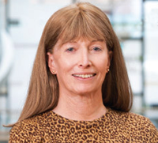
Back to the Future:
“If you want to change the future, start living as if you’re already there” – Lynn Conway
TECH
TALK
The Exploration of the Microworld
Has Only Just Begun!
’14

