Slide 1
Other Slides

Slide 2
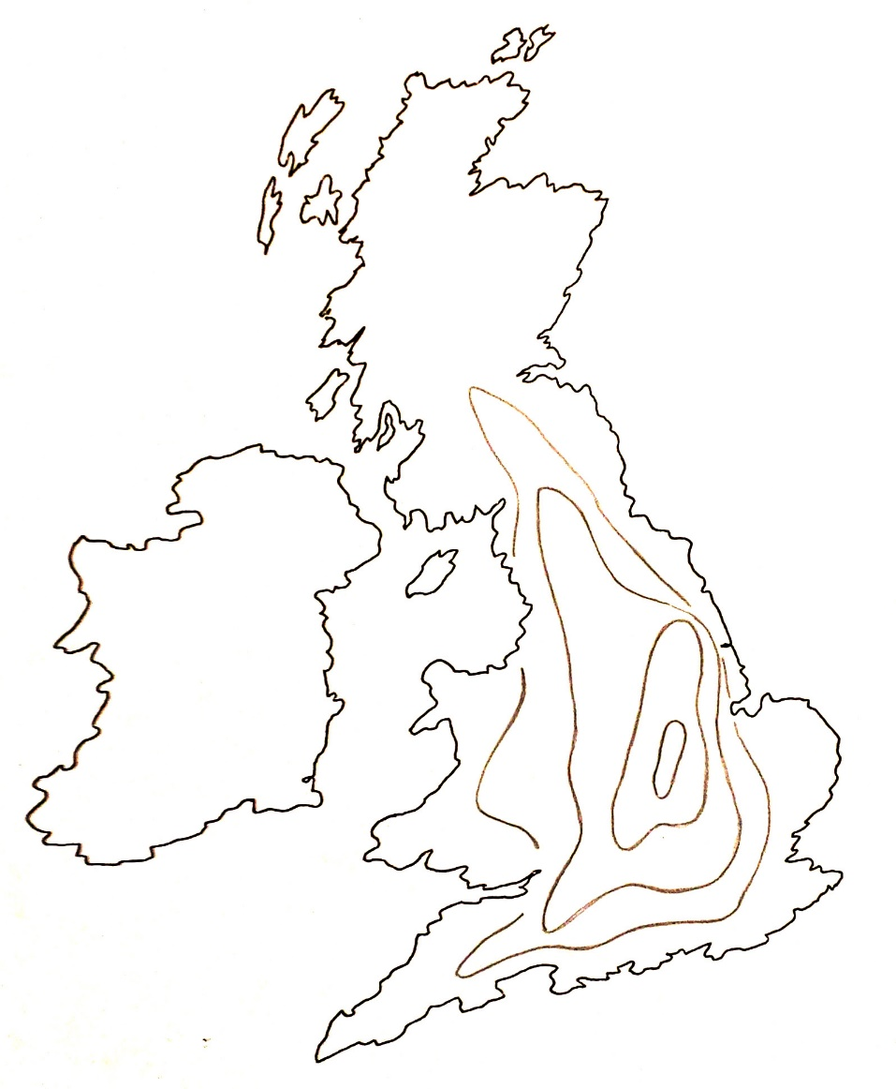
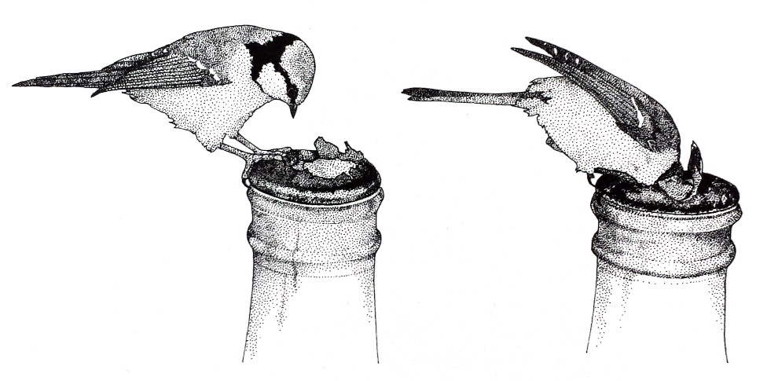
Thought Experiment!*
Visualizing the
diffusion of an ‘innovation’,
1921-1949
Mapping
an example
space-time diffusion process
t4
t3
t2
t1
John Tyler Bonner, The Evolution of Culture in Animals,
Princeton University Press, 1980, p.183-4.
*As unfolded by Lynn to mystified audiences decades ago
in her spirited keynotes at Spring Compcon ’83 and DAC ‘84.

Slide 3
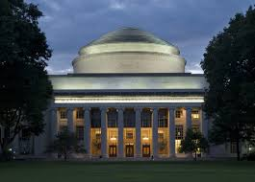
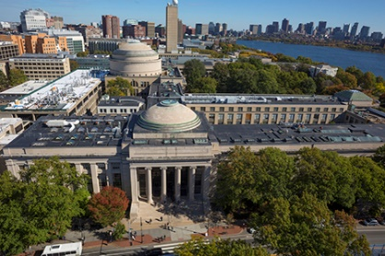
Visualizing the Conway Effect in action:
Most students in MIT’78 thought they were learning “how chips were designed in
Silicon Valley” (the course was, in effect, a giant MIT hack!). They “did it” without
realizing they were learning radical new methods.
The astonished reaction amongst Silicon Valley cognoscenti led to intense interest in reverse engineering “How MIT did this”, and many research universities immediately wanted to offer similar “MIT VLSI courses”.
The next year, the MPC79 chip designers took it for granted and just ‘used it’.
No one realized it was an even larger paradigm-shifting-hackathon that launched the
modern microchip “fabless design”+“silicon foundries”+“e-commerce” infrastructure.
By ‘hiding in plain sight’, MPC79 had ‘disappeared’ from view as an innovation!

Slide 4
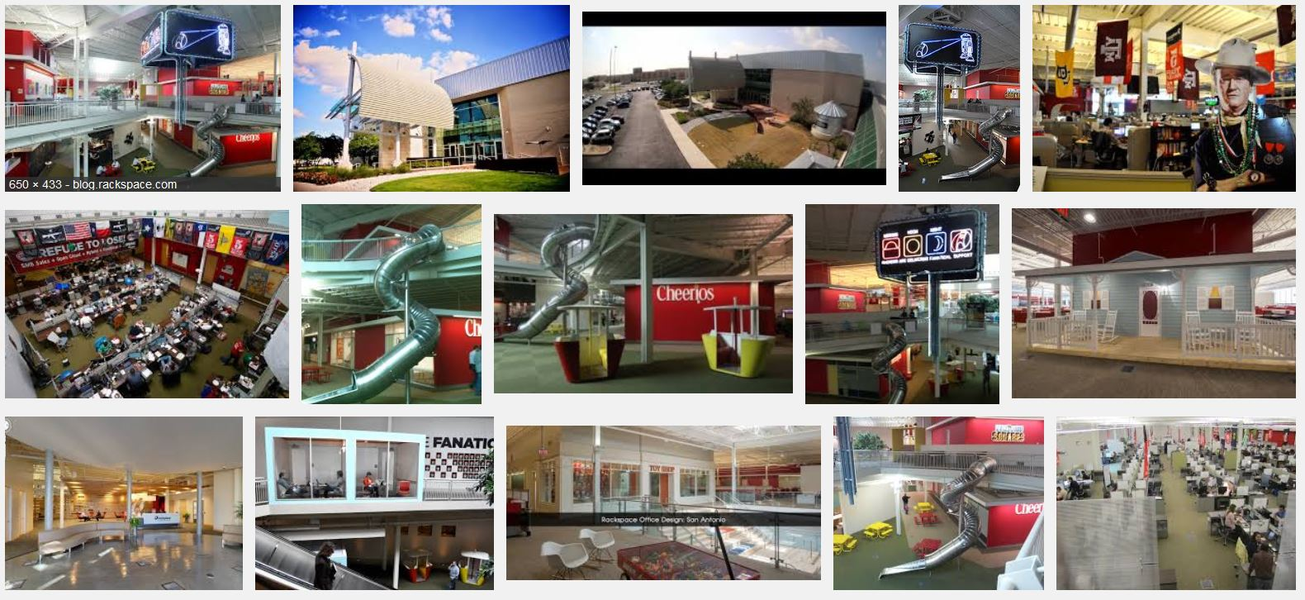
Thought Experiment: Inside Rackspace's Headquarters (video of “The Castle”)
Just imagine what’s going on inside “1 Fanatical Place, Windcrest, TX”,
and similar high-technology exploration-grounds all around the world!

Slide 5
Thought Experiment: Inside Rackspace's Headquarters (video of “The Castle”)
Just imagine what’s going on inside “1 Fanatical Place, Windcrest, TX”,
and similar high-technology exploration-grounds all around the world!

Slide 6
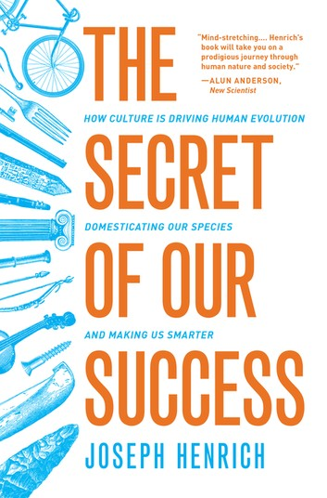
Q/A and Discussion:
Questions for you to ponder!
Have you noticed an innovation this week?
Have you made an innovation this week?
What is an innovation???
How to think about such things?
Gain insights from the evolution of culture in animals.
Visualize emerging techno-social dynamical-systems . . .
Joseph Henrich, 2015

Slide 7
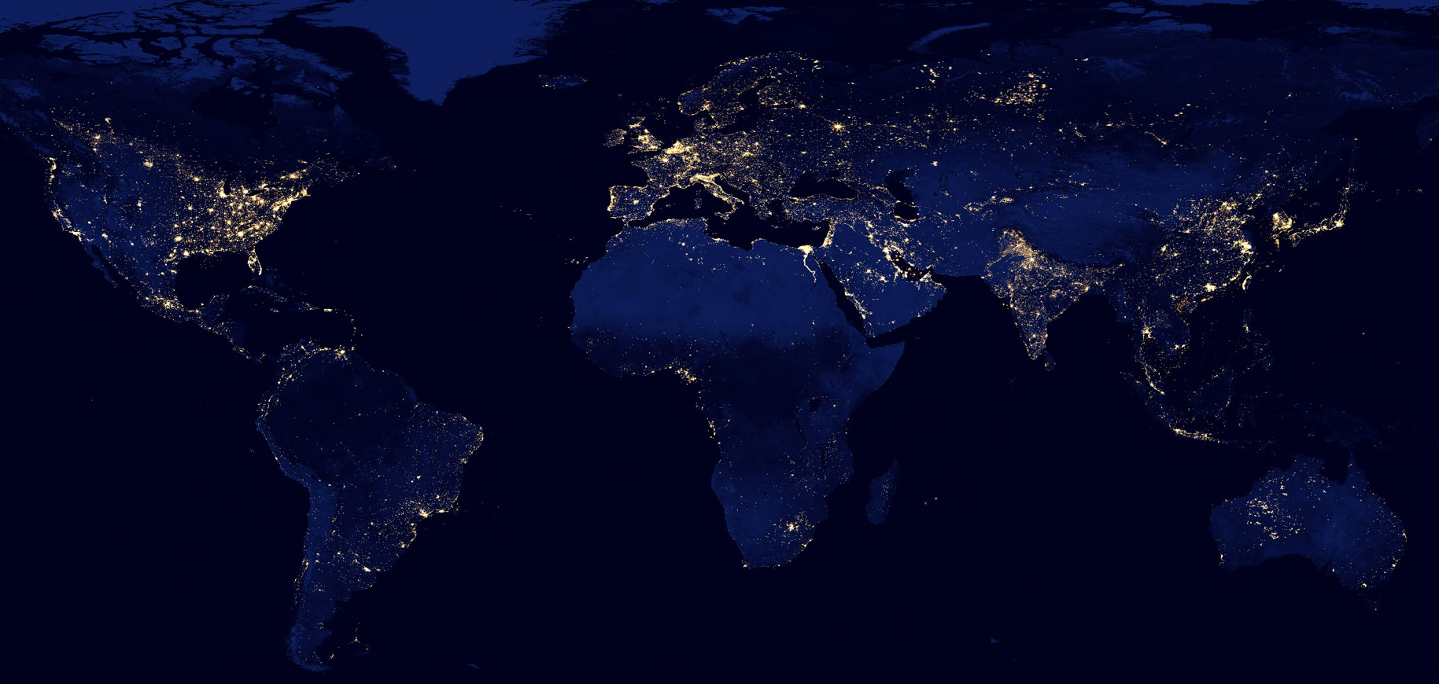
Now imagine what’s going on out there . . . all around the world . . .
as our internet connects ever-more-people and chip-empowered-things:
Setting the stage for what comes next . . .
NASA: Earth from space at night

