Slide 1

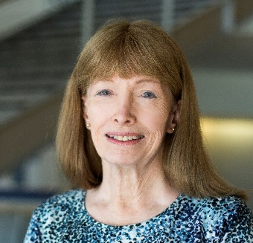
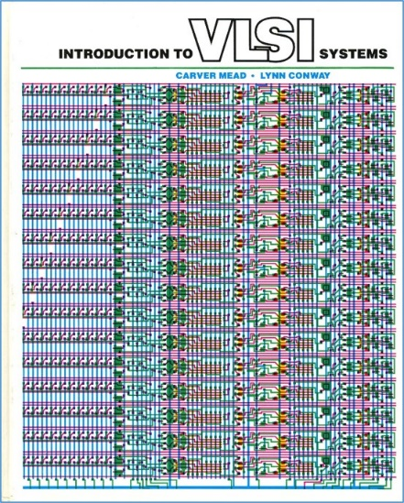

An Invisible Woman: The Inside Story Behind the Microelectronic Computing Revolution in Silicon Valley^{1,2}
Lynn Conway, Professor of EECS Emerita, University of Michigan, Ann Arbor
University Lecture, Hendricks Chapel, Syracuse University, Syracuse, NY.
Tuesday, March 26, 7:30 p.m.
In 2015, US CTO Megan Smith raised profound questions about women’s contributions in science, engineering and math being erased from history.
In this talk we explore a case study of such erasure, and surface a very
counter-intuitive conjecture about the underlying causes and effects.
1. In remembrance of pioneering novelist Ralph Ellison, author of Invisible Man, 1952.
2. http://ai.eecs.umich.edu/people/conway/Memoirs/Talks/Syracuse_2019/Inside_Story_Talk.pptx & .pdf

Slide 2
Framing the Story:
Reflections on the 2013 White House LGBT Pride Month Reception.
Visualizing Erasures of Women’s Contributions in STEM:
Past US-CTO Megan Smith Describes the Phenomenon (VIDEO)
Example Case Study of Erasure:
The ‘Inside Story’ Behind the VLSI Microchip Revolution
Introducing an Explanatory Conjecture:
It’s because of “The Conway Effect”!
Q/A and Discussion:
Including Thought-Experiments re the ‘Propagation of Innovations’

Slide 3
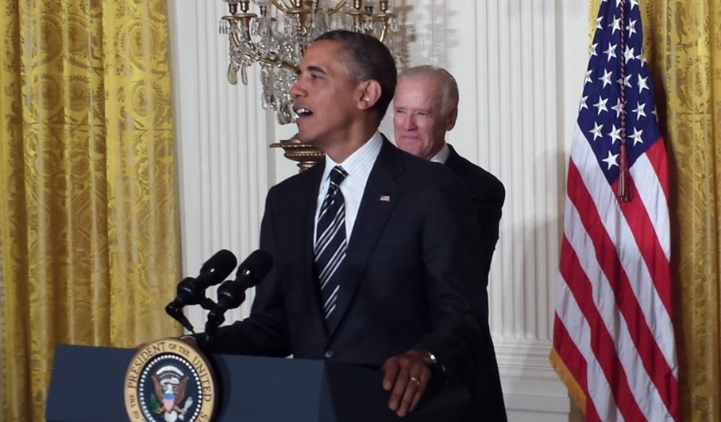
The Many Shades of ‘Out’, by Lynn Conway
Lynn reflects on the 2013 White House LGBT Pride Month Reception . . .
http://www.huffingtonpost.com/lynn-conway/the-many-shades-of-out_b_3591764.html

Slide 4
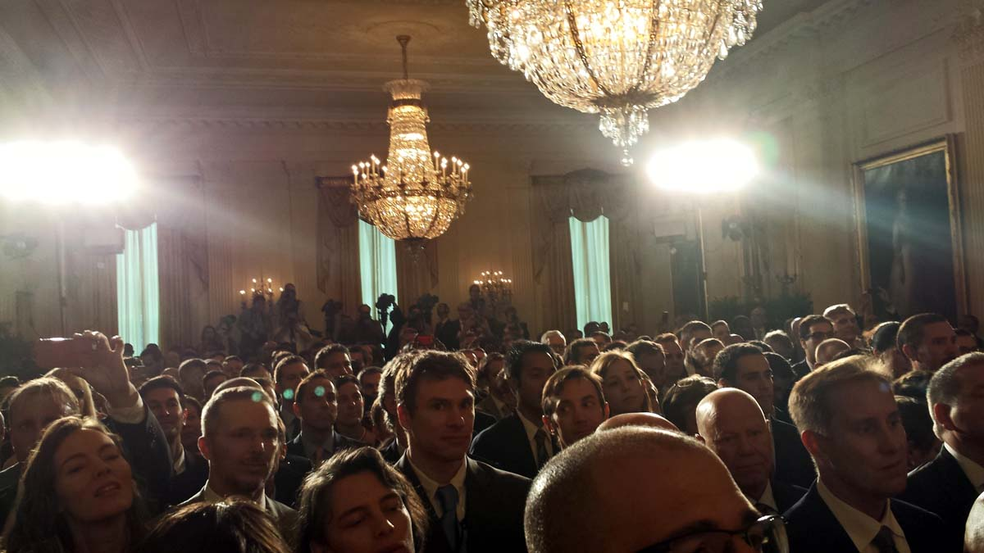
Listen . . . and imagine that you are there in the White House audience with Lynn . . .

Slide 5

With that as backdrop, let’s now examine
history’s treatment of women’s contributions in STEM
Link

Slide 6
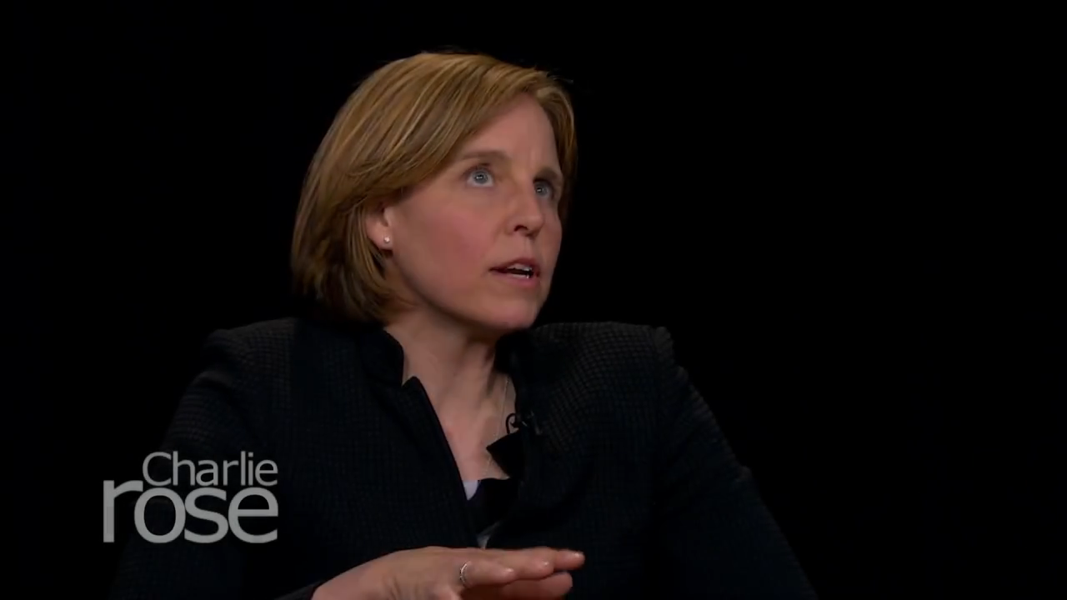
First, listen as former U. S. Chief Technology Officer
Megan Smith reveals how women in STEM are erased from history . . .
http://www.youtube.com/watch?v=fHyRdAyqV5c&t=0m1s
http://boingboing.net/2015/05/08/cto-megan-smith-explains-how-w.html

Slide 7
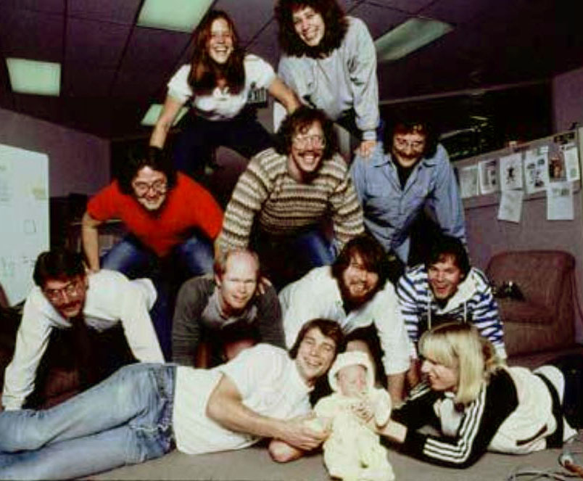
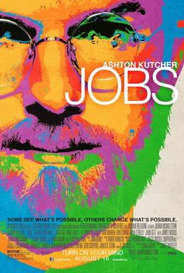
There were four women on the Macintosh team in the 1980s, but not a single one was cast in the 2013 biopic Jobs. Even worse, all seven men on the project had speaking roles in the film.
It’s not just harder for women to break into STEM fields, but the many contributions they do make aren’t celebrated. “It's debilitating to our young women to have their history almost erased,” Smith explains.

Slide 8
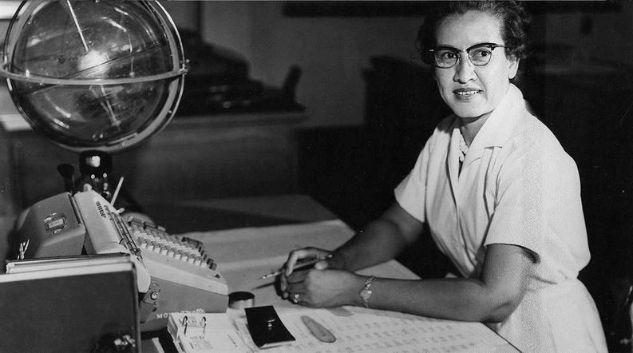
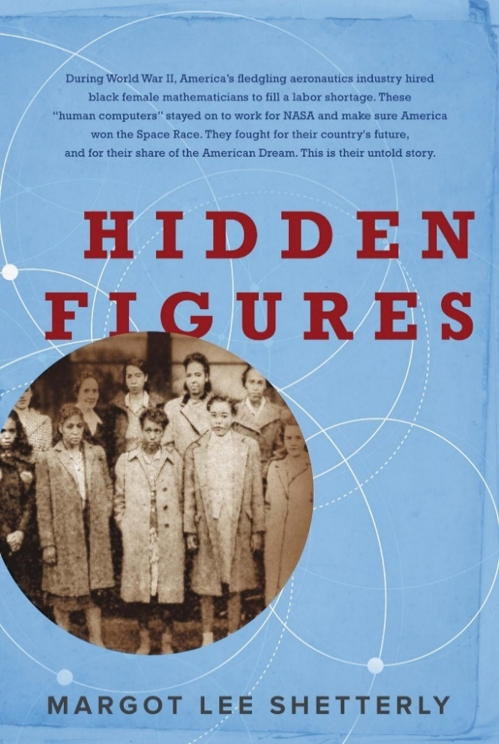
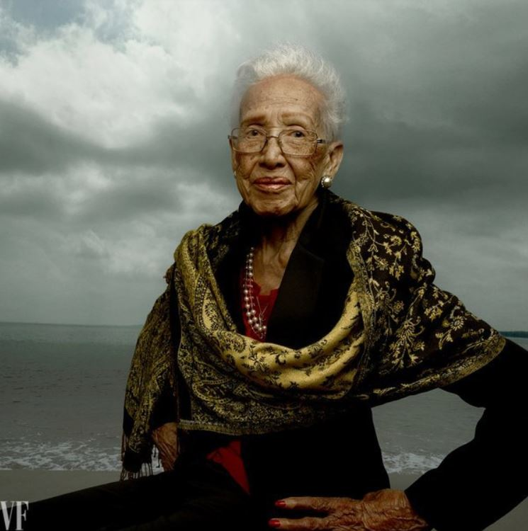
For more about Katherine Johnson, the NASA mathematician whose
story was discussed by Megan Smith, see the 2016 book and movie:
Katherine Johnson at her NASA Langley desk, 1960
Hidden Figures: The Story of the African-American Women Who Helped Win the Space Race, Margot Lee Shetterly (2016)
Katherine Johnson, age 98 Photo by Annie Leibovitz for Vanity Fair, 2016
Fortunately, she’s lived long-enough to see her story told!

Slide 9
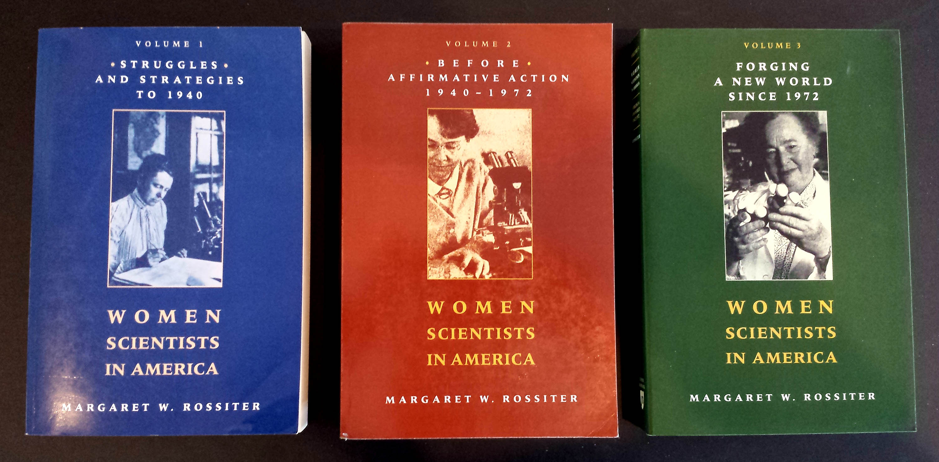
The effect is seen throughout the history of women in science, as discussed by
science historian Margaret Rossiter in Women Scientists in America (V 1-3):

Slide 10
Margaret Rossiter coined the term “Matilda effect” in 1993 for the systemic repression and denial of contributions of women scientists, whose work is often attributed to male colleagues.
This is similar to the term "Matthew effect“, coined by sociologist Robert Merton in 1968, which describes how eminent scientists get more credit than lesser-known researchers, even if their work is similar.
For example: a prize will usually awarded to the most senior researcher in a project, even if a grad student did all the work.

