Slide 1
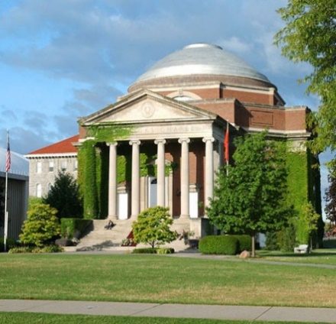
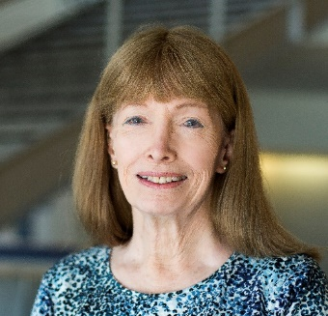
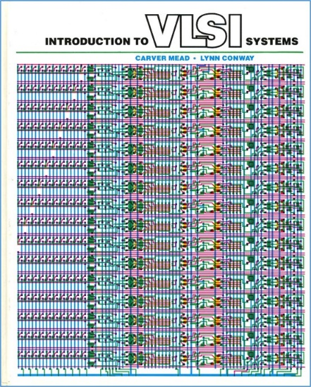
An Invisible Woman: The Inside Story Behind the Microelectronic Computing Revolution in Silicon Valley^{1,2}
Lynn Conway, Professor of EECS Emerita, University of Michigan, Ann Arbor
University Lecture, Hendricks Chapel, Syracuse University, Syracuse, NY.
Tuesday, March 26, 7:30 p.m.
In 2015, US CTO Megan Smith raised profound questions about women’s contributions in science, engineering and math being erased from history.
In this talk we explore a case study of such erasure, and surface a very
counter-intuitive conjecture about the underlying causes and effects.
1. In remembrance of pioneering novelist Ralph Ellison, author of Invisible Man, 1952.
2. http://ai.eecs.umich.edu/people/conway/Memoirs/Talks/Syracuse_2019/Inside_Story_Talk.pptx & .pdf

Slide 2
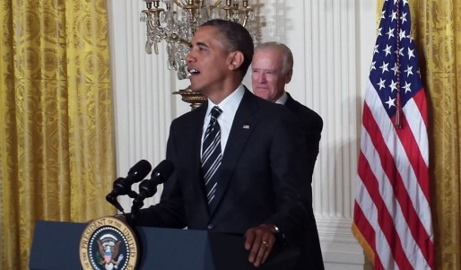
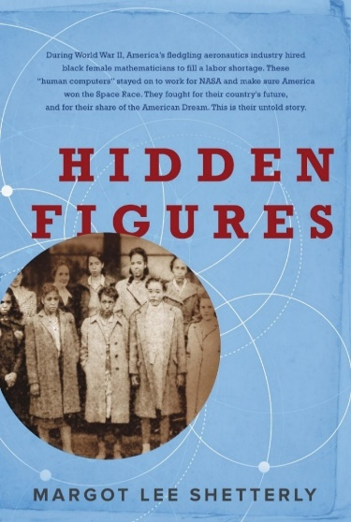
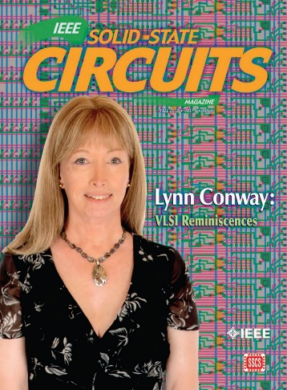
Lecture Overview:
1. Framing the Story
2013 White House LGBT Pride Month Reception
3. Investigate an Example Erasure
The ‘Inside Story’ of the VLSI Microchip Revolution
2. Visualize Past Erasures of Women’s STEM Contributions
4. Explanatory Conjecture:
It’s “The Conway Effect”!
5. Q/A & Discussion

Slide 3
The Many Shades of ‘Out’, by Lynn Conway*
Lynn reflects on the 2013 White House LGBT Pride Month Reception . . .
*See Appendix and this link: http://www.huffingtonpost.com/lynn-conway/the-many-shades-of-out_b_3591764.html

Slide 4
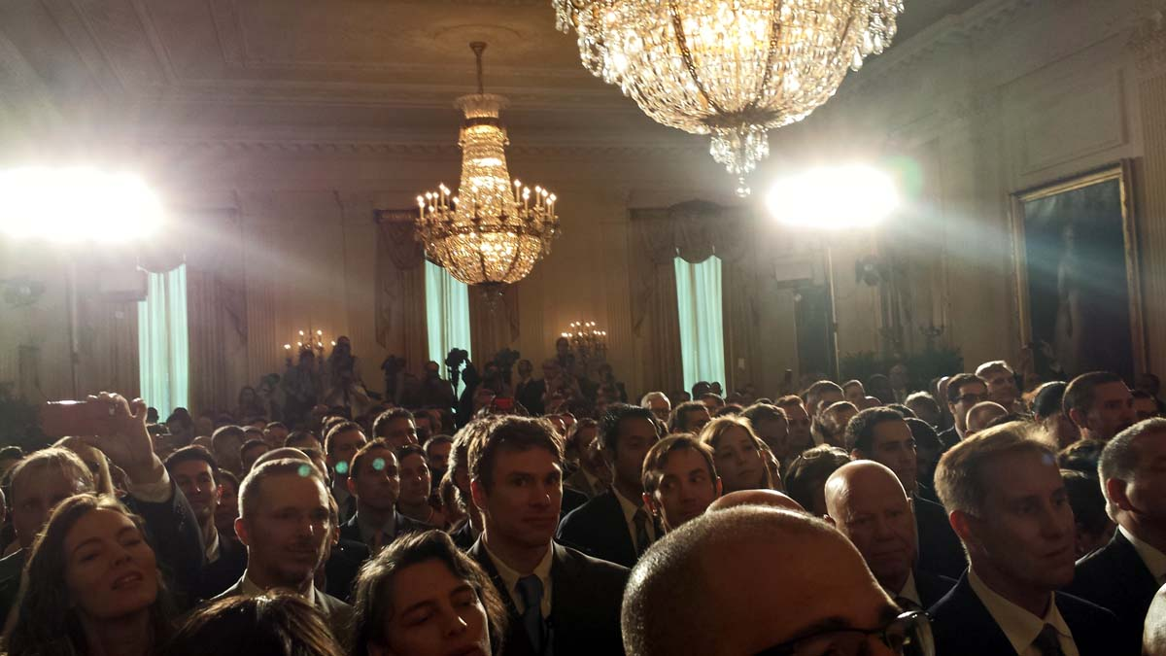
Listen . . . and imagine that you are there in the White House audience with Lynn . . .

Slide 5
With that as backdrop, let’s now examine
history’s treatment of women’s contributions in STEM
Link

Slide 6
First, listen as former U. S. Chief Technology Officer
Megan Smith reveals how women in STEM are erased from history . . .
http://www.youtube.com/watch?v=fHyRdAyqV5c&t=0m1s
http://boingboing.net/2015/05/08/cto-megan-smith-explains-how-w.html

Slide 7
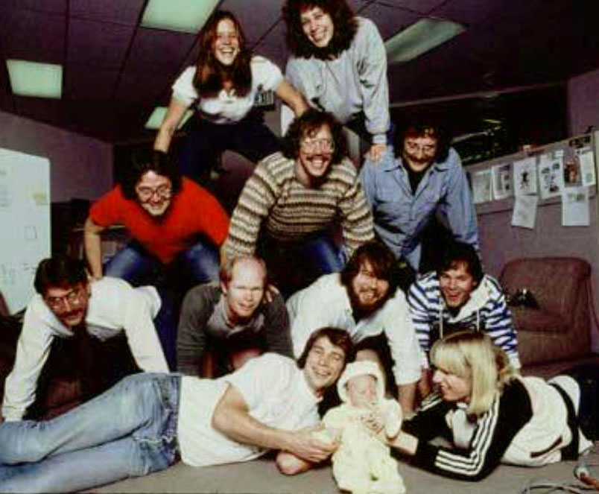
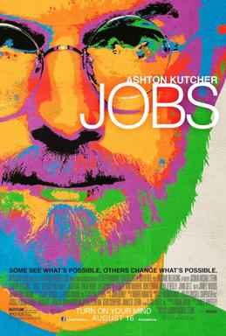
There were four women on the Macintosh team in the 1980s, but not a single one was cast in the 2013 biopic Jobs. Even worse, all seven men on the project had speaking roles in the film.
It’s not just harder for women to break into STEM fields, but the many contributions they do make aren’t celebrated. “It's debilitating to our young women to have their history almost erased,” Smith explains.

Slide 8
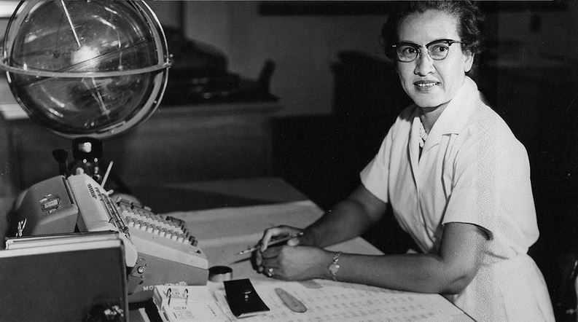
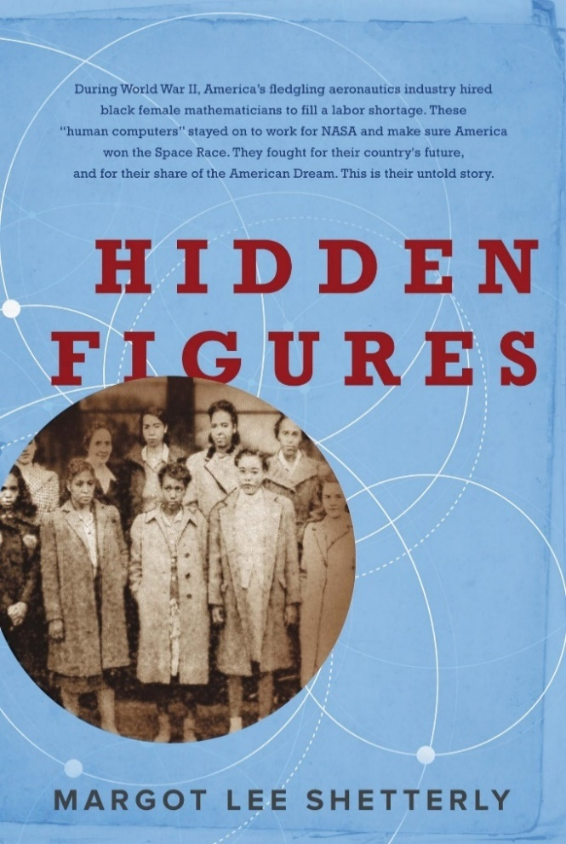
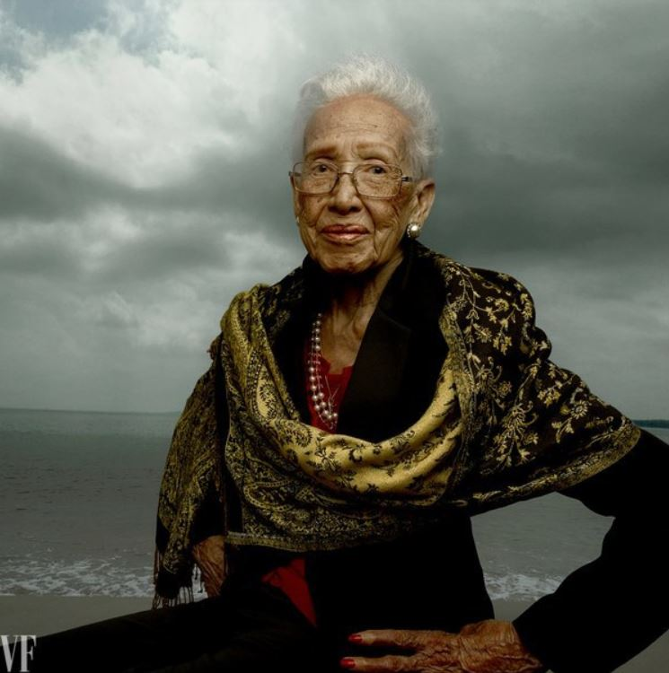
For more about Katherine Johnson, the NASA mathematician whose
story was discussed by Megan Smith, see the 2016 book and movie:
Katherine Johnson at her NASA Langley desk, 1960
Hidden Figures: The Story of the African-American Women Who Helped Win the Space Race, Margot Lee Shetterly (2016)
Katherine Johnson, age 98 Photo by Annie Leibovitz for Vanity Fair, 2016
Fortunately, she lived long-enough to see her story told!

Slide 9
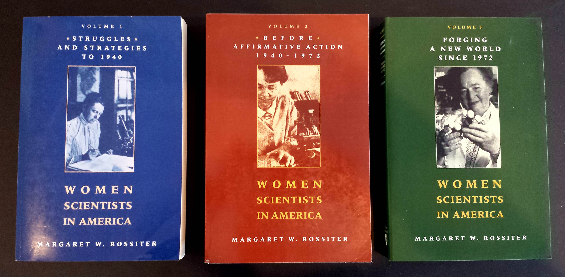
The effect is seen throughout the history of women in science, as discussed by
science historian Margaret Rossiter in Women Scientists in America (V 1-3):

Slide 10
Margaret Rossiter coined the term “Matilda effect” for the repression and denial of women scientists’ contributions, with their work often attributed to male colleagues.
This is similar to the "Matthew effect“, as coined by sociologist Robert Merton, describing how eminent scientists get more credit than lesser-known researchers, even if their work is similar.
For example: a prize will usually be awarded to the most senior researcher in a project, even if a grad student did all the work.

Slide 11
EXAMPLE CASE STUDY OF ERASURE:
The revolution in Very Large Scale Integrated (VLSI) microchip
design and manufacturing that began at Xerox PARC in 1976.
Link

Slide 12
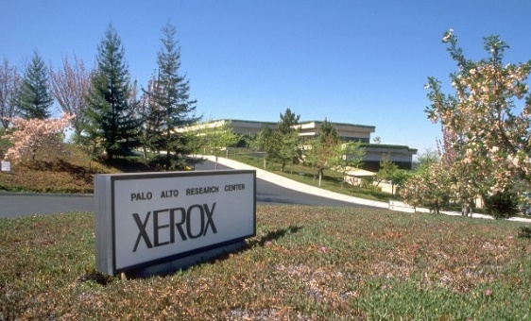
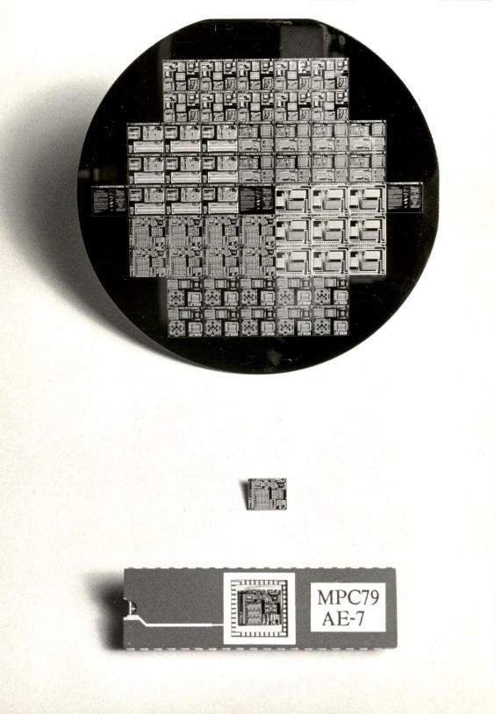
Birth of modern networked personal-computing paradigm:
Xerox PARC, 1972-78.
‘Covert’ Birth of modern VLSI chip-design paradigm: Xerox PARC, 1976-79.
Authors:
Use new image and word-processing tools to create digital document files.
Chip-Designers:
Use new design methods and chip-design tools to create digital chip-layout files.
Printers:
Laser-print document
patterns on paper media.
Foundries:
Lithographically ‘print’
chip-layouts on silicon wafers.
Results embedded-in:
Office-documents,
magazines, books, etc.
Results embedded-in:
Mobile-phones, laptops, autos,
homes, internet servers, etc.

Slide 13
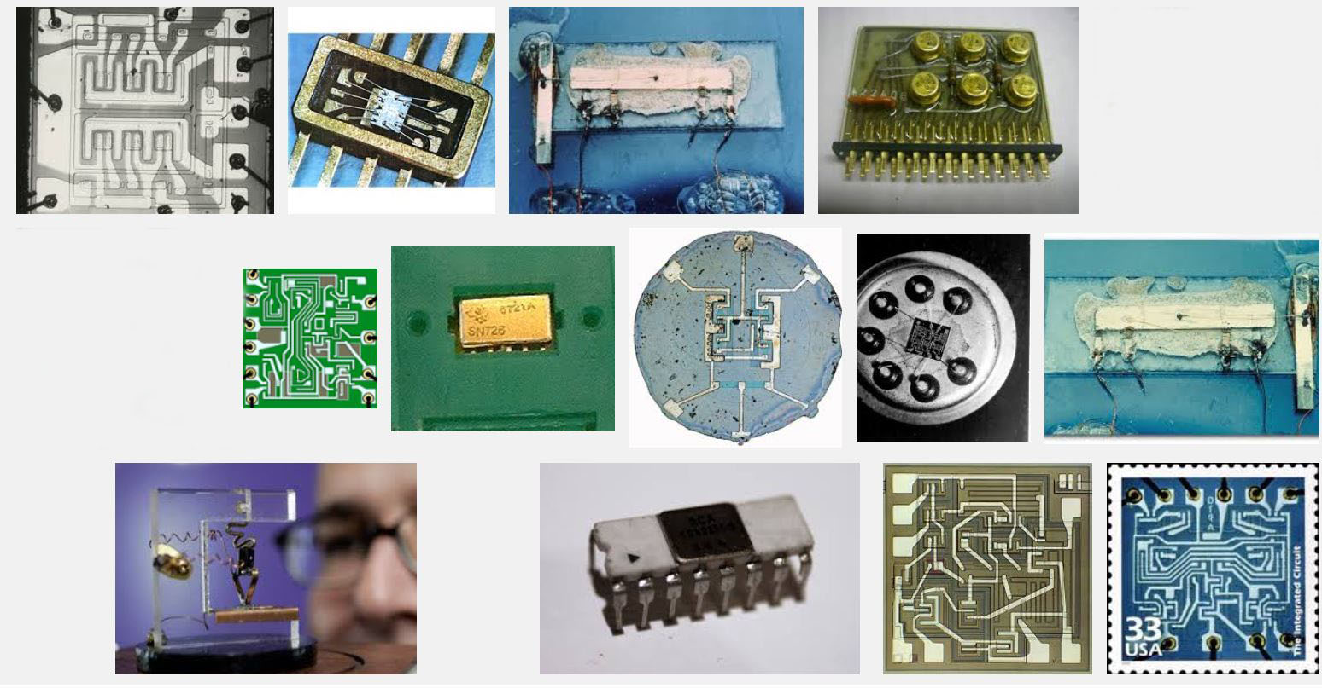
The stage had been set by the emergence of integrated circuit technology in the 1960’s, enabling modest numbers of transistors and wiring to be ‘printed’ onto chips of silicon . . .
Some early integrated circuits:
Snip from Goggle images

Slide 14
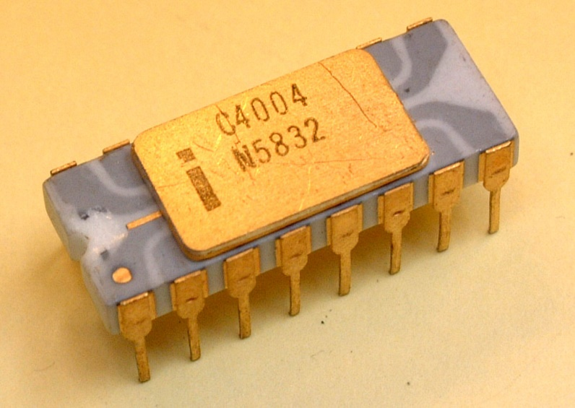
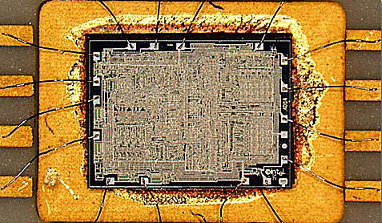
Rapid advances in optical/chemical lithography enabled the ‘printing’ of ever-finer features, and thus ever-increasing numbers of transistors could be printed on single chips.
A watershed was crossed in 1971
with the introduction of the Intel 4004, the first single-chip “microprocessor”:
a “computer processor on a chip” . . .
Source
It contained 2300 transistors . . .
Source

Slide 15
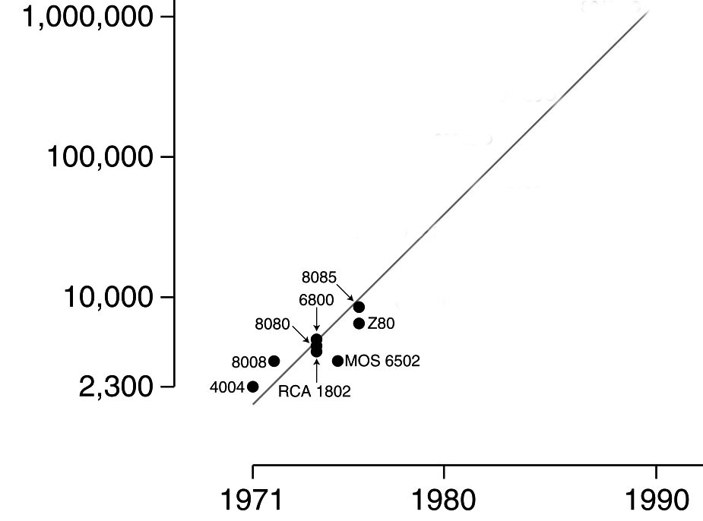
Intel’s Gordon Moore observed that the number of transistors reliably printable on chips was roughly doubling every two years . . .
Moore’s Law (as of 1976)
.
An exponential function,
graphed on a vertical log scale
Carver Mead named this “Moore’s Law”
(clever career move, eh?) and his student Bruce Hoeneisen showed there were no physical limits to densities up to several million transistors/cm².
N(t)/N(0) = 2^(t/2)
On looking ahead, we envisioned that by 1990
an entire “supercomputer” (of the day) could
be printed on a single chip . . .
In 1976 this triggered a research effort at Xerox PARC and Caltech to explore how to enable such complex chips to be designed.

Slide 16
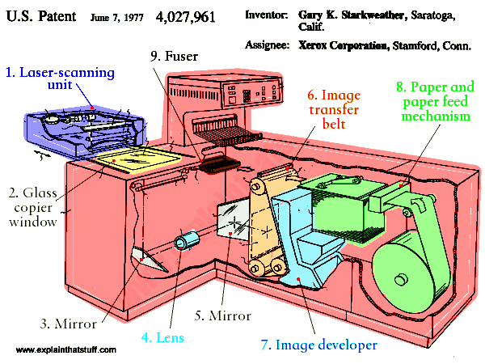
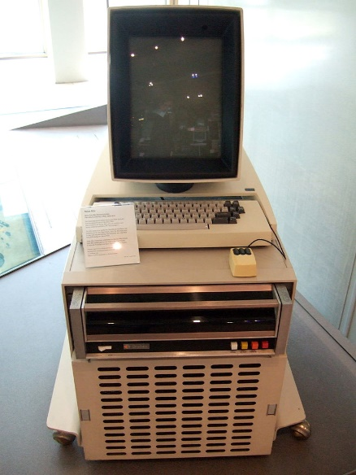
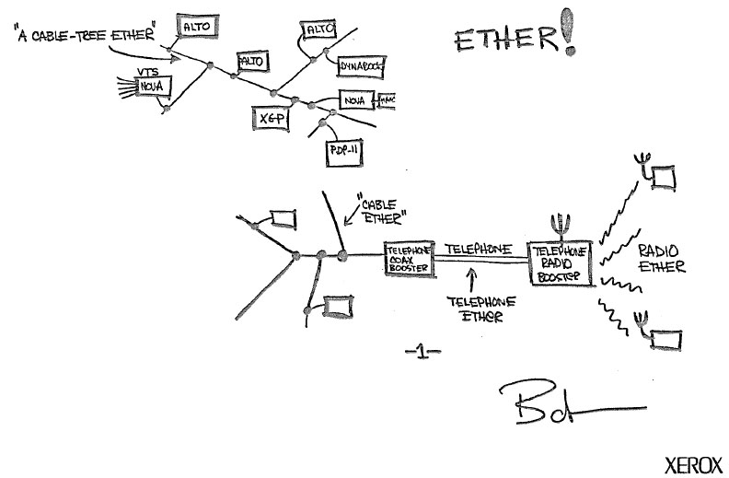
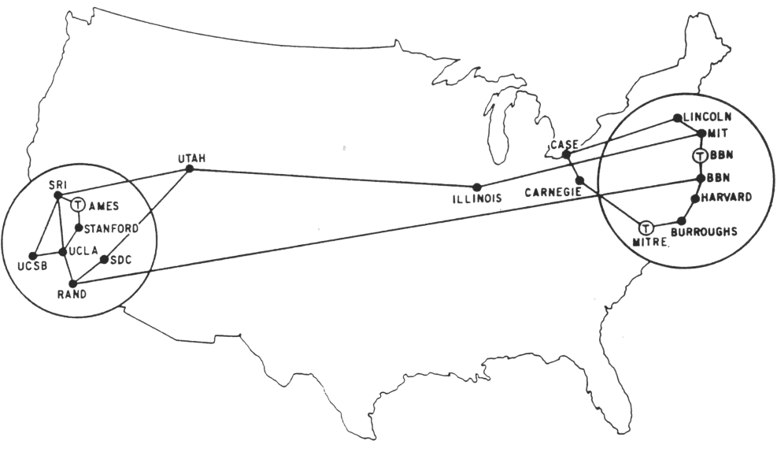
The stage was further set by seminal innovations in personal computing & networking:
The innovation of the interactive-display, mouse-controlled “personal computer”,
the “Ethernet” local-area network, and the “laser printer” at Xerox PARC) . . .
And by the Dept. of Defense’s “Arpanet” (the early internet), at DARPA . . .
Xerox Alto, 1973
Metcalfe’s original
Ethernet sketch, 1973
Laser printer, 1971
Source
Source
Arpanet map, 1971
Wiki commons

Slide 17
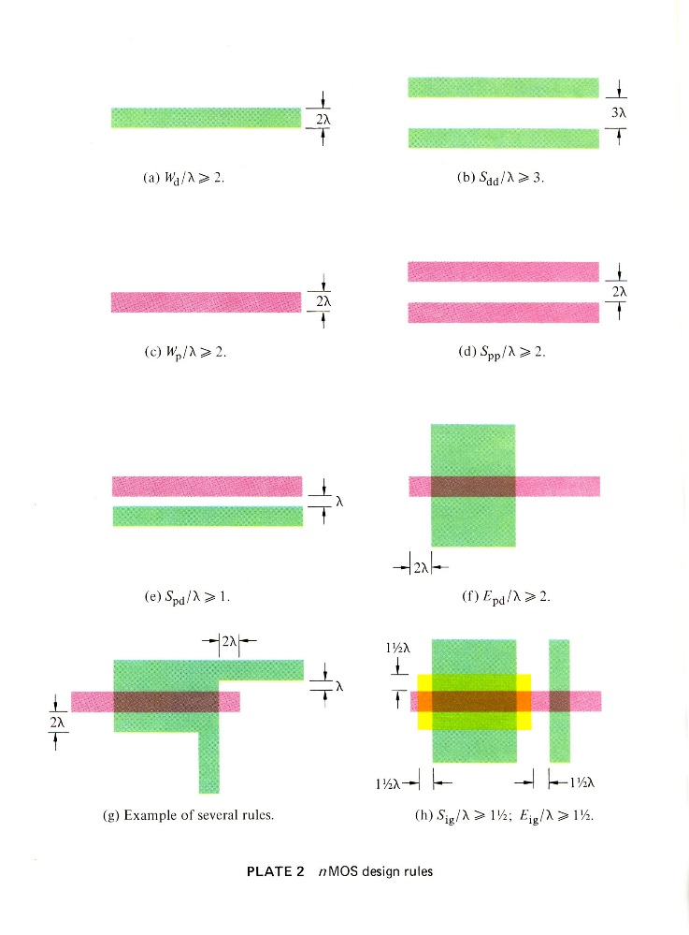
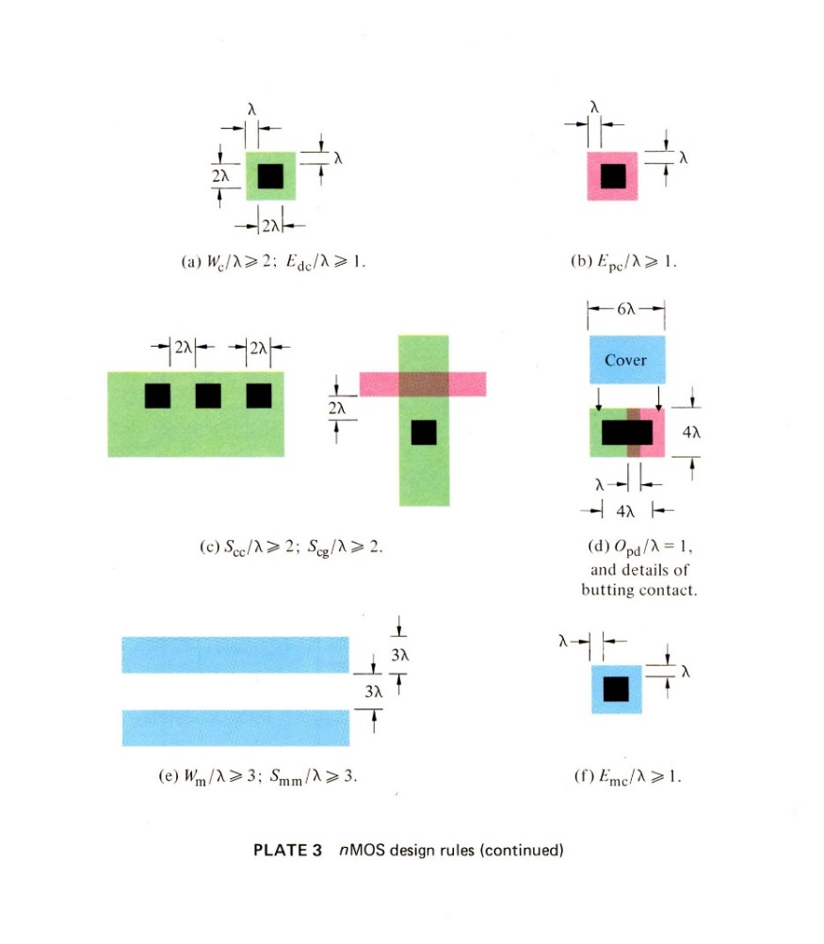
A sudden disruptive breakout was triggered by a cluster of abstract innovations made by Lynn Conway at Xerox PARC . . .
Included was a set of scalable VLSI chip-layout design-rules, encoded as dimensionless inequality equations
These enabled digital chip designs to be digitally encoded, scaled, and reused as Moore’s law advanced . . .
They also enabled chip design modules to be scaled and open-source shared . . .
Link

Slide 18
And an overall, meta-architectural, techno-social innovation:
As chip lithography scales-down according to Moore’s Law, and ever-more ever-faster transistors can be printed on individual chips as time passes, I envisioned launching the following “techno-social scripted-process”:
STEP (i):
Use design tools on current computers to DESIGN chip-sets for more powerful computers.
PRINT the more powerful chip-sets using foundries’ next-denser fabrication processes.
Use some of those chip-sets to UPDATE current computer-design computers & design tools.
REPEAT (as STEP (i+1))
If ever-more engineers and design-tool builders did this (on an expanding number of increasingly powerful computers), the iterating techno-social expansion-process could exploratorily and innovatively-generate ever-more, ever-more-powerful, digital systems . . .
I.e., that techno-social process could exponentiate! (until Moore’s Law saturates . . . )

Slide 19
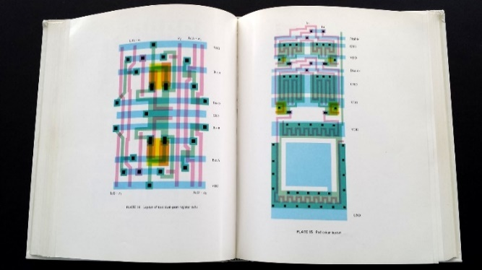
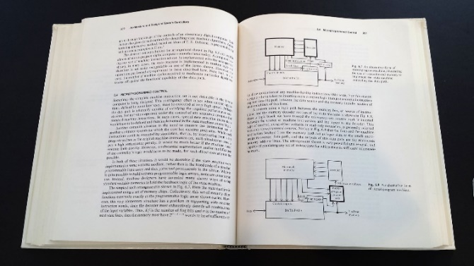
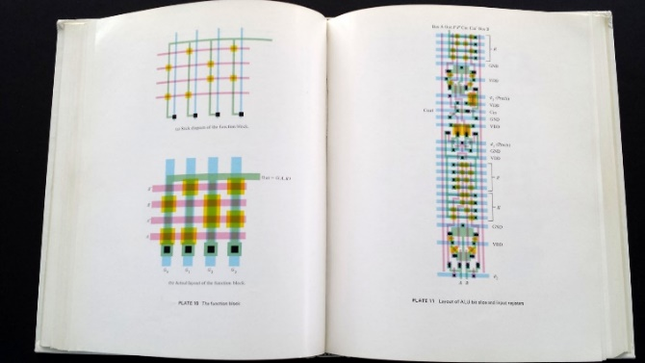
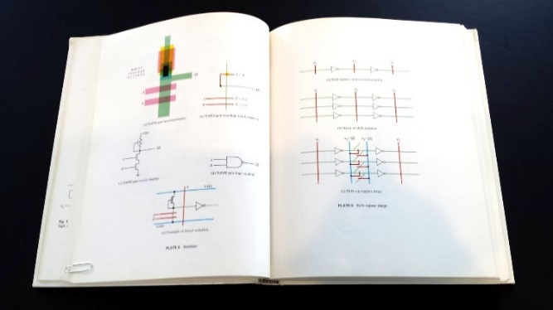
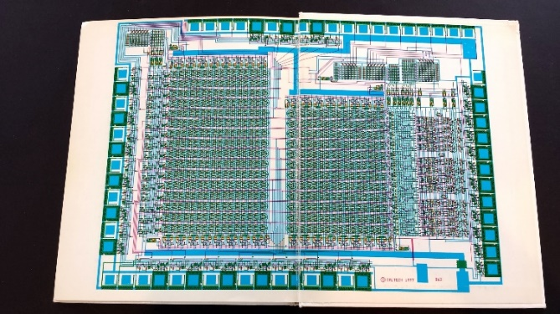
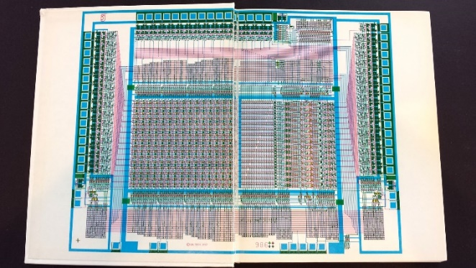
But there was a big problem: Where would all these engineers/programmers come from, and how would they learn to do all this?
In 1977, to help spread the ideas, I began documenting the innovative new
VLSI chip design methods in an evolving computer-edited laser-printed textbook . . .
Link

Slide 20
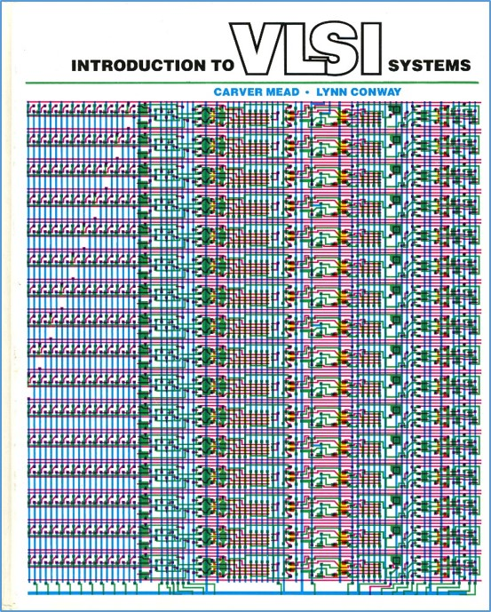
Using PARC’s Alto computers not only
to help mechanize the evolution of chip designs, but also to help mechanize the evolution of the design-knowledge itself . . .
The computer-edited evolving book, printed on PARC laser printers, became the draft of the seminal textbook . . .
Introduction to VLSI Systems
by Mead and Conway, 1980.
(later called “the book that
changed everything” . . . )

Slide 21
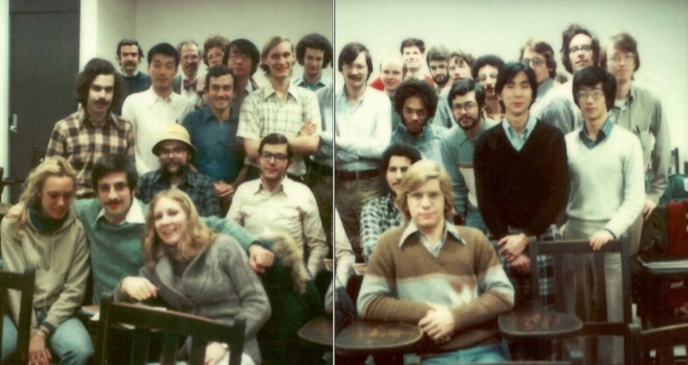
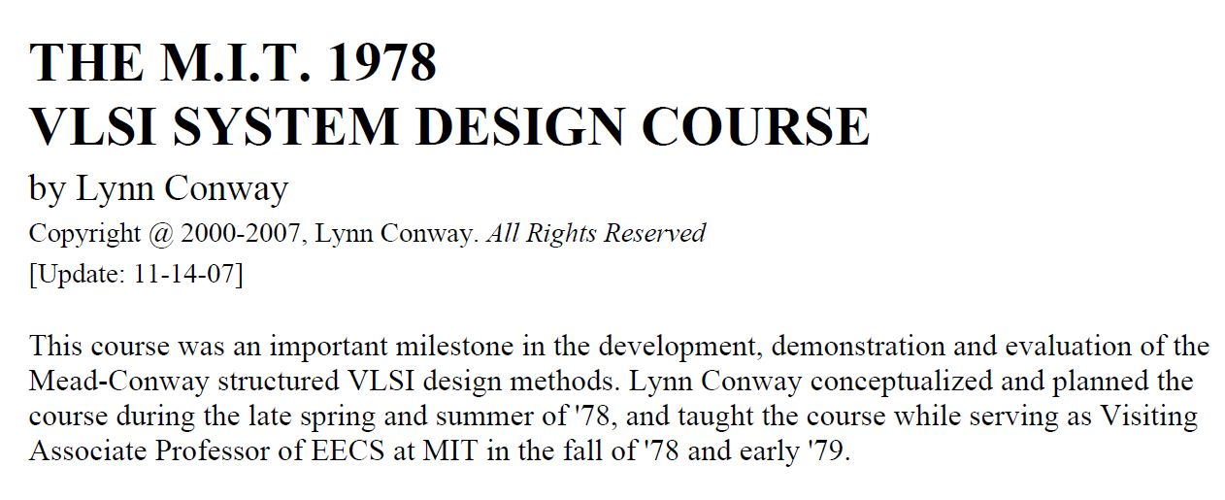
I introduced the new chip design methods in a special VLSI design course at MIT in 1978, following the ‘script’ Charles Steinmetz used to propagate his revolutionary AC electricity methods at Union College in 1912.
Link
Link
Link

Slide 22
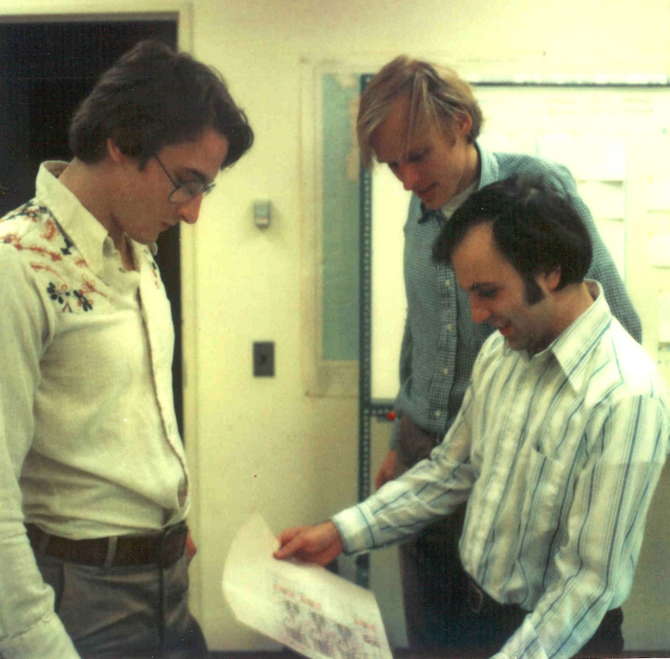
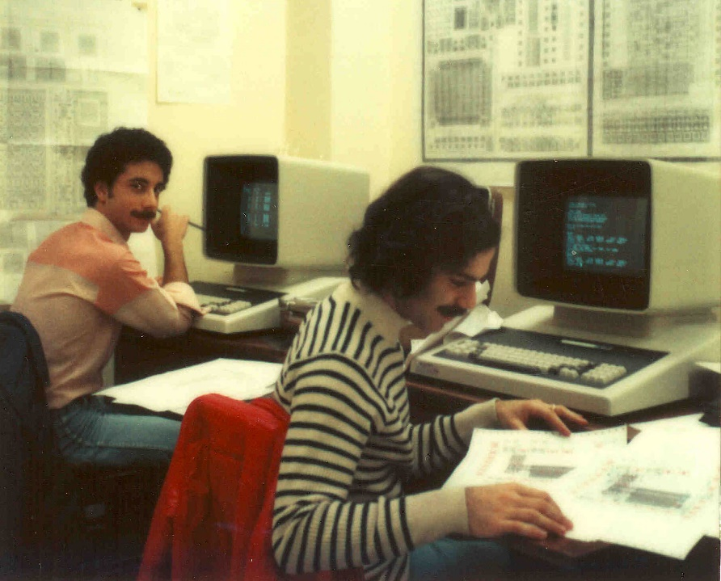
Students learned chip design in the
1st half course, and did project-chip designs in the 2nd half . . . which were fabricated at HP right after the course.
Among many amazing results was
a complete Lisp microprocessor designed by Guy Steele . . .

Slide 23
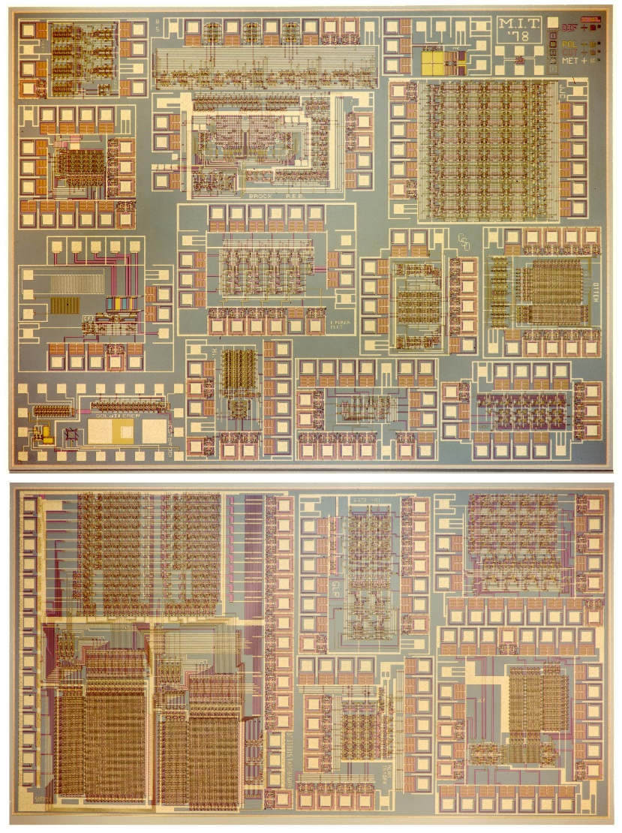
Map and photomicrograph
of the 19 student projects on
the MIT’78 ‘MultiProject’ Chip
For more about the MIT’78 course, see Lynn’s “MIT Reminiscences”

Slide 24
The MIT’78 course stunned various top folks across Silicon Valley . . .
Until then chip design had been mysterious, only grasped by a few computer engineers working for chip manufacturers . . thus having inside access to the “printing plants” . . .
Many other top research universities wanted to offer “MIT-like” courses. But how?
After intensive pondering, I grasped the answer: Try to rerun the MIT’78 course at a dozen research universities . . . using my MIT lecture notes to keep everything in sync.
But how to “print” all the student project chips?
I suddenly envisioned the idea of (what’s now called) an “e-commerce system” enabling student design files to be remotely submitted via the Arpanet to a “server” at PARC .
That server would run software to pack designs into multi-project chips (like composing the print-files for a magazine, using remotely-submitted articles) . . .
We’d then “print” the MPC’s again at HP Labs (where my colleague Pat Castro had prototyped the first “silicon foundry”), and quickly return the chips to students.

Slide 25
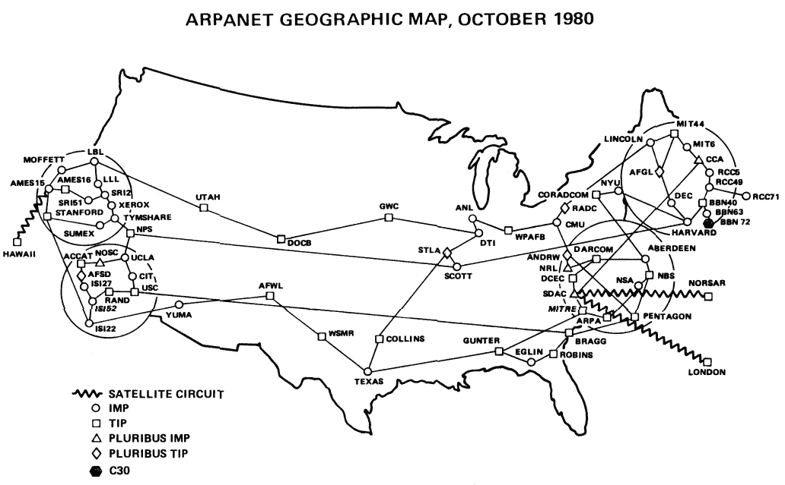
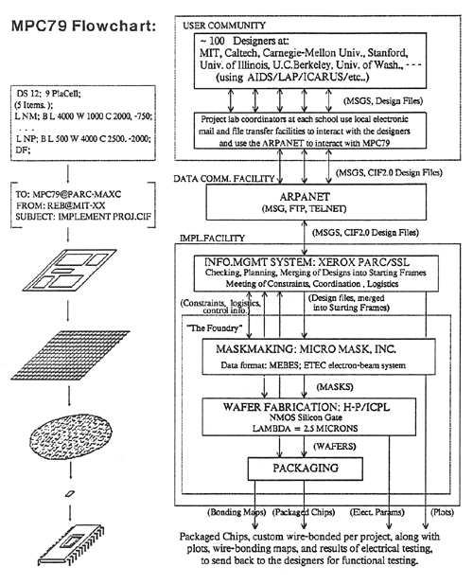
In the fall of 1979, I covertly-orchestrated a huge “Arpanet happening” (MPC79)* . . .
involving 129 budding VLSI-designers in Mead-Conway courses at 12 research-universities:
*The MPC Adventures: Experiences with the Generation of VLSI Design
and Implementation Methodologies, L. Conway, Xerox PARC, 1981 (PDF)

Slide 26
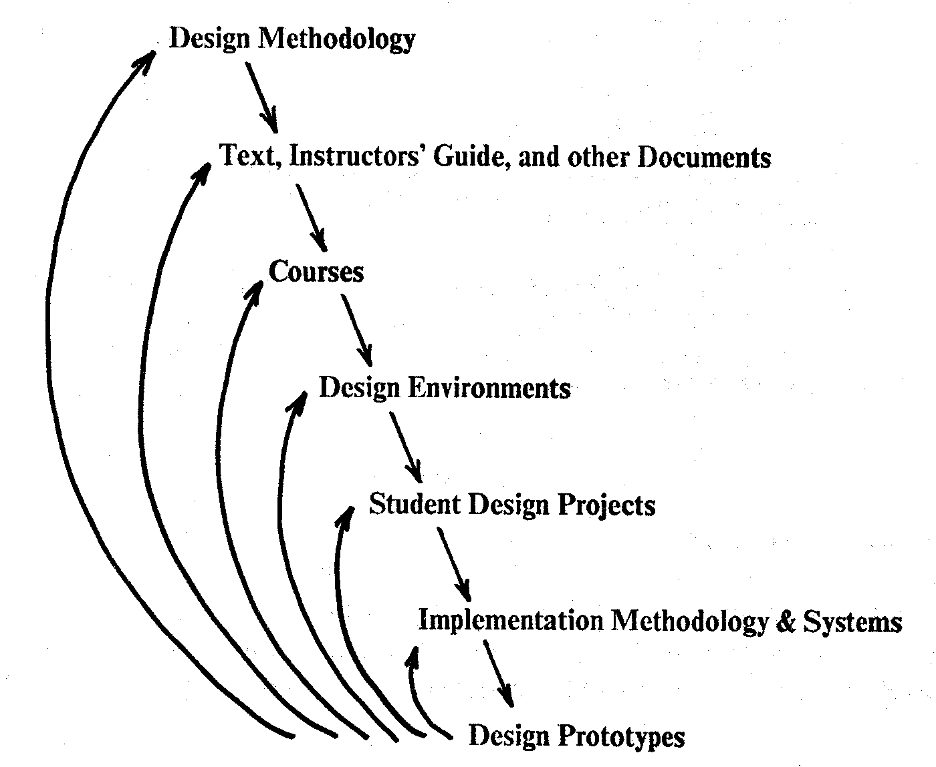
MPC79 provided a large-scale demonstration and validation of the VLSI design methods, design courses, design tools and e-commerce infrastructure.
It also triggered ‘cyclic gain’ in and exponentiation
of the budding VLSI design techno-social ecosystem.
By 1982-83, Mead-Conway VLSI design courses were
being offered at 113 universities all around the world
It was an early experimental-exploration of emergent techno-social system-dynamics in a
field now becoming known as “social physics.”
*Figure 8. The Joint Evolution of the Multi-Level
Cluster of Techno-Social Systems
From The MPC Adventures* (Lynn Conway, 1981, p. 16)

Slide 27
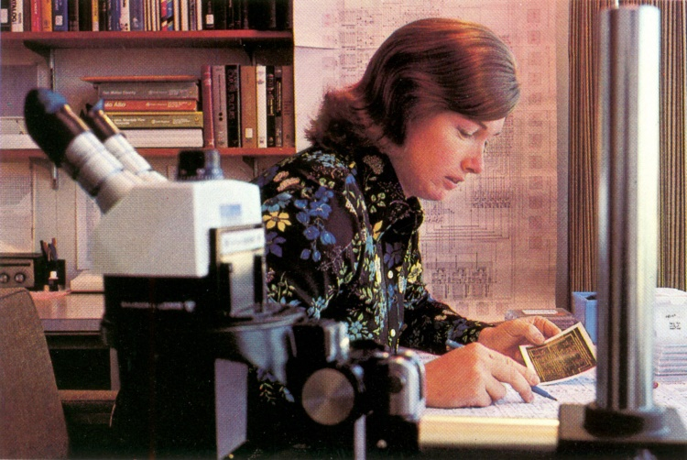
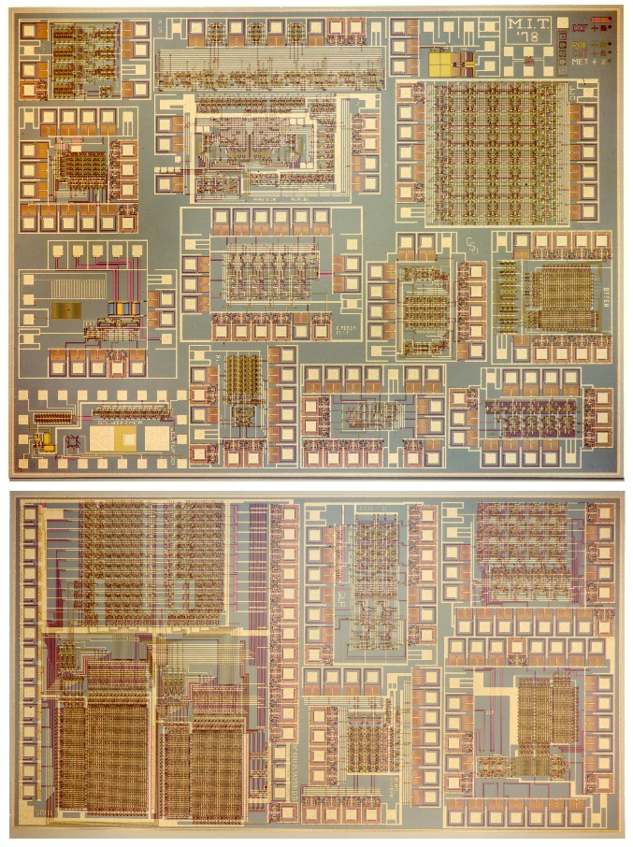
1976
1977
1978
1979
Visualizing the exponentiating
wave of VLSI innovation . . .
’76: How to cope with VLSI complexity?
’77: Inventing scalable VLSI design rules.
’78: Launching the VLSI methods at MIT!
’79: Launching the VLSI courses via MPC79!!

Slide 28
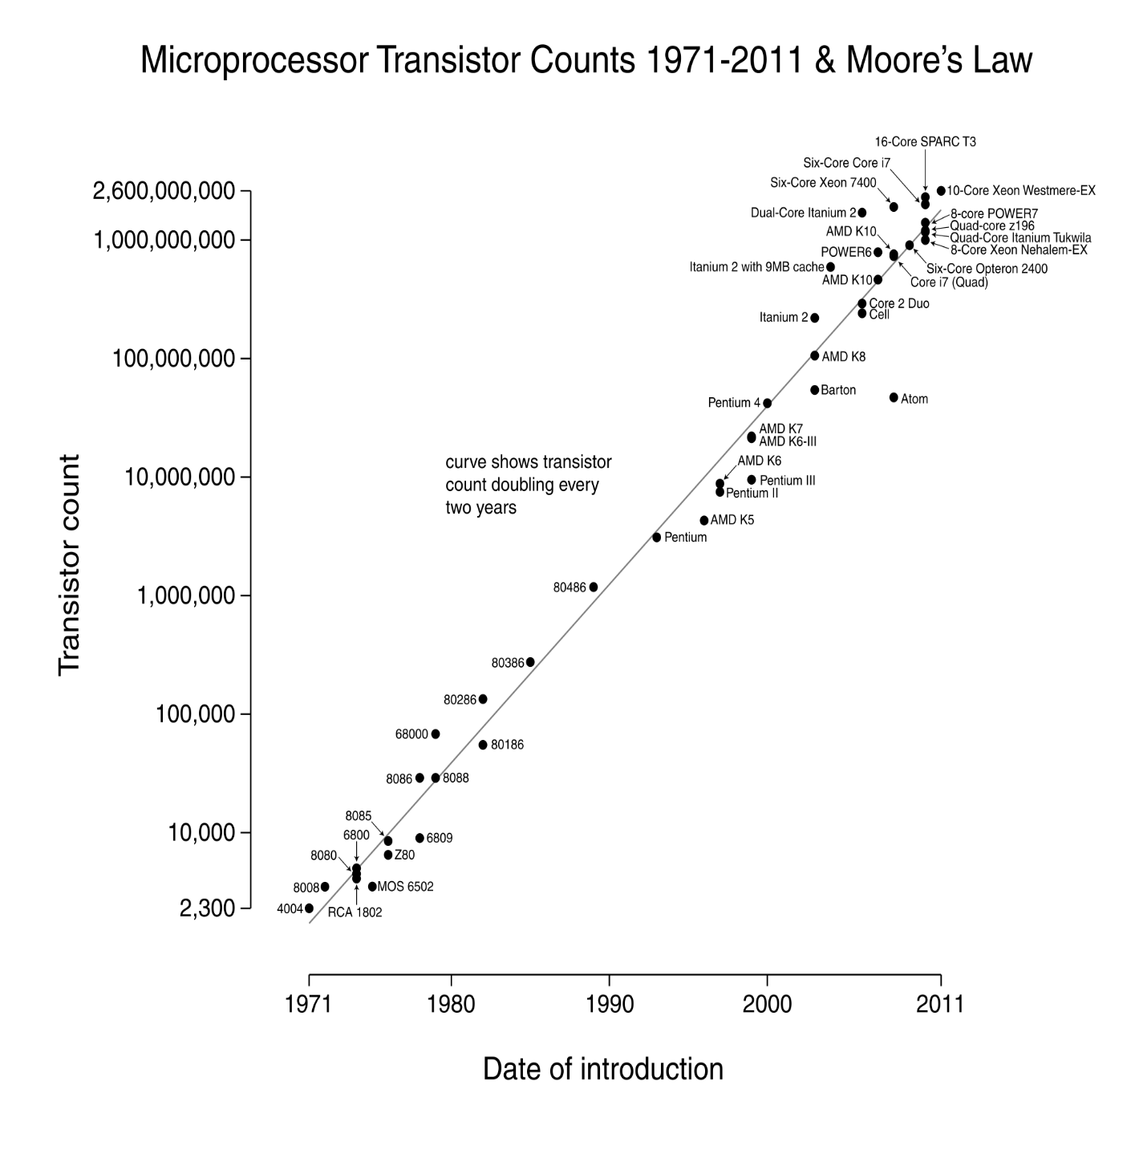
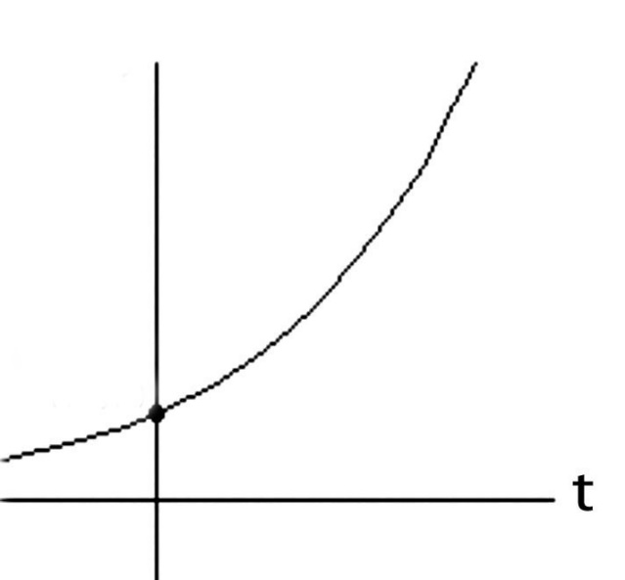
Over the past 40 years or so, Moore’s Law stayed on track all the way:
N
(exponential function
graphed on log scale)
(exponential function
with t in years)
N(t)/N(0) = 2^(t/2)
N(0), t(0)
Starting with several thousand in 1971, the number of transistors on
a chip passed one million by 1991, and passed several billion by 2011!

Slide 29
Exponentiation! Visualizing the compounding of techno-social-system “interest” . . .
Source

Slide 30
Let’s now go back and follow the high-tech community’s reactions
to the “Mead-Conway” innovations over the ensuing decades:
Link

Slide 31
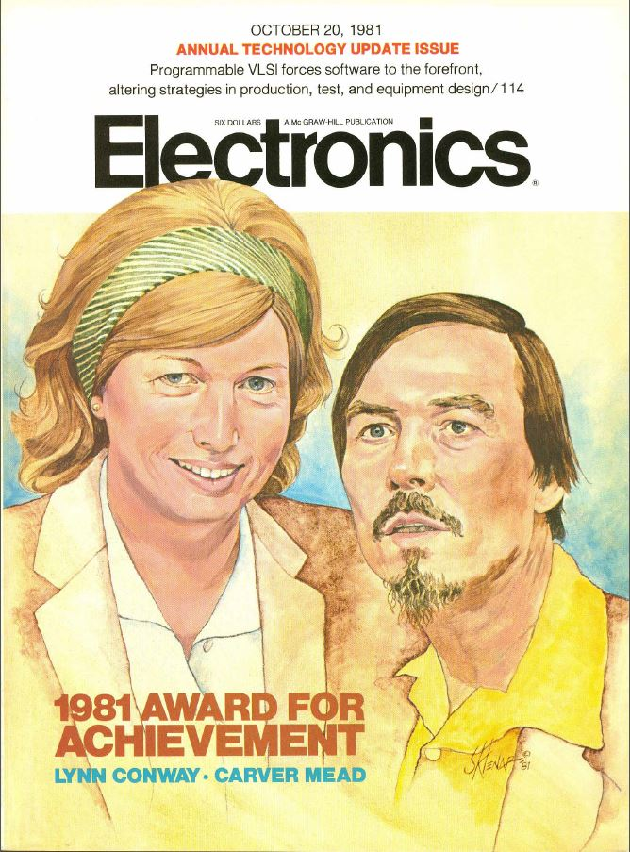
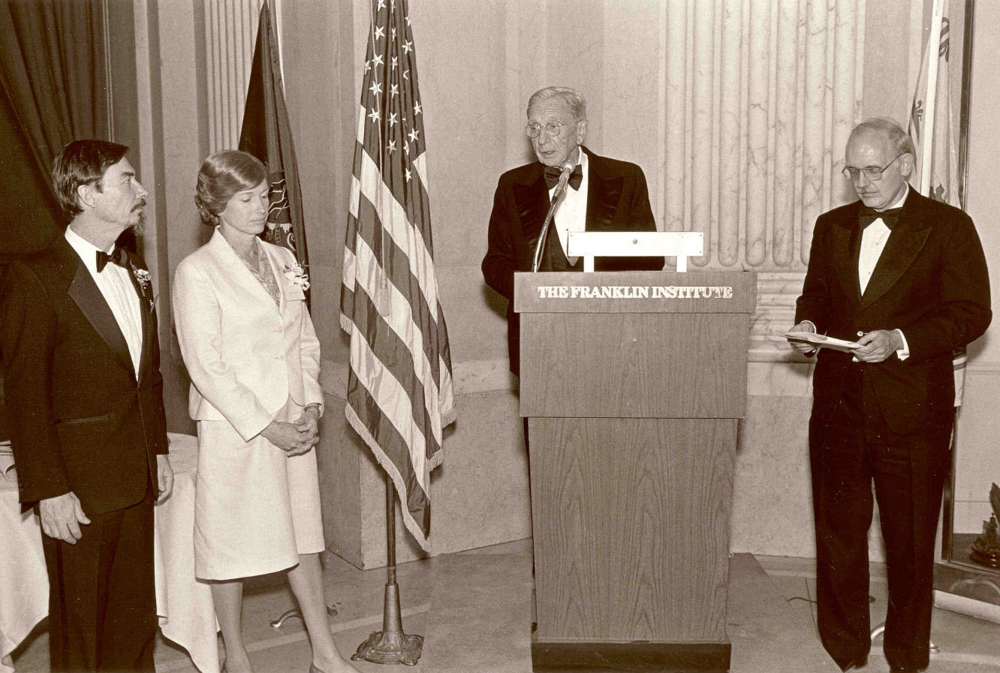
By ’81 key people sensed ‘something significant’
had happened, and Mead & Conway began
receiving major recognition during the 1980s:
Electronics Award for Achievement ‘81
Pender Award, Moore School ‘84
Wetherill Medal, Franklin Institute ’85
NAE, Mead ‘84
NAE, Conway ‘89. . .

Slide 32
However, from ‘89 on through the 00s, Mead received increasingly
major recognitions, while Conway’s role was erased*:
NAS ‘89
American Academy of Arts and Sciences ‘91
EDAC Phil Kaufman Award ‘96
IEEE John Von Neuman Medal ‘96
ACM Allen Newell Award ‘97
MIT Lemelson Award ‘99 ($500,000)
Fellow Award, Computer History Museum ‘02
National Medal of Technology ‘02
NAE Founders Award ‘03
Inventors Hall of Fame, at Computer History Museum Gala ‘09
*Most of these awards were for innovations that were solely Conway’s

Slide 33
As a result, by 2009 the erasure was complete:
Chip inventors getting their due at Hall of Fame induction
By Mike Cassidy, San Jose Mercury News
Apr. 30, 2009 --The 50th birthday celebration of the integrated circuit kicks off in Silicon Valley this weekend, and frankly, I'm a little overwhelmed . . .
On Saturday night, the National Inventors Hall of Fame is inducting this year's class. The sold-out ceremony (at the Computer History Museum) is in Silicon Valley for the first time, because the Ohio-based hall is honoring 15 who are responsible for breakthroughs in semiconductor technology -- the technology that put the "silicon" in Silicon Valley . . . In a way, it's as if the valley's founding fathers are coming together to be honored in person and posthumously. Inductees Gordon Moore, co-founder of Intel and namesake of Moore's Law, and Carver Mead, chip design pioneer and all-around brainiac, will be at the ceremony. So will lifetime achievement honoree Andy Grove, Intel's former CEO . . .

Slide 34
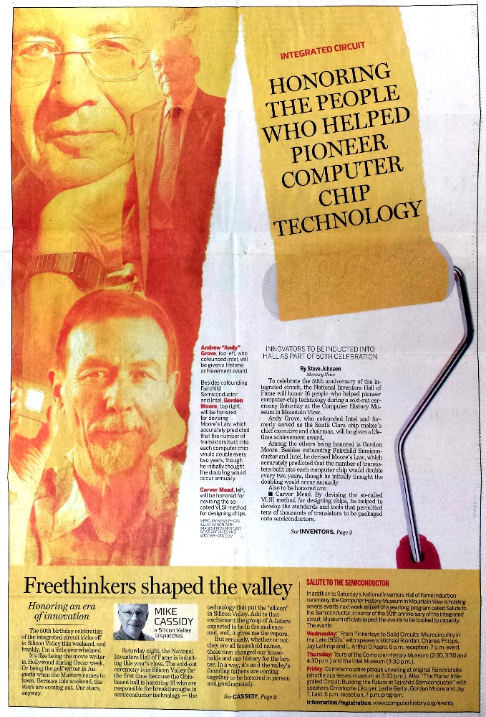
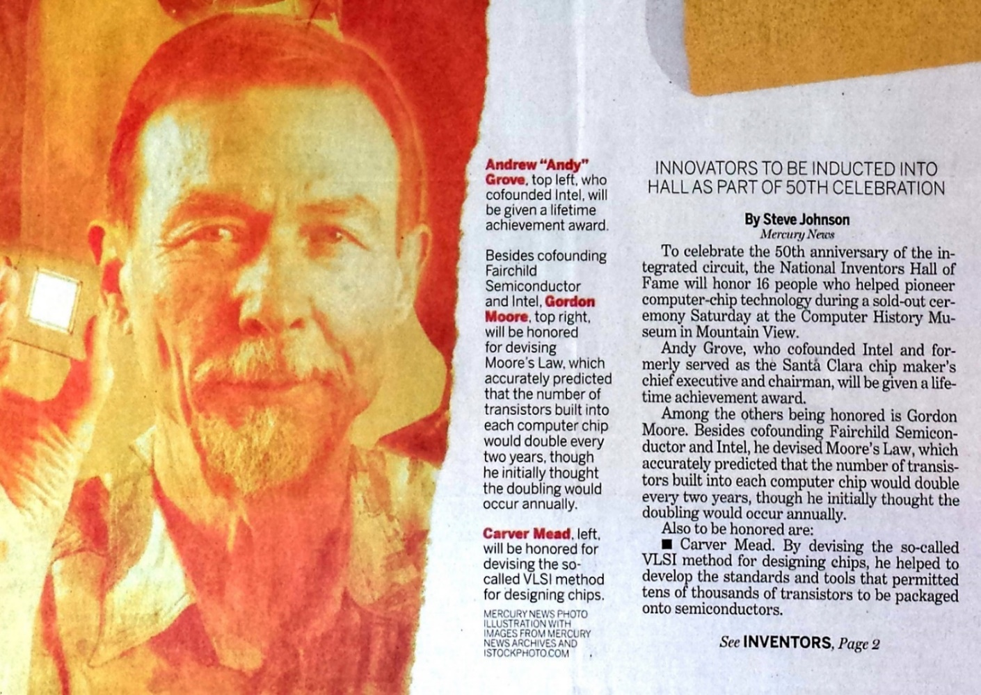
With Andy Grove, Gordon Moore and Carver Mead taking center stage:
San Jose Mercury News April 30, 2009
Not only was Lynn Conway not invited, she didn’t even know it was happening!
Hmm . . . Reminds us of the Apple Macintosh story, eh?

Slide 35
My investigations into and reporting on what happened,
hoping to regain some of my legacy along the way . . .
Link

Slide 36
The story of my recent investigations is quite a saga, yet to be fully told . . .
Along the way I uncovered all sorts
of fascinating data and evidence.
That led me to write and publish my “Reminiscences of the VLSI Revolution” in the
Fall 2012 IEEE Solid State Circuits Magazine.
The first time in decades I’d come forward
and begun telling the story . . .

Slide 37
Links re my investigation to understand
what happened, and to reclaim my life-legacy:
Compilation of the VLSI Archive, 2009-2012
Publication of my IBM-ACS Reminiscences, 2011
Publication of my VLSI Reminiscences, 2012
Publication of The Many Shades of ‘Out’, 2013
Publication of my MIT Reminiscences, 2014
Evidence that “the paradigm is shifting”:
Hall of Fellows, Computer History Museum, 2014
Honorary Doctorate, Illinois Institute of Technology, 2014
IEEE & Royal Society of Edinburgh, James Clerk Maxwell Medal, 2015
Honorary Doctorate, University of Victoria, 2016
Fellow of the AAAS, 2017.
Honorary Doctorate, University of Michigan, 2018.

Slide 38
But how did Lynn’s ‘disappearance” happen in the first place?
A Counter-Intuitive Explanatory-Conjecture: The ‘Conway Effect’!
Link

Slide 39
Throughout this example we “appear to observe” the following effects:
(i) the “Matilda effect” (repression of women scientists’ contributions)
(ii) the "Matthew effect“ (eminent scientists get more credit)
These effects involve “self-fulfilling prophecies”, which Merton describes as:
“. . . a false definition of the situation evoking a new behavior which makes the original false conception come true. This specious validity of the self-fulfilling prophecy perpetuates a reign of error. For the prophet will cite the actual course of events as proof that he was right from the very beginning.”
But is that all that’s happening?
Or are other, far deeper, systemic forces in play?

Slide 40
On closer investigation, I realized that something far more subliminal and fundamental was happening at a social level . . . something that involves no errors, no conspiracies, no repressions and no ‘bad guys’:
CONJECTURE: Almost all people are blind to innovations, especially ones made by ‘others’ whom they do not expect to make innovations.
Since for most people, ‘others’ = ‘almost all people’, few people ever witness or visualize innovations, even ones made right in front of their eyes, even including some made by themselves!
Instead, when internally-orientating towards ‘novelties’ they stumble upon, most people look for cues by others . . . and not just whether to accept or reject the novelty . . . but even whether to notice it in the first place!
From this perspective, the Mathew Effect and Matilda Effect are derivatives
of the newly conjectured “Conway Effect”, which covers ‘all outsiders’.
Link

Slide 41
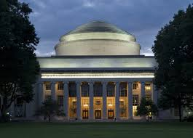
Visualizing the Conway Effect in action:
Most students in MIT’78 thought they were learning “how chips were designed in Silicon Valley” (the course was, in effect, a giant MIT hack!). They “did it” without realizing they were learning radical new methods.
The astonished reaction amongst Silicon Valley’s cognoscenti led to intense interest in reverse engineering “How MIT did this”, and many research universities immediately wanted to offer similar “MIT VLSI courses”.
The next year, the MPC79 chip designers took ‘foundry access’ for granted and just ‘used it’.
No one realized MPC79 was an even larger paradigm-shifting-hackathon that was launching
the modern microchip “fabless design”+“silicon foundries”+“e-commerce” infrastructure.
By ‘hiding in plain sight’, MPC79 simply ‘disappeared’ from view as an innovation!

Slide 42
What might MPC79 participants have been thinking?
Meanwhile, Conway remained hidden in the shadows until 2012, when she finally
felt able to emerge and explain how it happened . . .

Slide 43
The Conway Effect: Almost all people are blind to innovations,
especially those made by folks they don’t expect to make innovations.
• Innovations diffuse via social-processes involving subliminal subgroup noticings,
mimickings, rejections, adoptions, adaptations, tradings and displacements
Distracted by Greed!
Link
Meanwhile, credits for innovations as social-markers are separately
subliminally assigned, gained, granted, bartered, seized, etc . . .
• Crediting-processes are modulated by visibility, status, prestige, class, power,
location, credentials, prejudice, popularity, influence, money and accident . . .
The high visibility of crediting (vs the invisibility of innovations) sustains
both the crediting-processes and ongoing-blindness to innovations.
Covert Visioneering!
Corollary: It’s possible to trigger large paradigm-shifts right out
in the open, as long as people have no clue what you’re doing!
I wonder, could this even have happened any other way . . . ?

Slide 44
Link
THE END
Moral Of The Story:
“When Weirdness breaks out, don’t get upset . . . Do Science On It!”
http://ai.eecs.umich.edu/people/conway/Memoirs/Talks/Syracuse_2019/Inside_Story_Talk.pptx http://ai.eecs.umich.edu/people/conway/Memoirs/Talks/Syracuse_2019/Inside_Story_Talk.pdf
www.lynnconway.com ; conway@umich.edu

Slide 45
Q/A!
Questions for you to ponder:
Have you noticed an innovation this week?
Have you made an innovation this week?
What is an innovation???
How can we better triangulate on what’s happening?
Gain insights from the evolution of culture in animals.
Recent learnings from antropology, sociology and history.
Try envisioning future techno-social dynamical-systems . . .
Why and how all this could be very-different in the future:
The effects of ‘leaving tracks’ in real-time as we innovate . . .

Slide 46
APPENDICES:
A1. Thought Experiment
A2. Further Readings
A3. The Many Shades of ‘Out’
A4. References

Slide 47
A1. Thought experiment!**
“The most remarkable of such examples comes from the work of the Japanese Monkey Center where macaques were isolated in groups on small islands, and differences in the behavior patterns of different island populations arose by cultural evolution . . .
The greatest achievement is that of Imo, the female genius among the macaques.
At the age of two she invented washing the sand off sweet potatoes before eating them, and at a later date she found a way of separating wheat from sand by throwing the mixture in the water and skimming off the wheat from the surface.
These discoveries spread slowly through the colony, although in general the older individuals were the last to acquire the new tricks.”***
***John Tyler Bonner, The Evolution of Culture in Animals,
Princeton University Press, 1980, p.184.
**As unfolded by Lynn to mystified audiences decades ago
in her spirited keynotes at Spring Compcon ’83 and DAC ‘84.
Source

Slide 48
Now recall our discussion about ‘Exponentiation’, where we
visualized the compounding of techno-social-system “interest” . . .
Source

Slide 49
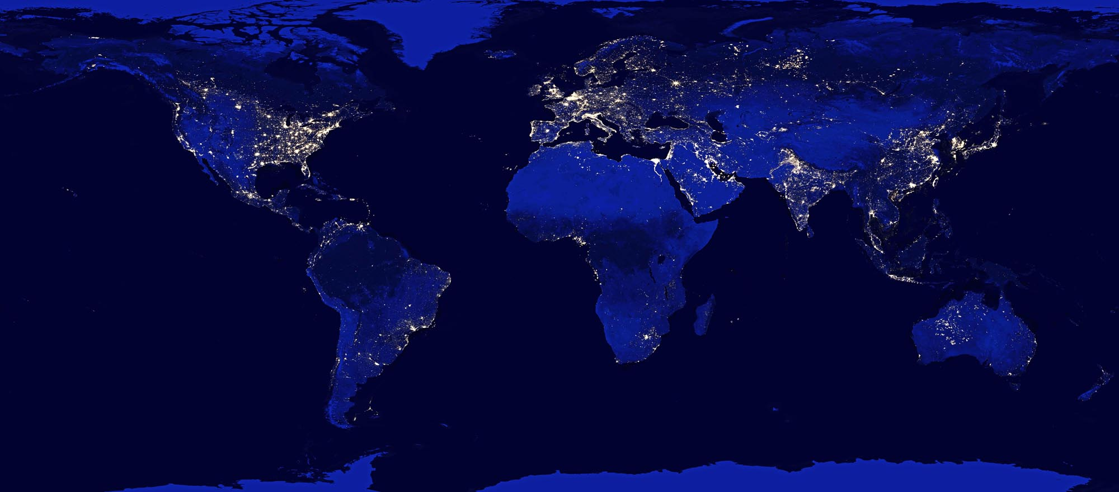
Now imagine what’s going on out there . . . all around the world . . .
as our internet connects ever-more-people and chip-empowered-things:
NASA: Earth from space at night
Setting the stage for what comes next . . .

Slide 50
. . . But that’s another story and another lecture! (see links below) . . .
http://ai.eecs.umich.edu/people/conway/Memoirs/Talks/UVIC/Techno_Social_Talk.pptx
http://ai.eecs.umich.edu/people/conway/Memoirs/Talks/UVIC/Techno_Social_Talk.pdf

Slide 51
A2. Further Readings:
To learn more about the "disappearance" of women in STEM and my conjecture about its causes, see this recent report:
Lynn Conway, “The Disappeared: Beyond Winning and Losing”, IEEE Computer, Oct. 2018, pp. 66-73.
https://www.computer.org/csdl/magazine/co/2018/10/mco2018100066/17D45WXIkDI (HTML)
http://ai.eecs.umich.edu/people/conway/Memoirs/IEEE_Computer/The_Disappeared_-_Beyond_Winning_and_Losing.pdf (PDF)

Slide 52
For more about Xerox PARC and
the amazing things done there, see
Michael Hiltzik’s Dealers of Lightning:
For insights into the role of
DARPA in VLSI’s emergence,
see this book from the NRC:
For a wider sociological perspective on ‘internet emergence’, see
Thomas Streeter’s The Net Effect

Slide 53
A3: The Many Shades of ‘Out’, by Lynn Conway:
On a sultry June afternoon, as my husband and I walked towards the White House, I reflected back on my gender transition in 1968.
Shamed as a social outcast, I'd lost my family, friends and social support. Fired by IBM, I’d lost a promising research career. In many cities I could’ve been arrested, or worse yet, institutionalized.
Evading those fates, I completed my transition, took on a secret new identity, and started all over as a contract programmer. Any 'outing' and I'd have become unemployable . . . Fear channeled me into 'stealth-mode‘. For over 30 years I covered my past, living as if I was a spy in my own country.
But it was now June 13, 2013 . . . My husband Charlie and I were joining many other advocates at the President's White House Reception for LGBT Pride Month. The air was full of joy, and as we awaited the President I reflected further.
I’d been 'out' for 15 years . . . or so I'd thought: out on the Internet to reveal my past to colleagues, out as an trans advocate and an activist against psychiatry’s pathologization of gender variance.
When I was hidden in the back-rooms of Xerox Palo Alto Research Center decades before, launching innovations as the hidden-hand behind the VLSI microelectronics revolution, I didn't mind being invisible in my field back then or that no one had a clue what I was doing . . . I was thrilled to even have a job.
But 'out' has many shades of grey -- and even in recent years I kept on shyly holding back, covering in the darker shadows. Although times had changed, I'd clung to old habits.
Down through the decades no one could explain how the VLSI revolution actually happened. The results were simply taken for granted. Although I'd gained vital knowledge about generating such paradigm shifts, I feared my personal history would loom large in folk's minds and obscure any attempt at explanation. It wasn't till 2012 that I got up the nerve to publish a memoir to begin revealing how the VLSI revolution came about.
As the president entered the room, I glanced around and took in the joyful vibes. As he began to speak, I grasped how far we'd come. Times had more than changed: a fresh wind was sweeping through our society, especially amongst younger generations.
Then I thought of the millions of other LGBT people out there. I tried to envision their lifelong struggles against ostracism, their losses of families and employment, their oppression by having to 'cover', while not being known for who they were, what they'd done, who they loved or who loved them.
In a flash, I saw the vastness of the suffering . . . Then it hit me: we've come so far so fast that many others could now begin uncovering too! After all, freedom isn't just an external concept framed by our laws. It's a gift of the spirit that we must give ourselves, by going towards brighter shades of 'out'.
http://www.huffingtonpost.com/lynn-conway/the-many-shades-of-out_b_3591764.html

Slide 54
A4: References:
Ken Shepard, “Covering”: How We Missed the Inside-Story of the VLSI Revolution”, IEEE Solid State Circuits Magazine, FALL 2012, pp. 40-42. (more)
Chuck House, “A Paradigm Shift Was Happening All Around Us”, IEEE Solid State Circuits Magazine, FALL 2012, pp. 32-35. (more)
Lynn Conway, “Reminiscences of the VLSI Revolution: How a series of failures triggered a paradigm shift in digital design”, IEEE Solid State Circuits Mag., FALL 2012, p. 8-31. (more)
Lynn Conway, “The Many Shades of Out”, Huffington Post, July 24, 2013.
Paul Penfield, "The VLSI Revolution at MIT", 2014 MIT EECS Connector, Spring 2014, pp. 11-13.
Lynn Conway, "MIT Reminiscences: Student years to VLSI revolution", lynnconway.com, March 11, 2014.
Computer History Museum: “Lynn Conway, 2014 Fellow, For her work in developing and disseminating new methods of integrated circuit design”, April 2014.
Nicole Casal Moore, “Life, Engineered: How Lynn Conway reinvented her world and ours”, The Michigan Engineer, FALL 2014, pp. 42-49.
Catharine June, “Lynn Conway to receive 2015 IEEE/RSE James Clerk Maxwell Medal”, Michigan Engineering News, December, 15, 2014.
IEEE and the Royal Society of Edinburgh, “James Clerk Maxwell Medal ceremony at the Royal Society of Edinburgh”, YouTube, Nov. 12, 2015.
IEEE/RSE Maxwell Medal Presentation at the Royal Society of Edinburgh: Citation by Barry Shoop, President-Elect of the IEEE, Nov. 12, 2015.
Magnus Linklater, “‘Life in stealth’ of microchip genius who migrated to a new identity: Lynn Conway beat transgender bias and began a revolution”, The Times (UK), Nov. 14, 2015.
University of Victoria, “Professor Lynn Conway’s Citation for the Degree Doctor of Engineering, Honoris Causa”, Univ. of Victoria, Nov 9, 2016.
Fellow of the AAAS (2017): Delia O’Hara, “Sense of Wonder Motivates VLSI Chip Revolutionary, Lynn Conway”, AAAS, Aug. 8, 2017
Lynn Conway, “The Disappeared: Beyond Winning and Losing”, Computer, Vol: 51, Issue: 10, Oct. 2018, pp. 66-73. (PDF)
Brad Whitehouse, “When pioneers disappear from history”, Michigan Engineering, February 22, 2019.
University of Michigan, “Professor Lynn Conway’s Citation for the Degree Doctor of Science, Honoris Causa”, Univ. of Michigan, Ann Arbor, Dec 16, 2018.

