Slide 1
Prologue:
Some reflections on LGBT Pride Month
Historical erasure of women’s contributions in STEM:
Megan Smith; Margaret Rossiter; the Matilda Effect; the Mathew Effect.
Case study:
The Inside Story Behind the VLSI Revolution
Conjecture:
The Conway Effect
Discussion, Q&A:
Visualizing and reflecting upon this effect

Slide 2
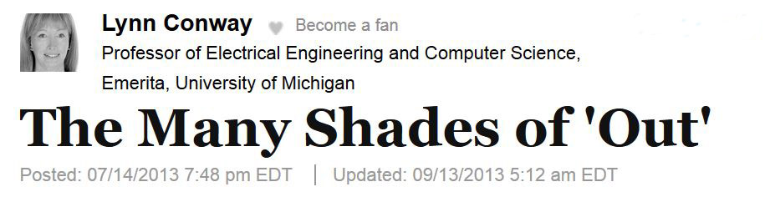
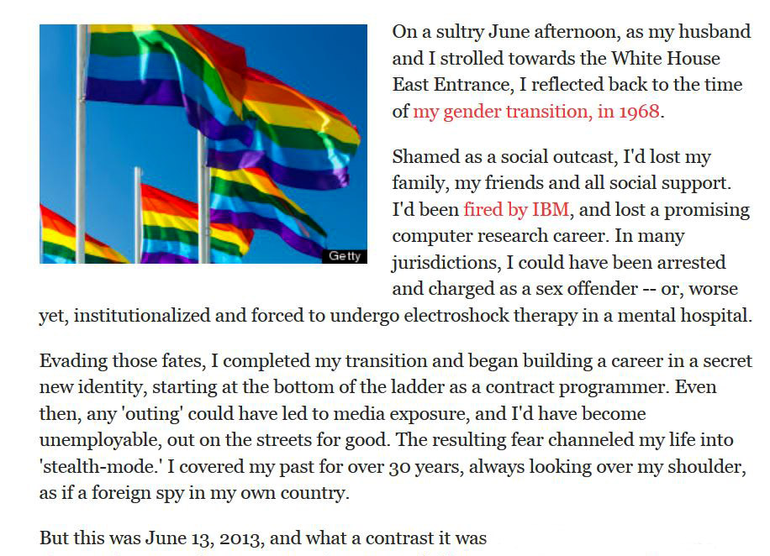
For full text, see:
http://www.huffingtonpost.com/lynn-conway/
the-many-shades-of-out_b_3591764.html
. . .

Slide 3
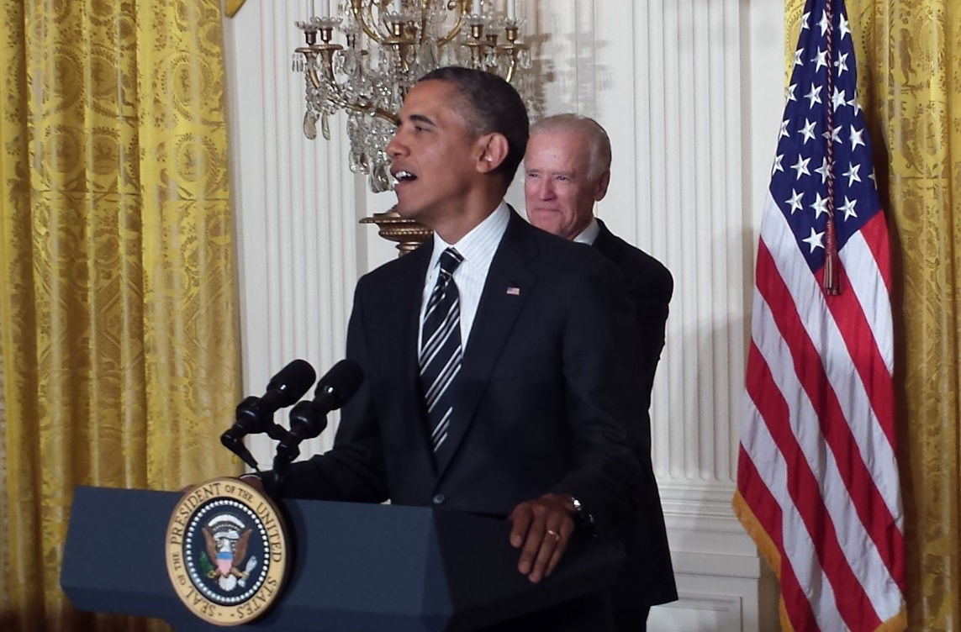
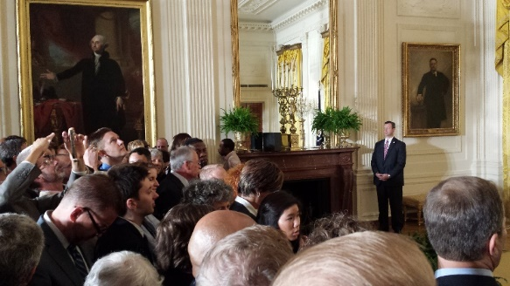
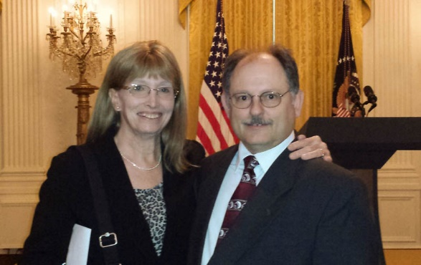
June 13, 2013: White House Reception to celebrate
LGBT Pride Month
For full text, see:
http://www.huffingtonpost.com/lynn-conway/
the-many-shades-of-out_b_3591764.html

Slide 4
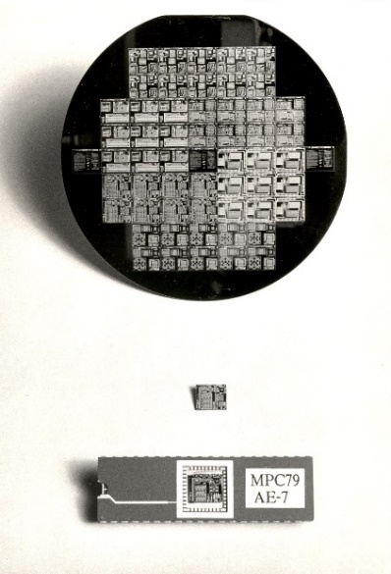
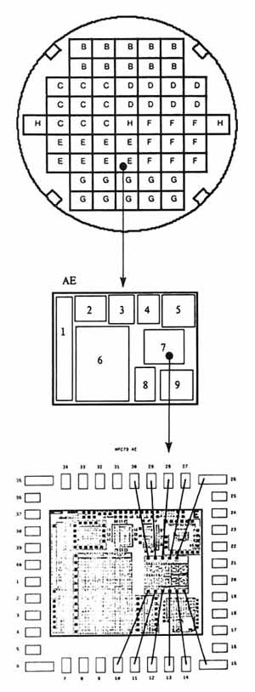
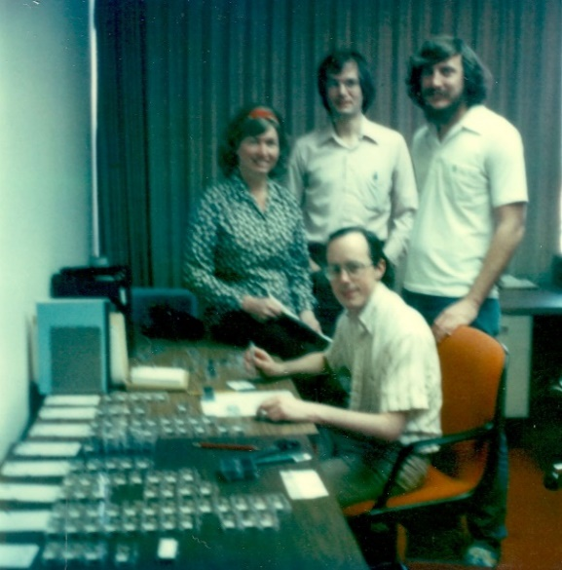
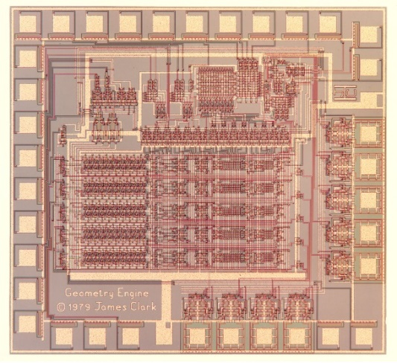
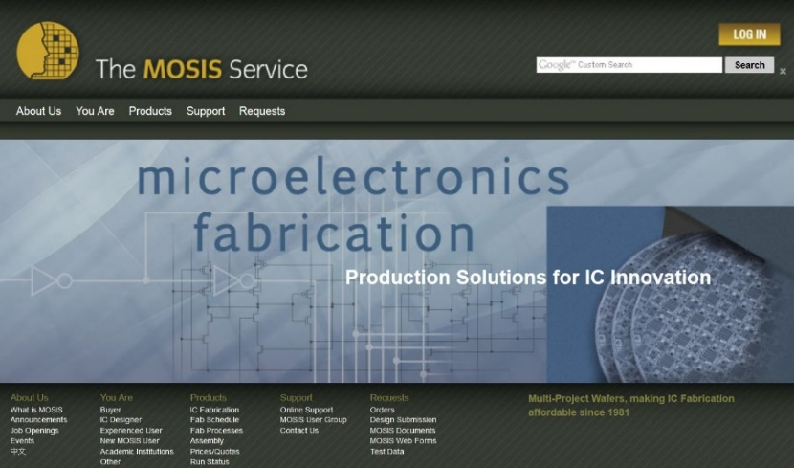
Thus breaking the “VLSI complexity barrier”, spawning the MOSIS* national chip-prototyping
service, and bootstrapping the “fabless-design + silicon foundry” paradigm of chip-making …
MPC79:
Wafer . . . . .
Chip . . . . . . .
Packaged Chip . .
Lynn and her team prepare packaged
chips to send to designers,
Jan 4, 1980
Example:
Jim Clark’s “Geometry
Engine”
*By transfer of MPC79 technology from Xerox
PARC to USC-ISI

Slide 5
2009: At the gala celebration of the 50th birthday of the integrated circuit, the National Inventors Hall of Fame and Computer History Museum honored the “founding fathers” of Silicon Valley:
Martin M. (John) Atalla (1924- )
Alfred Y. Cho (1937- )
Ross Freeman (1948-1989)
Dov Frohman-Bentchkowsky (1939- )
Andy Grove (1936- )
George Heilmeier (1936- ).
Jean Hoerni (1924-1997)
Larry Hornbeck (1943- )
Dawon Kahng (1931-1992)
John Macdougall (1940- )
Ken Manchester (1925- )
Carver Mead (1934- )
Gordon Moore (1929- )
Gordon Teal (1907-2003)
Frank Wanlass (1933- )
Robert Widlar (1937-1991)

Slide 6
Thought experiments (cont.):
“The most remarkable of such examples comes from the work of the Japanese Monkey Center where macaques were isolated in groups on small islands, and differences in the behavior patterns of different island populations arose by cultural evolution . . . The greatest achievement is that of Imo, the female genius among the macaques. At the age of two she invented washing the sand off sweet potatoes before eating them, and at a later date she found a way of separating wheat from sand by throwing the mixture in the water and skimming off the wheat from the surface. These discoveries spread slowly through the colony, although in general the older individuals were the last to acquire the new tricks.”*
*John Tyler Bonner, The Evolution of Culture in Animals, Princeton University Press, 1980, p.184.

