Slide 1
An Unexpected Woman:
The Inside Story Behind the VLSI Revolution*
Lynn Conway, Professor of EECS, Emerita
University of Michigan, Ann Arbor
US Chief Technology Officer Megan Smith recently raised profound questions
about how women’s contributions in science and engineering are erased from history. In this talk we explore a case study of such erasure, and surface conjectures about underlying causes and effects.
*Invited presentation on the occasion of LGBT Pride Month, National Science Foundation, Arlington, VA, June 10, 2015.

Slide 2
Setting the stage: Reflections on LGBT Pride Month
Historical erasure of women’s contributions in STEM
Case study: The Inside Story Behind the VLSI Revolution
Conjecture: The Conway Effect
Q&A and thoughts for discussion

Slide 3
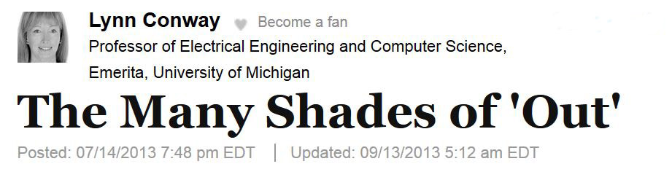
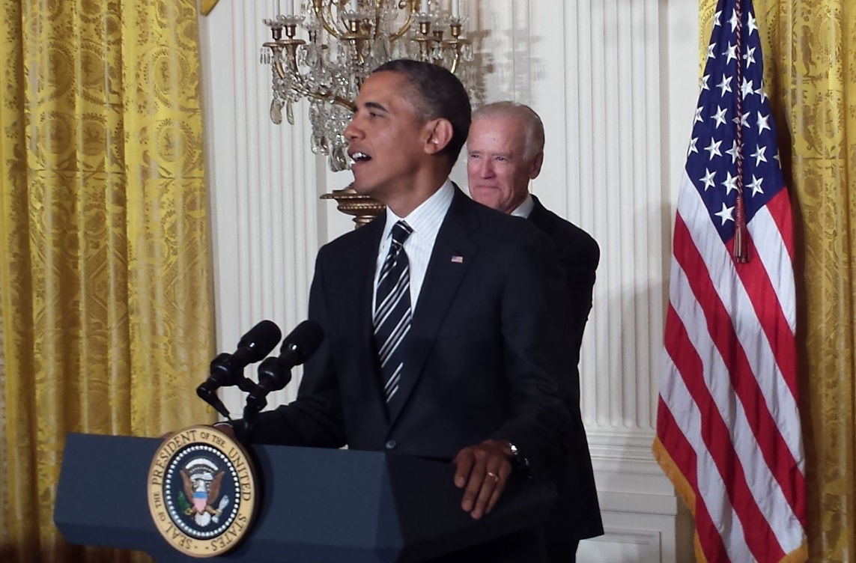
An essay reflecting on the
White House Reception
to celebrate LGBT Pride Month
June 13, 2013
For full text, see:
http://www.huffingtonpost.com/lynn-conway/
the-many-shades-of-out_b_3591764.html

Slide 4

With that as a backdrop, let’s now examine the
historical treatment of women’s contributions in STEM
Link

Slide 5

First, listen as OSTP Chief Technology Officer Megan Smith
reveals women in STEM being erased from history . . .
https://www.youtube.com/watch?v=fHyRdAyqV5c
http://boingboing.net/2015/05/08/cto-megan-smith-explains-how-w.html
http://www.charlierose.com/watch/60554078 (4-28-15)

Slide 6
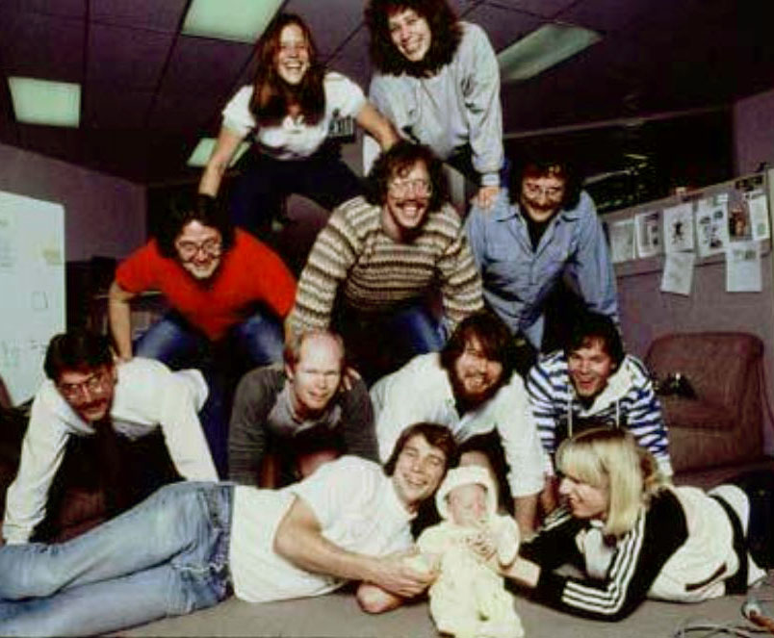
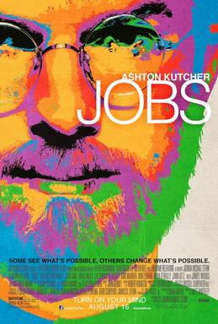
Although four women worked on the Macintosh team in the 1980s, not a single one was cast in the 2013 biopic Jobs with Ashton Kutcher. Even worse, all seven men who worked on the project had speaking roles in the film.
It’s not just that women have a harder time breaking into STEM fields, it’s that the many contributions they do make aren’t celebrated. “It's debilitating to our young women to have their history almost erased,” Smith explains.

Slide 7
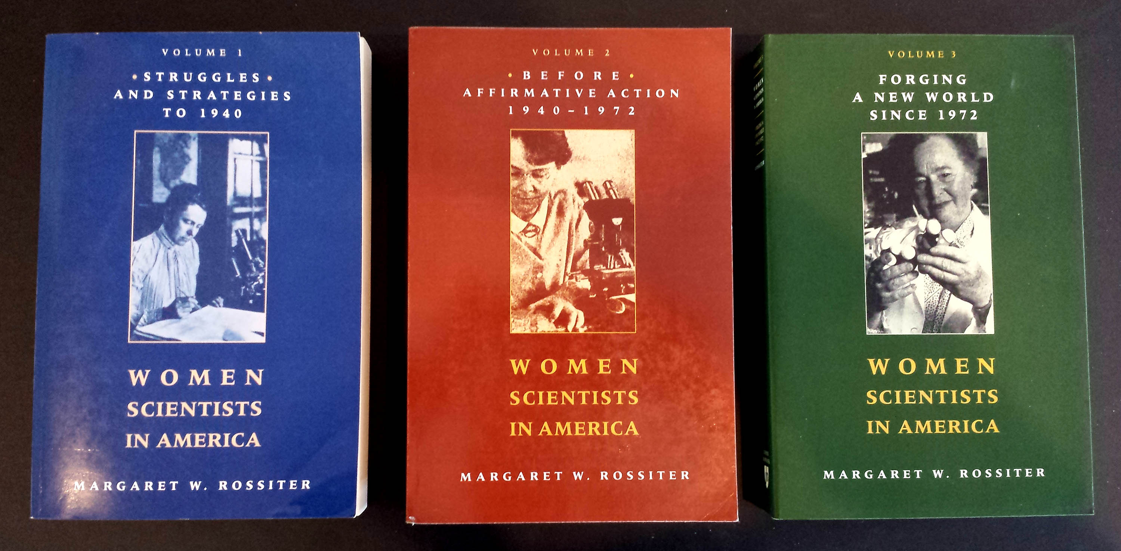
This effect is seen throughout the history of women in science,
as reported by Margaret Rossiter in Women Scientists in America.
Her volumes document numerous case studies of such historical erasures.

Slide 8
In 1993 Rossiter coined the term “Matilda effect” for the systematic repression and denial of the contributions of women scientists, whose work is often attributed to their male colleagues.
This is analogous to the term "Matthew effect“, coined by Robert K. Merton in 1968, describing how eminent scientists often get more credit than a lesser-known researcher, even if their work is similar.
For example, a prize will almost always be awarded to the most senior researcher involved in a project, even if the work was all done by a grad student.

Slide 9
CASE STUDY: The revolution in Very Large Scale Integrated (VLSI)
microchip design and manufacturing, beginning in 1976.
Link

Slide 10
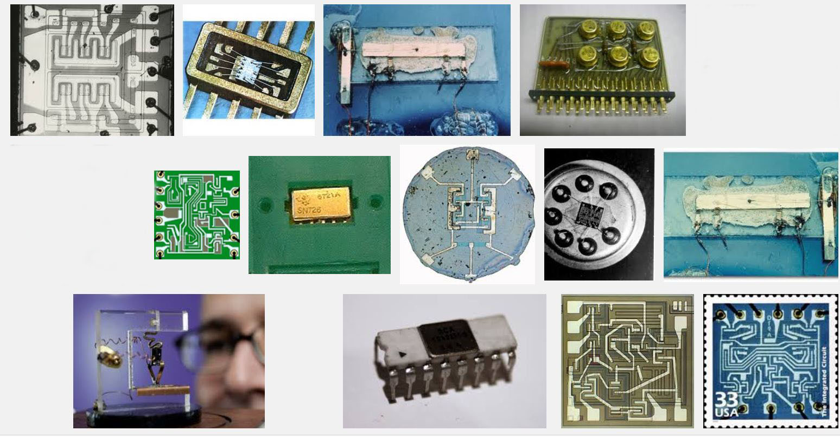
The stage was set by emergence of integrated circuit technology in the 1960’s, enabling numbers of transistors and their wiring to be ‘printed’ onto chips of silicon . . .
Some early integrated circuits:
Snip from Goggle images

Slide 11
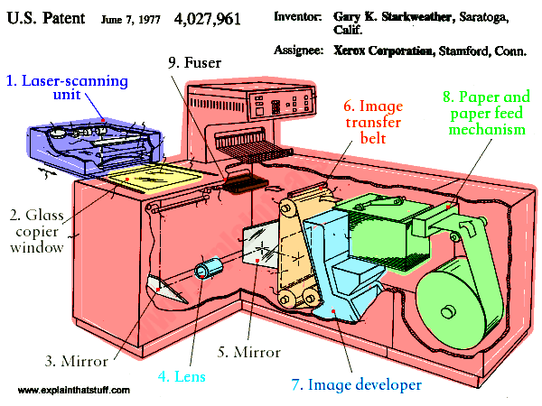
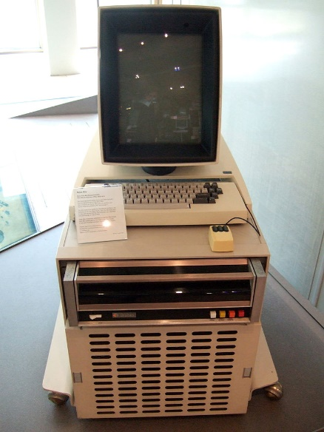
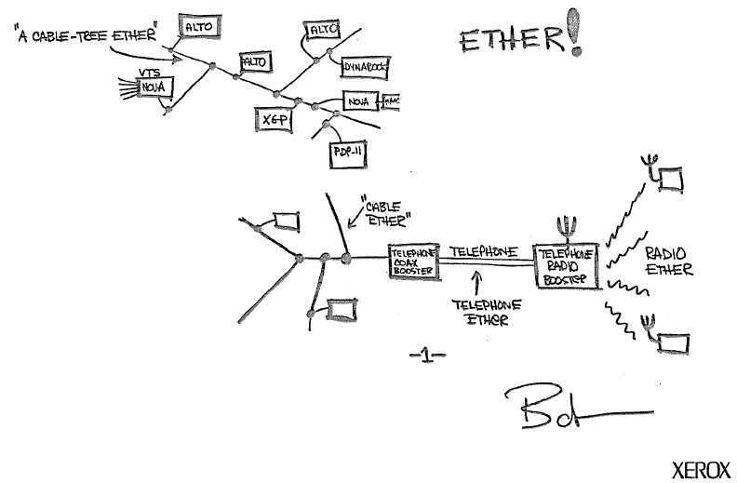
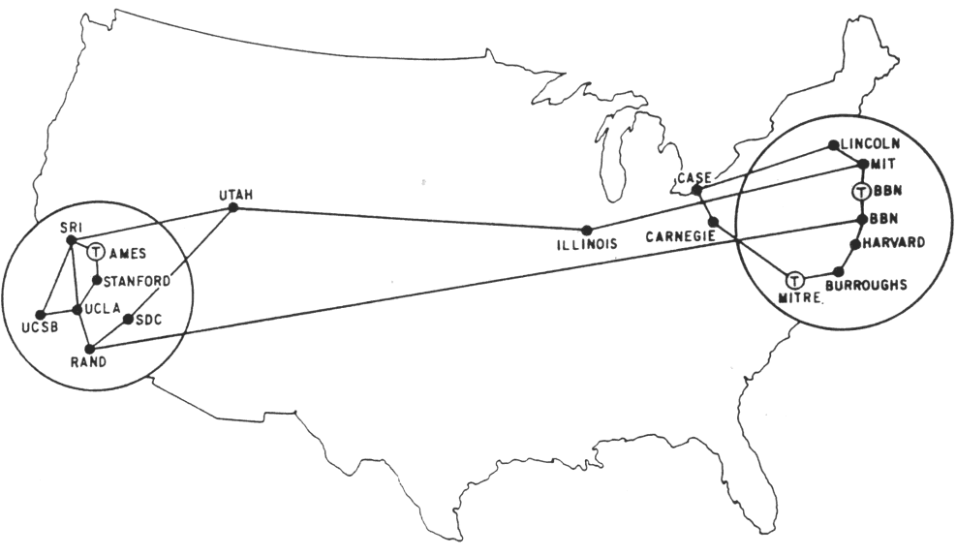
And ‘potentiated’ by the early 70s revolution in personal computing and networking:
Innovation of the interactive-display, mouse-controlled “personal computer”,
the “Ethernet” local-area network, and the “laser printer” (at Xerox PARC) . . .
And the Dept. of Defense’s “Arpanet” (the early internet, at DARPA) . . .
Xerox Alto, 1973
Metcalfe’s original
Ethernet sketch, 1973
Laser printer, 1971
Source
Source
Arpanet map, 1971
Wiki commons

Slide 12
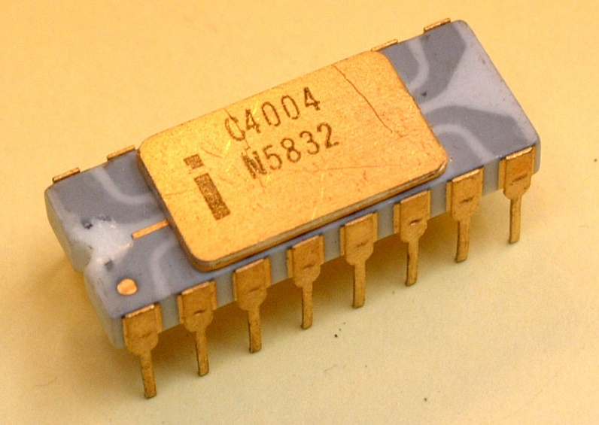
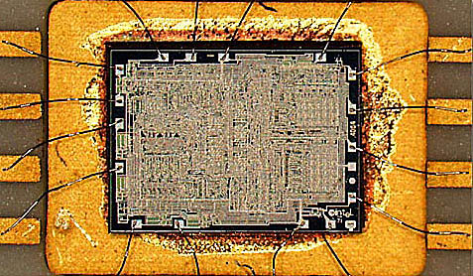
Ongoing advances in lithography kept enabling ever-finer features to be printed, rapidly increasing the number of transistors printable on single chips.
And by 1971, a watershed was crossed
with the introduction of the Intel 4004, the first single-chip “microprocessor”:
a “computer processor on a chip” . . .
Source
It contained 2300 transistors . . .
Source

Slide 13
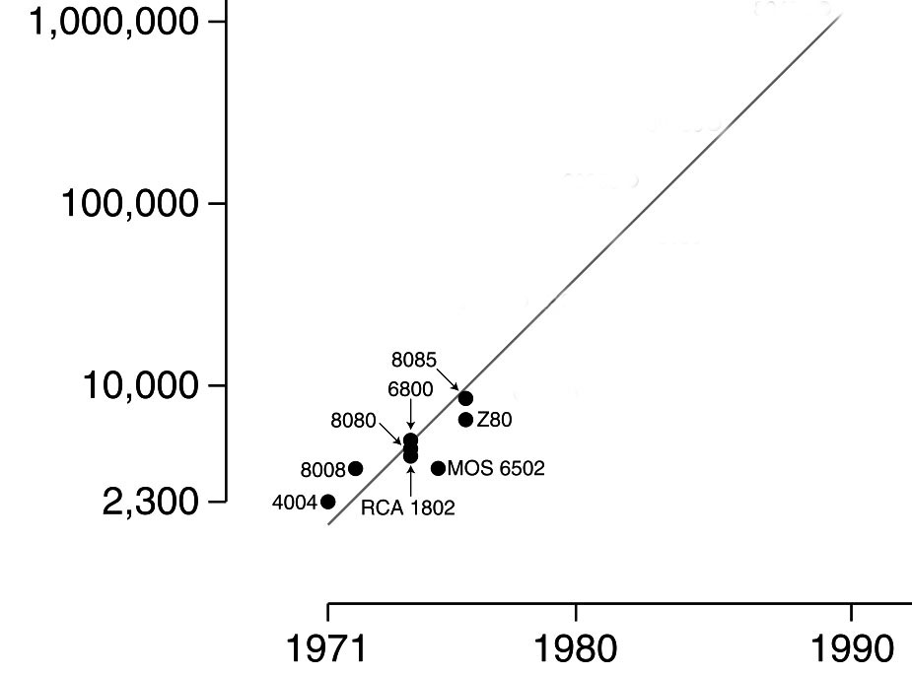
Gordon Moore at Intel observed
that the number of transistors reliably printable on commercial chips was roughly doubling every two years . . .
Moore’s Law (as of 1976)
.
An exponential function,
graphed on a vertical log scale
Carver Mead named this “Moore’s Law” and predicted that there were no physical limits to increasing chip density up to at least 1 million transistors.
N(t)/N(0) = 2^(t/2)
In 1976 this set-off a push at Xerox PARC and Caltech to figure out how to enable such complex chips to be designed.
After all, looking ahead it appeared conceivable
by ~1990 an entire “supercomputer” could be
printed on a single chip . . .

Slide 14
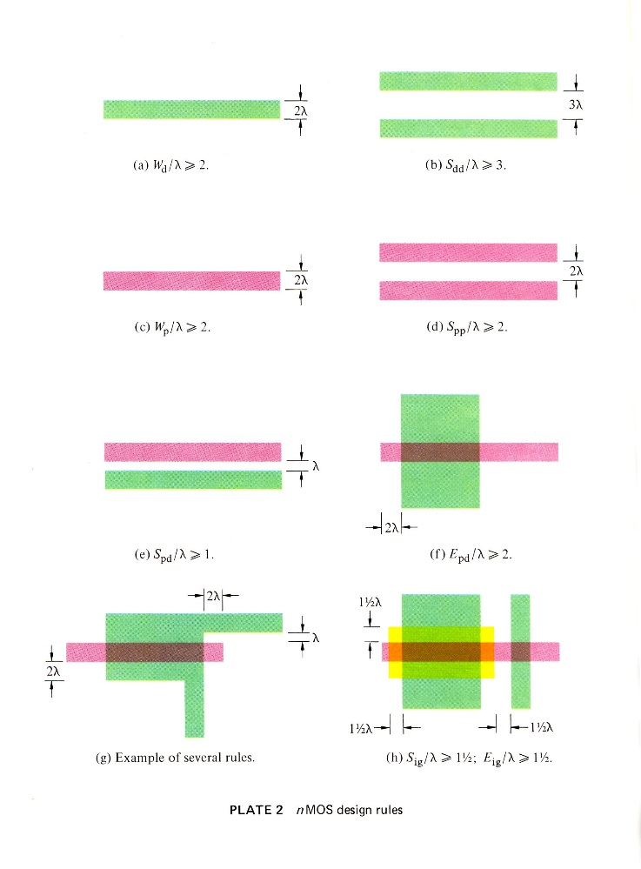
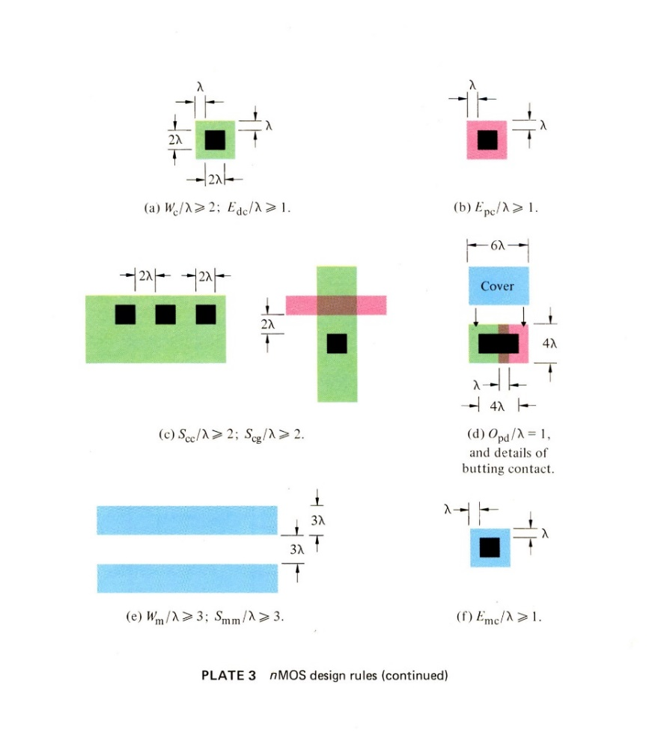
A sudden disruptive breakout was triggered
by a cluster of abstract innovations, primarily at PARC . . .
Included were a set of scalable VLSI chip-layout design rules, in the form of ratioed (dimensionless) inequality equations (Conway, Xerox PARC) . . .
These enabled abstract chip designs to be digitally shrunk down (and reused) as Moore’s law rapidly advanced . . .
They also enabled accruing chip subsystem designs to be widely shared . . .
Link

Slide 15
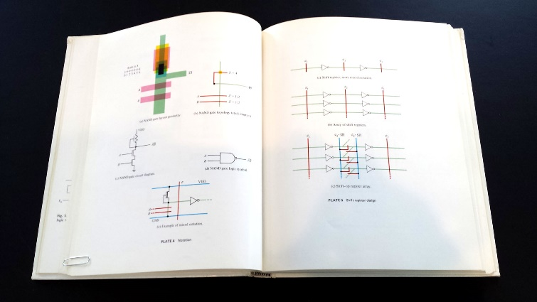
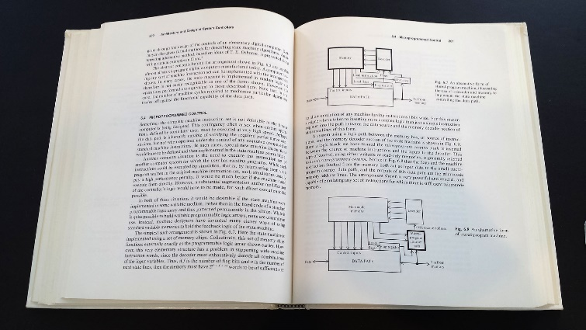
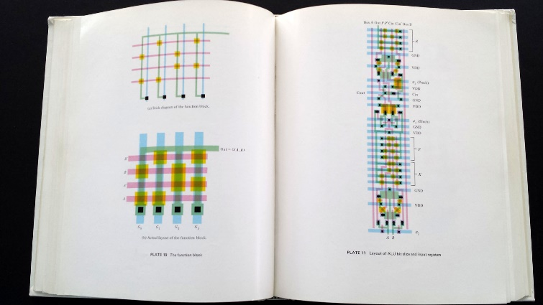
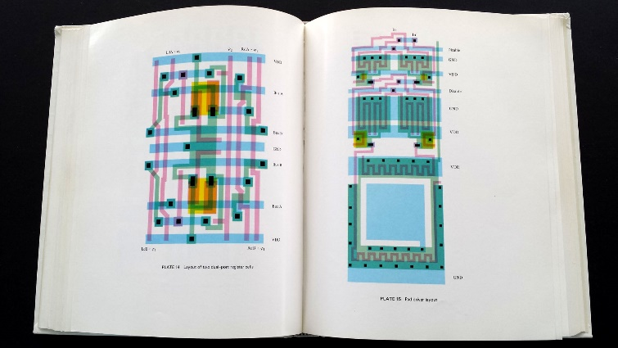
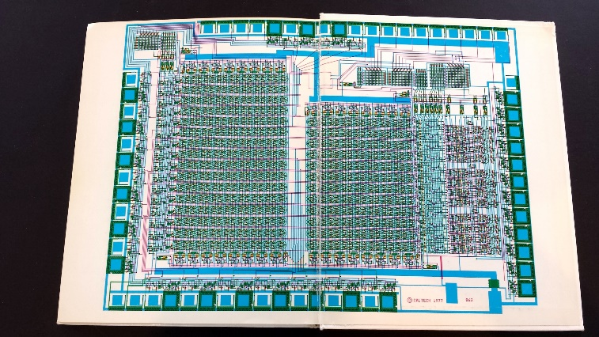
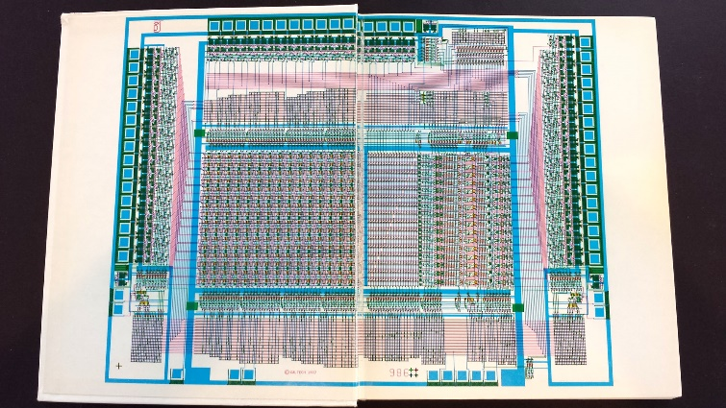
I began documenting the emerging new ‘Mead-Conway’ system of simplified, restructured,
design-level abstractions and chip design methods in an evolving computer-edited book . . .
Thus using our Alto computers not only as tools for generating chip-designs,
but also to mechanize the evolution of the chip-design knowledge itself . . .
Link

Slide 16
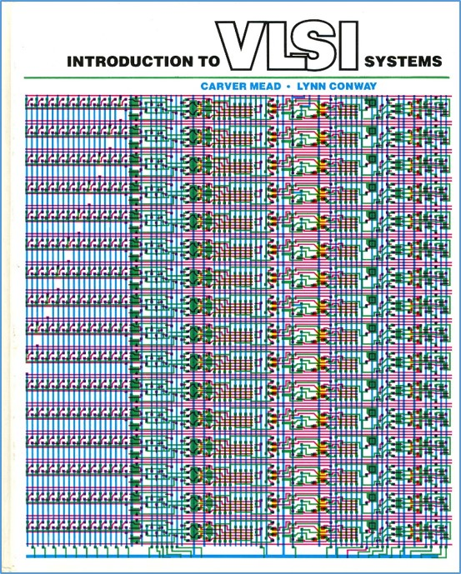
That computer-edited evolving book, printed using the laser printers at PARC, became the draft of the famous textbook:
Introduction to VLSI Systems
by Mead and Conway,
published in 1980.
(later called “the book that
changed everything” . . . )

Slide 17
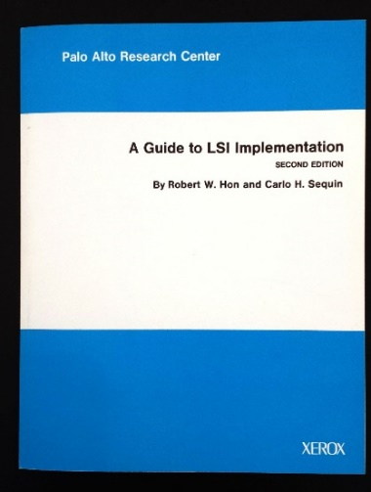
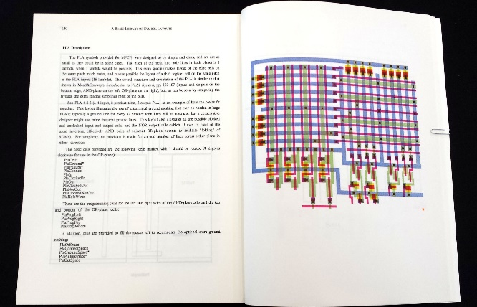
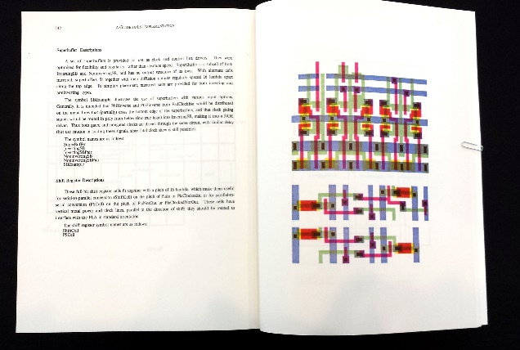
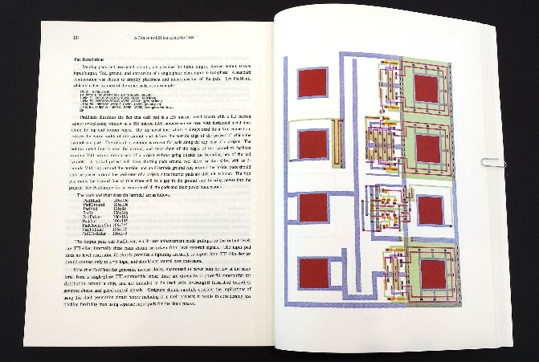
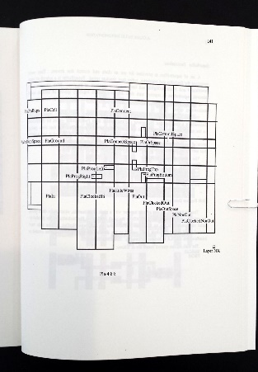
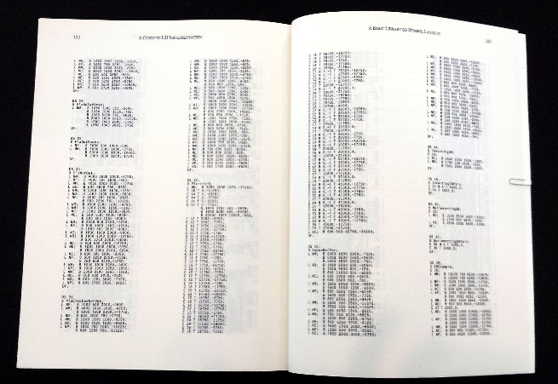
We also used our Altos (at Xerox PARC) to generate many open-source cell-layout-designs
for key digital-subsystems, easily disseminated to students and colleagues via the Arpanet …
URL
PLA cells
Clock drivers
I/O Pads
Cell locations
CIF 2.0 Cell-Library code

Slide 18
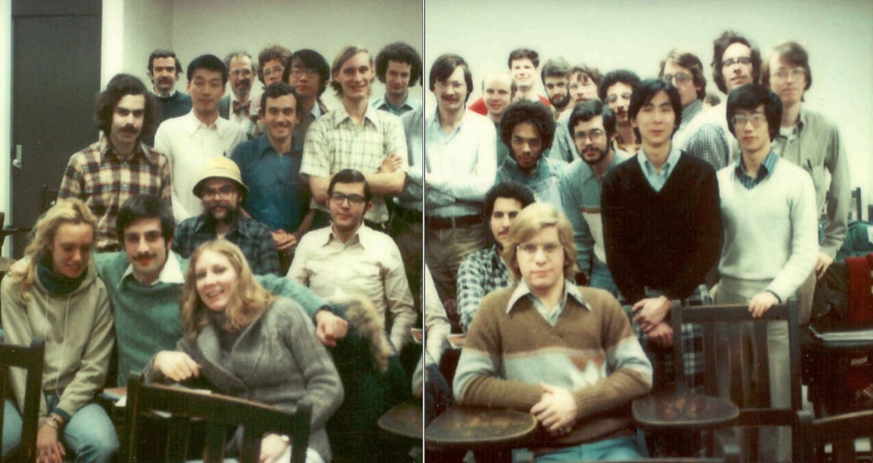
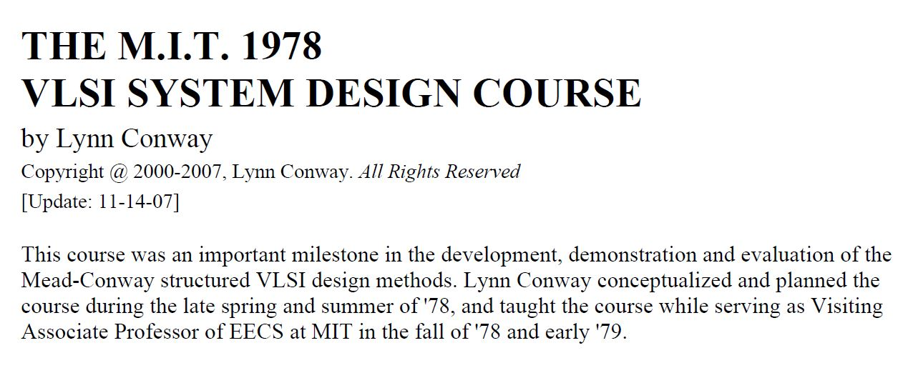
Following the “script” Charles Steinmetz used to propagate his revolutionary AC electricity methods at Union College, I introduced the new methods in a special VLSI design course at MIT in 1978.
Link
Link
Link

Slide 19
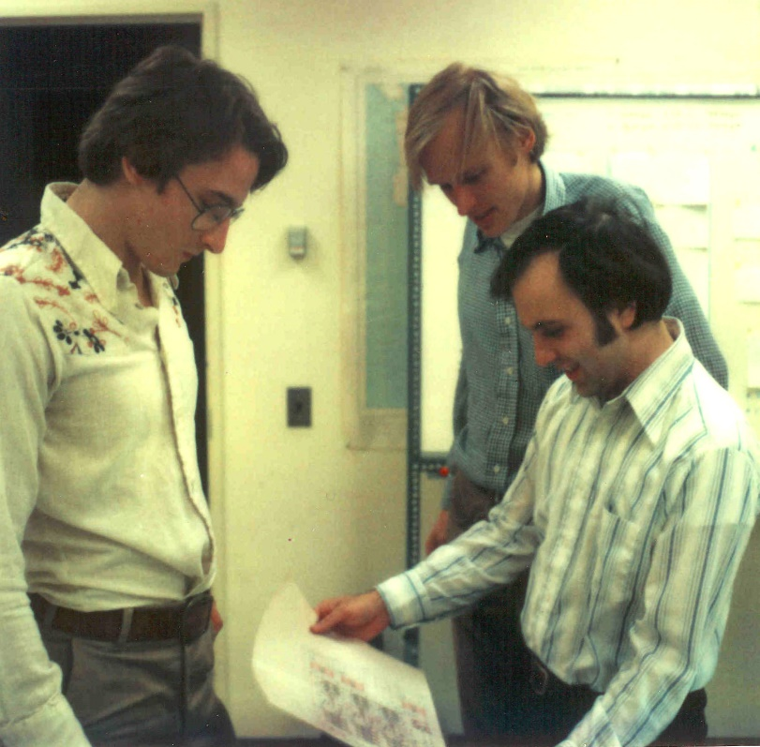
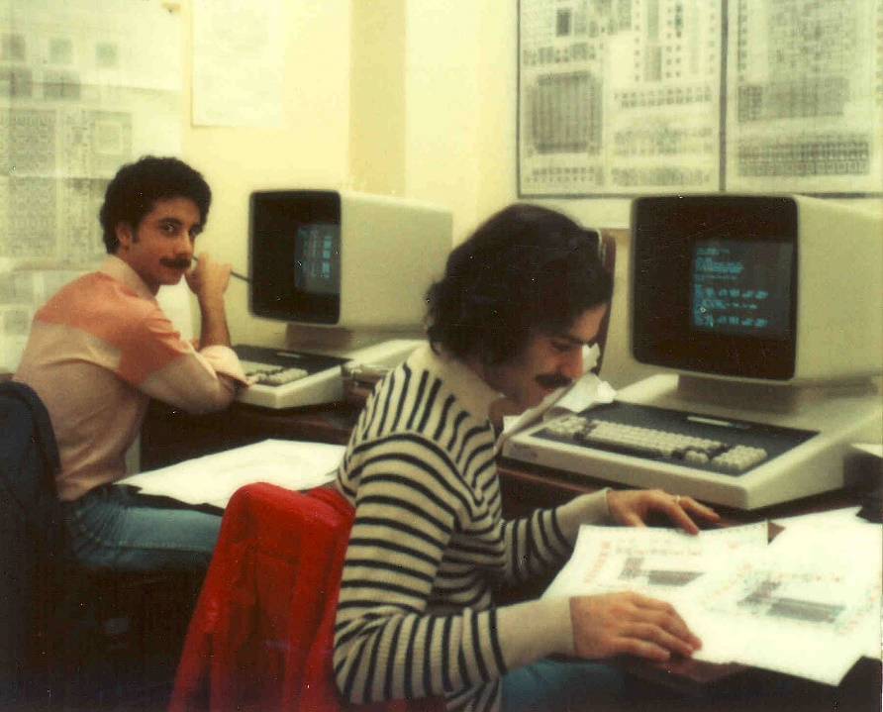
The students learned to design chips in the 1st half of the course, then did project-chip designs in the 2nd half. They were fabricated in Pat Castro’s lab at HP shortly after the course.
There were many amazing results including a complete Lisp microprocessor design
by Guy Steele . . .

Slide 20
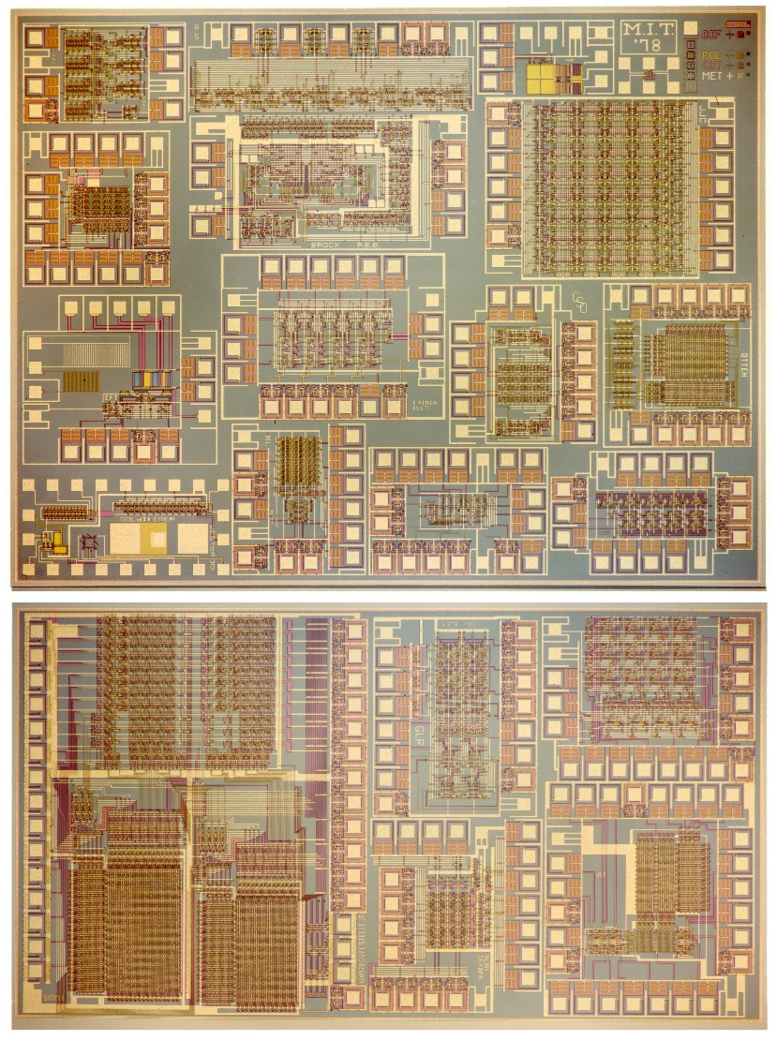
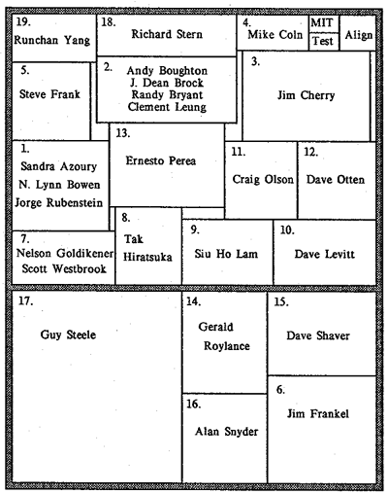
Map and photomicrograph
of the 19 student projects on
the MIT’78 ‘MultiProject’ Chip
For more about the MIT’78 course, see Lynn’s “MIT Reminiscences”

Slide 21
The MIT’78 course stunned top folks in Silicon Valley . . .
And many other top research universities wanted to offer such a course. But how?
Suddenly, the answer came to me: Simultaneously rerun the MIT’78 course at several research universities, using my MIT lecture notes to keep things in sync.
Hmm. But how to “print” the resulting student project chips?
I suddenly envisioned a new form of “E-commerce” manufacturing system, enabling student design files to be remotely submitted via the Arpanet to a “server” at PARC . . .
The server would run logistics-software to pack designs into multi-project chip files (like composing the print-files for a magazine, using remotely-submitted articles) . . .
We’d then make masks, “print” MPC’s at HP Labs (where my collaborator Pat Castro had prototyped the first “silicon foundry”), and quickly return the chips to students.

Slide 22
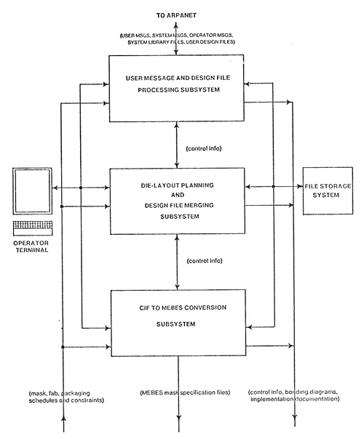
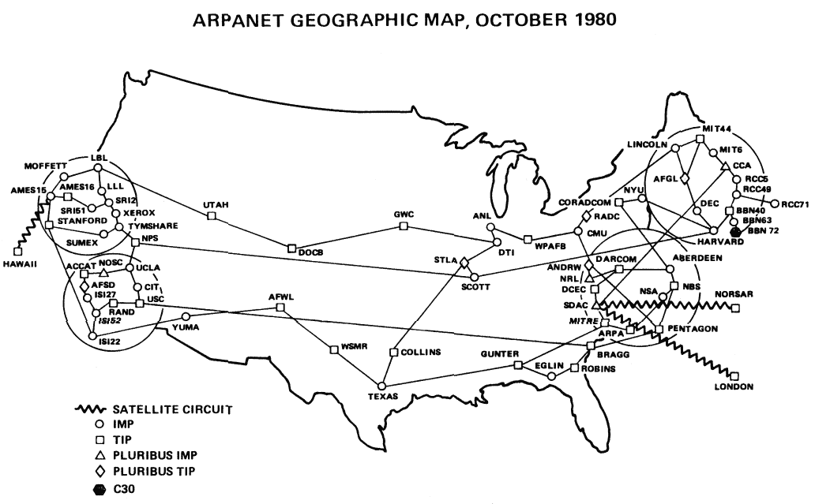
In the fall of 1979, I orchestrated a huge “happening” (MPC79)* . . . It involved 129 budding VLSI designers taking Mead-Conway courses at 12 research universities…
MPC79 Arpanet E-commerce system:
*The MPC Adventures: Experiences with the Generation of VLSI Design
and Implementation Methodologies, L. Conway, Xerox PARC, 1981 (PDF)

Slide 23
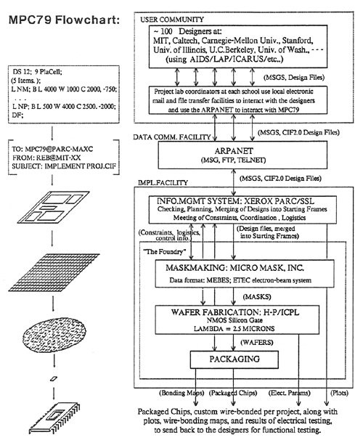
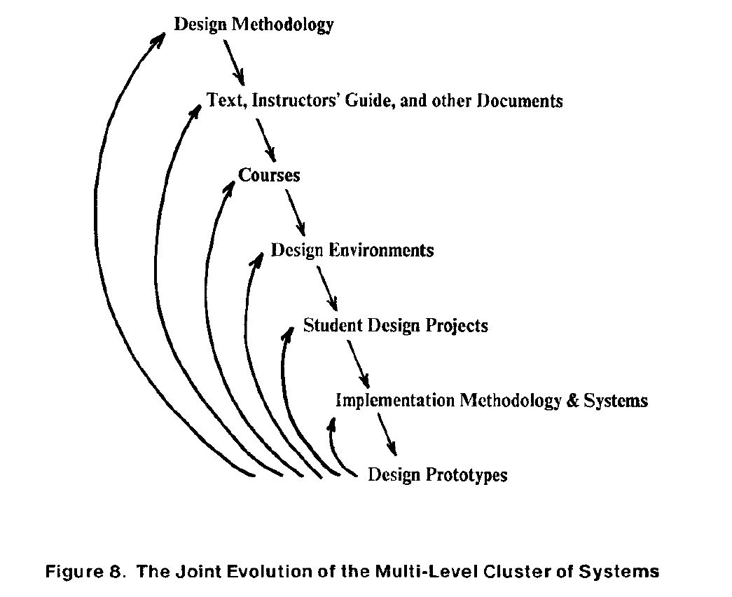
MPC79 not only provided a large-scale “demonstration-operation-validation” of the design methods, design courses, design tools and e-commerce digital-prototyping technology …
it also triggered ‘cyclic gain’ in, and exponentiation of, the budding VLSI-design-ecosystem…
The MPC Adventures, L.ynn Conway, Xerox PARC, 1981.

Slide 24
Visualizing how techno-social dynamics triggered an exponentiation in the spread of the innovative
VLSI design and making ideas via the emerging internet communication technology . . .
By 1982-83, Mead-Conway VLSI design courses were
being offered at 113 universities all around the world
It had been a successful early experimental-exploration into what is now termed “social physics”
The MPC Adventures (p. 16)

Slide 25
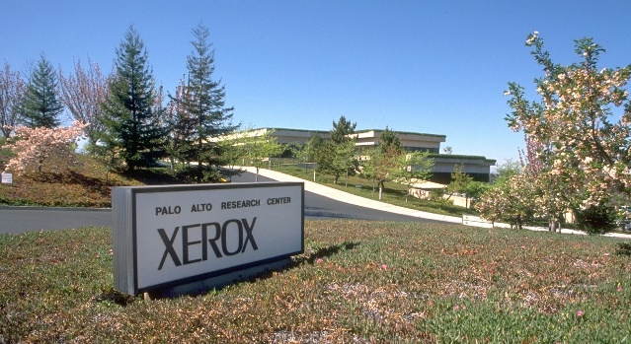
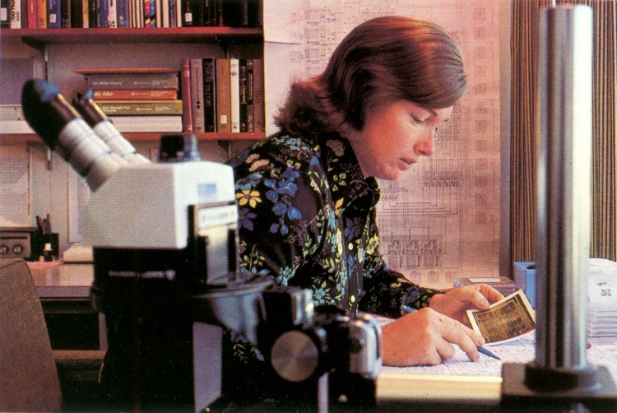
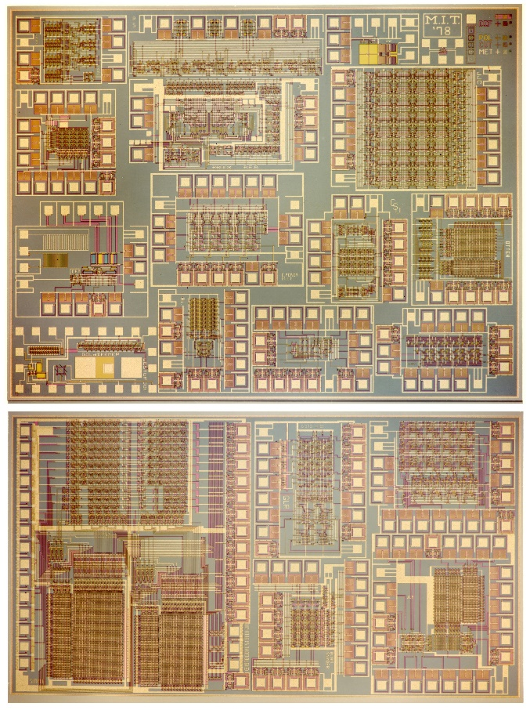
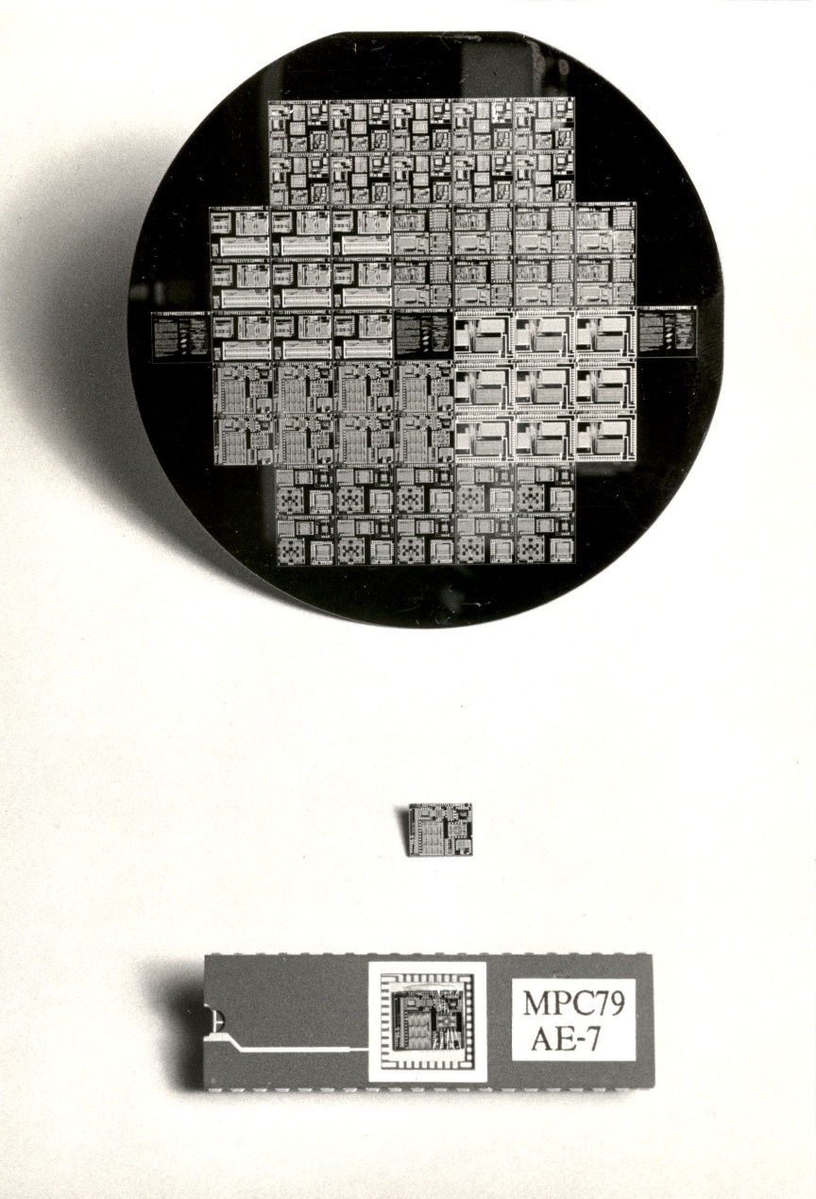
1976
1977
1978
1979
Visualizing the exponentiating
wave of VLSI innovation . . .
’76: How to cope with VLSI complexity?
’77: Inventing scalable VLSI design rules.
’78: Launching the VLSI methods at MIT!
’79: Launching the VLSI courses via MPC79!!

Slide 26
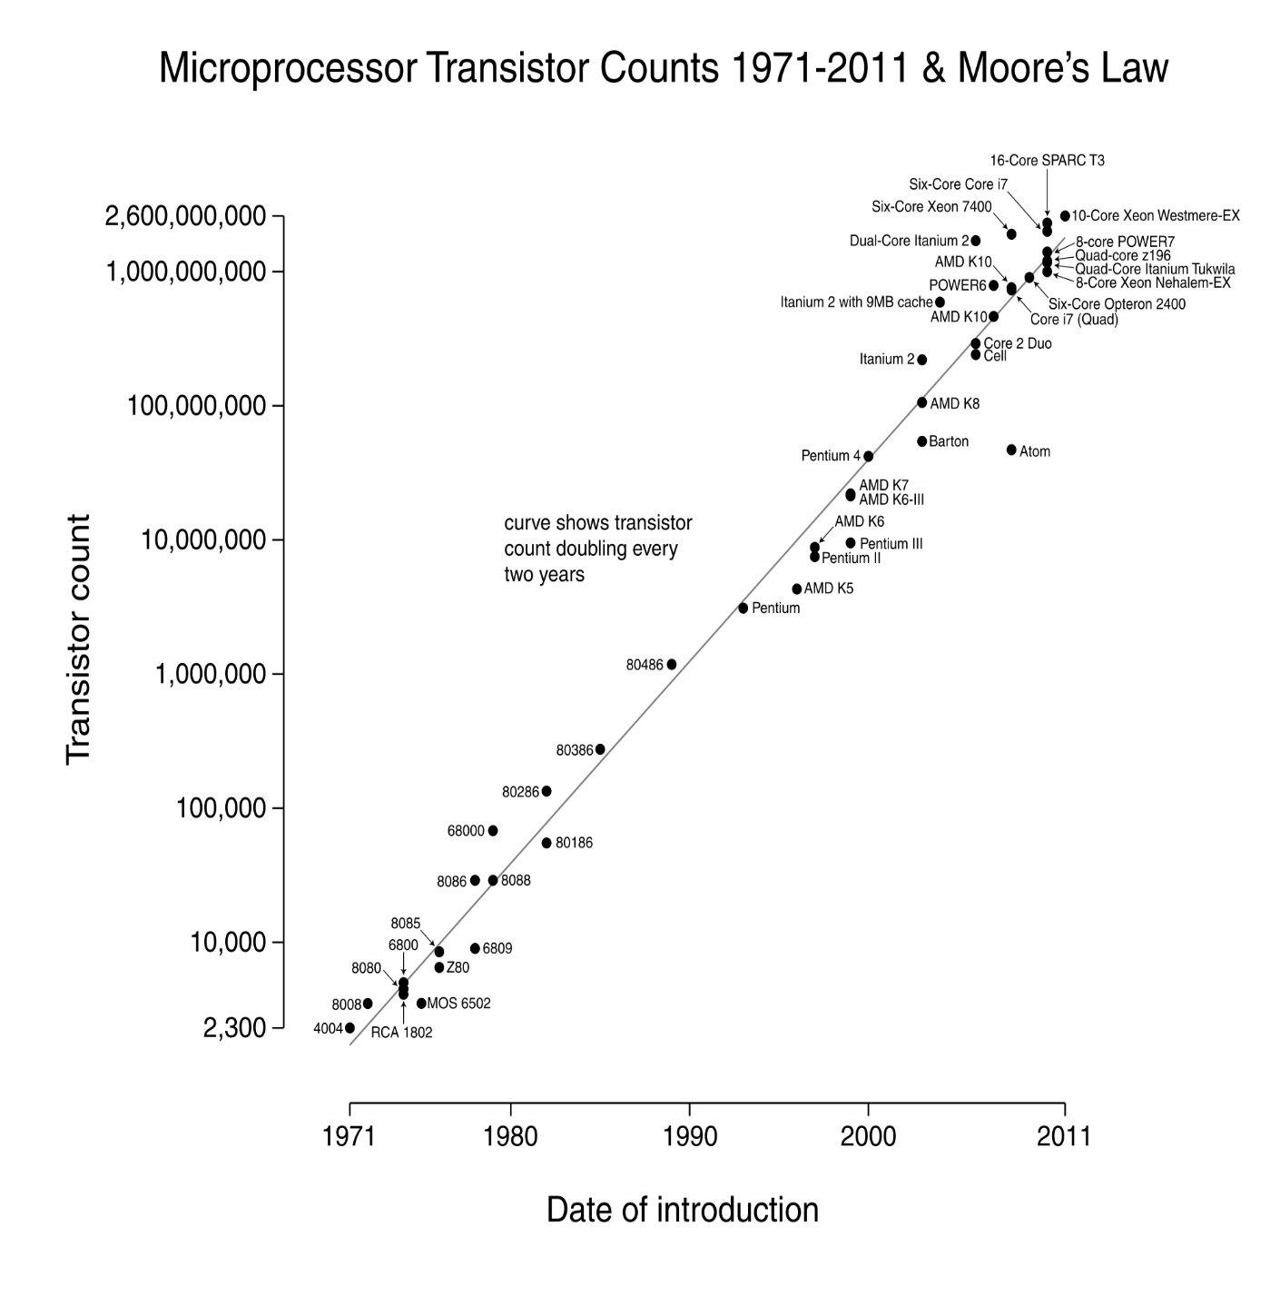
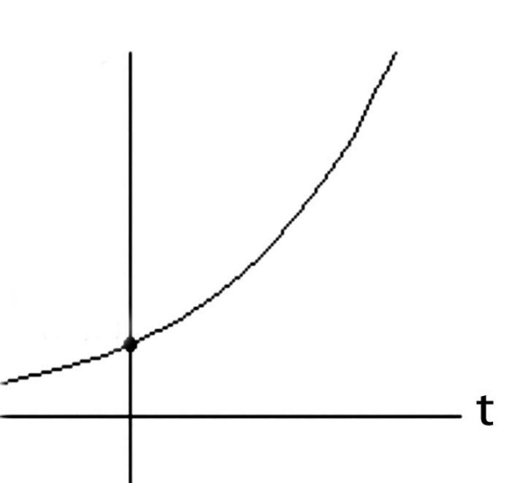
Over the past 40 years or so, Moore’s Law stayed on track all the way:
N
(exponential function
graphed on log scale)
(exponential function
with t in years)
N(t)/N(0) = 2^(t/2)
N(0), t(0)
Starting with several thousand
in 1971, the number of transistors on a chip passed one million by 1991, and by 2011 passed several billion!

Slide 27

Exponentiation, compounding ‘techno-social interest’, ‘techno-social entropy’ . . .
Link

Slide 28
Let’s now go back and follow the high-tech community’s reactions
to the “Mead-Conway” innovations during the ensuing decades:
Link

Slide 29
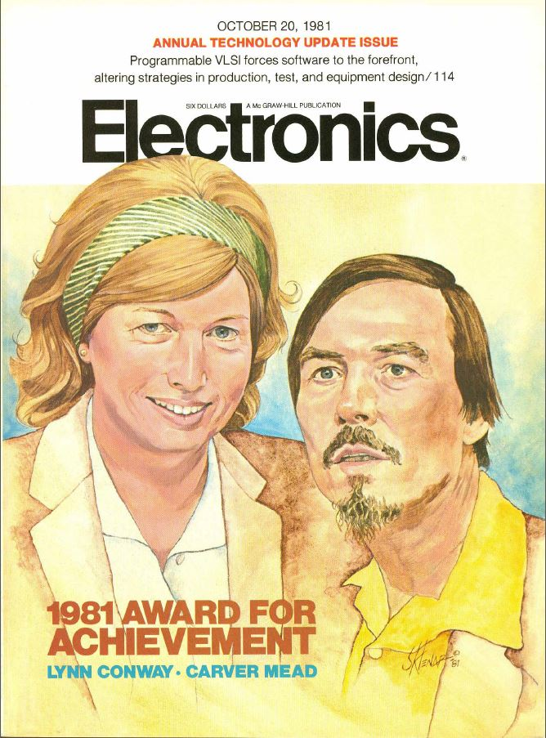
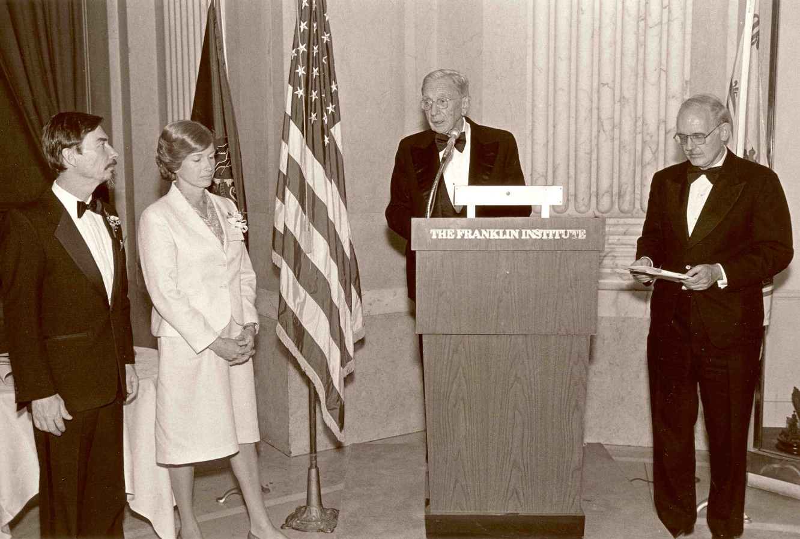
Key people sensed ‘something significant’
had happened, and Mead & Conway began
receiving major recognition in the 1980s:
Electronics Award for Achievement ‘81
Pender Award, Moore School ‘84
Wetherill Medal, Franklin Institute ’85
NAE, Mead ‘84
NAE, Conway ‘89. . .

Slide 30
However, from 1989 on through the 90s and 00s, Mead received increasingly major recognitions while Conway’s role was erased*:
NAS ‘89
American Academy of Arts and Sciences ‘91
EDAC Phil Kaufman Award ‘96
IEEE John Von Neuman Medal ‘96
ACM Allen Newell Award ‘97
MIT Lemelson Award ‘99 ($500,000)
Fellow Award, Computer History Museum ‘02
National Medal of Technology ‘02
NAE Founders Award ‘03
Inventors Hall of Fame ’09
*Most of these awards were for innovations that were Conway’s

Slide 31
As a result, by 2009 the erasure was complete:
Chip inventors getting their due at Hall of Fame induction
By Mike Cassidy, San Jose Mercury News
Apr. 30, 2009 --The 50th birthday celebration of the integrated circuit kicks off in Silicon Valley this weekend, and frankly, I'm a little overwhelmed . . .
On Saturday night, the National Inventors Hall of Fame is inducting this year's class. The sold-out ceremony (at the Computer History Museum) is in Silicon Valley for the first time, because the Ohio-based hall is honoring 15 who are responsible for breakthroughs in semiconductor technology -- the technology that put the "silicon" in Silicon Valley . . . In a way, it's as if the valley's founding fathers are coming together to be honored in person and posthumously.
Inductees Gordon Moore, co-founder of Intel and namesake of Moore's Law, and Carver Mead, chip design pioneer and all-around brainiac, will be at the ceremony. So will lifetime achievement honoree Andy Grove, Intel's former CEO . . .

Slide 32
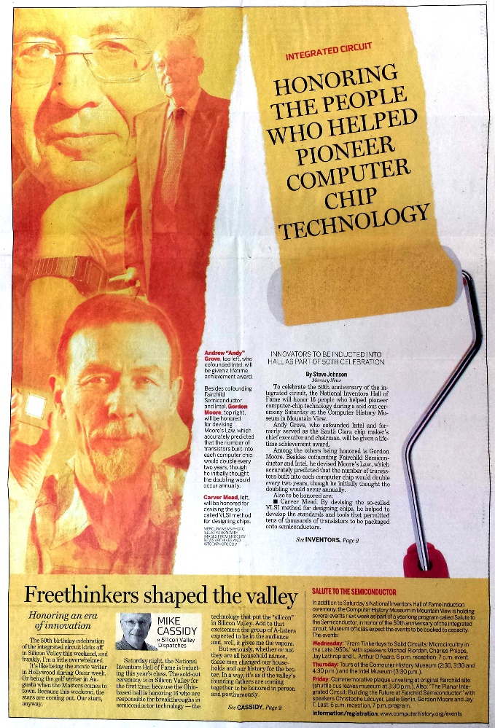
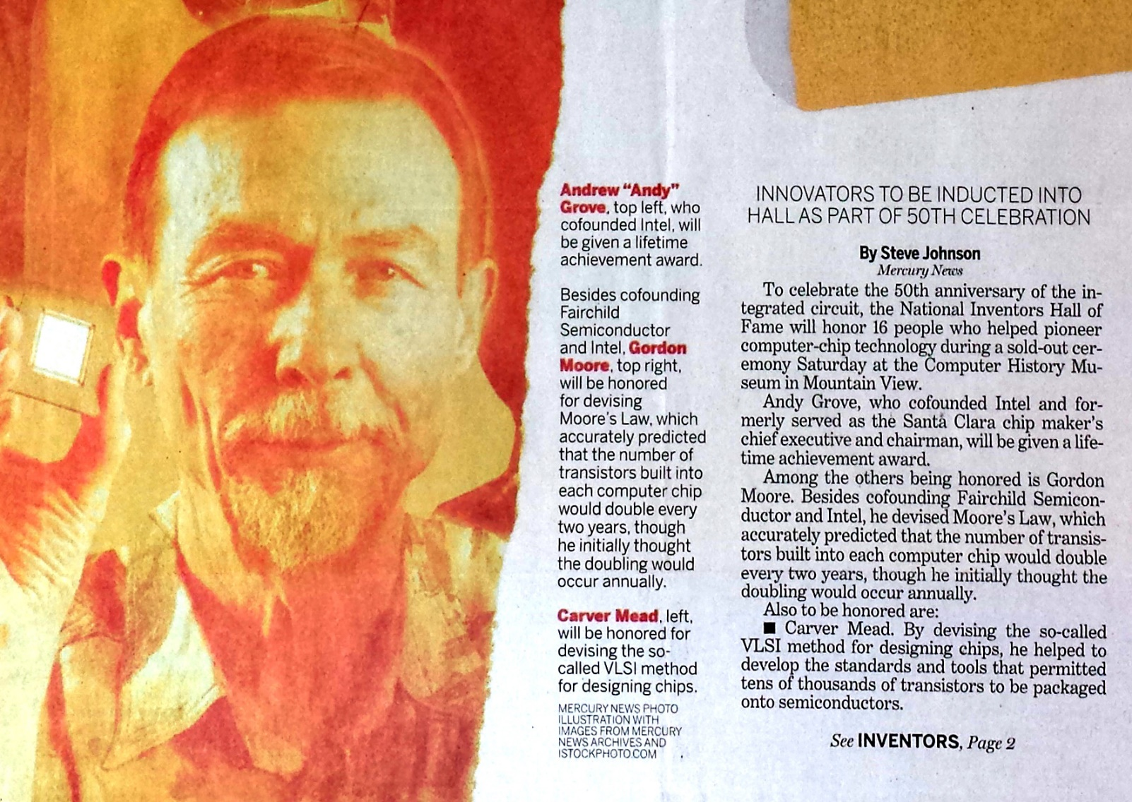
With Andy Grove, Gordon Moore and Carver Mead taking center stage:
San Jose Mercury News April 30, 2009
BTW, Conway wasn’t invited and didn’t even know it was happening . . .

Slide 33
2009-2012: Emerging to investigate, document and report on what happened,
hoping to regain some of my legacy along the way . . .
Link

Slide 34
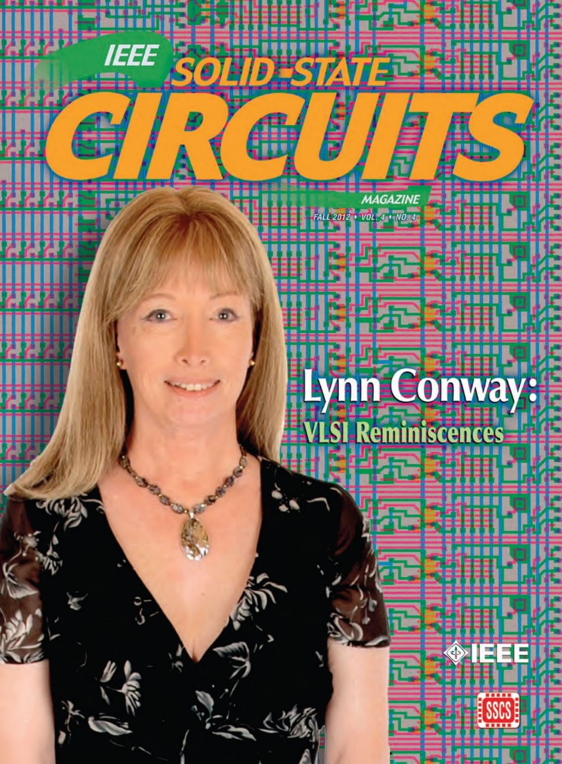
The story of my investigations over recent years is quite a saga, yet to be told . . .
To make a long-story short: I uncovered,
documented and archived all sorts of
interesting data and evidence.
That led me to write and publish my “Reminiscences of the VLSI Revolution” in the
Fall 2012 IEEE Solid State Circuits Magazine.
It was the first time I’d stepped openly forward to tell the whole story . . .

Slide 35
Sketch of the investigations, documenting and reporting
to understand what happened and to reclaim my legacy . . .
Compilation of the VLSI Archive, 2009-2012
Publication of my IBM-ACS Reminiscences, 2011
Publication of my VLSI Reminiscences, 2012
Publication of The Many Shades of ‘Out’, 2013
Publication of my MIT Reminiscences, 2014
Evidence that ‘it’s begun’:
Fellow Award, Computer History Museum, 2014
IEEE/RSE James Clerk Maxwell Medal, 2015

Slide 36
Lessons learned upon reflection:
Visualizing the Mathew, Matilda and Conway Effects
Link

Slide 37
Throughout this case study we observe the “Matilda effect” (repression of the contributions of women scientists) and the "Matthew effect“ (eminent scientists get more credit) in play.
Note that these effects involve “self-fulfilling prophecies”, described by Merton as:
“. . . a false definition of the situation evoking a new behavior which makes the original false conception come true. This specious validity of the self-fulfilling prophecy perpetuates a reign of error. For the prophet will cite the actual course of events as proof that he was right from the very beginning.”
But is that all that’s happening? Or are other forces also in play?

Slide 38
After closely investigating these events, I sense something more subliminal and fundamental is occurring at a social level . . . and it involves no errors, no conspiracies, no repressions, no ‘bad guys’:
CONJECTURE: almost all people are blind to innovations, especially ones made by ‘those’ whom they do not expect to make innovations.
Since for most people, ‘those’ = ‘almost all people’, very few people ever witness or visualize innovations, even ones made right in front of their eyes (including sometimes those made by themselves!).
They instead look for tells and cues from others when constructing internal-orientations towards ‘novelties’ they stumble upon . . . and not just whether or not to accept or reject a novelty, but also whether to even notice it in the first place!
From this perspective, the Mathew and Matilda Effects are derivatives of the conjectured social-level “Conway Effect”.

Slide 39
Visualizing the Conway Effect in action:
Students in MIT’78 thought they were learning “how chips were designed in Silicon Valley” (i.e., in effect the course was a giant MIT hack). They simply “did it”, without realizing they were learning radically new methods.
The astonished reaction amongst Silicon Valley cognoscenti then led to intense interest in reverse engineering “how MIT was doing this”, causing other research universities to immediately want to offer such courses.
Similarly, folks using MPC79 took it for granted and simply “used it”. No one realized MPC79 was an even larger paradigm-shifting-hackathon to launch the modern world of “fabless design” + “silicon foundries” + “internet-based e-commerce infrastructure.”

Slide 40
What might MPC79 participants been thinking?
Since MPC79 used the ARPANET, some thought DARPA “did it.”
Thus when DARPA funded the transfer of MPC79 technology to USC-ISI, many users thought “MOSIS” had been “created by DARPA” . . . and similar government supported MOSIS-like services began springing up in other countries . . .
The VLSI revolution thus swept through high-tech community without anyone realizing that it had been deliberately generated, much less how that was done and who did it.
Although the “VLSI Book by Mead” became iconically connected with these large-scale socio-technological events, Mead himself was never able to explain what happened.
Meanwhile, Conway remained in the shadows up until 2012, when she finally was able to emerge and explain how it happened . . .

Slide 41
The Conway Effect: Almost all people are blind to innovations, especially ones made by people whom they do not expect to make innovations.
As a result, innovations diffuse via social-processes involving subliminal subgroup noticings, mimickings, rejections, adoptions, adaptations, tradings and displacements.
“Credits for innovations” as social tokens are separately subliminally generated, gathered, seized, gained, granted, bartered, etc. . . .
via social-tokening-processes modulated by visibility, status, prestige, class, power, location, credentials, prejudice, popularity, influence, money and accident . . .
in ways that sustain those social-tokening processes . . . and thus maintain the underlying blindness to innovations.
Corollary: It’s possible to trigger large paradigm-shifts, right out in the open, without people having a clue to what you’re doing!

Slide 42
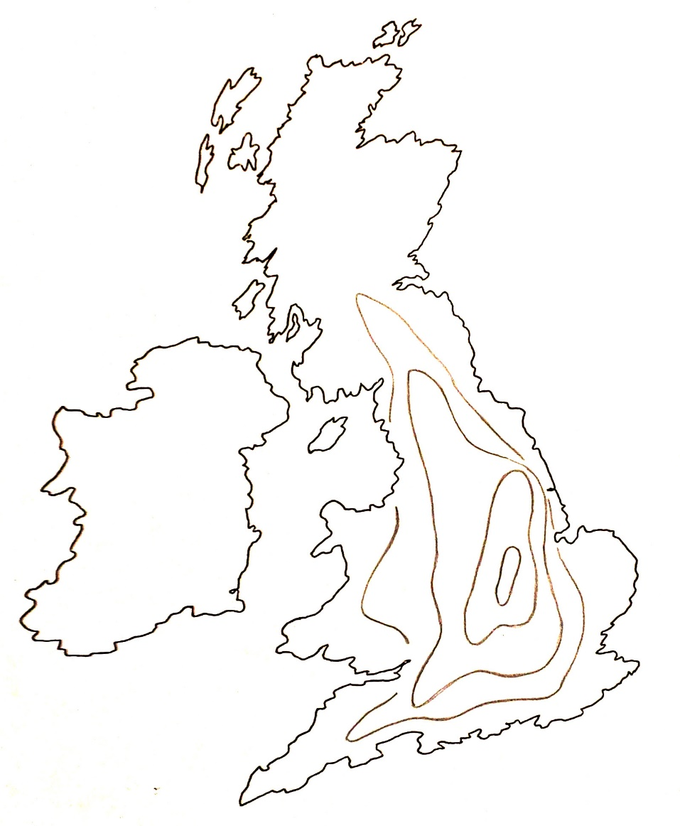

Q&A and thoughts for discussion:
Have you noticed an innovation today?
Have you made an innovation today?
What is an innovation?
Thought experiments:
Visualizing the diffusion of an innovation
t4
t3
t2
t1
John Tyler Bonner, The Evolution of Culture in Animals,
Princeton University Press, 1980, p.183-4.

Slide 43
Thought experiments (cont.):
“The most remarkable of such examples comes from the work of the Japanese Monkey Center where macaques were isolated in groups on small islands, and differences in the behavior patterns of different island populations arose by cultural evolution . . . The greatest achievement is that of Imo, the female genius among the macaques. At the age of two she invented washing the sand off sweet potatoes before eating them, and at a later date she found a way of separating wheat from sand by throwing the mixture in the water and skimming off the wheat from the surface. These discoveries spread slowly through the colony, although in general the older individuals were the last to acquire the new tricks.”*
*John Tyler Bonner, The Evolution of Culture in Animals,
Princeton University Press, 1980, p.184.

Slide 44
Readings:
Lynn Conway, “The Many Shades of Out”, Huffington Post, July 24, 2013.
Ken Shepard, “Covering”: How We Missed the Inside-Story of the VLSI Revolution”, IEEE Solid State Circuits Magazine, VOL. 4, NO. 4, FALL 2012, pp. 40-42. (more)
Chuck House, “A Paradigm Shift Was Happening All Around Us”, IEEE Solid State Circuits Magazine, VOL. 4, NO. 4, FALL 2012, pp. 32-35. (more)
Lynn Conway, “Reminiscences of the VLSI Revolution: How a series of failures triggered a paradigm shift in digital design”, IEEE Solid State Circuits Magazine, VOL. 4, NO. 4, FALL 2012, p. 8-31. (more)
Paul Penfield, "The VLSI Revolution at MIT", 2014 MIT EECS Connector, Spring 2014, pp. 11-13.
Lynn Conway, "MIT Reminiscences: Student years to VLSI revolution", lynnconway.com, March 11, 2014.
Computer History Museum: “Lynn Conway, 2014 Fellow, For her work in developing and disseminating new methods of integrated circuit design”, April 2014.
Nicole Casal Moore, “Life, Engineered: How Lynn Conway reinvented her world and ours”, The Michigan Engineer, FALL 2014, pp. 42-49.
Catharine June, “Lynn Conway to receive 2015 IEEE/RSE James Clerk Maxwell Medal”, Michigan Engineering News, December, 15, 2014.

Slide 45
END

