Slide 1
An Unexpected Woman:
The Inside Story Behind the VLSI Revolution*,**
Lynn Conway, Professor of EECS, Emerita
University of Michigan, Ann Arbor
US Chief Technology Officer Megan Smith recently raised profound questions about
how women’s contributions in science and engineering are erased from history.
In this talk we explore a case study of such erasure, and surface conjectures about underlying causes and effects.
*Invited presentation on the occasion of LGBT Pride Month, NSF, Arlington, VA, June 10, 2015.
**Condensed subset of the original 45 slideshow (n = 1-2, 5-6, 25, 29-32, 34-35, 37-41) for compact tutorials.
The NSF talk brochure, the full slideshow, and the NSF presentation video are posted at these links:
http://ai.eecs.umich.edu/people/conway/Memoirs/Talks/NSF/Images/NSF_2015_Pride_Program.jpg
http://www.nsf.gov/od/odi/presentations/2015_NSF_Pride_Talk_by_Lynn_Conway.ppsx
http://bcove.me/bkx8nwg8 (video)

Slide 2
Setting the stage: Reflections on LGBT Pride Month
Historical erasure of women’s contributions in STEM
Case study: The Inside Story Behind the VLSI Revolution
Conjecture: The Conway Effect
Q&A and thoughts for discussion

Slide 3

First, listen as OSTP Chief Technology Officer Megan Smith
reveals women in STEM being erased from history . . .
https://www.youtube.com/watch?v=fHyRdAyqV5c
http://boingboing.net/2015/05/08/cto-megan-smith-explains-how-w.html
http://www.charlierose.com/watch/60554078 (4-28-15)

Slide 4
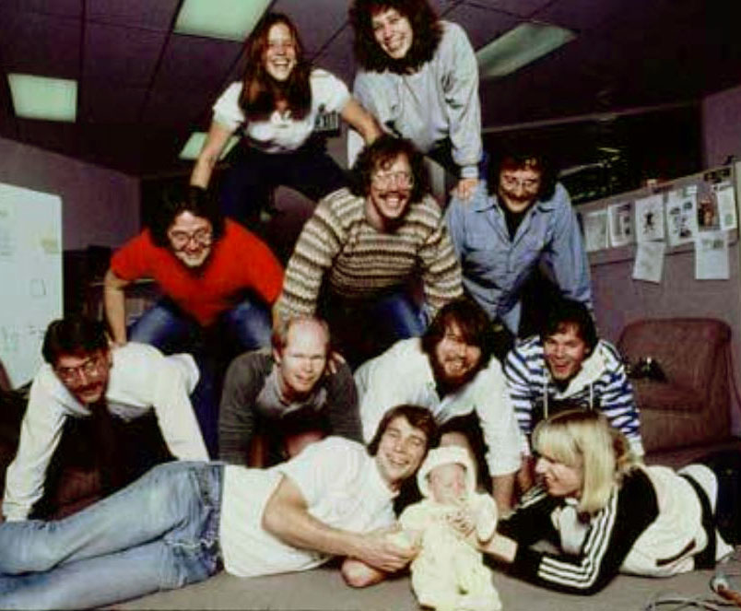
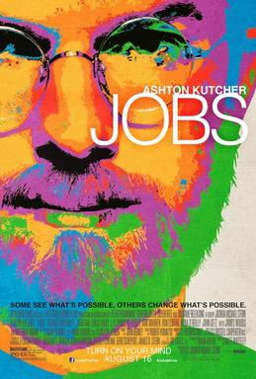
Although four women worked on the Macintosh team in the 1980s, not a single one was cast in the 2013 biopic Jobs with Ashton Kutcher. Even worse, all seven men who worked on the project had speaking roles in the film.
It’s not just that women have a harder time breaking into STEM fields, it’s that the many contributions they do make aren’t celebrated. “It's debilitating to our young women to have their history almost erased,” Smith explains.

Slide 5
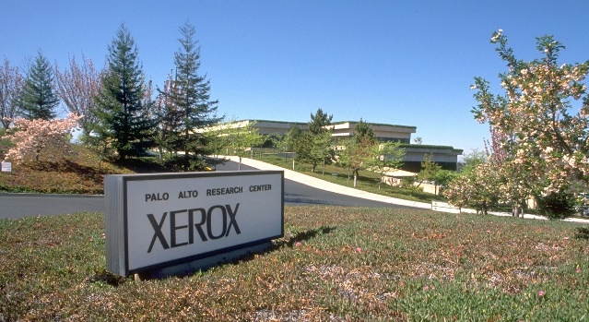
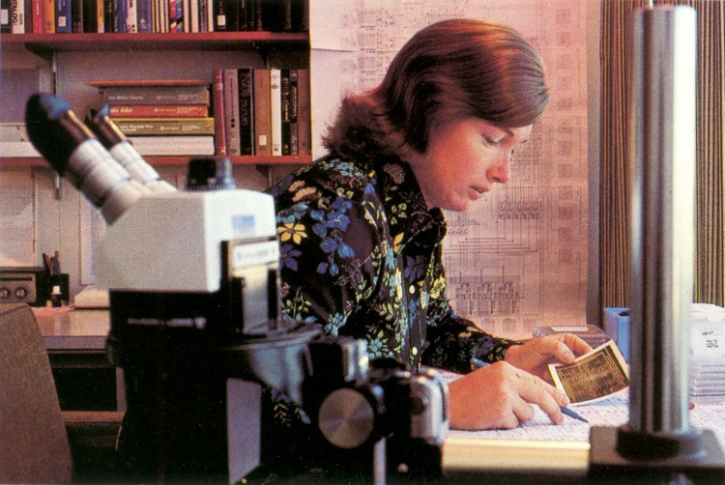
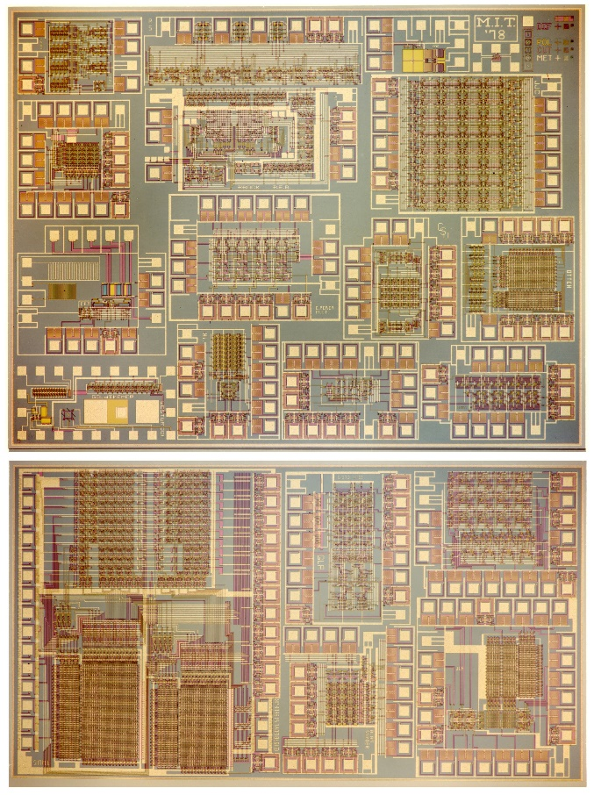
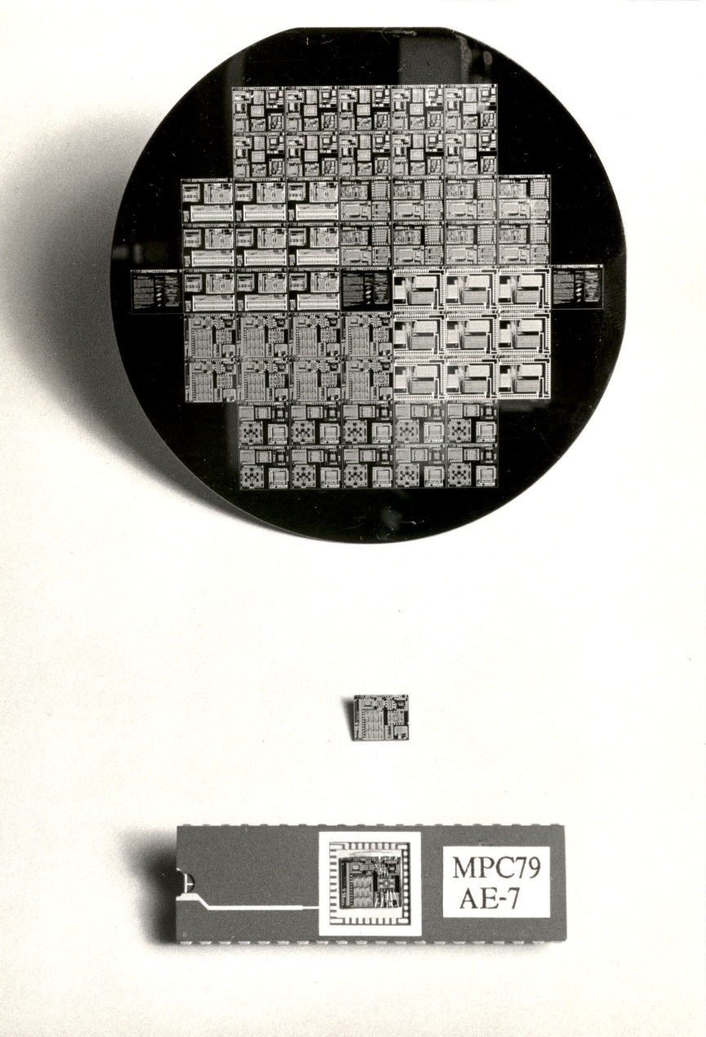
1976
1977
1978
1979
Visualizing the exponentiating
wave of VLSI innovation . . .
’76: How to cope with VLSI complexity?
’77: Inventing scalable VLSI design rules.
’78: Launching the VLSI methods at MIT!
’79: Launching the VLSI courses via MPC79!!

Slide 6
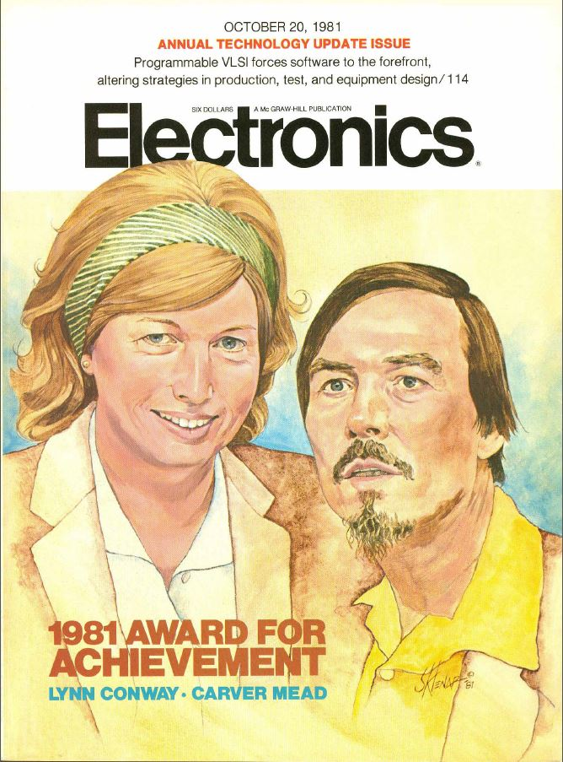
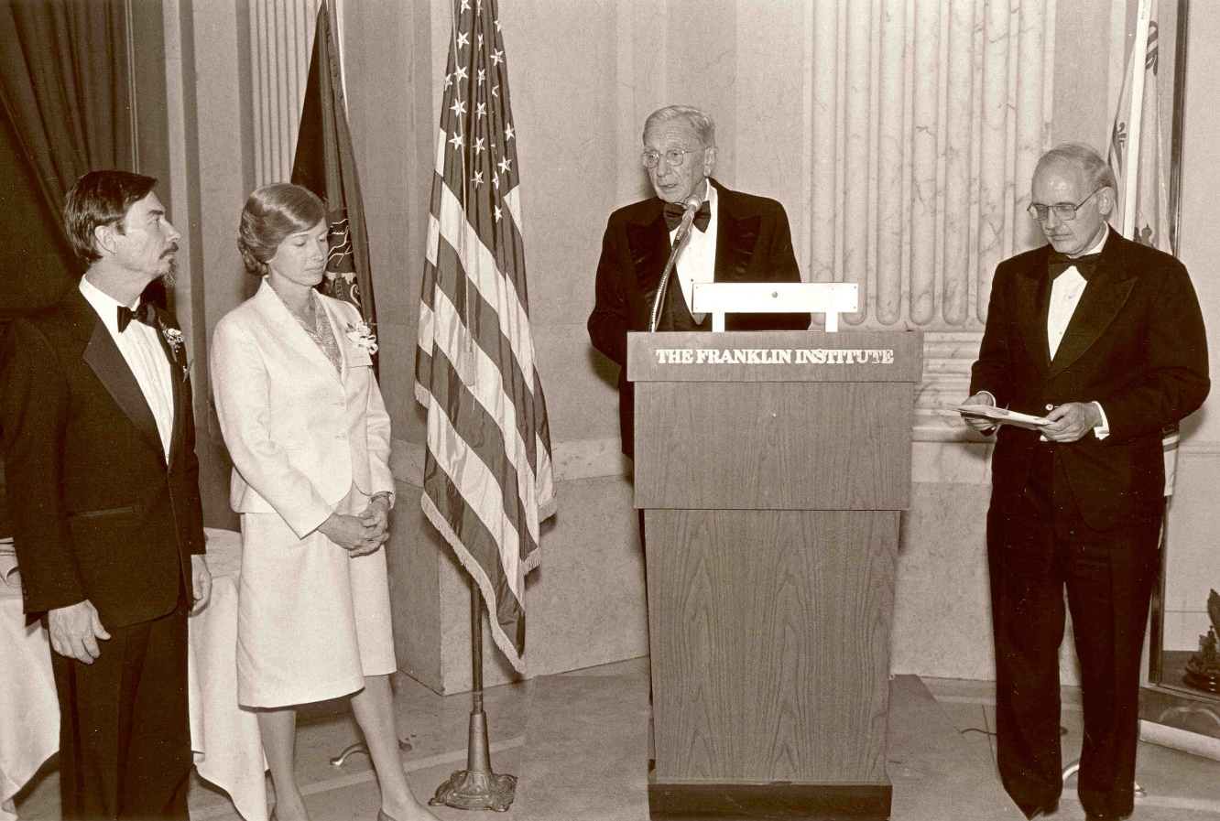
Key people sensed ‘something significant’
had happened, and Mead & Conway began
receiving major recognition in the 1980s:
Electronics Award for Achievement ‘81
Pender Award, Moore School ‘84
Wetherill Medal, Franklin Institute ’85
NAE, Mead ‘84
NAE, Conway ‘89. . .

Slide 7
However, from 1989 on through the 90s and 00s, Mead received increasingly major recognitions while Conway’s role was erased*:
NAS ‘89
American Academy of Arts and Sciences ‘91
EDAC Phil Kaufman Award ‘96
IEEE John Von Neuman Medal ‘96
ACM Allen Newell Award ‘97
MIT Lemelson Award ‘99 ($500,000)
Fellow Award, Computer History Museum ‘02
National Medal of Technology ‘02
NAE Founders Award ‘03
Inventors Hall of Fame ’09
*Most of these awards were for innovations that were Conway’s

Slide 8
As a result, by 2009 the erasure was complete:
Chip inventors getting their due at Hall of Fame induction
By Mike Cassidy, San Jose Mercury News
Apr. 30, 2009 --The 50th birthday celebration of the integrated circuit kicks off in Silicon Valley this weekend, and frankly, I'm a little overwhelmed . . .
On Saturday night, the National Inventors Hall of Fame is inducting this year's class. The sold-out ceremony (at the Computer History Museum) is in Silicon Valley for the first time, because the Ohio-based hall is honoring 15 who are responsible for breakthroughs in semiconductor technology -- the technology that put the "silicon" in Silicon Valley . . . In a way, it's as if the valley's founding fathers are coming together to be honored in person and posthumously. Inductees Gordon Moore, co-founder of Intel and namesake of Moore's Law, and Carver Mead, chip design pioneer and all-around brainiac, will be at the ceremony. So will lifetime achievement honoree Andy Grove, Intel's former CEO . . .

Slide 9
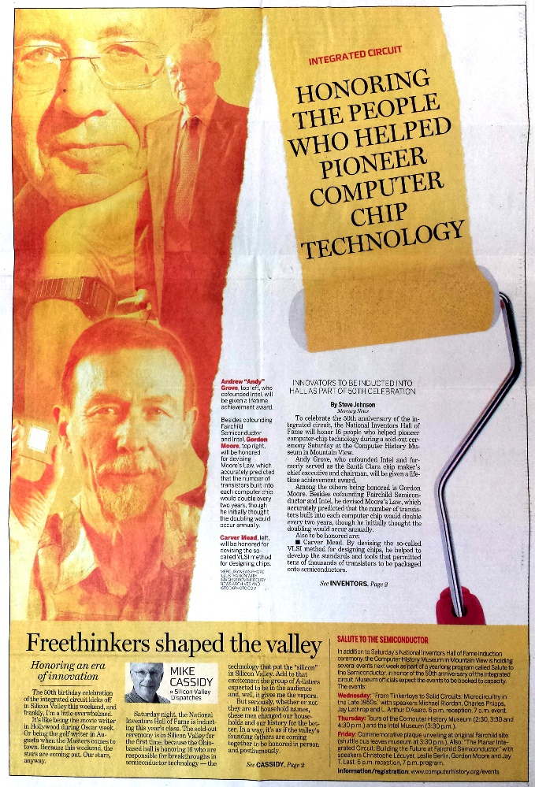
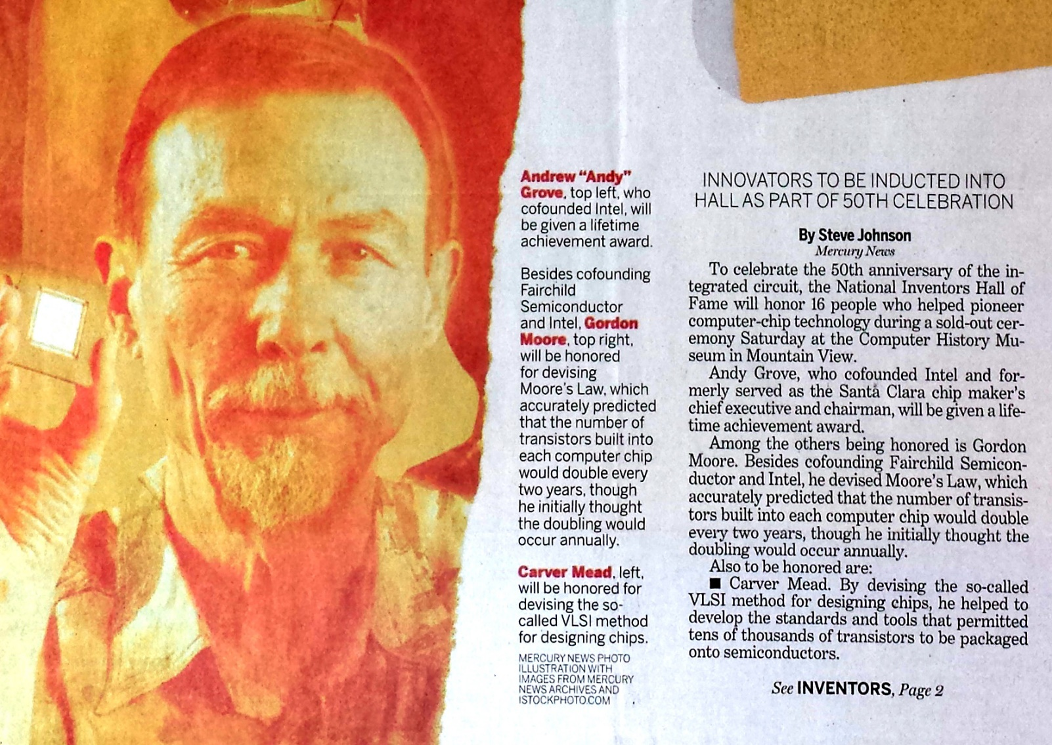
With Andy Grove, Gordon Moore and Carver Mead taking center stage:
San Jose Mercury News April 30, 2009
BTW, Conway wasn’t invited and didn’t even know it was happening . . .

Slide 10
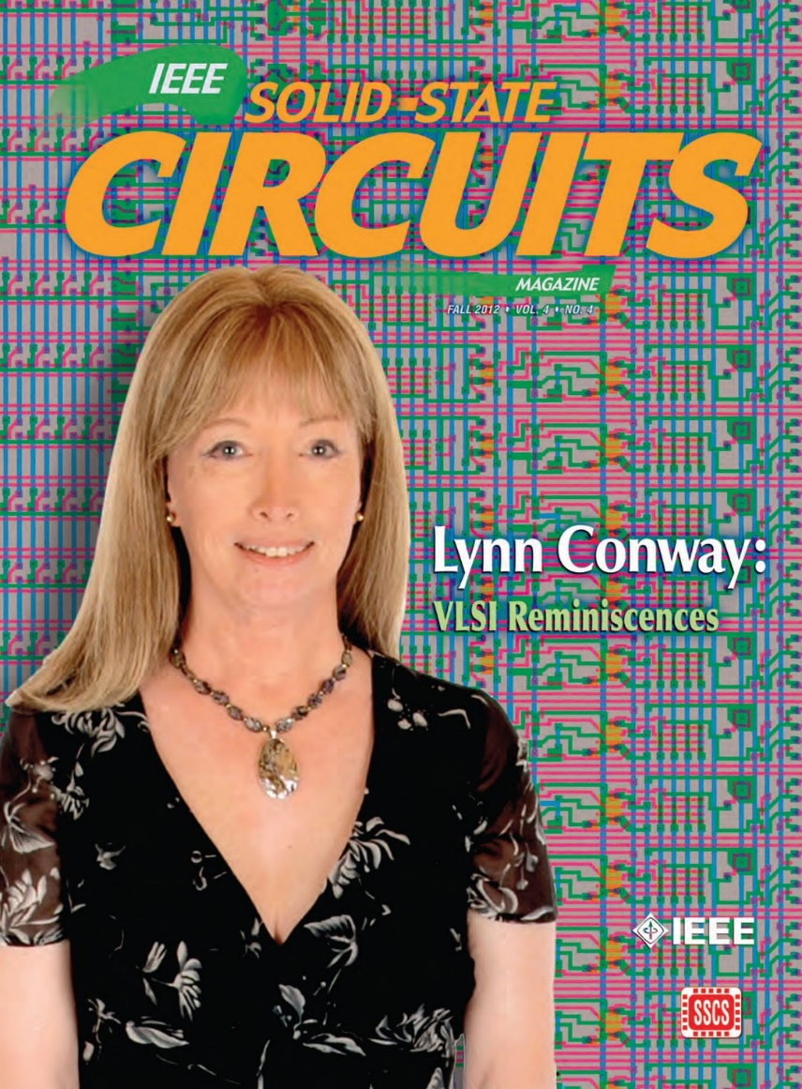
The story of my investigations over recent years is quite a saga, yet to be told . . .
To make a long-story short: I uncovered,
documented and archived all sorts of
interesting data and evidence.
That led me to write and publish my “Reminiscences of the VLSI Revolution” in the
Fall 2012 IEEE Solid State Circuits Magazine.
It was the first time I’d stepped openly forward to tell the whole story . . .

Slide 11
Sketch of the investigations, documenting and reporting
to understand what happened and to reclaim my legacy . . .
Compilation of the VLSI Archive, 2009-2012
Publication of my IBM-ACS Reminiscences, 2011
Publication of my VLSI Reminiscences, 2012
Publication of The Many Shades of ‘Out’, 2013
Publication of my MIT Reminiscences, 2014
Evidence that ‘it’s begun’:
Fellow Award, Computer History Museum, 2014
IEEE/RSE James Clerk Maxwell Medal, 2015

Slide 12
Throughout this case study we observe the “Matilda effect” (repression of the contributions of women scientists) and the "Matthew effect“ (eminent scientists get more credit) in play.
Note that these effects involve “self-fulfilling prophecies”, described by Merton as:
“. . . a false definition of the situation evoking a new behavior which makes the original false conception come true. This specious validity of the self-fulfilling prophecy perpetuates a reign of error. For the prophet will cite the actual course of events as proof that he was right from the very beginning.”
But is that all that’s happening? Or are other forces also in play?

Slide 13
After closely investigating these events, I sense something more subliminal and fundamental is occurring at a social level . . . and it involves no errors, no conspiracies, no repressions, no ‘bad guys’:
CONJECTURE: almost all people are blind to innovations, especially ones made by ‘those’ whom they do not expect to make innovations.
Since for most people, ‘those’ = ‘almost all people’, very few people ever witness or visualize innovations, even ones made right in front of their eyes (including sometimes those made by themselves!).
They instead look for tells and cues from others when constructing internal-orientations towards ‘novelties’ they stumble upon . . . and not just whether or not to accept or reject a novelty, but also whether to even notice it in the first place!
From this perspective, the Mathew and Matilda Effects are derivatives of the conjectured social-level “Conway Effect”.

Slide 14
Visualizing the Conway Effect in action:
Students in MIT’78 thought they were learning “how chips were designed in Silicon Valley” (i.e., in effect the course was a giant MIT hack). They simply “did it”, without realizing they were learning radically new methods.
The astonished reaction amongst Silicon Valley cognoscenti then led to intense interest in reverse engineering “how MIT was doing this”, causing other research universities to immediately want to offer such courses.
Similarly, folks using MPC79 took it for granted and simply “used it”. No one realized MPC79 was an even larger paradigm-shifting-hackathon to launch the modern world of “fabless design” + “silicon foundries” + “internet-based e-commerce infrastructure.”

Slide 15
What might MPC79 participants been thinking?
Since MPC79 used the ARPANET, some thought DARPA “did it.”
Thus when DARPA funded the transfer of MPC79 technology to USC-ISI, many users thought “MOSIS” had been “created by DARPA” . . . and similar government supported MOSIS-like services began springing up in other countries . . .
The VLSI revolution thus swept through high-tech community without anyone realizing that it had been deliberately generated, much less how that was done and who did it.
Although the “VLSI Book by Mead” became iconically connected with these large-scale socio-technological events, Mead himself was never able to explain what happened.
Meanwhile, Conway remained in the shadows up until 2012, when she finally was able to emerge and explain how it happened . . .

Slide 16
The Conway Effect: Almost all people are blind to innovations, especially ones made by people whom they do not expect to make innovations.
As a result, innovations diffuse via social-processes involving subliminal subgroup noticings, mimickings, rejections, adoptions, adaptations, tradings and displacements.
“Credits for innovations” as social tokens are separately subliminally generated, gathered, seized, gained, granted, bartered, etc. . . .
via social-tokening-processes modulated by visibility, status, prestige, class, power, location, credentials, prejudice, popularity, influence, money and accident . . .
in ways that sustain those social-tokening processes . . . and thus maintain the underlying blindness to innovations.
Corollary: It’s possible to trigger large paradigm-shifts, right out in the open, without people having a clue to what you’re doing!

