Slide 1
An Unexpected Woman:
The Inside Story Behind the VLSI Revolution*
Lynn Conway, Professor of EECS, Emerita
University of Michigan, Ann Arbor
US Chief Technology Officer Megan Smith has raised raised profound questions
about how women’s contributions in science and engineering are erased from history. In this talk we explore a case study of such erasure, and surface conjectures about underlying causes and effects.
*Based on an Invited Keynote Lecture sponsored by the Directorate for Computer Science and Engineering, the Directorate for Engineering and the Office of Diversity and Inclusion at the National Science Foundation, Arlington, VA, June 10, 2015.

Slide 2

First, listen as OSTP Chief Technology Officer Megan Smith
reveals women in STEM being erased from history . . .
https://www.youtube.com/watch?v=fHyRdAyqV5c
http://boingboing.net/2015/05/08/cto-megan-smith-explains-how-w.html
http://www.charlierose.com/watch/60554078 (4-28-15)

Slide 3
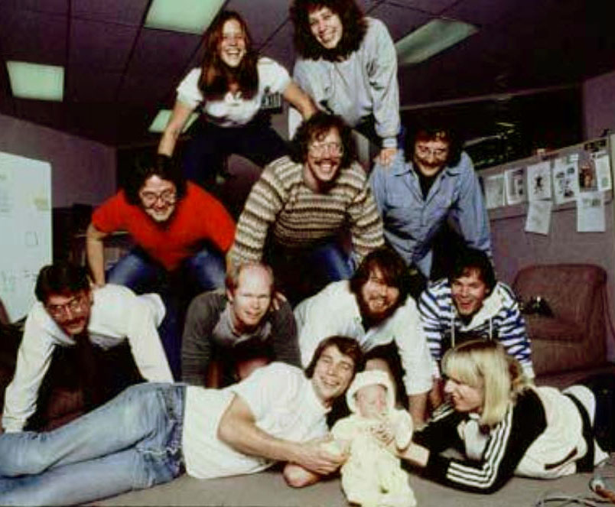
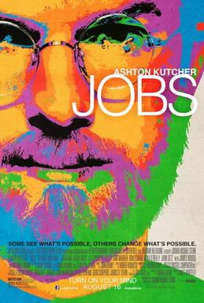
Although four women worked on the Macintosh team in the 1980s, not a single one was cast in the 2013 biopic Jobs with Ashton Kutcher. Even worse, all seven men who worked on the project had speaking roles in the film.
It’s not just that women have a harder time breaking into STEM fields, it’s that the many contributions they do make aren’t celebrated. “It's debilitating to our young women to have their history almost erased,” Smith explains.

Slide 4
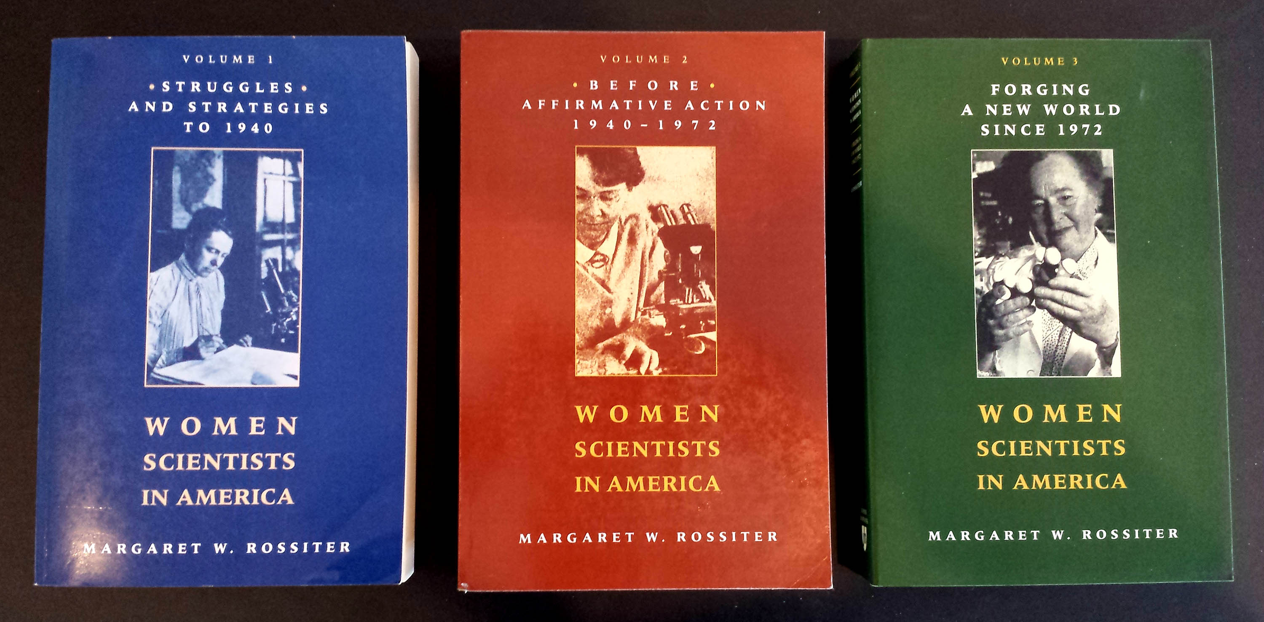
This effect is seen throughout the history of women in science,
as reported by Margaret Rossiter in Women Scientists in America.
Her volumes document numerous case studies of such historical erasures.

