Slide 1
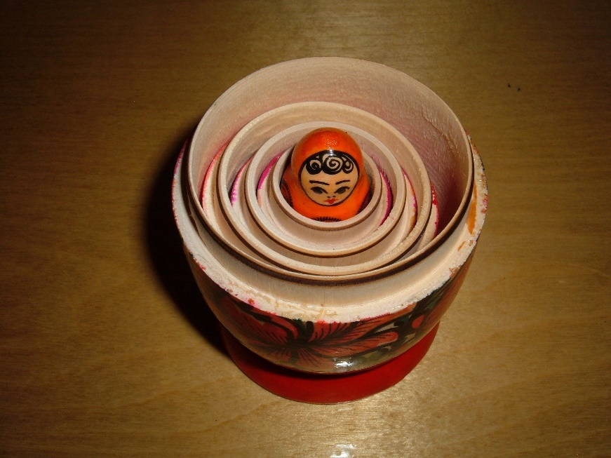
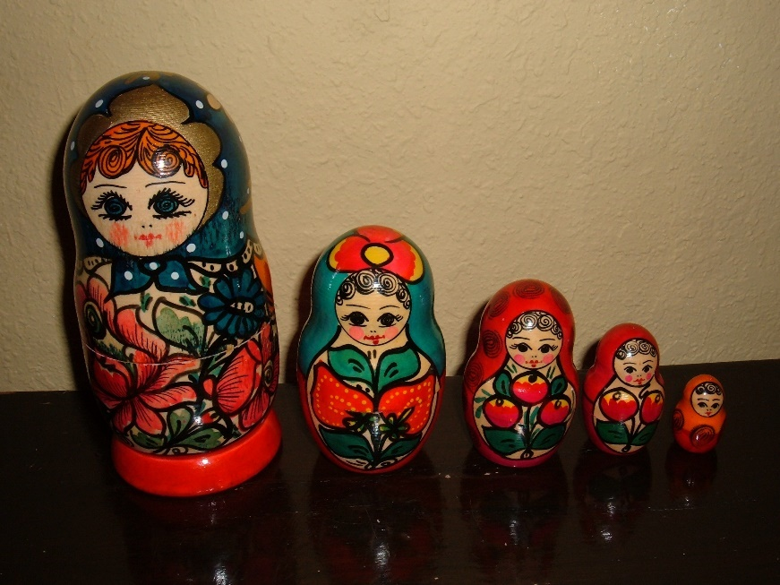
Matryoshka Dolls: Our Fascination with Nested, Recursive Storytelling
© BrokenSphere / Wikimedia Commons
© BrokenSphere / Wikimedia Commons
Compactly-encoded syntactical memory-aid, but doesn’t convey story-semantics.
Math example (Factorial): n! = n (n − 1)! = n (n − 1) (n – 2) ⋯ 1

Slide 2
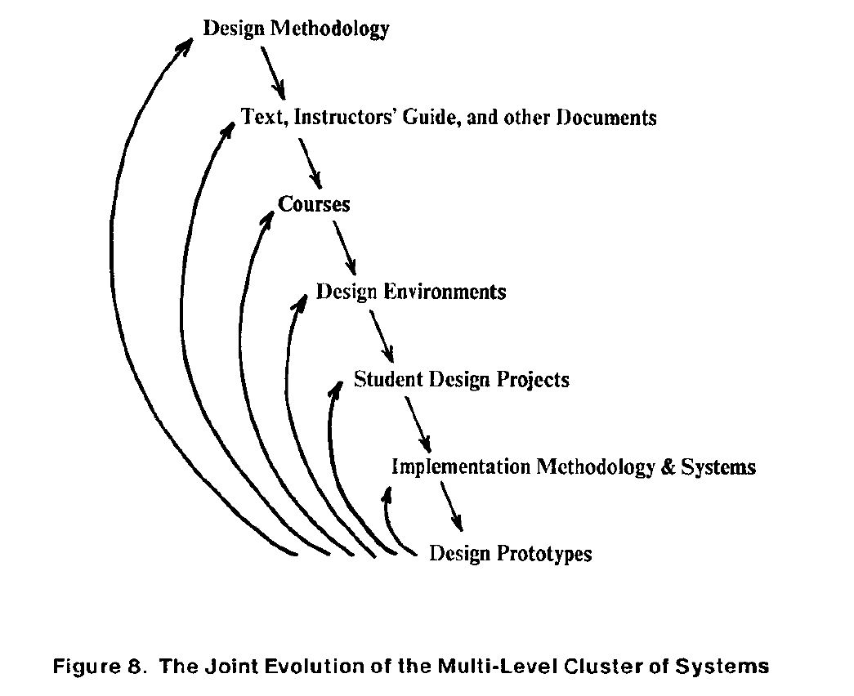
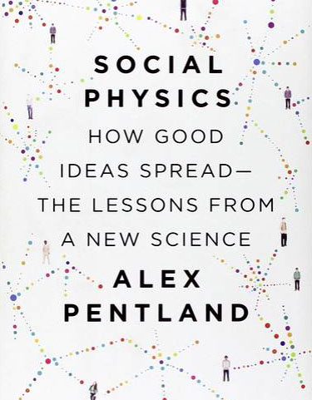
Ex: To envision the masses of ideas now cycling in techno-social motion, recall how we
diagrammed the nested-social-evolutionary-processes of the VLSI revolution.
Only now, vastly more such processes are running in parallel and cross-fertilizing.
And a new science is beginning to explore and map-out what’s happening . . .
The MPC Adventures (p. 16) Xerox PARC 1981.
URL

Slide 3
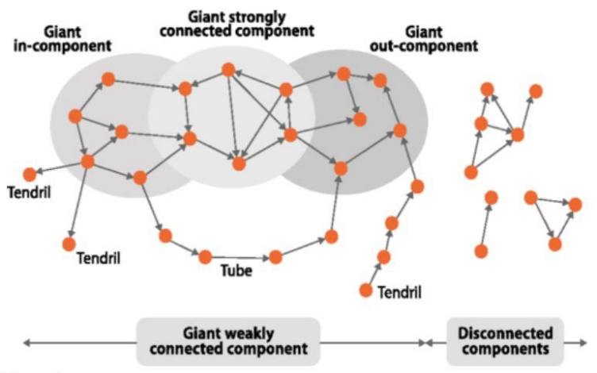
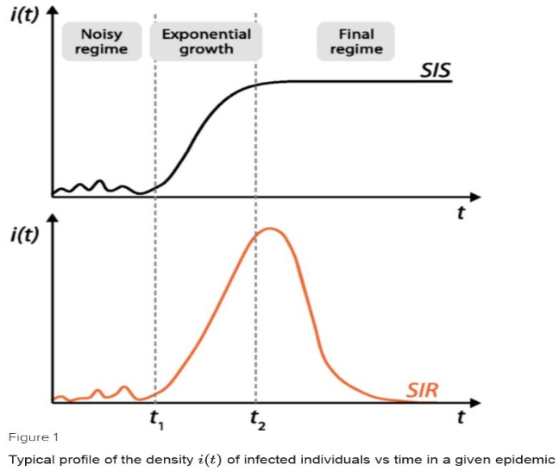
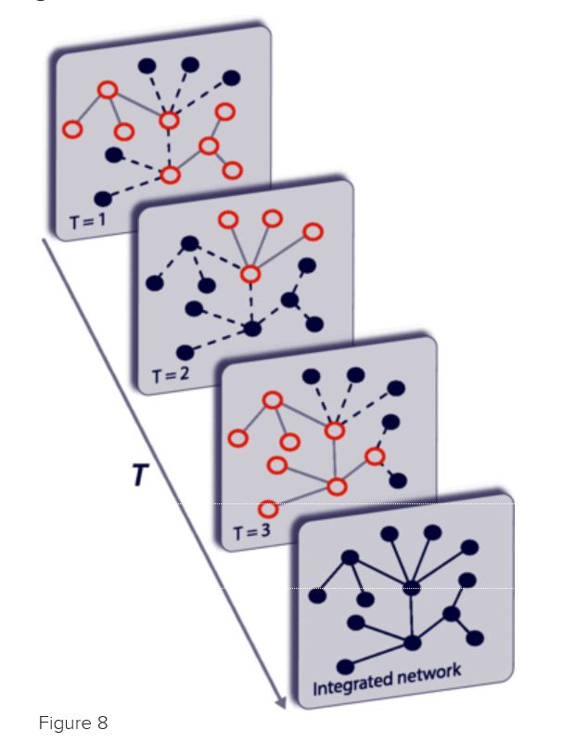
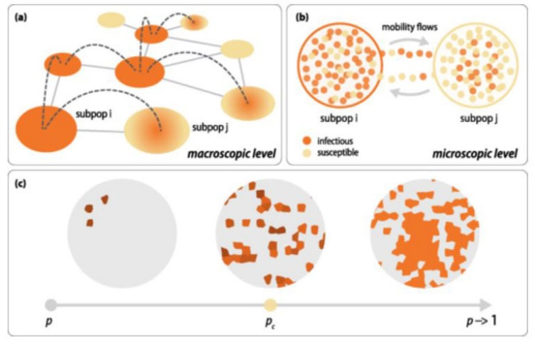
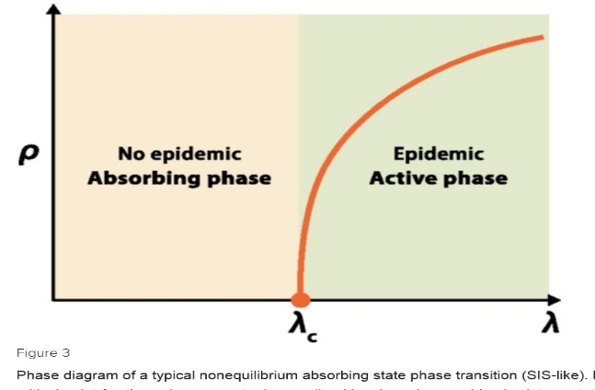
Epidemic Processes are already providing
mathematical frameworks for partly-modeling
techno-social dynamical-systems:
From: “Epidemic processes in complex networks” by
Pastor-Satorras, et al, Rev. Mod. Phys. 87, 925 – 8/31/15
See also recent work in CNNs, LVars, etc.

Slide 4
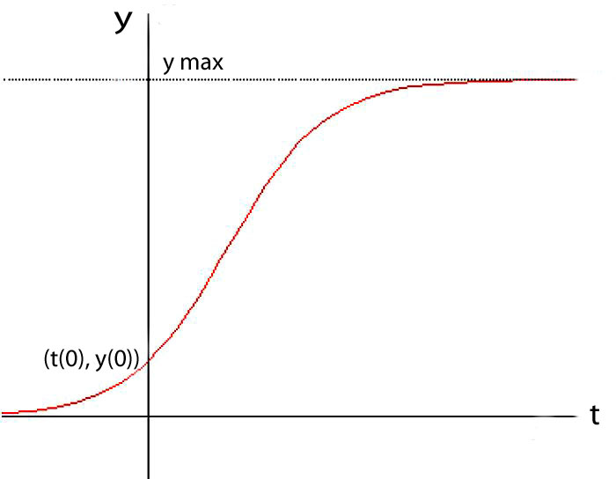
Now note that the big incoming wave is way more than a few nested
logistic ‘epidemic’ processes where each looks something like this:
nearing
Saturation
y(t) = ymax/(1+((ymax/y(0))–1))e^-rt)
unfolding
exponentiation
And even in this simple case, each 2D slice hides tons of what “composes the wave”*
*For more insight into this all this, see Van Quine’s discussion of “the river” in From A Logical Point of View, Ch.IV.
Let’s re-slice and zoom into our incoming wave in 4D⁺ to gain a better perspective

Slide 5
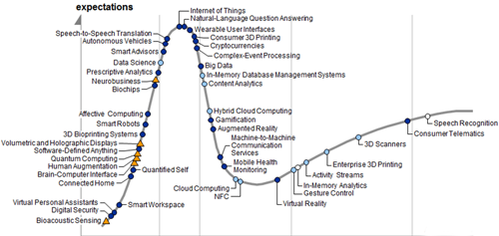
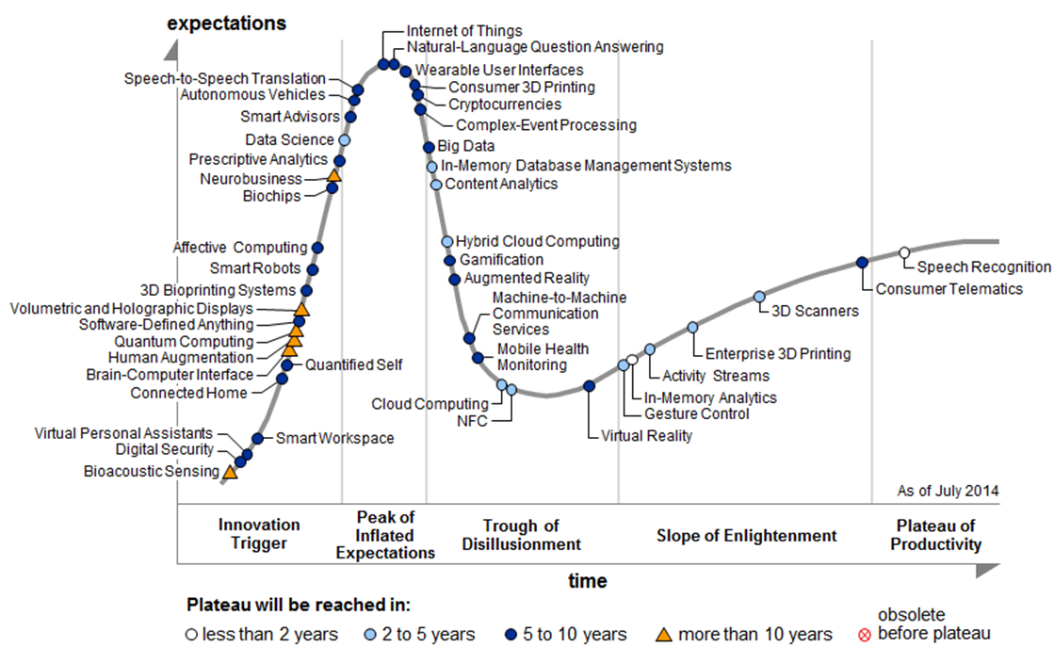
Meta-ethnomethodology:
Envisioning the incoming wave of innovation as
a time-series of “GHC profiles”(i.e., 2D⁺ slices
thru the 3D⁺ wave at increments in time) . . .
Gartner Hype Cycle 2014
http://www.gartner.com/newsroom/id/2819918
Is this a Traveling Wave?
A Standing Wave? Or What?
This stunning video*
hints at ways to
think about what
it all means . . .
*"Water," by Morgan Maasen http://vimeo.com/90429499

Slide 6
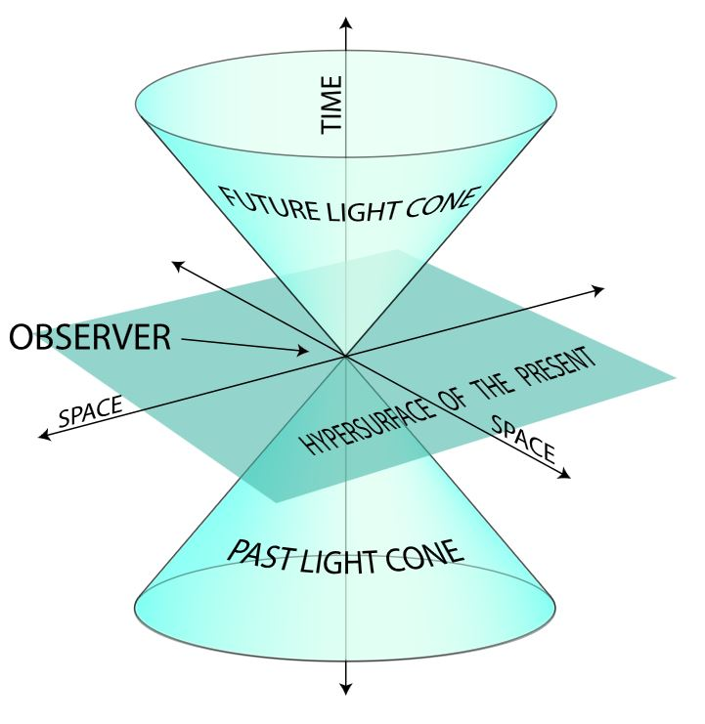
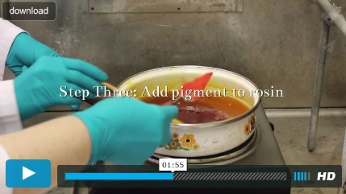
Zooming-in, these processes seem remarkably
similar to the workings of the alchemists,
i.e., the labyrinths of techno-social processes
that evolved and eventually “self-abstracted”
into the sciences of chemistry and materials.
Zooming out, such processes can be visualized as actions partially-bounded within regions of enhanced Minkowski-like 4D⁺ techno-social space-time diagrams:
Especially see work at Columbia and Princeton on reenacting the unfolding of medieval European
alchemy, in a deep form of hands-on, techno-social reverse-engineering of what happened back then:
The Making and Knowing Project
by Pamela Smith, Columbia (video).
Decoding Alchemy freshman seminar
by Jennifer Rampling, Princeton.
See also Scientiae and the Society for the History of Alchemy and Chemistry (SHAC)
To practice visualizing 4D space-time see Online
Resources on 4D like Curved Spaces and 4D Draw

