Slide 1
An Unexpected Woman:
The Inside Story Behind the VLSI Revolution*
Lynn Conway, Professor of EECS, Emerita
University of Michigan, Ann Arbor
In 2015, US CTO Megan Smith raised profound questions about women’s contributions in science, engineering and math being erased from history.
In this talk we explore a case study of such erasure, and surface a counter-intuitive conjecture about the underlying causes and effects.
*Keynote Lecture, LGBT Pride Month, Rackspace Inc., Windcrest, TX, June 28, 2016;
Based on a Lecture at the National Science Foundation, Arlington, VA, June 10, 2015.
http://www.slideshare.net/LynnConway1/an-unexpected-woman-the-inside-story-behind-the-vlsi-revolution
http://ai.eecs.umich.edu/people/conway/Memoirs/Talks/Rackspace/2016_Rackspace_Pride_Talk.pptx
http://ai.eecs.umich.edu/people/conway/Memoirs/Talks/Rackspace/2016_Rackspace_Pride_Talk.pdf
http://www.nsf.gov/od/odi/sep/lgbt.jsp; www.lynnconway.com; conway@umich.edu

Slide 2
Setting the Stage:
Reflections on LGBT Pride Month and Human Life Trajectories
Historical Erasure of Women’s Contributions in STEM
A Case Study: The Inside Story Behind the VLSI Revolution
A Counter-Intuitive Explanatory Conjecture: The Conway Effect
Thought-Experiments to Ponder:
Insights into Evolution of Culture in Animals
Glimpses into the Emerging Techno-Social Age

Slide 3
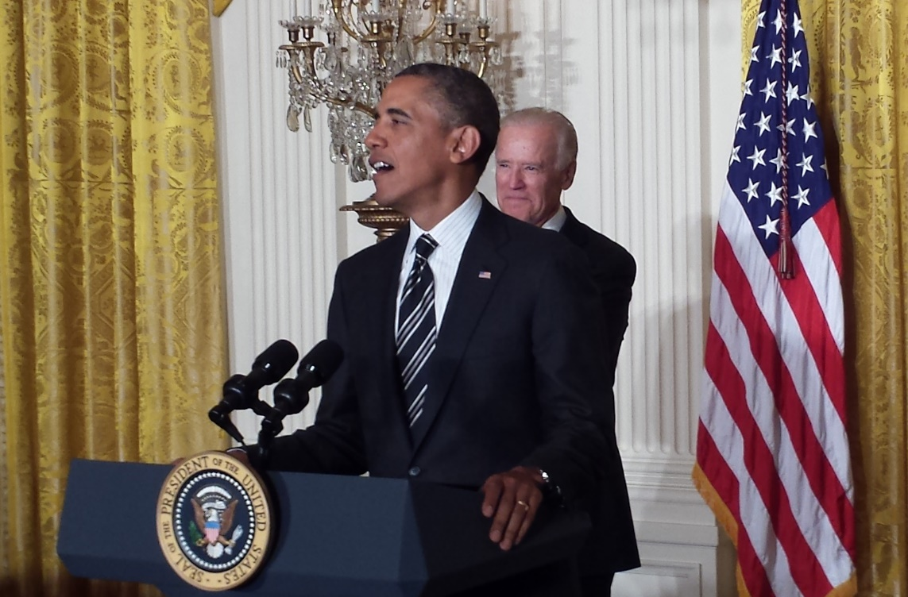
Reflections on LGBT Pride Month
and Human Life Trajectories
Readings from an essay on
the White House Reception
to celebrate LGBT Pride Month
June 13, 2013
For full text, see:
http://www.huffingtonpost.com/lynn-conway/
the-many-shades-of-out_b_3591764.html

Slide 4
The Many Shades of ‘Out’, by Lynn Conway
On a sultry June afternoon, as my husband and I strolled towards the White House East Entrance, I reflected back to the time of my gender transition, in 1968.
Shamed as a social outcast, I'd lost my family, my friends and all social support. I'd been fired by IBM, and lost a promising research career. In many jurisdictions, I could have been arrested and charged as a sex offender -- or, worse yet, institutionalized in a mental hospital.
Evading those fates, I completed my transition and began building a career in a secret new identity, starting at the bottom of the ladder as a contract programmer. Any 'outing' and I'd have become unemployable, out on the streets for good. Fear channeled me into 'stealth-mode', and for over 30 years I covered my past, always looking over my shoulder as if a foreign spy in my own country.
But this was June 13, 2013. What a contrast. My husband Charlie and I, along with many other activists, advocates and allies, were joining the President's White House Reception for LGBT Pride Month. The atmosphere was joyful and as we awaited the President, I reflected further.
I had been 'out' for 15 years now, or so I'd thought: out on the Internet to inform colleagues of my past, out as an advocate for transgender people, out as an activist against psychiatry’s pathologization of gender variance.
It was one thing to hide in the back-rooms of Xerox Palo Alto Research Center decades ago, launching innovations as the hidden-hand behind the VLSI microelectronics revolution in Silicon Valley. I didn't mind being invisible in my field back then, or that no one had a clue what I was really doing . . . much less who was doing it. I was thrilled to even have a job.
But 'out' has many shades of grey -- and even in recent years I kept on partly covering, shyly holding back, lingering in the darker shadows. Although times had changed, I'd clung to old habits.
Down through the decades no one could explain how the VLSI revolution actually happened. The results were simply taken for granted. Although I'd gained vital knowledge about generating such engineering paradigm shifts, I feared my personal history would loom large in folk's minds, and obscure attempts at explanation.
It wasn't till 2012 that I got up the nerve to publish a career memoir, and begin telling the story of how the VLSI revolution came about.
As the president entered the room, I glanced around and took in the joyful vibes. As he began to speak, I grasped the reality of how far we'd come. Times had more than changed: a fresh wind was sweeping through our society . . . especially amongst the younger generations.
Then I thought of the millions of other LGBT people out there. I tried to envision the enormity of lifelong struggles against stigmatization and ostracism, of losses of families and employment, of their oppression by having to 'cover', often not fully engaging life nor being known for who they were, what they'd done, who they loved or who loved them.
In a flash, I visualized the vastness of “The Many Shades of ‘Out’” down through time. And then it hit me: we've come so far, so fast, that ever so many others could begin shedding old habits too.
After all, freedom isn't just an external concept, framed by our laws. It's a gift of the spirit that we must give ourselves, in this case by going towards brighter shades of 'out'.
http://www.huffingtonpost.com/lynn-conway/the-many-shades-of-out_b_3591764.html

Slide 5
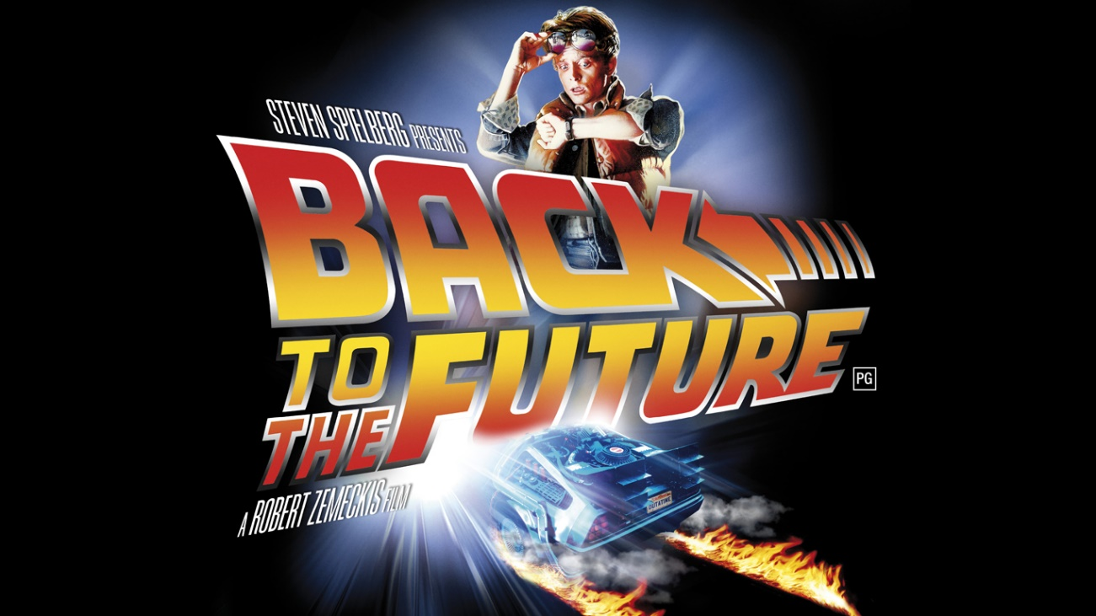
With that as a backdrop, let’s now examine
history’s treatment of women’s contributions in STEM
Link

Slide 6
First, listen as OSTP Chief Technology Officer Megan Smith
reveals women in STEM being erased from history . . .
http://www.youtube.com/watch?v=fHyRdAyqV5c&t=0m1s
http://boingboing.net/2015/05/08/cto-megan-smith-explains-how-w.html
http://www.charlierose.com/watch/60554078 (4-28-15)

Slide 7
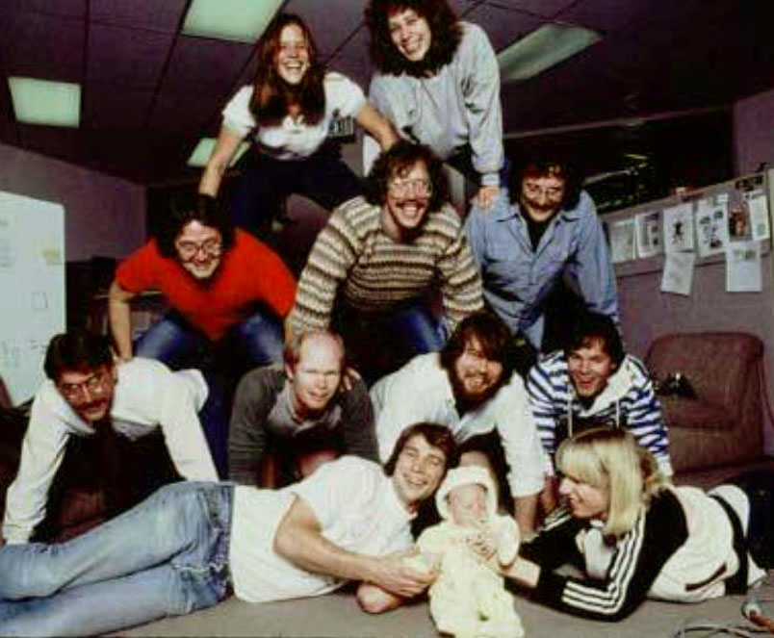
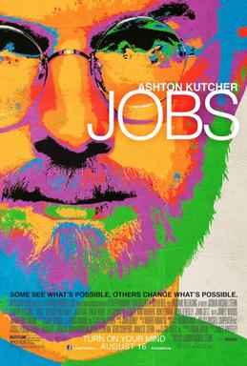
Although four women worked on the Macintosh team in the 1980s, not a single one was cast in the 2013 biopic Jobs with Ashton Kutcher. Even worse, all seven men who worked on the project had speaking roles in the film.
It’s not just that women have a harder time breaking into STEM fields, it’s that the many contributions they do make aren’t celebrated. “It's debilitating to our young women to have their history almost erased,” Smith explains.

Slide 8
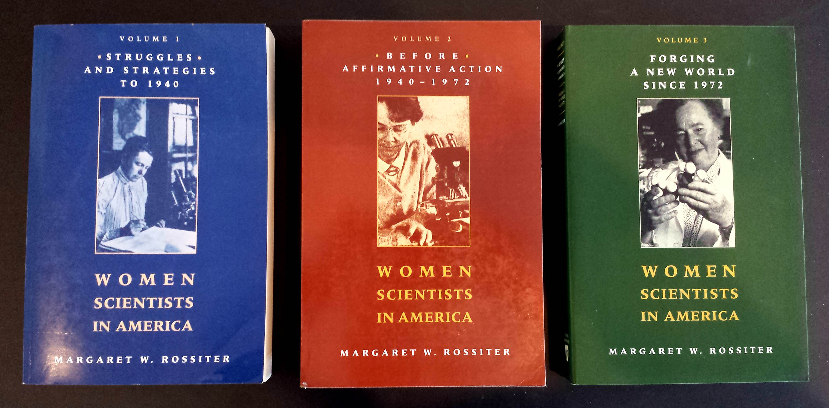
This effect is seen throughout the history of women in science,
as reported by Margaret Rossiter in Women Scientists in America.
Her volumes document numerous detailed case-studies of such historical erasures.

Slide 9
In 1993 Rossiter coined the term “Matilda effect” for the systematic repression and denial of the contributions of women scientists, whose work is often attributed to their male colleagues.
This is analogous to the term "Matthew effect“, coined by Robert K. Merton in 1968, describing how eminent scientists often get more credit than a lesser-known researcher, even if their work is similar.
For example, a prize will almost always be awarded to the most senior researcher involved in a project, even if the work was all done by a grad student.

Slide 10
CASE STUDY: The revolution in Very Large Scale Integrated (VLSI)
silicon microchip design and manufacturing, beginning in 1976.
Link

Slide 11
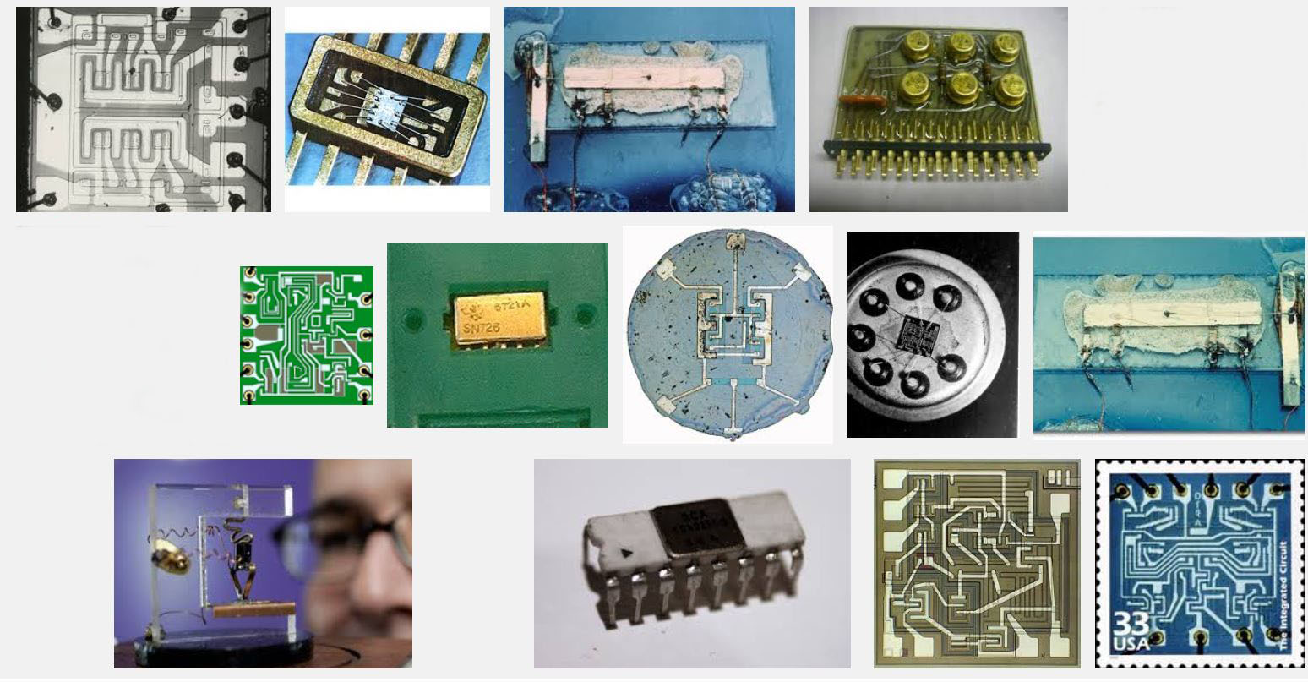
The stage was set by emergence of integrated circuit technology in the 1960’s, enabling numbers of transistors and their wiring to be ‘printed’ onto chips of silicon . . .
Some early integrated circuits:
Snip from Goggle images

Slide 12
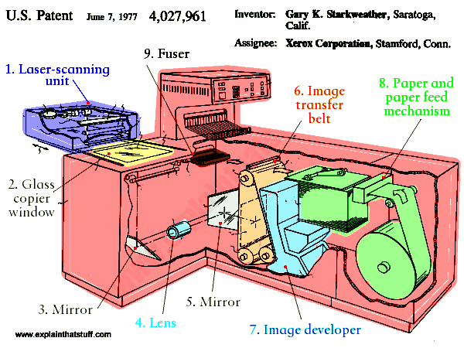
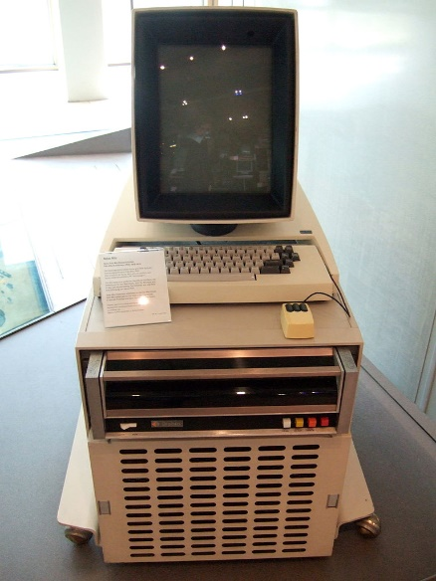
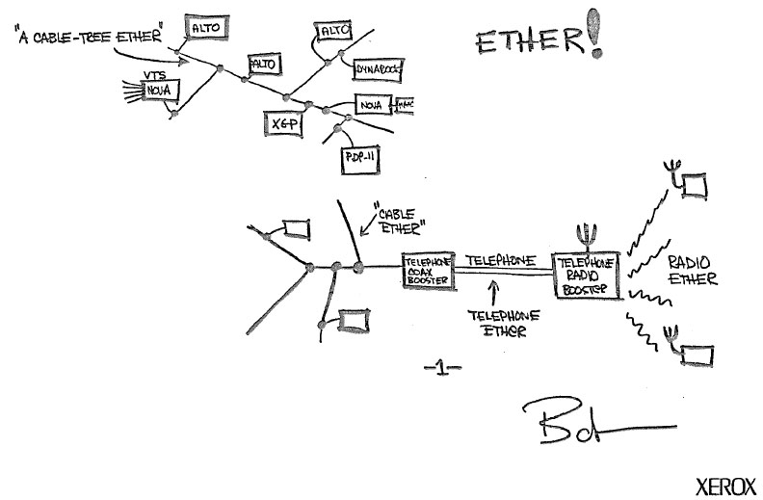
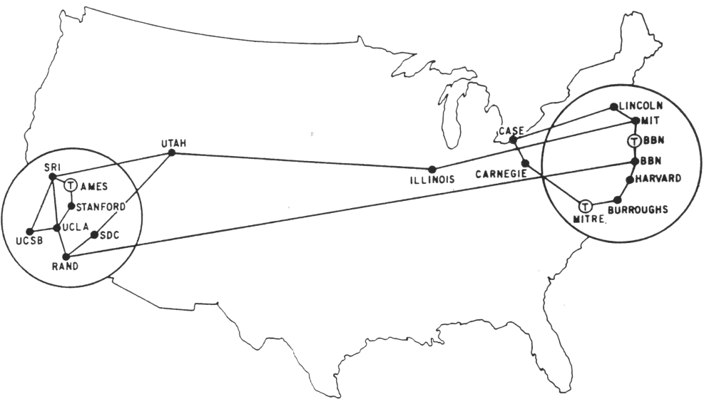
And ‘potentiated’ by the early 70s revolution in personal computing and networking:
Innovation of the interactive-display, mouse-controlled “personal computer”,
the “Ethernet” local-area network, and the “laser printer” (at Xerox PARC) . . .
And the Dept. of Defense’s “Arpanet” (the early internet, at DARPA) . . .
Xerox Alto, 1973
Metcalfe’s original
Ethernet sketch, 1973
Laser printer, 1971
Source
Source
Arpanet map, 1971
Wiki commons

Slide 13
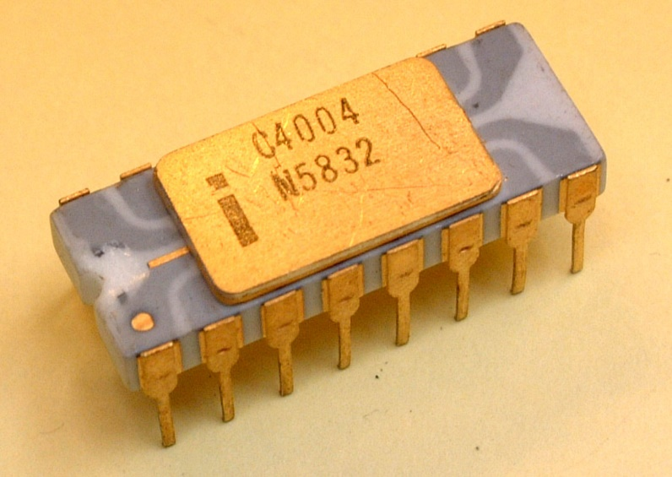
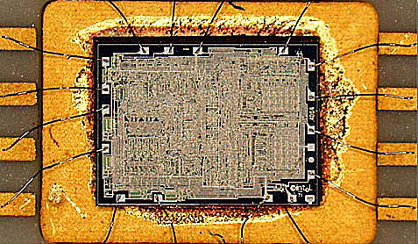
Ongoing advances in lithography kept enabling ever-finer features to be printed, rapidly increasing the number of transistors printable on single chips.
And by 1971, a watershed was crossed
with the introduction of the Intel 4004, the first single-chip “microprocessor”:
a “computer processor on a chip” . . .
Source
It contained 2300 transistors . . .
Source

Slide 14
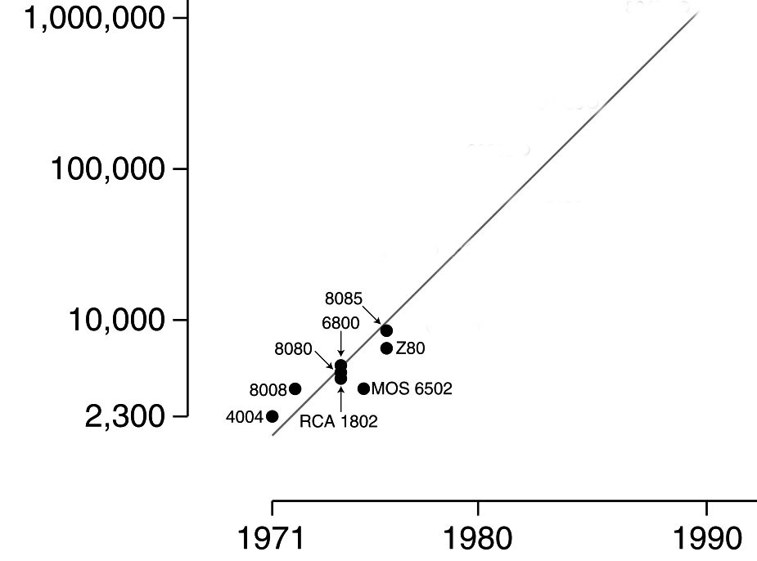
Gordon Moore at Intel observed
that the number of transistors reliably printable on commercial chips was roughly doubling every two years . . .
Moore’s Law (as of 1976)
.
An exponential function,
graphed on a vertical log scale
Carver Mead named this “Moore’s Law” and predicted that there were no physical limits to increasing chip density up to at least 1 million transistors.
N(t)/N(0) = 2^(t/2)
In 1976 this set-off a push at Xerox PARC and Caltech to figure out how to enable such complex chips to be designed.
After all, looking ahead it appeared conceivable
by ~1990 an entire “supercomputer” could be
printed on a single chip . . .

Slide 15
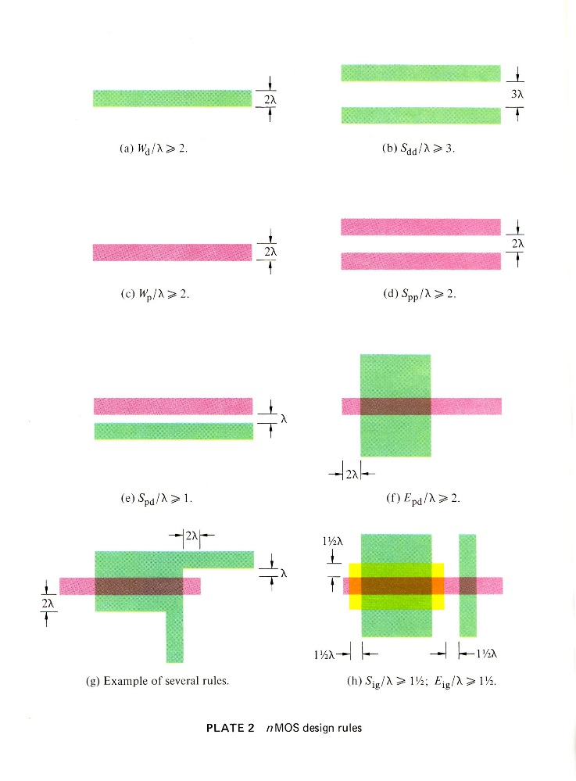
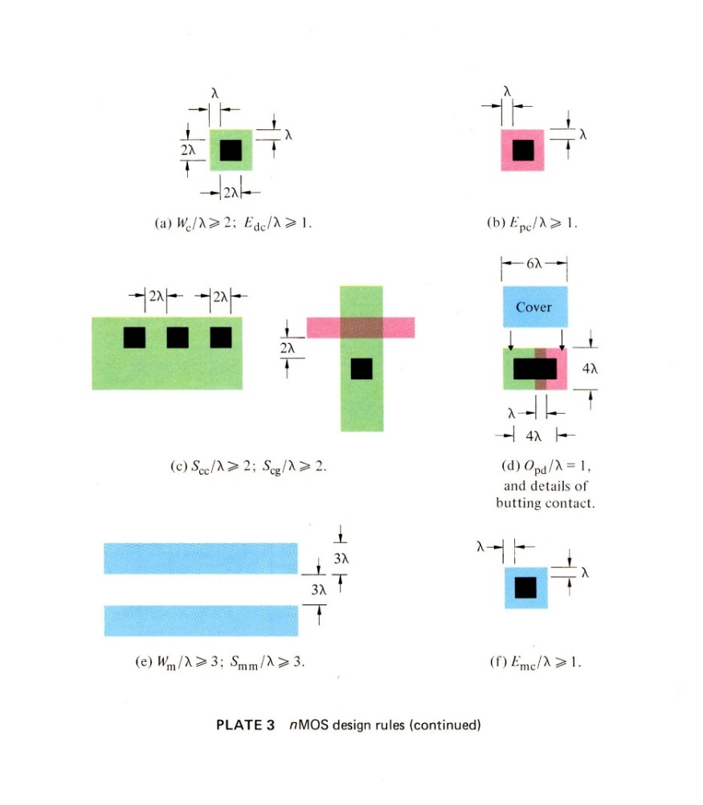
A sudden disruptive breakout was triggered
by a cluster of abstract innovations, primarily at PARC . . .
Included was a set of scalable VLSI chip-layout digital design rules, as ratioed (dimensionless) inequality equations (Conway, Xerox PARC) . . .
These enabled abstract chip designs to be digitally shrunk down (and reused) as Moore’s law rapidly advanced . . .
They also enabled accruing chip subsystem designs to be widely shared . . .
Link

Slide 16
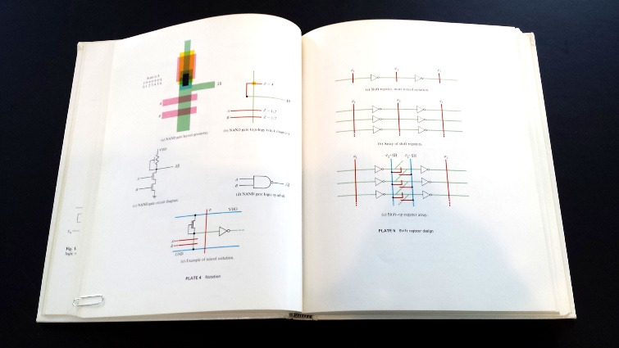
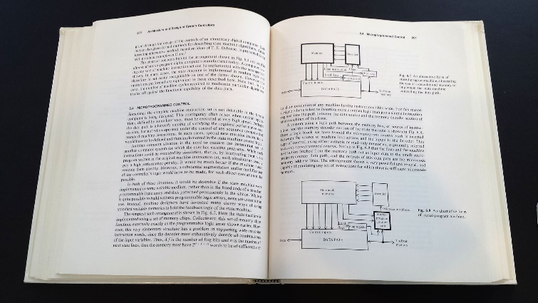
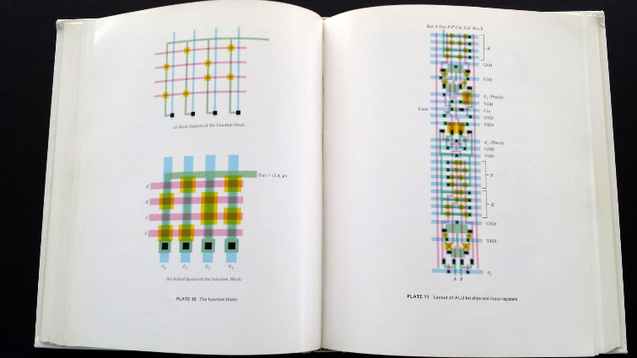
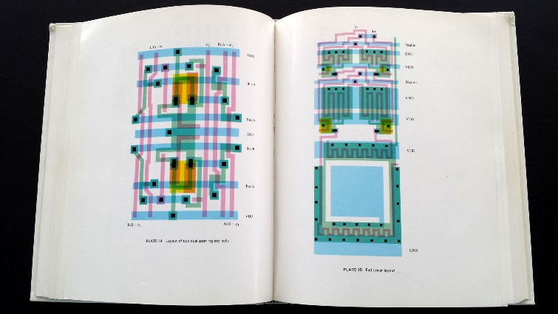
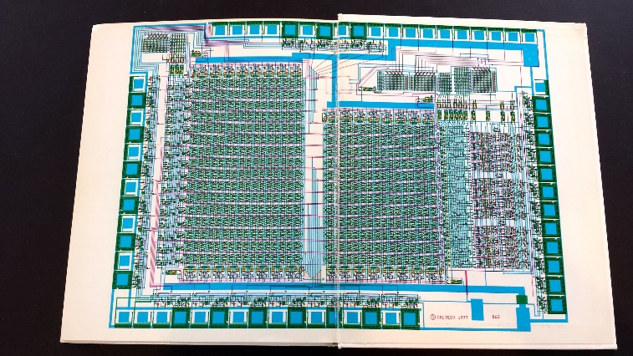
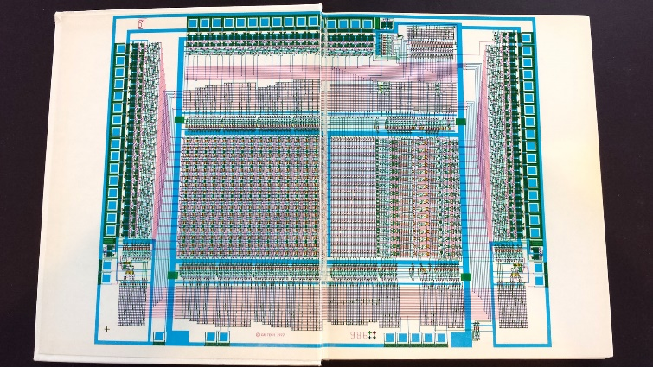
I began documenting the emerging new ‘Mead-Conway’ system of simplified, restructured,
design-level abstractions and chip design methods in an evolving computer-edited book . . .
Thus using our Alto computers at PARC not only as tools for generating chip-designs,
but also to mechanize the evolution of the chip-design knowledge itself . . .
Link

Slide 17
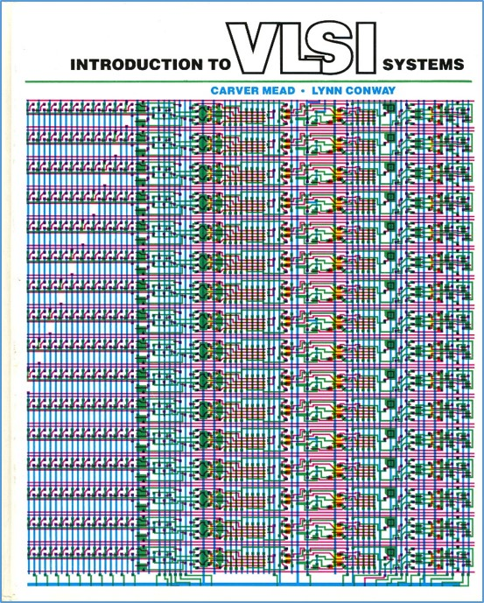
That computer-edited evolving book, printed using the laser printers at PARC, became the draft of the seminal textbook:
Introduction to VLSI Systems
by Mead and Conway,
published in 1980.
(later called “the book that
changed everything” . . . )

Slide 18
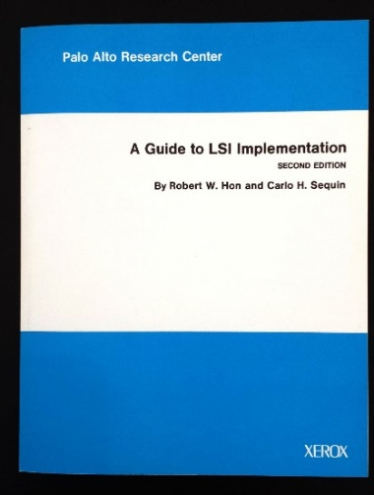
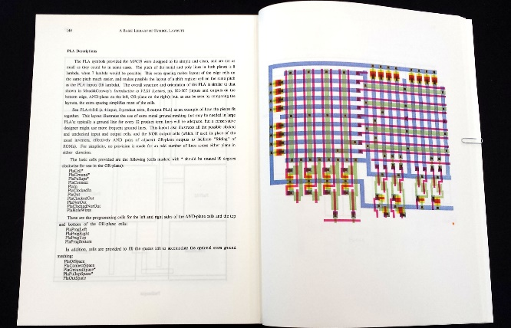
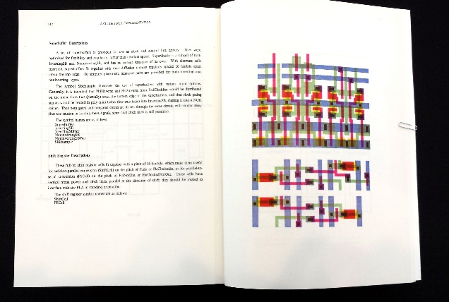
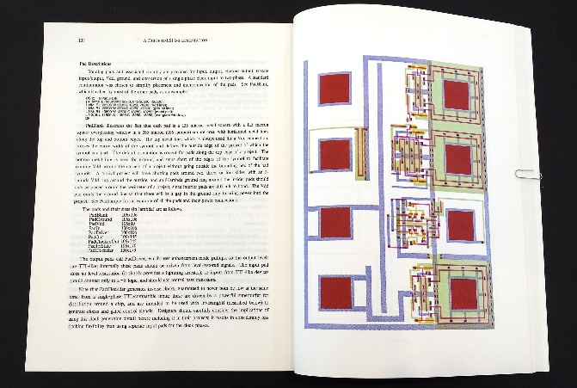
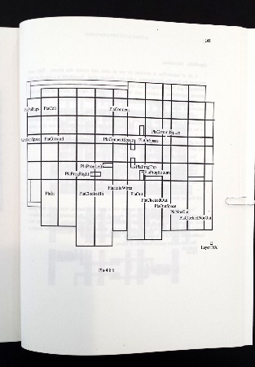
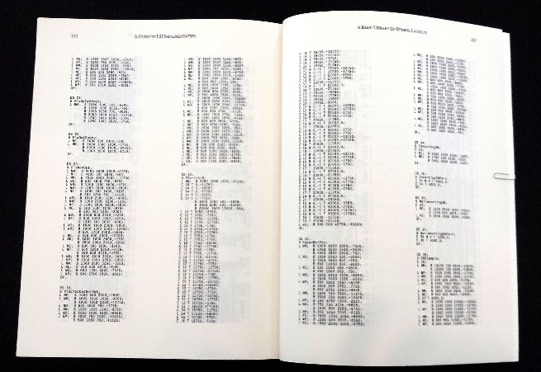
We also used our Altos (at Xerox PARC) to generate many open-source cell-layout-designs
for key digital-subsystems, easily disseminated to students and colleagues via the Arpanet …
URL
PLA cells
Clock drivers
I/O Pads
Cell locations
CIF 2.0 Cell-Library code

Slide 19
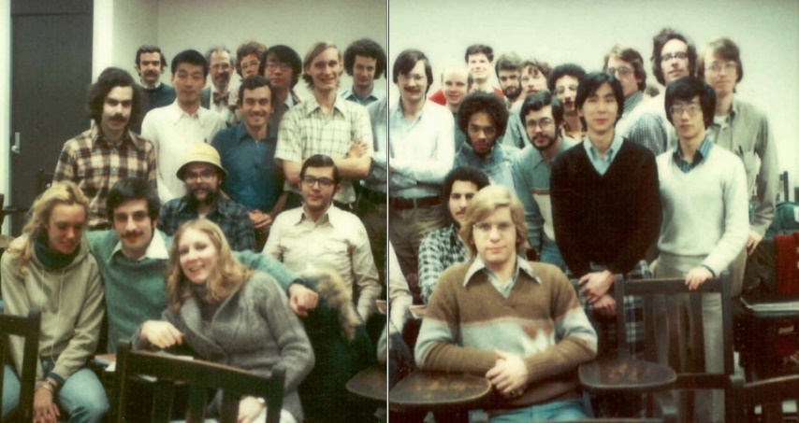
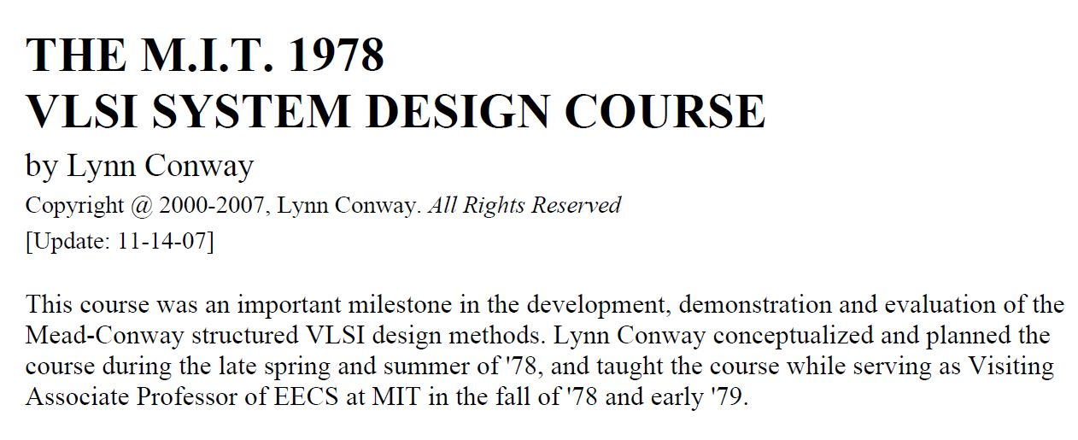
Following the “script” Charles Steinmetz used to propagate his revolutionary AC electricity methods at Union College in 1912, I introduced the new methods in a special VLSI design course at MIT in 1978.
Link
Link
Link

Slide 20
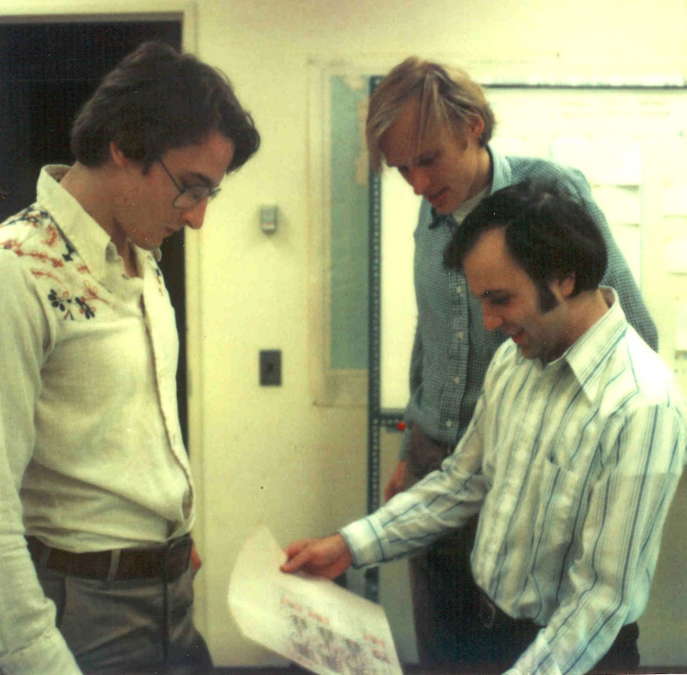
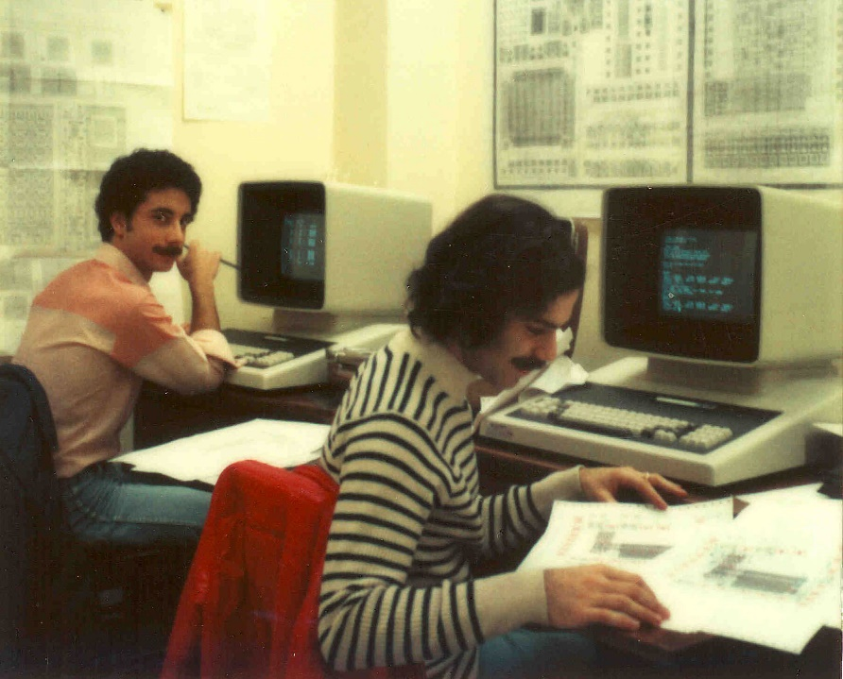
The students learned to design chips
in the 1st half of the course, then did project-chip designs in the 2nd half. These were fabricated in Pat Castro’s lab at HP shortly after the course.
There were many amazing results including a complete Lisp microprocessor design
by Guy Steele . . .

Slide 21
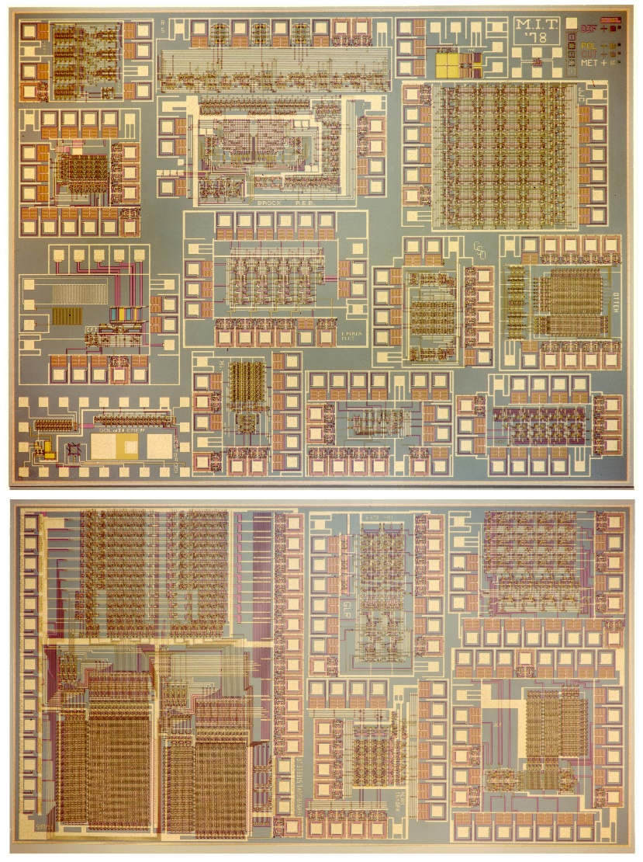
Map and photomicrograph
of the 19 student projects on
the MIT’78 ‘MultiProject’ Chip
For more about the MIT’78 course, see Lynn’s “MIT Reminiscences”

Slide 22
The MIT’78 course stunned top folks in Silicon Valley . . .
And many other top research universities wanted to offer such a course. But how?
Suddenly, the answer came to me: Simultaneously rerun the MIT’78 course at several research universities, using my MIT lecture notes to keep things in sync.
Hmm. But how to “print” the resulting student project chips?
I suddenly visualized a new form of “E-commerce” QTA manufacturing system, enabling students’ design-files to be remotely submitted via the Arpanet to a “server” at PARC . . .
The server would run logistics-software to pack designs into “multi-project chip” files
(like composing the print-files for a magazine, using remotely-submitted articles) . . .
We’d then make masks, “print” MPC’s at HP Labs (where my collaborator Pat Castro had prototyped the first “silicon foundry”), and quickly return the chips to students.

Slide 23
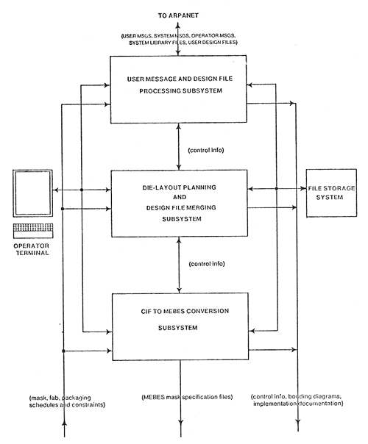
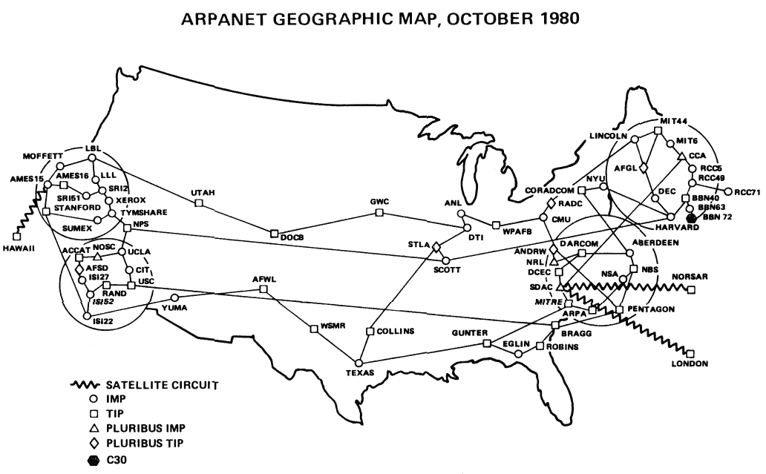
In the fall of 1979, I orchestrated a huge “happening” (MPC79)* . . . It involved 129 budding VLSI designers taking Mead-Conway courses at 12 research universities…
MPC79 Arpanet E-commerce system:
*The MPC Adventures: Experiences with the Generation of VLSI Design
and Implementation Methodologies, L. Conway, Xerox PARC, 1981 (PDF)

Slide 24
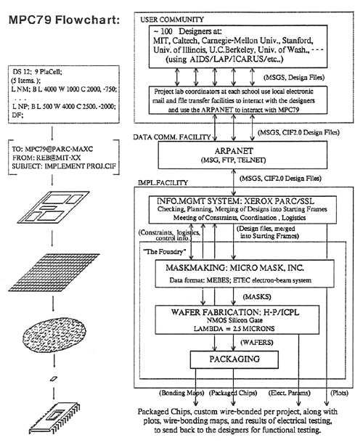
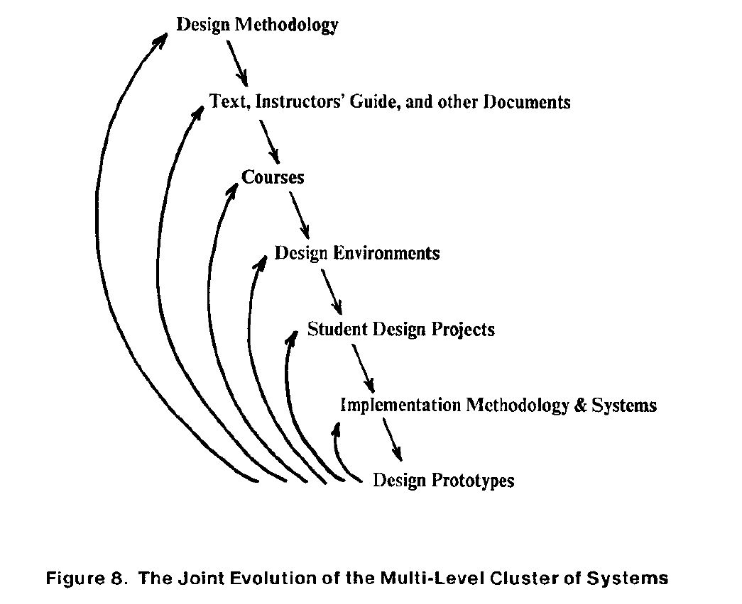
MPC79 not only provided a large-scale “demonstration-operation-validation” of the design methods, design courses, design tools and e-commerce digital-prototyping technology …
it also triggered ‘cyclic gain’ in, and exponentiation of, the budding VLSI-design-ecosystem…
The MPC Adventures, L.ynn Conway, Xerox PARC, 1981.

Slide 25
Visualizing how techno-social dynamics triggered an exponentiation in the spread of the innovative
VLSI design and making ideas via the emerging internet communication technology . . .
By 1982-83, Mead-Conway VLSI design courses were
being offered at 113 universities all around the world
It had been a successful early experimental-exploration into what is now termed “social physics”
The MPC Adventures (p. 16)

Slide 26
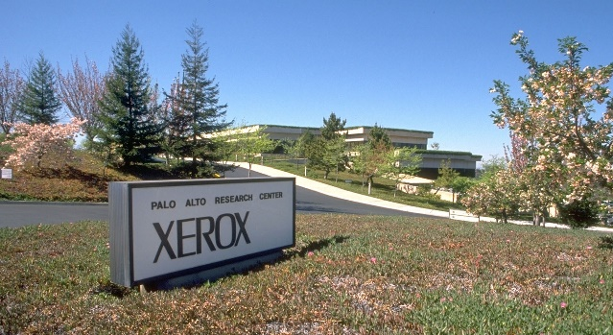
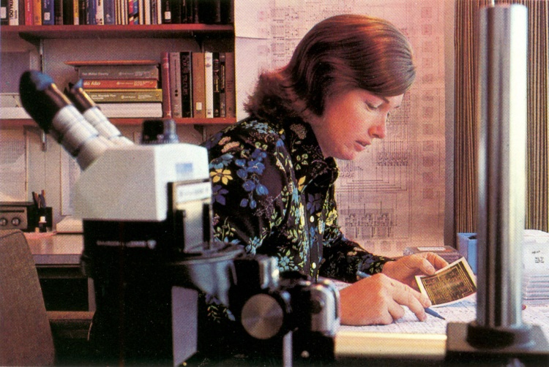
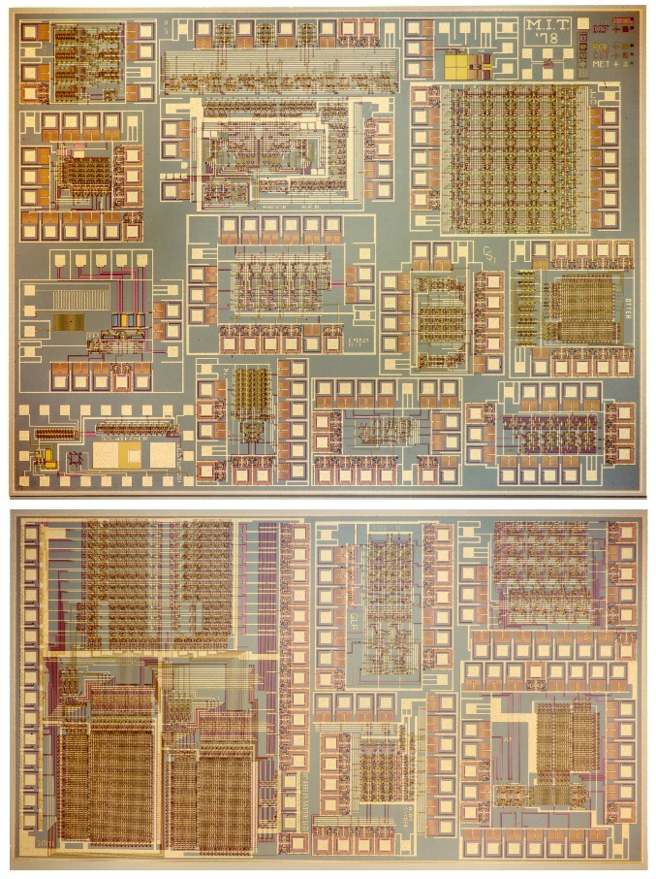
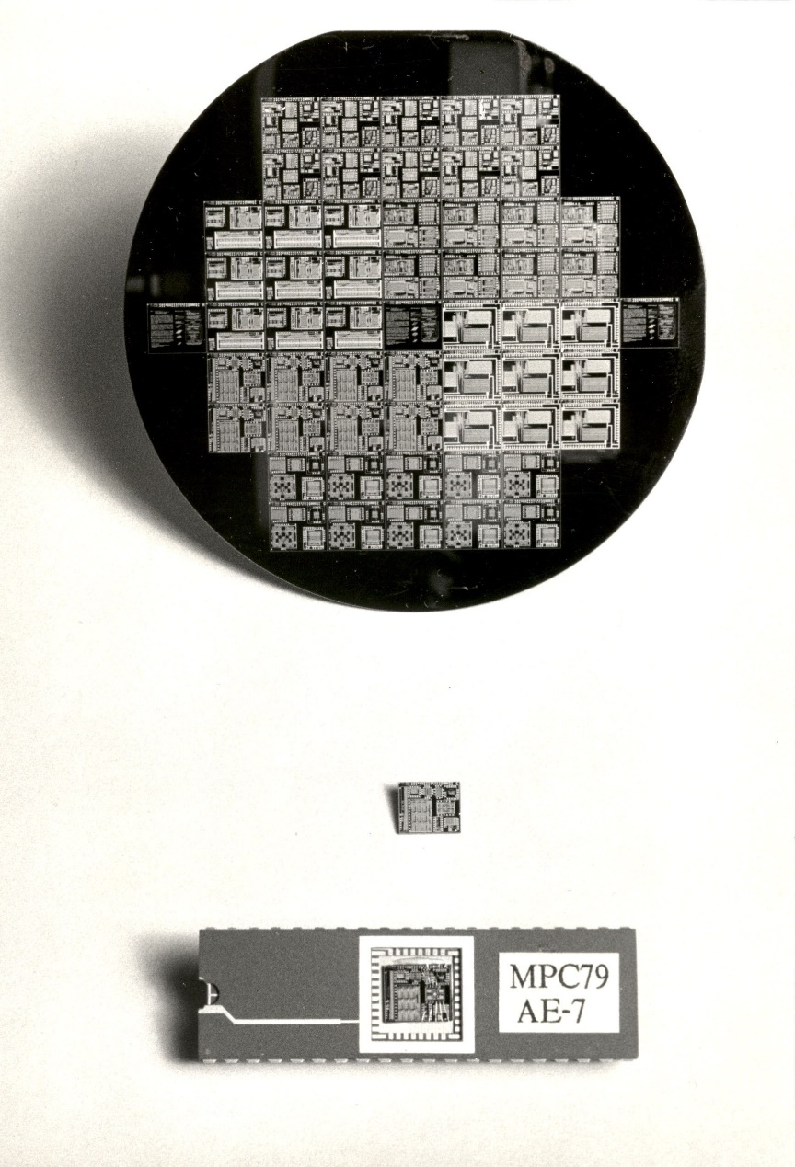
1976
1977
1978
1979
Visualizing the exponentiating
wave of VLSI innovation . . .
’76: How to cope with VLSI complexity?
’77: Inventing scalable VLSI design rules.
’78: Launching the VLSI methods at MIT!
’79: Launching the VLSI courses via MPC79!!

Slide 27
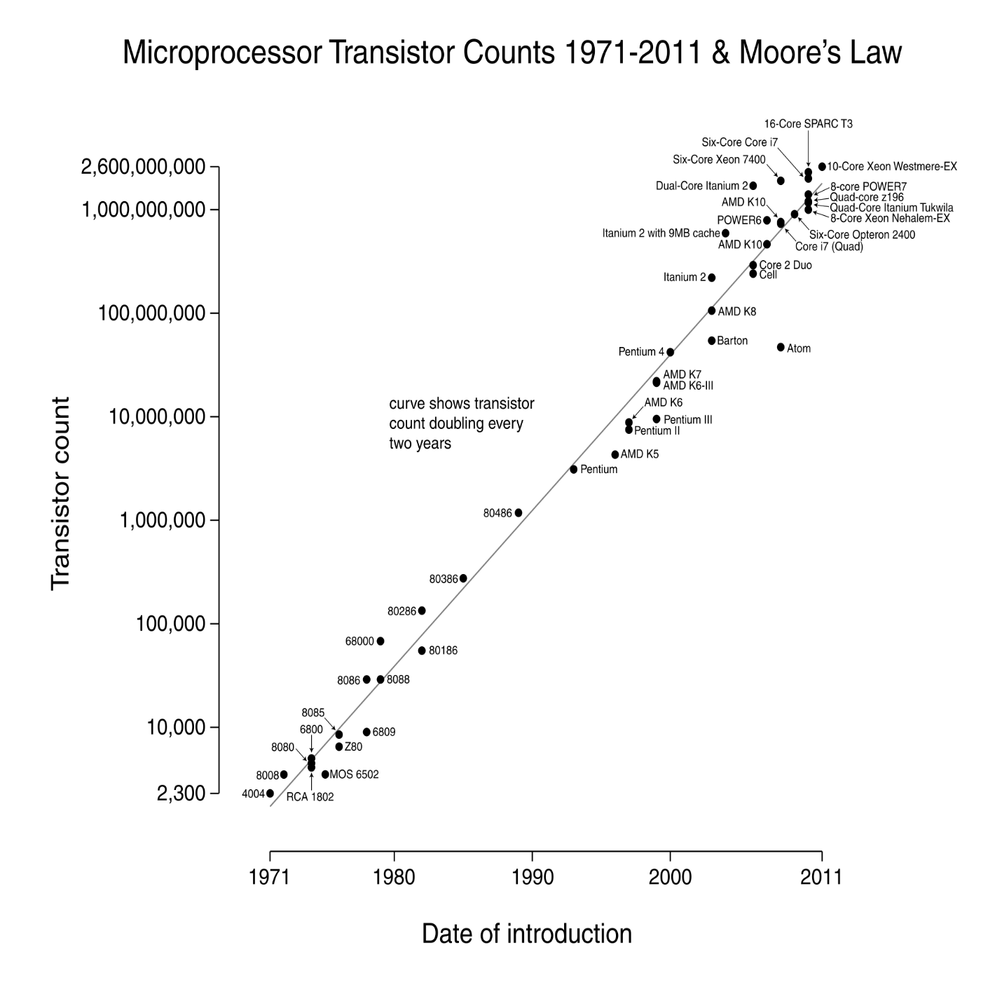
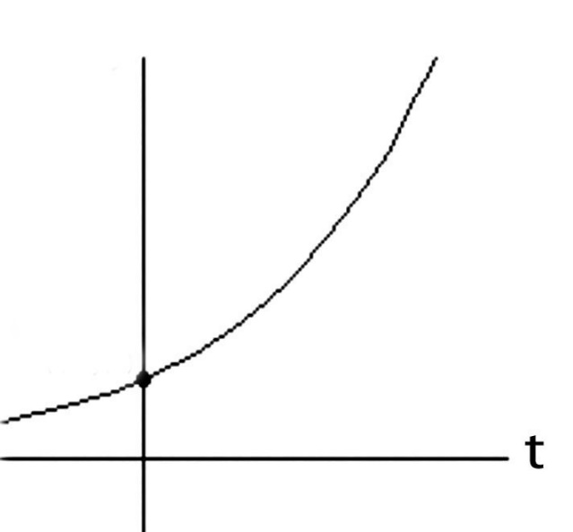
Over the past 40 years or so, Moore’s Law stayed on track all the way:
N
(exponential function
graphed on log scale)
(exponential function
with t in years)
N(t)/N(0) = 2^(t/2)
N(0), t(0)
Starting with several thousand
in 1971, the number of transistors on a chip passed one million by 1991, and by 2011 passed several billion!

Slide 28
Visualizing exponentiation and compounding ‘techno-social interest’ . . .
Link

Slide 29
Let’s now go back and follow the high-tech community’s reactions
to the “Mead-Conway” innovations during the ensuing decades:
Link

Slide 30
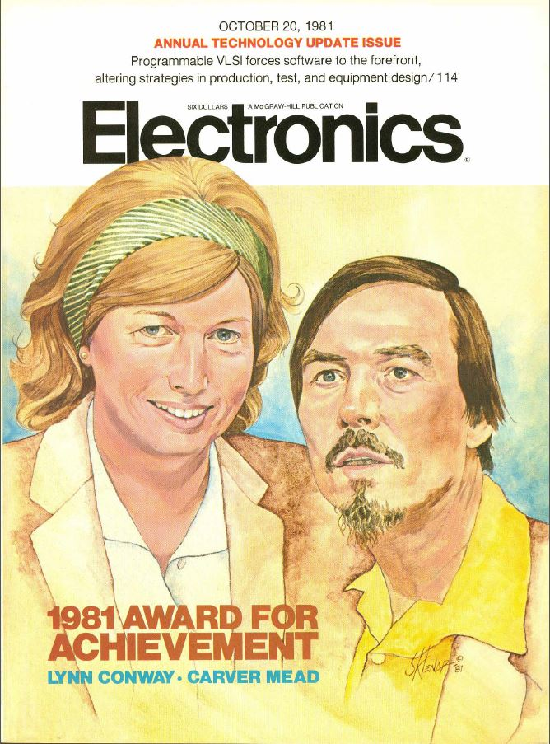
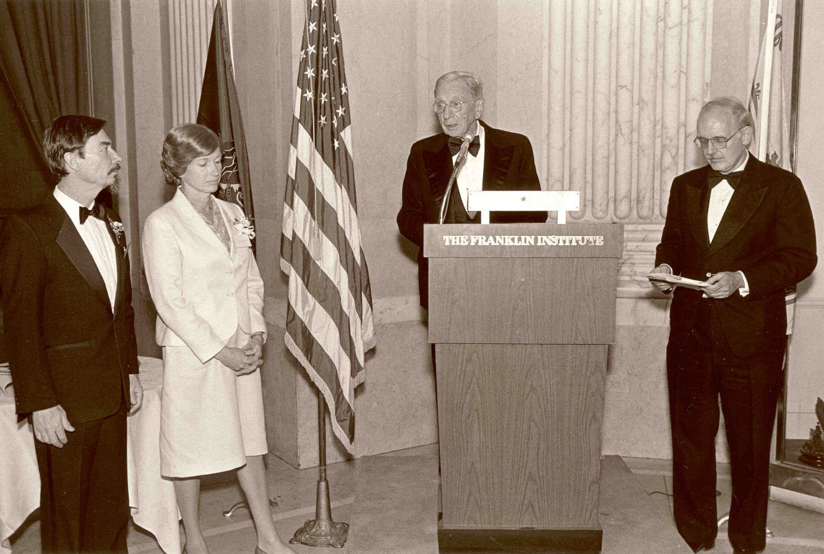
Key people sensed ‘something significant’
had happened, and Mead & Conway began
receiving major recognition in the 1980s:
Electronics Award for Achievement ‘81
Pender Award, Moore School ‘84
Wetherill Medal, Franklin Institute ’85
NAE, Mead ‘84
NAE, Conway ‘89. . .

Slide 31
However, from ‘89 through the 90s and 00s, Mead received these increasingly major recognitions, while Conway’s role was erased*:
NAS ‘89
American Academy of Arts and Sciences ‘91
EDAC Phil Kaufman Award ‘96
IEEE John Von Neuman Medal ‘96
ACM Allen Newell Award ‘97
MIT Lemelson Award ‘99 ($500,000)
Fellow Award, Computer History Museum ‘02
National Medal of Technology ‘02
NAE Founders Award ‘03
Inventors Hall of Fame, at Computer History Museum Gala ‘09
*Most of these awards were for innovations that were Conway’s

Slide 32
As a result, by 2009 the erasure was complete:
Chip inventors getting their due at Hall of Fame induction
By Mike Cassidy, San Jose Mercury News
Apr. 30, 2009 --The 50th birthday celebration of the integrated circuit kicks off in Silicon Valley this weekend, and frankly, I'm a little overwhelmed . . .
On Saturday night, the National Inventors Hall of Fame is inducting this year's class. The sold-out ceremony (at the Computer History Museum) is in Silicon Valley for the first time, because the Ohio-based hall is honoring 15 who are responsible for breakthroughs in semiconductor technology -- the technology that put the "silicon" in Silicon Valley . . . In a way, it's as if the valley's founding fathers are coming together to be honored in person and posthumously. Inductees Gordon Moore, co-founder of Intel and namesake of Moore's Law, and Carver Mead, chip design pioneer and all-around brainiac, will be at the ceremony. So will lifetime achievement honoree Andy Grove, Intel's former CEO . . .

Slide 33
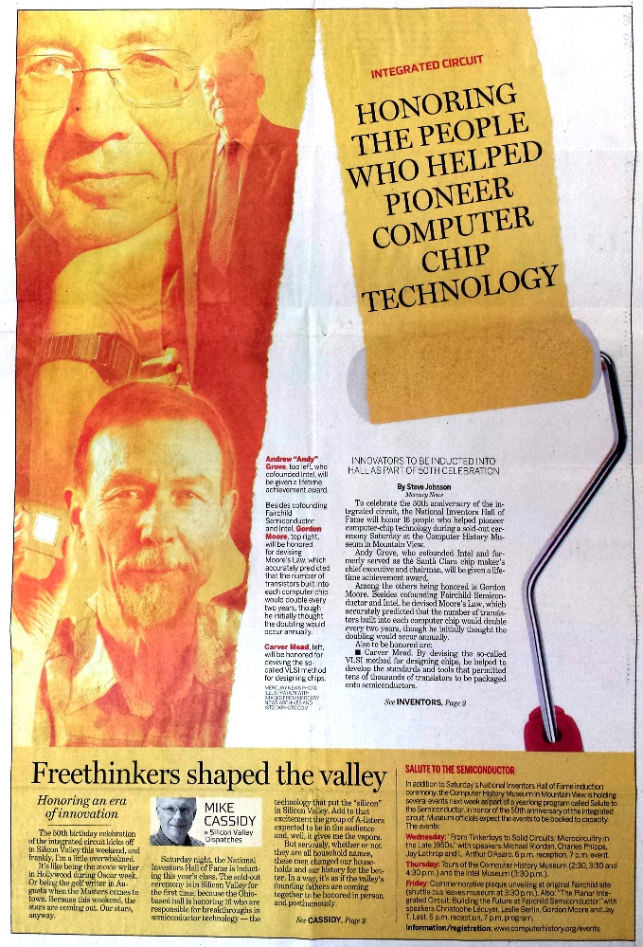
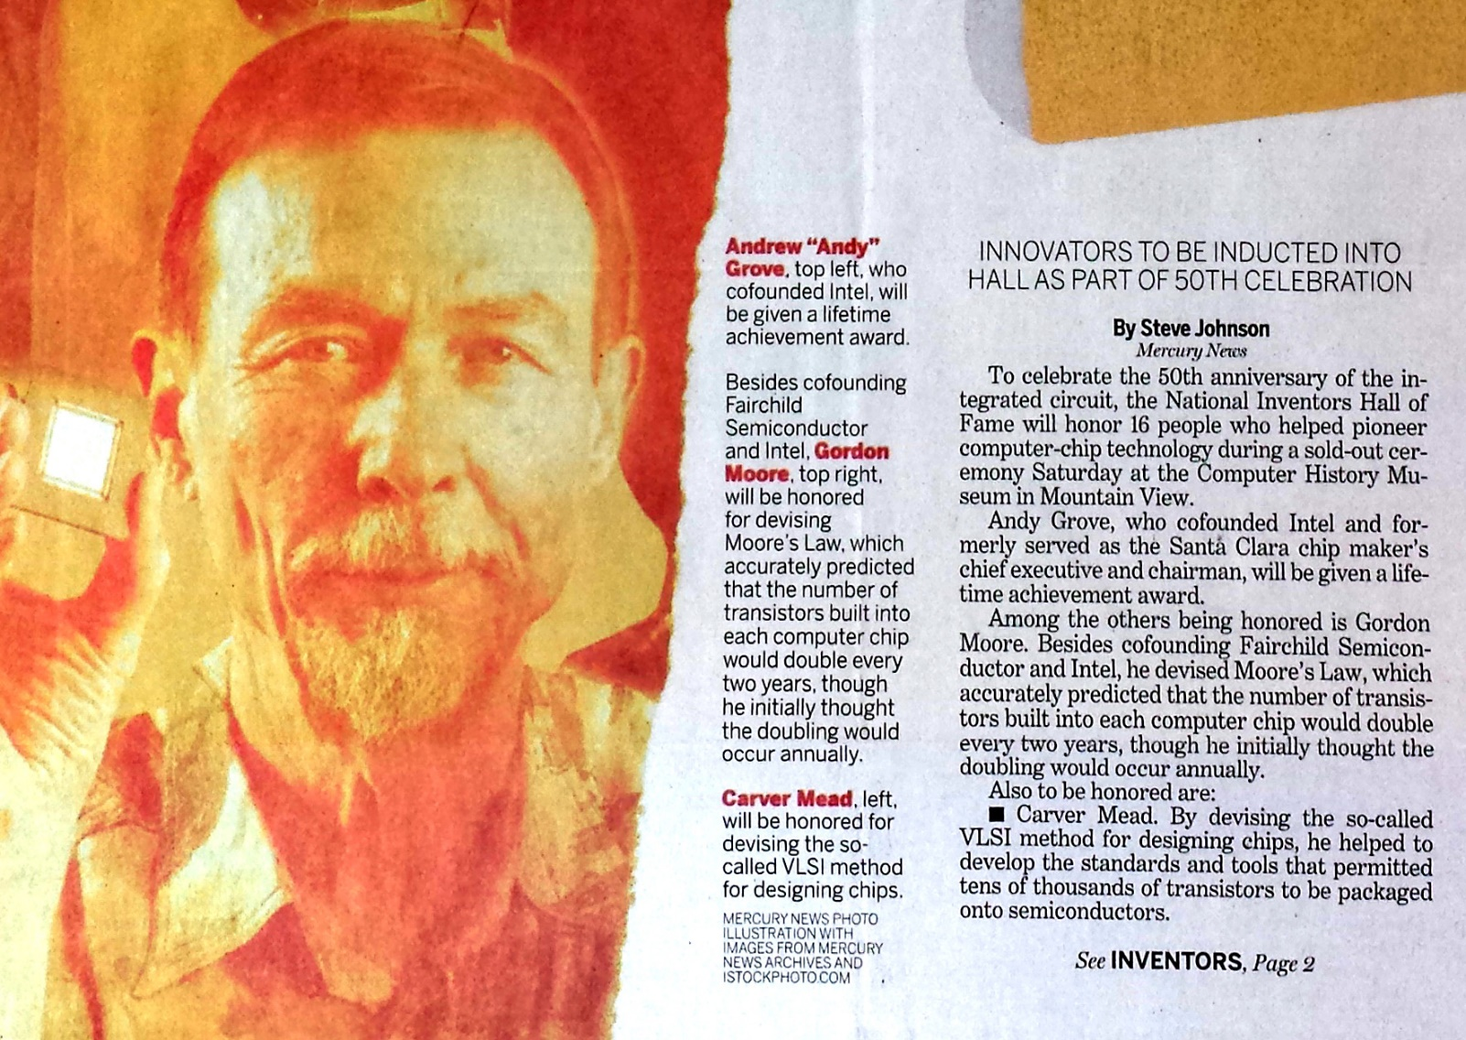
With Andy Grove, Gordon Moore and Carver Mead taking center stage:
San Jose Mercury News April 30, 2009
BTW, Conway wasn’t invited and didn’t even know it was happening . . .

Slide 34
Recent investigations into and reporting on what happened,
Hoping to regain some of my legacy along the way . . .
Link

Slide 35
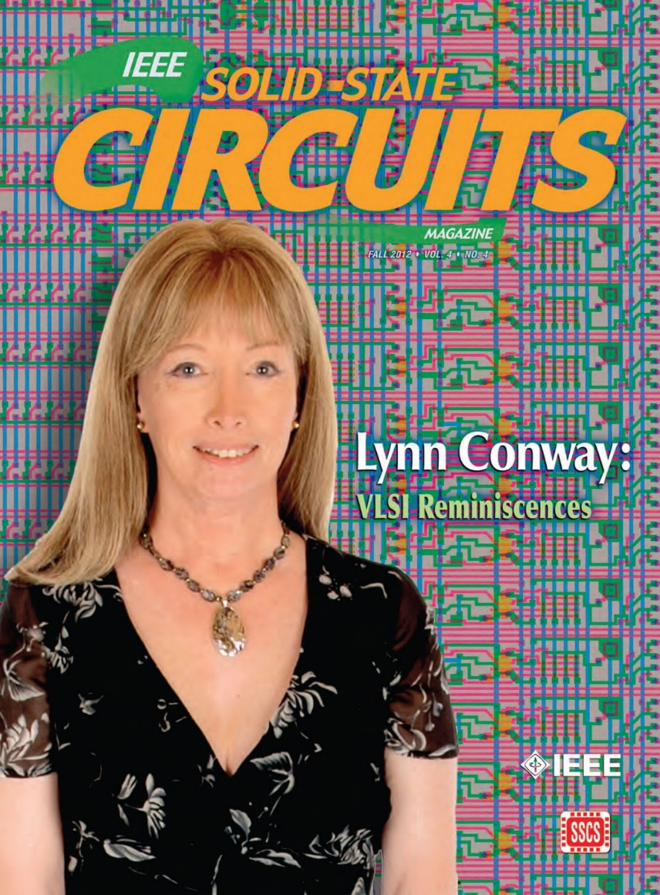
The story of my investigations in recent years is quite a saga, yet to be told . . .
To make a long-story short:
I uncovered, documented and archived
all sorts of fascinating data and evidence.
All that led me to write and publish my “Reminiscences of the VLSI Revolution” in the
Fall 2012 IEEE Solid State Circuits Magazine.
It was the first time I’d stepped openly forward to tell the whole story . . .

Slide 36
Reports re the investigation to understand
what happened and reclaim my life-legacy:
Compilation of the VLSI Archive, 2009-2012
Publication of my IBM-ACS Reminiscences, 2011
Publication of my VLSI Reminiscences, 2012
Publication of The Many Shades of ‘Out’, 2013
Publication of my MIT Reminiscences, 2014
Evidence that ‘it’s begun’:
Fellow Award, Computer History Museum, 2014
IEEE/RSE James Clerk Maxwell Medal, 2015

Slide 37
A Counter-Intuitive Explanatory-Conjecture:
Visualizing Mathew Effects, Matilda Effects and now Conway Effects!
Link

Slide 38
Throughout this case study we’ve observed the following effects in play:
(i) the “Matilda effect” (repression of contributions of women scientists)
(ii) the "Matthew effect“ (eminent scientists get more credit)
Note that these effects involve “self-fulfilling prophecies”, described by Merton as:
“. . . a false definition of the situation evoking a new behavior which makes the original false conception come true. This specious validity of the self-fulfilling prophecy perpetuates a reign of error. For the prophet will cite the actual course of events as proof that he was right from the very beginning.”
But is that all that’s happening? Or are other forces also in play?

Slide 39
After closely investigating these events, I sensed something more subliminal,
more fundamental happening at a social level . . . and it involves no errors, no conspiracies, no repressions, and no ‘bad guys’:
CONJECTURE: almost all people are blind to innovations, especially ones
made by ‘those others’ whom they do not expect to make innovations.
Since for most people, ‘those others’ = ‘almost all people’, few people ever witness
or visualize innovations, even ones made right in front of their eyes (including sometimes those made by themselves!).
They instead look for tells and cues from others when constructing internal-orientations towards ‘novelties’ they stumble upon . . . and not just whether or not to accept or reject a novelty, but also whether to even notice it in the first place!
From this perspective, the Mathew and Matilda Effects are derivatives of the
newly-conjectured “Conway Effect”, which affects ‘all outsiders’.

Slide 40
Visualizing the Conway Effect in action:
Students in MIT’78 thought they were learning “how chips were designed in Silicon Valley” (the course was, in effect, a giant MIT hack!). They simply “did it”, without realizing they were learning radically new methods.
The astonished reaction amongst Silicon Valley cognoscenti then led to intense interest in reverse engineering “how MIT did this”, causing other research universities to immediately want to offer such courses.
Similarly, folks using MPC79 took it for granted and simply “used it”.
No one realized MPC79 was an even larger paradigm-shifting-hackathon
to launch the modern world of “fabless design” + “silicon foundries” + “internet-based e-commerce infrastructure.”

Slide 41
What might MPC79 participants been thinking?
Since MPC79 used the ARPANET, many thought DARPA “did it.”
Thus when DARPA funded the transfer of MPC79 technology to USC-ISI, many users thought “MOSIS” had been “created by DARPA” . . .
And similar government supported MOSIS-like services soon sprang up in other countries!
The VLSI revolution thus swept through high-tech community without anyone realizing that it had been deliberately generated, much less how that was done and who did it.
Although the “VLSI Book by ‘Mead’” became iconically-connected with these large-scale socio-technological events, Mead himself was never able to explain what happened . . .
Meanwhile, Conway remained in the shadows up until 2012, when she finally was able to emerge and explain how it happened . . .

Slide 42
The Conway Effect: Almost all people are blind to innovations, especially those made by people whom they don’t expect to make innovations.
As a result, innovations diffuse via social-processes involving subliminal subgroup noticings, mimickings, rejections, adoptions, adaptations, tradings and displacements.
Credits for innovations as social tokens are separately subliminally assigned, gathered, seized, gained, granted, bartered, etc. . . .
These crediting-processes are modulated by visibility, status, prestige, class, power, location, credentials, prejudice, popularity, influence, money and accident . . .
The visibility of crediting for (as opposed to visualizations of) innovations sustains
both the crediting-processes and the ongoing-blindness to the underlying innovations.
Corollary: It’s possible to trigger large paradigm-shifts, right out in the open, without people having a clue what you’re doing!

Slide 43
Questions to Ponder!
Have you noticed an innovation this week?
Have you made an innovation this week?
What is an innovation?
How to think abstractly about such things?
Insights from the evolution of culture in animals . . .
Glimpses into Emerging Techno-Social Dynamical-Systems . . .

Slide 44
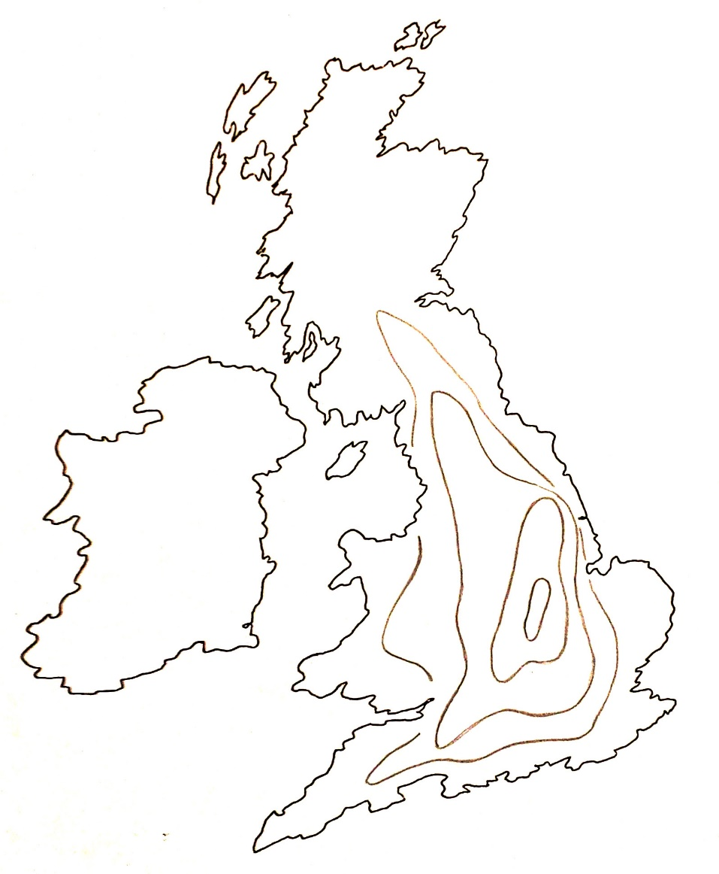
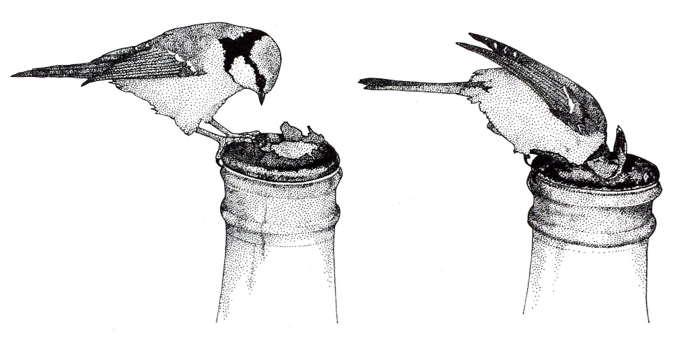
Thought Experiment!
Visualizing the diffusion of an innovation
t4
t3
t2
t1
John Tyler Bonner, The Evolution of Culture in Animals,
Princeton University Press, 1980, p.183-4.

Slide 45
Thought experiment!
“The most remarkable of such examples comes from the work of the Japanese Monkey Center where macaques were isolated in groups on small islands, and differences in the behavior patterns of different island populations arose by cultural evolution . . .
The greatest achievement is that of Imo, the female genius among the macaques.
At the age of two she invented washing the sand off sweet potatoes before eating them, and at a later date she found a way of separating wheat from sand by throwing the mixture in the water and skimming off the wheat from the surface.
These discoveries spread slowly through the colony, although in general the older individuals were the last to acquire the new tricks.”*
*John Tyler Bonner, The Evolution of Culture in Animals,
Princeton University Press, 1980, p.184.
Source

Slide 46
Thought Experiment: Inside Rackspace's Headquarters
Rackspace Castle, 1 Fanatical Place, Windcrest, TX

Slide 47
Glimpses into Techno-Social Systems in the emerging Social Age . . .
Lynn Conway, “Our Travels Through Techno-Social Space-Time: Envisioning Incoming Waves of Technological Innovation”, 2016 Magill Lecture, Columbia University, March 23, 2016
Jesse Adams, “Magill Lecture: Visionary Engineer Lynn Conway BS’62, MS’63 Heralds Dawn of the Techno-Social Age”, Columbia Engineering, April 7, 2016

Slide 48
Readings:
Ken Shepard, “Covering”: How We Missed the Inside-Story of the VLSI Revolution”, IEEE Solid State Circuits Magazine, FALL 2012, pp. 40-42. (more)
Chuck House, “A Paradigm Shift Was Happening All Around Us”, IEEE Solid State Circuits Magazine, FALL 2012, pp. 32-35. (more)
Lynn Conway, “Reminiscences of the VLSI Revolution: How a series of failures triggered a paradigm shift in digital design”, IEEE Solid State Circuits Magazine, FALL 2012, p. 8-31. (more)
Lynn Conway, “The Many Shades of Out”, Huffington Post, July 24, 2013.
Paul Penfield, "The VLSI Revolution at MIT", 2014 MIT EECS Connector, Spring 2014, pp. 11-13.
Lynn Conway, "MIT Reminiscences: Student years to VLSI revolution", lynnconway.com, March 11, 2014.
Computer History Museum: “Lynn Conway, 2014 Fellow, For her work in developing and disseminating new methods of integrated circuit design”, April 2014.
Nicole Casal Moore, “Life, Engineered: How Lynn Conway reinvented her world and ours”, The Michigan Engineer, FALL 2014, pp. 42-49.
Catharine June, “Lynn Conway to receive 2015 IEEE/RSE James Clerk Maxwell Medal”, Michigan Engineering News, December, 15, 2014.
IEEE and the Royal Society of Edinburgh, “James Clerk Maxwell Medal ceremony at the Royal Society of Edinburgh”, YouTube, Nov. 12, 2015.
Magnus Linklater, “‘Life in stealth’ of microchip genius who migrated to a new identity: Lynn Conway beat transgender bias and began a revolution”, The Times (UK), Nov. 14, 2015.

Slide 49
END
http://ai.eecs.umich.edu/people/conway/Memoirs/Talks/Rackspace/2016_Rackspace_Pride_Talk.pdf
http://ai.eecs.umich.edu/people/conway/Memoirs/Talks/Rackspace/2016_Rackspace_Pride_Talk.pptx
http://www.slideshare.net/LynnConway1/an-unexpected-woman-the-inside-story-behind-the-vlsi-revolution
www.lynnconway.com; conway@umich.edu

Slide 50
EPILOGUE: Excerpts from Lynn’s 2016 Magill Lecture
“Our Travels Through Techno-Social Space-Time: Envisioning Incoming Waves of Technological Innovation”
2016 Magill Lecture, Columbia University, March 23, 2016

Slide 51
As we travel through space-time . . .
be sure to keep these words in mind:
Link
“The farther backward you can look, the farther forward you can see.” – Winston Churchill

Slide 52
As we turn 180⁰ and look ahead . . .
we can glimpse another huge incoming
wave of innovation . . .
It’s out there now, just beyond the social-time-horizon . . .

Slide 53
One thing for sure:
This is the “Big One”! . . .
URL

Slide 54
Ex: To envision the masses of ideas now cycling in techno-social motion, recall how we
diagrammed the nested-social-evolutionary-processes of the VLSI revolution.
Only now, vastly more such processes are running in parallel and cross-fertilizing.
And a new science is beginning to explore and map-out what’s happening . . .
The MPC Adventures (p. 16) Xerox PARC 1981.
URL

Slide 55
Epidemic Processes are already providing
mathematical frameworks for partly-modeling
techno-social dynamical-systems:
From: “Epidemic processes in complex networks” by
Pastor-Satorras, et al, Rev. Mod. Phys. 87, 925 – 8/31/15
See also recent work in CNNs, LVars, etc.

Slide 56
Now, note that the big incoming wave is way more than a few nested
logistic ‘epidemic’ processes where each looks something like this:
nearing
Saturation
y(t) = ymax/(1+((ymax/y(0))–1))e^-rt)
unfolding
exponentiation
And even in this simple case, each 2D slice hides tons of what “composes the wave”*
*For more insight into this all this, see Van Quine’s discussion of “the river” in From A Logical Point of View, Ch.IV.
Let’s re-slice and zoom into our incoming wave in 4D⁺ to gain a better perspective

Slide 57
Meta-ethnomethodology:
Envisioning the incoming wave of innovation as
a time-series of “GHC profiles”(i.e., 2D⁺ slices
thru the 3D⁺ wave at increments in time) . . .
Gartner Hype Cycle 2014
http://www.gartner.com/newsroom/id/2819918
Is this a Traveling Wave?
A Standing Wave? Or What?
This stunning video*
hints at ways to
think about what
it all means . . .
*"Water," by Morgan Maasen http://vimeo.com/90429499

Slide 58
Zooming-in, these processes seem remarkably
similar to the workings of the alchemists,
i.e., the labyrinths of techno-social processes
that evolved and eventually “self-abstracted”
into the sciences of chemistry and materials.
Zooming out, such processes can be visualized as actions partially-bounded within regions of enhanced Minkowski-like 4D⁺ techno-social space-time diagrams:
Especially see work at Columbia and Princeton on reenacting the unfolding of medieval European
alchemy, in a deep form of hands-on, techno-social reverse-engineering of what happened back then:
The Making and Knowing Project
by Pamela Smith, Columbia (video).
Decoding Alchemy freshman seminar
by Jennifer Rampling, Princeton.
See also Scientiae and the Society for the History of Alchemy and Chemistry (SHAC)
To practice visualizing 4D space-time see Online
Resources on 4D like Curved Spaces and 4D Draw

Slide 59
In Conclusion, a Conjecture about possible futures:
By cooperatively generating and sharing ideas for doing ever-more with ever-less, the incoming wave of techno-social innovation has the stunning potential of:
Sustainably providing ever-increasing infrastructural functionality and life experiential-amplification per person,
While consuming ever-decreasing energy and material resources per person
Thus beginning the reigning-in of our unsustainable over-use of planet earth
While simultaneously opening-up unprecedented explorations of the greatest frontier . . . the frontier of what it’s possible to do!
Thus we Begin another Renaissance, as we Enter the Techno-Social Age.

Slide 60
Finally, a personal perspective on “Our Travels Through Time”. . .
Source
“If you want to change the future, start living as if you’re already there!”
– Lynn Conway

