Slide 1
the albert Nerken School of Engineering
A BRIEF HISTORY OF COOPER UNION
Summer 2020

Slide 2
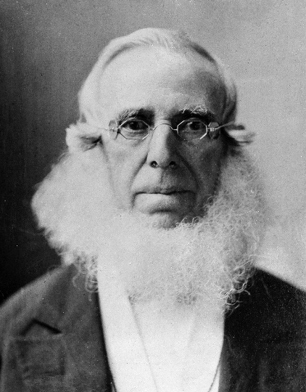
Peter Cooper – Our Founder
February 12, 1791 – April 4, 1883
Inventor
  Tom Thumb (1st American steam locomotive)
  Gelatin (patented in 1845)
  Transatlantic telegraph cable (1858)
Philanthropist
  Founded New York Juvenile Asylum (orphanage) in 1851 → Children’s Village (one of the oldest non-profit organizations in the US)
Politician
  Active in the anti-slavery movement
  Nominated for President (1876, Greenback Party)
  Edward Cooper (son) and Abram Hewitt (son-in-law) were both mayors of NYC
Suggested Reading/Viewing:
  Mechanic to Millionaire: The Peter Cooper Story (2009)
  “Making Millions and Making a Difference” – Prof. Robert Topper
  https://en.wikipedia.org/wiki/Peter_Cooper

Slide 3
The Cooper Union - Infrastructure
1853 – construction began for a free institute in NY to offer practical education to adults in the mechanical arts and science, as well as prepare men and women of the working classes for success in business
  An education “equal to the best technology schools established”, independent of an individual’s race, religion, sex, wealth or social status
  Should be “open and free to all”
Foundation Building
  1859 – open-admission night classes (2000 students, 600 dropped out)
  1st building to have rolled-iron I-beams
  1st elevator shaft
Women’s School of Design – daytime courses in engraving, lithography, painting and drawing
1912 – Hewitt Building – housed School of Art
1956-1961 – 51 Astor Place – housed School of Engineering
1992 – Residence Hall
2009 – New Academic Building
https://en.wikipedia.org/wiki/Cooper_Union

Slide 4
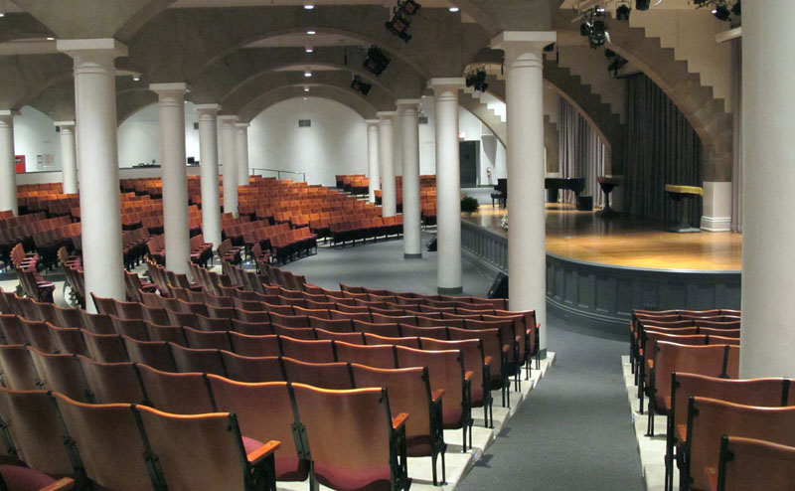
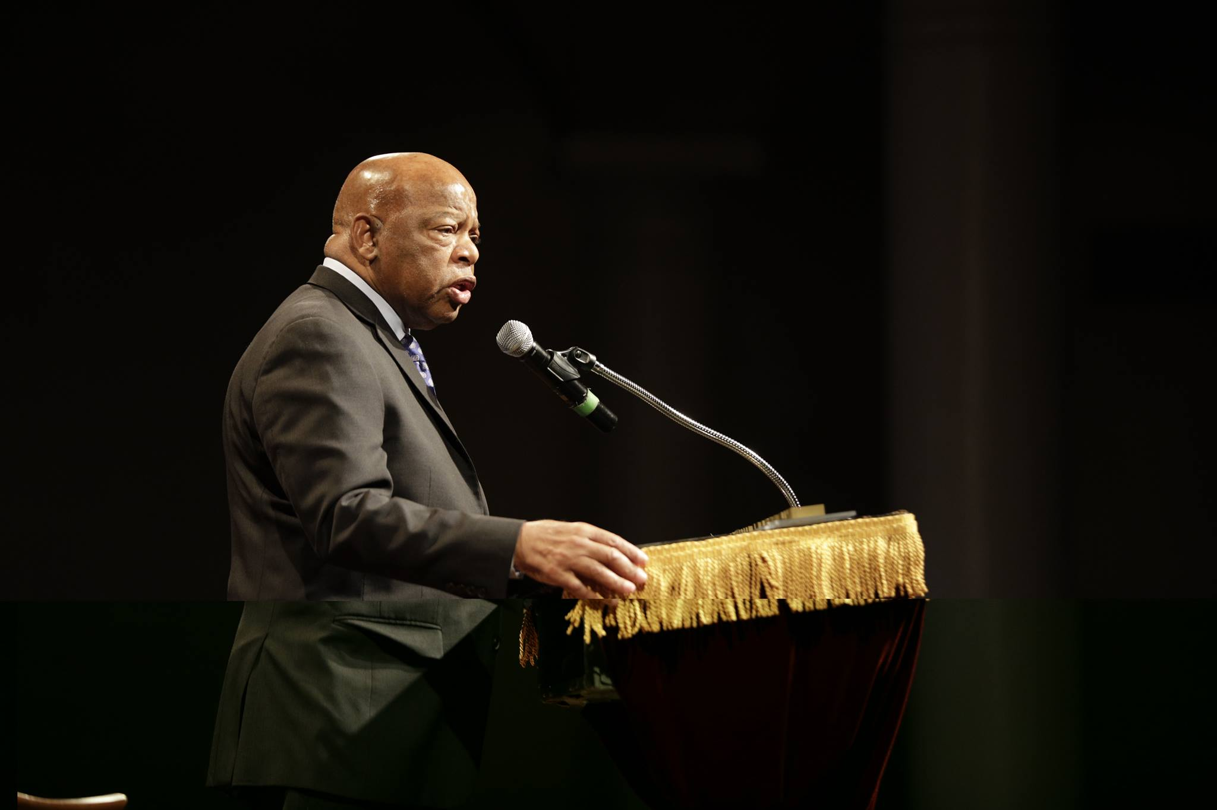
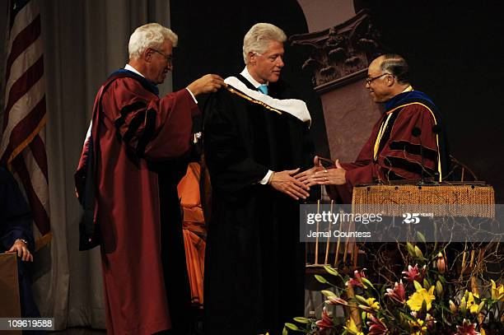
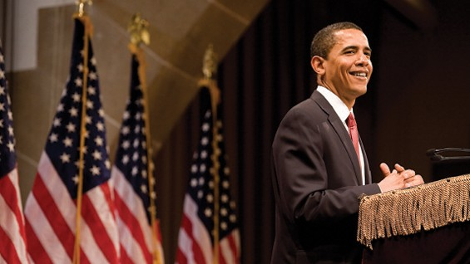
The Great Hall
Historic site for civic discourse (including radical views)
1860 – Abraham Lincoln gave a speech that contribute to his nomination by Republican party as a presidential candidate
  Presidents Grant, Cleveland, Taft, T. Roosevelt and Clinton (3x), Obama
Frederick Douglass, Susan B. Anthony, Elizabeth Cady Stanton, Mark Twain
NYC Mayors – Giuliani and Bloomberg
Mahmoud Abbas – Palestinian National Authority
President Hugo Chavez (Venezuela)

Slide 5
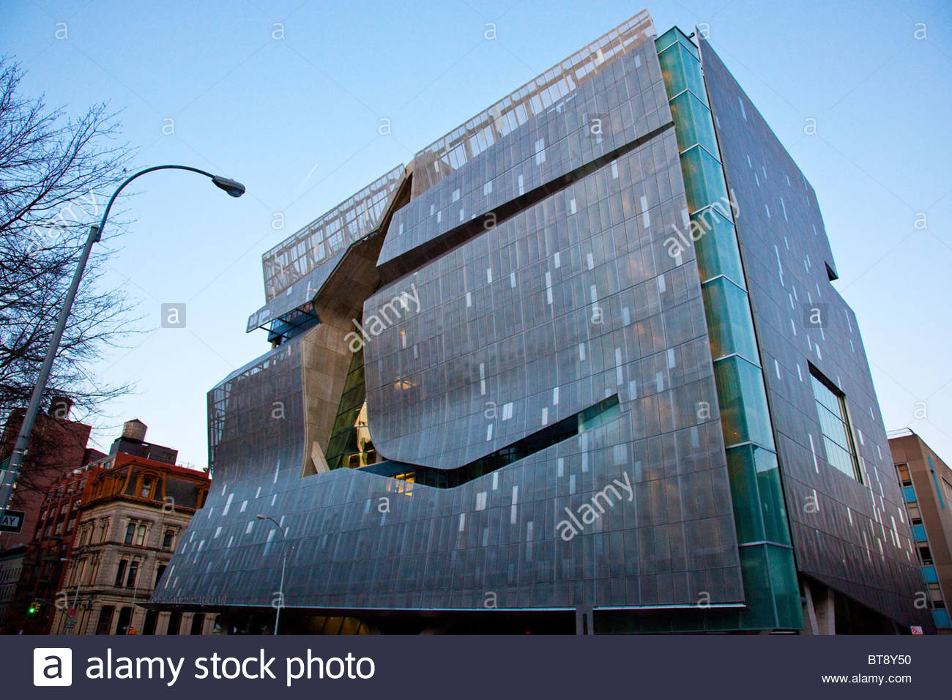
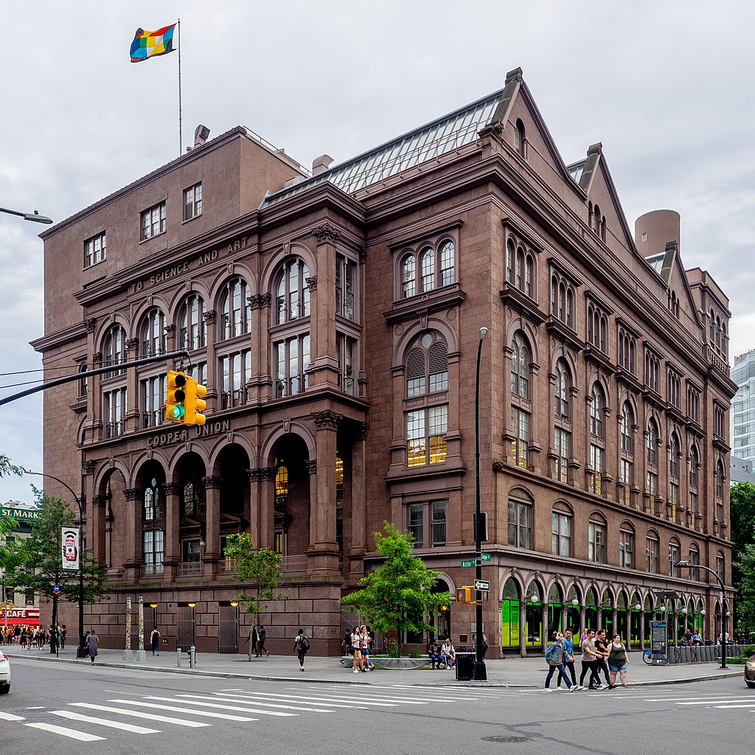
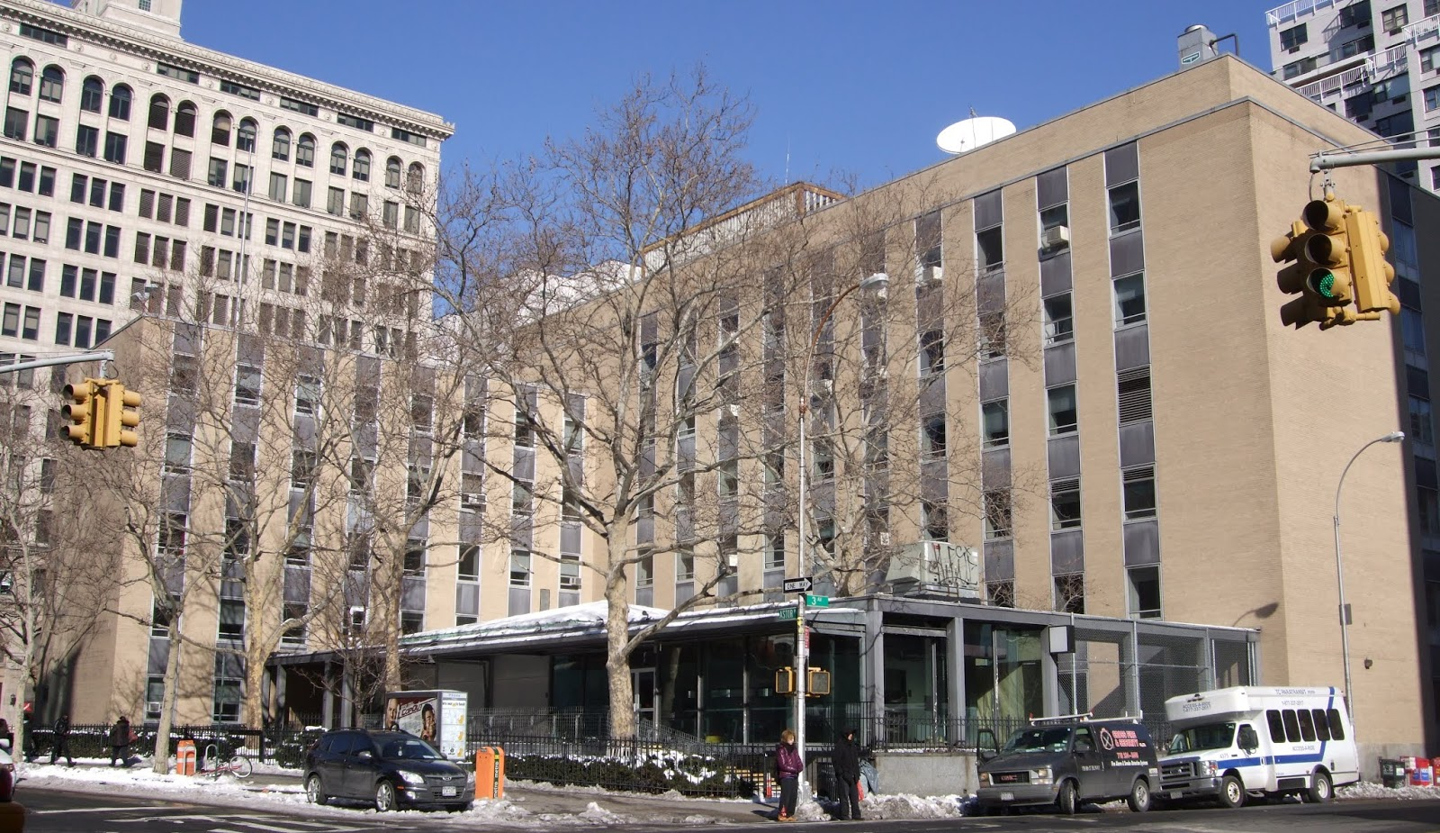

The Albert Nerken School of Engineering

Slide 6
Engineering at Cooper Union – A Brief History
1860 – Night courses in mathematics, chemistry, mechanical philosophy, architectural drawing, mechanical drawing, free hand drawing, vocal music and vocal physiology
1901 – Night School of Art and Night School of Science created (3-year programs), including civil, mechanical and electrical engineering courses
1902 – Four-year undergraduate program was established, where each student received a full-tuition scholarship
1905 – Bachelor’s of engineering began (5-year night program)
1906 – Day School of Science
1914 – Bachelor’s degree now includes CE, EE and ME
1948 – Art and Engineering Day and Evening Schools are accredited by Middle States
1955 – Bachelor’s of engineering degree as a result of a new curriculum!
1964 – Graduate program began (1st master’s degree conferred in 1967)
1967 – BSE degree offered, as well as a physics major
1975 – Physics, mathematics and distributed science majors are dropped
1977 – Cooper Union partners with NYU to offer 14 new joint-degree programs
  BS from NYU’s College of Arts and Science and BE/ME from CU’s School of Engineering
1981 – Bioengineering program in conjunction with Hospital for Joint Disease
Katie Blumenkrantz

Slide 7
Other Collaborations
  Study abroad program – Iceland, Spain, Germany, others
  Engineering and Medicine (Mt. Sinai) – Cooper Union (and Princeton) engineering students could apply to medical school without taking MCAT
  Exchange program – Indian Institute of Technology (IIT – Mumbai) and Iceland
  Mt. Sinai – research and course exchange

Slide 8
Notable Alumni
Joshua Lionel Cowen, inventor of the flash-lamp and co-founder of Lionel Corporation
John M. Eargle, Oscar and Grammy-winning audio engineer and musician
Thomas Edison, inventor
Joel H. Ferziger, authority in computational fluid dynamics
Russell Hulse, 1993 winner of the Nobel Prize in Physics
Michael Kasha, physical chemist and guitar designer
Alexia Massalin, computer scientist and programmer
Bruce Pasternack, President and CEO of the Special Olympics
Richard Sarles, CEO and General Manager of Washington Metropolitan Area Transit Authority
Sy Schulman, civil engineer and planner, Mayor of White Plains, New York (1993–1997)
John L. Smith, German-born American chemist, pharmaceutical executive and co-owner of the Brooklyn Dodgers
Richard Velazquez, Honda and Porsche designer
Jackie Yi-Ru Ying, chemical engineer and nanotechnology scientist
https://en.wikipedia.org/wiki/List_of_alumni_of_Cooper_Union

Slide 9
Organizational Structure – Dean’s Office
Deans and Associate Deans
  Eleanor Baum (1987-2010)
    Arsete Lucchesi, Simon Ben-Avi (probably others)
  Simon Ben-Avi (2010-2012)
  Alan Wolf (2012-2013)
    George Delagrammatikas
  Teresa Dahlberg (2013-2015)
    George Sidebotham → Anita Raja
  Richard Stock (2015-2018)
    Anita Raja
    Ruben Savizky
  Barry Shoop (2019-???)
    Anita Raja → Lisa Shay
    Ruben Savizky

Slide 10
Timeline of Recent Events
January 2019
February 2019
March 2020
COVID-19
“The Flood”
Dean Shoop arrives!
FEC report
2018
“Tuition Era”
Fall 2014
Fall 2015
“The Lawsuit”
The Ivory Tower (2014) – Available on Netflix

Slide 11
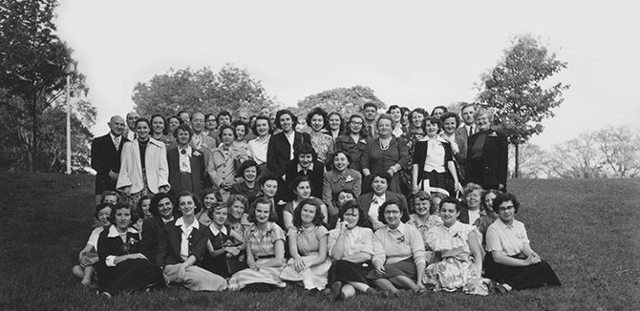
Traditions/Events
Green Camp
  Land in NJ that was gifted to Cooper Union by Norvin Hewitt Green (great-grandson of Peter Cooper)
  Led to SWE!!! (1950)
  Eventually sold to NJ in 1978
https://www.support.cooper.edu/s/1289/support/interior-social.aspx?sid=1289&gid=1&pgid=2115

Slide 12
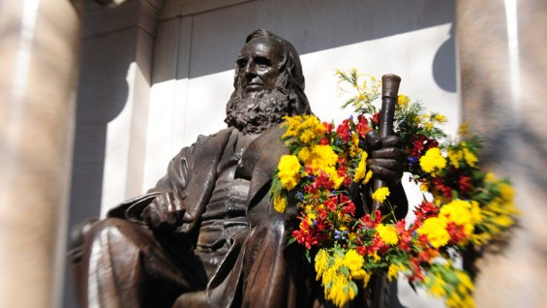
Traditions/Events
Egg Drop
Wreath Laying
Culture Show
https://www.support.cooper.edu/s/1289/support/interior-social.aspx?sid=1289&gid=1&pgid=2115

Slide 13
