Slide 1
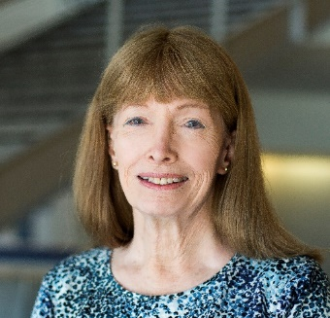
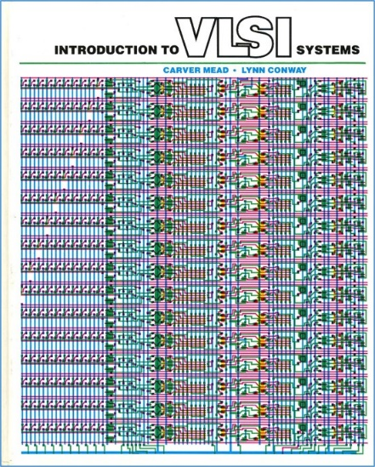
SoE Diversity, Equity and Inclusion Town Hall
Cooper Union, Dec. 17, 2020 at 5:00-6:00 pm.
The Disappeared: Beyond Winning and Losing*
Lynn Conway, Professor of EECS Emerita, University of Michigan, Ann Arbor
When “others” (such as women and people of color) make innovative contributions in scientific and technical fields, they often “disappear” from later history and their contributions are ascribed elsewhere. This is seldom deliberate — rather, it’s a result of the accumulation of advantage by those who are expected to innovate. This lecture chronicles an example of such a disappearance and introduces the Conway Effect to elucidate the disappearance process (to be followed by a Q/A session).
*In remembrance of pioneering novelist Ralph Ellison, author of Invisible Man, 1952.

