Slide 1



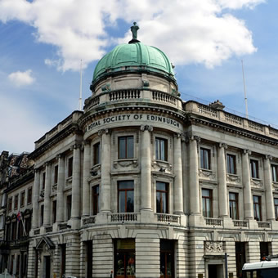
Our Travels Through Time:
Envisioning Historical Waves of Technological Innovation
Lynn Conway
Professor of EECS, Emerita
University of Michigan, Ann Arbor
An invited presentation at the
Royal Society of Edinburgh
November 12, 2015
Note: This slideshow with its embedded links
is posted online for later reference.
[ Version 11-12-2015 ]

Slide 2

To set the stage, let’s visualize some past waves . . .
Link
Dropping-in just before them, then coming forward through time . . .

Slide 3

And as we travel through time . . .
keep these words in mind:
Link
“The farther backward you can look, the farther forward you can see.” – Winston Churchill

Slide 4
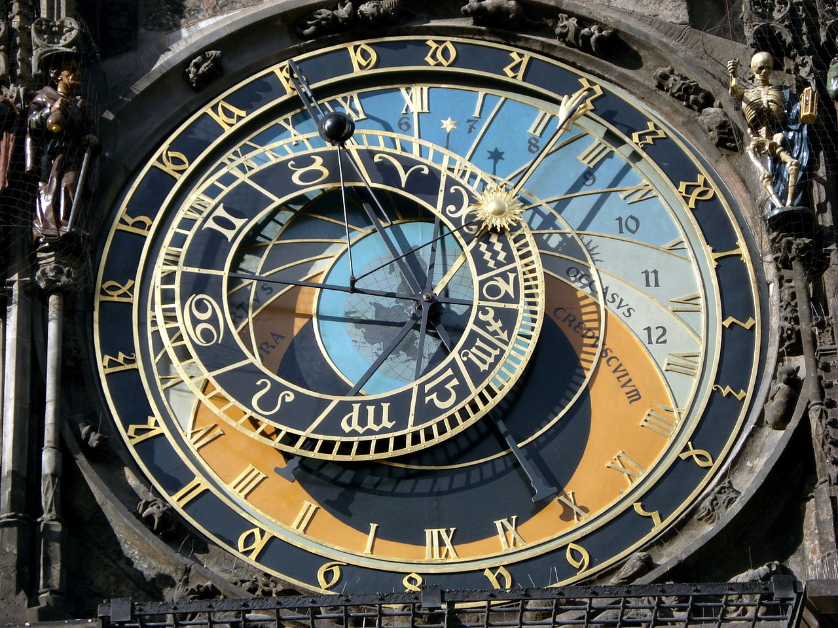
We’ll begin in the 1400s,
during the Renaissance,
a time of transformational
cultural advances . . .
Prague Astronomical Clock, c. 1410:
The mechanization of astronomical calculations during the Renaissance:
A stunning confluence of the Mathematics, Science, Engineering
Architecture and Art of the time . . .
Photo by Hector Zenil (www.hectorzenil.net)

Slide 5
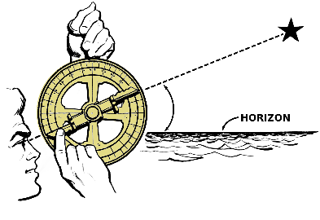
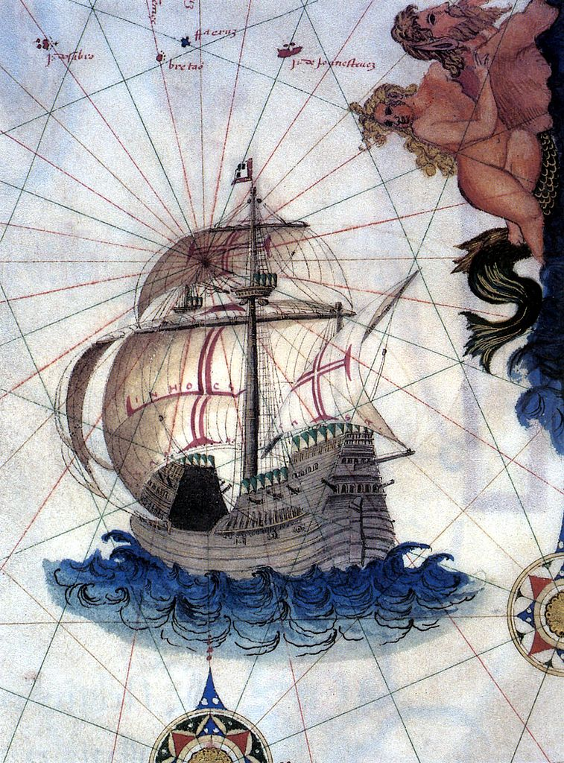
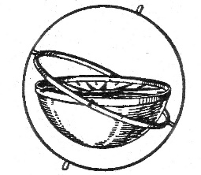
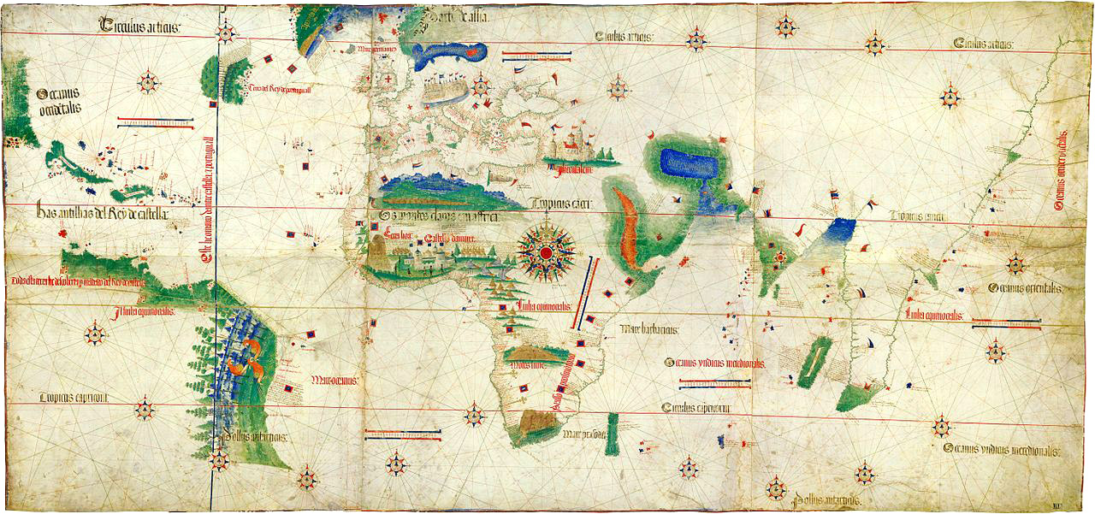
By the late 1400’s advances in shipbuilding, navigation & mapping reached a ‘tipping point’ . . .
Mariner’s Astrolabe
Portuguese Carrack
Triggering the Age of Discovery
by enabling explorations across
the open seas . . .
Gimbal Compass
Cantino planisphere (1502)

Slide 6
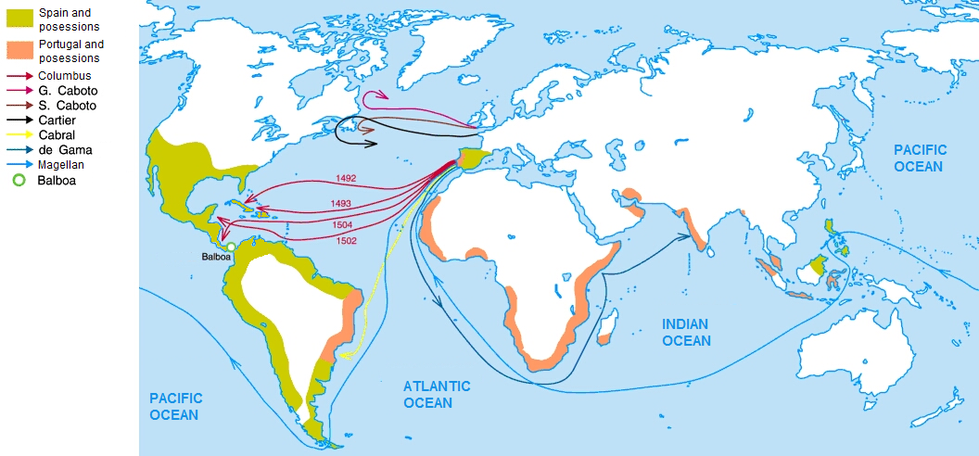
Thus it begins:
Charting the Early Voyages during the Age of Discovery, c.1492-1522 . . .
Wiki Commons

Slide 7
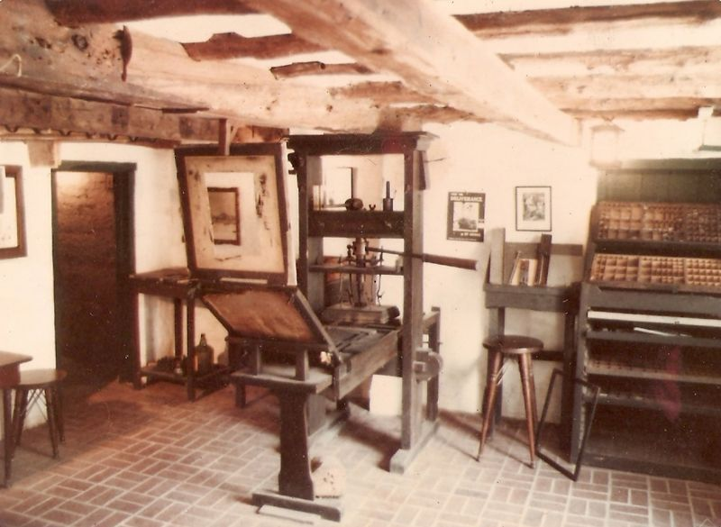
As mass-communication by printing spread in the late 1400s,
it enabled adventurers to ever-more quickly propagate news of what they’d found and where they’d found it . . . dramatically escalating the exploration rate . . .
Replica Gutenberg Press at the Featherbed Alley Printshop Museum:
Link; Attribution: Aodhdubh at English Wikipedia

Slide 8
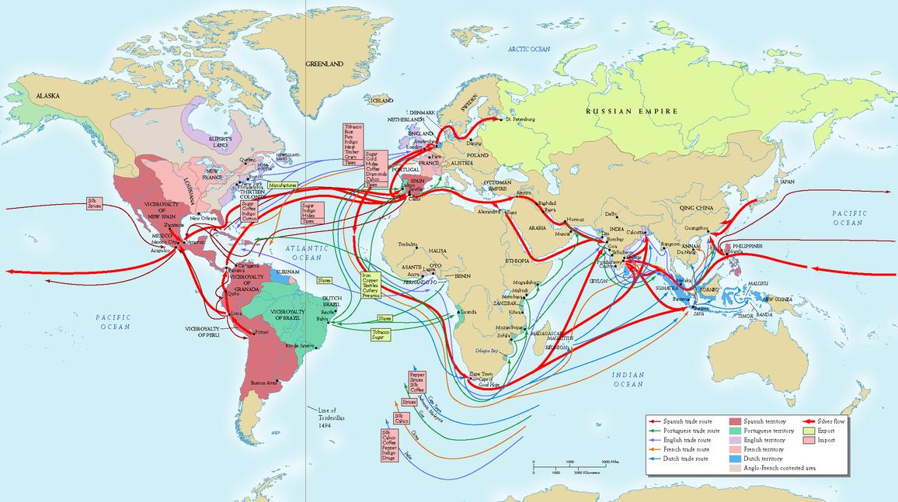
By the early 1700’s, exponentiation had generated a massive global trading system . . .
Source

Slide 9
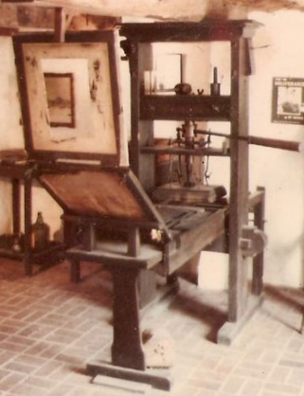
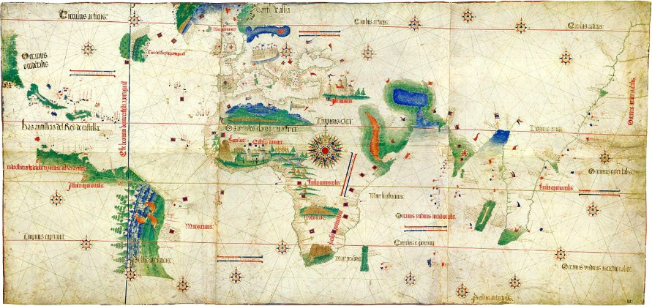
Now, what’ happening here?
Just exponentiation of THINGS?
Is that all this is?
Or exponentiation of key clusters of innovative
IDEAS in the minds of ever more people?
IDEAS on how to MAKE and USE things . . .

Slide 10
By the mid-1700’s, the stage was set for yet another
tremendous disruptive wave of innovation . . .
and so began the industrial revolution (~1760) . . .
Link

Slide 11
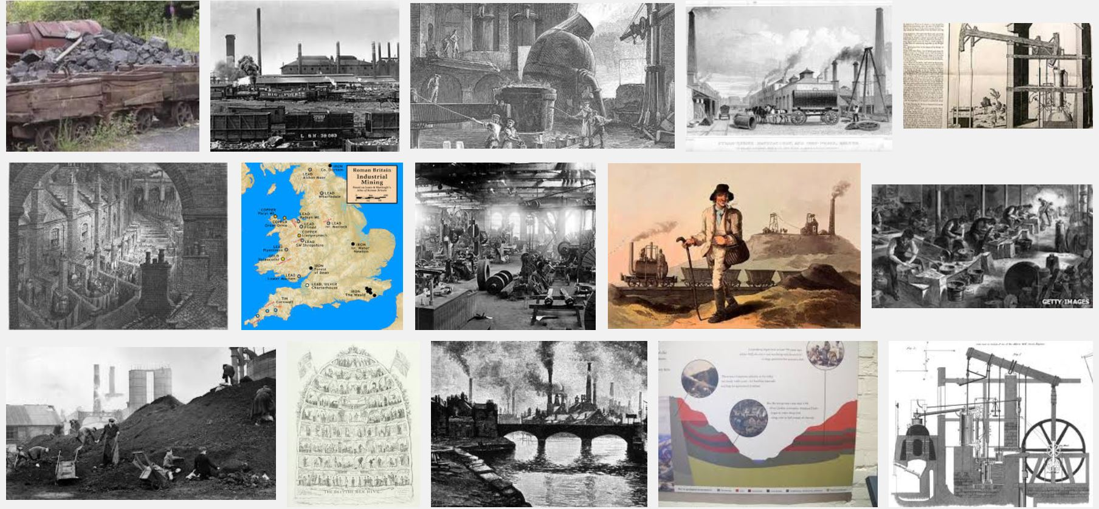
During the Industrial Revolution the mining/processing of
coal and iron-ore was greatly amplified by steam-power . . .
Snip from Google Images
Some of the resulting iron was used to make more steam engines,
and this positive feedback fueled an iterative expansion-process . . .

Slide 12
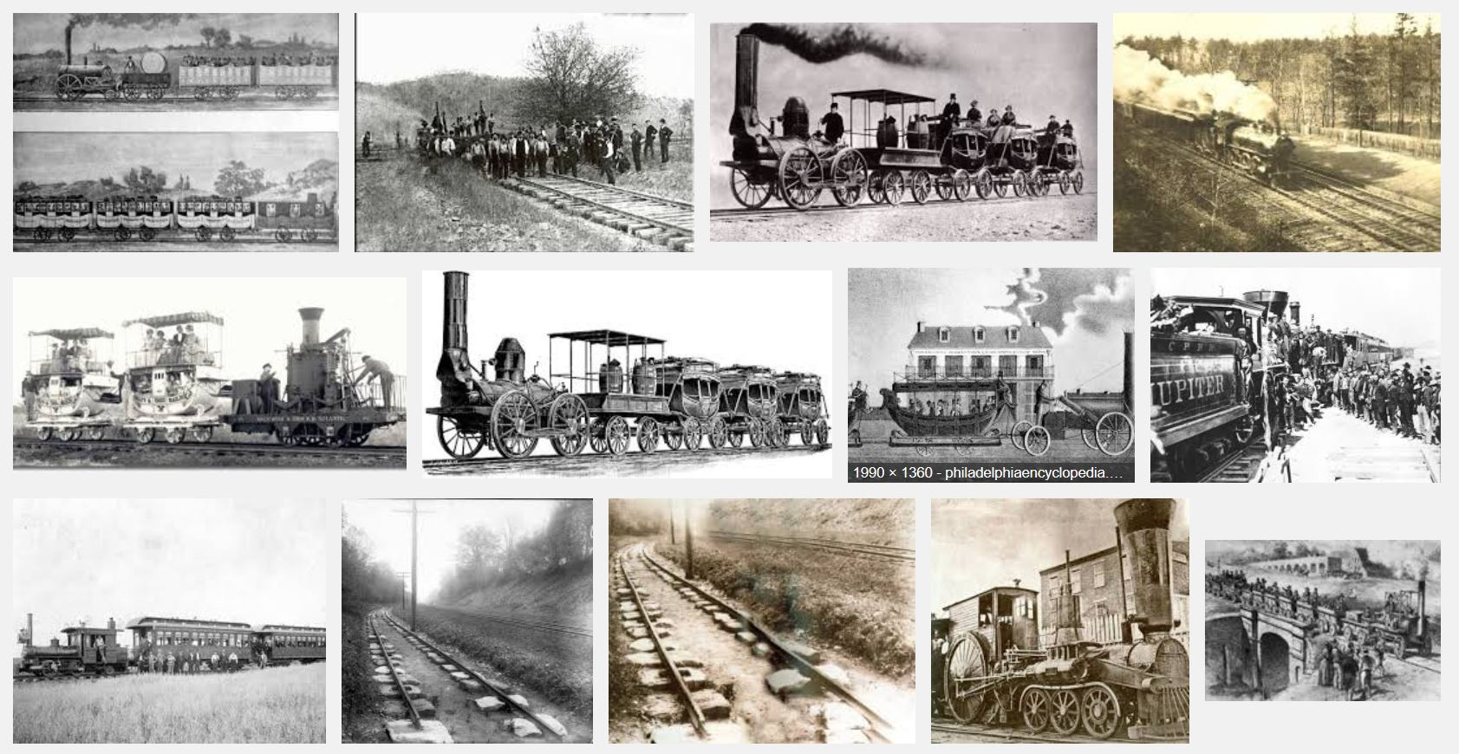
By the 1830’s, steam-powered railroads began interconnecting mines to
iron-works and rail-makers, enabling ever more rapid expansion of the railroads . . .
Snip from Google Images

Slide 13
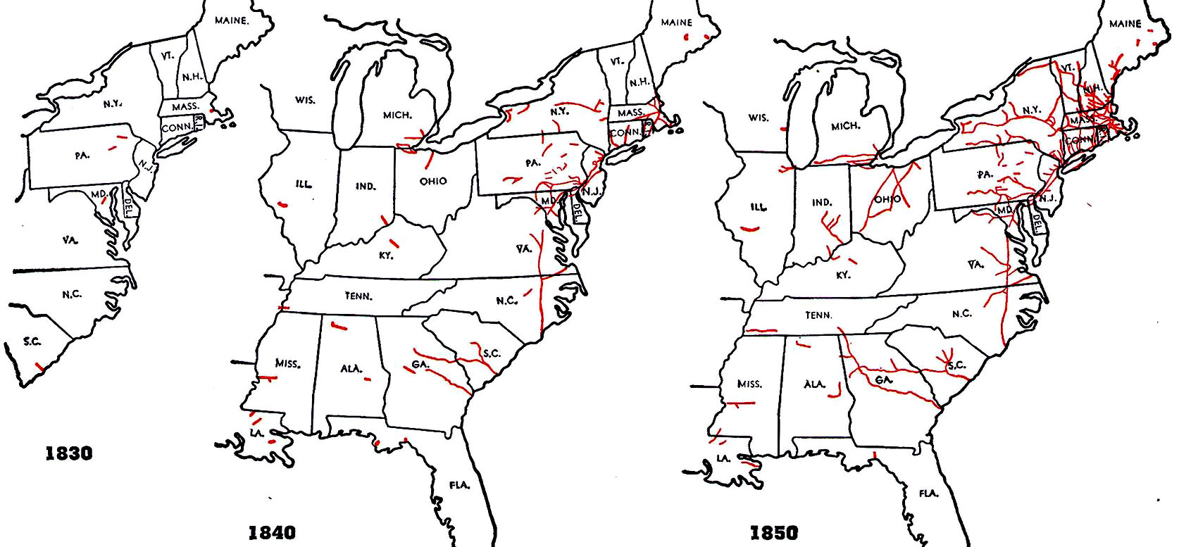
Maps showing the rapid early-spread of railroading in the United States. . .
http://www.cprr.org/Museum/RR_Development.html#2

Slide 14
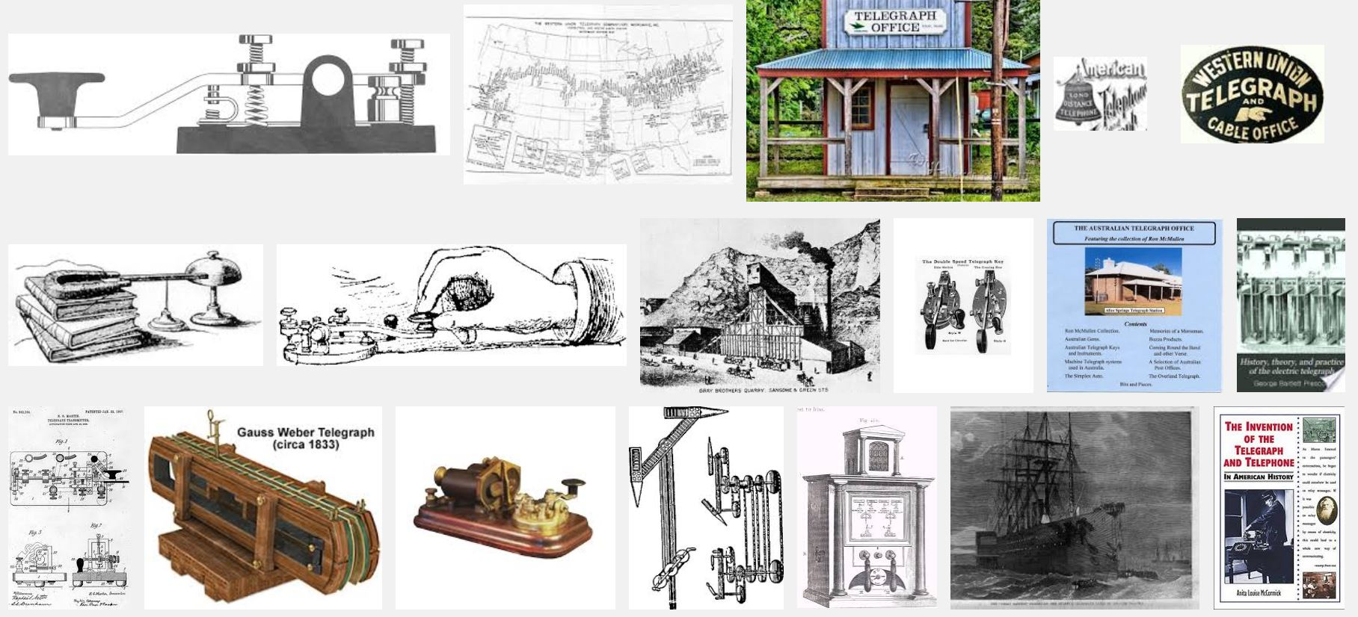
The expansion was accelerated by rapid-spread of telegraphy in the 1850s,
an effect analogous to that of printing during the age of discovery . . .
(Snip from Google Images)

Slide 15
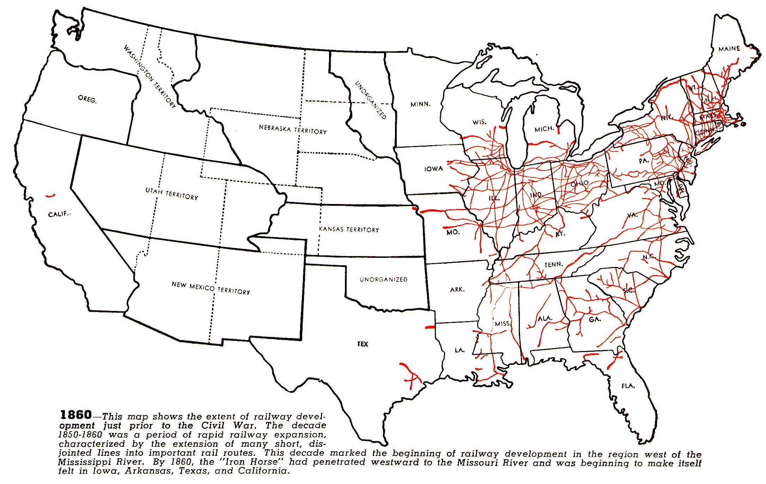
As seen in this map a decade later . . .
1860
source

Slide 16
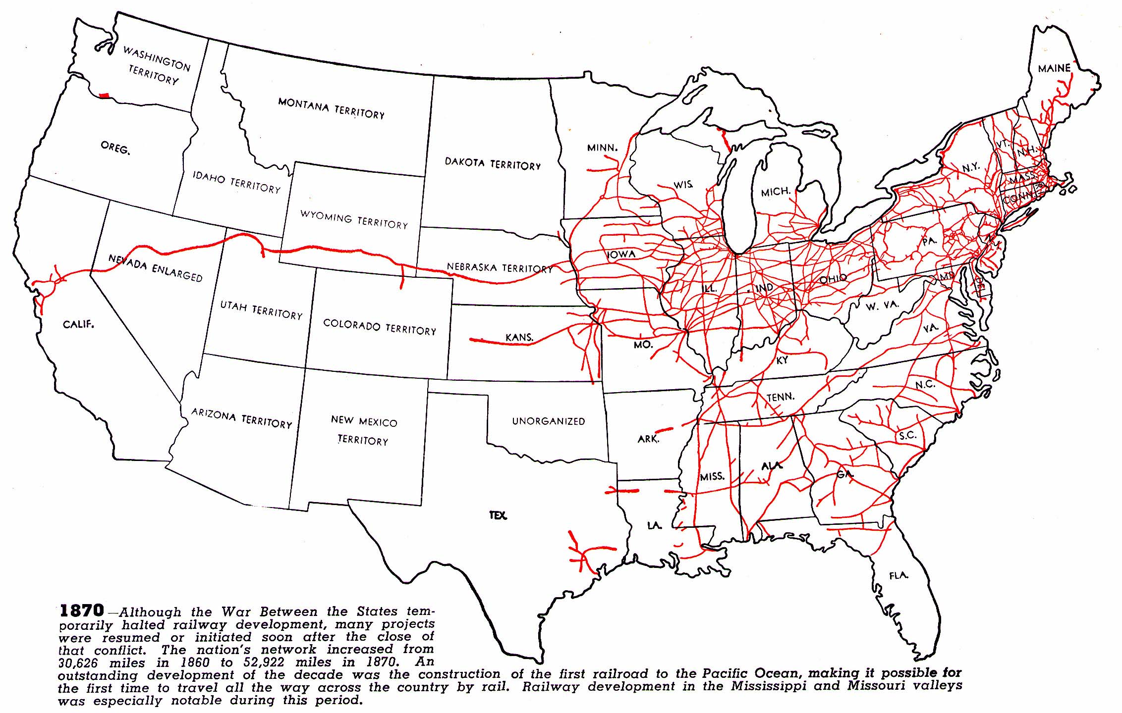
1870
source

Slide 17
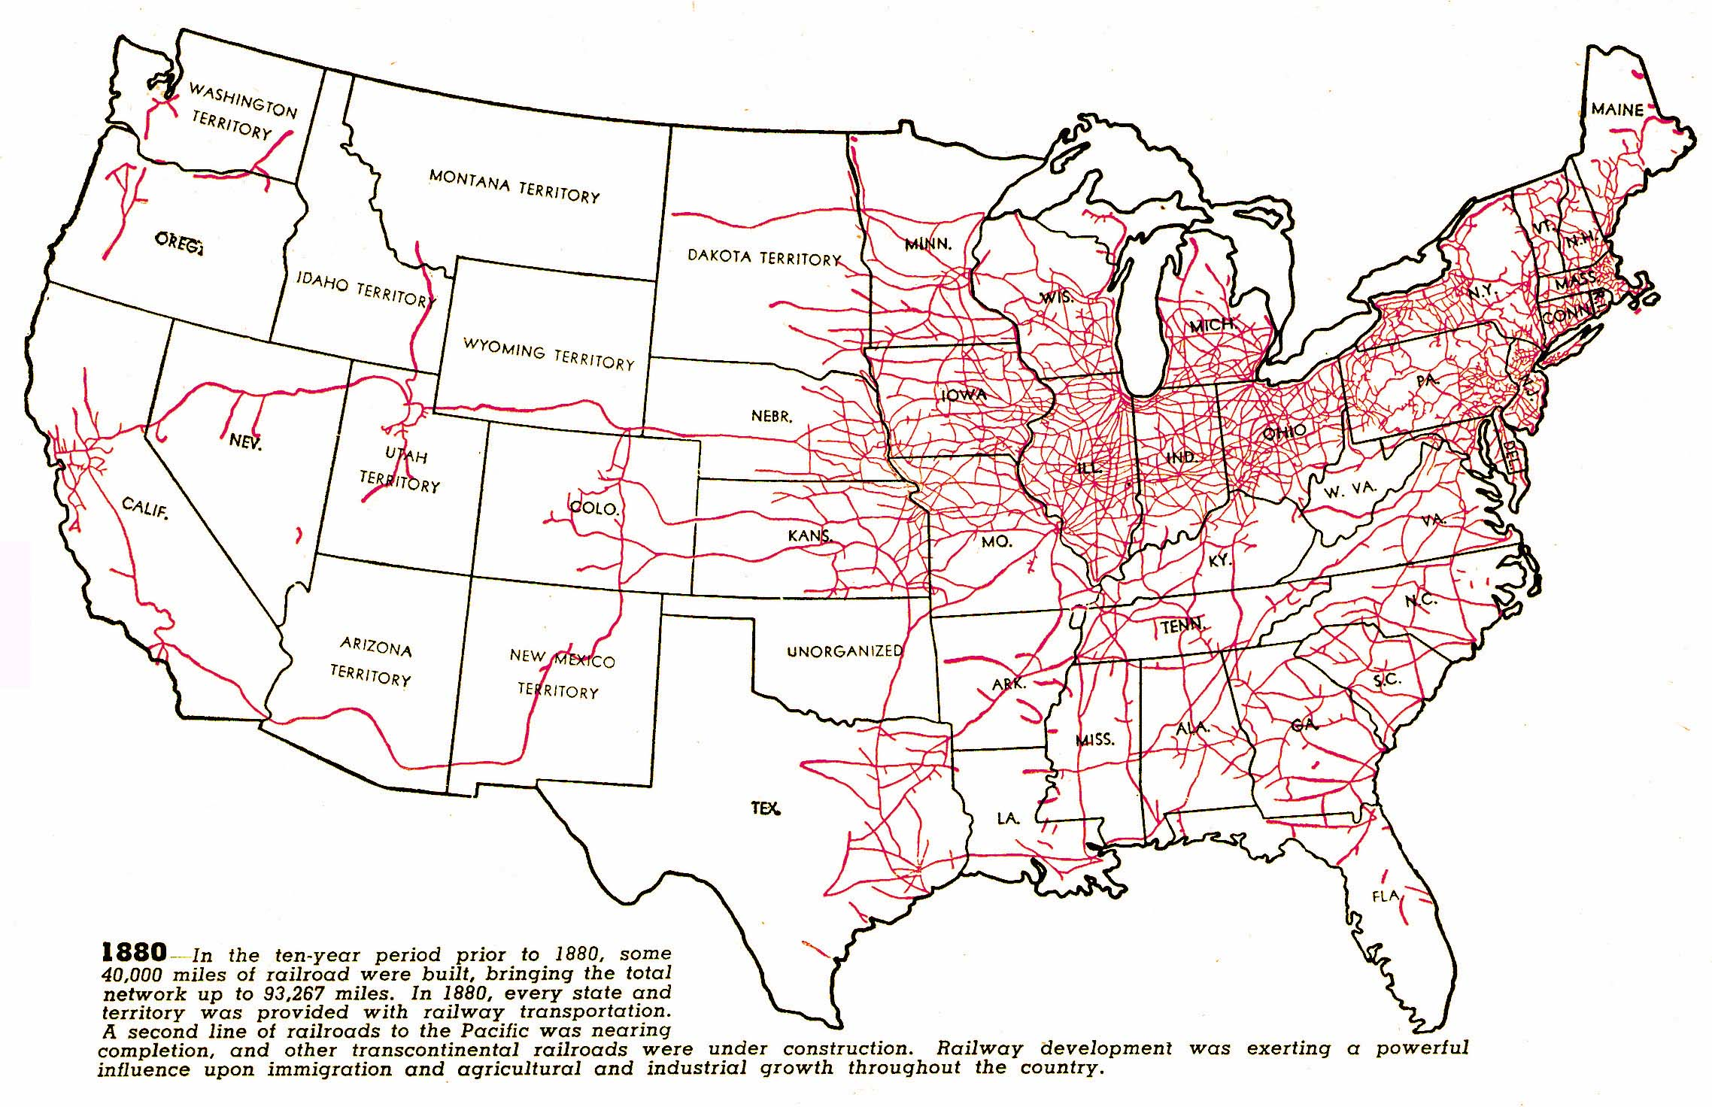
1880
source

Slide 18
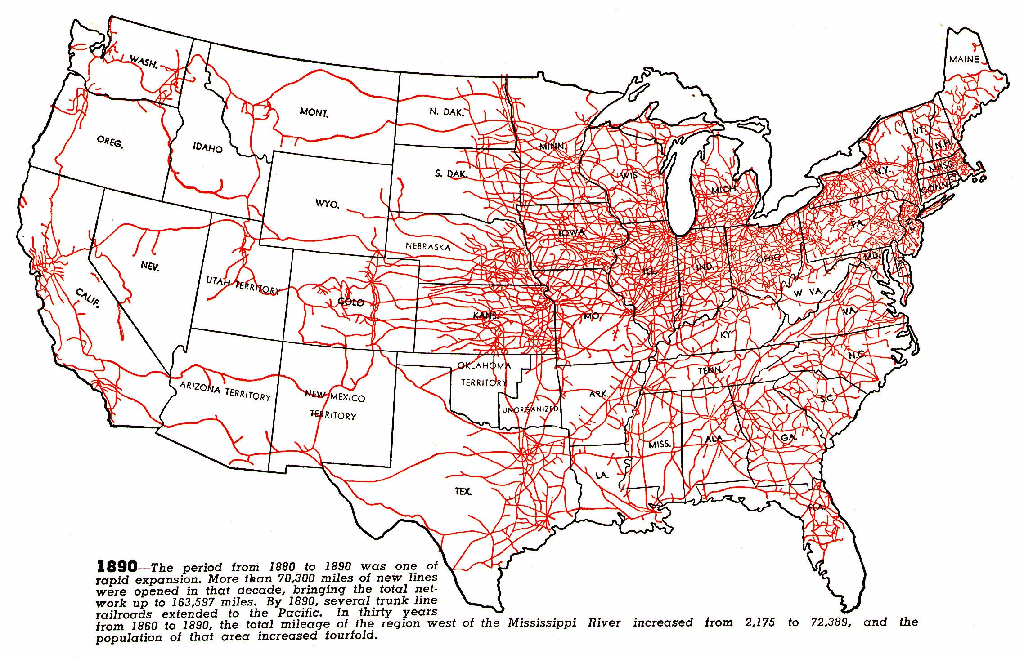
1890
source

Slide 19
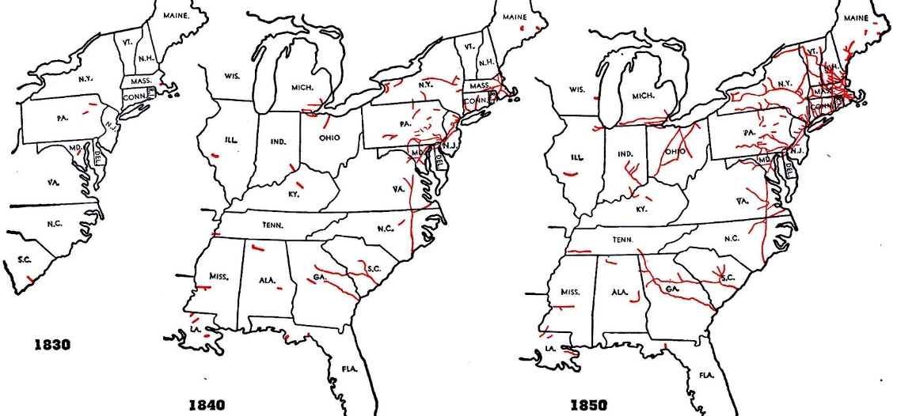
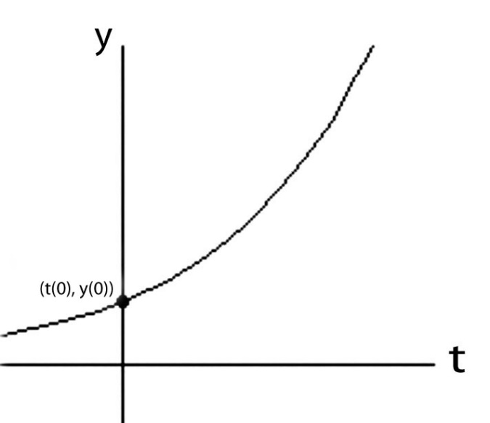
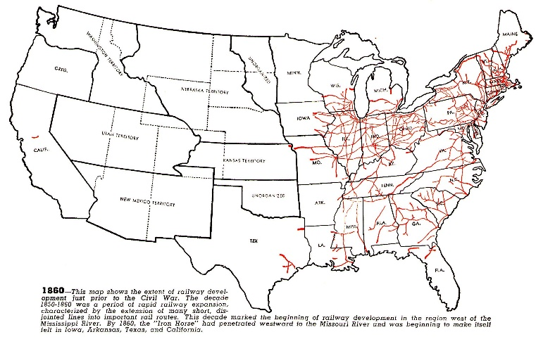
Like compound interest, the early social-diffusion rate of such clusters of technological ideas is approximately proportional to what’s accumulated
to there at any given point in time . . .
(I.e., it’s an exponential function):
y(t) = y(0)e^rt
source

Slide 20
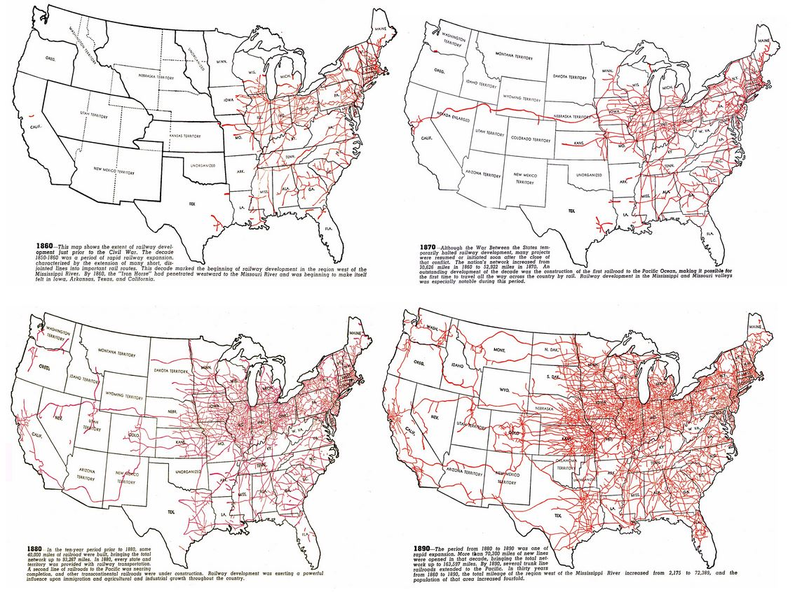
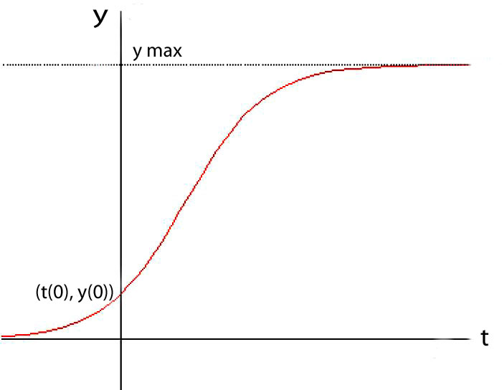
But as the opportunity-space fills,
the diffusion rate of technological ideas slows as that cluster nears its expansion limits . . .
(I.e., it becomes a logistic function):
later saturation
y(t) = ymax/(1+((ymax/y(0))–1))e^-rt)
early exponentiation
source

Slide 21
As a result of widespread harnessing of electricity by the 1890’s, innovative technology clusters lurched out into wild new dimensions:
Electric generators, motors, lights and telephones were embedded in a rapidly-expanding, electrically-empowered industrial, commercial, transportation and communications infrastructure.
Names such as Edison, Westinghouse, Tesla, Steinmetz, Bell, and Marconi were becoming famous for their roles in creating these new technologies.

Slide 22
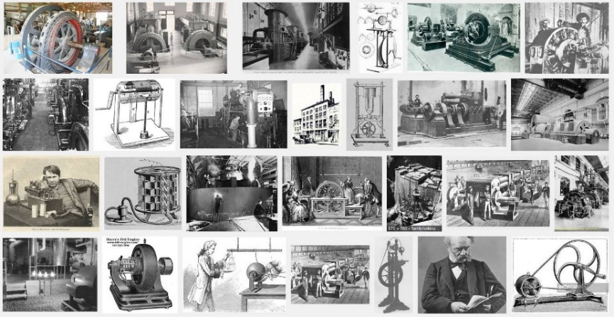
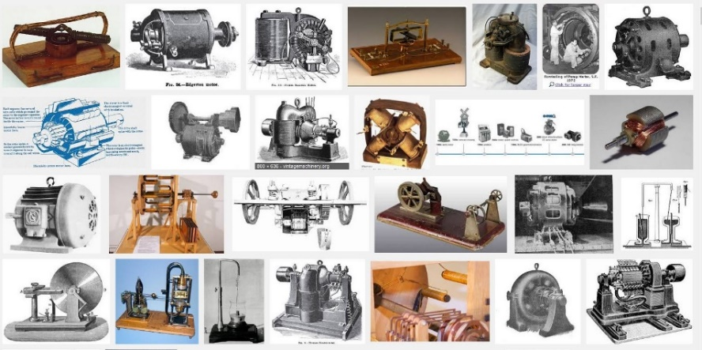
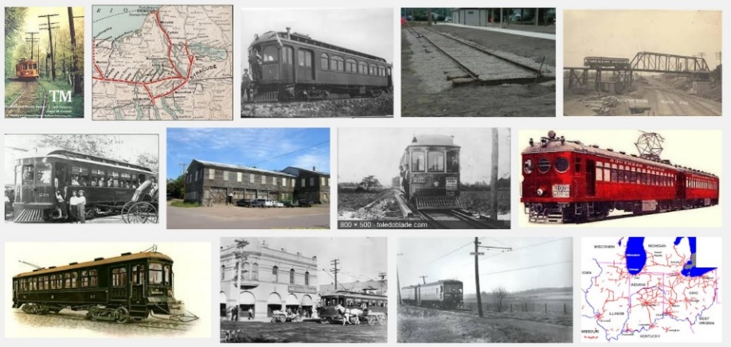
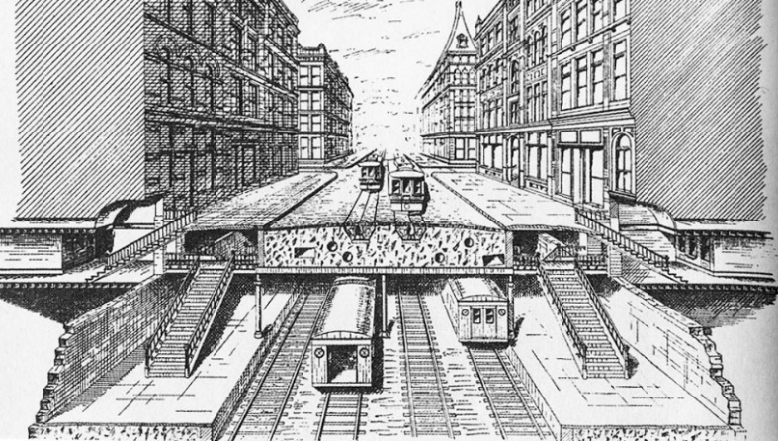
Thus began the rapid diffusion of electrification, and it’s co-evolution with the
spread of lighting, electric traction subways and interurban light-rail systems . . .
Generators
Motors
Interurban rail
Subways
Planning the IRT, 1891

Slide 23
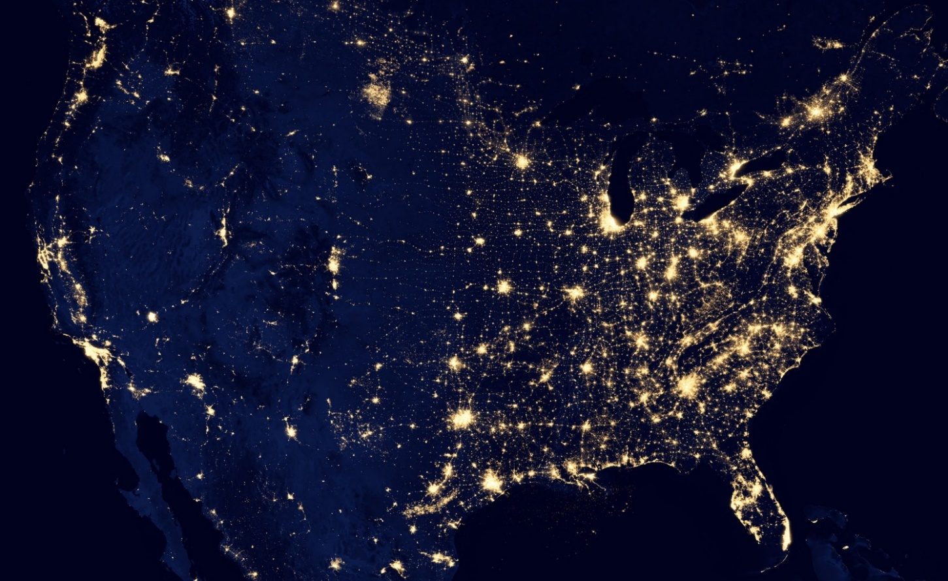
The dramatic results of the ongoing exponentiation of
electrification are easily seen from space today . . .
NASA
Just think how many minds the ideas of Faraday, Maxwell,
Hertz, Steinmetz, et al, passed through to make this happen!

Slide 24

Let’s now look at an innovation-wave I surfed-on back in the 1970’s:
The revolution in VLSI (Very Large Scale Integrated) microchip design . . .

Slide 25
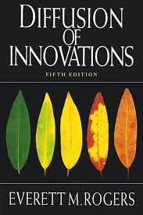
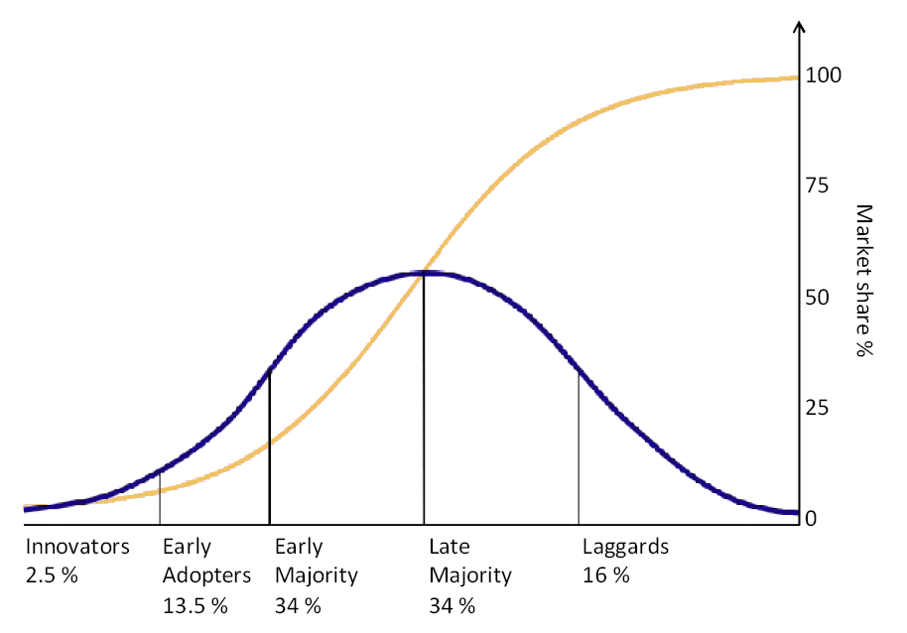
While doing so, let’s more-consciously
note how “the flow of ideas” expands . . .
as a function of the increasing connectivity and bandwidth . . . and the decreasing time-delays, in social-communications . . .
While also thinking along lines explored by Everett Rogers in his seminal 1962 text
Diffusion of Innovations:
URL

Slide 26
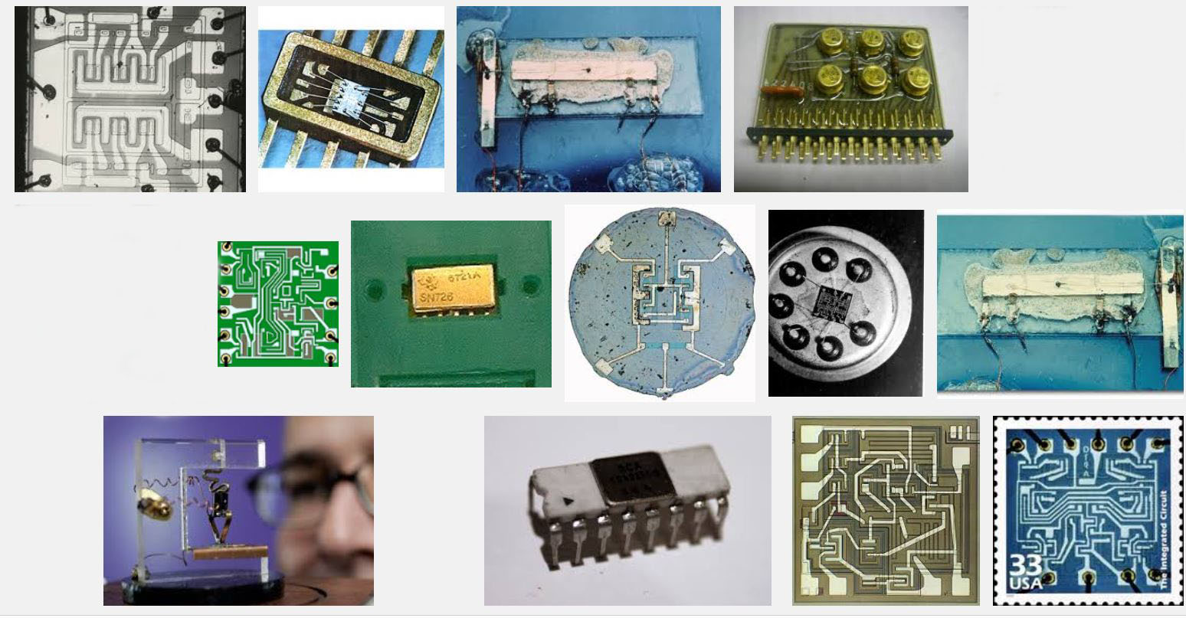
The stage was set by innovations in integrated circuitry in the 1960’s,
enabling transistors and wiring to be lithographically ‘printed’ onto chips of silicon . . .
Snip from Goggle images
Some early integrated circuits:

Slide 27
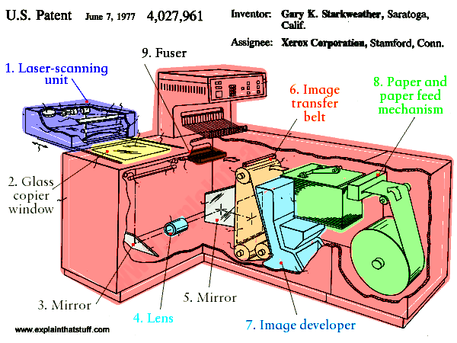
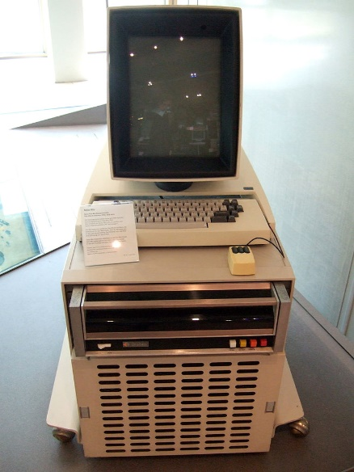
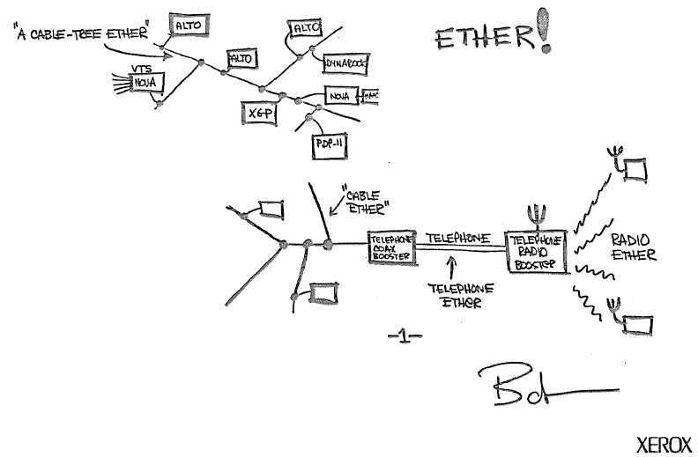
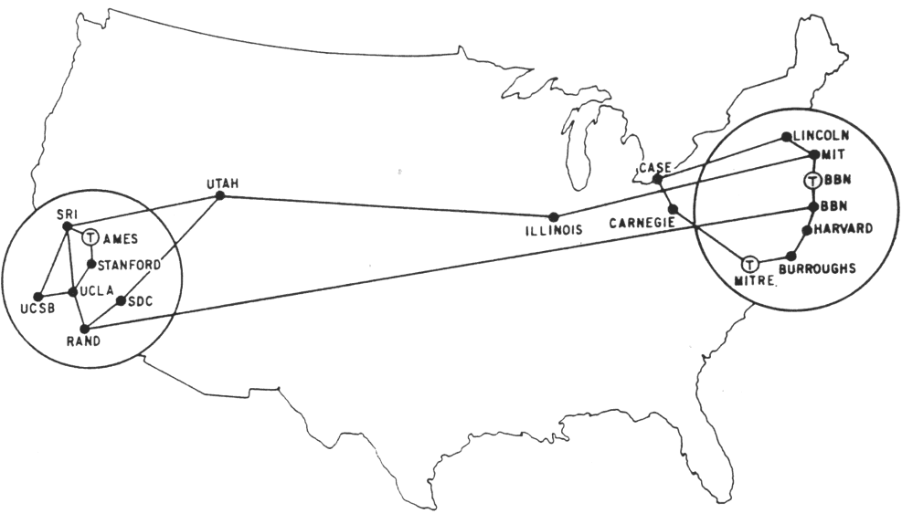
It was further set by innovations in computing at Xerox PARC in the early 70’s,
including the “Alto personal computer”, the “Ethernet” and the “laser printer”. . .
and by the rapid evolution of the “Arpanet” (the early internet) at DARPA . . .
Xerox Alto, 1973
Metcalfe’s original
Ethernet sketch, 1973
Laser printer, 1971
Source
Source
Wiki commons
Arpanet map, 1971

Slide 28
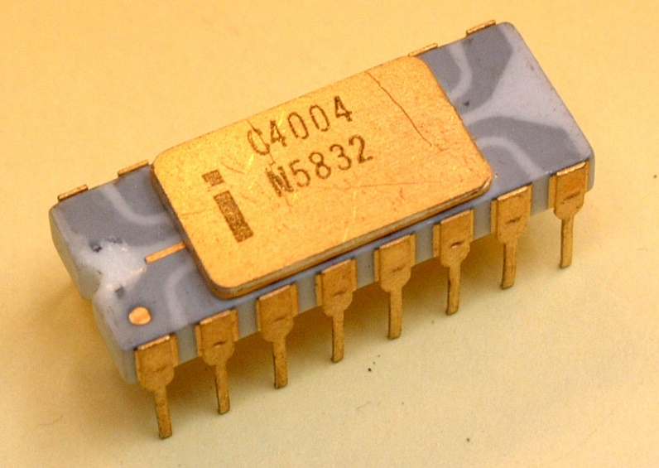
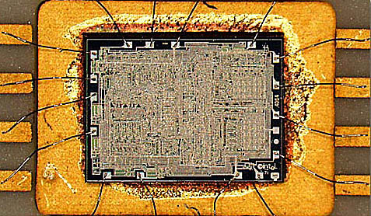
Advances in lithography enabled the ‘printing’ of ever-increasing numbers
of transistors on single chips.
A watershed was crossed in 1971
with the introduction of Intel’s 4004, the first single-chip “microprocessor”
Source
It contained 2300 transistors . . .
Source

Slide 29
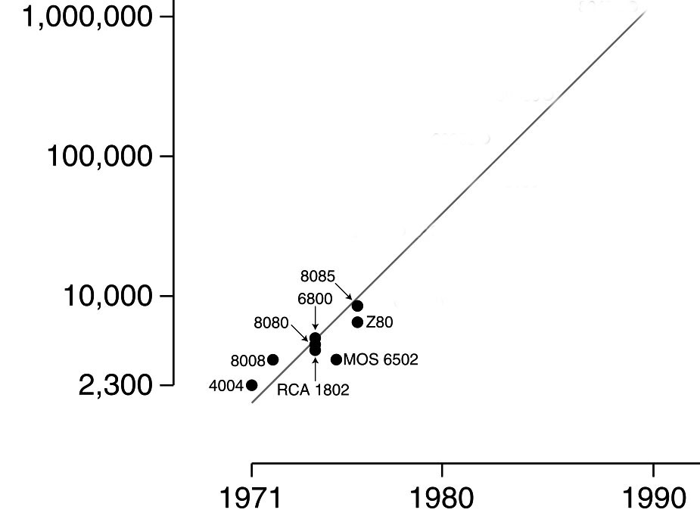
Gordon Moore at Intel noted that the number of transistors printable on a chip was ~ doubling every two years . . .
Moore’s Law (as of 1976)
.
An exponential function,
graphed on a vertical log scale
Carver Mead at Caltech named this “Moore’s Law” and determined there were no physical limits to increasing the number up to ~ 1 million transistors.
N(t)/N(0) = 2^(t/2)
It appeared possible that by ~1990
an entire “supercomputer” could
be printed on a single chip . . .
In 1976 this set-off a push by teams
at Xerox PARC and Caltech to figure out how
to enable such complex chips to be designed.

Slide 30
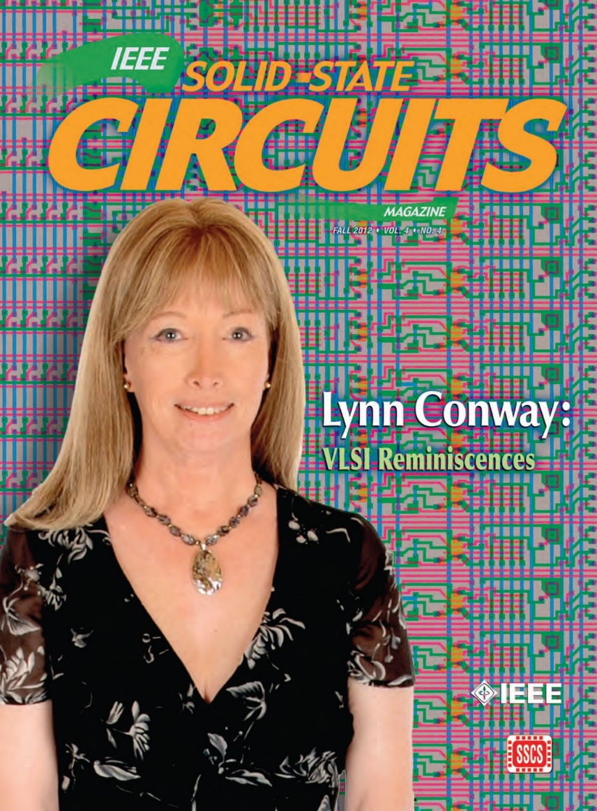
The story of what happened over
the next four years is quite a saga . . .
For insights into all that, see my
“Reminiscences of the VLSI Revolution” in
Fall 2012 IEEE Solid State Circuits Magazine
That was the first time I’d stepped forward to tell the story . . .
Note that since I didn’t look like an engineer, Silicon Valley at that point had no clue
what I’d done during the 1970’s!
For now we’ll just hit some highlights . . .

Slide 31
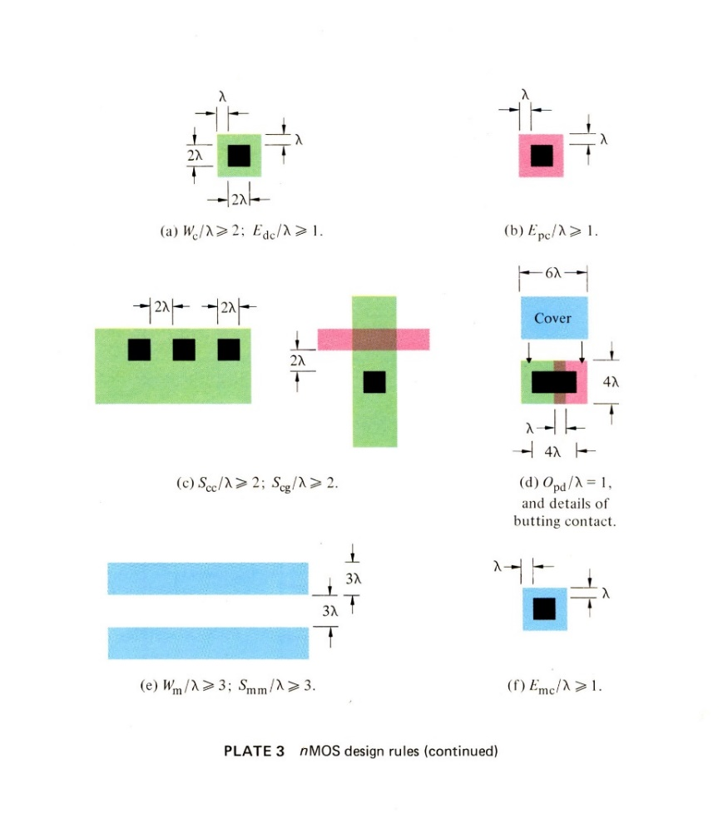
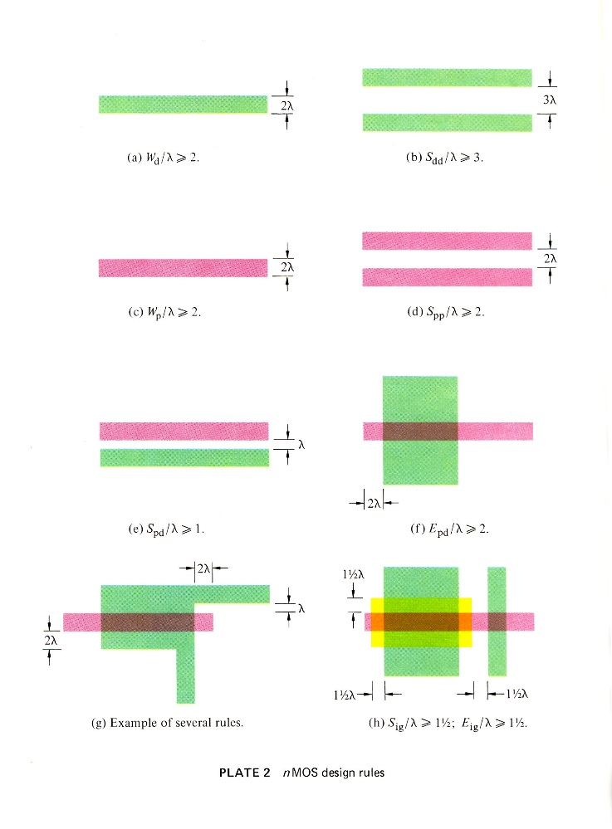
The breakout was triggered by a cluster of abstract innovations at Xerox PARC and Caltech . . .
Included were a set of scalable VLSI chip-layout design rules, framed as dimensionless inequality equations (Conway, PARC).
These enabled chip designs to be digitally shrunk down (and reused) as Moore’s law rapidly advanced . . .
They also enabled accruing open-source chip subsystem designs to be widely shared.
Link

Slide 32
The driving meta-architectural idea:
Given: As chip lithography scales-down according to Moore’s Law, ever-more
ever-faster transistors can be printed on individual chips as time passes.
STEP (i): Use a computer to design the chip-set for a more powerful computer . . .
then “print” that chip-set using the next-denser fabrication process.
STEP ( i+1): Use that more powerful chip-set to update your “computer-design” computer, then repeat step (i).
If ever-more engineers and design-tool builders began doing this (on an expanding number of increasingly powerful computers), the iterative expansion-process could explosively generate ever-more, ever-more-powerful, digital systems . . .
I.e., that process could Exponentiate!

Slide 33
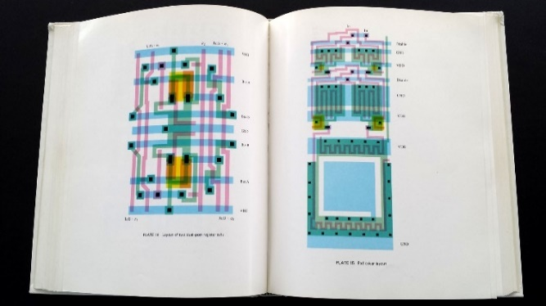
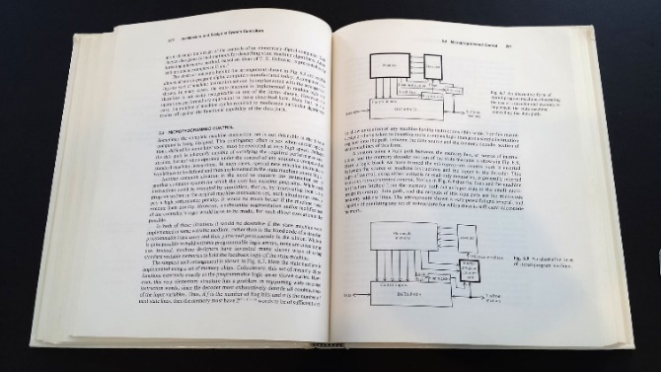
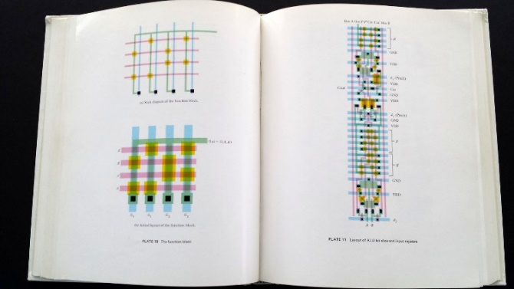
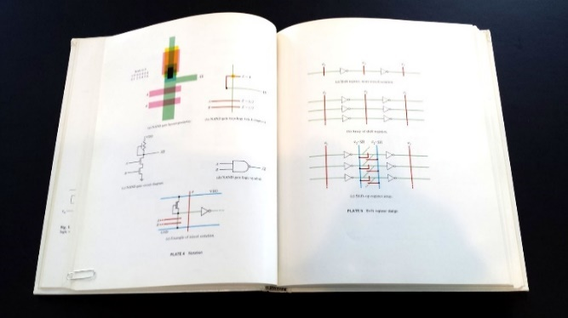
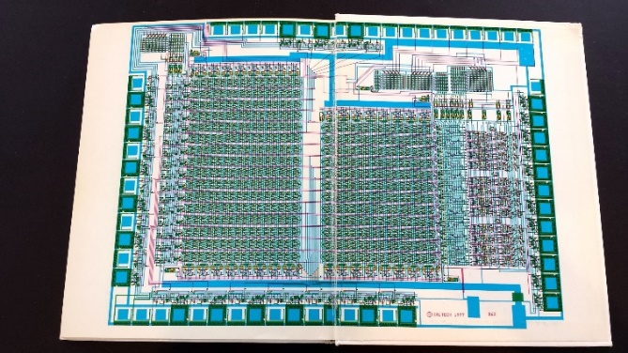
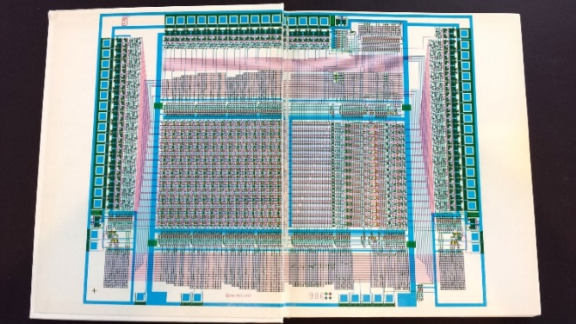
But there’s a big problem: Where will all these engineers/programmers
come from, and how will they learn to do all this?
To cope with this, I began documenting the new system of simplified, restructured
chip design methods in an evolving computer-edited book . . .
Link

Slide 34
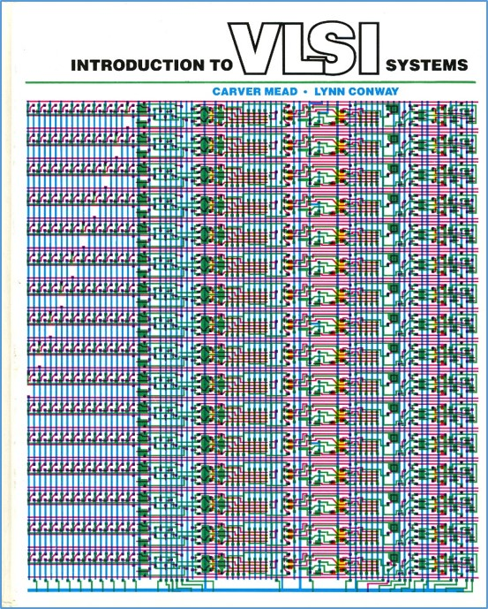
Thus using Alto computers not only
to mechanize the generation of chip-designs, but also the evolution of the design-knowledge-book itself . . .
That computer-edited, rapidly evolving book, printed using the laser printers at PARC, became the draft of the
later-iconic textbook . . .
Introduction to VLSI Systems
by Mead and Conway,
published in 1980 . . .

Slide 35
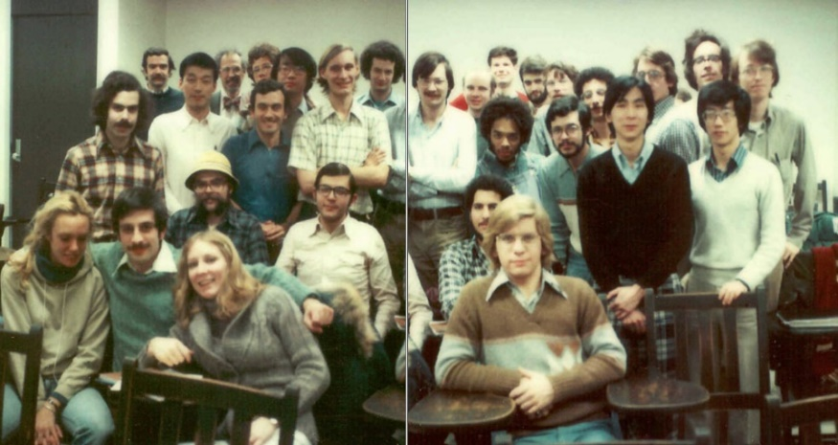

Then, following the script used by
Charles Steinmetz to propagate his revolutionary AC electrical methods
at Union College in 1910, I introduced
the new methods in a special
VLSI design course at MIT in 1978.
Link
Link
Link

Slide 36


Students learned the design methods
in the 1st half-course & designed project-chips in the 2nd half, which
were then “printed” at my colleague
Pat Castro’s laboratory at HP . . .
The many amazing results included
a complete Lisp microprocessor chip
by MIT grad student Guy Steele . . .

Slide 37


Map and photomicrograph
of the 19 student projects on
the MIT’78 ‘MultiProject’ Chip
For more about the MIT’78 course, see Lynn’s “MIT Reminiscences”

Slide 38
The MIT’78 course stunned various top folks across Silicon Valley . . .
Chip design till then had been a mystery, only grasped by a few computer engineers working for chip manufacturers . . who thus had access to the “printing plants” . . .
Many other top research universities wanted to offer an “MIT-like” course. But how?
After intensive pondering, I grasped the answer: Rerun the MIT’78 course at a dozen research universities . . . using my MIT lecture notes to keep everything in sync.
But how to “print” all the student project chips?
I suddenly envisioned the conception of an “E-commerce” system, enabling student design files to be remotely submitted over the Arpanet to a “server” at PARC . . .
It would run software to pack designs into multi-project chips (like composing the
print-files for a magazine, using remotely-submitted articles) . . .
We’d then “print” the MPC’s again at HP (where Pat Castro had prototyped
the first “silicon foundry”), and quickly return the chips to students.

Slide 39


From PARC, I announced, and then orchestrated, a huge “internet-happening” (MPC79) in the fall of ‘79 . . .
recruiting 129 budding student designers to take new Mead-Conway VLSI courses at 12 research universities . . .
MPC79 Arpanet E-commerce system:

Slide 40




1976
1977
1978
1979
Envisioning the exponentiating
wave of VLSI innovation . . .
’76: How to cope with VLSI complexity?
’77: Inventing scalable VLSI design rules.
’78: Launching the VLSI methods at MIT!
’79: Launching the VLSI courses via MPC79!!

Slide 41


Visualizing how techno-social dynamics triggered exponentiation in the evolution and diffusion of the new VLSI design ideas . . .
in the emerging ARPAnet computer research community:
By 82/83, Mead-Conway VLSI courses were being offered at 113 universities around the world . . .
Thereby bootstrapping the modern “fabless-design”
+ “silicon-foundry” paradigm of chip-making . . .
From The MPC Adventures (p. 16)

Slide 42


And, over the past 40+ years
Moore’s Law has stayed on-track all the way . . .
N
(exponential function
graphed on log scale)
(exponential function
with t in years)
N(t)/N(0) = 2^(t/2)
N(0), t(0)
Starting with several thousand
in 1971, the number of transistors on single chips had passed several billion by 2011!
though there are signs that
it’s now nearing saturation . . .

Slide 43


For example, this iPhone 5 ‘A6’ chip
contains several
billion transistors!
<------
----->
Source
Source

Slide 44




Such chips are now used by engineers/programmers/makers to mechanize mathematical-logic
and thus functionally empower . . . all sorts of things they’re embedded inside of . . .
Smartphones
Wearables
Autos
Drones
Snips from Google Images

Slide 45


Including the silicon chips that empower the vast internet infrastructure . . .
which also continues to expand exponentially . . .
Interactive Zoom-in
Internet Map, 2015
exponential function
Link

Slide 46

And with the internet connecting ever-more people and chip-empowered
things, just imagine what’s going on out there now . . .
all around the world!
NASA: Earth from space at night
Setting the stage for what’s coming next . . . !

Slide 47


For more about Xerox PARC and the amazing things innovated there, see Michael Hiltzik’s Dealers of Lightning:
For a wider sociological perspective on the emergence of the internet, see Thomas Streeter’s The Net Effect

Slide 48
"What's past is prologue" – William Shakespeare
Link
It’s now time to look forward, into the future . . . !

Slide 49
As we turn 180⁰ and look ahead . . .
we can glimpse another huge incoming
wave of innovation . . .
It’s out there now, just beyond the social-time-horizon . . .

Slide 50

One thing for sure:
This’s the “Big One”! . . .
URL

Slide 51




But why is it starting now? . . . Let’s further set the stage:
Recall that till now microsystems have been deeply embedded,
out-of-sight and out-of-mind, inside “things” like . . .
Smartphones
Wearables
Autos
Drones

Slide 52




Thus few folks visualize the “many ideas in motion” behind effects such as the
astonishing ‘out-of-body’ experiences while flying a Parrot Bebop using an Oculus Rift . . .
www.youtube.com/watch?v=6ZdSMAG90Rs
www.youtube.com/watch?v=Io6V0NR7DN0

Slide 53

But that’s all about to change, as efforts
like Motorola's "Project Ara" create
modular smartphones and popularize
the concept of micro ‘Hardware Apps’ . . .
I.e., incredibly tiny modular versions
of till-now ‘big things” like cameras, GPS
units and inertial measurement systems.
The many microsystems in smartphones
will suddenly become socially-visible . . .
Especially tiny micro-mechanisms (MEMS chips)
designed on computers and “printed” in “foundries”. . .

Slide 54


To glimpse where this’s heading, check out the UK Zano drone,
a soon available (~ £200) “micro-animated system” . . .
Source
Extremely tiny, it includes an HD cam, IMU, GPS, MCU, IR obstacle avoidance, gesture control, auto following, swarming and more…
It’s capabilities have so many dimensions, it’s hard to say where the “system” begins and where it ends . . . check out this amazing VIDEO!

Slide 55
These aren’t frivolous play-things . . . and instead metaphorically illuminate a vast frontier for human empowerment and amplification . . .
Consider a patient confined by an lengthy hospital stay:
She can even now actively explore the world beyond her window,
using her smartphone to control her drone and see what’s out there . . .
Now imagine joining friends on group “drone-tours” of remote places around the world, right from own individual homes . . .
With each of our drones remotely “carrying our eyes”, in the form of fisheye lens microcams (as in the Parrot Bebop) . . .
Which we look through using our Oculus Rifts over the internet!

Slide 56




Imagine the impact when today’s children start peeking inside Zano nanodrones!
Imagine the wild things they might figure out how to do next!
URL

Slide 57
So, what’s happening here?
Instead of just printing a billion transistors onto single “large” smartphone chips.
We could print a million transistors onto 1000 very tiny but powerful chips.
[And you can actually do a LOT with a million transistors!]
Thus we could embed lots and lots of tiny micro-control-processors . . . and MEMS micro-mechanisms . . . into almost everything.
Putting them where they get and process local physical-data such as position, acceleration, temperature, pressure, etc.
Enabling embedded-clusters of tiny-chips to logically-animate and interactively-control lots of macro-things . . . such as robots, drones, mobility and heath systems.

Slide 58



This embedded-microsystems revolution is getting up a big head of steam in
emerging “Silicon Valleys”, “Cambridges” and “Maker Valley’s” all around the world …

Slide 59

We can zoom-in on the details in specific micro-technology areas,
using tech-mappings like this for microcamera image sensors . . .
Source

Slide 60

And we can zoom-out and follow the paths of emerging application-area-clusters
along Gartner “Hype Cycle” infographs that frame the overall technology-wave . . .
2014
URL

Slide 61


Just one cluster on that incoming wave is “3D Printing”. . .
Enabling all kinds of “things” to be “printed” from
digital-design specifications created on personal computers . . .
3D printed
prosthetic
<------------------ hand
URL
URL
Once perfected, those design-files could be shared/marketed
to users of 3D printers anywhere

Slide 62

Even better, what about making 3D printers that print 3D printers!
That’s UK engineer Adrian Bowyer’s vision for the global RepRap Project:
For more about RepRap
and the philosophy behind it,
watch this remarkable video:
“A machine that builds itself?”
Just as some iron was recursively fed-back to make more steam engines
to help make more iron to further empower the industrial revolution . . .
Providing such systemic positive feedback provides “gain” in the emergent 3D printing technology-generation ecosystem.

Slide 63

However, where will all the young innovators come from,
and how can they learn to surf on this vast incoming wave?
Fortunately, a wave of change is also sweeping through STEM education, just in time!

Slide 64




Many incoming students also have gained hands-on team-experiences at . . .
LEGO Camps
Maker Faires
FAB Labs
Robot Competitions

Slide 65

They’ll also gain emerging knowledge, just-in-time as needed,
using rapidly evolving internet-based learning-resources . . .
udemy
Coursera
Khan Academy
UDACITY
edX
NPTEL
MIT EdX
myopencourses
Image source

Slide 66



Some engineers will exploit new “multi-physics” design tools and
electronic design automation (EDA) to innovate new micro-systems:
Gyro Chip
Close-up of the MEMS
Gyro chip tuning-forks
Example:
A MEMS 3-axis gyroscope for
motion-sensing in an iPhone 4
Combined with a micro electronic
compass and a micro 3-axis
accelerometer, this provides full
9-degree-of-freedom motion sensing.
URL

Slide 67




While mechatronics designers will use team-based augmented reality systems, such as
Dassault’s 3D Experience Platform
and Canon’s MREAL System . . .
https://www.youtube.com/watch?v=hJ6vMfzMz5k
To imaginatively embed smart modular hardware into and thus animate a new wave of human-scale systems . . .
https://www.youtube.com/watch?v=Ymsea8aEImE

Slide 68



World-wide, automotive technology will be a huge driver of the rapid embedding
of micro-hardware Apps into human-scale systems . . .
Starting within cars
then on into Mobility technology
and into Smart Roadways

Slide 69






The innovative embedding
of ever-tiner micro-hardware
apps will quickly spread . . .
And begin
enhancing the functionality of just about everything:
http://blogs.jabil.com/2014/08/13/internet-of-things-infographic/

Slide 70

But how will we cope with the ‘complexity’ of
the emerging techno-social ecosystem?
From: The Age of Opportunity: Harnessing Complexity To Solve Big World Problems
by Frank Spencer, kedgefutures.com

Slide 71

By exploiting rapidly-evolving new techno-social methods such as collaborative learning, crowdsourcing, crowdfunding, IP brokering, agile design rapid-digital-prototyping, and more . . .
Everyone from engaged-users to innovators to makers will be able to scale up their levels of participation and impact.

Slide 72


Only now, instead of just exploring how to make ever-bigger things, and things that go ever-further, ever-faster . . . such as when reaching for the clouds, or out into “outer space”. . .
NASA

Slide 73


and peer
down into the “inner spaces” of the micro/bio/nano/pico worlds . . .
We’ll increasingly invert our spherical-perspective by 180⁰
Randy Scott Slavin
nupex.eu
As we explore how to make, share and exploit vast-exponentiations of ever-tinier, ever-more humanly-empowering “micro/bio/nano things” . . .

Slide 74


As we zoom ever-further into micro-biological, molecular
and atomic levels . . .
Scanning Tunneling Microscopy (STM)
Atomic Force Microscopy (AFM)
discoveries there will enable adventurers
to better gear-up for human-scale explorations in places & frontiers such as . . .

Slide 75

Multi-physics EDA
Augmented Reality
Teleautonomous Systems
Social Media
Harvard Wyss Institute
Inductive Programming
Hyperscale
Model-Based Design
Biologically Inspired Engineering
Draper Lab
MIT Nano
Collaboration Technology
Multiengineering
Meta^2Mathematics
Meta Architecture
Machine Vision
Machine Hearing
Augmented Kinesthetics
Social Physics
Social Dynamics
Social Machines
Social Learning
DARPA Microsystems
Research Universities
Google ATAP
Microsoft Research
Facebook
IaaS
Synthetic Biology
Paas
UPS
Amazon
Data Science
Genetic Algorithms
Metamaterials
Self Assembling Systems
Exploration Infrastructure
Machine Learning
STEM + ARTS = STEAM

Slide 76
Thus it begins, all around the world . . .

Slide 77

And before long, adventurers everywhere will be “surfing” somewhere on this wave . . .!

Slide 78

To envision the masses of ideas now in motion, recall how we
diagrammed the rapid nested-evolutionary-process of the VLSI revolution . . .
Now vastly more such processes are running in parallel and cross-fertilizing . . .
And a new science is exploring and mapping-out what’s happening . . .
The MPC Adventures (p. 16) Xerox PARC 1981.
URL

Slide 79
This is way more than a single exponential/logistics process:
nearing
saturation
unfolding
exponentiation
Such 2D ‘wave slices’ hide tons of what’s going on to actually “compose the wave” . . .
Let’s re-slice and zoom-view the incoming wave in 4D⁺ to gain better perspective . . .

Slide 80



Envisioning the incoming wave of innovation as
a time-series of “GHC profiles”(i.e., 2D⁺ slices
thru the 3D⁺ wave at increments in time) . . .
Gartner Hype Cycle 2014
http://www.gartner.com/newsroom/id/2819918
Is this a Traveling Wave?
A Standing Wave? Or What?
This stunning video*
hints at ways to
think about it . . .
*"Water," by Morgan Maasen
http://vimeo.com/90429499

Slide 81

Escalating techno-social-change will
also greatly challenge existing cultural patterns, because of massive accumulations of past social habits:
So, just what is this new game?
Who gets to play?
What rules do we play by?
Where can we turn for guidance?
URL
Especially, how do we drop old habits?

Slide 82
Then too, “How can we ever adjust and keep up?”
Hasn’t the train already left the station for many folks?
Words to ponder:
"In a world of change, the learners shall inherit the earth,
while the learned shall find themselves perfectly suited for
a world that no longer exists" – Eric Hoffer
Meantime, something awesome is now underway:
“As the rate of techno-social change increases,
we’ll all live far further into the unfolding social-future
than we ever dared dream“ – Lynn Conway

Slide 83


But a word of caution: do avoid becoming distracted by all the rapidly-emerging “things” . . .
As Kentaro Toyama says in Geek Heresy, “technology alone won’t change the world”. . . We must instead rescue “Social Change from the Cult of Technology”!
URL
URL
One key will be the evolution
of effective “social leadership”
for the incoming “Social Age”,
as discussed by Julian Stodd . . .
Kentaro Toyama, 2015
Julian Stodd, 2014

Slide 84


URL
Again, this isn’t about things.
It’s about the escalating
generation + diffusion of
ever-better ideas on how
to make and use things!
It’s triggering huge
re-alignments in political economy and the role of The City in History . . .
URL
And to the emergence of cooperative capitalism, as discussed by Robin Chase of ZipCar fame in Peers Inc
Lewis Mumford, 1961
Robin Chase, 2015

Slide 85
In Conclusion, a conjecture about possible futures:
By cooperatively generating and sharing ideas for doing ever-more with ever-less, the incoming wave of innovation has the stunning potential of:
Sustainably providing ever-increasing infrastructural functionality and life amplification per person,
While consuming ever-decreasing energy and material resources per person
Thus beginning the reigning-in of our unsustainable over-use of planet earth
While simultaneously opening an unprecedented exploration of the greatest of frontiers . . . the frontier of “What it’s possible to do”!

Slide 86

Finally, a personal perspective on “Our Travels Through Time”. . .
Source
“If you want to change the future, start living as if you’re already there!”
– Lynn Conway

Slide 87
END
Links to Powerpoint Slides, Notes & References
http://ai.eecs.umich.edu/people/conway/Memoirs/Talks/RSE/2015_RSE_Lecture_by_Lynn_Conway.pptx
http://ai.eecs.umich.edu/people/conway/Memoirs/Talks/RSE/2015_RSE_Lecture_SlidesNotesRefs.html

