Slide 1
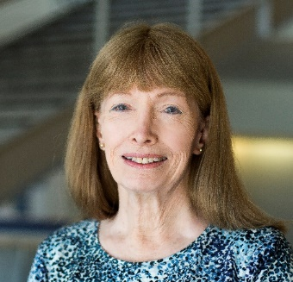
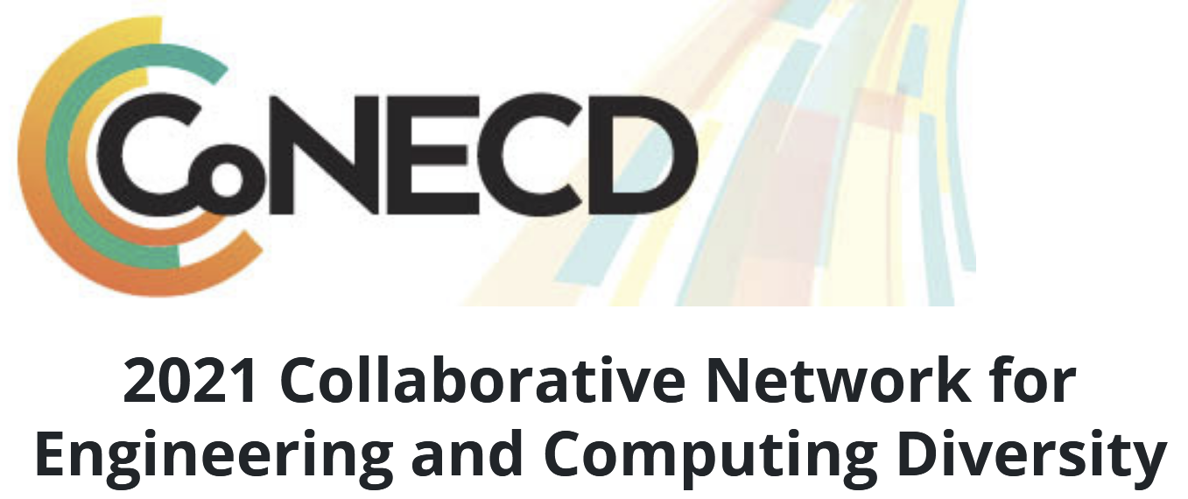
An Invisible Woman: The Inside Story Behind the Microelectronic Computing Revolution in Silicon Valley^{1,2}
Lynn Conway, Professor Emerita of EECS, University of Michigan, Ann Arbor
Keynote talk, ASEE virtual CoNECD Conference, Jan 25, 2021, 12-1 pm ET.
In 2015, US CTO Megan Smith raised profound questions about women’s contributions in science, engineering and math being erased from history.
In this talk we explore a case study of such erasure, and surface a very counter-intuitive conjecture about the underlying causes and effects.
1. In remembrance of pioneering novelist Ralph Ellison, author of Invisible Man, 1952.
2. http://ai.eecs.umich.edu/people/conway/Memoirs/Talks/CoNECD-2021/Inside_Story_Talk.pptx & .pdf

Slide 2
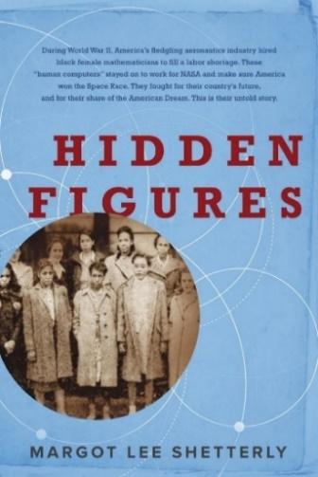
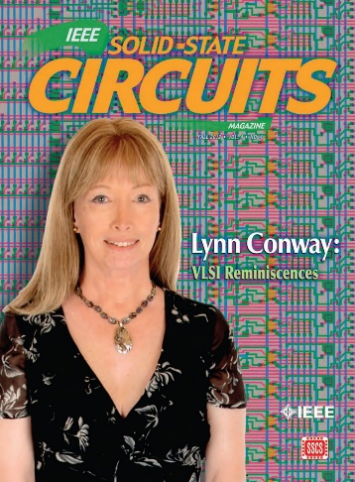
Overview of Talk:
1. Visualize Past Erasures of Women’s Contributions in STEM
2. The ‘Inside Story’ of:
(a) the VLSI Revolution and (b) my ‘Disappearance’
3. Investigation Into:
(a) What Happened
(b) Why Did It Happen

Slide 3
1. Let’s first examine history’s treatment of women’s contributions in STEM . . .
Link

Slide 4
In a widely-seen 2015 TV-interview, U. S. CTO Megan Smith reflected on
how women in STEM are regularly erased from history . . .
http://www.youtube.com/watch?v=fHyRdAyqV5c&t=0m1s
http://boingboing.net/2015/05/08/cto-megan-smith-explains-how-w.html

Slide 5
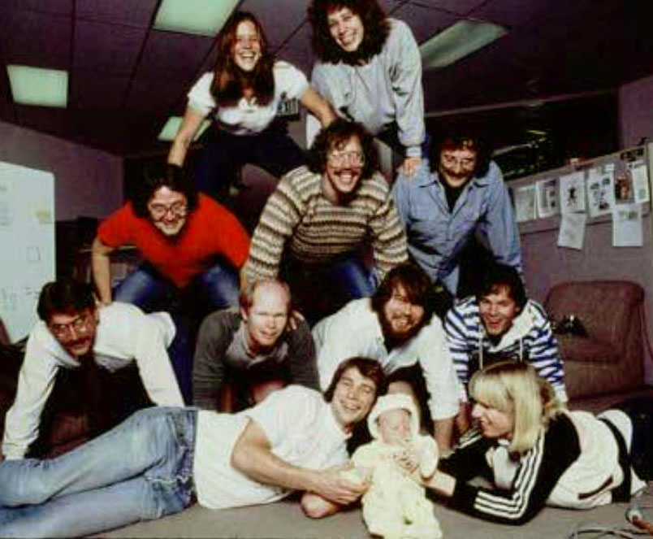
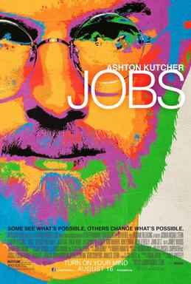
Smith pointed out this example:
There were four women on the Macintosh team in the 1980s . . .
But not a single one was cast in the 2013 biopic Jobs. Even worse, all seven men on the project had speaking roles in the film.
It’s not just harder for women to break into STEM fields, but the many contributions they do make aren’t celebrated. “It's debilitating to our young women to have their history almost erased,” Smith explains.

Slide 6
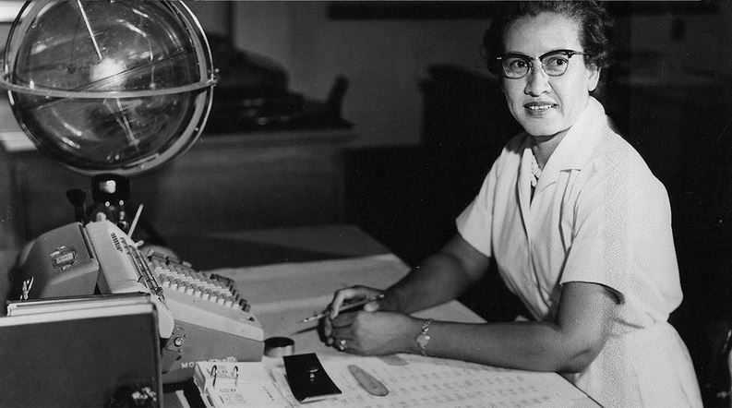
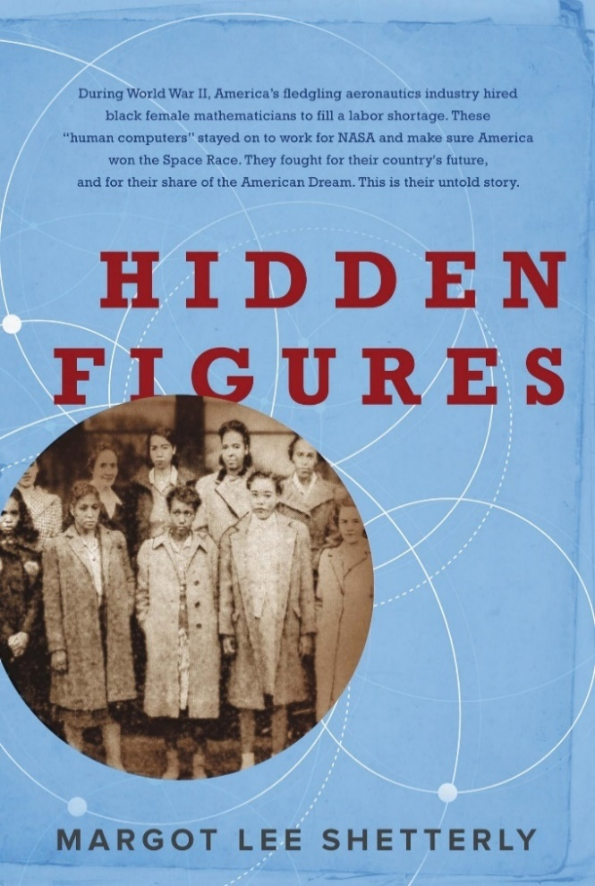
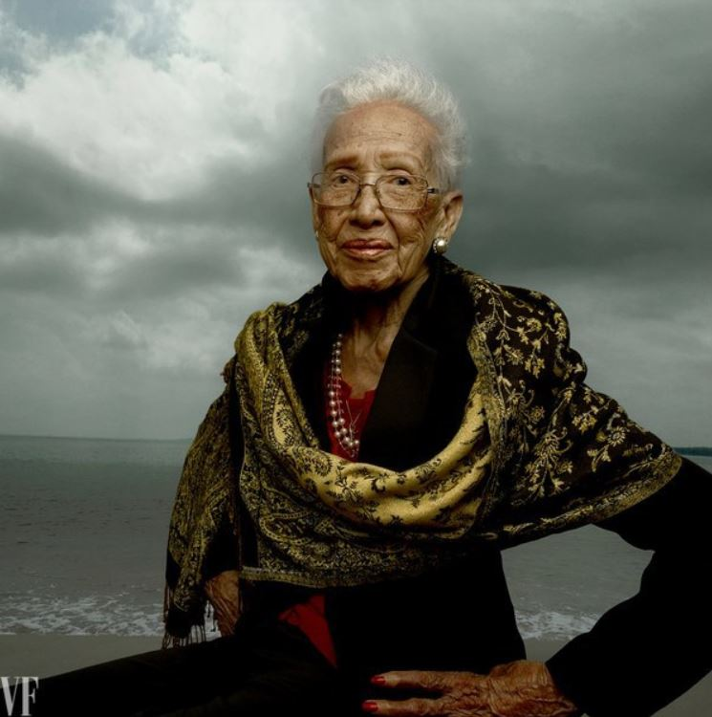
Smith also discussed the erasure of NASA mathematician Katherine Johnson,
whose story was widely revealed in the 2016 book and movie “Hidden Figures”:
Katherine Johnson, age 42, at her NASA Langley desk,1960
Hidden Figures: The Story of the African-American Women Who Helped Win the Space Race, Margot Lee Shetterly (2016)
Katherine Johnson at age 98 Photo by Annie Leibovitz for Vanity Fair, 2016
Fortunately, she lived long-enough to see her story told!

Slide 7
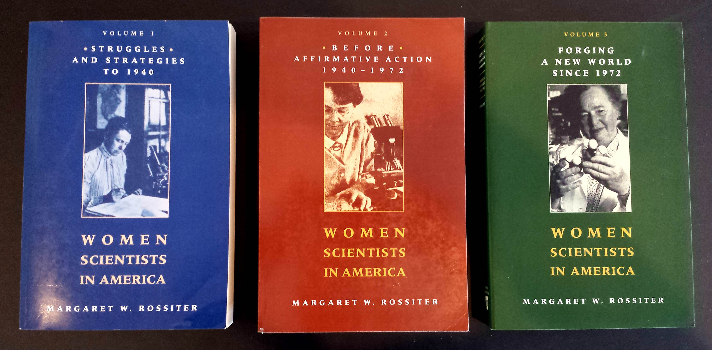
The effect is seen throughout the history of women in science, as discussed by
science historian Margaret Rossiter in Women Scientists in America (V 1-3):

Slide 8
Margaret Rossiter coined the term “Matilda effect” for the repression and denial of women scientists’ contributions, with their work often attributed to male colleagues.
This is similar to the "Matthew effect“, as coined by sociologist Robert Merton, describing how eminent scientists get more credit than lesser-known researchers, even if their work is similar.
For example: An award will usually be granted to the most senior researcher in a project, even if a grad student did all the work.

Slide 9
2. NOW LET’S STUDY AN EXAMPLE ERASURE:
The revolution in Very Large Scale Integrated (VLSI) microchip
design and manufacturing that began at Xerox PARC in 1976.
Link

Slide 10
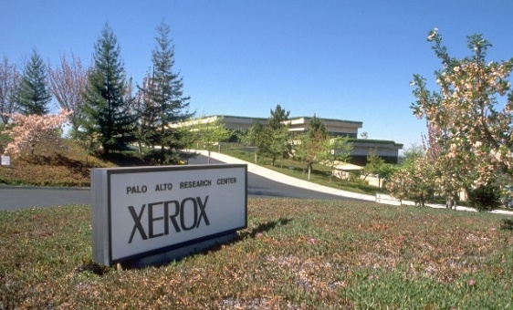
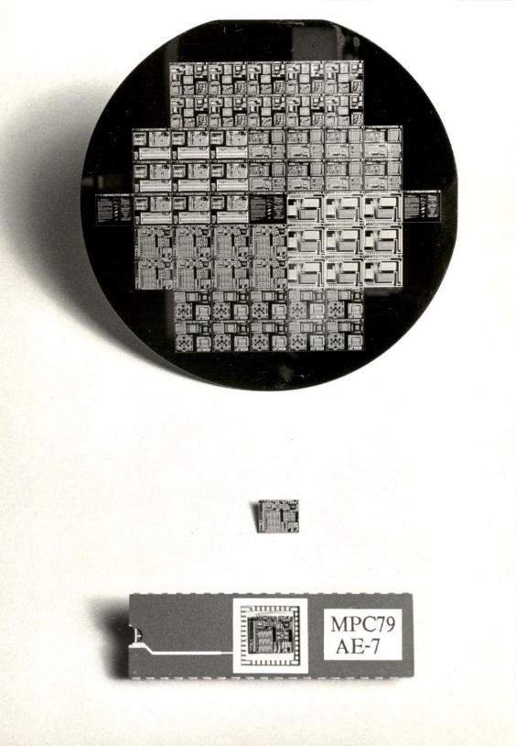
‘Birth’ of modern networked personal-computing paradigm
at Xerox PARC, 1972-78:
‘Covert Birth’ of modern VLSI chip-design paradigm at Xerox PARC, 1976-80:
Authors:
Use new image and word-processing tools to create and share digital document files.
Chip-Designers:
Use new design methods and chip-design tools to create and share digital chip-layout files.
Laser Printers:
Print document patterns
on paper media.
Foundries:
Lithographically ‘print’
chip-layouts on silicon wafers.
Results embedded-in:
Office-documents,
magazines, books, etc.
Results embedded-in:
Mobile-phones, laptops, autos,
homes, internet servers, etc.

Slide 11
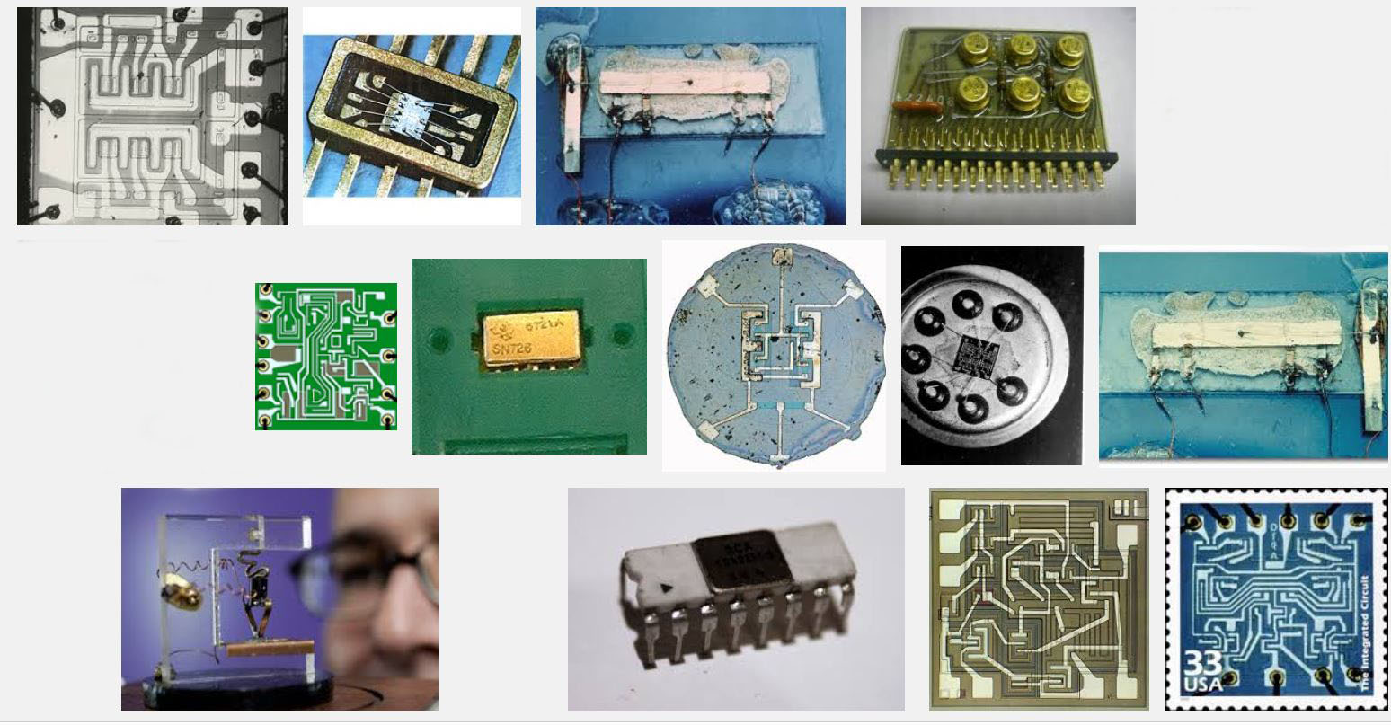
The stage had been set by the emergence of integrated circuit technology in the 1960’s, enabling modest numbers of transistors and wiring to be ‘printed’ onto chips of silicon . . .
Some early integrated circuits:
Snip from Goggle images

Slide 12
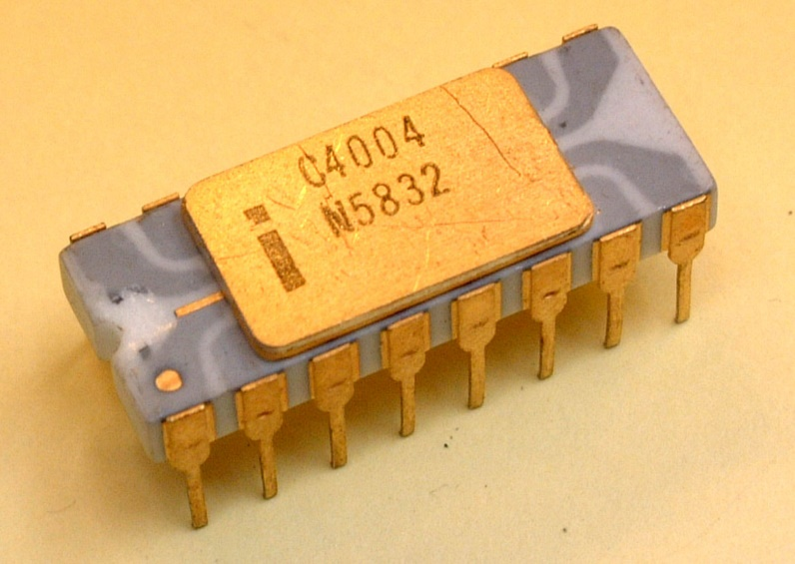
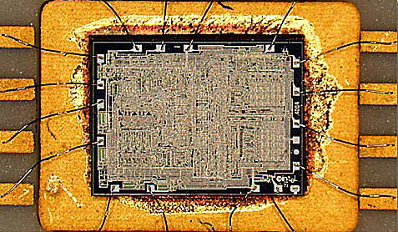
Rapid advances in optical/chemical lithography enabled the ‘printing’ of ever-finer features, and thus ever-increasing numbers of transistors could be printed on single chips.
A watershed was crossed in 1971
with the introduction of the Intel 4004, the first single-chip “microprocessor”:
a “computer processor on a chip” . . .
Source
It contained 2300 transistors . . .
Source

Slide 13
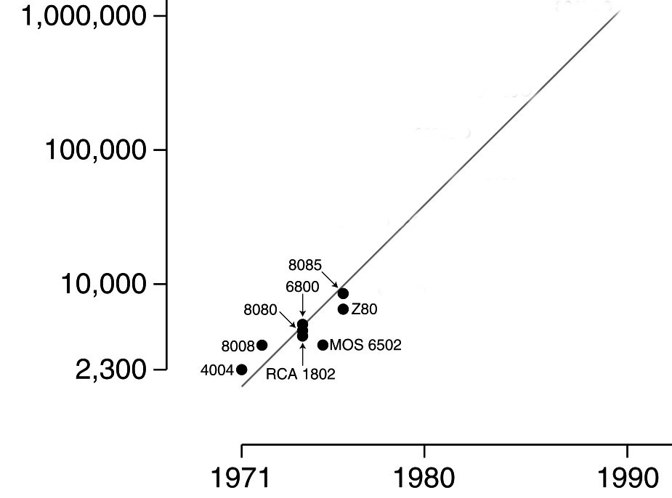
Intel’s Gordon Moore observed that the number of transistors reliably printable on chips was roughly doubling every two years . . .
Moore’s Law (as of 1976)
.
An exponential function,
graphed on a vertical log scale
Carver Mead named this “Moore’s Law”
(clever career move, eh?) and his student Bruce Hoeneisen showed there were no physical limits to densities up to several million transistors/cm².
N(t)/N(0) = 2^(t/2)
On looking ahead, we envisioned that by 1990
an entire “supercomputer” (of the day) could
be printed on a single chip . . .
In 1976 this triggered a research effort at Xerox PARC and Caltech to explore how to enable such complex chips to be designed.

Slide 14
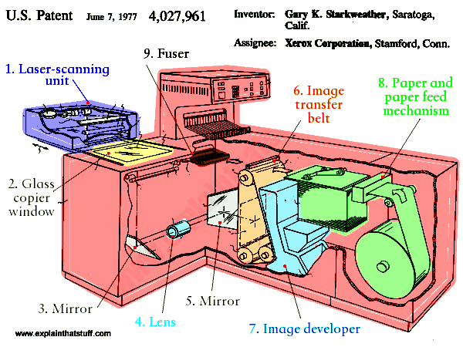
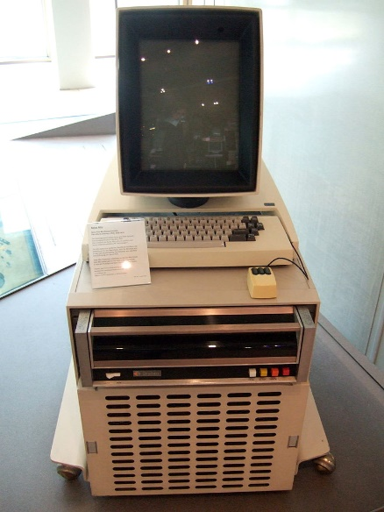
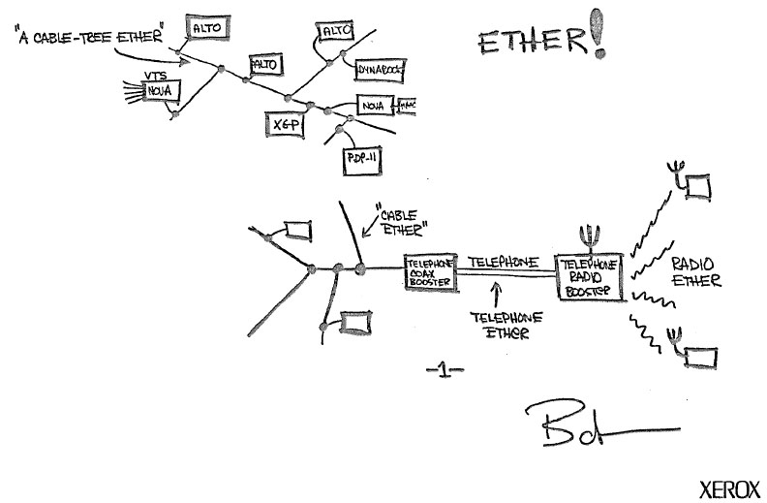
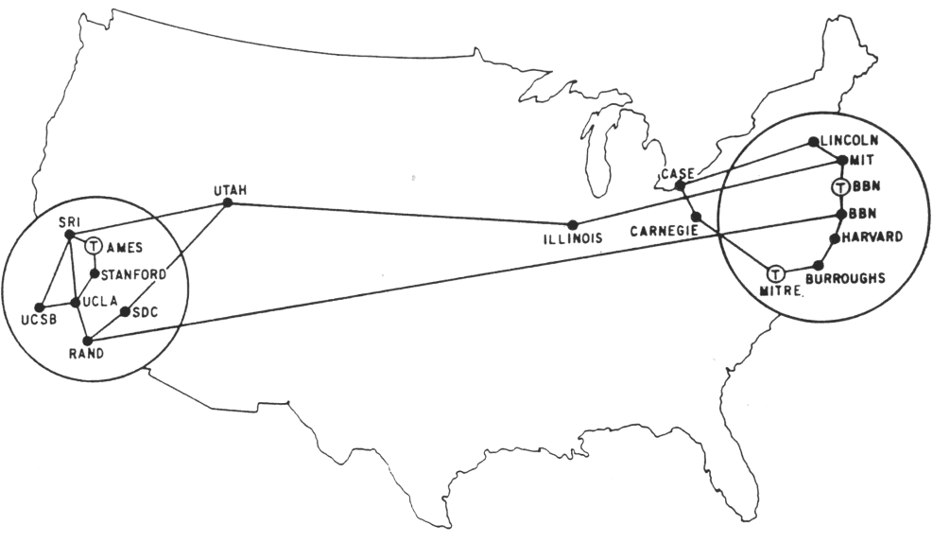
The stage was further set by seminal innovations in personal computing & networking:
The innovation of the interactive-display, mouse-controlled “personal computer”,
the “Ethernet” local-area network, and the “laser printer” at Xerox PARC) . . .
And by the Dept. of Defense’s “Arpanet” (the early internet), at DARPA . . .
Xerox Alto, 1973
Metcalfe’s original
Ethernet sketch, 1973
Laser printer, 1971
Source
Source
Arpanet map, 1971
Wiki commons

Slide 15
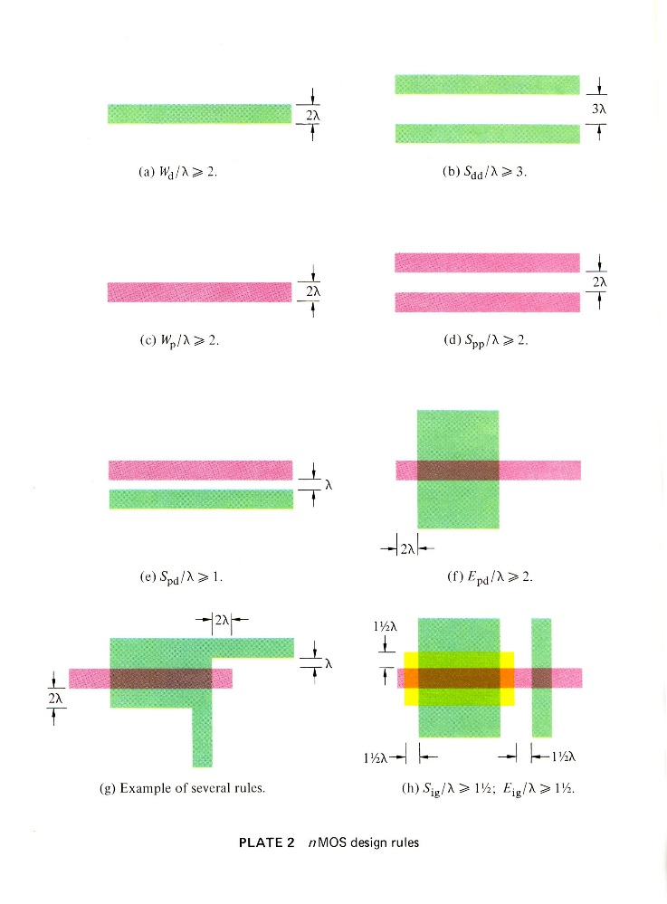
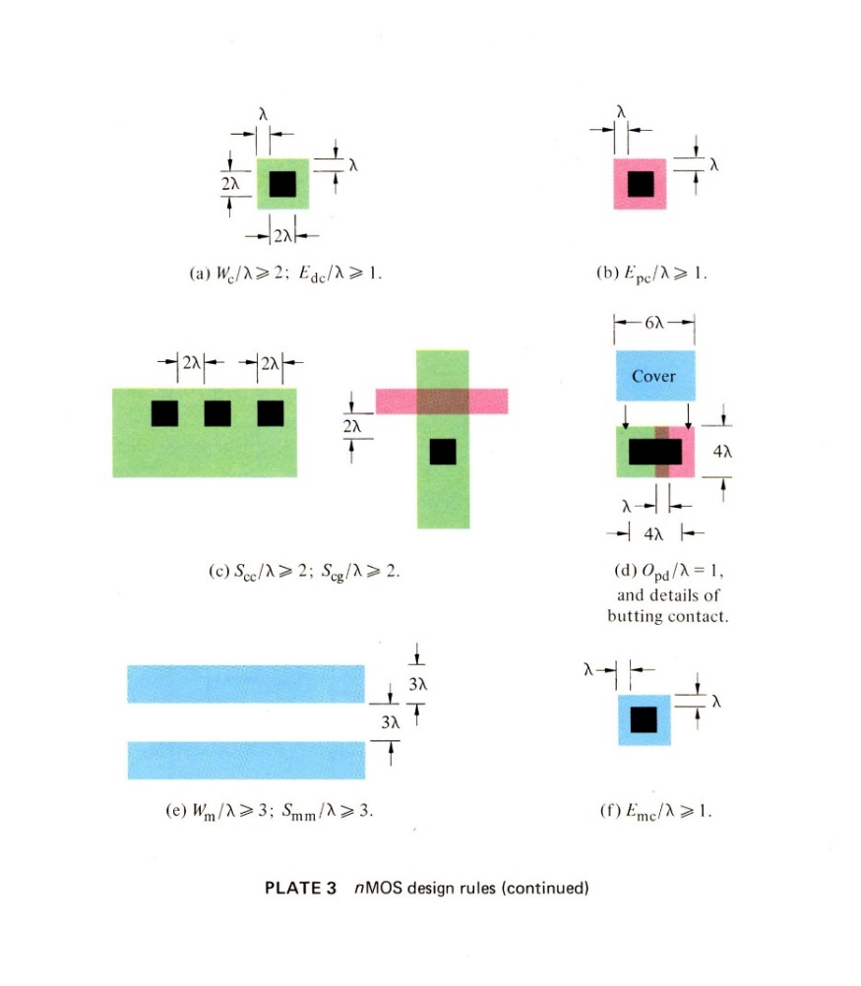
A sudden disruptive breakout was triggered by a cluster of abstract innovations made by Lynn Conway at Xerox PARC . . .
Included was a set of scalable VLSI chip-layout design-rules, encoded as dimensionless inequality equations
These enabled digital chip designs to be digitally encoded, scaled, and reused as Moore’s law advanced . . .
They also enabled chip design modules to be scaled and open-source shared . . .
Link

Slide 16
And an overall, meta-architectural, techno-social innovation:
As chip lithography scaled-down according to Moore’s Law, and ever-more ever-faster transistors can be printed on individual chips as time passes, I envisioned launching the following “techno-social scripted-process”:
STEP (i):
• Use design tools on current computers to DESIGN chip-sets for more powerful computers.
• PRINT the more powerful chip-sets using foundries’ next-denser fabrication processes.
• Use some of those chip-sets to UPDATE current computer-design computers & design tools.
REPEAT (i) as STEP (i+1)
If ever-more engineers and design-tool builders did this (on an expanding number of increasingly powerful computers), the iterating techno-social expansion-process could exploratorily and innovatively-generate ever-more, ever-more-powerful, digital systems . . .
I.e., that techno-social process could exponentiate! (until Moore’s Law saturated . . . )

Slide 17
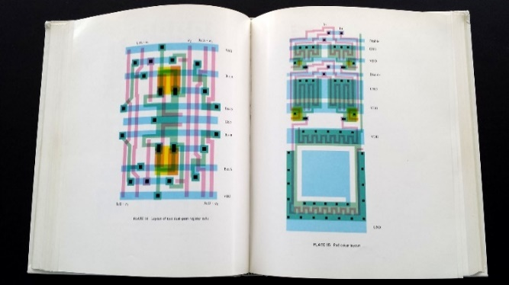
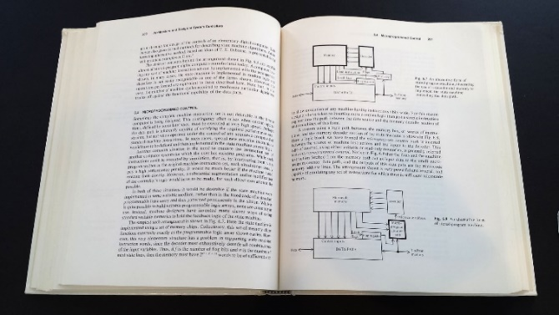
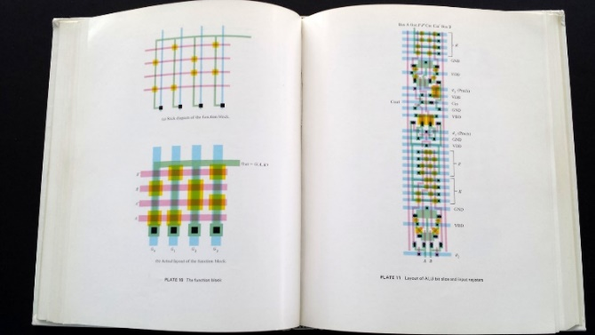
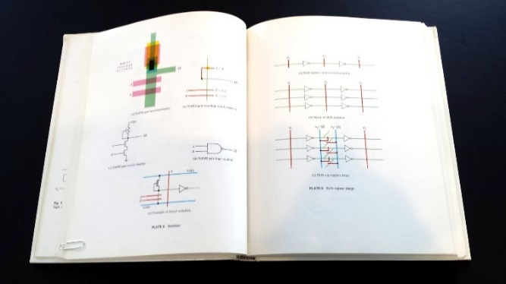
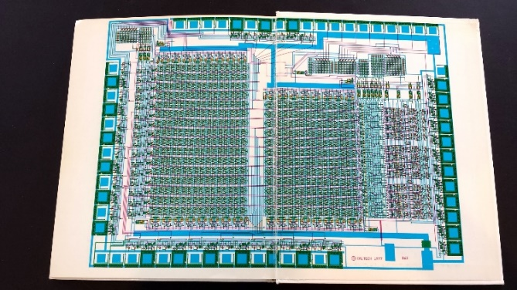
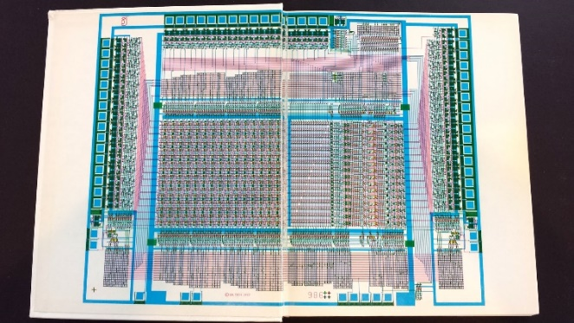
But there was a big problem: Where would all these engineers/programmers come from, and how would they learn to do all this?
In 1977, to help spread the ideas, I began documenting the innovative new
VLSI chip design methods in an evolving computer-edited laser-printed textbook . . .
Link

Slide 18
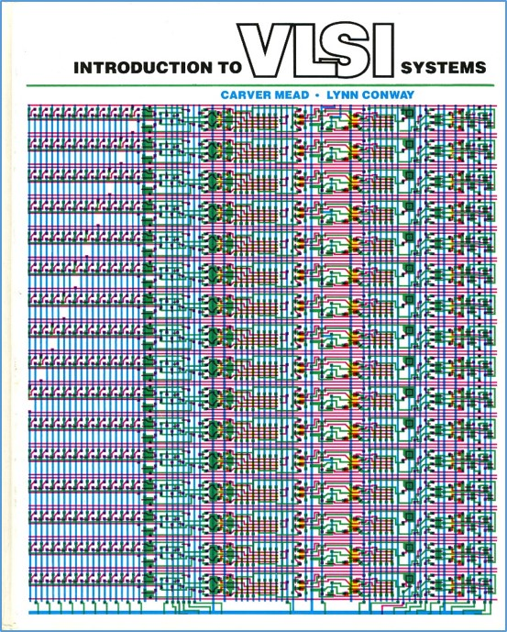
Thus using PARC’s Alto computers not only
to help mechanize the evolution of chip designs . . . but also to help mechanize the evolution of the design-knowledge itself
That computer-edited evolving book, printed on PARC laser printers, became the draft of the seminal textbook . . .
Introduction to VLSI Systems
by Mead and Conway, 1980.
Later called “the book that
changed everything” . . .

Slide 19
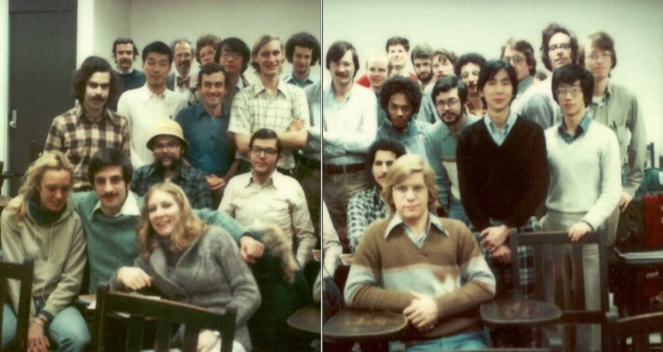
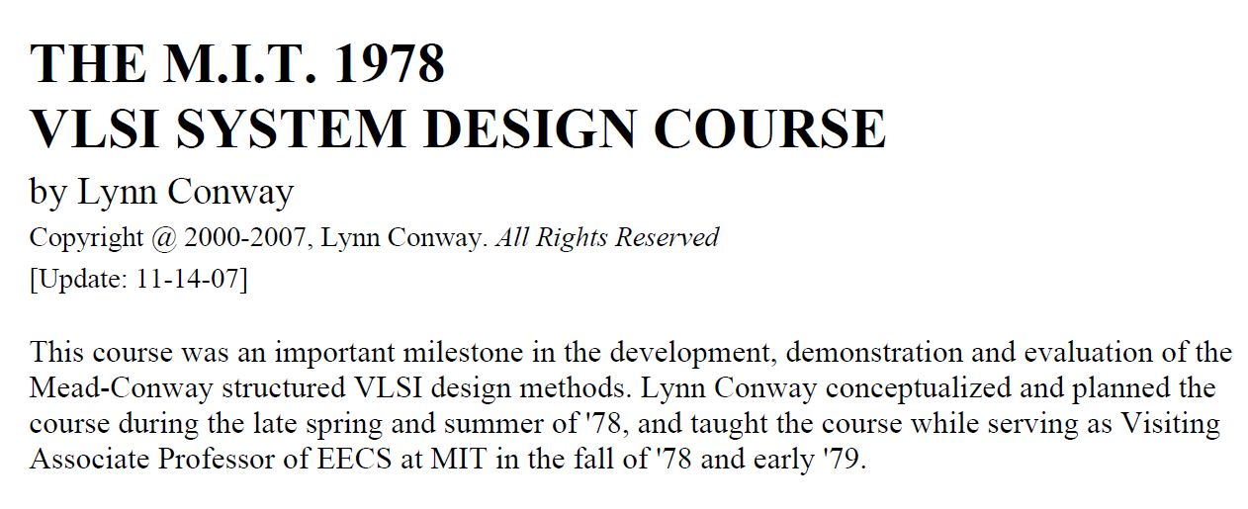
I introduced the new chip design methods in a special VLSI design course at MIT in 1978, following the ‘script’ Charles Steinmetz used to propagate his revolutionary AC electricity methods at Union College back in 1912.
Link
Link
Link

Slide 20
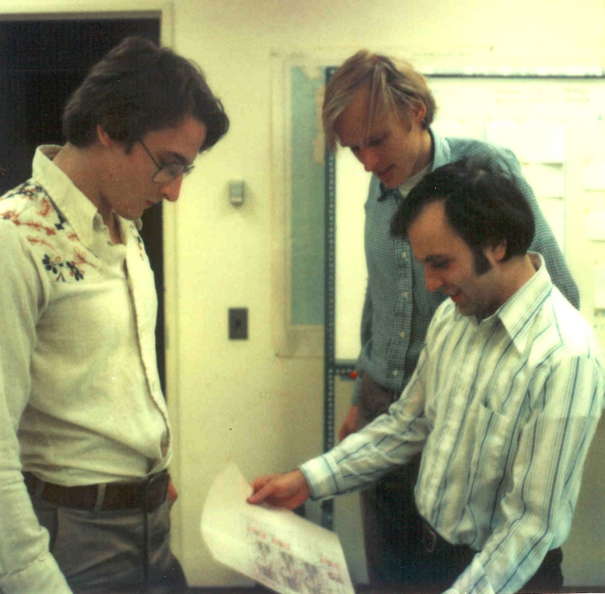
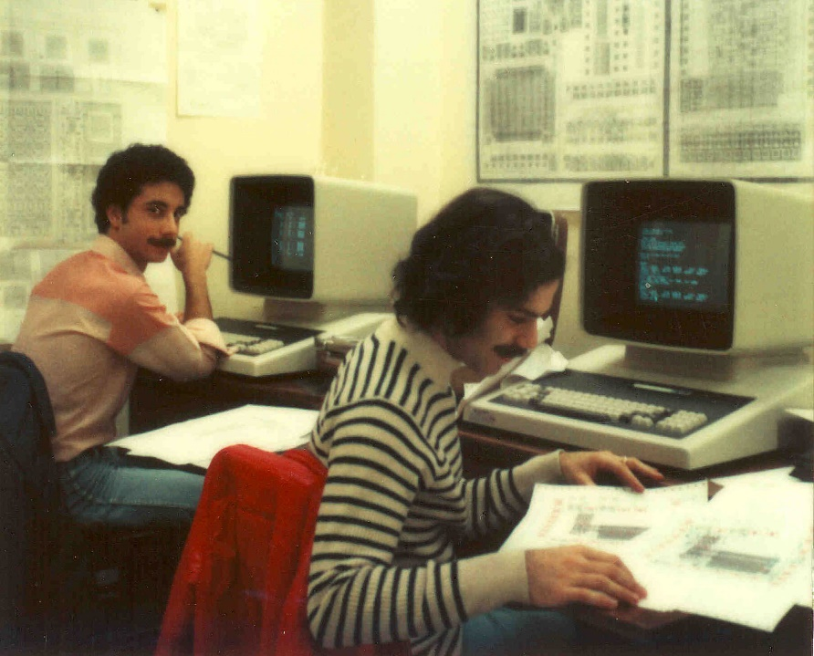
Students learned chip design in the
1st half course, and did project-chip designs in the 2nd half . . . which were fabricated at HP right after the course.
Among many amazing results was
a complete Lisp microprocessor designed by Guy Steele . . .

Slide 21
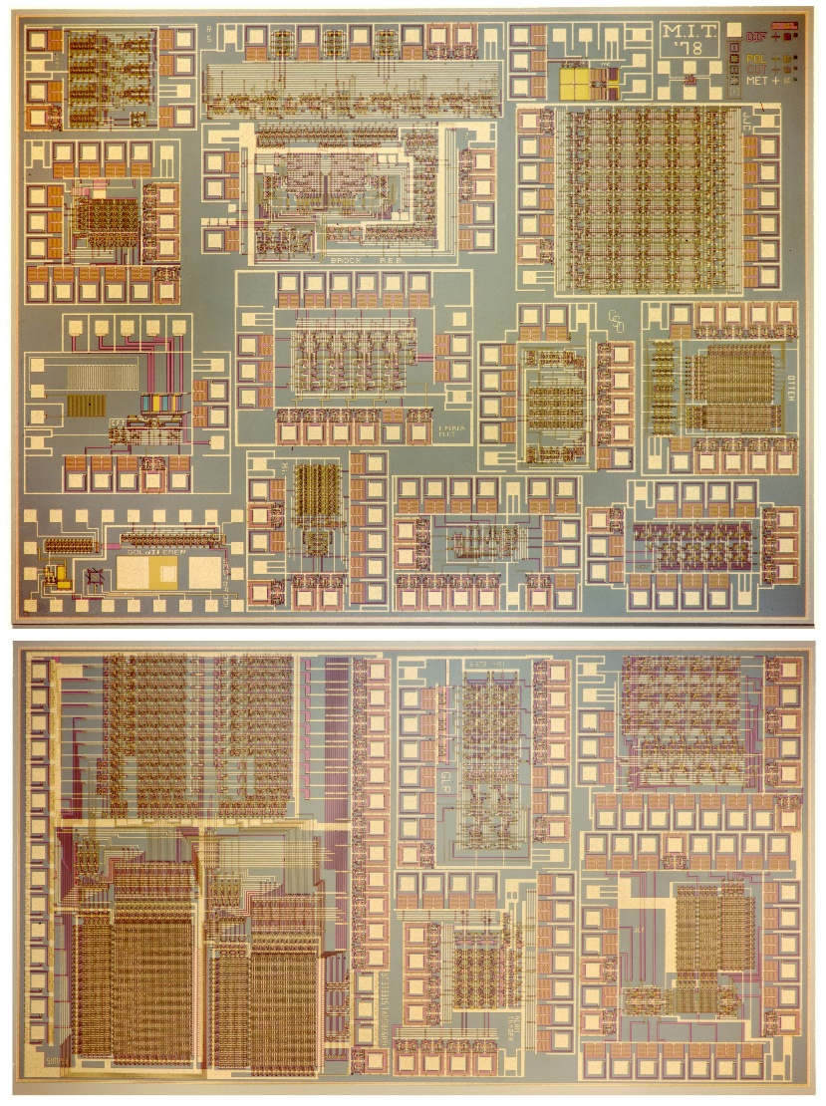
Map and photomicrograph
of the 19 student projects on
the MIT’78 ‘MultiProject’ Chip
For more about the MIT’78 course, see Lynn’s “MIT Reminiscences”

Slide 22
The MIT’78 course stunned various top folks across Silicon Valley . . .
Until then chip design had been mysterious, only grasped by a few computer engineers working for chip manufacturers . . thus having inside access to the “printing plants” . . .
Many other top research universities wanted to offer “MIT-like” courses. But how?
After intensive pondering, I grasped the answer: Try to rerun the MIT’78 course at a dozen research universities . . . using my MIT lecture notes to keep everything in sync.
But how to “print” all the student project chips?
I suddenly envisioned the idea of (what’s now called) an “e-commerce system” enabling student design files to be remotely submitted via the Arpanet to a “server” at PARC .
That server would run software to pack designs into multi-project chips (like composing the print-files for a magazine, using remotely-submitted articles) . . .
We’d then “print” the MPC’s again at HP Labs (where my colleague Pat Castro had prototyped the first “silicon foundry”), and quickly return the chips to students.

Slide 23
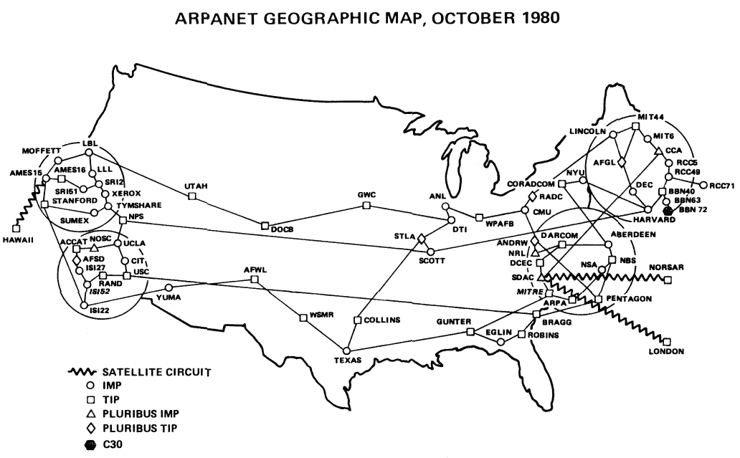
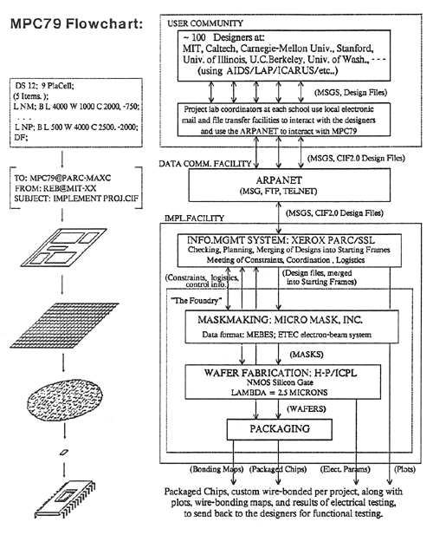
In the fall of 1979, I covertly-orchestrated a huge “Arpanet happening” (MPC79)* . . .
involving 129 budding VLSI-designers in Mead-Conway courses at 12 research-universities:
*The MPC Adventures: Experiences with the Generation of VLSI Design
and Implementation Methodologies, L. Conway, Xerox PARC, 1981 (PDF)

Slide 24
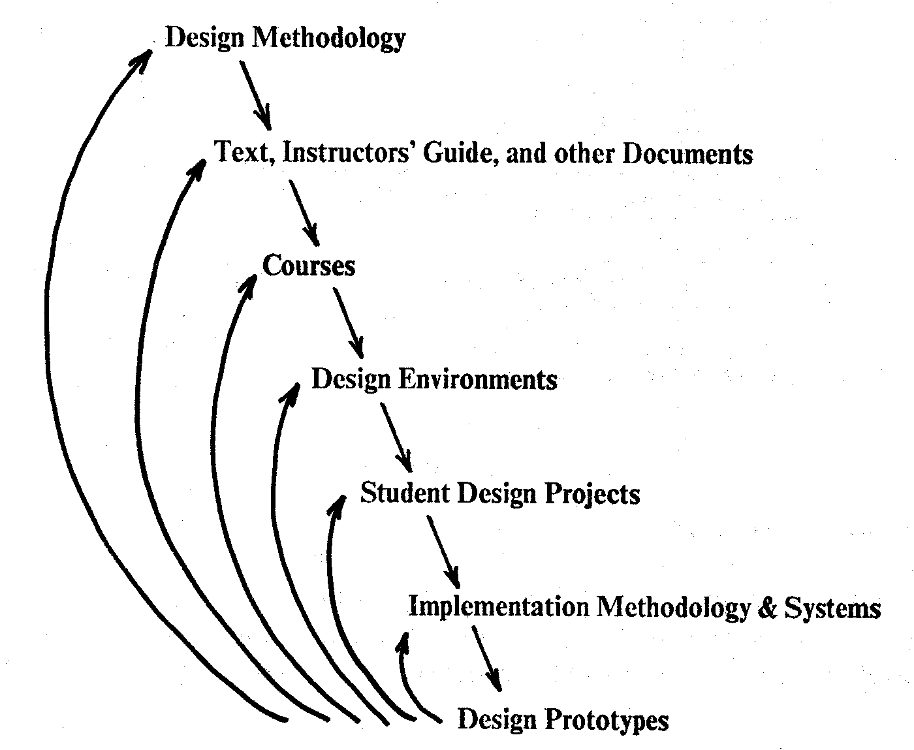
MPC79 provided a large-scale demonstration and validation of the VLSI design methods, design courses, design tools and e-commerce infrastructure.
It also triggered synchronized ‘cyclic gain’ in and exponentiation of the budding VLSI design techno-social ecosystem . . . composed of new tribes of VLSI instructors, designers, design tool builders, digital infrastructure providers, fabricators and their collectively entangled artifacts.
By 1982-83, Mead-Conway VLSI design courses were
being offered at 113 universities all around the world
It was an early experimental-exploration of emergent techno-social system-dynamics in a
field now becoming known as “social physics.”
*Figure 8. The Joint Evolution of the Multi-Level
Cluster of Techno-Social Systems
From The MPC Adventures* (Lynn Conway, 1981, p. 16)

Slide 25
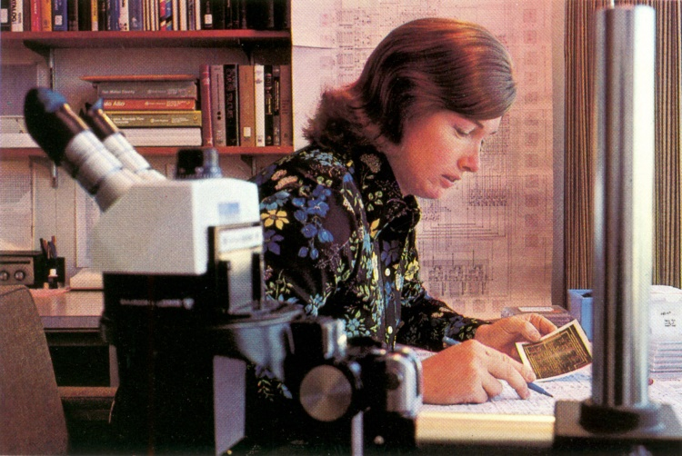
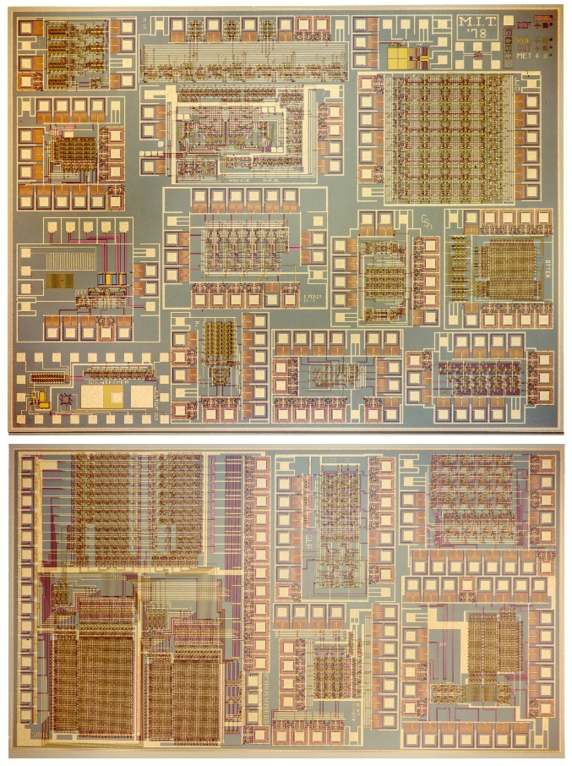
1976
1977
1978
1979
Visualizing the exponentiating
wave of VLSI innovation . . .
’76: How to cope with VLSI complexity?
’77: Inventing scalable VLSI design rules.
’78: Launching the VLSI methods at MIT!
’79: Launching the VLSI courses via MPC79!!

Slide 26
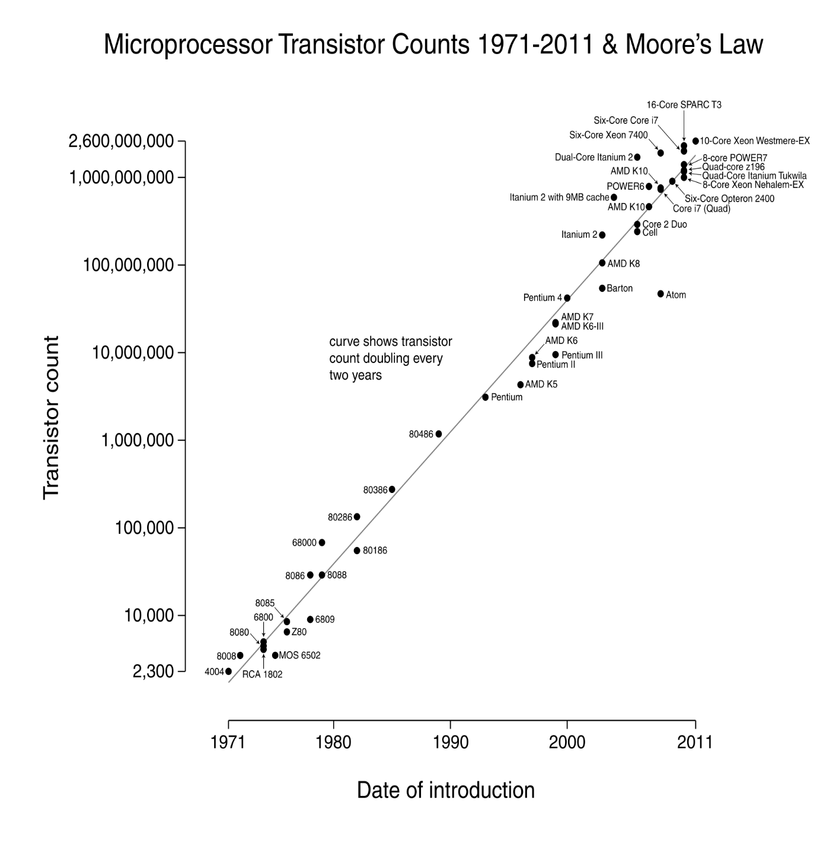
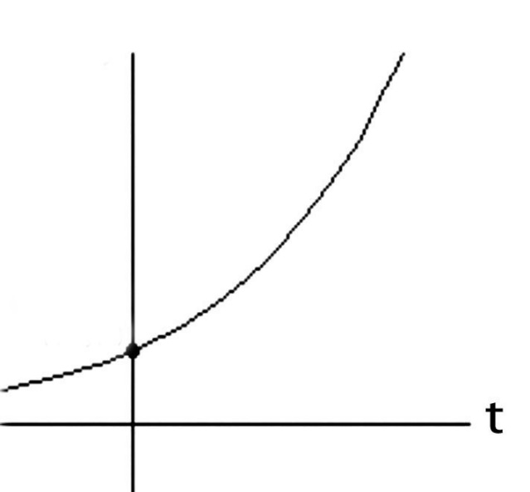
Over the past 40 years or so, Moore’s Law stayed on track all the way:
N
(exponential function
graphed on log scale)
(exponential function
with t in years)
N(t)/N(0) = 2^(t/2)
N(0), t(0)
Starting with several thousand in 1971, the number of transistors on
a chip passed one million by 1991, and passed several billion by 2011!

Slide 27
Exponentiation! Visualizing the compounding of techno-social-system “interest” . . .
Source

Slide 28
2(b). Let’s now go back and follow high-tech community reactions
to the “Mead-Conway” innovations over the ensuing decades:

Slide 29
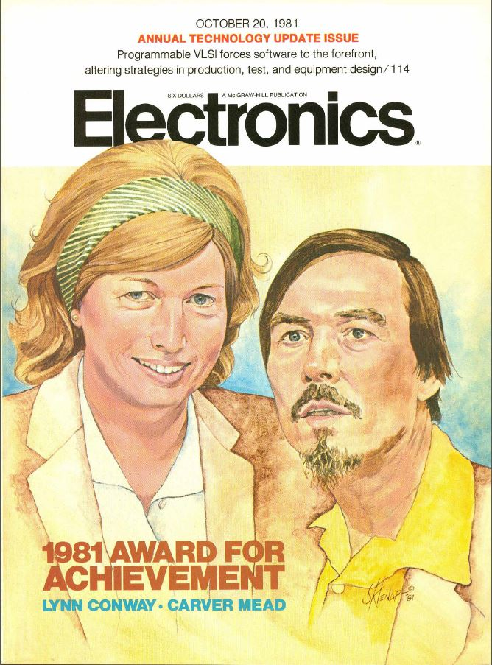
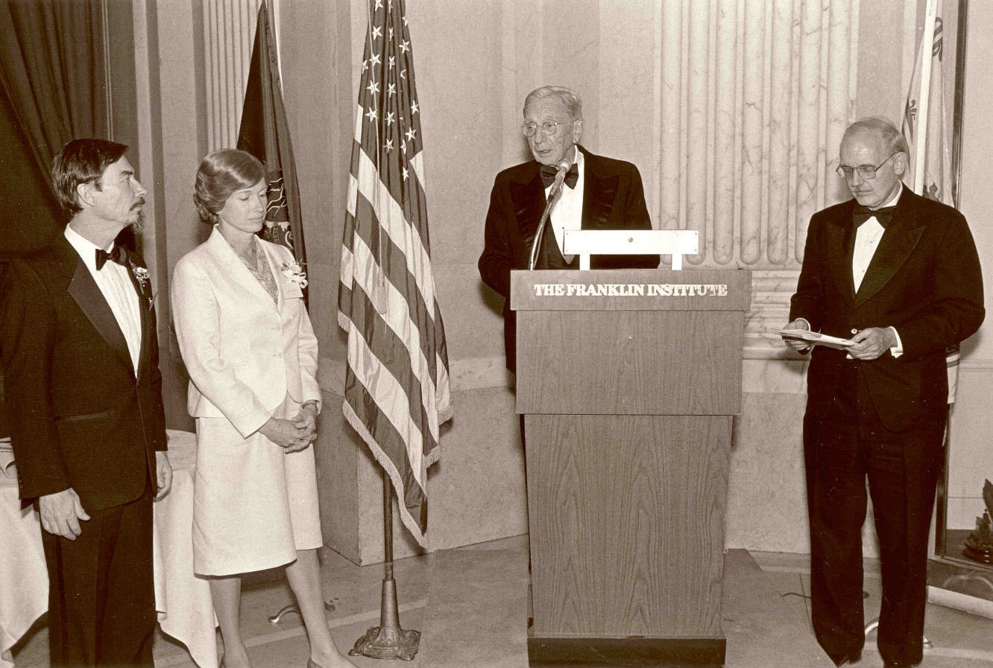
By ’81 key people sensed ‘something significant’
had happened, and Mead & Conway began
receiving major recognition during the 1980s:
Electronics Award for Achievement ‘81
Pender Award, Moore School ‘84
Wetherill Medal, Franklin Institute ’85
NAE, Mead ‘84
NAE, Conway ‘89. . .

Slide 30
However, from ‘89 on through the ‘00s, Mead received increasingly
major recognitions, while Conway’s role was erased*:
NAS ‘89
American Academy of Arts and Sciences ‘91
EDAC Phil Kaufman Award ‘96
IEEE John Von Neuman Medal ‘96
ACM Allen Newell Award ‘97
MIT Lemelson Award ‘99 ($500,000)
Fellow Award, Computer History Museum ‘02
National Medal of Technology ‘02
NAE Founders Award ‘03
Inventors Hall of Fame, at Computer History Museum Gala ‘09
*Most of these awards were for innovations that were solely Conway’s

Slide 31
As a result, by 2009 the erasure was complete:
Chip inventors getting their due at Hall of Fame induction
By Mike Cassidy, San Jose Mercury News
Apr. 30, 2009 --The 50th birthday celebration of the integrated circuit kicks off in Silicon Valley this weekend, and frankly, I'm a little overwhelmed . . .
On Saturday night, the National Inventors Hall of Fame is inducting this year's class. The sold-out ceremony (at the Computer History Museum) is in Silicon Valley for the first time, because the Ohio-based hall is honoring 15 who are responsible for breakthroughs in semiconductor technology -- the technology that put the "silicon" in Silicon Valley . . . In a way, it's as if the valley's founding fathers are coming together to be honored in person and posthumously. Inductees Gordon Moore, co-founder of Intel and namesake of Moore's Law, and Carver Mead, chip design pioneer and all-around brainiac, will be at the ceremony. So will lifetime achievement honoree Andy Grove, Intel's former CEO . . .

Slide 32
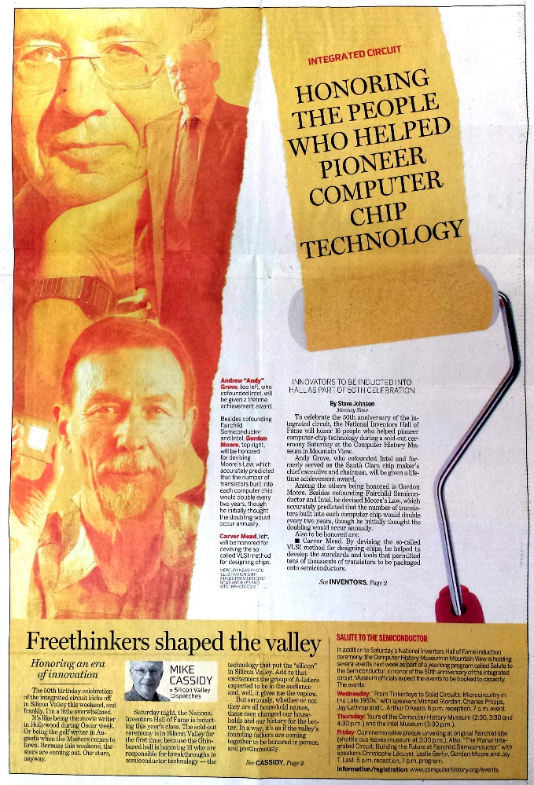
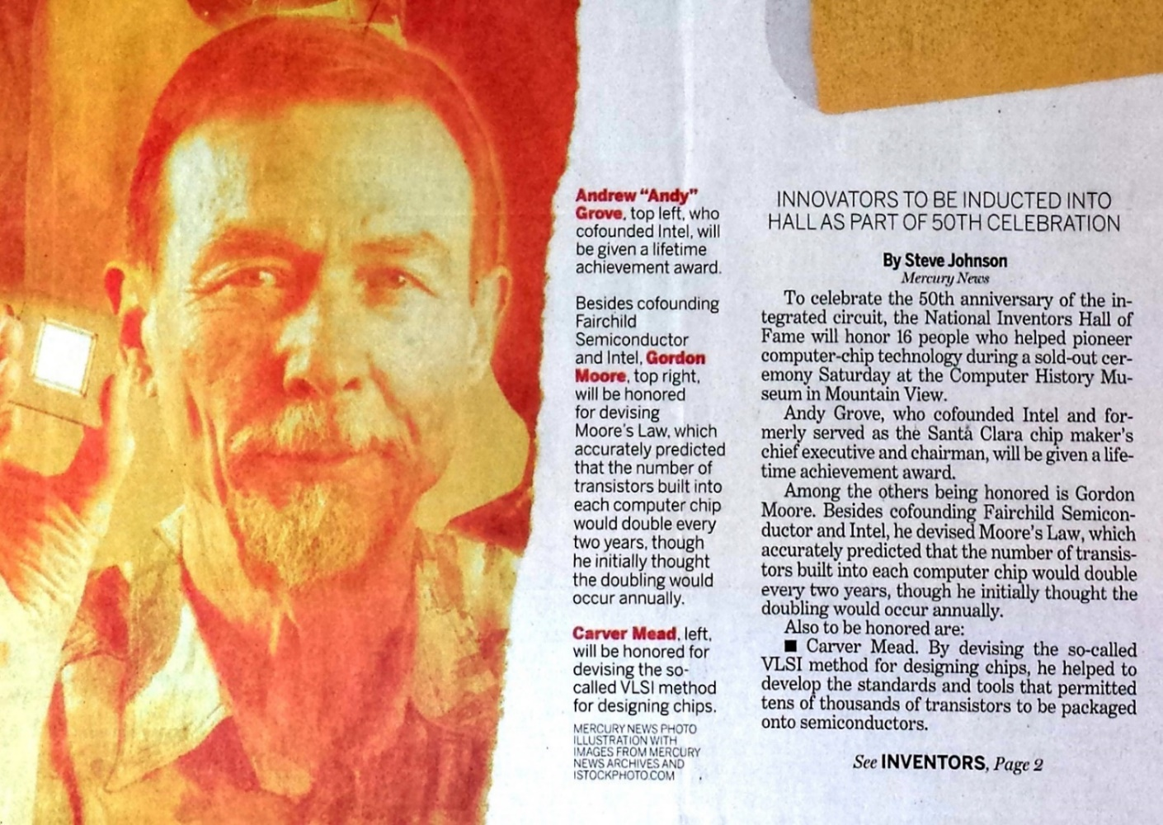
With Andy Grove, Gordon Moore and Carver Mead taking center stage:
San Jose Mercury News April 30, 2009
Not only was Lynn Conway not invited, she didn’t even know it was happening!
Hmm . . . Reminds us of the Apple Macintosh story, eh?

Slide 33
3. My investigations into and reporting on what happened,
hoping to regain some of my legacy along the way . . .
Link

Slide 34
The story of my recent investigations is quite a saga, yet to be fully told . . .
Along the way I uncovered all sorts
of fascinating data and evidence.
That led me to write and publish my “Reminiscences of the VLSI Revolution” in the
Fall 2012 IEEE Solid State Circuits Magazine.
The first time in decades I’d come forward
and begun telling the story . . .

Slide 35
I also began to visualize how my transgender journey affected my role in the revolution.
I’d been fired from my research position at IBM during my transition back in 1968, and restarted my career all over again in “stealth mode”, in a covert new identity.
Rising from contract programmer, to computer architect at Memorex, to working at Xerox PARC, I lived like a foreign spy in my own country . . . Always looking over my shoulder, terrified I’d be outed and lose my career again.
Not wanting to call attention to myself, I used “tradecraft” I’d learned during my transition to covertly make things happen . . . while staying hidden behind the scenes.
And now my reminiscences were finally triggering my reappearance . . .

Slide 36
Links re my investigation to understand
what happened, and to reclaim my life-legacy:
Compilation of the VLSI Archive, 2009-2012
Publication of my IBM-ACS Reminiscences, 2011
Publication of my VLSI Reminiscences, 2012
Publication of my MIT Reminiscences, 2014
Evidence that “the paradigm is shifting”:
Hall of Fellows, Computer History Museum, 2014
Honorary Doctorate, Illinois Institute of Technology, 2014
IEEE & Royal Society of Edinburgh, James Clerk Maxwell Medal, 2015
Honorary Doctorate, University of Victoria, 2016
Fellow of the AAAS, 2017.
Honorary Doctorate, University of Michigan, 2018.
Lifetime Achievement Award, IBM Corporation, 2020

Slide 37
3(b). But Why did Lynn’s ‘disappearance” happen in the first place?
A Counter-Intuitive Explanatory-Conjecture: The ‘Conway Effect’!
Link

Slide 38
Throughout this example we “appear to observe” the following effects:
(i) the “Matilda effect” (repression of women scientists’ contributions)
(ii) the "Matthew effect“ (eminent scientists get more credit)
These effects involve “self-fulfilling prophecies”, which Merton describes as:
“. . . a false definition of the situation evoking a new behavior which makes the original false conception come true. This specious validity of the self-fulfilling prophecy perpetuates a reign of error. For the prophet will cite the actual course of events as proof that he was right from the very beginning.”
But is that all that’s happening?
Or are other, far deeper, systemic forces in play?

Slide 39
On closer investigation, I realized that something far more subliminal and fundamental was happening at a social level . . . something that involves no errors, no conspiracies, no repressions and no ‘bad guys’:
CONJECTURE: Almost all people are blind to innovations, especially ones made by ‘others’ whom they do not expect to make innovations.
Since for most people, ‘others’ = ‘almost all people’, few people ever witness or visualize innovations, even ones made right in front of their eyes, even including some made by themselves!
Instead, when internally-orientating towards ‘novelties’ they stumble upon, most people look for cues by others . . . and not just whether to accept or reject the novelty . . . but even whether to notice it in the first place!
From this perspective, the Mathew Effect and Matilda Effect are derivatives
of the newly conjectured “Conway Effect”, which covers ‘all outsiders’.
Link

Slide 40
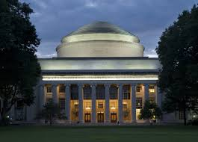
Visualizing the Conway Effect in action:
Most students in MIT’78 thought they were learning “how chips were designed in Silicon Valley” (the course was, in effect, a giant MIT hack!). They “did it” without realizing they were learning radical new methods.
The astonished reaction amongst Silicon Valley’s cognoscenti led to intense interest in reverse engineering “How MIT did this”, and many research universities immediately wanted to offer similar “MIT VLSI courses”.
The next year, the MPC79 chip designers took ‘foundry access’ for granted and just ‘used it’.
No one realized MPC79 was an even larger paradigm-shifting-hackathon that was launching
the modern microchip “fabless design”+“silicon foundries”+“e-commerce” infrastructure.
By ‘hiding in plain sight’, MPC79 simply ‘disappeared’ from view as an innovation!

Slide 41
What might MPC79 participants have been thinking?
Meanwhile, Conway remained hidden in the shadows until 2012, when she finally
felt able to emerge and explain how it happened . . .

Slide 42
The Conway Effect: Almost all people are blind to innovations,
especially those made by folks they don’t expect to make innovations.
• Innovations diffuse via social-processes involving subliminal subgroup noticings,
mimickings, rejections, adoptions, adaptations, tradings and displacements
Distracted by Greed!
Link
Meanwhile, credits for innovations as social-markers are separately
subliminally assigned, gained, granted, bartered, seized, etc . . .
• Crediting-processes are modulated by visibility, status, prestige, class, power,
location, credentials, prejudice, popularity, influence, money and accident . . .
The high visibility of crediting (vs the invisibility of innovations) sustains
both the crediting-processes and the ongoing-blindness to innovations.
Covert Visioneering!
Corollary: It’s possible to trigger large paradigm-shifts right out
in the open, as long as people have no clue what you’re doing!
I wonder, could this even have happened any other way . . . ?

Slide 43
Closing Reflections:
If women are not expected to innovate, the stories of their innovations, even major ones, disappear. Credit then goes to men associated with the innovations, who do not have to aggrandize credit. Credit accrues to those men as they are remembered, while the women disappear.
To be able to “win at innovation,” women must be expected to be able to win. This expectation must live inside women themselves. And to live inside them, it must fully-live in society.
As a previously-marginalized “unexpected-innovator” this struggle was existentially-difficult at times, especially during the decades of my disappearance . . .
Fortunately, it has led to insights into how people can be wronged, even when no one is deliberately doing wrong. Hopefully these insights can help empower us . . . to better-visualize what’s going on, better seize our moments, and better-trigger positive social change.

Slide 44
Link
THE END
Moral Of The Story:
“When Weirdness breaks out, don’t get upset . . . Do Science On It!”
http://ai.eecs.umich.edu/people/conway/Memoirs/Talks/CoNECD-2021/Inside_Story_Talk.pptx
http://ai.eecs.umich.edu/people/conway/Memoirs/Talks/CoNECD-2021/Inside_Story_Talk.pdf
www.lynnconway.com ; conway@umich.edu

