Slide 1
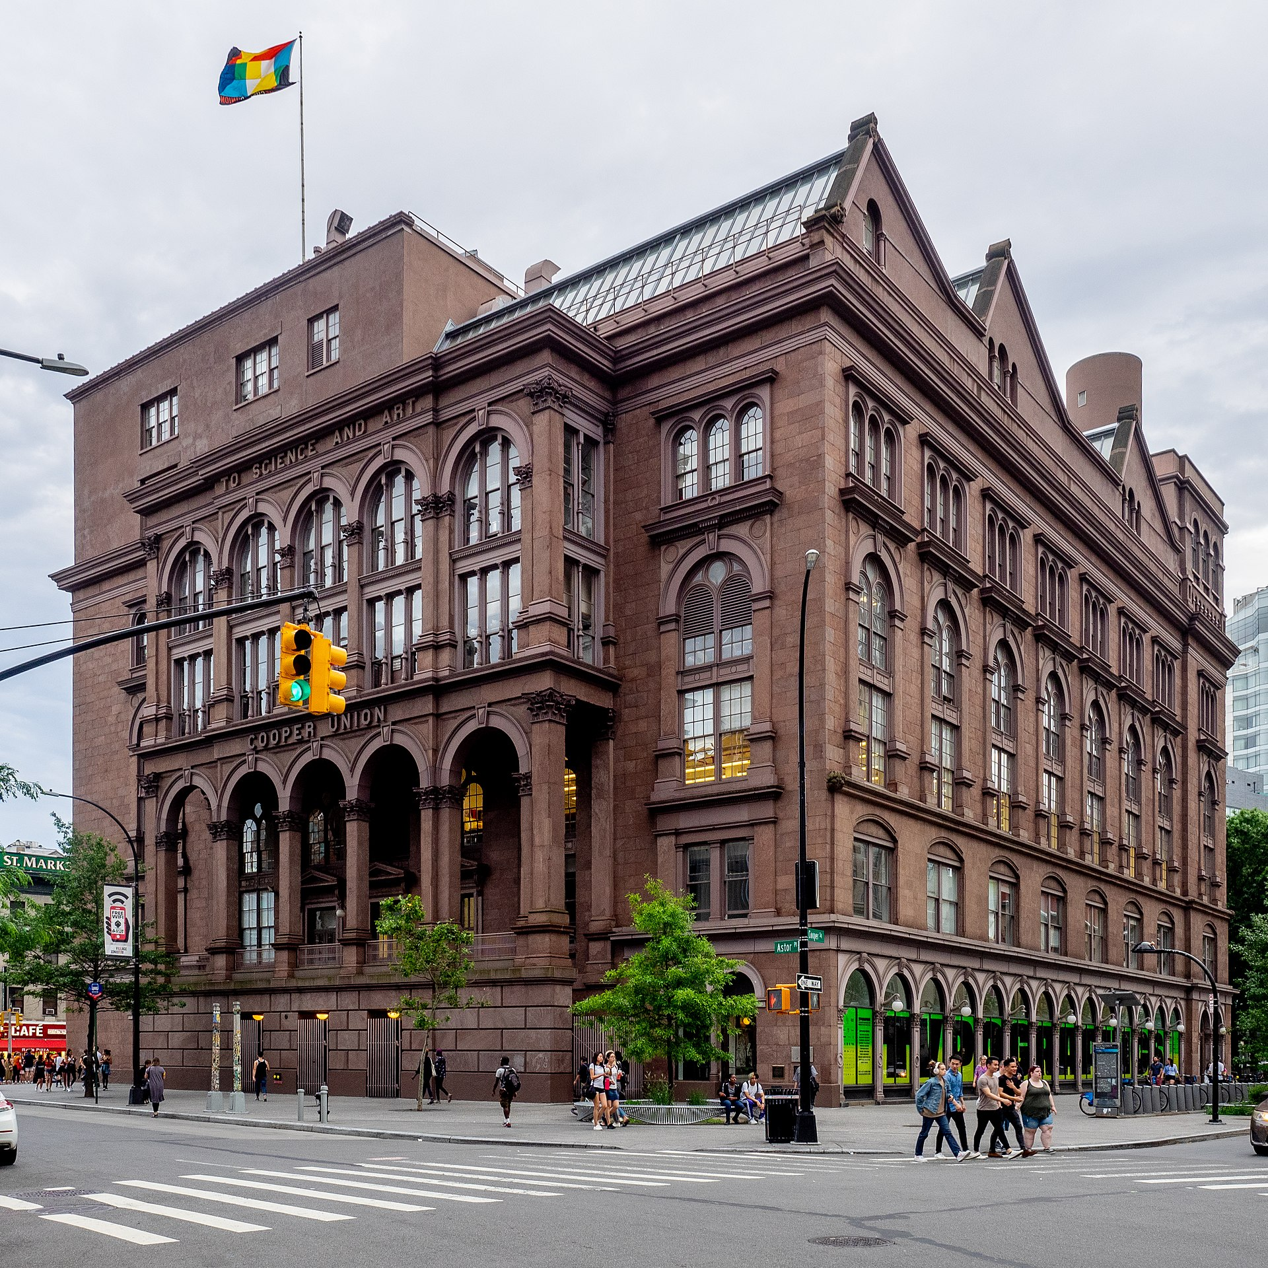
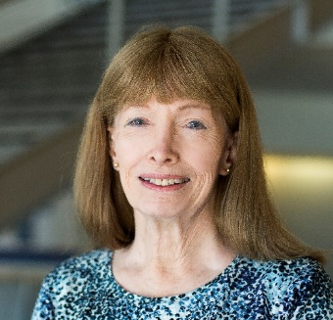

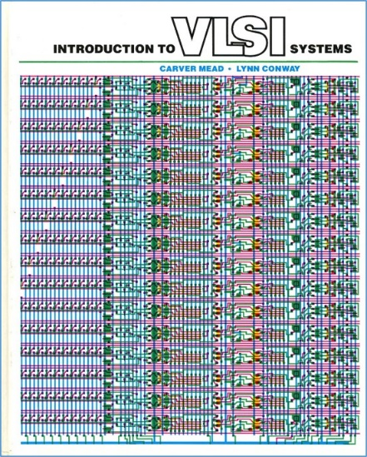
SoE Diversity, Equity and Inclusion Town Hall
Cooper Union, Dec. 17, 2020 at 5:00-6:00 pm.
The Disappeared: Beyond Winning and Losing*
Lynn Conway, Professor of EECS Emerita, University of Michigan, Ann Arbor
When “others” (such as women and people of color) make innovative contributions in scientific and technical fields, they often “disappear” from later history and their contributions are ascribed elsewhere. This is seldom deliberate — rather, it’s a result of the accumulation of advantage by those who are expected to innovate. This lecture chronicles an example of such a disappearance and introduces the Conway Effect to elucidate the disappearance process (to be followed by a Q/A session).
*In remembrance of pioneering novelist Ralph Ellison, author of Invisible Man, 1952.

Slide 2
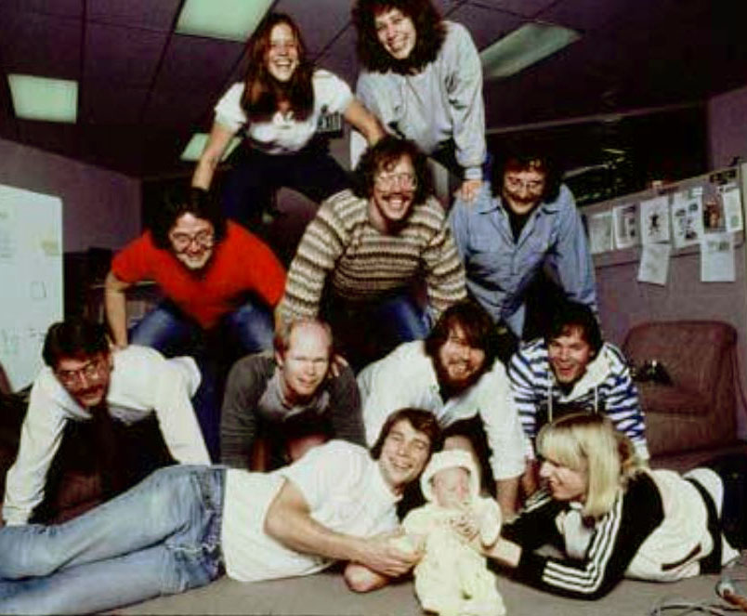
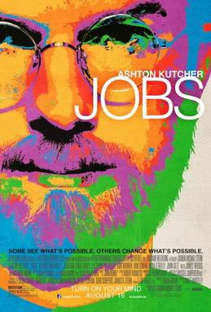
1
There were four women on the Macintosh team in the 1980s . . .
But not a single one was cast in the 2013 biopic Jobs. Even worse, all seven men on the project had speaking roles in the film.
Can you imagine how it feels to be “disappeared”?

Slide 3
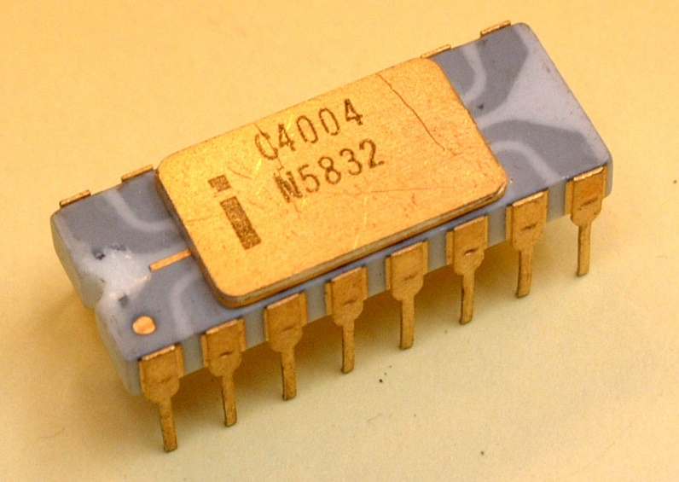
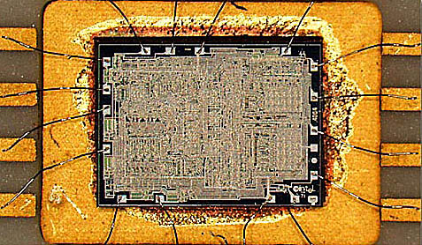
2
Rapid advances in optical/chemical lithography enabled the ‘printing’ of ever-finer features, and thus ever-increasing numbers of transistors could be printed on single chips.
A watershed was crossed in 1971
with the introduction of the Intel 4004, the first single-chip “microprocessor”:
a “computer processor on a chip” . . .
Source
It contained 2300 transistors . . .
Source

Slide 4
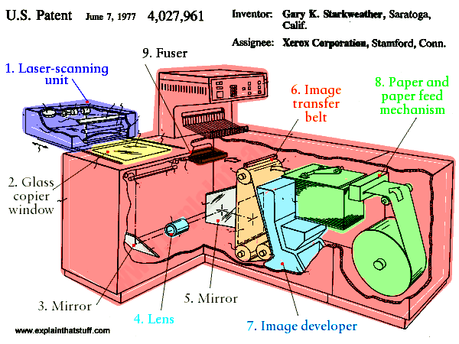
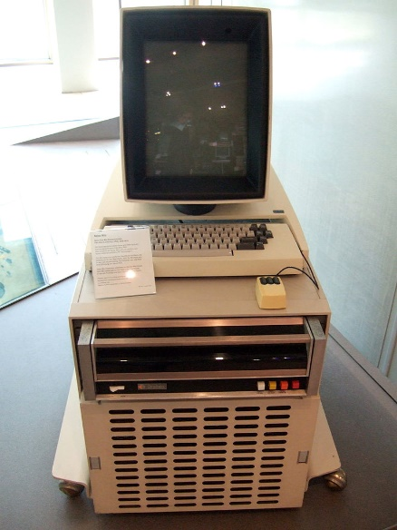
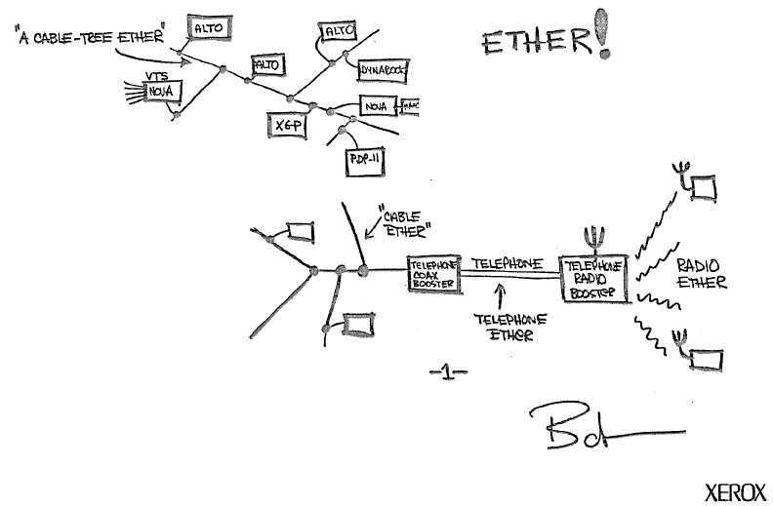
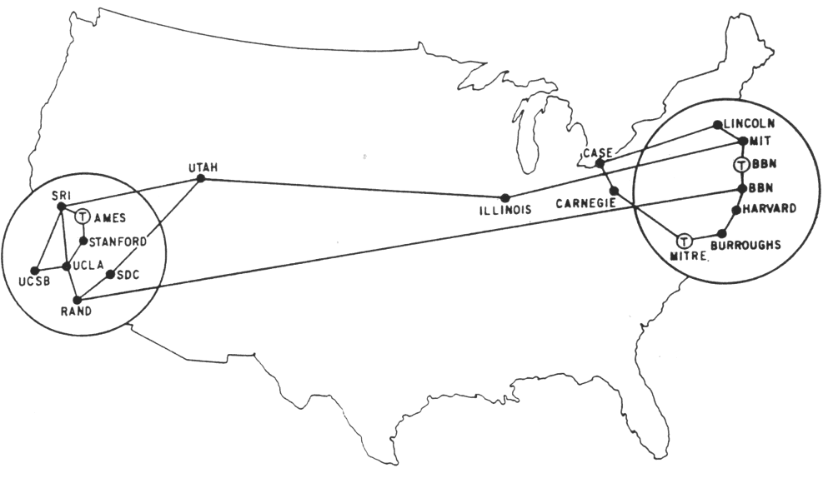
3
The stage was further set by seminal innovations in computing & networking:
The innovation of the interactive-display, mouse-controlled Alto “personal computer”,
The “Ethernet” local-area network, and the “laser printer” at Xerox PARC . . .
And by the Dept. of Defense’s “Arpanet” (the early internet), at DARPA . . .
Xerox Alto, 1973
Metcalfe’s original
Ethernet sketch, 1973
Laser printer, 1971
Source
Arpanet map, 1971

Slide 5
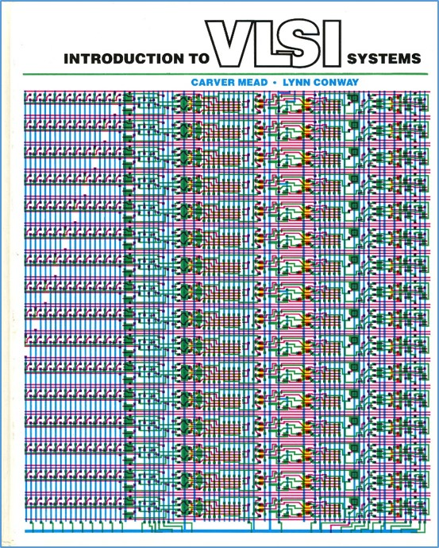
4
Using PARC’s Alto computers not only
helped mechanize the evolution of chip designs . . . it also to helped mechanize the evolution of the design-knowledge itself
That computer-edited evolving book, printed on PARC laser printers, became the draft of the seminal textbook . . .
Introduction to VLSI Systems
by Mead and Conway, 1980.
(later called “the book that
changed everything” . . . )

Slide 6
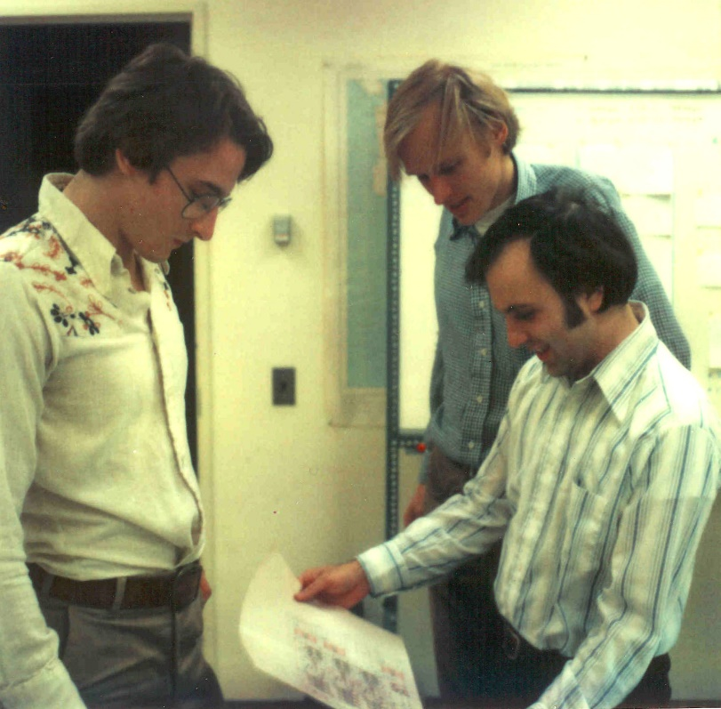
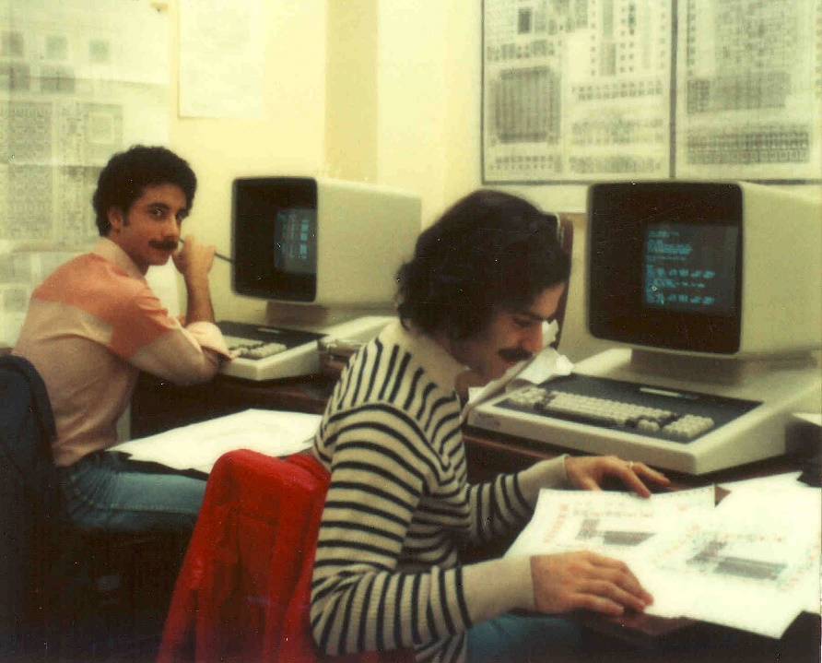
5
Students learned chip design in the
1st half course, and did project-chip designs in the 2nd half . . . which were fabricated at HP right after the course.
Among many amazing results was
a complete Lisp microprocessor designed by Guy Steele . . .

Slide 7
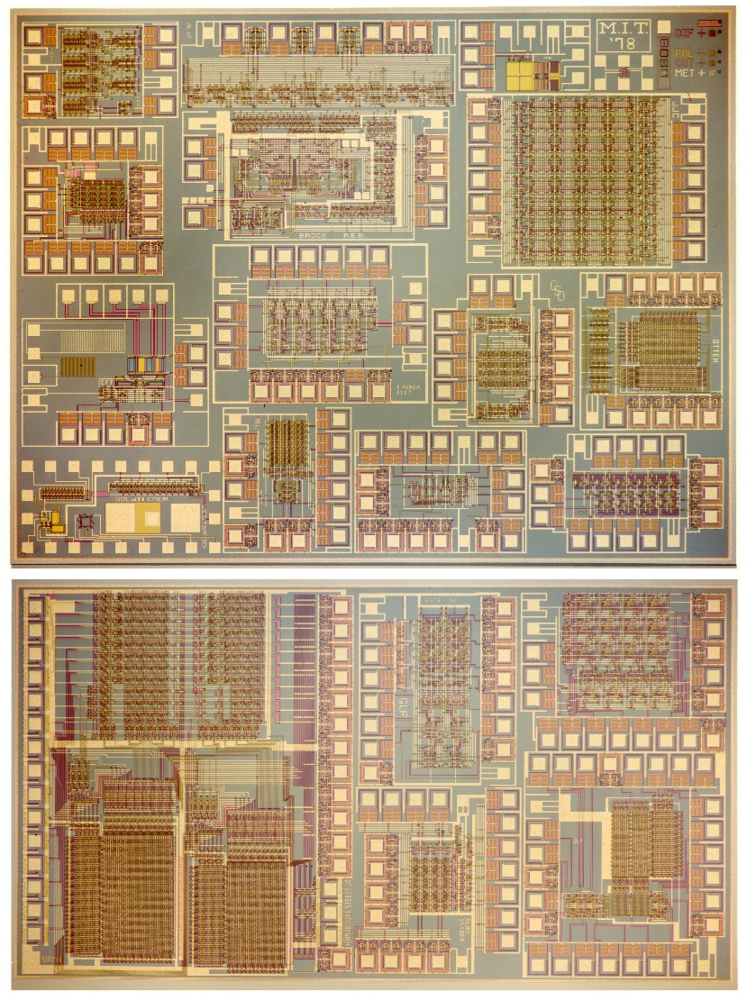
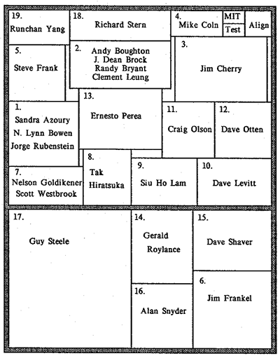
6
Map and photomicrograph
of the 19 student projects on
the MIT’78 ‘MultiProject’ Chip
For more about the MIT’78 course, see Lynn’s “MIT Reminiscences”

Slide 8
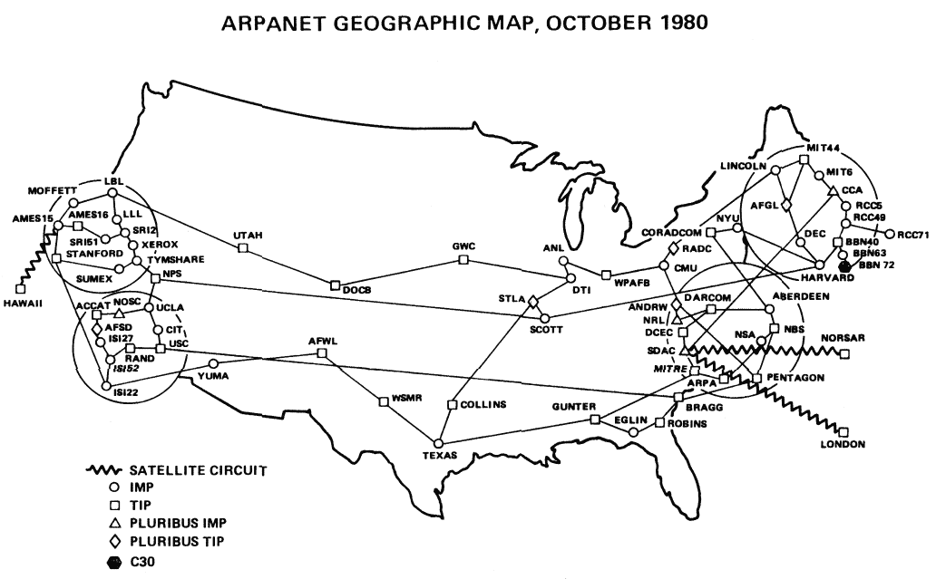
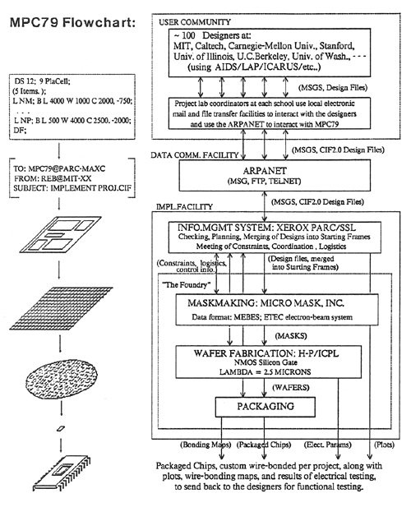
7
In the fall of 1979, I covertly-orchestrated a huge “Arpanet happening” (MPC79)* . . .
involving 129 budding VLSI-designers in Mead-Conway courses at 12 research-universities:
*The MPC Adventures: Experiences with the Generation of VLSI Design
and Implementation Methodologies, L. Conway, Xerox PARC, 1981 (PDF)

Slide 9
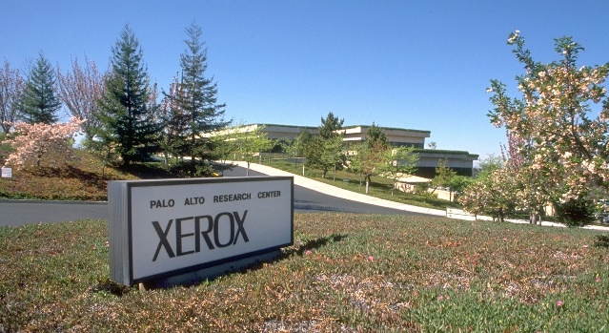
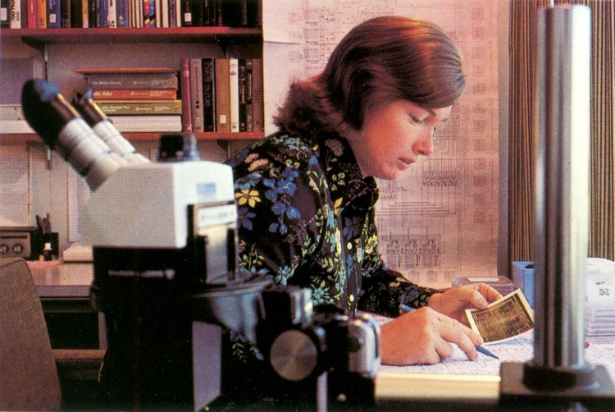
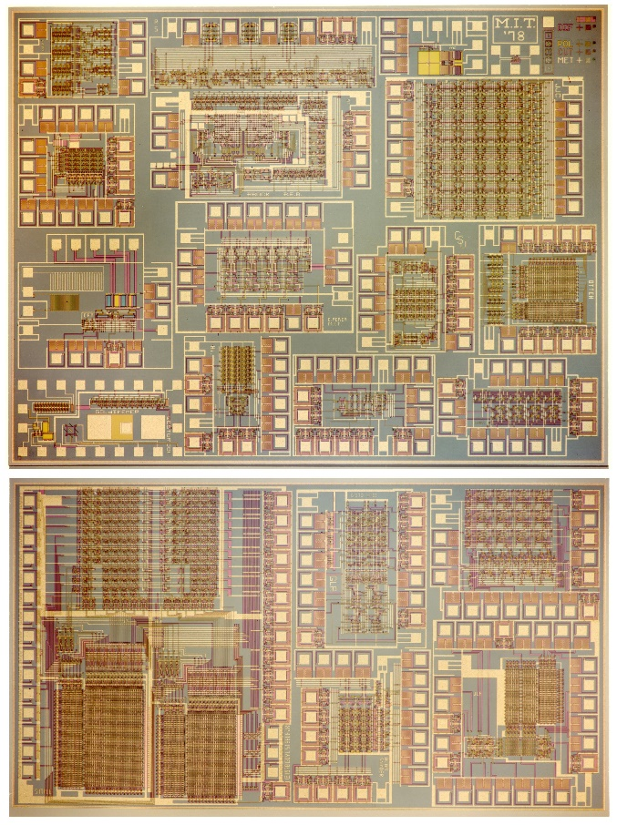
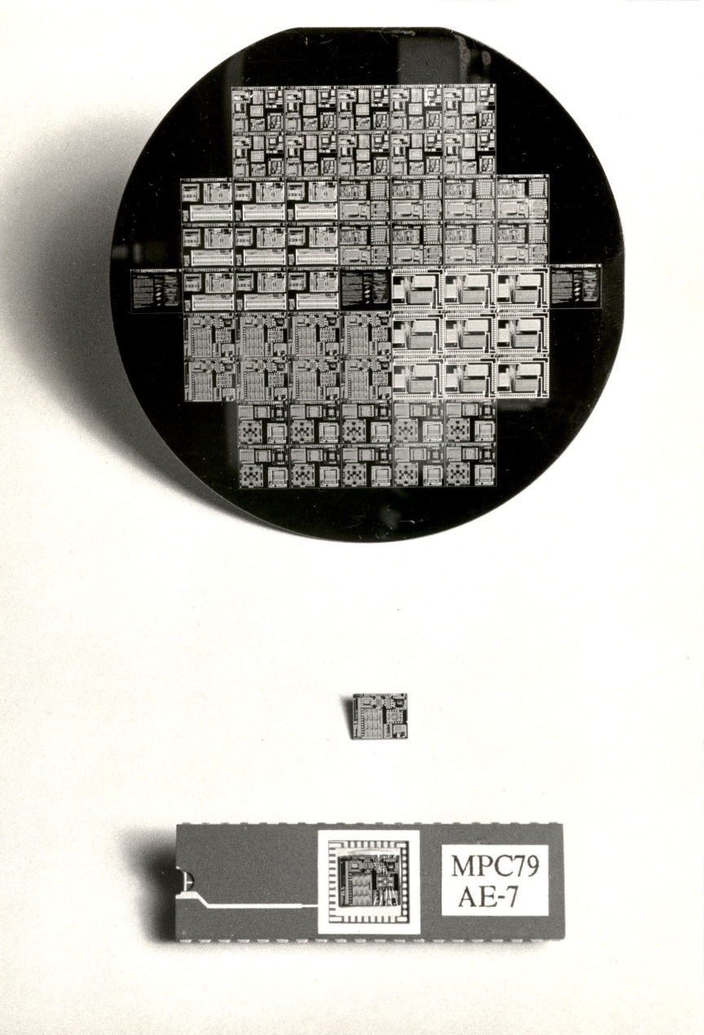
1976
8
1977
1978
1979
Visualizing the exponentiating
wave of VLSI innovation . . .
’76: How to cope with VLSI complexity?
’77: Inventing scalable VLSI design rules.
’78: Launching the VLSI methods at MIT!
’79: Launching the VLSI courses via MPC79!!

Slide 10
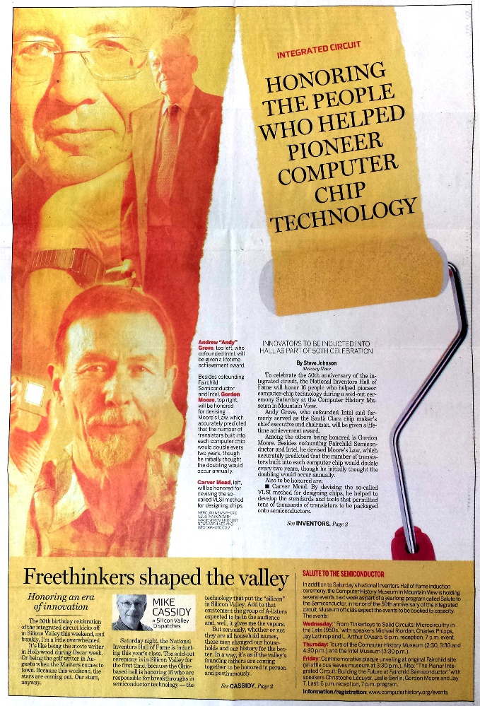
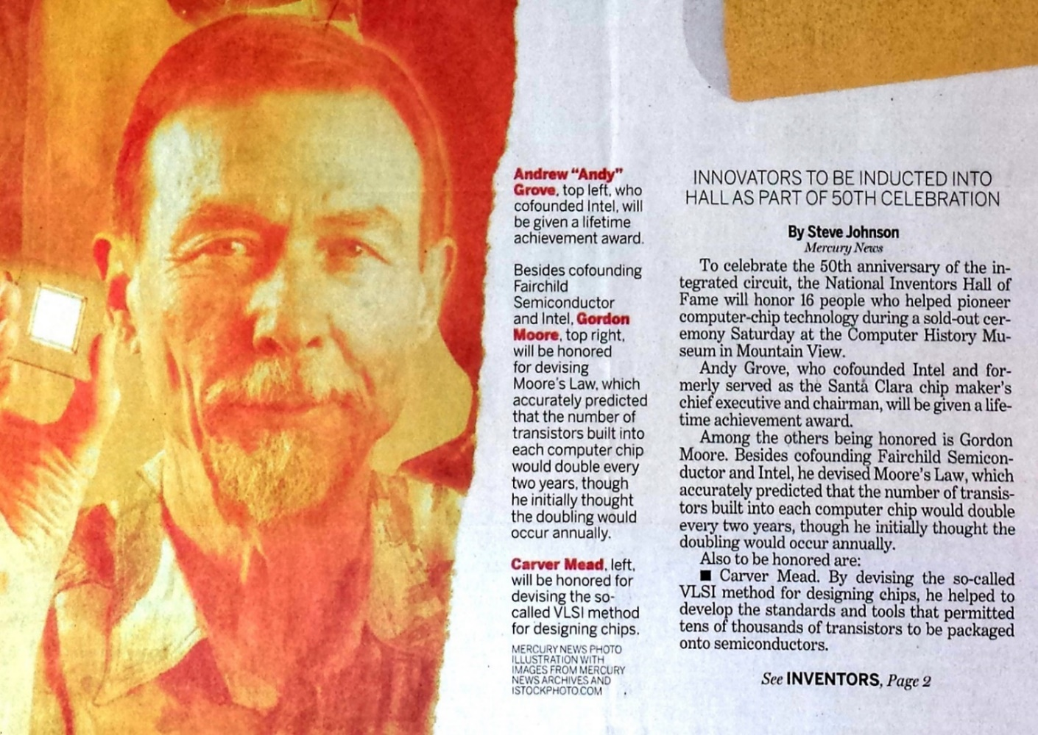
9
Gordon Moore and Carver Mead take center stage:
San Jose Mercury News April 30, 2009
Not only was Lynn Conway not invited, she didn’t even know it was happening!
Hmm . . . Reminds us of the Apple Macintosh story, eh?

Slide 11

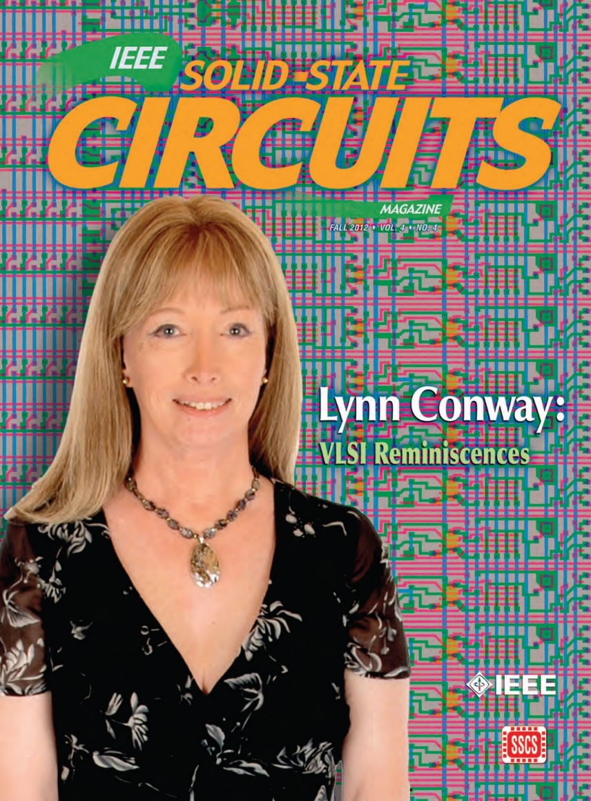
10
The story of my recent investigations is quite a saga, yet to be fully told . . .
Along the way I uncovered all sorts
of fascinating data and evidence.
That led me to write and publish my “Reminiscences of the VLSI Revolution” in the
Fall 2012 IEEE Solid State Circuits Magazine.
The first time in decades I’d come forward
and begun telling the story . . .

Slide 12
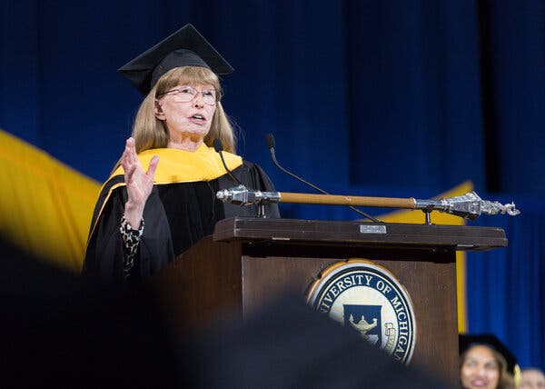
11
Evidence of Reappearance . . .
The New York Times
52 Years Later, IBM Apologizes for Firing Transgender Woman
By Maria Cramer, Nov. 21, 2020
Lynn Conway was one of the company’s most promising young computer engineers but after confiding to supervisors that she was transgender, they fired her . . .
Lynn Conway receives an honorary doctorate, and gives the Winter 2018 commenment address at the University of Michigan, Ann Arbor

Slide 13
12
Link
Moral Of The Story:
“When Weirdness breaks out, don’t get upset . . .
Do Science On It!”
www.lynnconway.com ; conway@umich.edu

