Slide 1
MOORE’S LAW +
The Journey Continues
Mark Papermaster
CTO & SVP, Technology & Engineering

Slide 2

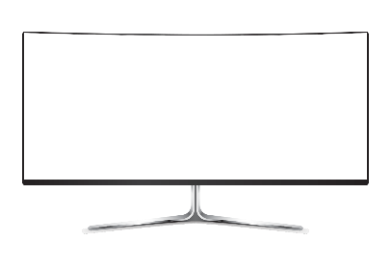


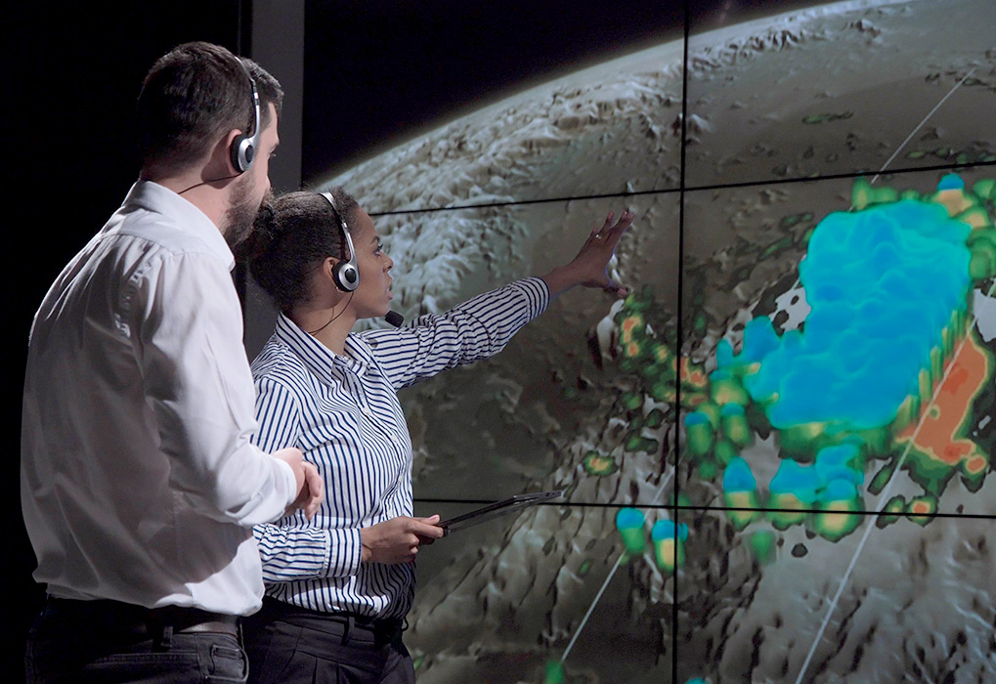


DEMAND FOR BETTER EXPERIENCES
VOICE, GESTURE, FACE RECOGNITION
SUPER HIGH RESOLUTION DISPLAYS
VR, AR
HUGE DEMAND FOR MORE COMPUTE
BIG DATA ANALYTICS
HIGH-PERFORMANCE COMPUTING
MACHINE LEARNING

Slide 3
Gpu & Cpu performance trends
GPU SINGLE PRECISION FLOATING POINT
OPERATIONS PER SECOND TREND
SPECINT®_RATE2006 2P SERVER
PERFORMANCE TREND OVER TIME
CONSISTENT AND EXPONENTIAL GPU/CPU PERFORMANCE GAINS
See Endnotes

Slide 4
System-level performance/Watt improving at the same rate
PERFORMANCE-PER-WATT TREND OVER TIME IN SERVER CPUS
2X every 2.4 years
PERFORMANCE GAINS HAVE BEEN SYSTEM LEVEL POWER-NEUTRAL
See Endnotes

Slide 5
MOORE’S LAW IS SLOWING
50 YEARS OF MICROPROCESSOR TREND DATA
More transistors
more power efficiency
10⁷
10⁶
10⁵
10⁴
10³
10²
10¹
10⁰
Less frequency gain per node
Transistors (thousands)
Frequency (MHz)
1970
1980
1990
2000
2010
2020
2030
See Endnotes

Slide 6
MOORE’S LAW SLOWS WHILE COSTS CONTINUE TO INCREASE
COST PER YIELDED MM² FOR A 250MM² DIE
Normalized Cost/yielded mm
INCREASING DIE SIZES ARE ECONOMICALLY PROBLEMATIC
Source: AMD

Slide 7
Welcome to Moore’s Law +
INTEGRATION
SYSTEM DESIGN
SOFTWARE
Multi-Chip Architectures
Accelerators
Compilers
2/2.5/3D Packaging
New Memory Architectures
Open Source Libraries
Scalable Fabrics
Industry Standard Interconnect
Frameworks

Slide 8
ACCELERATING THE EXPONENTIAL
A BETTER FUTURE DEPENDS ON IMPROVING COMPUTATION EFFICIENCY
NEW APPROACHES NEW ARCHITECTURE
IMPROVEMENT OPPORTUNITIES FOR THE NEXT DECADE
>2X/2.4 years
3D Stacking
Log Scale System Performance/Watt
Novel Memory
2X/2.4 years
Software
Accelerators
Multi-Chip Architecture
2007
2017
2027
Process Technology
See Endnotes

Slide 10
Disclaimer & Attribution
The information presented in this document is for informational purposes only and may contain technical inaccuracies, omissions and typographical errors.
The information contained herein is subject to change and may be rendered inaccurate for many reasons, including but not limited to product and roadmap changes, component and motherboard version changes, new model and/or product releases, product differences between differing manufacturers, software changes, BIOS flashes, firmware upgrades, or the like. AMD assumes no obligation to update or otherwise correct or revise this information. However, AMD reserves the right to revise this information and to make changes from time to time to the content hereof without obligation of AMD to notify any person of such revisions or changes.
AMD MAKES NO REPRESENTATIONS OR WARRANTIES WITH RESPECT TO THE CONTENTS HEREOF AND ASSUMES NO RESPONSIBILITY FOR ANY INACCURACIES, ERRORS OR OMISSIONS THAT MAY APPEAR IN THIS INFORMATION.
AMD SPECIFICALLY DISCLAIMS ANY IMPLIED WARRANTIES OF MERCHANTABILITY OR FITNESS FOR ANY PARTICULAR PURPOSE. IN NO EVENT WILL AMD BE LIABLE TO ANY PERSON FOR ANY DIRECT, INDIRECT, SPECIAL OR OTHER CONSEQUENTIAL DAMAGES ARISING FROM THE USE OF ANY INFORMATION CONTAINED HEREIN, EVEN IF AMD IS EXPRESSLY ADVISED OF THE POSSIBILITY OF SUCH DAMAGES.
ATTRIBUTION
© 2018 Advanced Micro Devices, Inc. All rights reserved. AMD, the AMD Arrow logo and combinations there of are trademarks of Advanced Micro Devices, Inc. in the United States and/or other jurisdictions. Other names are for informational purposes only and may be trademarks of their respective owners.

Slide 11
ENDNOTES
Slides 3,4,5,6,8
Lisa T. Su, Samuel Naffziger, and Mark Papermaster, “Multi-Chip Technologies to Unleash Computing Performance Gains over the Next Decade,” IEDM Conference 2017.
Slide 5:
Original data up to the year 2010 collected and plotted by M. Horowitz, F Labonte O.Shacham, K. Olukotun, L. Hammond, and C. Batten.
New plot and data collected for 2010-2015 by K. Rupp. https://www.karlrupp.net/2015/06/40-years-of-microprocessor-trend-data/

