Slide 1
Andreas
Olofsson
Program Manager
Microsystems Technology Office

Slide 2
DARPA is building a silicon compiler
DISTRIBUTION STATEMENT A: Approved for public release.

Slide 3
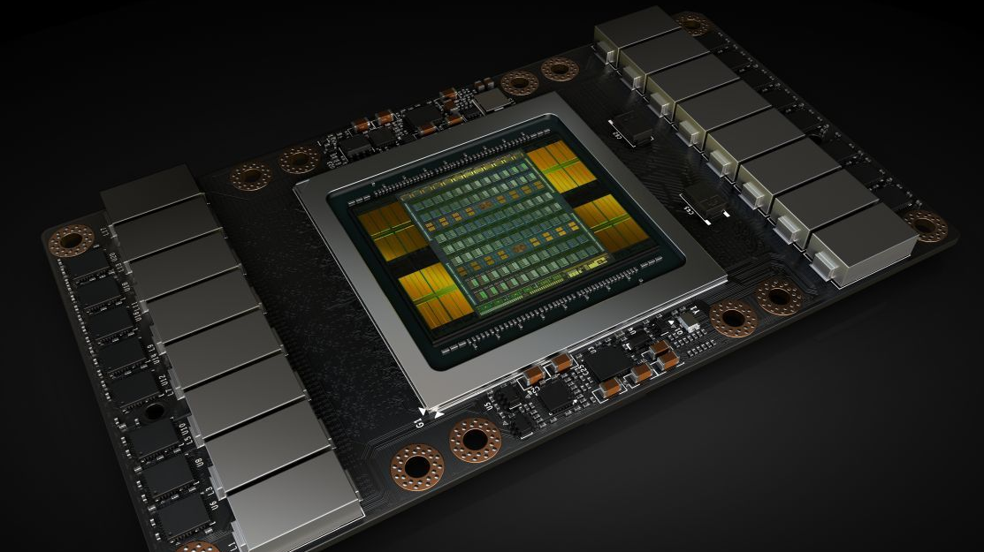
21 Billion Transistors
12-nanometer manufacturing
NRE cost of $3 billion
Metal interconnects spanning miles in one tiny chip
Sources: NVIDIA
DISTRIBUTION STATEMENT A: Approved for public release.

Slide 4
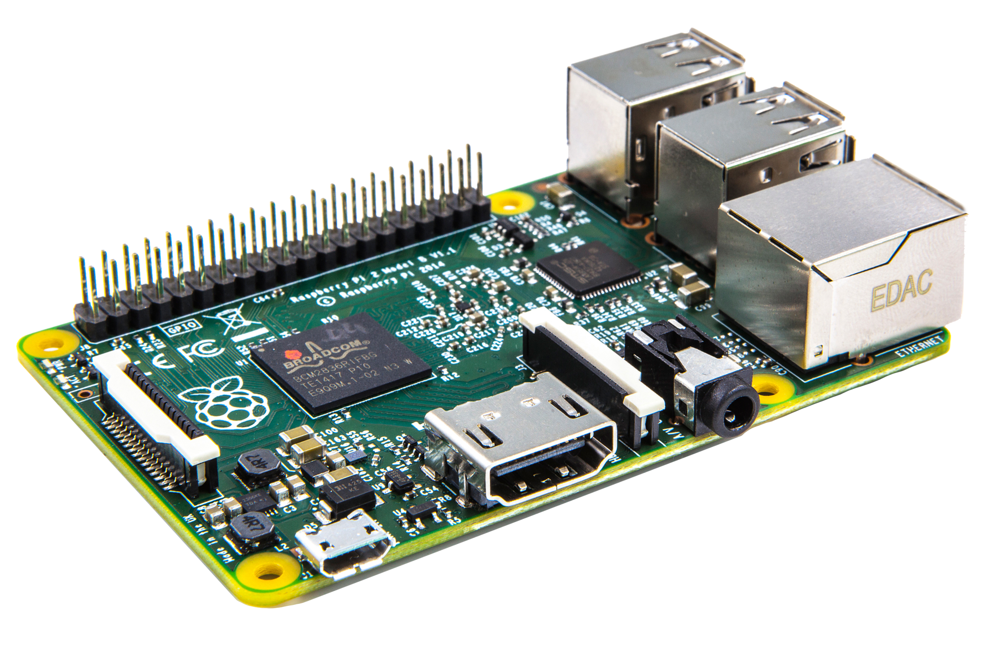
DARPA’s $100M SILICOn compiler PROGRAM
No human in the loop electronic circuit layout
Design by Intent
Open source hardware design
Sources: Raspberry Pi
DISTRIBUTION STATEMENT A: Approved for public release.

Slide 5
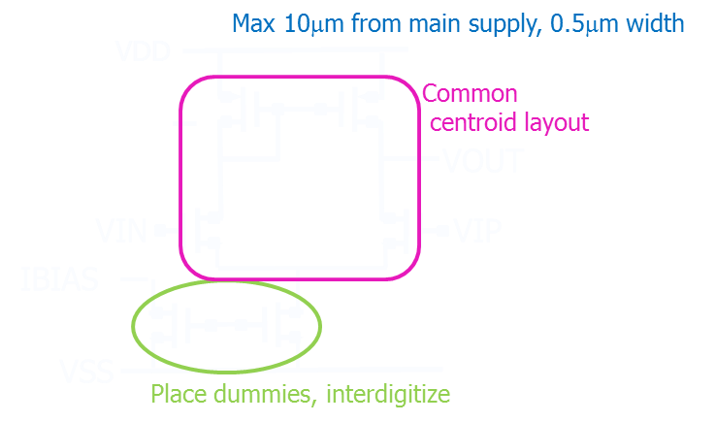
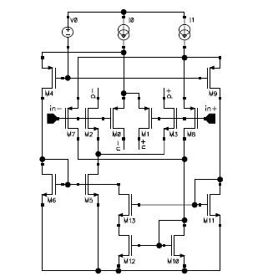
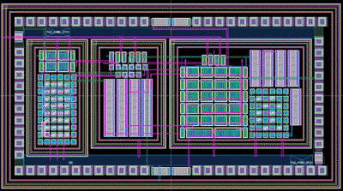
IDEA: No human in the loop digital AND analog layout!
Today
Future
Designer provides manual constraints to layout person (or tool)
Automatically assign constraints based on trained circuit & layout models
Isolate with guard ring and well!
Circuit Classifier
Model
Training
Assign Strategies
Novelty:
Auto create layout constraints by classifying circuit patterns and applying strategies from knowledge database.
Common Vocabulary of Strategies
Auto-Placement
A
B
B
A
A
B
A
B
C
Auto-Routing
B
A
A
B
C
D
A
B
B
A
D
E
B
A
A
B
Centroid
Mirroring
Isolation
DISTRIBUTION STATEMENT A: Approved for public release.

Slide 6
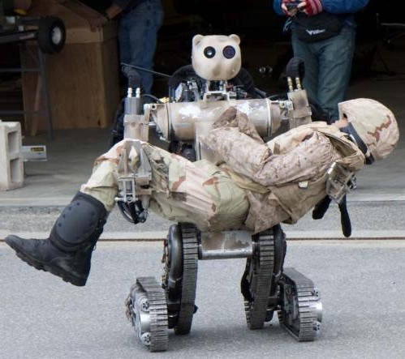
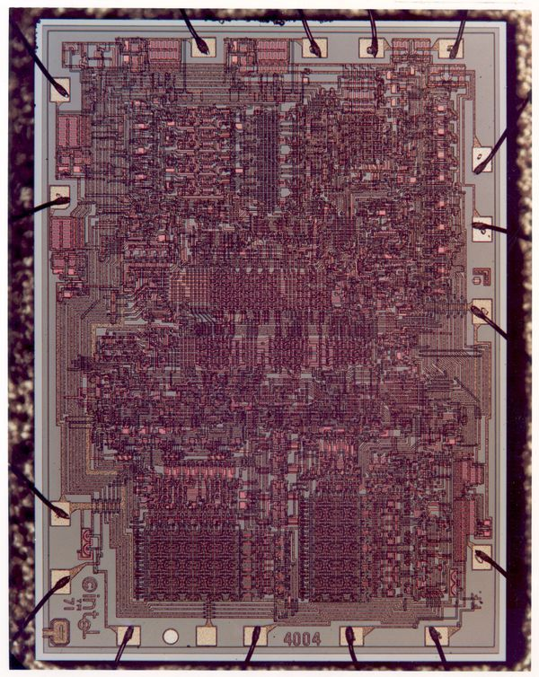
ERI Design End state – the WORLD’S first general purpose silicon compiler
Programmer’s View
Disruptive Impact
Manager’s View
DISTRIBUTION STATEMENT A: Approved for public release.
Sources: Amazon, Duke Research Blog, US Army, Intel

