Slide 1

William
chappell
Office director
Microsystems technology office

Slide 2
The intertwined history of Darpa and moore’s law

Slide 3
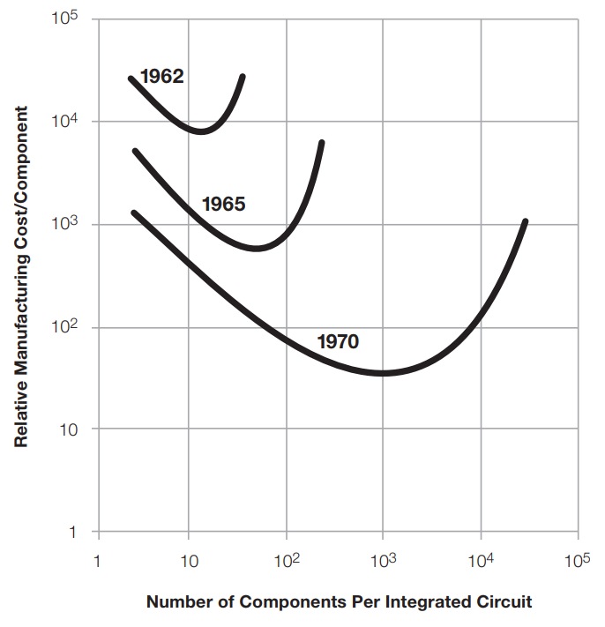
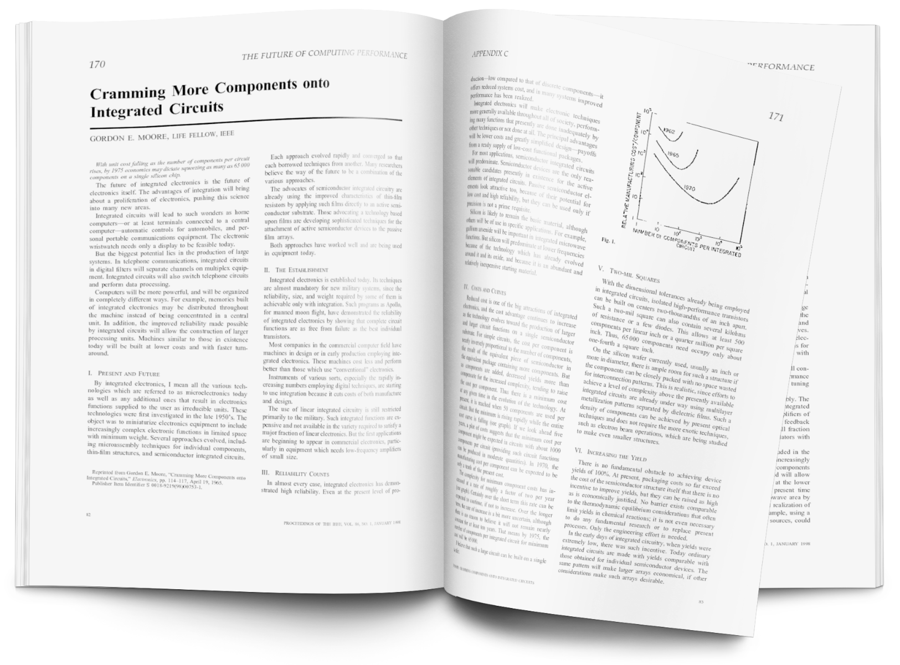

Slide 4

Semiconductors play an outsized role in the U.S. Economy
Top 3 manufactured U.S. export
More R&D intensive than any other industry
U.S. Manufacturing Sector Growth in Real Value Added to GDP (1987-2011)
Semiconductors $43 Billion
Percent domestic sales of R&D
0%
40%
80%
120%
160%
200%
240%
280%
Semiconductors
Semiconductors and
Related Devices
265%
20%
Petroleum and Refineries
223%
Automobiles $53 Billion
Pharmaceutical preparations
167%
Pharmaceuticals
Aircraft $121 Billion
17%
Aircraft
93%
Iron and Steel Mills
59%
GDP Growth 85.3%
Source: BEA 2007, ASM 2011, SIA
Source: 2016 U.S. International Trade Commission, SIA
Source: NSF Business Research and Development and Innovation Survey

Slide 5
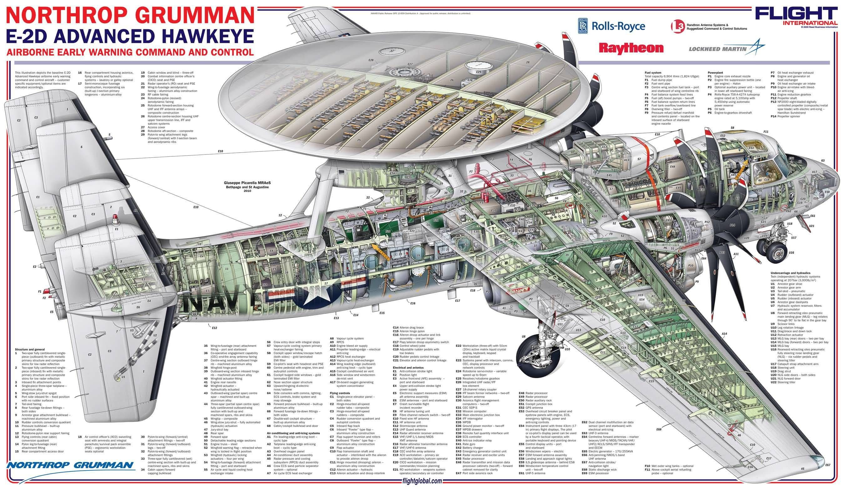
NAVAIR Public Release SPR 10-959 Distribution A: Approved for public release, distribution unlimited
Image: Flightglobal.com

Slide 6
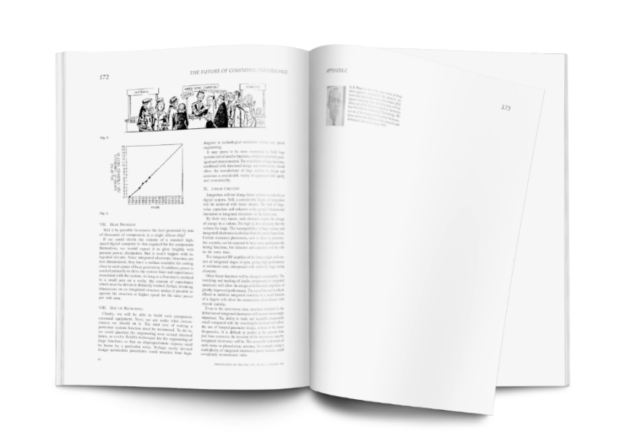
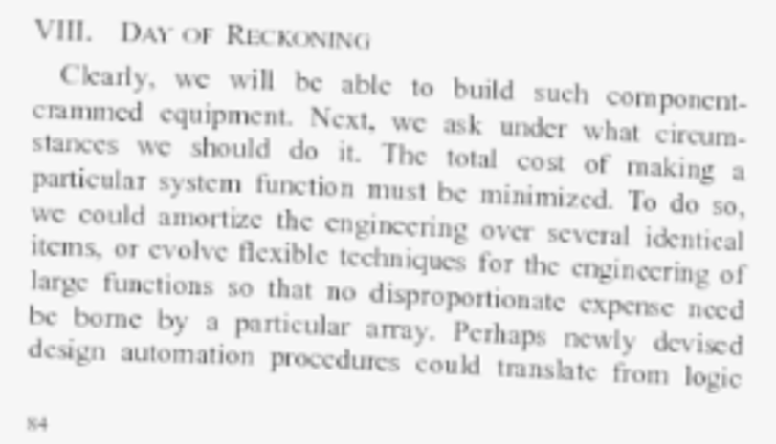
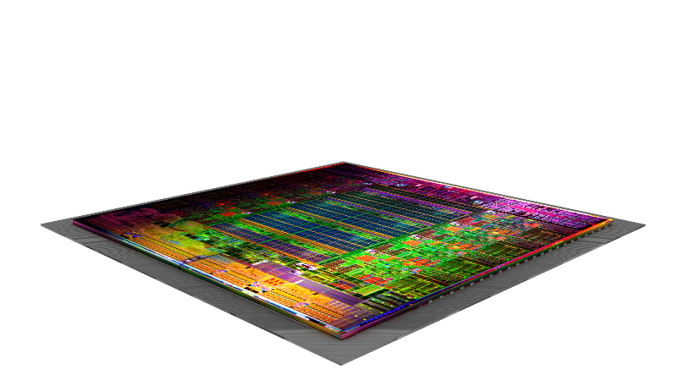
VIII. DAY OF RECKONING
Clearly, we will be able to build such component-crammed equipment. Next, we ask under what circumstances we should do it. The total cost of making a particular system function must be minimized. To do so, we could amortize the engineering over several identical items, or evolve flexible techniques for the engineering of large functions so that no disproportionate expense need be borne by a particular array. Perhaps newly devised design automation procedures could translate from logic diagram to technological realization without any special engineering.
It may prove to be more economical to build large systems out of smaller functions, which are separately packaged and interconnected. The availability of large functions, combined with functional design and construction, should allow the manufacturer of large systems to design and construct a considerable variety of equipment both rapidly and economically.
P.3
Electronics, April 19, 1965: Cramming More Components onto Integrated Circuits; Gordon Moore
Today
“component-crammed equipment”
DISTRIBUTION STATEMENT A. Approved for public release. Distribution is unlimited.

Slide 7
Cost ($M)
10¹⁵
1200
10¹⁴
1000
10¹³
800
FLOPS
10¹²
600
>$500M
10¹¹
400
Software
10¹⁰
Mobile processing units
200
High-performance processing units
Hardware
10⁹
0

Slide 8
Complexity Bind
Cost
The cost of integrated circuit fabrication, design, and verification is skyrocketing, limiting innovation
Foreign Investments
Foreign investments are distorting the market and driving a shift outside of the U.S.
Rising Stakes
Digital influence is so pervasive in our society that we can’t afford to have flaws in the digital foundation

Slide 9
VIII. DAY OF RECKONING
Clearly, we will be able to build such component-crammed equipment. Next, we ask under what circumstances we should do it. The total cost of making a particular system function must be minimized. To do so, we could amortize the engineering over several identical items, or evolve flexible techniques for the engineering of large functions so that no disproportionate expense need be borne by a particular array. Perhaps newly devised design automation procedures could translate from logic diagram to technological realization without any special engineering.
It may prove to be more economical to build large systems out of smaller functions, which are separately packaged and interconnected. The availability of large functions, combined with functional design and construction, should allow the manufacturer of large systems to design and construct a considerable variety of equipment both rapidly and economically.
P.3
Electronics, April 19, 1965: Cramming More Components onto Integrated Circuits; Gordon Moore
Today
“component-crammed equipment”
Materials & Integration
Adding separately packaged novel materials and using integration to provide specialized computing
DISTRIBUTION STATEMENT A. Approved for public release. Distribution is unlimited.

Slide 10
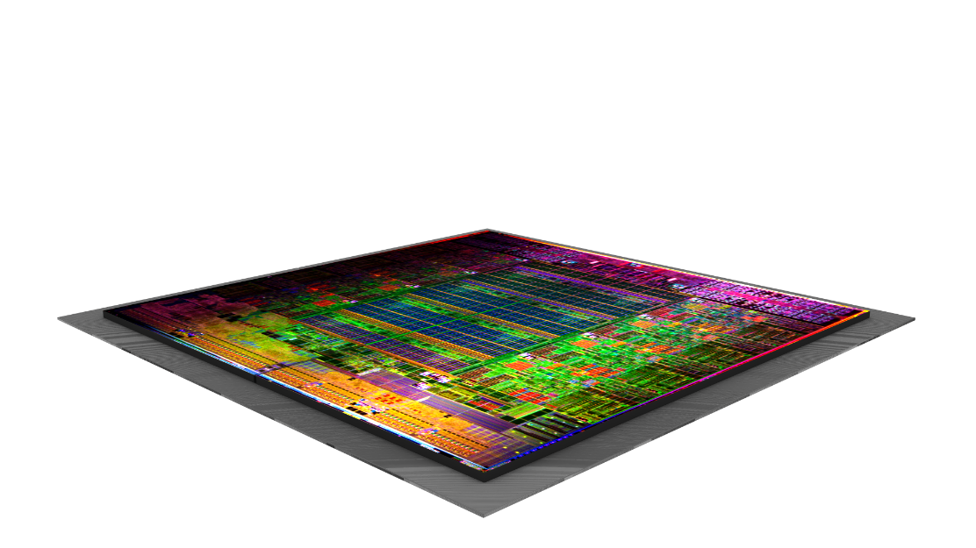
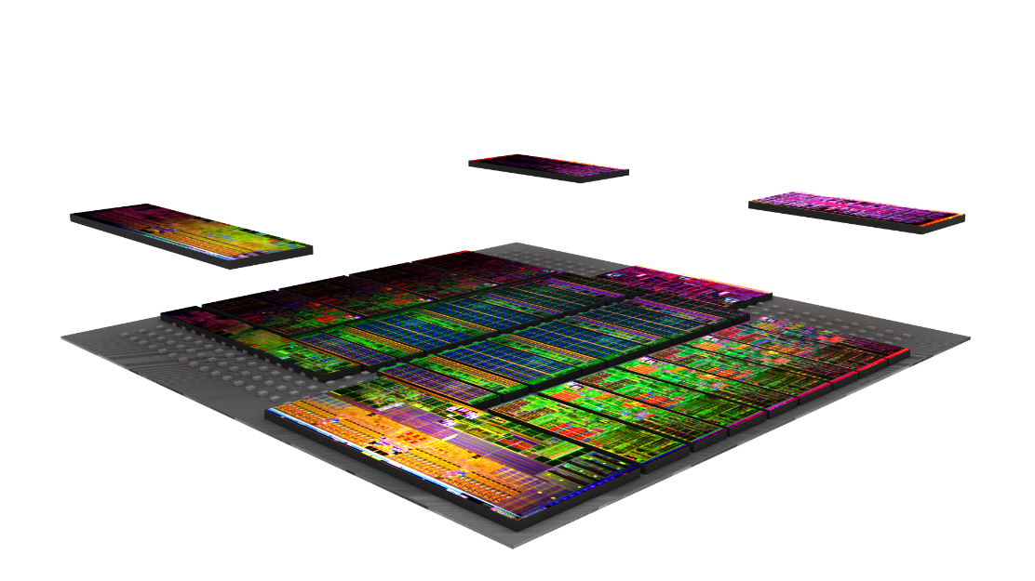
CHIPS
“It may prove to be more economical to build large systems out of smaller functions, which are separately packaged and interconnected.”
Notes:
So this is the CHIPS program that we started. This is a great start, because now I can invent a smaller portion of the system, and I don’t have to recreate IP that I already designed just because some other portion gets better because of scaling. We can use the right node for the right system. We can design systems faster.
But that isn’t an exponential on it own. However, this gets interesting. Because now, we can have not just many more places designing for the system, but now we can look at new processes and materials to get back into the game.

Slide 11
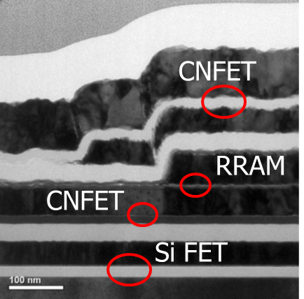
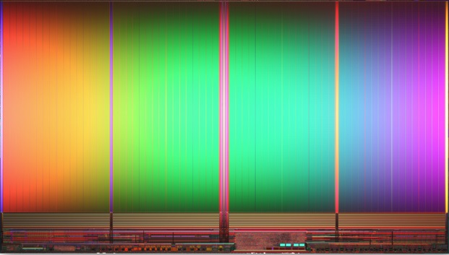
3DSOC
FRANC
MTJ
Images: Stanford, MIT
Image: GLOBALFOUNDRIES
CHIPS
Notes:
So this allows for exploring novel integration such as monolithic 3D integration. For functions where collocated memory and processing are the most important, then this can be a leap ahead. We are asking the simple question, is there a way to use 3D integration to interlace processing memory together such that the combined unit will be better than a 7 nm technology. This is the program that we call 3DSOC, and will be a partnership between Stanford, MIT and a trusted fabrication facility called Skywater in Minnesota.
The second program is FRANC, where we look at new materials which allow us to have novel processing within the memory blocks using the eccentricities of the material itself.
Together, there is a chance that splitting a design into smaller pieces, allowing new processes and material advancements to flourish, we can pick up a new exponential.
MRAM made using Perpendicular Magnetic Tunnel junctions (pMTJ) in 22nm FD=SOI have been demonstrated by GF. This type of memory is lower power and fast switching. This new memory will be used in Deep In-Memory Architectures (DIMA) with statistical modeling to further increase memory density for low power operation.
3D System on Chip (3DSOC)
How can we exploit the third-dimension to make older 90nm nodes perform better than 7nm nodes?
Foundations Required for Novel Compute (FRANC)
How do we bring in new materials to enable specialized processing and computing?
Common Heterogeneous Integration and IP Reuse Strategies (CHIPS)
How do we explode the tyranny of monolithic IC design to enable unique devices?

Slide 12
VIII. DAY OF RECKONING
Clearly, we will be able to build such component-crammed equipment. Next, we ask under what circumstances we should do it. The total cost of making a particular system function must be minimized. To do so, we could amortize the engineering over several identical items, or evolve flexible techniques for the engineering of large functions so that no disproportionate expense need be borne by a particular array. Perhaps newly devised design automation procedures could translate from logic diagram to technological realization without any special engineering.
It may prove to be more economical to build large systems out of smaller functions, which are separately packaged and interconnected. The availability of large functions, combined with functional design and construction, should allow the manufacturer of large systems to design and construct a considerable variety of equipment both rapidly and economically.
P.3
Electronics, April 19, 1965: Cramming More Components onto Integrated Circuits; Gordon Moore
Design
Quickly enabling specialization
Materials & Integration
Adding separately packaged novel materials and using integration to provide specialized computing
DISTRIBUTION STATEMENT A. Approved for public release. Distribution is unlimited.
Notes:
Next, Moore, said we should explore “newly design automation procedures to translate from logic diagram to tech realization.” He is calling for a revolution in eda.

Slide 13


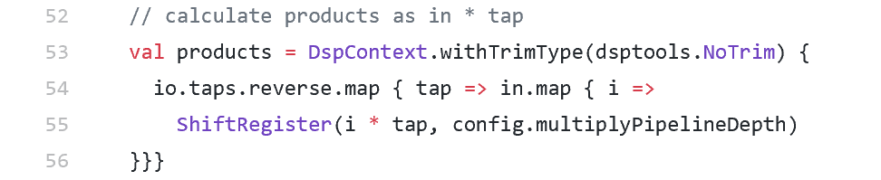
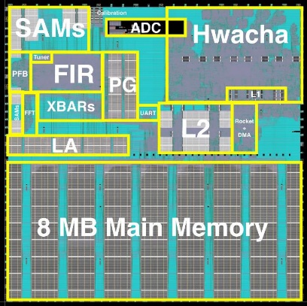
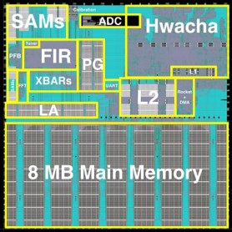



IDEA
CRAFT
“Perhaps newly devised design automation procedures could translate from logic diagram to technological realization without any special engineering”
CRAFT
Image: UC Berkeley
POSH
Notes:
We started this program with a program we called CRAFT. This is was to substantially reduce the time to design, but also allow for porting of the design to wherever manufacturing might exist. An example of what was done is shown here where fairly sizable SOC was designed with Graduate students at UC Berkley. The FIR Filter is represented as the lines of code shown here.
Softwarizing the hardware generation was a nice first step but rapid design doesn’t create an exponential. So we added two new programs. First was to complete the loop, such that each design can reinforce the next one. This is intersection of machine learning and the eda cycle. If we can have each design, lead to yet an easier time with our next design, this is a path to an exponential. People standing on the shoulders of those who came before them, a path to exponential.
Now that we can create a simple way to create IP blocks, then we can share the results. This is focused of the POSH program, which is really focused on the verification cycle
Circuit Realization At Faster Timescales (CRAFT)
How can the design process be abstracted to accelerate IC designs for any node and foundry?
Intelligent Design of Electronic Assets (IDEA)
How do we take the human out of physical layout generation?
Posh Open Source Hardware (POSH)
How do rapidly inspect circuit blocks at a deeper level to greatly expand access to IP?

Slide 14
VIII. DAY OF RECKONING
Clearly, we will be able to build such component-crammed equipment. Next, we ask under what circumstances we should do it. The total cost of making a particular system function must be minimized. To do so, we could amortize the engineering over several identical items, or evolve flexible techniques for the engineering of large functions so that no disproportionate expense need be borne by a particular array. Perhaps newly devised design automation procedures could translate from logic diagram to technological realization without any special engineering.
It may prove to be more economical to build large systems out of smaller functions, which are separately packaged and interconnected. The availability of large functions, combined with functional design and construction, should allow the manufacturer of large systems to design and construct a considerable variety of equipment both rapidly and economically.
P.3
Electronics, April 19, 1965: Cramming More Components onto Integrated Circuits; Gordon Moore
Architectures
Maximizing specialized functions
Design
Quickly enabling specialization
Materials & Integration
Adding separately packaged novel materials and using integration to provide specialized computing
DISTRIBUTION STATEMENT A. Approved for public release. Distribution is unlimited.

Slide 15
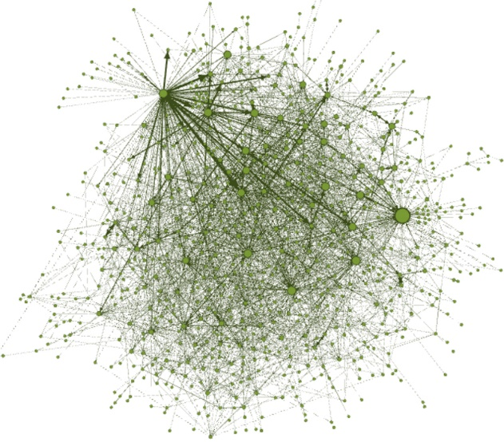
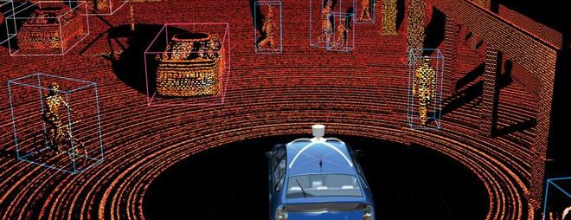
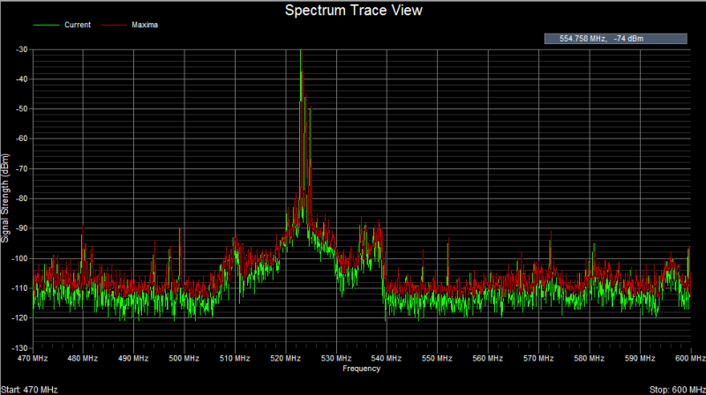
HIVE
LiDAR
Array of sensors
DSSoC
RF
HIVE
“…amortize the engineering over several identical items, or evolve flexible techniques for the engineering of large functions…”
Audio
SDH
Image: Drexel Univ.
Notes:
Hierarchical Identify Verify Exploit (HIVE)
How can specialized integrated circuit be used to analyze large-scale datasets?
Software Defined Hardware (SDH)
How do we realize computing architectures that automatically adapt to the data and application?
Domain-specific System on Chip (DSSoC)
How do we efficiently coordinate a massive number of accelerator cores on a single chip?

Slide 16


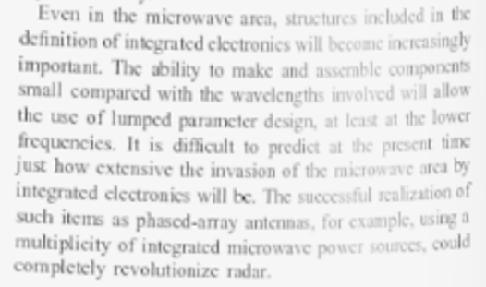
Even in the microwave area, structures included in the definition of integrated electronics will become increasingly important. The ability to make and assemble components small compared with the wavelengths involved will allow the use of lumped parameter design, at least at the lower frequencies. It is difficult to predict at the present time just how extensive the invasion of the microwave area by integrated electronics will be. The successful realization of such items as phased-array antennas, for example, using a multiplicity of integrated microwave power sources, could completely revolutionize radar.

Slide 17

10¹⁴
10¹²
10¹⁰
10⁸
FLOPS
“Since my 1965 paper that ERI references, what has actually happened in the intervening 52 years is far beyond anything I contemplated.
10⁶
It is a testimony to the creativity of many engineers and scientists that the industry has surmounted apparent roadblocks that looked to be the end of transistor scaling.”
- Gordon Moore, December 1, 2017
10⁴
10²
10⁰

Slide 18
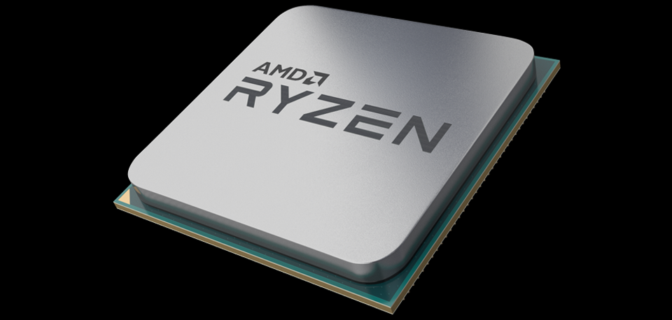
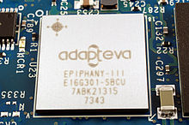

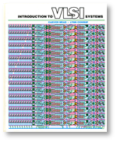
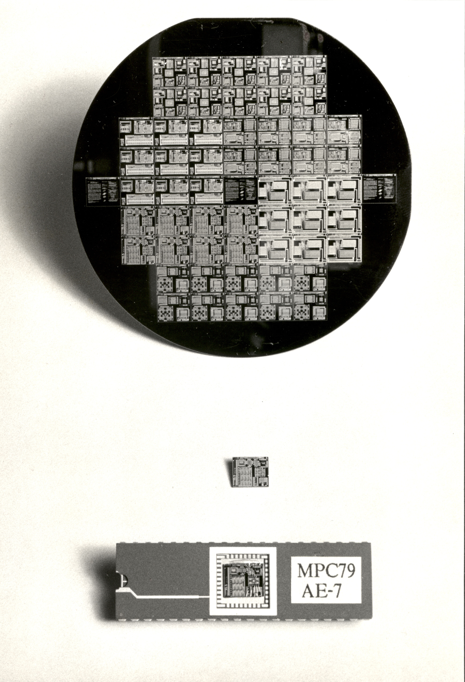
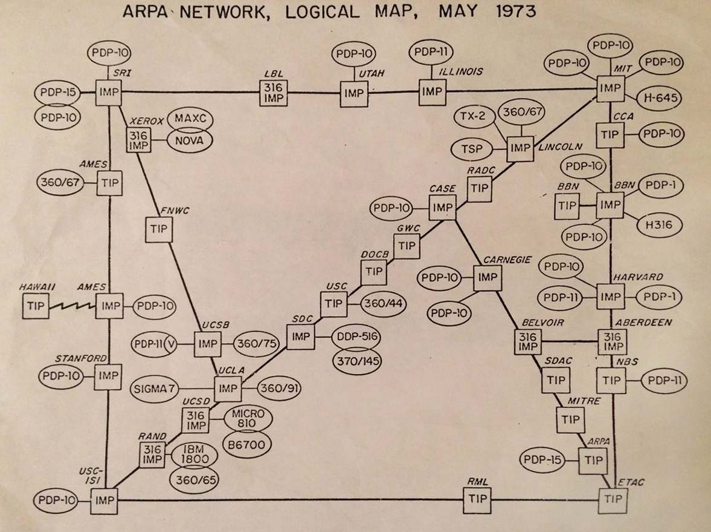
10¹⁴
10¹²
10¹⁰
10⁸
FLOPS
“Since my 1965 paper that ERI references, what has actually happened in the intervening 52 years is far beyond anything I contemplated.
10⁶
It is a testimony to the creativity of many engineers and scientists that the industry has surmounted apparent roadblocks that looked to be the end of transistor scaling.”
- Gordon Moore, December 1, 2017
10⁴
10²
10⁰

