Slide 1
GUN FIRE CONTROL BREAKTHROUGH HELPS U.S. and U.K. in WWII
THE SHOEBOX and the MARK 14 GUNSIGHTS On loan from the Smithsonian Institution’s National Air & Space Museum, the Shoebox gunsight was Dr. Charles Stark Draper’s first gunsight. Gun directors of 1939 could not cope with fast flying planes. Dr. Draper displaced the fixed sight to the gun by placing the computing shoe box directly on the gun, enabling the gunner to hold the reticle of the gunsight on a moving target. Out of this, came the Navy’s Mark 14 gunsight. Sponsored by the Sperry Gyroscope Company, Dr. Draper’s engineering work led to the development of the Mark 14 gunsight during World War II. The gunsight withstood combat on the USS South Dakota, shooting down 32 Japanese attack aircraft in its first major engagement. Dr. Draper continued work with gunfire control developments until the late 1950’s, earning the title Mr. Gyro.

Slide 3
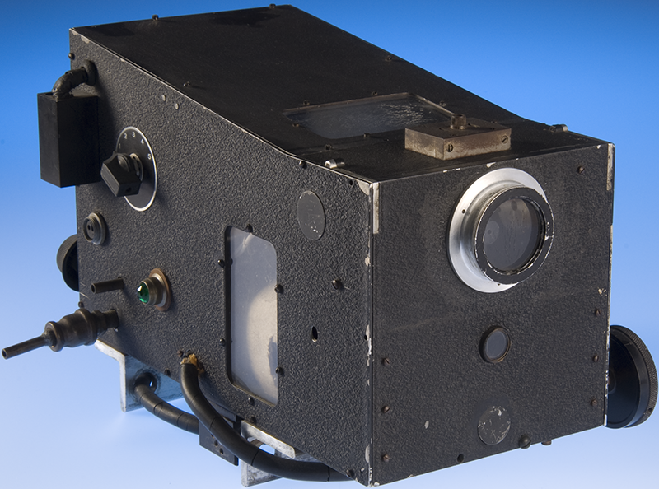
Shoebox

Slide 4
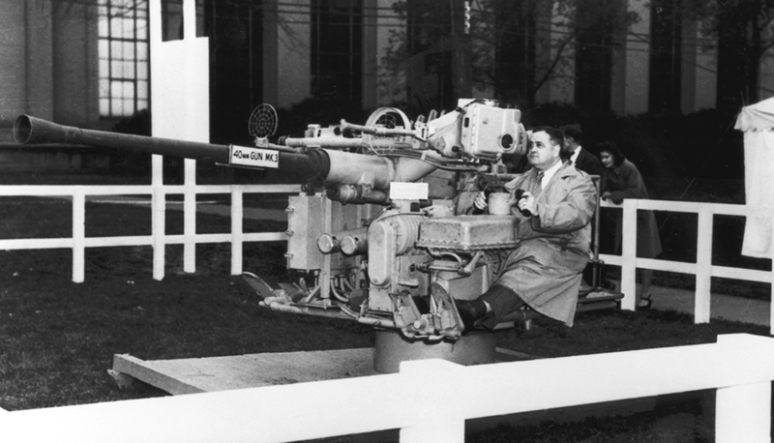
Mark 14 Gunsights

Slide 5
Development of Inertial Navigation Systems
Dr. Charles Stark Draper Inertial navigation allows a vehicle to determine its position without receiving data from the external environment. Gyros measure changes in vehicle direction or orientation; accelerometers measure changes in vehicle velocity. These measurements are combined in an inertial navigation system that provides continuous estimates of position and orientation with respect to an inertial frame of reference. Since no external references are required, inertial navigation systems are immune to jamming and deception. The original gyroscopes and accelerometers were highly complex electro-mechanical spinning mass systems that required hundreds of precision machined parts, advanced low loss bearings, and highly skilled machinists, technicians and engineers to design, build and test the systems. As Doc Draper and his staff advanced inertial navigation, systems became progressively more accurate and more compact, as shown by the instruments on display. Draper Laboratory has been the nation’s leader in high performance inertial systems technology since the 1930s. Our systems have been fielded in ballistic missiles, spacecraft, guided munitions, and a wide variety or air, land and undersea vehicles.

Slide 6
Development of Inertial Navigation Systems
3. 45FG-4 #210 / 23 LBS-1 OZ.
45 FG / SPIRE/MAST
4. 10FGI-2B #334 / 15 LBS-8 OZ.
10FG / SPIRE JR.
5. 4FBG-1A #808 / 6 LBS-12 OZ.
4FBG / SINS
6. 16PIP MOD / POLARIS
7. 25IRIG MOD-I / POLARIS I
8. 16PIP MOD B / POSEIDON
9. 25IRIG MOD III / POSEIDON
10. 16PIP MOD I / TRIDENT I
11. MK6 STAR TRACKER
12. 18IRIG MOD A / DSS
13. 25IRIG MOD II / APOLLO
14. TGG / AIRS/PCKR
15. SFIR J / AIRS/MPMS
Lynn, we have all of this hardware on hand - if you’d like a photo of any,
we’ll take it and send it to you…

Slide 7
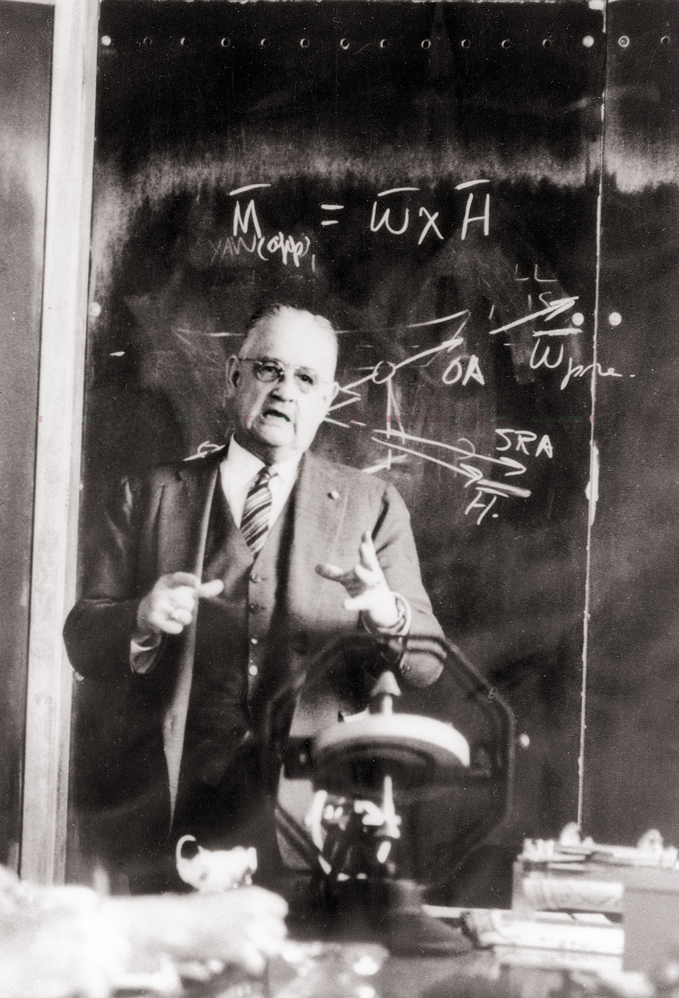
Doc at blackboard: The equation on the blackboard is an expression of gyroscopic precession and applies to the single-degree-of-freedom gyro that Doc Draper developed to very high performance.

Slide 8
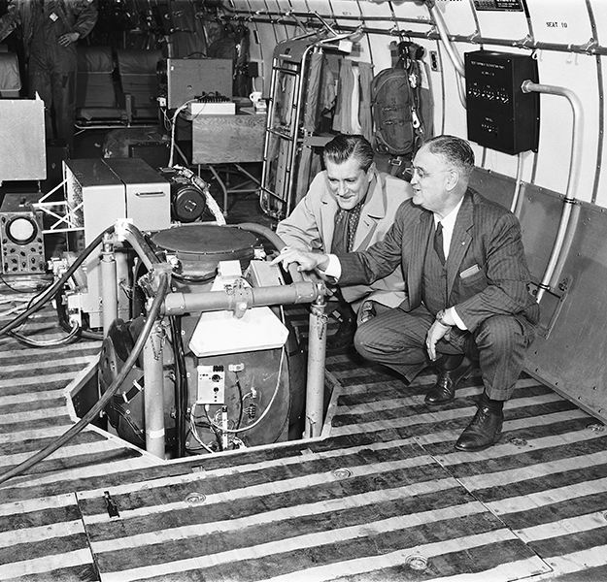
SPIRE Jr.
Doc with SPIRE Jr.: CBS TV’s Eric Sevareid and Doc Draper in 1957, shortly before the flight of SPIRE, Jr. The historic earlier 1953 SPIRE flight from Massachusetts to Los Angeles was the first time that a plane flew from coast to coast without relying on a pilot.

Slide 9
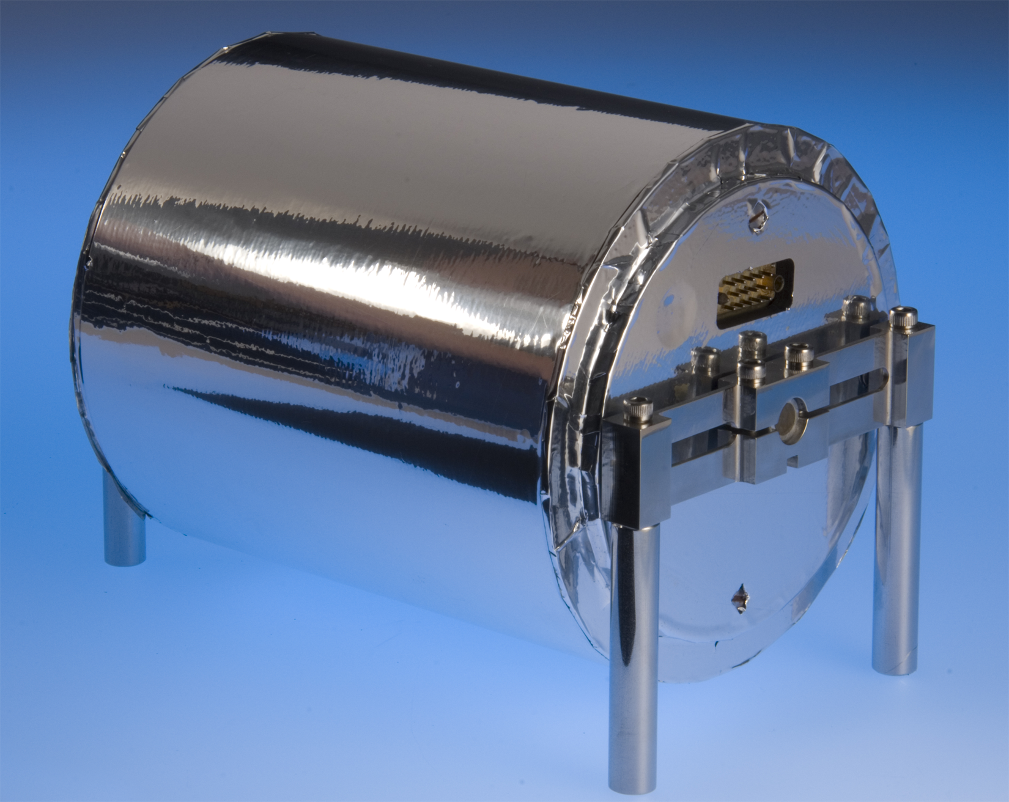
Spire

Slide 10
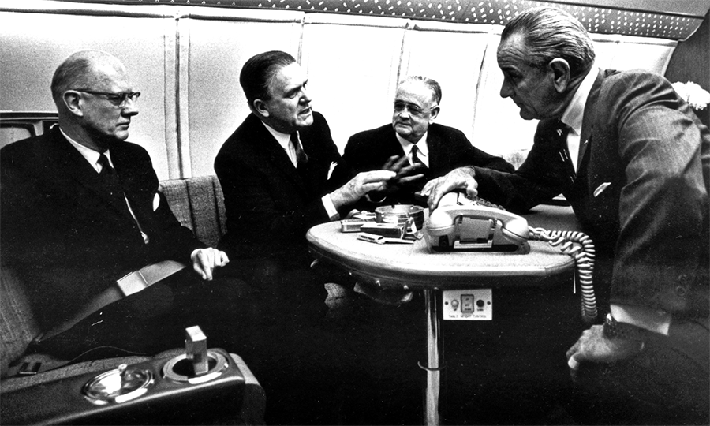
Doc on Air Force 1: Dr. Draper (third from left) confers with (from left) National Academy of Sciences President Dr. Frederick Seitz, NASA Administrator James Webb, and President Johnson aboard Air Force One during the Apollo space program in 1964.

Slide 11
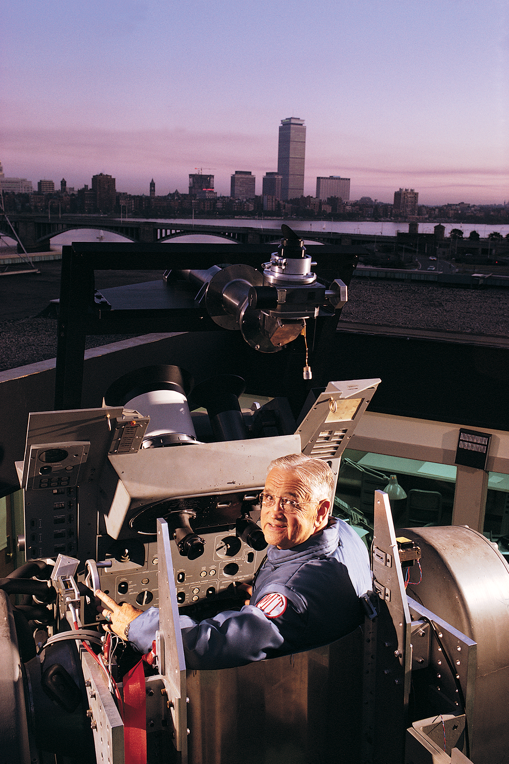
Doc on roof with Star Sighting equipment: Doc in 1968 on the roof of a Lab building demonstrating the Apollo primary guidance, navigation, and control system, including its star telescope (or “Doc Draper demonstrates how star sightings are used to update the Apollo guidance system.”)

Slide 12
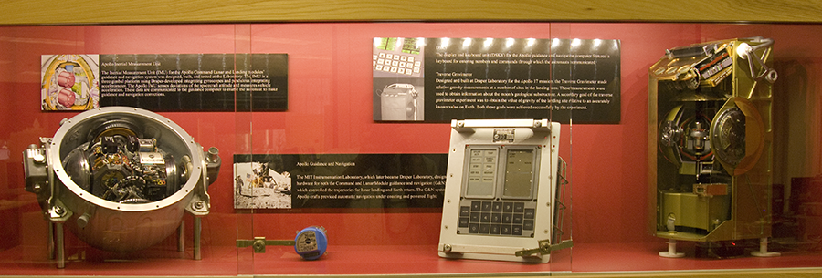
Apollo
Apollo Inertial Measurement Unit
Traverse Gravimeter
Again, we have all of this hardware on hand - if you’d like a photo of any,
we’ll take it and send it to you…

Slide 13
Traverse Gravimeter
Designed and built at Draper Laboratory for the Apollo 17 mission, the Traverse Gravimeter made relative gravity measurements at a number of sites in the landing area. These measurements were used to obtain information about the moon’s geological substructure. A secondary goal of the traverse gravimeter experiment was to obtain the value of gravity of the landing site relative to an accurately known value on Earth. Both these goals were achieved successfully by the experiment.

Slide 14
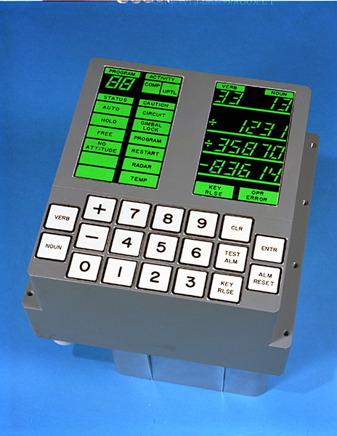
DSKY
The display and keyboard unit (DSKY) for the Apollo guidance and navigation computer featured a keyboard for entering numbers and commands through which the astronauts communicated.

Slide 15
Apollo Inertial Measurement Unit
The Inertial Measurement Unit (IMU) for the Apollo Command Lunar and Landing modules’ guidance and navigation system was designed, built, and tested at the Laboratory. The IMU is a three-gimbal platform using Draper-developed integrating gyroscopes and pendulous integrating accelerometer. The Apollo IMU senses deviations of the spacecraft attitude and measures vehicle acceleration. These data are communicated to the guidance computer to enable the astronaut to make guidance and navigation corrections.

Slide 16
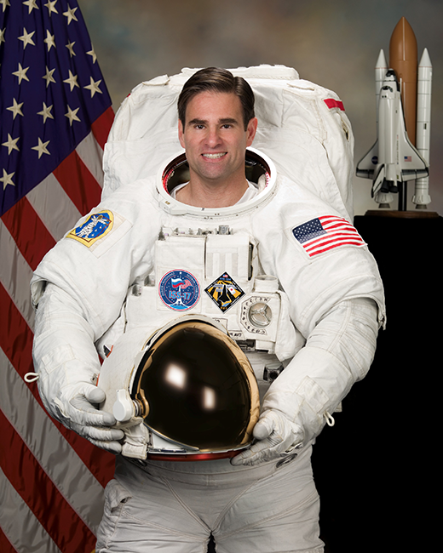
MEMS gyro flown in space by Greg Chamitoff
The Draper-designed microelectromechanical systems tuning fork gyroscope flew in space in 2008 aboard the Space Shuttle and International Space Station, brought by Astronaut Greg Chamitoff, Draper Fellow 1985-1992.

